Slide 1
Information Model Structure
Date: [2017-10-31]
Authors:
Name | Affiliation | Phone | Email
Hao Wang | Fujitsu R&D Center | +86-10-59691000 | wangh@cn.fujitsu.com
Xiaojing Fan | Fujitsu R&D Center | +86-10-59691000 | fanxiaojing@cn.fujitsu.com
Ryuichi Matsukura | Fujitsu/Fujitsu Laboratory | +81-44-754-2667 | r.matsukura@jp.fujitsu.com
Notice: This document does not represent the agreed view of the IEEE 802.1 OmniRAN TG. It represents only the views of the participants listed in the ‘Authors:’ field above. It is offered as a basis for discussion. It is not binding on the contributor, who reserve the right to add, amend or withdraw material contained herein.
Copyright policy: The contributor is familiar with the IEEE-SA Copyright Policy <http://standards.ieee.org/IPR/copyrightpolicy.html>.
Patent policy: The contributor is familiar with the IEEE-SA Patent Policy and Procedures: <http://standards.ieee.org/guides/bylaws/sect6-7.html#6> and <http://standards.ieee.org/guides/opman/sect6.html#6.3>.
Abstract
This presentation provides further thoughts on the 802.1CF information model structure.

Slide 2
Information Model Structure
2017-10-31
Hao Wang
Fujitsu R&D Center

Slide 3
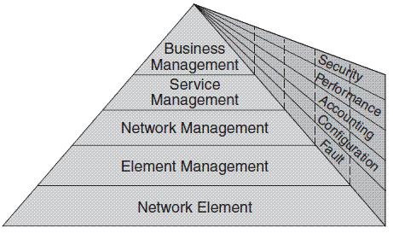
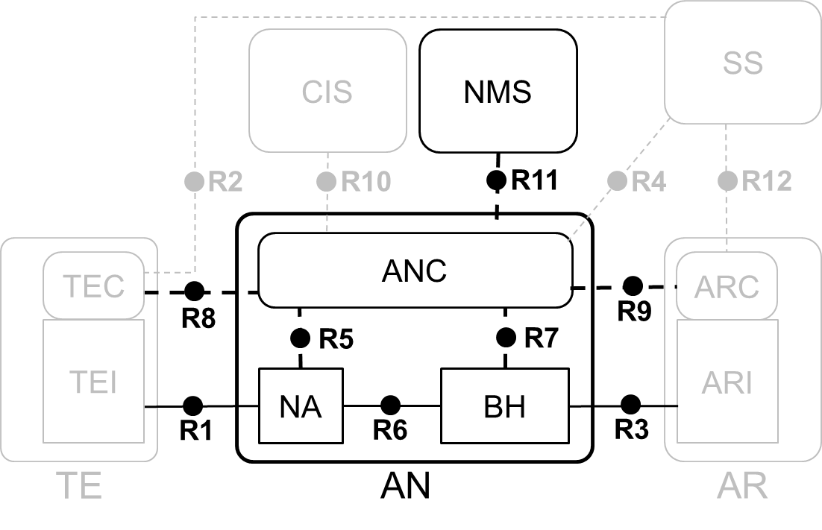
TMN 5-Layer Management Architecture
Every layer suggests certain management functionalities
EML provides management functions for network elements on an individual or group basis. It also supports an abstraction of the functions provided by the network element layer.
NML offers a holistic view of the network, independent of device types and vendors. It manages a network as supported by the element management layer.
FCAPS have different tasks at each layer.
EML-NML interface is the point

Slide 4
Two Basic Questions
What should be modeled?
Access network management functions (EMS on ANC)
Access network elements (NA, BH)
Additional managed objects to support AN management functions
Network Resources: data interfaces R1, R3, R6
Virtual entities: control interfaces R8, R9
What management purpose should the information model be used for?
FCAPS vs. OAMPT?
The ‘C’ only (YANG data model for configuration management)

Slide 5
Basic Elements to be Described by IM
Take AN setup for unlicensed spectrum (7.1) as an example
NMS
ANC_enabled
AN_configuration
AN_activated
enable
(power-up)
ANC
Status, set and/or cleared by source
AN operator
Procedures initiated by source and consumed by destination
(no need to specify details, maybe out of scope of 802)
NA_enabled
NA_activated
…
enable
(power-up)
NA_configuration
AN operator
NA
BH

Slide 6
An Information Model (1)
Network Management Service
NMS-ID
bool AN_activated
1
Access Network Control
ANC-ID
bool enabled, NA_activated, BH_activiated
1
Backhaul
BH-ID
Bool enabled
1+
Node of Attachment
NA-ID
Bool enabled
1+
AssociationStatistics
AssociationID
1+
AuthenticationStatistics
User-ID
1+
Datapath
Datapath-ID
1+
User service
Session-ID
1+
Accounting record
AccountingRecord-ID

Slide 7
An Information Model (2)
AssociationStatistics
Association-ID
LinkConfiguration:
...
LinkConfiguration ASSOCIATE (SupportedLinkCapabilities, PreferredLinkProfile, SupportedSecurityCapabilities,
PreferredSecurityProfile, SupportedQosCapabilities,
PreferredQosProfile)
LinkConfiguration REASSOCIATE ()
void DISASSOCIATE ()

Slide 8
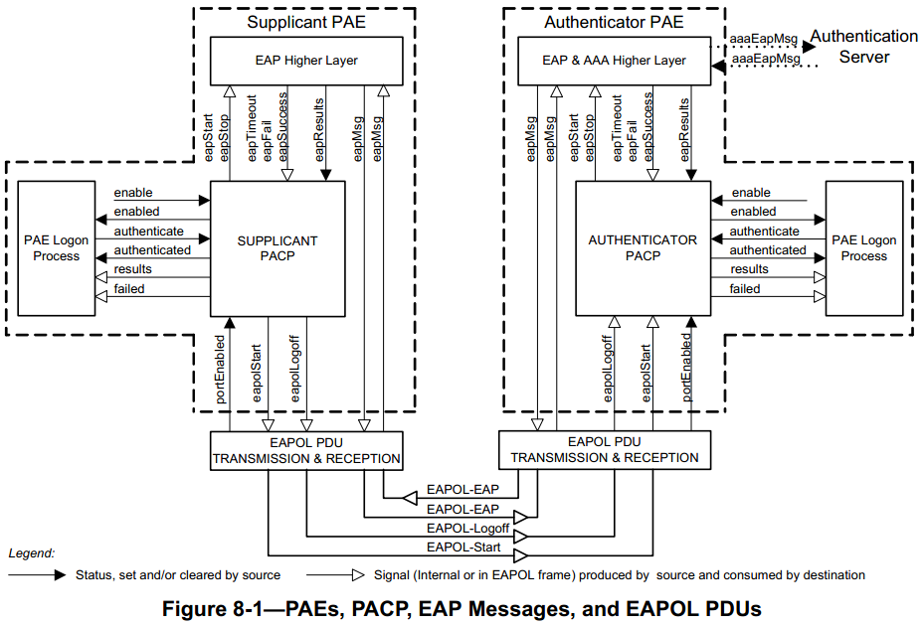
Reference: 802.1X model
(3)
(1)
(2)
(2)
(4)

Slide 9
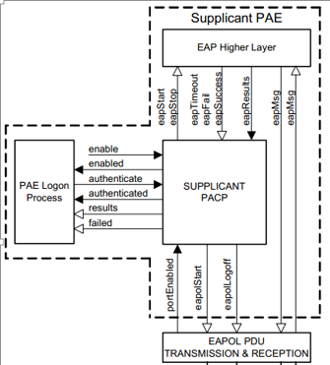
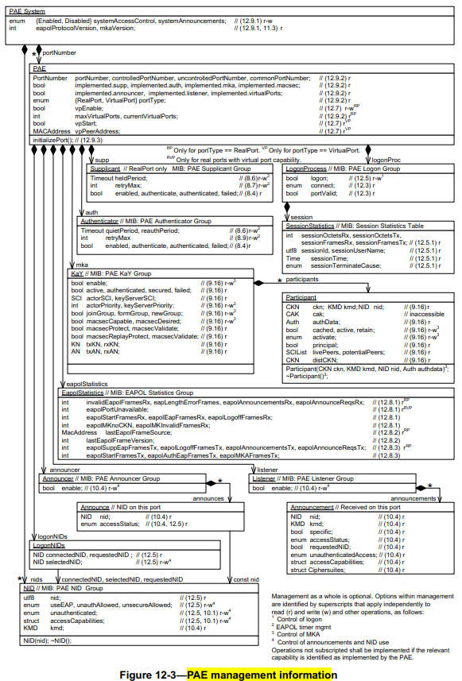
Reference: 802.1X model
logon

Slide 10
Discussions
Details need further process
Attributes, class-procedures
TE, SS, AR may not need to be appeared at all
Duplication needs to be eliminated
802.1CF model vs. superset of 802 protocol models
How many details about 802 protocols should be included?
Separate FDM model may be needed
FDM Parameters can be included in the NRM model or Service model

Slide 11
Questions, Comments Thank YOU!

