Slide 1
P802.1CF within the scope of 5G
Date: 2015-11-09
Authors:
Name | Affiliation | Phone | Email
Max Riegel | Nokia Networks | +491732938240 | maximilian.riegel@nokia.com
Yonggang Fang | ZTE |  | yfang@ztetx.com
Notice: This document does not represent the agreed view of the IEEE 802.1 OmniRAN TG. It represents only the views of the participants listed in the ‘Authors:’ field above. It is offered as a basis for discussion. It is not binding on the contributor, who reserve the right to add, amend or withdraw material contained herein.
Copyright policy: The contributor is familiar with the IEEE-SA Copyright Policy <http://standards.ieee.org/IPR/copyrightpolicy.html>.
Patent policy: The contributor is familiar with the IEEE-SA Patent Policy and Procedures: <http://standards.ieee.org/guides/bylaws/sect6-7.html#6> and <http://standards.ieee.org/guides/opman/sect6.html#6.3>.
Abstract
Initial considerations about Wi-Fi as component of 5G indicate that deployment of IEEE 802 radio access technologies would require not only the PHY and MAC of the radio interface but a comprehensive model of a Radio Access Network
This presentation provide further observations on deploying IEEE 802 access network as part of a 5G cellular system.

Slide 2
P802.1CF within the scope of 5G
Max Riegel, Nokia Networks
Yonggang Fang, ZTE

Slide 3
Outline
IEEE 802 radio technologies and 5G requirements
Results of Bangkok OmniRAN discussions
IEEE 802.11 in public communication networks
Interfacing options of P802.1CF with 5G core
Introduction of 5G network requirements

Slide 4
Radio Requirements
P802.1CF within the scope of 5G

Slide 5
IEEE 802 matches 5G requirements
5G Technology Directions
IEEE 802 technologies
Extreme broadband
802.11ac, 802.11ad
Upcoming: .11ax & .11ay
M2M
802.11ah
Various 802.15 radios
Upcoming: ‘LRLP@2.4G’
Critical communication
802.11e
802.11p
Extreme Broadband
High throughput, consistent QoE
5G Radio Requirements
M2M
Low cost, low battery consumption
Critical communication
Low latency, high reliability

Slide 6
5G Radio Requirements
IEEE 802 has technologies fitting into the scope of 5G
IEEE 802.11 already today has solutions fitting well 5G requirements
Ultra broadband with up to 6.9 Gbps
M2M with multiple years of single battery operation
Critical communication support for V2V communication
IEEE 802.11 is evolving its technology in all directions
Other IEEE 802 technologies match 5G requirements as well
E.g. IEEE 802.15 has multiple radio interfaces optimized for M2M deployments

Slide 7
Initial discussions in Bangkok, TH
P802.1CF within the scope of 5G

Slide 8
OmniRAN TG Discussions ‘802.11 as a component’
Special 2hrs session on Sept. 16th
Well attended by industry (14 organizations)
2 presentations
WLAN as a Component (WaaC)
Yonggang Fang (ZTETX)
https://mentor.ieee.org/omniran/dcn/15/omniran-15-0043-01-CF00-wlan-as-a-component.pptx
Introduces a new perspective on discussion that essentially a WLAN RAN may be required to successfully introduce 802.11 to 5G
Radio Interface Component from an OmniRAN perspective
Max Riegel (Nokia Networks)
https://mentor.ieee.org/omniran/dcn/15/omniran-15-0044-01-CF00-radio-interface-component.pptx
Showed that OmniRAN approach provides both, a model for a 802.11 radio component as well as a 802.11 Radio Access Network.
No consensus on how to treat terminals in the component discussions.

Slide 9
OmniRAN TG Discussions ‘802.11 as a component’
Conclusion of the discussions
Agreement that there is an opportunity to define a new set of interfaces to address the 5G requirements for inclusion of IEEE 802.11
This work would result in an 802.11 Radio Access Network (RAN).
OmniRAN P802.1CF could potentially provide the network architecture (Stage 2) for this RAN.

Slide 10
IEEE 802.11 in Public Communication Networks
P802.1CF within the scope of 5G

Slide 11
Currently IEEE 802.11 is mainly used as wireless access technology in fixed networks … but consumers perceive it as ‘mobile’
GSM/WCDMA/LTE
Wi-Fi
2G/3G
LAN
4G
xDSL
FTTH
Cable
Leased
Line
Mobile Core
CSP Backbone
CSP Backbone
CSP Backbone
Internet

Slide 12




IEEE 802.11 in mobile networks
Integration of IEEE 802.11 with mobile networks
Control plane is connected through TWAP to AAA server in 3GPP Core.
User plane is connected to PDN GW over TWAG.
Mainly used as stationary offload of bulk data, not as primary connection to serve Wi-Fi terminals
HSS
(TWAP)
STa
AAA Server
BSS1
3GPP CORE
(TWAG)
S2a
NA1
PDN GW
Trusted Non-3GPP WLAN
NA2
BSS2

Slide 13
Current usage of IEEE 802.11 in public communication networks
Mobile operators currently consider IEEE 802.11 as a kind of ‘fixed’ wireless access technology
Despite customers using their Wi-Fi terminals in a mobile fashion
Not considering Wi-Fi as a primary mean to provide service
3GPP specifications currently treat Wi-Fi only as a secondary radio technology for ‘offload’
Trying to squeeze IEEE 802.11 into a radio access network following completely different design approaches
3GPP cellular radio interfaces are fully centrally controlled, while IEEE 802.11 vastly relies on terminal intelligence and local decisions
Leading to requests to IEEE 802.11 to make the technology controllable like a 3GPP technology
Leveraging full potential of IEEE 802.11 might require other integration approaches.
Full potential of IEEE 802.11 as managed technology fulfilling highest requirements can be experienced today in Enterprise Wi-Fi networks.
Fixed network specification groups have done more comprehensive work to fully leverage IEEE 802.11 potentials
E.g. BBF (TR069/TR181), CableLabs (WR-SP-WiFi-MGMT)

Slide 14
Interface Options to 5G
P802.1CF within the scope of 5G

Slide 15
Assumptions about network integration of the various Radio Access Technologies
From the NGMN Alliance 5G whitepaper:

Slide 16
NGMN Alliance thoughts on 5G interface options
NGMN currently considers 3 options
Option 1 has minimal impact to exisiting RATs but limitations to introduce full 5G performance services
Option 2 allows for full evolution of network services for 5G but requires new interfacing with EPC and Fixed/Wi-Fi
Option 3 would be the most comprehensive approach by integrating LTE, 5G and Fixed/Wi-Fi but has manifold implications.
NGMN mandates further research into Option 3 before drawing conclusions.
Option 3 allows to fully leverage IEEE 802 technologies capabilities
However option 3 would require that IEEE 802 provides an appropriate network interface to the 5G core

Slide 17
P802.1CF Interface option to 5G
IEEE 802 Access Network
5G NW Functions
Subscription
Service
Coordination and Information Service
R2
R10
R4
R11
TE Ctrl
AN Ctrl
AR Ctrl
R8
R9
Terminal Interface
R5
R7
Access Router Interface
NA
Backhaul
R1
R6
R3
Terminal
Access Network
Access Router

Slide 18
5G Requirements
P802.1CF within the scope of 5G

Slide 19
NGMN 5G White Paper Contents http://ngmn.org/fileadmin/ngmn/content/images/news/ngmn_news/NGMN_5G_White_Paper_V1_0.pdf
Table of Contents
Executive Summary
Introduction
5G Vision
Business Context
Use Cases
Business Models
Requirements
Technology and Architecture
Spectrum
IPR
Way Forward
Conclusions
Annexes
Mainly spectrum and radio aspects were introduced to 802.11 by https://mentor.ieee.org/802.11/dcn/15/11-15-0547-00-0wng-ngmn-5g-white-paper-overview.pptx
This presentation focuses on networking aspects in relation to the scope of P802.1CF

Slide 20
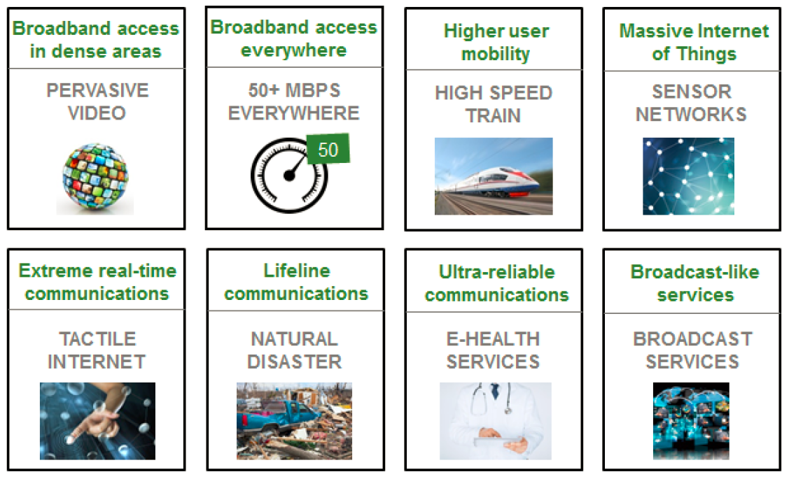
NGMN 5G Use Cases

Slide 21
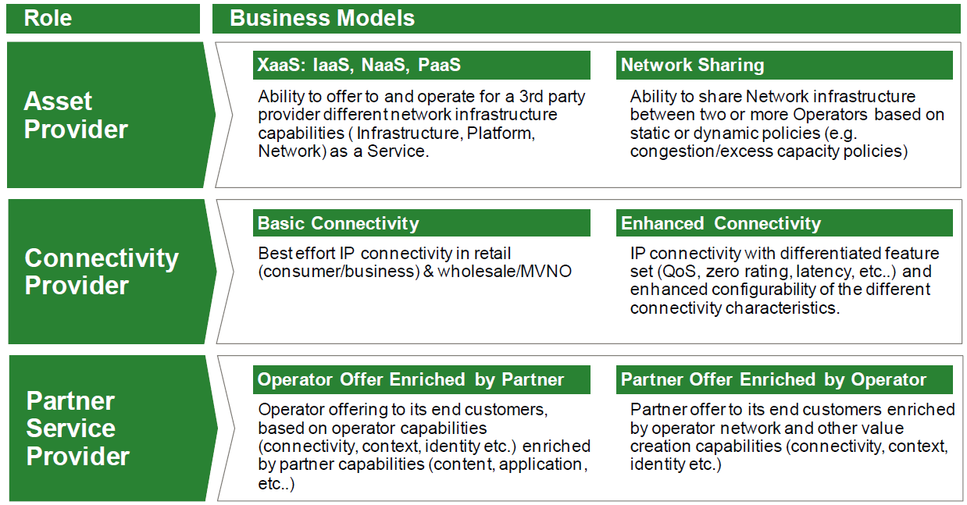
NGMN 5G Business Models

Slide 22
Architectural implications by NGMN 5G Business Models
Network sharing
Leverage network assets from multiple sources
Provide networking functions to others
Enhanced connectivity
Enable dynamically configured connectivity with differentiated feature sets
Enriched offers by partnership
Allow for combination and integration of network services with other assets and information sources

Slide 23
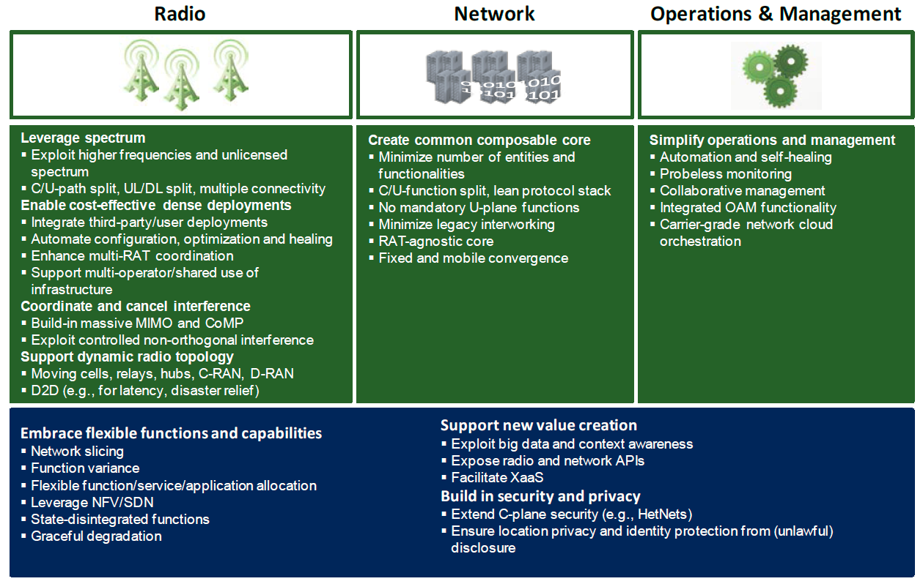
NGMN 5G Design Principles

Slide 24
Design Principles
Core Network
Operation & Management
Create common composable core
Minimize number of entities and functionalities
C/U-function split, lean protocol stack
No mandatory U-plane functions
Minimize legacy interworking
RAT-agnostic core
Fixed and mobile convergence
Simplify operations and management
Automation and self-healing
Probeless monitoring
Collaborative management
Integrated OAM functionality
Carrier-grade network cloud orchestration

Slide 25
NGMN 5G Architecture

Slide 26
Network Slicing
A “5G slice” provides a particular connection service with specific C- and U-plane functionality
Collection of 5G network functions and specific RAT settings for a particular service
Can span all domains of the network
Not all slices contain the same functions
Can be only subset of today’s mobile networks
Provides only the traffic treatment that is necessary for the particular use case.
Flexibility of slicing is a key enabler for value creation.
Third-party entities can be given permission to control certain aspects of slicing.

Slide 27
NGMN 5G Network Slicing

Slide 28
Technology Building Blocks N1 – Network Flexibility
Software-Defined Networking
Programmable network with centralized logically abstracted control, separated from a flow-based data/forwarding plane, like P-GW/S-GW and so on.
Virtualized Mobile Core Network
Software based functionality abstracted from common pool of hardware. Enables mobile core network elements as virtualized functions decoupled from specialized hardware, managing function and resources more flexibly and intelligently
Virtualization platform can provide open APIs to management functions utilizing shared resources.
State-disintegrated Core Node
State of a core node is separated and kept in a remote database
Smart Edge Node
A node at the edge of the network (e.g., base station, small cell or even terminal) can actively carry out some of the core network functionalities or additional services (example: context-aware dynamic caching)

Slide 29
Technology Building Blocks N2 - Efficient/Adaptive Network Resource Usage
Traffic Optimization
Adapting the transported traffic to the characteristics of the transmission path and/or the end-device using middleboxes in the network. Intelligently choosing the transmission path and last mile based on attributes of the end-device, available access technologies at the end-device’s location and status of network (paths and nodes)
Scalable service architecture
Ability to adapt and scale to service needs based on the use case (and mapped resource allocation)
Big data
To capture, analyze, make usable and leverage the vast amount of data available in many instances of content/service delivery. Additionally, along with behavior, context and proximity aspects, captured (or discovered & provided) by user devices, social media/networks, content/service delivery, user-data management, research and trial data, machine/sensors (including discovery) and IoT.
Content-optimization and adaptive streaming
Use of client-side and server-side techniques to adapt content delivery to path characteristics and the attributes of the end-device.

Slide 30
Technology Building Blocks N3 – Other Enablers
Technologies for massive connectivity
There are a wide variety of small packets transmissions with different QoE (Quality of Experience) for both M2M and H2H, e.g. Periodic keep-alive packets, Bursty Instant Messages, or Real-time critical message delivery
These small packet transmissions may cause frequent RRC transitions and contribute to network signaling congestion. Moreover, the current RRC transitions may introduce extra delay and thereby cannot satisfy the real-time requirement for some applications generating small packets transmissions. 3GPP is looking for signaling optimization of small packet transmission. Evolutional and some revolutionary mechanisms need to be devised to address this for 5G.
Privacy and Security Aspects
There are different aspects related to security that will play an important role for 5G design, including:
Radio link encryption of user traffic. Most applications that require security often implement it themselves, for instance using TLS/SSL, IPsec or some other application-specific security. Given this, how shall we handle link encryption of user traffic in 5G?
Security-design for low-latency use cases. Some 5G use cases require extremely low latency – including the latency of initiating communications. This will be an important shaping factor for the security design.
Location and identity privacy will require improvements with respect to current solutions used for 4G.

Slide 31
Conclusion
P802.1CF within the scope of 5G

Slide 32
Conclusion
IEEE 802 radio technologies fit well to NGMN 5G expectations
IEEE 802 radio technologies require an own version of radio access network to fully unleash their capabilities.
P802.1CF provides an generic approach to provide an IEEE 802 radio access network.
NGMN has demanding expectations on the upcoming mobile networks.
P802.1CF can fulfill NGMN expectations and requirements for the 5G radio access network.
Except wide area high mobility, which is not in scope

