Slide 1
IEEE 802 omniRAN R9c Reference Point
Date: 2014-03-xx
Authors:
Name | Affiliation | Phone | Email
Yonggang Fang | ZTE |  | yfang@ztetx.com
Bo Sun | ZTE |  | sun.bo1@zte.com.cn
He Huang | ZTE |  | Huang.he@zte.com.cn
Notice: This document represents only the views of the participants listed in the ‘Authors:’ field above. It is offered as a basis for discussion. It is not binding on contributors, who reserve the right to add, amend or withdraw material contained herein.
Copyright policy: The contributor is familiar with the IEEE-SA Copyright Policy <http://standards.ieee.org/IPR/copyrightpolicy.html>.
Patent policy: The contributor is familiar with the IEEE-SA Patent Policy and Procedures: <http://standards.ieee.org/guides/bylaws/sect6-7.html#6> and <http://standards.ieee.org/guides/opman/sect6.html#6.3>.
Abstract
This contribution discusses and suggests the reference point R9c of IEEE 802 based RAN architecture for shared access in Recommended Practice document.

Slide 2
Background and Issues
Reference Points (R9c)
Represents the external interface between ANC and CIS which is used for the ANC to query the Authorized Shared Access information on particular location and receive the instruction from the CIS.
CIS may locate at different place in NRM, depending on the implementation: Co-located with RAN, or CN.
But the current omniRAN NRM contains only one option.
In addition, CIS also needs to be authenticated before ANC acquires and uses the authorized shared access information.

Slide 3
Current omniRAN Reference Model
Coordination
Subscription
and
Service
Information
R2
Service
R3s
R9c
TE Ctrl
AN Ctrl
CNI Ctrl
R8c
R3c
R6c
R7c
Core
Terminal
Interface
Network
NA
Backhaul
Interface
R1
R3d
R6d
Core
Network
Terminal
Access Network

Slide 4
Proposal of modified NRM
R9c
R9c could be the interface between CIS and AN Ctrl (ANC), or CIS and CNI Ctrl (CNC)
R9c (CIS-ANC or CIS-CNC) contains same protocols
CIS
CIS is a database used to store the information of authorized shared access. It also provides the function of mutual authentication with ANC or CNC.

Slide 5
Proposal of modified NRM
CNI Ctrl
CNI Ctrl has an interface to Subscription Service (SS) to acquire subscriber’s information during the user authentication, authorization and datapath establishment.
CNI Ctrl has an interface (R9c) to CIS to access the authorized shared access information on the particular location and radio channel.
CNI Ctrl has an interface (R3c) to ANC to control the operation of CN for user’s datapath establishment, teardown, or relocation.

Slide 6
Proposal omniRAN Reference Model
Coordination
Subscription
and
Service
Information
R2
Service
R3s
R9c
R9c
TE Ctrl
AN Ctrl
CNI Ctrl
R8c
R3c
R6c
R7c
Core
Terminal
Interface
Network
NA
Backhaul
Interface
R1
R3d
R6d
Core
Network
Terminal
Access Network

Slide 7
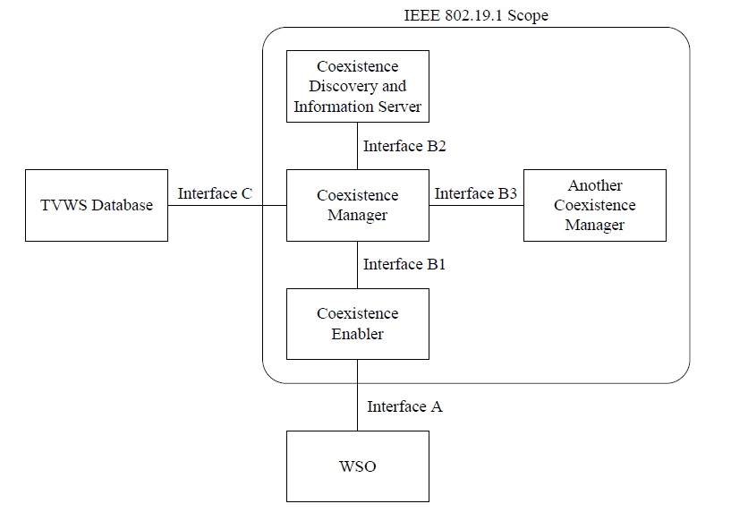
Backup
IEEE 802.19.1 Co-existence architecture for shared access

