Slide 1
SDN-based OmniRAN Use Cases Summary
Date: 2013-05-16
Authors:
Name | Affiliation | Phone | Email
Antonio de la Oliva | UC3M | +34 657079687 | aoliva@it.uc3m.es
Juan Carlos Zúñiga | InterDigital | +1 514 904 6300 | j.c.zuniga@ieee.org
Roger Marks | EthAirNet | +1 619 393 1913 | roger@EthAir.net
Notice: This document does not represent the agreed view of the OmniRAN EC SG. It represents only the views of the participants listed in the ‘Authors:’ field above. It is offered as a basis for discussion. It is not binding on the contributor, who reserve the right to add, amend or withdraw material contained herein.
Copyright policy: The contributor is familiar with the IEEE-SA Copyright Policy <http://standards.ieee.org/IPR/copyrightpolicy.html>.
Patent policy: The contributor is familiar with the IEEE-SA Patent Policy and Procedures: <http://standards.ieee.org/guides/bylaws/sect6-7.html#6> and <http://standards.ieee.org/guides/opman/sect6.html#6.3>.
Abstract
This presentation summarizes the description, derived requirements and gap analysis for the SDN-based Use Cases previously introduced in the OmniRAN 802 EC Study Group.

Slide 2
SDN-based OmniRAN Use Cases Summary
OmniRAN use cases contribution
Antonio de la Oliva, UC3M
Juan Carlos Zuniga, InterDigital
Roger Marks, EthAirNet Associates

Slide 3
Deployment Domain
SDN-based OmniRAN Use Case

Slide 4

OmniRAN Architecture
sdf
Access 1
Terminal
Access 2
Core
Access
Internet
Core Operator
Access 3
Access Network Operator

Slide 5
OmniRAN Architecture with multiple Cores
sdf
Core
Access 1
Core Operator A
Terminal
Core
Access 2
Access
Internet
Core Operator B
Access 3
Core
Access Network Operator
Core Operator C

Slide 6
USE Case description
SDN-based OmniRAN Use Case

Slide 7
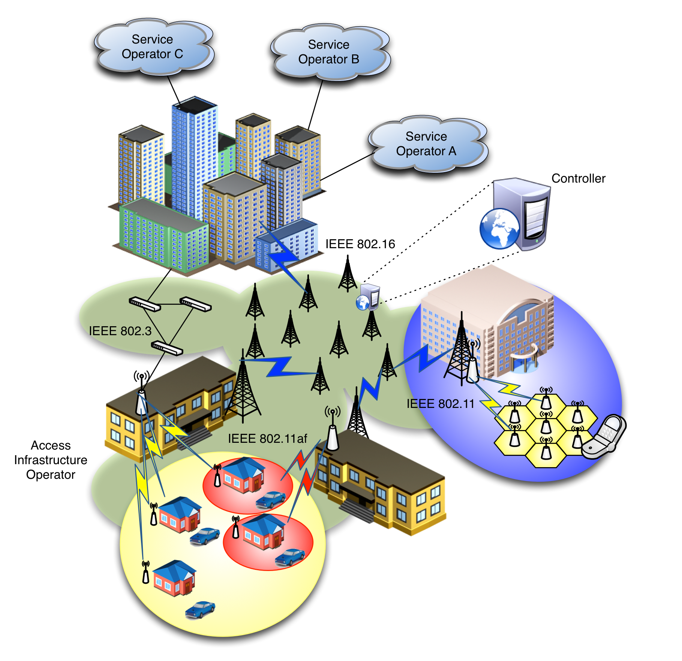
Scenario
Centrally controlled configuration, from Core to Terminal, of heterogeneous IEEE 802 links
Dynamic creation of data paths with dynamic reconfiguration and mapping to the terminal at flow granularity
Clean separation of data and control planes

Slide 8

SDN-based OmniRAN Architecture
Core
Operator A
Access 1
Access Abstraction
Backhaul
Terminal
Core
Operator B
Access 2
Internet
Access Abstraction
Access Abstraction
Multiple Cores sharing Access Network
Access Abstraction
Data and Control plane separation
Central control
SDN
Controller
Core
Operator C
Access 3
Access Abstraction
Access Network Operator
Core Operators
Data path
Control path

Slide 9
Mapping to OmniRAN
SDN-based OmniRAN Use Case

Slide 10
R1
Core
Operator A
Access 1
Access Abstraction
Backhaul
Terminal
R1
Core
Operator B
Access Abstraction
Access 2
Internet
Access Abstraction
SDN
Controller
Core
Operator C
Access 3
Access Abstraction
Access Network Operator
Core Operators
R1: Access link
SDN-based configuration/interaction between infrastructure and Terminal

Slide 11
R2
Core
Operator A
Access 1
Access Abstraction
Backhaul
Terminal
Core
Operator B
Access Abstraction
Access 2
R2
Internet
Access Abstraction
AAA
SDN
Controller
Core
Operator C
Access 3
Access Abstraction
Access Network Operator
Core Operators
R2: Control Path only
Control path from Terminal to the corresponding Core operator

Slide 12
R3
Core
Operator A
Access 1
Access Abstraction
Backhaul
R3
Terminal
Core
Operator B
Access Abstraction
Access 2
Internet
Access Abstraction
SDN
Controller
Core
Operator C
Access 3
Access Abstraction
Access Network Operator
Core Operators
R3: User data connection, service management
SDN controller configuring user data path (end-to-end forwarding) and mobility update, real-time flow-based counter monitoring, queue control, link connection control, heterogeneous access network control

Slide 13
R4
Core
Operator A
Access 1
Access Abstraction
Backhaul
R4
Terminal
Core
Operator B
Access Abstraction
Access 2
Internet
Access Abstraction
SDN
Controller
Core
Operator C
Access 3
Access Abstraction
Access Network Operator
Core Operators
R4: Inter-access network coordination and cooperation, fast inter-technology handover
SDN-based forwarding state updates across different access networks

Slide 14
R5
Core
Operator A
Access 1
Access Abstraction
Backhaul
R5
Terminal
Core
Operator B
Access Abstraction
Access 2
Internet
Access Abstraction
R5
SDN
Controller
Core
Operator C
Access 3
Access Abstraction
Access Network Operator
Core Operators
R5: Inter-operator roaming control interface
Inter-operator roaming outside access network

Slide 15
Functional Requirements
R1: Access link
  SDN-based configuration/interaction between infrastructure and Terminal
    Remote configuration/management mechanisms for 802 radio links, including terminal and access network side.
    SDN-based configuration of 802 links, including QoS, setup, teardown, packet classification
    User plane management of the multiple-interfaced Terminal (e.g. generic 802-based logical interface to present to L3)
R2: User & terminal authentication, subscription & terminal management
  Control path from Terminal to the corresponding Core operator
    Setting up control path between Terminal and AAA Proxy server
    Setting up control path between AAA Proxy server and AAA server of corresponding operator
    Identification and mapping of user’s traffic data paths/flows
    Dynamic modification of control path (e.g. SDN-based actions based on packet content)
    Per-user radio statistics for terminal management

Slide 16
Functional Requirements
R3: User data connection, service management
  SDN controller configuring user data path (end-to-end forwarding) and mobility update, real-time flow-based counter monitoring, queue control, link connection control, heterogeneous access network control
    Southbound interface for configuration/management of heterogeneous 802 links in the backhaul
    Generalized data plane with common behavior for 802 technologies
    Provisioning of data paths across heterogeneous 802 links with QoS support
    Per-user counters for accounting
R4: Inter-access network coordination and cooperation, fast inter-technology handover
  SDN-based forwarding state updates across different access networks
    SDN-based reconfiguration of data path
R5: Inter-operator roaming control interface
  Inter-operator roaming outside access network
    Subscription information exchange between service operators

Slide 17
GAPS To EXISTING IEEE 802 Functionality
SDN-based OmniRAN Use Case

Slide 18
GAP Analysis
Control of data forwarding plane, common to 802 technologies
  Southbound interface enabling the communication between the 802 technologies and the central controller (e.g. access abstraction)
  Clearly defined interfaces, SAPs and behaviors
  Ability to modify data path based on arbitrary but bounded selection parameters
    Packet classification mechanisms based on templates (á la OpenFlow)
    End-to-end packet flow and QoS
Radio configuration mechanism for access and backhaul links
  With defined metrics and reporting
Data plane management of the multiple-interface Terminal
  Notion of 802 logical interface facing L3
Generic 802 access authorization and attachment

