Slide 1
802.24.1 Smart Grid TAG
Consolidated White Paper Presentation
Date: May14, 2015
Authors:

Slide 2
Note – this is a draft: work in progress…

Slide 3
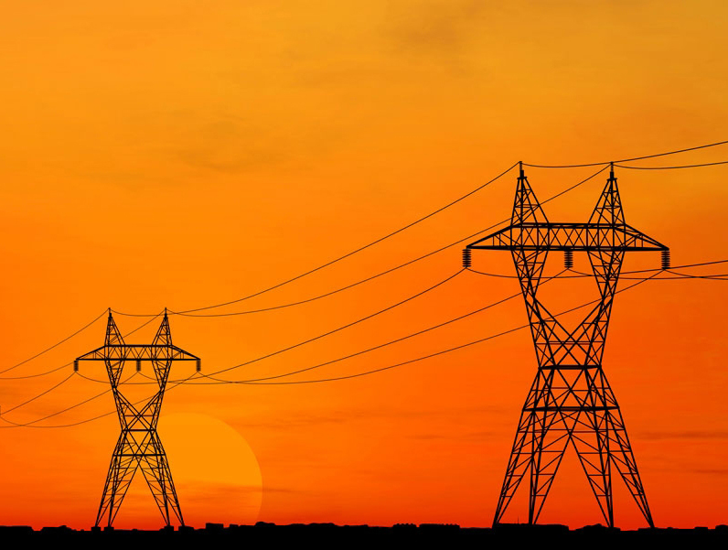

IEEE-SA Smart Grid

Slide 4
Smart Grid
Smart Grid is defined as:
  Providing bidirectional communication of power quality, supply, and demand across the power grid to utilize electricity more dynamically resulting in increased energy efficiency and power grid reliability. This change is necessary to manage the increased variability caused by renewable resources, the increased peak demand created by energy intensive consumers such as electric vehicles, and to minimize the environmental impact of ever increasing aggregate demand for electrical power.
Notes:
Split into two.

Slide 5
IEEE 802 and Smart Grid
IEEE 802 networking technologies bring the following advantages to Smart Grid communications:
  Enterprise grade security compatibility
  Huge ecosystem (billions of products, hundreds of manufacturers)
  Long-term (20 year), battery-powered operation
  Continued operation during line fault events when using wireless media
  Wide choice of products across the spectrum of power versus performance
  Ability to be implemented in resource-constrained devices
  Ongoing development of standards to address changing environment and technology
  Wireless standards that operate in a licensed and license-exempt spectrum
  Offers a rich set of data rate/range/latency tradeoffs
  Common upper layer interface to seamlessly integrate into existing IT systems

Slide 6
IEEE 802 Standards Applicable to Grid Communications
IEEE Std 802.1™ for bridging, time-sensitive networks, and link security
IEEE Std 802.3™ (Ethernet) for wired LANs
IEEE Std 802.11™ (Wi-Fi) for wireless LAN and HAN
IEEE Std 802.15™ (ZigBee and Wi-SUN) for HAN and AMI networks (NAN)
IEEE Std 802.16™ (WiMAX) for FAN and MAN
IEEE Std 802.21™ for media independent handover and multicast group management
IEEE Std 802.22™ for wireless regional area networks (WRAN) in TV white space (TVWS) bands

Slide 7
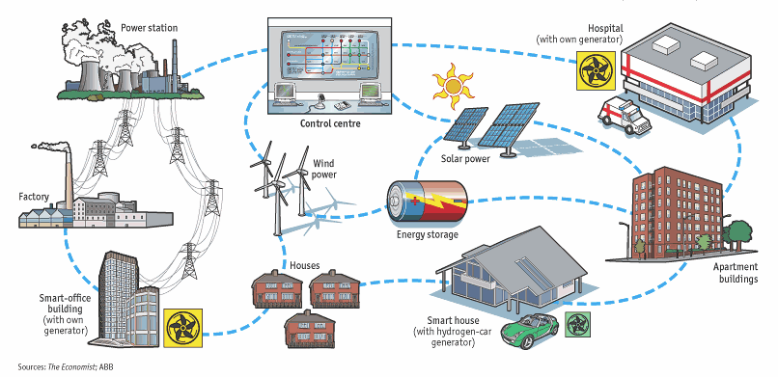
The Integrated Grid
Notes:
Clarify the meaning of “intelligence” with a new bullet
Remove or clean-up figure. Larger text.
More inclusive phrase (considering water and gas applications as well)? Find a phrase that avoids “Smart Grid”

Slide 8








Examples of utility communications protocols
Application
Layer
Other Applications
Metering
IEC 61968 CIM, ANSI C12.22,
DLMS/COSEM,…
SCADA
IEC 61850, 60870
DNP3/IP, Modbus/TCP,…
DNS, NTP, IPfix/Netflow, SSH
RADIUS, AAA, LDAP, SNMP,…
(RFC 6272 IP in Smart Grid)
Session
Layer
Web Services, EXI, SOAP,
RestFul,HTTPS/CoAP
Transport
Layer
UDP/TCP
Security (DTLS/TLS)
Network
Layer
IPv6/IPv4
Addressing, Routing, Multicast, QoS, Security
IPv6 RPL
Data
Link
Layer
802.1X / EAP-TLS & IEEE 802.11i based Access Control
IPv6 over PPP
(RFC 5072)
LLC`
802.15.9 KMP
IPv6 over Ethernet (RFC 2464)
IP or Ethernet
Convergence SubL.
6LoWPAN (RFC 6282)
M
A
C
IEEE 802.15.4e MAC enhancements
IEEE 802.11
Wi-Fi
IEEE 802.3
Ethernet
IEEE 802.16
WiMAX
IEEE 802.22
WRAN
2G, 3G, LTE
Cellular
IEEE 802.15.4
including FHSS
IEEE 1901.2
802.15.4 frame
format
Physical
Layer
IEEE 802.15.4g
2.4GHz, 915, 868MHz
DSSS, FSK, OFDM
IEEE 1901.2
NB-PLC
OFDM
IEEE 802.11
Wi-Fi
2.4, 5 GHz, Sub-GHz
IEEE 802.3
Ethernet
UTP, FO
IEEE 802.16
WiMAX
1.x - 3.x GHz
IEEE 802.22
TV White
Space
2G, 3G, LTE
Cellular

Slide 9
Overview of AMI Applications
Meter Reading
Theft Detection
Prepay Metering
Electric
Demand Response
Time Of Use
  Service Disconnect/Reconnect
  Outage and Restoration Management
  Voltage and VAr Optimization (power factor monitoring)
Gas / Water
  Leak Detection
  Seismic Event
  Cathodic Protection

Slide 10


SG Network Architecture
High level example of an AMI system
May be called FAN or NAN
Data Aggregation Point
Optional
Notes:
Put detailed diagram into a backup section – only used by those who are have the background.

Slide 11
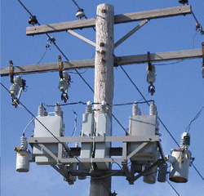
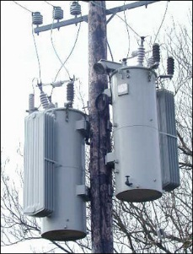
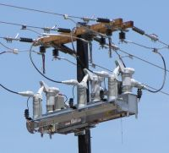
Overview of DA Applications
Distribution Automation (DA) involves monitoring and control of devices on the medium voltage (2 kV to 35 kV) grid, which provides the connection between a substation and customer transformer
DA Applications include:
  Voltage VAr (Capacitor Bank Control)
    Compensating for reactive power losses due to inductive load by switching in capacitor banks on the distribution circuit
  Voltage regulation
    Compensating for voltage loss and varying voltage due to load by changing taps on a specialized autotransformer
  Switching / Sectionalizers
    Remotely switching the connectivity of the distribution grid to balance load or route power around damaged areas.

Slide 12
Security Overview
Something on cyber security and IEEE 802
Scope limited to link-layer
Support higher layer security protocols (required in most cases)
Evolution to AES256 – future
List in SP800-57
References to FIPS, 2006 version, and later versions.
We would like to show how IEEE 802 fits into a comprehensive security architecture.
Generally 802 provides layer 2 authentication and encryption. Show key management interfaces and mechanisms. Cypher suites
NISTIR (Phil Beecher to provide this. Describe PKI, EAPOL, KMP, )
X – Y chart showing NISTIR requirements in rows, and 802 protocols in columns

Slide 13
802.1X Security
(key management – 802.1X GCM)

Slide 14
802.11 Security
Security from 802.11 (CCM, WPA PSK)

Slide 15
802.15 Security
Security section on 15.4 section 9: Ask Tero
Something from 15.9 (Tero)

Slide 16
802.16 Security

Slide 17
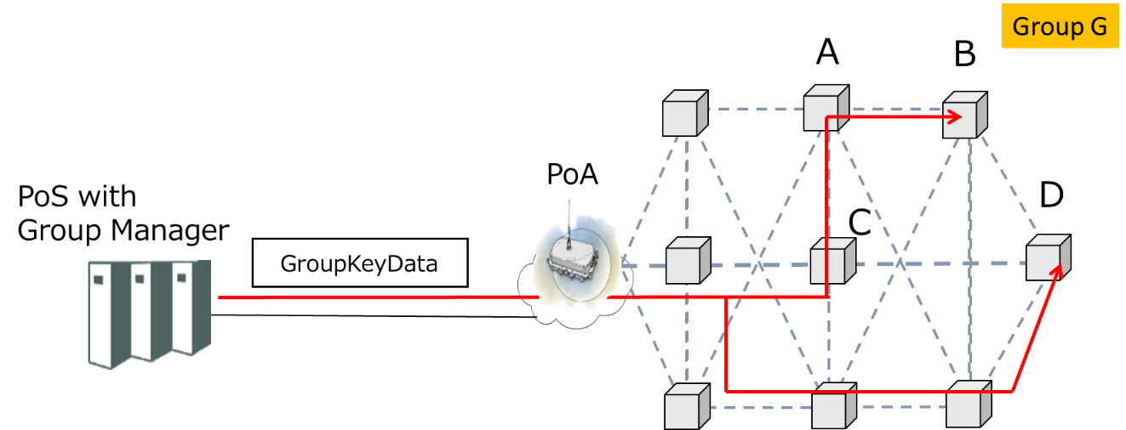
Security for 802.21d
Multicast Group Management
IEEE 802.21d standardizes a mechanism for distributing a symmetric key to group members, securely and efficiently.
Group Ciphersuites:
AES CCM128 (NIST SP 800-38C)
ECDSA256 (curve P-256 and hash function SHA-256)
Group key distribution Ciphersuites
Wrapping: AES_KeyWrapping-128, AES_ECB-128 (NIST SP 800-38F)
MAC Algorithm for VerifyGroupCode: AES-CMAC-128

Slide 18
802.22 Security
Apurva: 802.22 – GCM AES ECC

Slide 19
Non Mains and Low Power Applications
Example applications that take advantage of low power operation, (water, oil/gas, line sensors)
Example of “constrained” types of devices
Notes:
Ben Rolfe will create this

Slide 20
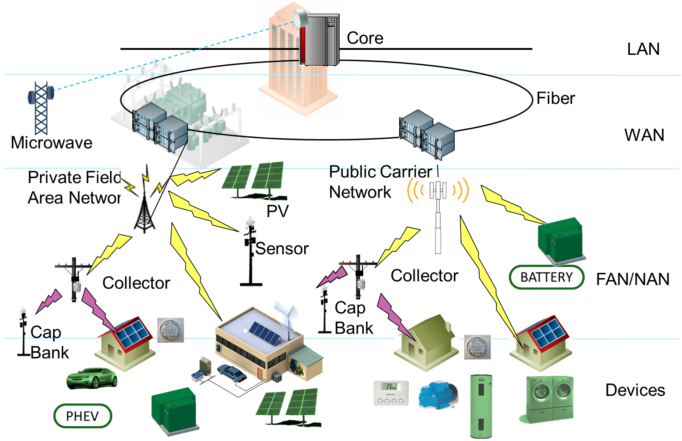
Standards for Grid Communications Networks
IEEE 802.3
IEEE 802.11
IEEE 802.3 1000BASE-X
IEEE 802.22
IEEE 802.16
IEEE 802.11
(Mesh Topology)
IEEE 802.15.4:
(SUN, LECIM, TVWS)
IEEE 802.11ah, 802.11af
IEEE 802.11
IEEE 802.15.4

Slide 21
Complementary Communications Technologies
Narrowband Power Line Communications (PLC) is used in some geographic areas for metering and other purposes.
  Operation below 500 KHz
  PLC technologies are difficult to scale into applications that do not have a connection to the electric grid (water, gas, etc)
Commercial wireless network operators are often employed, both for backhaul and direct connection to grid devices and meters.
Notes:
Jeritt Kent will provide

Slide 22
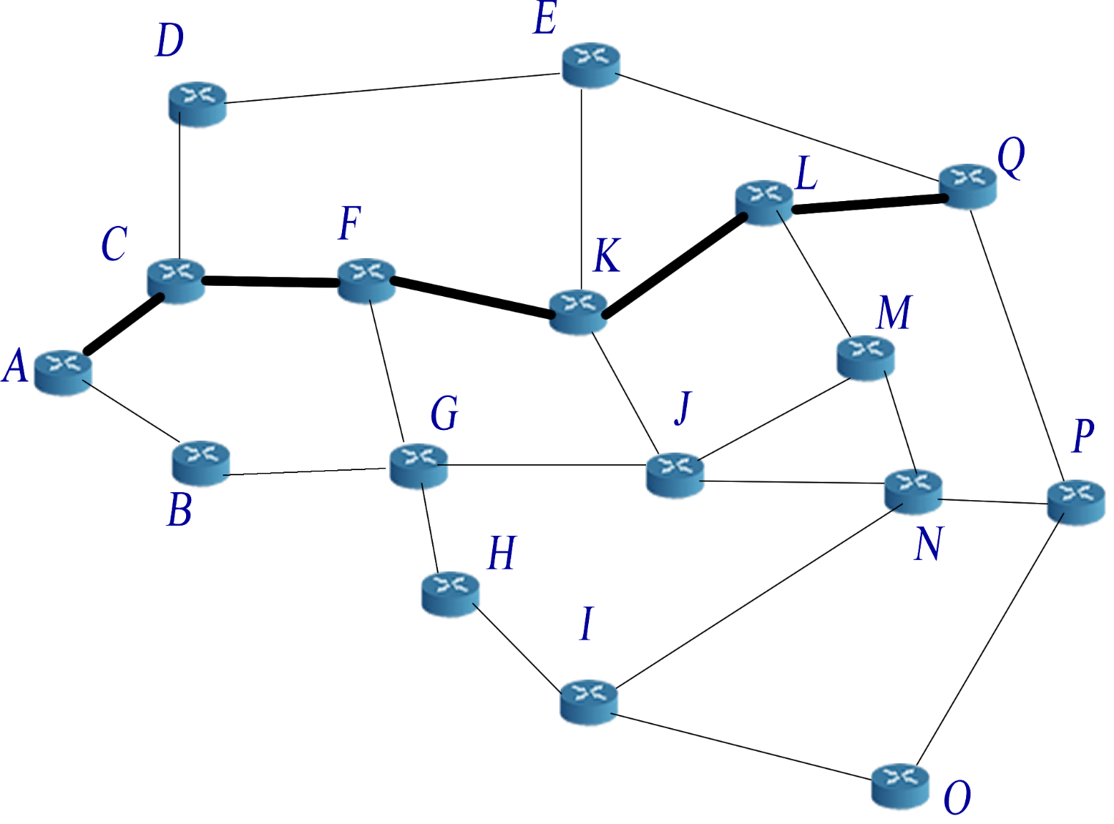
Example of Mesh Network
http://upload.wikimedia.org/wikipedia/commons/c/c5/17_node_mesh_network.png
Notes:
Look in L2R contributions.

Slide 23
Lifecycle Considerations
Many utility field networks and devices are expected to have a lifetime of 15 or more years.
IEEE 802 standards continue to evolve, but typically provide a backward compatibility path to older versions, enabling extended life cycles.

Slide 24
Backup Section

Slide 25
IEEE 802.11 standards hierarchy
IEEE
802.3
802.11
802.15
802.16
802.21
802.22
802.11a through 802.11z: Completed
Completed
Active: More Grid relevant
11ac
Higher rate in 5GHz band
11ad
Higher rate in 60GHz band
Active: Less Grid relevant
11ae
Prioritization of management frames
11af
TV White Space
11ah
915MHz Band operation (sub 1GHz)
11ai
Fast Initial Association
11aj
China Millimeter Wave Task Group
11ak
General Link (full bridging over WLAN) joint with 802.1
11aq
Pre-Association Discovery Task Group
11ax
High Efficiency WLAN (HEW)

Slide 26
802.11 – Spectrum / Rate view
.11ad
500MHz
1GHz
2GHz
5GHz
10GHz
60GHz
802.11ac
500Mbps
802.11n
802.11n
100Mbps
.11af
.11ah
802.11g
.11y
.11j
802.11a
.11p
10Mbps
802.11
802.11b
1Mbps

Slide 27
IEEE 802.15 standards hierarchy
IEEE
802.3
802.11
802.15
802.16
802.21
802.22
802.15.4
ZigBee
Completed
4e
Smart Utility Networks (WiSUN) AMI
4g
Active – More Grid relevant
4k
LECIM
Active – Less Grid relevant
4m
WiSUN (AMI) for TV White Space
4n
4q
4r
Layer 2 Routing Task Group
Key Management
Protocol Task Group
802.15.9
802.15.10

Slide 28
802.15.4 PHY Overview (data rate vs frequency)
10Kbps
100Kbps
1Mbps
5GHz
O-QPSK
CSS
CSS
2GHz
4g 2FSK
4g 2FSK
4g 4FSK
4g O-QPSK
4g ODFM
4g 2FSK
4g 2FSK
4g 4FSK
1GHz
4g ODFM
BPSK DSSS
4g 2FSK
GFSK
4g 2FSK
O-QPSK, ASK
920
4g 4FSK
915
4g ODFM
BPSK DSSS
O-QPSK
868
4g O-QPSK
BPSK DSSS
O-QPSK, ASK
863
4g ODFM
780
O-QPSK, ASK
MPSK
500MHz
4g O-QPSK
4g 2FSK
4g 2FSK
4g 4FSK
4g 2FSK
4g ODFM

Slide 29
IEEE 802.16 standards hierarchy
IEEE
802.3
802.11
802.15
802.16
802.21
802.22
802.16-2012
WiMAX
16n
Completed – Grid Relevant
16p
Small Cell Backhaul
Completed – Less Relevant
16r
Multi-Tier Networks
WiMAX 2
16q
Active – Limited grid relevance
High Reliability
802.16.1
Machine to Machine
1a
1b
Performance Metrics
802.16.3

Slide 30
802.22 and other TV White Space standards

Slide 32
SG Network Architecture
Notes:
Backup section – only used by those who have the background.

