Slide 1
IEEE P802.22b Mar. 2013 Plan & Report
IEEE P802.22 Wireless RANs Date: 2013-3-18
Authors:
Notice: This document has been prepared to assist IEEE 802.22. It is offered as a basis for discussion and is not binding on the contributing individual(s) or organization(s). The material in this document is subject to change in form and content after further study. The contributor(s) reserve(s) the right to add, amend or withdraw material contained herein.
Release: The contributor grants a free, irrevocable license to the IEEE to incorporate material contained in this contribution, and any modifications thereof, in the creation of an IEEE Standards publication; to copyright in the IEEE’s name any IEEE Standards publication even though it July include portions of this contribution; and at the IEEE’s sole discretion to permit others to reproduce in whole or in part the resulting IEEE Standards publication. The contributor also acknowledges and accepts that this contribution July be made public by IEEE 802.22.
Patent Policy and Procedures: The contributor is familiar with the IEEE 802 Patent Policy and Procedures
<http://standards.ieee.org/guides/bylaws/sb-bylaws.pdf>, including the statement "IEEE standards July include the known use of patent(s), including patent applications, provided the IEEE receives assurance from the patent holder or applicant with respect to patents essential for compliance with both mandatory and optional portions of the standard." Early disclosure to the Working Group of patent information that might be relevant to the standard is essential to reduce the possibility for delays in the development process and increase the likelihood that the draft publication will be approved for publication. Please notify the Chair Apurva Mody <apurva.mody@ieee.org> as early as possible, in written or electronic form, if patented technology (or technology under patent application) might be incorporated into a draft standard being developed within the IEEE 802.22 Working Group. If you have questions, contact the IEEE Patent Committee Administrator at <patcom@ieee.org>.

Slide 2
Meeting Protocol
Please announce your affiliation when you first address the group during a meeting slot

Slide 3
Attendee
https://imat.ieee.org/attendance
Register
Indicate attendance

Slide 4
Introduction
Welcome to the IEEE P802.22b Mar., Plenary Meeting in Orlando
TG Chairs and secretary
Chair: Chang-woo Pyo (NICT)
Vice-chair : Sunghyun Hwang (ETRI)
Recording Secretary: Zhang Xin(NICT)
Recording your attendance
Send email to: zhang@ieee.org

Slide 5
New Member
Welcome to 802.22b TG
Introduction

Slide 6
Patent Policy
Following 5 slides

Slide 7
Instructions for the WG Chair
The IEEE-SA strongly recommends that at each WG meeting the chair or a designee:
Show slides #1 through #4 of this presentation
Advise the WG attendees that:
The IEEE’s patent policy is consistent with the ANSI patent policy and is described in Clause 6 of the IEEE-SA Standards Board Bylaws;
Early identification of patent claims which may be essential for the use of standards under development is strongly encouraged;
There may be Essential Patent Claims of which the IEEE is not aware. Additionally, neither the IEEE, the WG, nor the WG chair can ensure the accuracy or completeness of any assurance or whether any such assurance is, in fact, of a Patent Claim that is essential for the use of the standard under development.
Instruct the WG Secretary to record in the minutes of the relevant WG meeting:
That the foregoing information was provided and that slides 1 through 4 (and this slide 0, if applicable) were shown;
That the chair or designee provided an opportunity for participants to identify patent claim(s)/patent application claim(s) and/or the holder of patent claim(s)/patent application claim(s) of which the participant is personally aware and that may be essential for the use of that standard
Any responses that were given, specifically the patent claim(s)/patent application claim(s) and/or the holder of the patent claim(s)/patent application claim(s) that were identified (if any) and by whom.
The WG Chair shall ensure that a request is made to any identified holders of potential essential patent claim(s) to complete and submit a Letter of Assurance.
It is recommended that the WG chair review the guidance in IEEE-SA Standards Board Operations Manual 6.3.5 and in FAQs 12 and 12a on inclusion of potential Essential Patent Claims by incorporation or by reference.
Note: WG includes Working Groups, Task Groups, and other standards-developing committees with a PAR approved by the IEEE-SA Standards Board.

Slide 8
Participants, Patents, and Duty to Inform
All participants in this meeting have certain obligations under the IEEE-SA Patent Policy. Participants:
“Shall inform the IEEE (or cause the IEEE to be informed)” of the identity of each “holder of any potential Essential Patent Claims of which they are personally aware” if the claims are owned or controlled by the participant or the entity the participant is from, employed by, or otherwise represents
“Personal awareness” means that the participant “is personally aware that the holder may have a potential Essential Patent Claim,” even if the participant is not personally aware of the specific patents or patent claims
“Should inform the IEEE (or cause the IEEE to be informed)” of the identity of “any other holders of such potential Essential Patent Claims” (that is, third parties that are not affiliated with the participant, with the participant’s employer, or with anyone else that the participant is from or otherwise represents)
The above does not apply if the patent claim is already the subject of an Accepted Letter of Assurance that applies to the proposed standard(s) under consideration by this group
Quoted text excerpted from IEEE-SA Standards Board Bylaws subclause 6.2
Early identification of holders of potential Essential Patent Claims is strongly encouraged
No duty to perform a patent search

Slide 9
Patent Related Links
All participants should be familiar with their obligations under the IEEE-SA Policies & Procedures for standards development.
Patent Policy is stated in these sources:
IEEE-SA Standards Boards Bylaws
http://standards.ieee.org/guides/bylaws/sect6-7.html#6
IEEE-SA Standards Board Operations Manual
http://standards.ieee.org/guides/opman/sect6.html#6.3
Material about the patent policy is available at
http://standards.ieee.org/board/pat/pat-material.html
If you have questions, contact the IEEE-SA Standards Board Patent Committee Administrator at patcom@ieee.org or visit http://standards.ieee.org/board/pat/index.html
This slide set is available at http://standards.ieee.org/board/pat/pat-slideset.ppt

Slide 10
Call for Potentially Essential Patents
If anyone in this meeting is personally aware of the holder of any patent claims that are potentially essential to implementation of the proposed standard(s) under consideration by this group and that are not already the subject of an Accepted Letter of Assurance:
Either speak up now or
Provide the chair of this group with the identity of the holder(s) of any and all such claims as soon as possible or
Cause an LOA to be submitted

Slide 11
Other Guidelines for IEEE WG Meetings
All IEEE-SA standards meetings shall be conducted in compliance with all applicable laws, including antitrust and competition laws.
Don’t discuss the interpretation, validity, or essentiality of patents/patent claims.
Don’t discuss specific license rates, terms, or conditions.
Relative costs, including licensing costs of essential patent claims, of different technical approaches may be discussed in standards development meetings.
Technical considerations remain primary focus
Don’t discuss or engage in the fixing of product prices, allocation of customers, or division of sales markets.
Don’t discuss the status or substance of ongoing or threatened litigation.
Don’t be silent if inappropriate topics are discussed … do formally object.
---------------------------------------------------------------
See IEEE-SA Standards Board Operations Manual, clause 5.3.10 and “Promoting Competition and Innovation: What You Need to Know about the IEEE Standards Association's Antitrust and Competition Policy” for more details.

Slide 12
802.22b Title, PAR Scope and Purpose
Title
Enhancement for Broadband Services and Monitoring Applications
PAR
This amendment specifies alternate Physical Layer (PHY) and necessary Medium Access Control Layer (MAC) enhancements to IEEE std. 802.22-2011 for operation in Very High Frequency (VHF)/ Ultra High Frequency (UHF) TV broadcast bands between 54 MHz and 862 MHz to support enhanced broadband services and monitoring applications. The standard supports aggregate data rates greater than the maximum data rate supported by the IEEE Std. 802.22-2011. This standard defines new classes of 802.22 devices to address these applications and supports more than 512 devices in a network. This standard also specifies techniques to enhance communications among the devices and makes necessary amendments to the cognitive, security & parameters and connection management clauses. This amendment supports mechanisms to enable coexistence with other 802 systems in the same band.
Purpose
The purpose of this amendment is to enhance the MAC and define an alternate PHY to accommodate broadband extensions and monitoring use cases for IEEE 802.22 devices operating is VHF/UHF TV broadcast bands between 54 MHz and 862 MHz.

Slide 13
Tentative TG 802.22b Agenda for the Week
Agenda
Motion to approve Mar. 802.22b agenda as contained in 22-13-0044-00-000b
Move: Chang-woo Pyo
Second: Zhang Xin
No objection. Motion passes

Slide 14
TGb Slot 1
Time: Tuesday Jan. 19th PM1
Review from January
Approve minutes from January
Discussion Items
Time slot for Presentation

Slide 15
Review of January Meeting
Contributions
Keat Beng Toh, MAC Proposal for IEEE 802.22b by Hitachi Kokusai Electric (802.22-12/0087r1)
Zhang Xin, Link Budget Calculation for NICT proposal (22-13-0011-01-000b)
Masayuki Oodo, PHY Performance Comparison between 802.22 PHY and Proposed PHY (22-13-0013-00-000b)
Discuss Future Plan

Slide 16
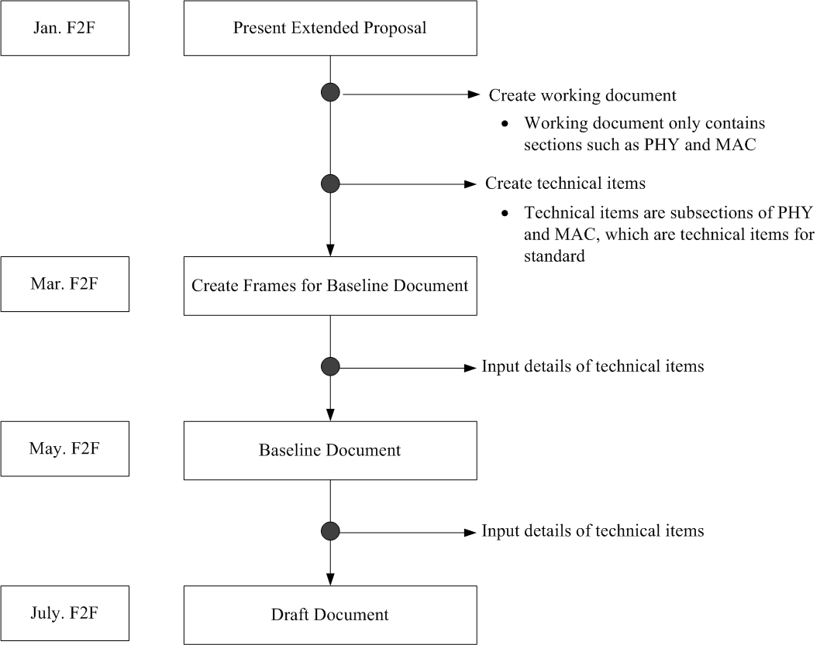

Slide 17
January Minutes
Motion to approve Jan. 802.22b minutes as contained in 22-13-0040-00-000b
Move: Chang-woo Pyo
Second: Sunghyun Hwang
No objection, Motion passes.

Slide 18
Review of Conference Calls
Feb. 7 : Create working document
Feb. 14 : Create technical items
Feb. 21 : Create technical items
Feb. 28 : Create technical items
Mar. 7 : Create technical items

Slide 19
Conference Call Minutes
Motion to approve 802.22b conference call minutes as contained in
22-13-0021-00-000b,
22-13-0026-00-000b,
22-13-0029-00-000b,
22-13-0038-00-000b,
22-13-0042-00-000b
Move: Chang-woo Pyo
Second: Zhang Xin
No objection. Motion passes

Slide 20
Discussion Items
Working Document
22-13-0020-00
Technical Items
22-13-0038-00-000b (Sheet Format)
PHY Items
MAC Items
Network Configuration and Definitions
22-13-0036-00-000b
Network Operations
Others

Slide 21
Contributions
Tuesday Jan. 19th PM1
Tuesday Jan. 19th PM2
Wednesday Jan. 20th PM1
Wednesday Jan. 20th PM2
Thursday Jan. 21th AM1
Wednesday Jan. 21th AM2

Slide 22
TGb Slot 2
Time: Tuesday Jan. 19th PM2

Slide 23
TGb Slot 3
Time: Wednesday Jan. 20th PM1

Slide 24
TGb Slot 4
Time: Wednesday Jan. 20th PM2

Slide 25
TGb Slot 5
Time: Thursday Jan. 21th AM1

Slide 26
TGb Slot 6
Time: Thursday Jan. 21th AM2

Slide 27
Items for the next F2F meeting

Slide 28
Teleconference Plan

Slide 29
Closing Report

Slide 30
802.22b Task Group Updated Timeline
 | 2012 |  |  |  |  |  | 2013 |  |  |  |  |  | 2014
 | 1 | 3 | 5 | 7 | 9 | 11 | 1 | 3 | 5 | 7 | 9 | 11 | 1 | 3 | 5 | 7 | 9 | 11
Task Group formed | x
Process document | x | x
Functional Requirements | x | x
Call for Proposals issued |  | x
Selection Criteria |  | x | x | x
Technical/Informative Contributions |  |  | x | x | x
Proposal presentations |  |  |  |  |  | x
Baseline proposal selected |  |  |  |  |  |  | x
Draft for 1st letter ballot |  |  |  |  |  |  |  | x | x
1st letter ballot completed |  |  |  |  |  |  |  |  |  | x
Comment Resolution |  |  |  |  |  |  |  |  |  |  | x
2nd letter ballot completed |  |  |  |  |  |  |  |  |  |  |  | x
Comment Resolution and recirculation |  |  |  |  |  |  |  |  |  |  |  |  | x
Sponsor ballot |  |  |  |  |  |  |  |  |  |  |  |  |  | x
Comment Resolution and recirculation |  |  |  |  |  |  |  |  |  |  |  |  |  |  | x | x
RevCom/NesCom Approval |  |  |  |  |  |  |  |  |  |  |  |  |  |  |  |  | x | x

