Slide 1
IEEE 802.21 MEDIA INDEPENDENT HANDOVER
DCN: 21-13-0196-00-SAUC
Title: MIH Service Use Cases for Network-Assisted D2D Communication of Service Providers and Network Operators
Date Submitted: November 9th, 2013
Presented at IEEE 802.21 Session #59 –Dallas, USA
Authors or Source(s):
Hyunho Park (ETRI), Hyeong-Ho Lee (ETRI), Seung-Hwan Lee (ETRI), and Jin Seek Choi (Korea Ethernet Forum)
Abstract: This document introduces MIH service use cases for network-assisted D2D communication of service providers and network operators.

Slide 2
  IEEE 802.21 presentation release statements
This document has been prepared to assist the IEEE 802.21 Working Group. It is offered as a basis for discussion and is not binding on the contributing individual(s) or organization(s). The material in this document is subject to change in form and content after further study. The contributor(s) reserve(s) the right to add, amend or withdraw material contained herein.
The contributor grants a free, irrevocable license to the IEEE to incorporate material contained in this contribution, and any modifications thereof, in the creation of an IEEE Standards publication; to copyright in the IEEE’s name any IEEE Standards publication even though it may include portions of this contribution; and at the IEEE’s sole discretion to permit others to reproduce in whole or in part the resulting IEEE Standards publication. The contributor also acknowledges and accepts that this contribution may be made public by IEEE 802.21.
The contributor is familiar with IEEE patent policy, as stated in Section 6 of the IEEE-SA Standards Board bylaws <http://standards.ieee.org/guides/bylaws/sect6-7.html#6> and in Understanding Patent Issues During IEEE Standards Development http://standards.ieee.org/board/pat/faq.pdf>

Slide 3





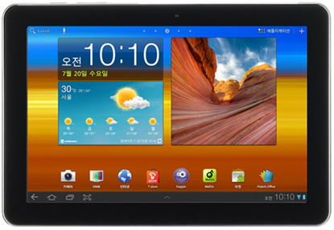










Use Cases of Device-to-Device (D2D) Communications
Social Networking
  Example: Local group chatting
Advertisement
  Example: Advertisement form nearby shops
1
Broadcast Ad for McDonald’s Hamburger
Friends
Retailer
2
Receive Ad from near-by shop when hitting the score
John
Ads in Game
Public Safety
  Example: Emergency Service & Alarm
Data Sharing
  Example: Content sharing
SoS message
Personal DJ
SoS message
Ref. 15-12-0046-01-0008, “PAC Introduction.”

Slide 4
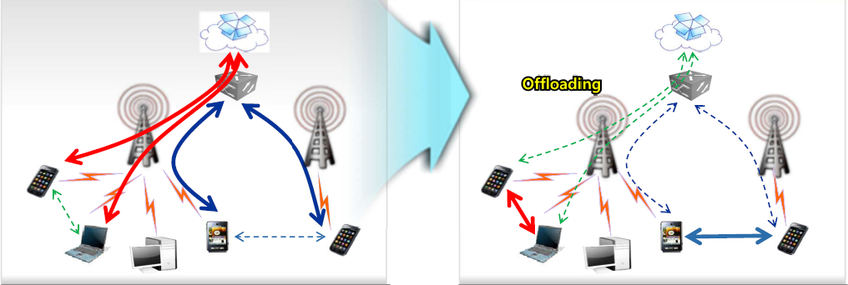
Use Cases of D2D Communications
Data Offload
Data transfer through a wireless network
Data transfer through a
wireless
network
D2D Communication
D2D Communication
Ref. 15-12-0255-02-0008, “Response to the Call for Applications.”

Slide 5
Network-Assisted D2D Communication and Its Service Providers
Network-Assisted D2D Communication (NADC)
  D2D (Device-to-Device) communication between two mobile nodes in proximity with the assistance of legacy networks (e.g., WLAN, WPAN, WiMAX network, and 3GPP network)
Service providers with NADC
Network operators with NADC
Use Cases | Service Providers with NADC
Social networking | Social network service providers
Advertisement | Advertisement providers
Public safety | Public safety service providers
Data sharing | Content service providers
Use Cases | Service Providers with NADC
Data offload | Network operators - Explained in “MIH Service Use Cases for Network-Assisted D2D Communication” (DCN: 21-13-0160-00-SAUC)

Slide 6


NADC of Social Network Service Providers
Social network service providers with NADC help a mobile node to discover its peer.
Social Network Service Provider
(3) Peter can introduce a good restaurant near Mary by using D2D communication.
I am near “Hotel A” but cannot find any restaurant by using web map service such as Google map.
I want ask someone near me for a restaurant.
WLAN/
WPAN/
WiMAX/
Cellular Network
(5) Configuration information to connect to Mary’s mobile node by using D2D communication
(4) Configuration information to connect to Peter’s mobile node by using D2D communication
(2) Request for a peer
Hotel A
Mary
Peter
(6) Is there any good restaurant near “Hotel A.”
Mary’s
mobile node
Peter’s mobile node
(7) “Restaurant B” near back door of “Hotel A” is wonderful.

Slide 7

NADC of Advertisement Providers
Advertisement providers (e.g., local shops) with NADC can advertise their products based on customers’ preference.
Database of Customers
(3) Shop B, which is near Mary, has lots of snickers of “Brand A.”
WLAN/
WPAN/
WiMAX/
Cellular Network
(1) I want to buy a snicker of “Brand A.”
(2) Mary’s preference information (“Brand A”)
(4) Mary’s preference (Brand A)
(4) Configuration information to receive advertisement from Shop B’s terminal through D2D communication
Shop B
Mary
(5) Snicker C of Brand A
- Design
- Cost: $10
Mary’s mobile node
Shop B’s terminal for D2D communication

Slide 8
NADC of Public Safety Service Providers
Public safety service providers with NADC can distribute information to cope with emergency situation.
Public Safety Service Provider
(1) Many base stations were broken because of earth quake. Mary can receive information about emergency shelter. Mary, please distribute information about emergency shelter.
Map to Emergency Shelter
Hotel
WLAN/
WPAN/
WiMAX/
Cellular Network
Emergency Shelter
(Elementary School)
(2) Information about emergency shelter
(3) Request for distribution of information about emergency shelter by using D2D communication
Mary
(5) I will go to the elementary school to receive care.
Smith
Mary’s mobile node
(4) Distribution of information about emergency shelter by using D2D communication
Smith’s mobile node

Slide 9


NADC of Content Service Providers
Content service provider with NADC can distribute contents by using D2D communication to reduce load of content server.
Content Service Provider
Content servers need to reduce load.
Content distribution through D2D communication will reduce load of content servers.
WLAN/
WPAN/
WiMAX/
Cellular Network
(1) Content (e.g., video clip) transmission
(4) Configuration information to connect to Mary’s mobile node by using D2D communication
(3) Request for content distribution through D2D communication
Mary
Bob
Mary’s mobile node
(5) Content distribution through D2D communication
Bob’s
mobile node

Slide 10
  NADC of Network Operators
  Network operators with NADC can offload data to D2D communication.
(2) Network is congested.
Network Operator
(1) Data session is routed over the network infrastructure.
Enterprise/
Campus/ Mobile Network
Bob
Peter
(3) Configuration information for D2D communication between Bob and Peter
(4) Connection by using D2D communication
Bob’s
mobile node
John’s
mobile node
(5) Data offload to D2D communication

Slide 11
MIH Framework for
Service Providers with NADC
MIH framework is common platform to support interworking between networks using IEEE802 and non-IEEE802 technologies
  MIH framework can be a good platform of NADC for Wi-Fi Direct, PAC, and ProSe Direct Communication.
  MIH PoS (Point of Service) can be a network controller for NADC.
MIH information server can store location information of mobile nodes.
  MIH information server can help a mobile node to discover its peer.

Slide 12
Requirements of MIH Framework for Service Providers with NADC
MIH information server should provide information on MN’s peer discovery.
MIH PoS should select optimal D2D communication (e.g., Wi-Fi direct and PAC) and assign radio resources (e.g., frequency and time slot) for terminals that use NADC.
Service provider servers should access to MIH information server and MIH PoS.
MIH
Information
Server
Request for peer discovery of mobile nodes
Service Provider Server
(MIH PoS)
Request for selection of D2D communication and resource management of NADC
MIH PoS
MIH PoS
WLAN/ WPAN/WiMAX/
Cellular Network
Configuration information for connecting to peer node (Terminal B)
Configuration information for connecting to peer node (Terminal A)
Selection of D2D communication and assignment of radio resource
PoA B
PoA A
D2D Communication
Terminal A
Terminal B

Slide 13
Conclusions
This contribution presented NADC use cases of various service providers and network operators.
  NADC of Social Network Service Providers
  NADC of Advertisement Providers
  NADC of Public Safety Service Providers
  NADC of Content Service Providers
  NADC of Network Operators
MIH framework can provide a good platform for NADC.

Slide 14
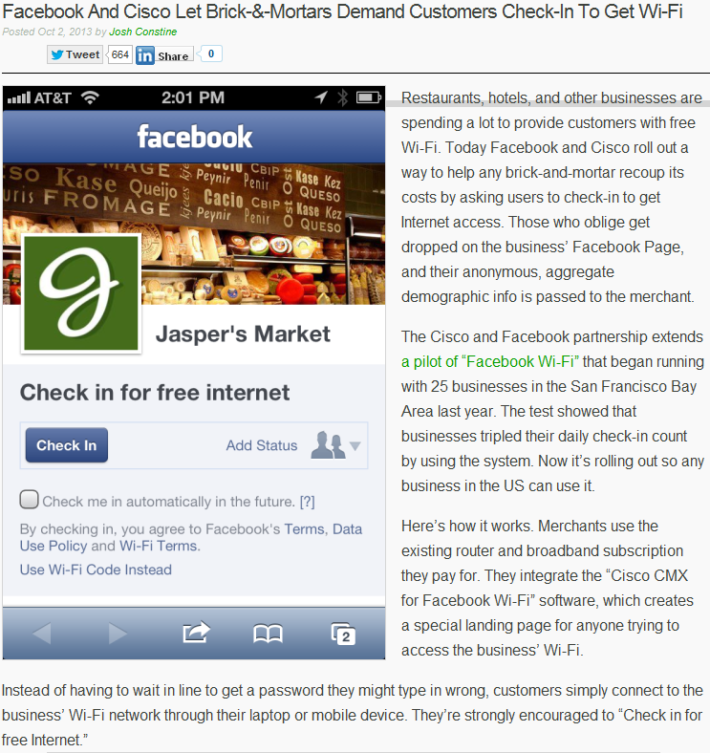
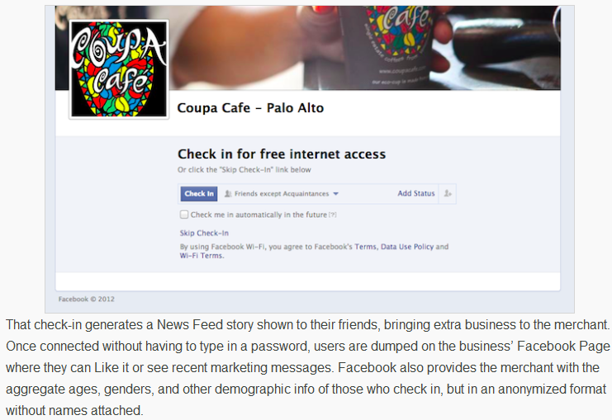
Appendix
Cooperation between Cisco and Facebook
Ref. http://techcrunch.com/2013/10/02/facebook-wifi/

Slide 15

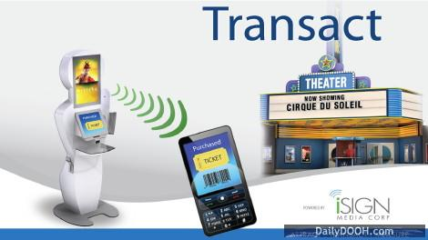
Appendix (Continued)
Advertisement by using D2D communication
BT-Pusher of Device Gate in China
Advertisement using Bluetooth
ISign media in Canada
Advertisement using Bluetooth and Wi-Fi
Ref. http://www.bt-pusher.com/
Ref. http://www.dailydooh.com/archives/41807

