Slide 1
TG19.3a Meeting Slides and Agenda Details September Wireless Interim
Date: 2025-09-15
Authors:
Name | Affiliations | email
Benjamin Rolfe | BCA, MERL | Ben.rolfe @ ieee.org
Notice: This document has been prepared to assist IEEE 802.19. It is offered as a basis for discussion and is not binding on the contributing individual(s) or organization(s). The material in this document is subject to change in form and content after further study. The contributor(s) reserve(s) the right to add, amend or withdraw material contained herein.

Slide 2

Tg19.3a
September Wireless Interim
Waikaloa Beach, Big Island, HI, USA
And remote around the world

Slide 3
Project Overview
PAR approved: https://development.standards.ieee.org/myproject-web/app#viewpar/14995/11032
Scope of the project: This amendment updates and expands coexistence recommendations to address new market requirements, increasing data traffic, greater device density of devices, and increased potential for congestion based on both IEEE Std 802.11-2020 and IEEE Std 802.15.4 sub-1 GHz standards. This amendment includes recommendations with respect to new devices, as well as compatibility with deployed legacy devices.

Slide 4
TG Overview
1 | Task Group Chair | Benjamin Rolfe
2 | Task Group Technical Editor | Shoichi Kitazawa
3 | Task Group Vice Chair | Kazuto Yano
4 | Task Group Vice Chair | Joerg Robert
5 | Task Group Recording Secretary | Yukimasa Nagai

Slide 5
Proposed Focus for September
Continue preparation for drafting process
Review received proposed draft text contributions
Hear additinao PDT contributions
Approve PDT for generation of Draft 0

Slide 6
Agenda
 | Topic | Presenter | Time | DCN
 | Monday
1 | Intro and overhead | Chair | 00:10
1.1 | Agenda Review | Chair | 00:05
3 | Technical Contributions and Discussion
3.1 | Status of PDT integration | Technical Editor | 00:15
3.2 | Proposed draft text TBD | TBD | 00:30
3.3 | Proposed draft text TBD | TBD | 00:30
3.4
4 | Recess | Chair

Slide 7

Recess

Slide 8
Agenda
 | Topic | Presenter | Time
 | Thursday
5 | Opening reminders and Agenda review | Chair | 00:05
6 | Technical Contributions and Discussion
6.1 | TBD | TBD | 00:25
6.2 | TBD | TBD | 00:30
7 | Schedule Review | Chair | 00:10
8 | Editor’s requests | Technical Editor | 00:10
9 | Next Steps | Chair | 00:05
10 | Aob |  | 00:05
11 | Adjourn

Slide 9
Minor PAR issue
5.2.a Scope of the complete standard:
This recommended practice provides guidance on the implementation, configuration, and commissioning of systems sharing spectrum in frequencies below 1 GHz. It addresses the IEEE Std 802.11-2020 sub 1 GHz (S1G) physical layer (PHY), the IEEE Std 802.15.4 smart utility networking (SUN) frequency shift keying (FSK) PHY, and the IEEE Std 802.15.4 SUN Orthogonal Frequency Division Multiplexing (OFDM) PHY.
5.2.b Scope of the project:
This amendment updates and expands coexistence recommendations to address new market requirements, increasing data traffic, greater device density of devices, and increased potential for congestion based on both IEEE Std 802.11-2020 and IEEE Std 802.15.4 sub-1 GHz standards. This amendment includes recommendations with respect to new devices, as well as compatibility with deployed legacy devices.
Issue: IEEE Std 802.11-2024 has been completed and published, and we are referencing features in the latest revision
Remedy: Amend PAR scope to remove the date on IEEE Std 802.11

Slide 10
Amended PAR Scope
5.2.a Scope of the complete standard:
This recommended practice provides guidance on the implementation, configuration, and commissioning of systems sharing spectrum in frequencies below 1 GHz. It addresses the IEEE Std 802.11-2020 sub 1 GHz (S1G) physical layer (PHY), the IEEE Std 802.15.4 smart utility networking (SUN) frequency shift keying (FSK) PHY, and the IEEE Std 802.15.4 SUN Orthogonal Frequency Division Multiplexing (OFDM) PHY.
5.2.b Scope of the project:
This amendment updates and expands coexistence recommendations to address new market requirements, increasing data traffic, greater device density of devices, and increased potential for congestion based on both IEEE Std 802.11-2020 and IEEE Std 802.15.4 sub-1 GHz standards. This amendment includes recommendations with respect to new devices, as well as compatibility with deployed legacy devices.
Needs to be done before initial SA ballot
Working Group balloting can commence prior to NESCOM approval
Action: TG and WG Chair to prepare and submit par amendment
NesCom agenda deadline 20 October 2025 for December 2025 mtgs
NesCom agenda deadline 19 December 2025 for January 2026 mtgs
Options include seeking LMSC approval in October telecon or November plenary

Slide 11
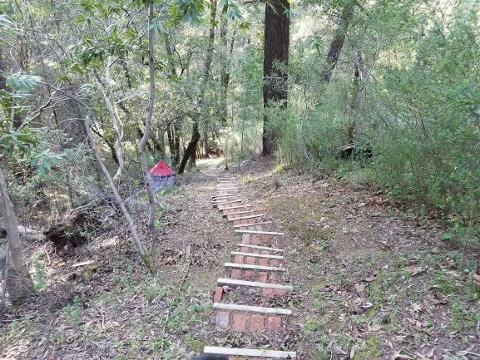
Next Steps

Slide 12
Continue the Drafting Process
September – November:
Complete Proposed Draft Text
Turn PDTs into Draft 0
Initiate informal TG and WG review and comment collection
November:
Review and Resolve issues identified
Prepare Draft 1
Initiate WG ballot

Slide 13
Proposed Schedule

Slide 14
PDT Motion(s) Template
Move to approve the text contents of
Moved:
Second:
Discussion:
Result:

Slide 15
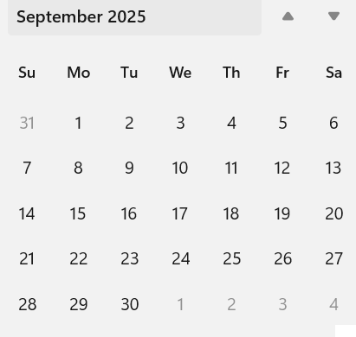
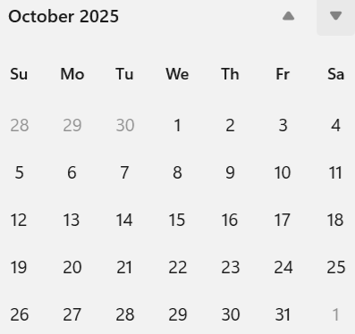
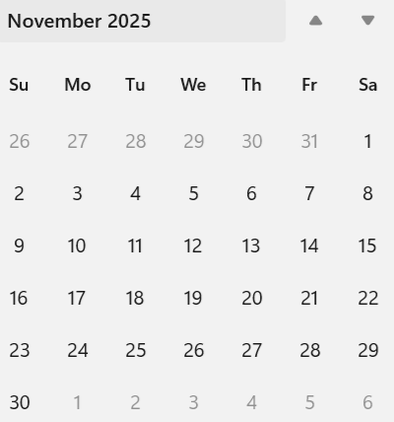
Interim Webex
Day(s): To be discussed

Slide 16
Any Other Business?

Slide 17
Adjourn

