Slide 1
TG19.3a Meeting Slides and Agenda
September 2nd Interim Call
Date: 2025-09-01
Authors:
Name | Affiliations | email
Benjamin Rolfe | BCA, MERL | Ben.rolfe @ ieee.org
Notice: This document has been prepared to assist IEEE 802.19. It is offered as a basis for discussion and is not binding on the contributing individual(s) or organization(s). The material in this document is subject to change in form and content after further study. The contributor(s) reserve(s) the right to add, amend or withdraw material contained herein.

Slide 2
Tg19.3a
September 2nd 2025 Interim Call

Slide 3
Project Overview
PAR approved: https://development.standards.ieee.org/myproject-web/app#viewpar/14995/11032
Scope of the project: This amendment updates and expands coexistence recommendations to address new market requirements, increasing data traffic, greater device density of devices, and increased potential for congestion based on both IEEE Std 802.11-2020 and IEEE Std 802.15.4 sub-1 GHz standards. This amendment includes recommendations with respect to new devices, as well as compatibility with deployed legacy devices.

Slide 4
TG Overview
1 | Task Group Chair | Benjamin Rolfe
2 | Task Group Technical Editor | Shoichi Kitazawa
3 | Task Group Vice Chair | Kazuto Yano
4 | Task Group Vice Chair | Joerg Robert
5 | Task Group Recording Secretary | Yukimasa Nagai

Slide 5
Agenda
 | Topic | Presenter | Time | DCN
1 | Intro and overhead | Chair | 00:10
1.1 | Agenda Review | Chair | 00:05
3 | Technical Contributions and Discussion
3.1 | Application of Suspendable CSMA/CA (update) | Jianlin Guo | 00:15 | 19-25-0049
3.2 | Proposed draft text related to the coexistence experiment between IEEE 802.15.4 SUN and IEEE 802.11 S1G | Kazuto Yano | 00:20 | 19-25-0048
3.3 | Proposed draft text | Shoichi Kitazawa | 00:30 | 19-25-0050
4 | September interim planning | Chair | 00:10
5 | Any other business
6 | Adjourn

Slide 6
Agenda
DCN | Title | Presenter | Time
 | Thursday 15-May
5 | Opening reminders and Agenda review | Chair | 00:05
6 | Technical Contributions and Discussion
6.1 | Coexistence experiment between IEEE 802.15.4 SUN and IEEE 802.11 S1G systems and recommendations | Kazuto Yano | 00:30
6.2 | Suspendable CAMA/CA | Takenori Sumi | 00:25
6.3 | Simulation update | Takenori Sumi | 00:25
7 | Schedule discussion | Chair | 00:15
8 | Next Steps | Chair | 00:05
9 | Aob |  | 00:05
10 | Adjourn

Slide 7

Next Steps

Slide 8
Continue the Drafting Process
Develop a Proposed Draft Text document
  Following the outline for the amendment as proposed
  Develop and integrate text contributions for each are identified in the outline
  Review and refine PDT contributions
Upon reaching critical mass..
  …

Slide 9
Continue the Drafting Process
Upon reaching critical mass..
  Submit PDT to TG for approval
  Create draft amendment from PDT
  Review and refine
  Initiate WG letter ballot
    Comment collection
    Comment resolution
    Draft recirculation
  Initiate SA ballot
    Repeat the same process as for WG letter ballot

Slide 10
September Interim Planning
Develop technical content
Review Proposed Draft Document so far
Technical contributions:

Slide 11
Proposed Schedule

Slide 12
PDT Motion(s)
Move to approve the text contents of
Moved:
Second:
Discussion:
Result:

Slide 13
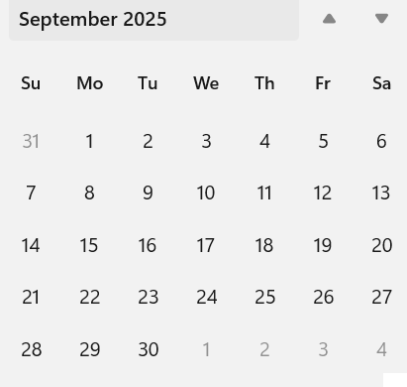
Interim Webex Aug-Sept
Day:
20-Aug 06:00 PT USA
2-Sep 06:00 PT USA

Slide 14
Any Other Business?

Slide 15
Adjourn

