Slide 1
Coexistence experiment between IEEE 802.15.4 SUN and IEEE 802.11 S1G systems, and possible recommended practice
Date: 2025-07-29
Authors:
Notice: This document has been prepared to assist IEEE 802.19. It is offered as a basis for discussion and is not binding on the contributing individual(s) or organization(s). The material in this document is subject to change in form and content after further study. The contributor(s) reserve(s) the right to add, amend or withdraw material contained herein.

Slide 2
Introduction
To confirm what happens when IEEE 802.15.4 SUN and IEEE 802.11 S1G coexist, some simulation has been conducted [1].
In addition, an initial coexistence experiment between IEEE 802.11 S1G and IEEE 802.15.4 SUN systems has been conducted [2]. Through this experiment, it was confirmed that IEEE 802.11 S1G communications can cause performance degradation of IEEE 802.15.4 SUN communications.
This contribution shows some results of a detail coexistence experiment between these systems, and then describes an issue for coexistence.
Through the experimental results, this contribution proposes some possible recommended practices for better coexistence.

Slide 3
Radio equipment used in the experiment
In both IEEE 802.15.4 SUN and IEEE 802.11 S1G systems, two types of equipment were used for this experiment.
IEEE 802.15.4 SUN (Equipment 15-A and 15-B)
  Equipment 15-A supports the normal CSMA/CA mechanism. This equipment supports both FSK-PHY and OFDM-PHY.
  Equipment 15-B supports the suspendable-CSMA/CA mechanism. This equipment supports only FSK-PHY.
IEEE 802.11 S1G (Equipment 11-A and 11-B)
  Equipment 11-A enables frame aggregation. It performs 10%-duty control by setting a 9 times longer waiting time than the duration of the previous transmitted frame.
  Equipment 11-B can disable frame aggregation. It performs 10%-duty control by stopping frame transmission if the total transmission time reaches the upper limit in a timing window.

Slide 4
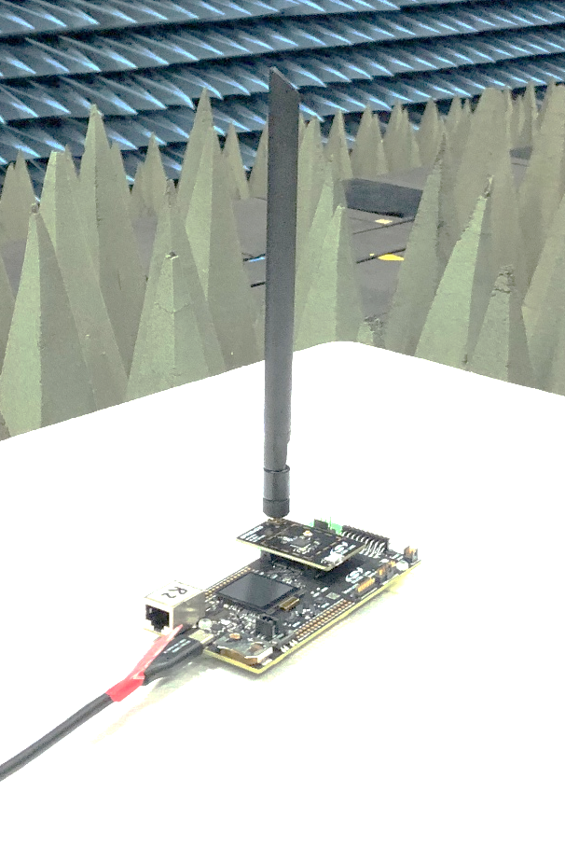
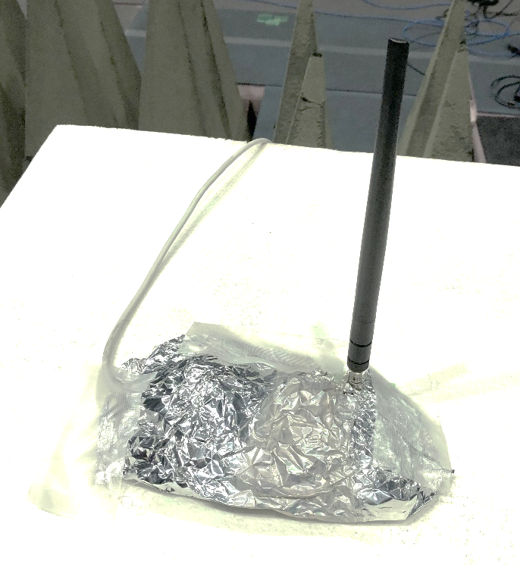
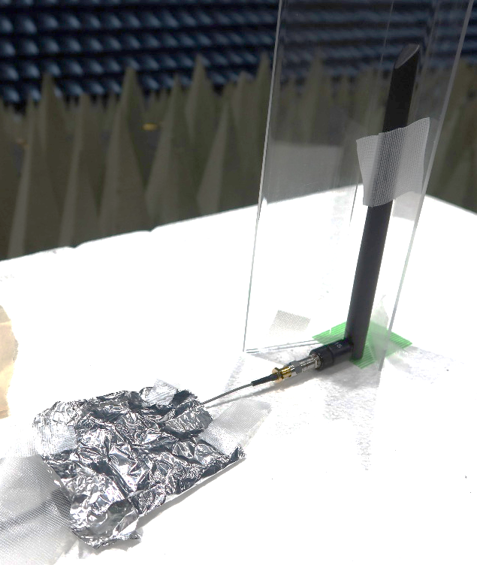
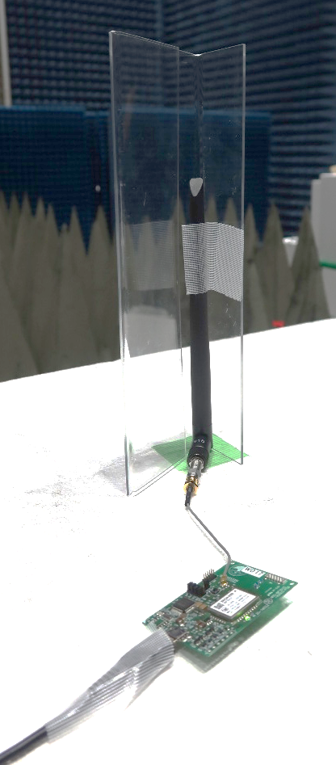
Photos of IEEE 802.15.4 SUN equipment
Equipment 15-A
Equipment 15-B

Slide 5
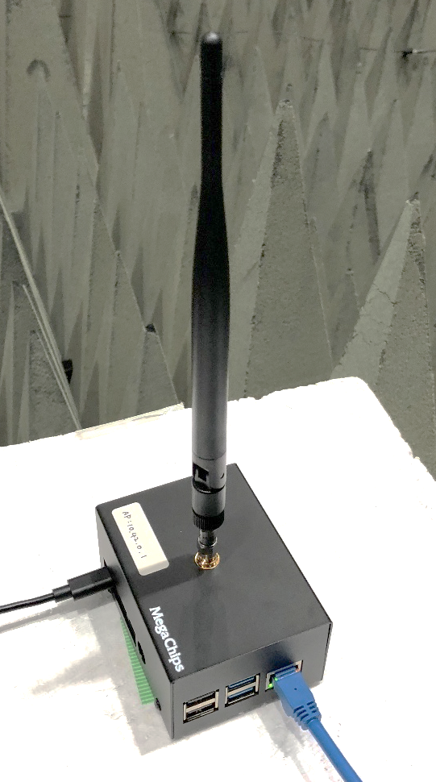
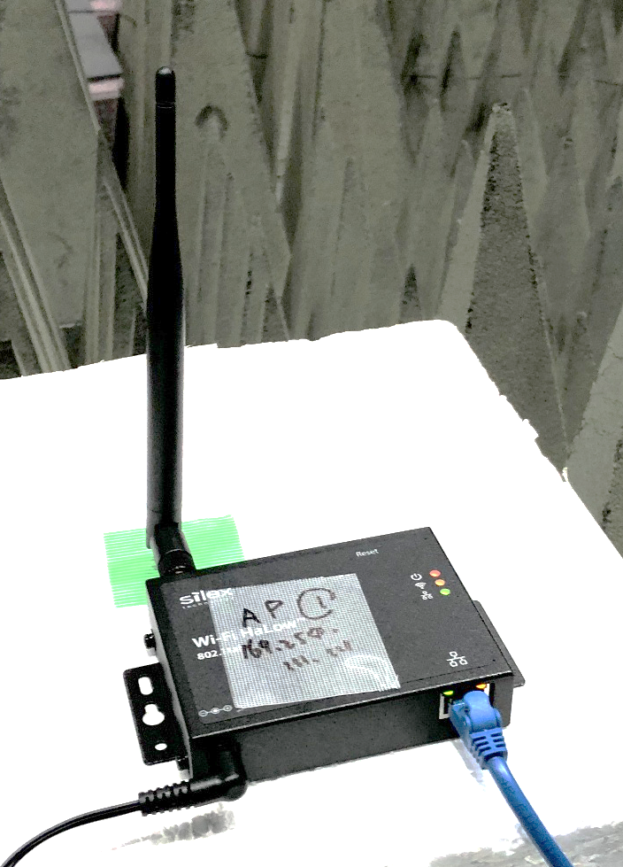
Photos of IEEE 802.11 S1G equipment
Equipment 11-A
Equipment 11-B

Slide 6
Node layout
We conducted experiment in an anechoic chamber.
  One PANC/AP and two NODEs/STAs were employed for each system.
  All nodes were located at a vertices of a regular hexagon
  so that the level of inter-system interference becomes
  same among the all nodes.
  Attenuator was inserted at the RF port of each node.
    20 dB to emulate a transmission distance of 74 m over
    the SEAMCAT Extended Hata model (suburban) with
    an antenna height of 6 m at PANC/AP, 1.8 m at
    NODE/STA. Most of signal transmission from the
    other node be detected by ED.
    25 dB to emulate a situation that each NODE/STA is
    located at cell-edge. (The target transmission distance
    is 96 m.) The hidden-node problem occurs frequently.
IEEE 802.15.4 SUN PANC
3.3 m > 10 λ
IEEE 802.11 S1G STA
IEEE 802.15.4 SUN
NODE
5.7 m
IEEE 802.11 S1G AP

Slide 7
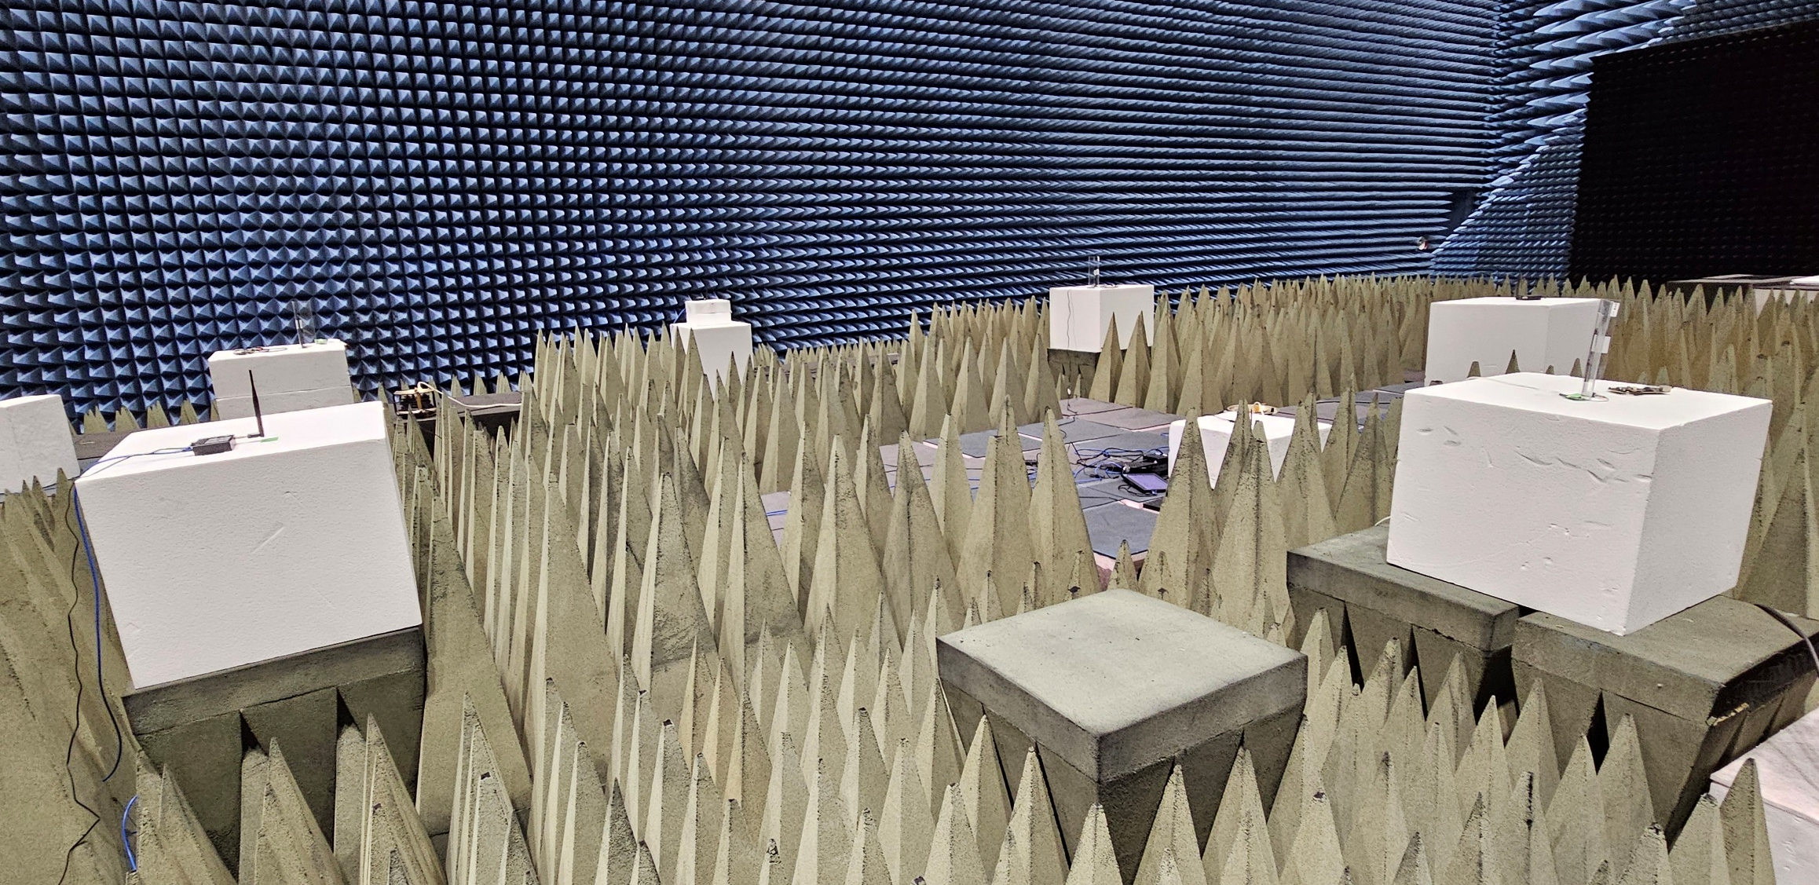
Photos of the experiment site
IEEE 802.11 S1G AP
IEEE 802.15.4 SUN NODE
IEEE 802.15.4 SUN NODE
IEEE 802.11 S1G STA
IEEE 802.15.4 SUN PANC
IEEE 802.11 S1G STA

Slide 8
Parameters of IEEE 802.15.4 SUN MAC for experimental evaluation
In this experiment, following MAC parameters for IEEE 802.15.4 SUN MAC were used.
  macMinBe: 3
  macMaxBe: 5
  BE: [macMinBe, macMaxBe]
  RetryLimit: 4
  Backoffs: 4
  CA: 1

Slide 9
Parameters of IEEE 802.11 S1G MAC for experimental evaluation
In this experiment, following MAC parameters for IEEE 802.11 S1G MAC were used.
  CWmin: 15
  CWmax: 1023
  CW: [CWmin, CWmax]
  RetryLimit: 7 (Equipment 11-A), not disclosed (Equipment 11-B)

Slide 10
Parameters of PHY
In this experiment, following PHY parameters were used.
  MCS
    IEEE 802.15.4 SUN: 2-FSK (FSK PHY) or MCS 5 (OFDM PHY)
    IEEE 802.11 S1G: MCS 0
  Transmission power: 13 dBm
  Channel bandwidth
    IEEE 802.15.4 SUN: 400 kHz
    IEEE 802.11 S1G: 1 MHz or 4 MHz

Slide 11
Channel configurations
The channel configurations for IEEE 802.15.4 SUN and IEEE 802.11 S1G systems are shown below. The frequency channel of IEEE 802.15.4 SUN was set to overlap the spectra of IEEE 802.15.4 SUN and IEEE 802.11 S1G each other.
For 1-MHz IEEE 802.11 S1G
For 4-MHz IEEE 802.11 S1G
IEEE 802.15.4 SUN
(Center: 924.1 MHz))
IEEE 802.15.4 SUN
(Center: 924.5 MHz or 923.3 MHz)
IEEE 802.11 S1G
(Center: 924.5 MHz)
IEEE 802.11 S1G
(Center: 924.0 MHz)
Freq.
Freq.
Either of two frequencies is used.

Slide 12
Parameters of data traffic
In this experiment, following traffic configurations were used.
  IEEE 802.15.4 SUN NODEs send constant bitrate (CBR) traffic in the uplink using a dedicated packet generator.
  IEEE 802.11 S1G STAs send CBR traffic over UDP in the uplink using Iperf.
  Offered load per node:
    Equipment 15-A (FSK/OFDM PHY) : 7.5 kb/s (due to the limitation of the equipment capability)
    Equipment 15-B (FSK PHY) : 10 kb/s
    IEEE 802.11ah (1-MHz signal bandwidth) : 10 kb/s
    IEEE 802.11ah (4-MHz signal bandwidth) : 10 kb/s or 40 kb/s
  Packet size: 100 bytes, 200 bytes (15.4 SUN and 11 S1G) or 1250 bytes (11 S1G only)

Slide 13
Measurement configurations (1/2)
IQ data was recorded by a USRP. From the recorded IQ data, spectrogram was calculated.
  Sampling rate: 4 MHz
  FFT size for spectrogram calculation: 500
  Frequence range of spectrogram: 4 MHz (The center frequency is set to that of the IEEE 802.11 S1G signal.)

Slide 14
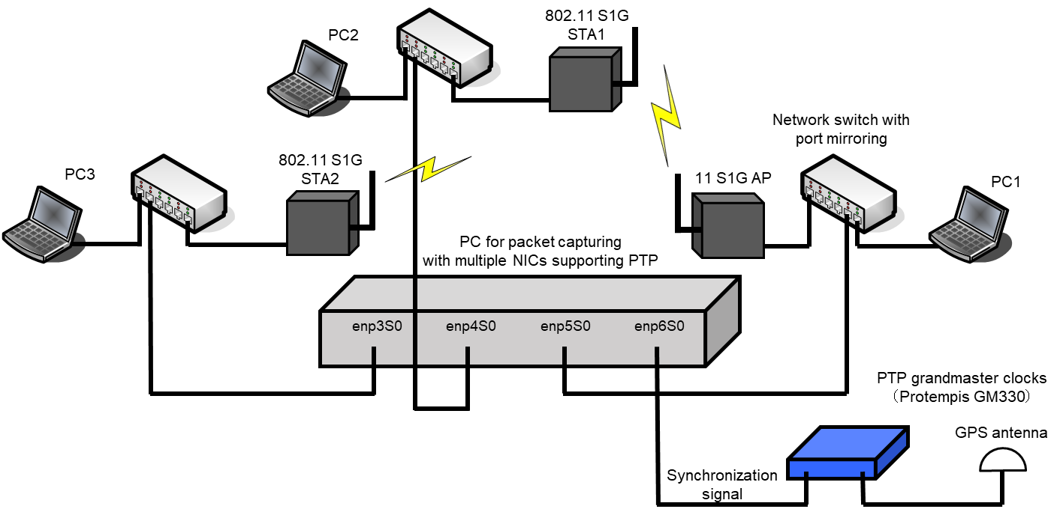
Measurement configurations (2/2)
For fine measurement of transmission latency over IEEE 802.11 S1G, we set up a packet capturing PC with multiple NICs supporting IEEE 1588 Precision Time Protocol (PTP).
Forwording the transmitted
and received packets to
the capturing PC by port
mirroring, these packets
are captured by
time-synchronized NICs, and
the latency is measured.

Slide 15
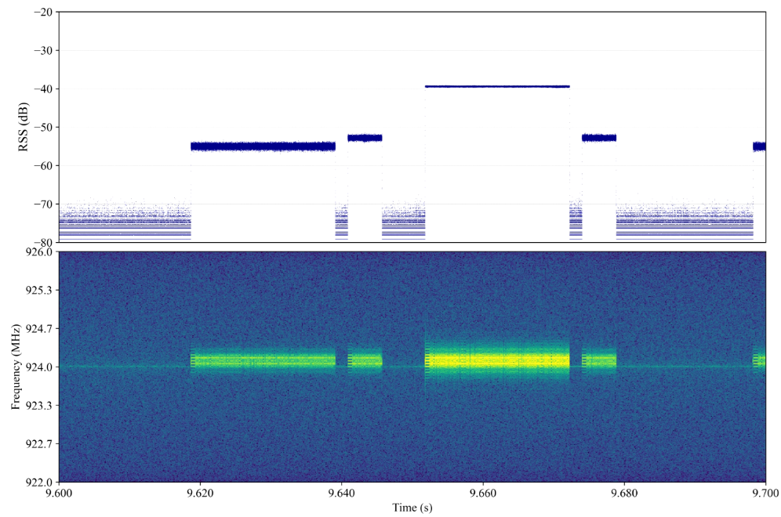
Experimental result
15.4 SUN : Legacy CSMA, 2-FSK, 924.1 MHz , 7.5 kb/s offered load, 100-byte packet
11 S1G : N/A / Attenuator : 20 dB
Average latency of IEEE 802.15.4 SUN is about 72 ms. There is 1.6 ms spacing between Data and Ack frames of IEEE 802.15.4 SUN. 2 ~ 3 % of Data frames make CCA attempt and/or retry.
100 ms
Result of IEEE 802.15.4 SUN.
Power
# of packets | 1300
Packet delivery rate | 100 %
# of CCA attempts | 28
# of retries | 30
Average latency | 72.53 ms
Spectrogram
4 MHz
Result of IEEE 802.11 S1G.
# of packets | N/A
Packet delivery rate | N/A
Average latency | N/A
Snapshot of channel usage.

Slide 16
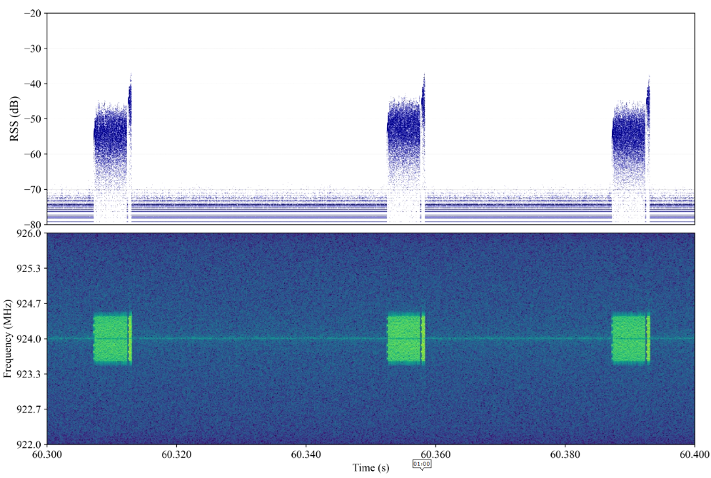
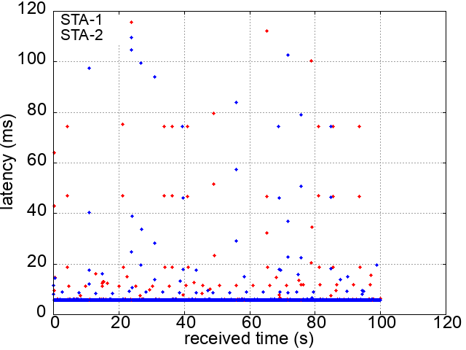
Experimental result
15.4 SUN : N/A
11 S1G : 9x waiting time, 1 MHz channel width, 10 kb/s offered load, 100-byte packet / Attenuator : 20 dB
For most of packets, latency is around or less than 7 ms.
Result of IEEE 802.15.4 SUN.
Power
# of packets | N/A
Packet delivery rate | N/A
# of CCA attempts | N/A
# of retries | N/A
Average latency | N/A
Spectrogram
Result of IEEE 802.11 S1G.
# of packets | 2500
Packet delivery rate | 100%
Average latency | 7.19 ms
Snapshot of channel usage.
Plot of 802.11 S1G latency.

Slide 17
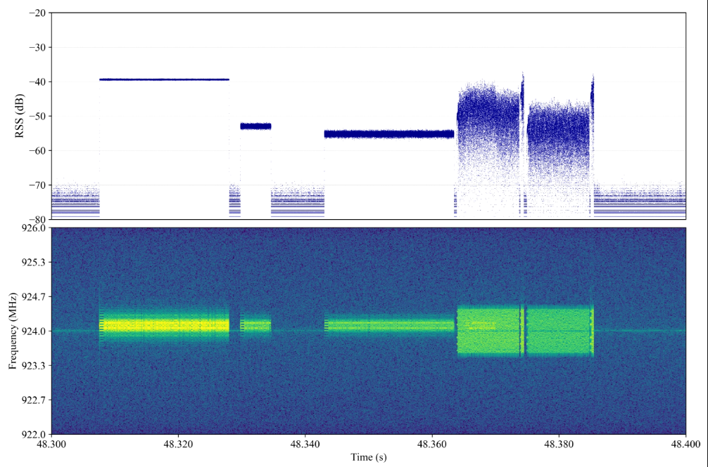
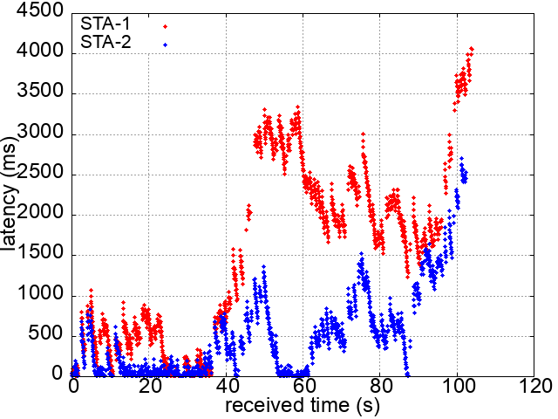
Experimental result
15.4 SUN : Legacy CSMA, 2-FSK, 924.1 MHz, 7.5 kb/s offered load, 100-byte packet
11 S1G : 9x waiting time, 1 MHz channel width, 10 kb/s offered load, 100-byte packet / Attenuator : 20 dB
IEEE 802.11 S1G transmits a Data frame between Data and Ack transmissions of IEEE 802.15.4 SUN. It causes many collisions between two systems and cause severe performance degradation.
Result of IEEE 802.15.4 SUN.
Power
# of packets | 1700
Packet delivery rate | 99.7 %
# of CCA attempts | 450
# of retries | 431
Average latency | 97.23 ms
Spectrogram
Result of IEEE 802.11 S1G.
# of packets | 2500
Packet delivery rate | 97.08 %
Average latency | 1016.87 ms
Snapshot of channel usage.
Plot of 802.11 S1G latency.

Slide 18
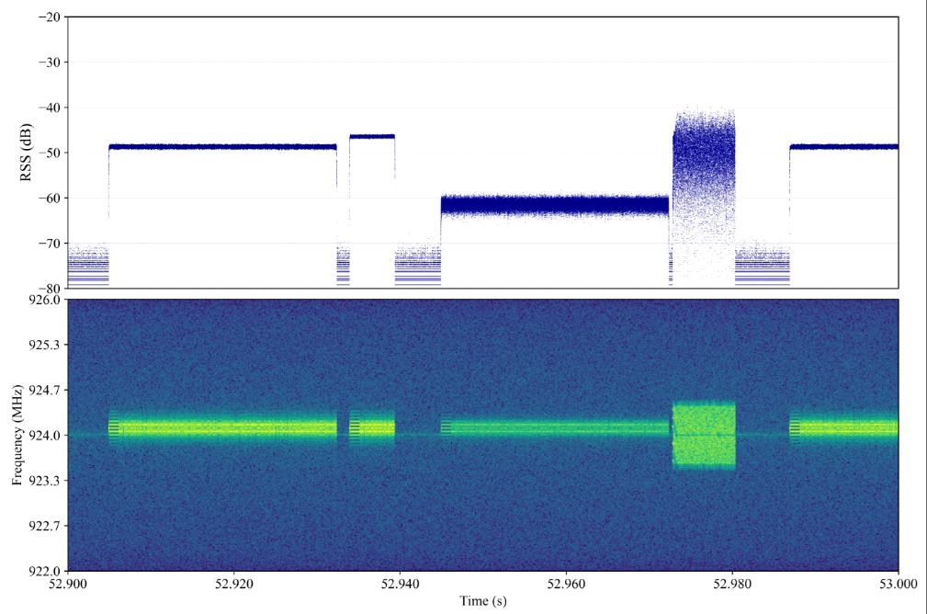
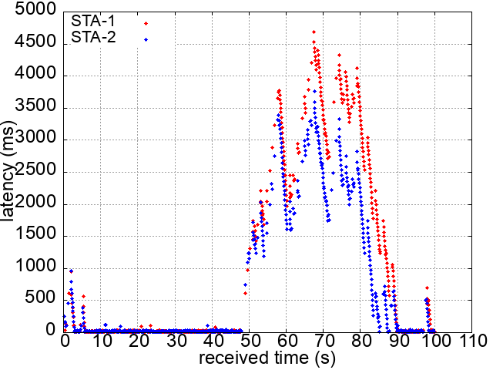
Experimental result
15.4 SUN : Suspendable-CSMA, 2-FSK, 924.1 MHz, 10 kb/s offered load, 100-byte packet
11 S1G : 9x waiting time, 1 MHz channel width, 10 kb/s offered load, 100-byte packet / Attenuator : 20 dB
When IEEE 802.15.4 SUN employs Suspendable-CSMA, CCA attempts and retries of IEEE 802.15.4 SUN occur more frequently because IEEE 802.15.4 SUN makes more frame transmissions than legacy CSMA.
Result of IEEE 802.15.4 SUN.
Power
# of packets | 1800
Packet delivery rate | 94.5 %
# of CCA attempts | 2678
# of retries | 1345
Average latency | 258.66 ms
Spectrogram
Result of IEEE 802.11 S1G.
# of packets | 1250
Packet delivery rate | 96.0 %
Average latency | 930.43 ms
Snapshot of channel usage.
Plot of 802.11 S1G latency.

Slide 19
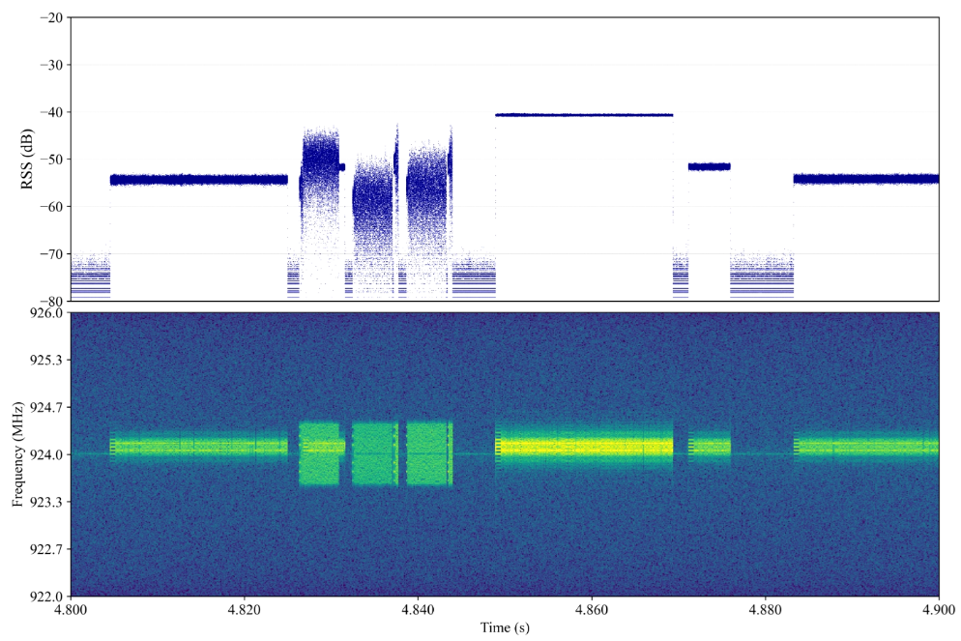
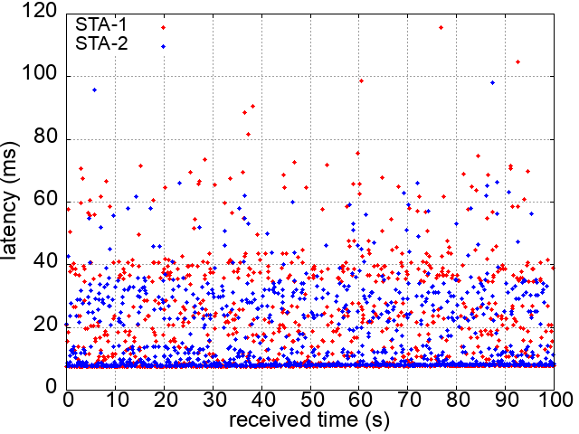
Experimental result
15.4 SUN : Legacy CSMA, 2-FSK, 924.1 MHz, 7.5 kb/s offered load, 100-byte packet
11 S1G : 180 s duty window, 1 MHz channel width, 10 kb/s offered load, 100-byte packet / Attenuator : 20 dB
Within the duty window, IEEE 802.11 S1G transmits its frames with a small interval. When the transmission of IEEE 802.15.4 SUN is sparse, it seems to reduce collisions because transmission patterns become different between two systems.
Result of IEEE 802.15.4 SUN.
Power
# of packets | 1300
Packet delivery rate | 99.9 %
# of CCA attempts | 360
# of retries | 172
Average latency | 103.60 ms
Spectrogram
Result of IEEE 802.11 S1G.
# of packets | 2500
Packet delivery rate | 100 %
Average latency | 17.58 ms
Snapshot of channel usage.
Plot of 802.11 S1G latency.

Slide 20
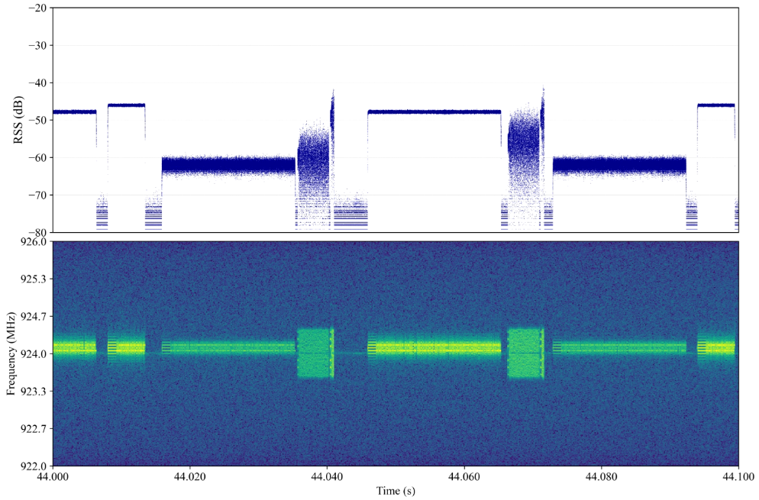
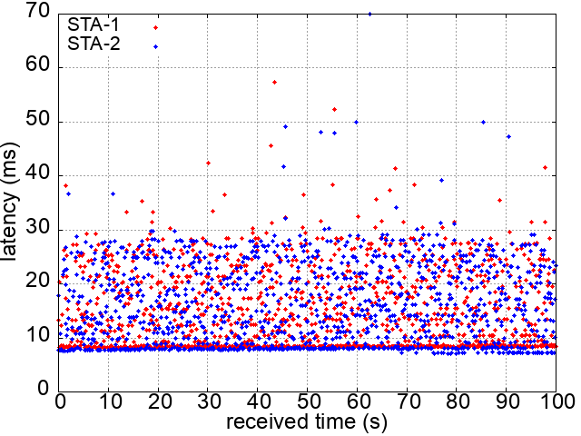
Experimental result
15.4 SUN : Suspendable-CSMA, 2-FSK, 924.1 MHz, 10 kb/s offered load, 100-byte packet
11 S1G : 180 s duty window, 1 MHz channel width, 10 kb/s offered load, 100-byte packet / Attenuator : 20 dB
Although transmission chances of IEEE 802.15.4 SUN are increased by Suspendable-CSMA, its performance is degraded because IEEE 802.11 S1G frequently transmits its signal before IEEE 802.15.4 SUN Ack.
Result of IEEE 802.15.4 SUN.
Power
# of packets | 2500
Packet delivery rate | 94.0 %
# of CCA attempts | 2592
# of retries | 1657
Average latency | 272.43 ms
Spectrogram
Result of IEEE 802.11 S1G.
# of packets | 2500
Packet delivery rate | 100 %
Average latency | 15.50 ms
Snapshot of channel usage.
Plot of 802.11 S1G latency.

Slide 21
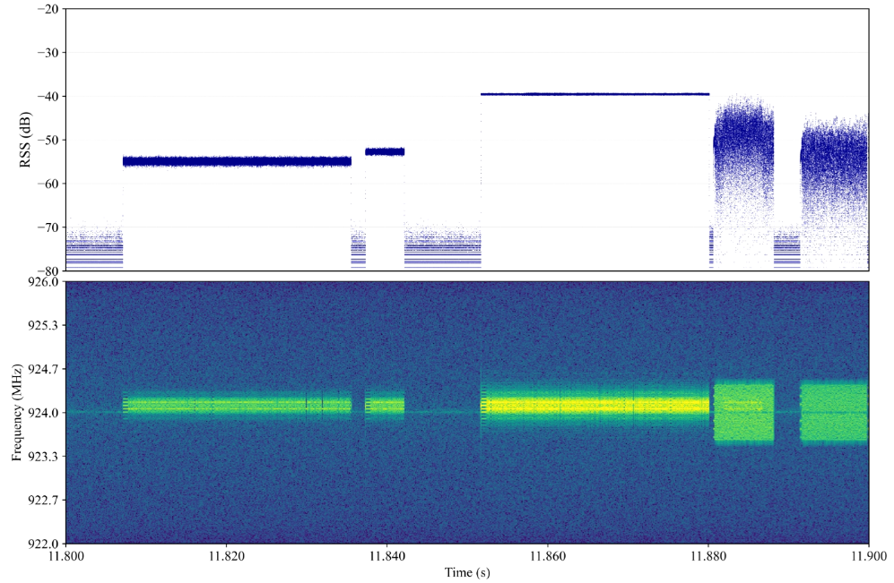
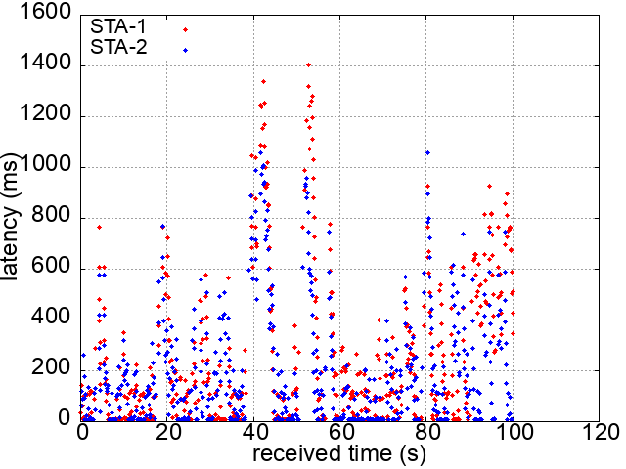
Experimental result
15.4 SUN : Legacy CSMA, 2-FSK, 924.1 MHz, 7.5 kb/s offered load, 200-byte packet
11 S1G : 9x waiting time, 1 MHz channel width, 10 kb/s offered load, 200-byte packet / Attenuator : 20 dB
The average latency of the IEEE 802.11 S1G is greatly improved by increasing the packet length from 100 bytes to 200 bytes. Reducing the number of transmitted frames may contribute to reduce collisions.
Result of IEEE 802.15.4 SUN.
Power
# of packets | 1300
Packet delivery rate | 99.8 %
# of CCA attempts | 159
# of retries | 296
Average latency | 107.05 ms
Spectrogram
Result of IEEE 802.11 S1G.
# of packets | 1250
Packet delivery rate | 96.96%
Average latency | 231.40 ms
Snapshot of channel usage.
Plot of 802.11 S1G latency.

Slide 22
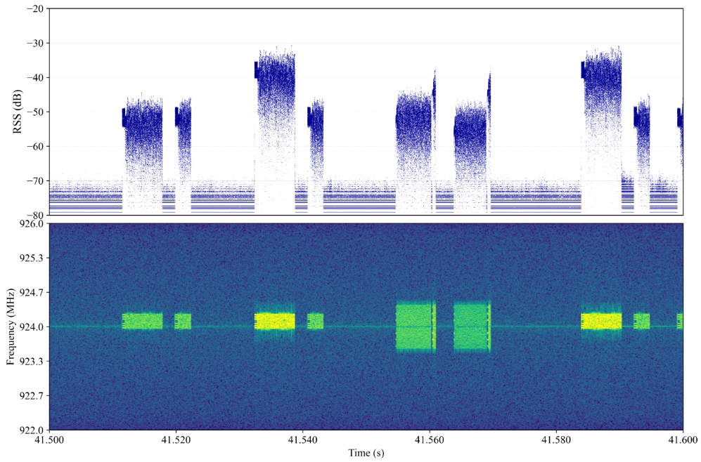
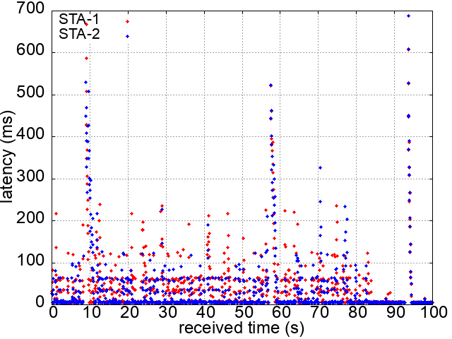
Experimental result
15.4 SUN : Legacy CSMA, MCS 5, 924.1 MHz, 7.5 kb/s offered load, 100-byte packet
11 S1G : 9x waiting time, 1 MHz channel width, 10 kb/s offered load, 100-byte packet / Attenuator : 20 dB
Raising the MCS of IEEE 802.15.4 SUN also improves the performances of both systems because the duration of the Data frames becomes short and collisions less occurs.
Result of IEEE 802.15.4 SUN.
Power
# of packets | 1300
Packet delivery rate | 100 %
# of CCA attempts | 404
# of retries | 273
Average latency | 72.48 ms
Spectrogram
Result of IEEE 802.11 S1G.
# of packets | 2500
Packet delivery rate | 99.64%
Average latency | 37.88 ms
Snapshot of channel usage.
Plot of 802.11 S1G latency.

Slide 23
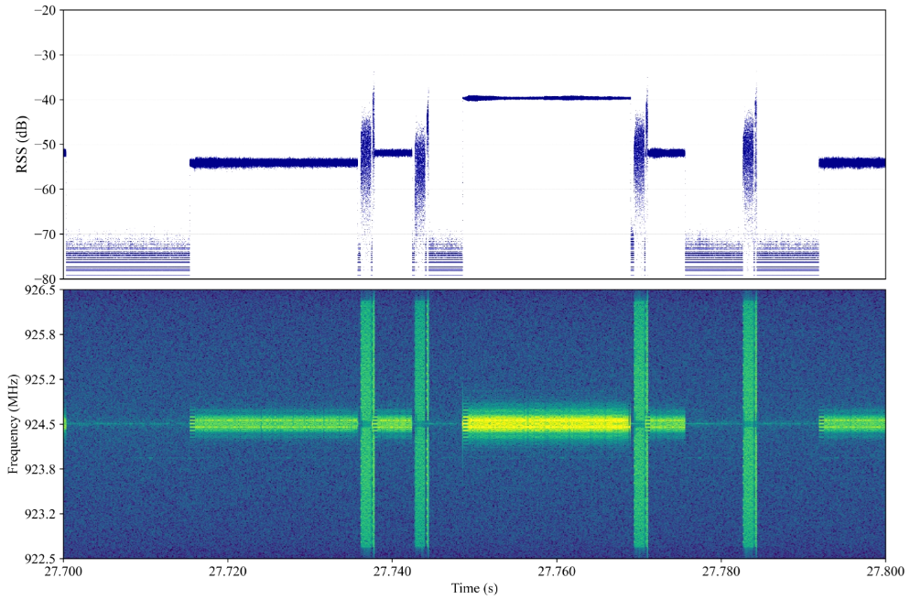
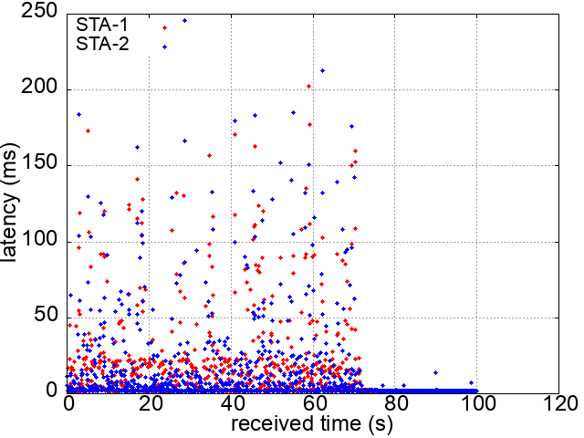
Experimental result
15.4 SUN : Legacy CSMA, 2-FSK, 924.5 MHz, 7.5 kb/s offered load, 100-byte packet
11 S1G : 9x waiting time, 4 MHz channel width, 10 kb/s offered load, 100-byte packet / Attenuator : 20 dB
We can find that the frame transmission of IEEE 802.11 S1G seems completed before IEEE 802.15.4 SUN transmits an Ack frame. As a result, good coexistence is achieved.
Result of IEEE 802.15.4 SUN.
Power
# of packets | 1300
Packet delivery rate | 99.7 %
# of CCA attempts | 89
# of retries | 7
Average latency | 69.94 ms
Spectrogram
Result of IEEE 802.11 S1G.
# of packets | 2500
Packet delivery rate | 100 %
Average latency | 12.93 ms
Snapshot of channel usage.
Plot of 802.11 S1G latency.

Slide 24
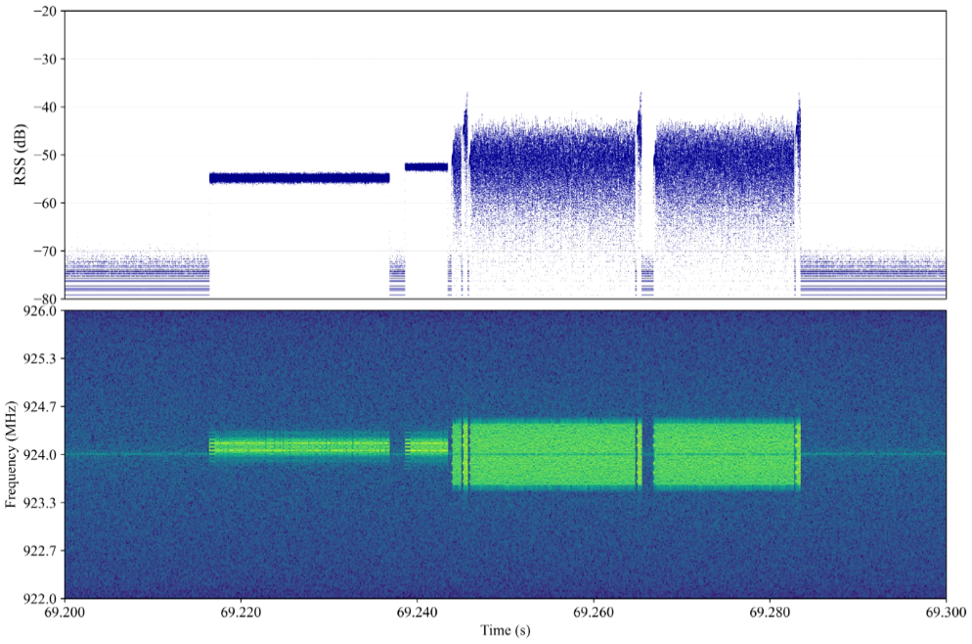
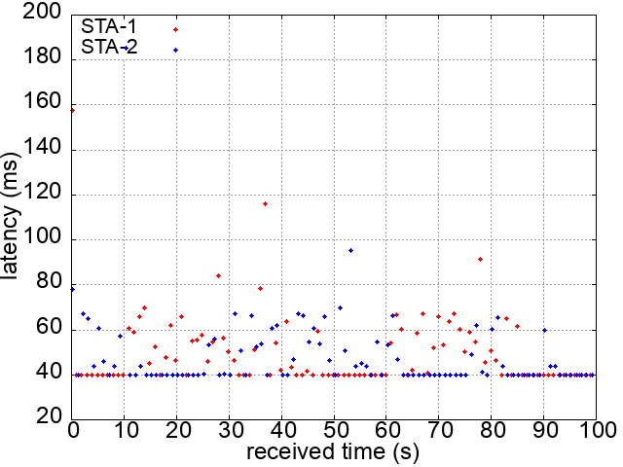
Experimental result
15.4 SUN : Legacy CSMA, 2-FSK, 924.1 MHz, 7.5 kb/s offered load, 100-byte packet
11 S1G : 9x waiting time, 1 MHz channel width, 10 kb/s offered load, 1250-byte packet / Attenuator : 20 dB
The number of CCA attempts and retries of IEEE 802.15.4 SUN is reduced by increasing the packet length of IEEE 802.11 S1G to 1250 bytes because the number of the transmitted frames in IEEE 802.11 S1G is much reduced.
Result of IEEE 802.15.4 SUN.
Power
# of packets | 1300
Packet delivery rate | 100 %
# of CCA attempts | 245
# of retries | 66
Average latency | 82.74 ms
Spectrogram
Result of IEEE 802.11 S1G.
# of packets | 200
Packet delivery rate | 100 %
Average latency | 49.43 ms
Snapshot of channel usage.
Plot of 802.11 S1G latency.

Slide 25
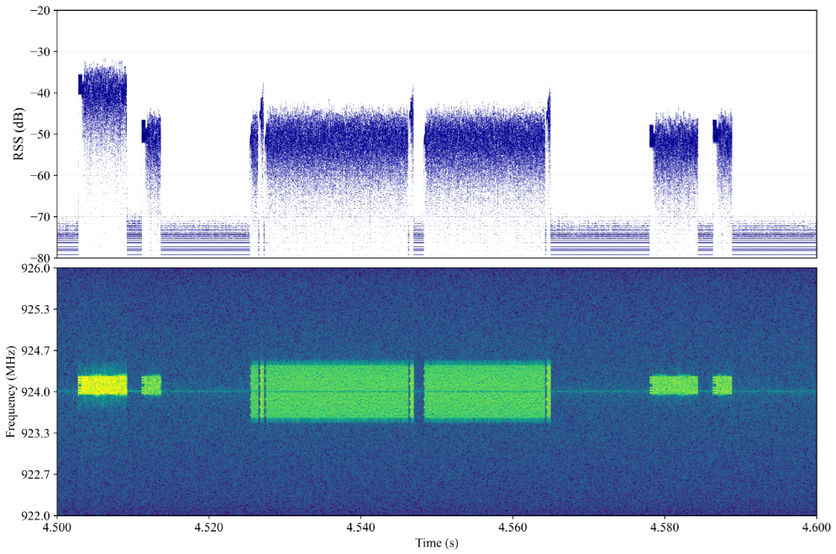
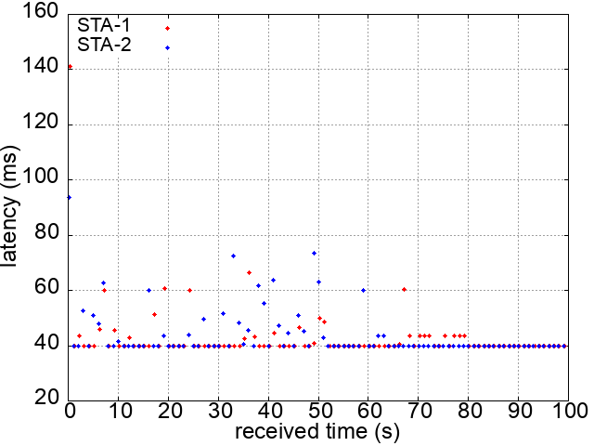
Experimental result
15.4 SUN : Legacy CSMA, MCS 5, 924.1 MHz, 7.5 kb/s offered load, 100-byte packet
11 S1G : 9x waiting time, 1 MHz channel width, 10 kb/s offered load, 1250-byte packet / Attenuator : 20 dB
The performances of both IEEE 802.15.4 SUN and IEEE 802.11 S1G are improved by using a higher MCS for IEEE 802.15.4 SUN.
Result of IEEE 802.15.4 SUN.
Power
# of packets | 1100
Packet delivery rate | 100 %
# of CCA attempts | 194
# of retries | 29
Average latency | 60.69 ms
Spectrogram
Result of IEEE 802.11 S1G.
# of packets | 200
Packet delivery rate | 100 %
Average latency | 43.35 ms
Snapshot of channel usage.
Plot of 802.11 S1G latency.

Slide 26
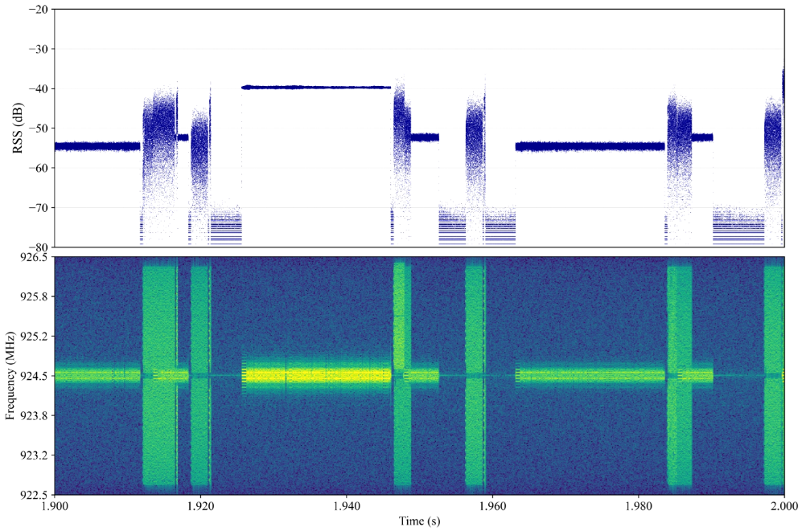
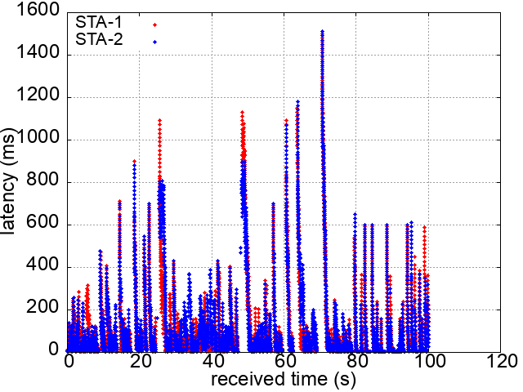
Experimental result
15.4 SUN : Legacy CSMA, 2-FSK, 924.5 MHz, 7.5 kb/s offered load, 100-byte packet
11 S1G : 9x waiting time, 4 MHz channel width, 40 kb/s offered load, 100-byte packet / Attenuator : 20 dB
We can find that the duration of some Data frames of IEEE 802.11 S1G becomes longer by frame aggregation when the offered load is increased. As a result, such Data frames are overlapped with IEEE 802.15.4 SUN Ack frames.
Result of IEEE 802.15.4 SUN.
Power
# of packets | 1300
Packet delivery rate | 100 %
# of CCA attempts | 183
# of retries | 9
Average latency | 77.76 ms
Spectrogram
Result of IEEE 802.11 S1G.
# of packets | 10000
Packet delivery rate | 98.67 %
Average latency | 148.24 ms
Snapshot of channel usage.
Plot of 802.11 S1G latency.

Slide 27
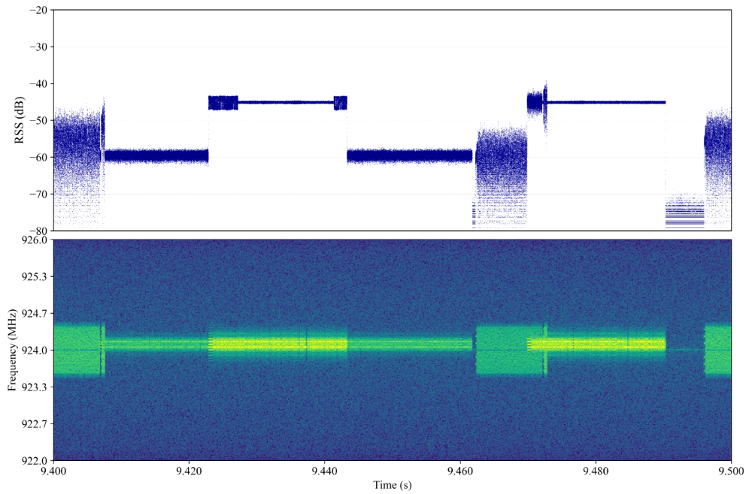
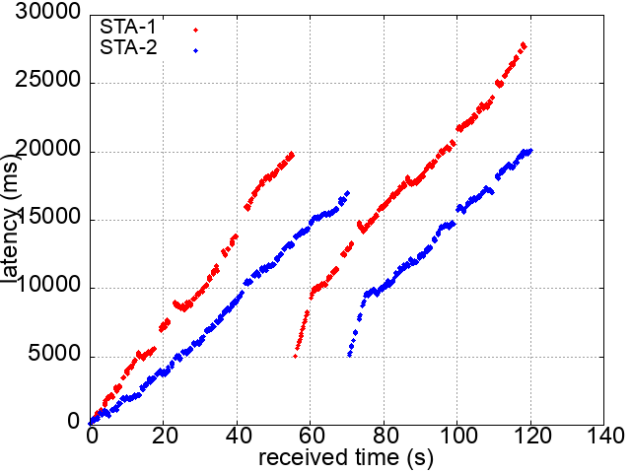
Experimental result
15.4 SUN : Legacy CSMA, 2-FSK, 924.1 MHz, 7.5 kb/s offered load, 100-byte packet
11 S1G : 9x waiting time, 1 MHz channel width, 10 kb/s offered load, 100-byte packet / Attenuator : 25 dB
By increasing the attenuation of each link, hidden node problem occurs more frequently, and thus the performances of both IEEE 802.15.4 SUN and IEEE 802.11 S1G are degraded.
Result of IEEE 802.15.4 SUN.
Power
# of packets | 1500
Packet delivery rate | 93.1 %
# of CCA attempts | 38
# of retries | 1238
Average latency | 91.89 ms
Spectrogram
Result of IEEE 802.11 S1G.
# of packets | 2108
Packet delivery rate | 95.35 %
Average latency | 12164.42 ms
Snapshot of channel usage.
Plot of 802.11 S1G latency.

Slide 28
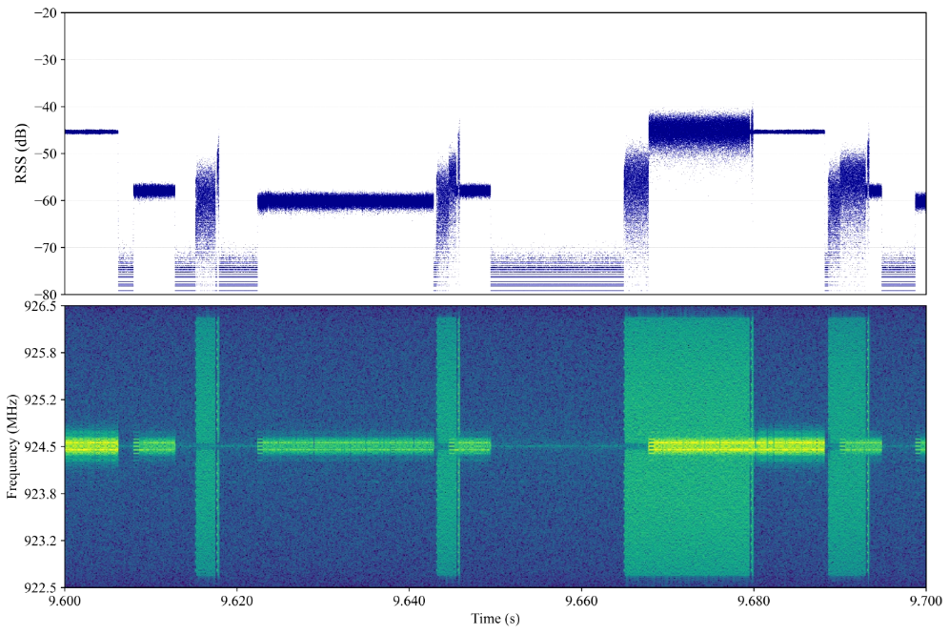
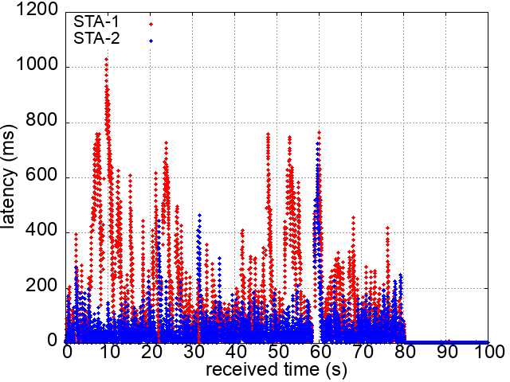
Experimental result
15.4 SUN : Legacy CSMA, 2-FSK, 924.5 MHz, 7.5 kb/s offered load, 100-byte packet
11 S1G : 9x waiting time, 4 MHz channel width, 40 kb/s offered load, 100-byte packet / Attenuator : 25 dB
The performances of both systems are improved by making the signal bandwidth of IEEE 802.11 S1G wider. It seems that channel coding of IEEE 802.11 S1G works better and SINR of IEEE 802.15.4 SUN improved.
Result of IEEE 802.15.4 SUN.
Power
# of packets (1 NODE) | 750
Packet delivery rate | 99.8 %
# of CCA attempts | 2
# of retries | 54
Average latency | 64.79 ms
Spectrogram
Result of IEEE 802.11 S1G.
# of packets | 10000
Packet delivery rate | 98.92 %
Average latency | 94.07 ms
Snapshot of channel usage.
Plot of 802.11 S1G latency.

Slide 29
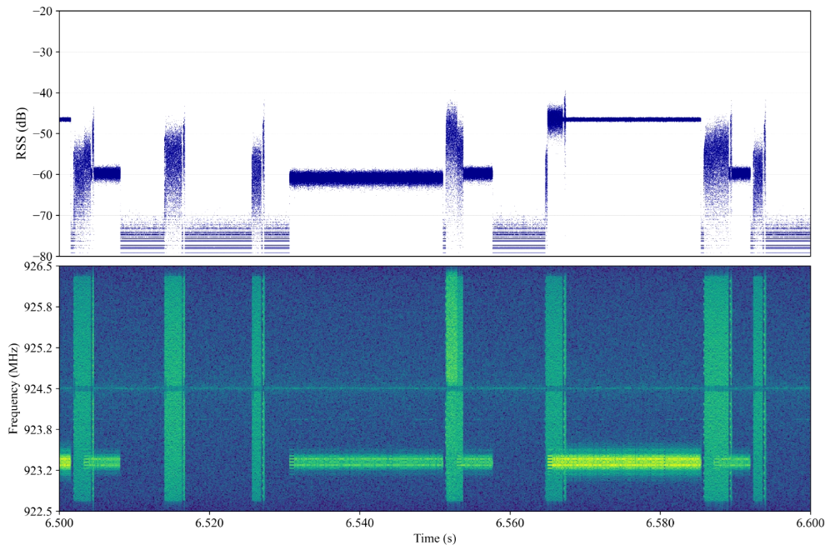
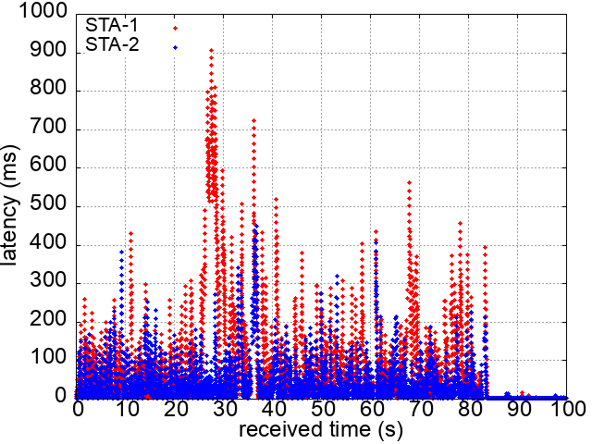
Experimental result
15.4 SUN : Legacy CSMA, 2-FSK, 923.3 MHz, 7.5 kb/s offered load, 100-byte packet
11 S1G : 9x waiting time, 4 MHz channel width, 40 kb/s offered load, 100-byte packet / Attenuator : 25 dB
By adding offset of carrier frequency to IEEE 802.15.4 SUN, the performance of IEEE 802.11 S1G improves slightly. There may be benefit to avoid using the center frequency of IEEE 802.11 S1G by IEEE 802.15.4 SUN.
Result of IEEE 802.15.4 SUN.
Power
# of packets | 1500
Packet delivery rate | 99.8 %
# of CCA attempts | 10
# of retries | 111
Average latency | 66.99 ms
Spectrogram
Result of IEEE 802.11 S1G.
# of packets | 10000
Packet delivery rate | 99.34 %
Average latency | 66.69 ms
Snapshot of channel usage.
Plot of 802.11 S1G latency.

Slide 30
Issue on the coexistence between IEEE 802.15.4 S1G and IEEE 802.11 SUN system
In many cases, an IEEE 802.11 S1G STA transmits a Data frame between Data and Ack frames of IEEE 802.15.4 SUN because macTsRxTx (1000 μs in default) in IEEE 802.15.4 SUN is longer than a random backoff time in IEEE 802.11 S1G. If the frame transmission of the IEEE 802.11 S1G system does not finish before the IEEE 802.15.4 SUN sends an Ack packet, a collision occurs.
Power
Spectrogram
Ack frame of IEEE 802.15.4 SUN
Data frame of IEEE 802.11 S1G

Slide 31
Possible recommended practice
To reduce collisions, there are two approaches.
  Making the frame duration shorter to reduce the channel occupancy of each system.
    Raise the MCS.
    Increase the signal bandwidth (for IEEE 802.11 S1G).
    Make the frame duration of IEEE 802.11 S1G shorter than macTsRxTx of IEEE 802.15.4 SUN.
  Increasing the payload length of Data frames if the offered load is small.
Increasing the signal bandwidth of IEEE 802.11 S1G may have other merits.
  Even though collision between two systems occur …
    The SINR of IEEE 802.15.4 SUN will improves.
    Channel coding of IEEE 802.11 S1G work better.
  It may be better to avoid using the center frequency of IEEE 802.11 S1G by IEEE 802.15.4 SUN.

Slide 32
Consideration for future standards
For better coexistence, we can consider to introduce new features for each system.
  Introduce Delayed Block Ack into IEEE 802.15.4 SUN to protect Ack.
  Introduce adaptive configuration of AIFSN to IEEE 802.11 S1G to protect Ack frame transmission of IEEE 802.15.4 SUN.

Slide 33
Summary
We conducted coexistence experiment between IEEE 802.15.4 SUN and IEEE 802.11 S1G systems.
IEEE 802.11 S1G can transmit a Data frame between Data and Ack frames of IEEE 802.15.4 SUN due to long macTsRxTx in IEEE 802.15.4 SUN. This leads to inter-system collision. Hence, protecting Ack frame transmission of IEEE 802.15.4 SUN is important for better coexistence.
Reducing the frame duration of IEEE 802.11 S1G can be possible recommended practice to protect Ack of IEEE 802.15.4 SUN.
We can consider to introduce new features for each system to protect Ack of IEEE 802.15.4 SUN in inter-system coexisting situations in the Sub-1 GHz band.

Slide 34
Reference
[1] doc. IEEE 802.19-25/0018r1
[2] doc. IEEE 802.19-25/0019r0

