Slide 1
TG19.3a Meeting Slides and Agenda
July 2025
Date: 2025-07-27
Authors:
Name | Affiliations | email
Benjamin Rolfe | BCA, MERL | Ben.rolfe @ ieee.org
Notice: This document has been prepared to assist IEEE 802.19. It is offered as a basis for discussion and is not binding on the contributing individual(s) or organization(s). The material in this document is subject to change in form and content after further study. The contributor(s) reserve(s) the right to add, amend or withdraw material contained herein.

Slide 2
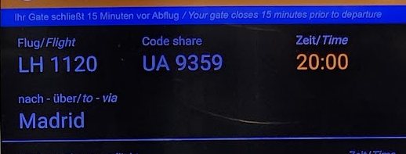
Tg19.3a
802 Plenary Session,
In person in Madrid Spain and remote world-wide
July 2025

Slide 3
Project Overview
PAR approved: https://development.standards.ieee.org/myproject-web/app#viewpar/14995/11032
Scope of the project: This amendment updates and expands coexistence recommendations to address new market requirements, increasing data traffic, greater device density of devices, and increased potential for congestion based on both IEEE Std 802.11-2020 and IEEE Std 802.15.4 sub-1 GHz standards. This amendment includes recommendations with respect to new devices, as well as compatibility with deployed legacy devices.

Slide 4
Proposed Focus for July
Begin drafting process!
Update background information:
  Review update regulations
  More RF studies
  Simulation updates
Review drafting process
Consider technical proposals for draft recommendations

Slide 5
TG Overview
1 | Task Group Chair | Benjamin Rolfe
2 | Task Group Technical Editor | Shoichi Kitazawa
3 | Task Group Vice Chair | Kazuto Yano
4 | Task Group Vice Chair | Joerg Robert
5 | Task Group Recording Secretary | Yukimasa Nagai

Slide 6
Agenda
 | Topic | Presenter | Time
 | Monday 12-May
1 | Intro and overhead | Chair | 00:05
1.1 | Agenda Review | Chair | 00:05
1.2 | Approval of minutes | Chair | 00:05
2 | Drafting Process | Chair | 00:10
3 | Technical Contributions and Discussion |  | 00:
3.1 | Recommended Outline for P802.19.3a contribution | Jianlin Guo | 00:20
3.2 | Japan Regulation Update | Takenori Sumi | 00:20
3.3 | Proposed draft text related to the radio noise emission from electronic devices | Kazuto Yano | 00:15
4 | Recess

Slide 7

Recess

Slide 8
Agenda
 | Topic | Presenter | Time
 | Thursday 15-May
5 | Opening reminders and Agenda review | Chair | 00:05
6 | Technical Contributions and Discussion
6.1 | Coexistence experiment between IEEE 802.15.4 SUN and IEEE 802.11 S1G systems and recommendations | Kazuto Yano | 00:30
6.2 | Suspendable CAMA/CA | Takenori Sumi | 00:25
6.3 | Simulation update | Takenori Sumi | 00:25
7 | Schedule discussion | Chair | 00:15
8 | Next Steps | Chair | 00:05
9 | Aob |  | 00:05
10 | Adjourn

Slide 9

Next Steps

Slide 10
Near Term Milestones
PAR Approval
Officer appointment
Call for contributions for May 2024 Wireless interim
Collect background information
  Use cases
  Technical constraints and characteristics
  Supporting data (simulation, measurements)
    Simulation planned
    Empirical studies planned
Develop technical content
  Begin preparation of proposed draft document

Slide 11
Next Steps

Slide 12
Continue the Drafting Process
Develop a Proposed Draft Text document
  Following the outline for the amendment as proposed
  Develop and integrate text contributions for each are identified in the outline
  Review and refine PDT contributions
Upon reaching critical mass..
  …

Slide 13
Continue the Drafting Process
Upon reaching critical mass..
  Submit PDT to TG for approval
  Create draft amendment from PDT
  Review and refine
  Initiate WG letter ballot
    Comment collection
    Comment resolution
    Draft recirculation
  Initiate SA ballot
    Repeat the same process as for WG letter ballot

Slide 14
Proposed Schedule

Slide 15
PDT Motion
Move to approve the text contents of 19-25-0046r0, 19-25-0045r0, 19-25-0043r0 and 19-25-0039r0 into the Proposed Draft Text document
Moved: Yukimasa Nagai (Mitsubishi Electric)
Second: Kazuto Yano (ATR)
Discussion: None
Approved by unanimous consent

Slide 16
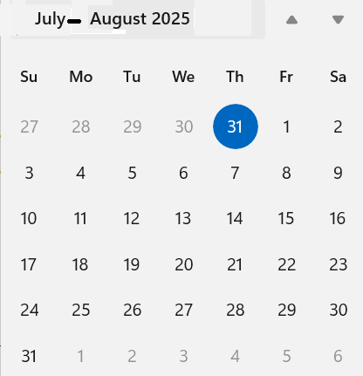
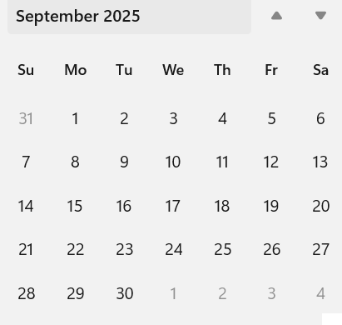
Interim Webex Aug-Sept
Day:
20-Aug 06:00 PT USA
2-Sep 06:00 PT USA
Duration: 1.5

Slide 17
Any Other Business?

Slide 18
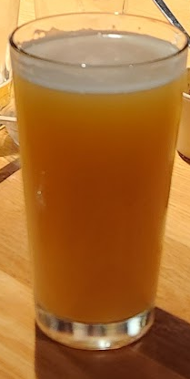
Adjourn

