Slide 1
Follow up on measurement of radio noise over Sub-1 GHz band emitted from mini PC and laptop PC, and its impact on communication performance of IEEE 802.11ah
Date: 2025-03-10
Authors:
Notice: This document has been prepared to assist IEEE 802.19. It is offered as a basis for discussion and is not binding on the contributing individual(s) or organization(s). The material in this document is subject to change in form and content after further study. The contributor(s) reserve(s) the right to add, amend or withdraw material contained herein.

Slide 2
Introduction
The sub-1 GHz band is used by not only IEEE 802.11ah and IEEE 802.15.4, but also other radio systems. Moreover, several kinds of machinery emit powerful radio noise in this frequency band, and it may have a large impact on the system performance of wireless communication systems.
Measurement results of radio noise emission over the Sub-1 GHz bands from Mini PCs and laptop PCs were reported [1].
This contribution reports about…
Calibrated measure spectrogram of radio noise emission from three mini PCs and two laptop PCs,
Experimental evaluation result of the impact of the radio noise from a mini PC on the communication performance (packet delivery rate and jitter) of IEEE 802.11ah.

Slide 3
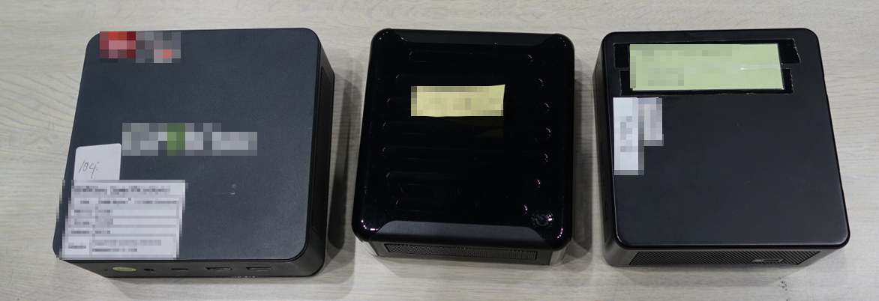
Recap: DUTs (mini PCs)
We measured radio emission from three different mini PCs as in [1]. They are made in different countries/area.
Mini PC-C
Mini PC-B
Mini PC-A
CPU: AMD Ryzen 7 5700U
1.8-4.3 GHz
CPU: AMD Ryzen5 7535U
2.0-4.55 GHz
CPU: Intel Core i7-1165G7
2.8-4.7 GHz

Slide 4
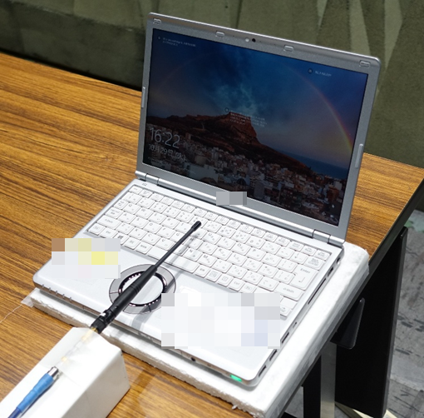
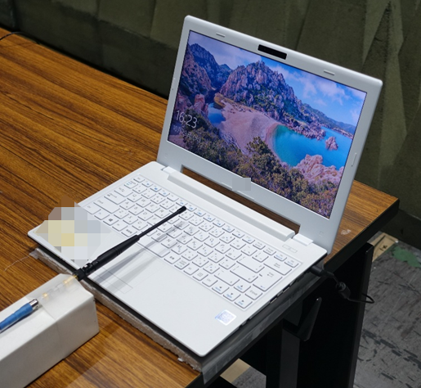
Recap: DUTs (laptop PCs)
We also measured radio emission from two different laptop PCs. They are manufactured by different vendors.
Laptop PC-A
Laptop PC-B
CPU: Intel Celeron 3865U (Kaby Lake), 1.8 GHz
CPU: Intel Core i5-7200U, 2.50-3.10 GHz

Slide 5
Recap: Measurement experiment
We conducted measurement in an anechoic chamber. In the experiment, IQ sampling data was recorded by a data logger during 60 seconds in booting the PCs. Measurement covers the Sub-1 GHz bands in EU, USA (US) and Japan (JP).
The recorded I/Q data was converted to spectrogram.
Mini-Circuits
ZX60-83LN+
Antenna
Data logger
LNA
（20dB）
Cable (3.5 m)
BPF
DUT
Distance between antenna and DUT is changed.
Mini-Circuits VBFZ-925-S 800M-1050MHz

Slide 6
Configurations of spectrum measurement
Sampling: 16-bit sampling for I/Q data @ 80 Msamples/s
Center frequency: 895 MHz
FFT size: 4000 (without overlapping)
Window function: Hann window
Antenna: Monopole antenna
Measurement Distance: 2 cm, 15 cm, 100 cm, 200 cm

Slide 7
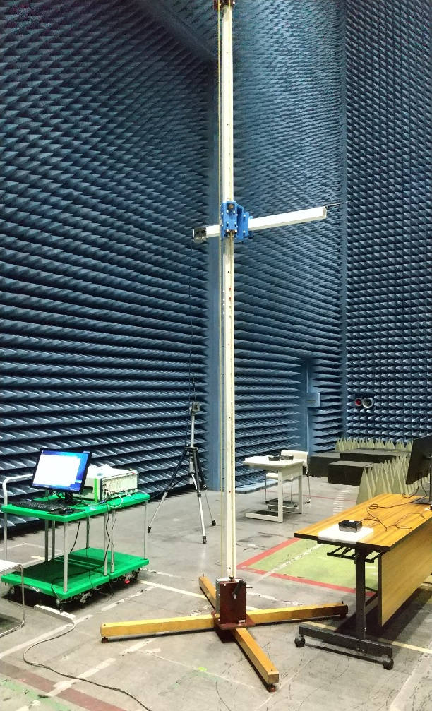
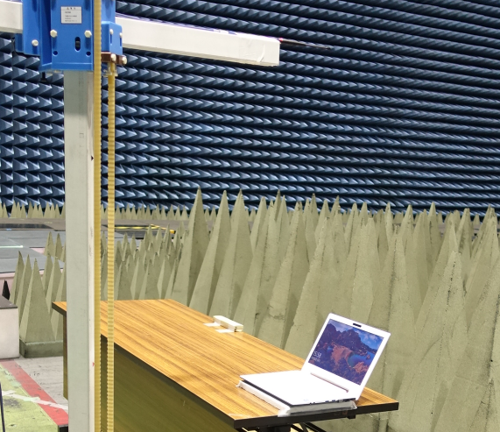
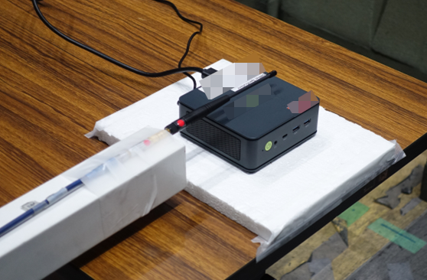
Recap: Measurement environment
Monopole antenna
For 900 MHz band
Monopole antenna
For 900 MHz band
Data logger
Mini PC
(DUT)
Laptop PC
(DUT)
BPF

Slide 8
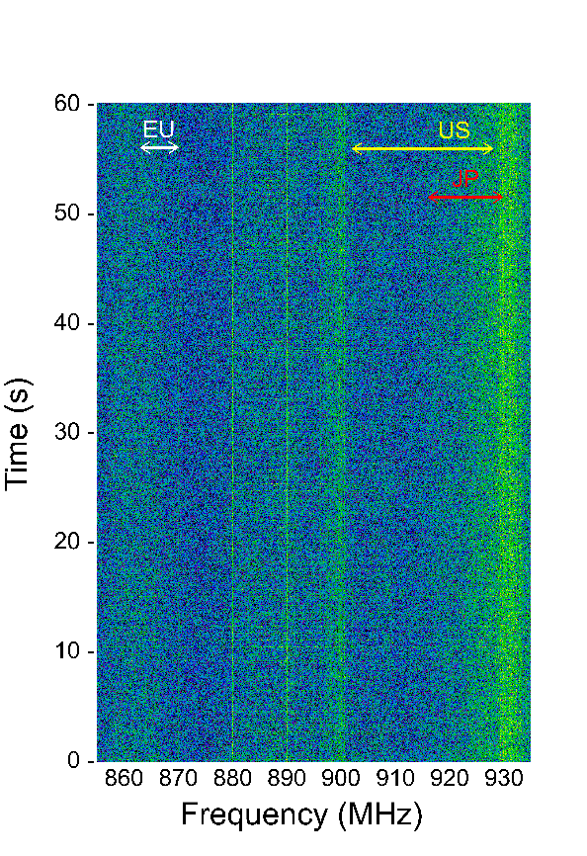
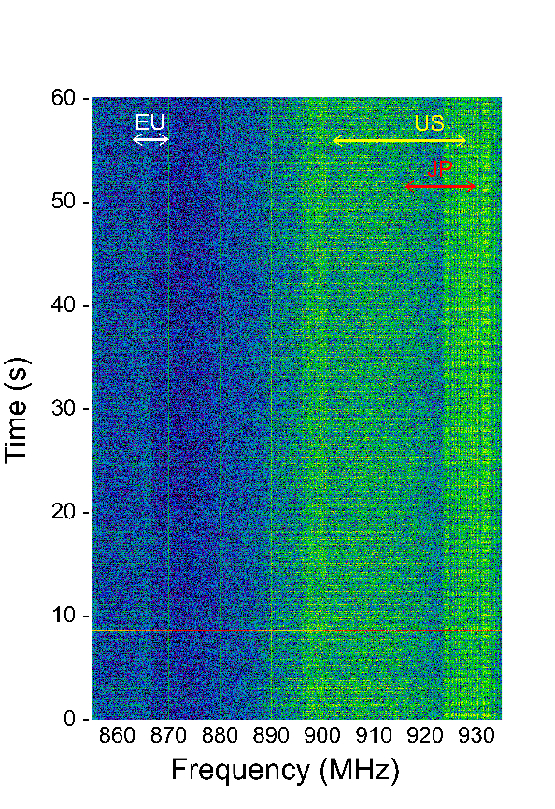
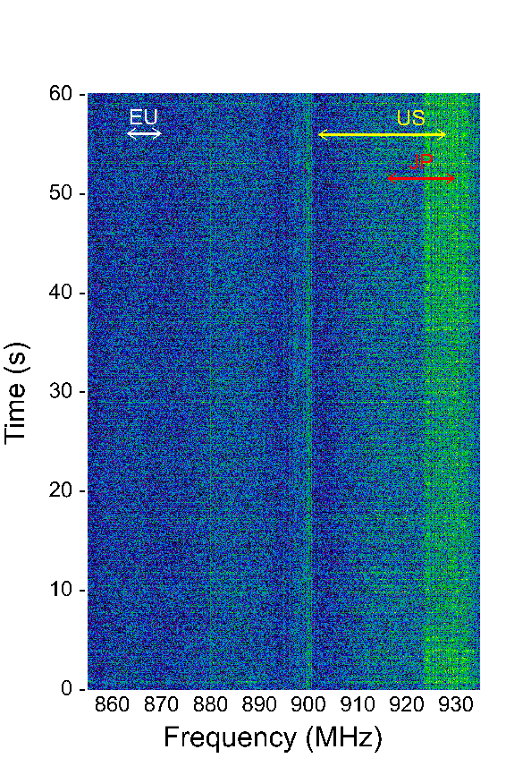
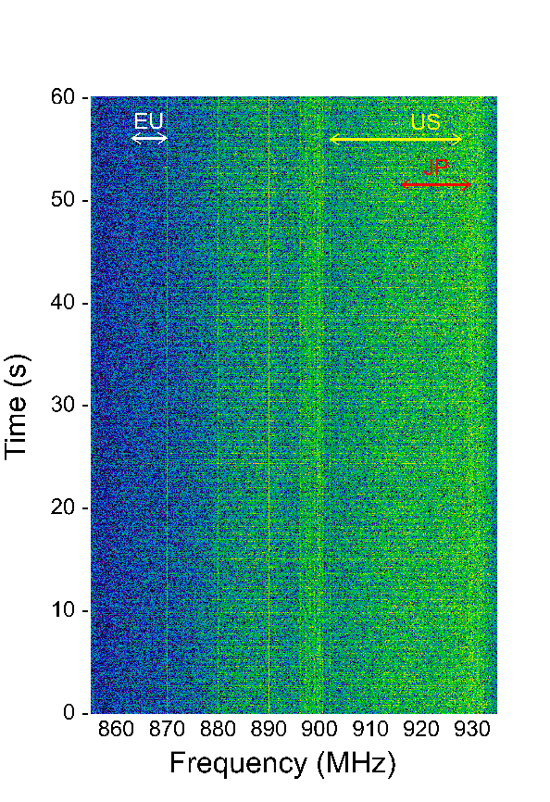
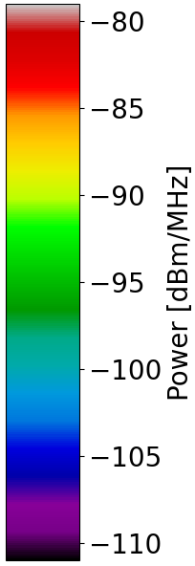
Measurement result for 60 seconds (without DUT)
Radio emission from measurement equipment (data logger) is observed at some frequencies.
Distance: 2 cm
Distance: 15 cm
Distance: 100 cm
Distance: 200 cm

Slide 9
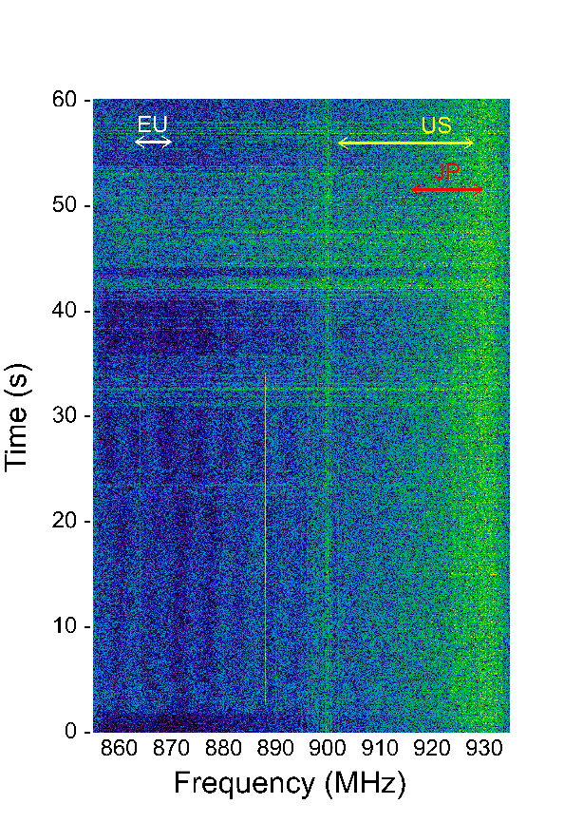
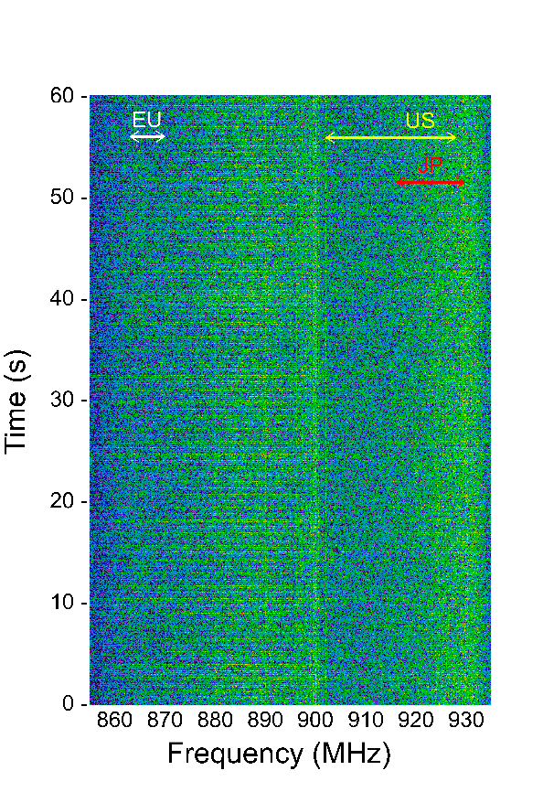
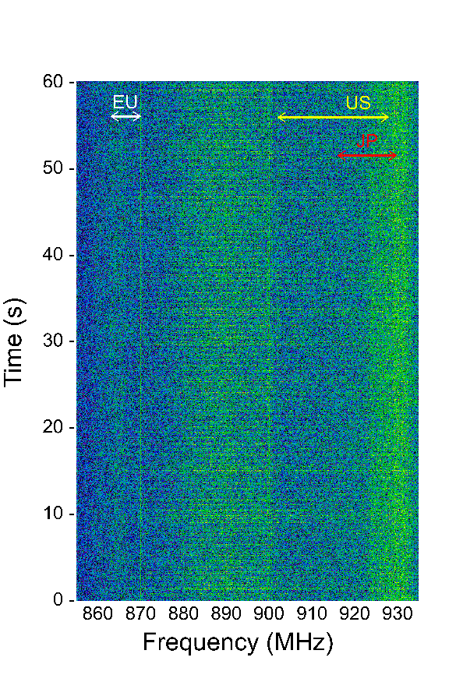
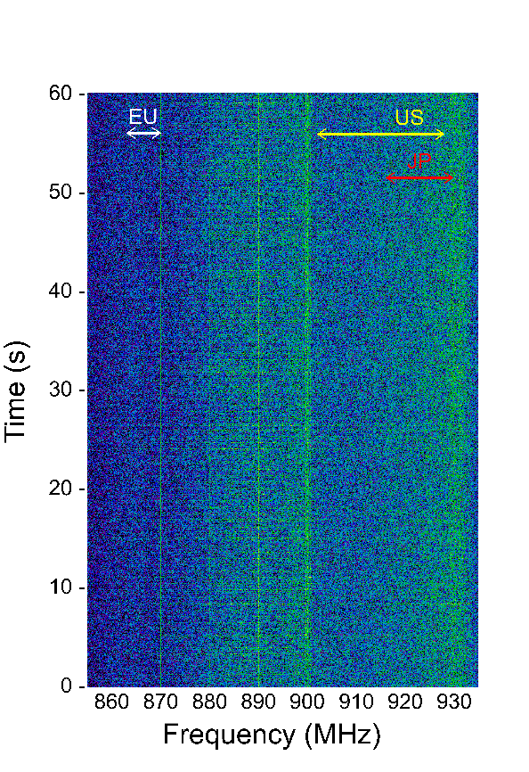
Measurement result for 60 seconds (mini PC-A)
Weak wideband radio emission (lower than -90 dBm / 1 MHz) is observed at 2 cm from mini PC-A. It may affect CCA results and/or transmission performance of IEEE 802.11/15.4 devices if they are operated at a low SNR.
Distance: 2 cm
Distance: 15 cm
Distance: 100 cm
Distance: 200 cm

Slide 10
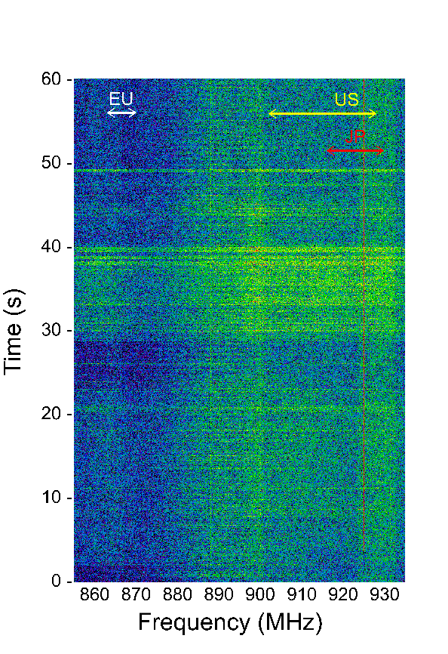
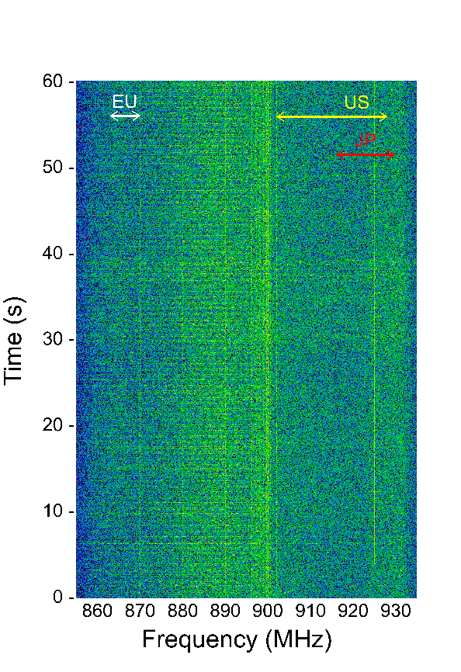
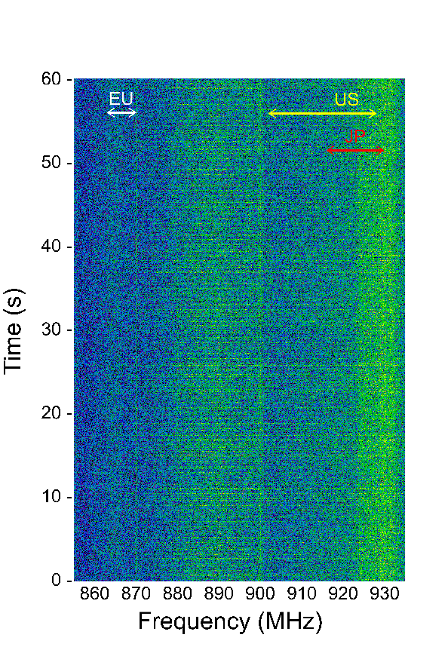
Measurement result for 60 seconds (mini PC-B)
Mini PC-B also emits weak wideband radio noise (lower than -90 dBm / 1 MHz) at 2 cm.
Distance: 2 cm
Distance: 15 cm
Distance: 100 cm
Distance: 200 cm

Slide 11
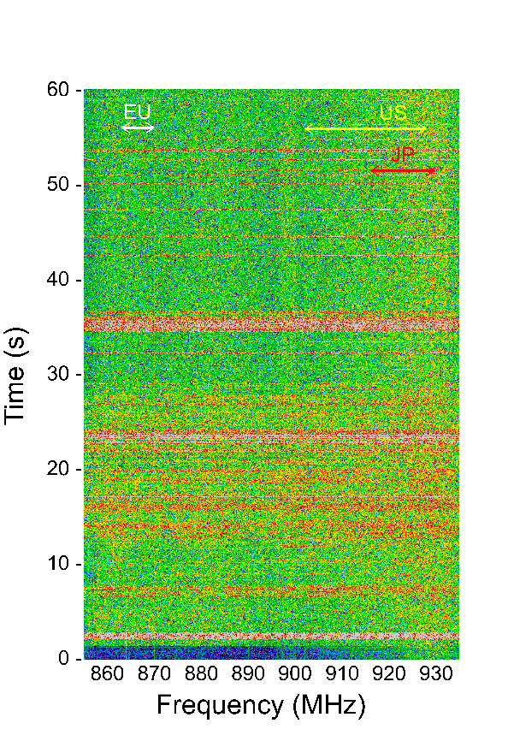
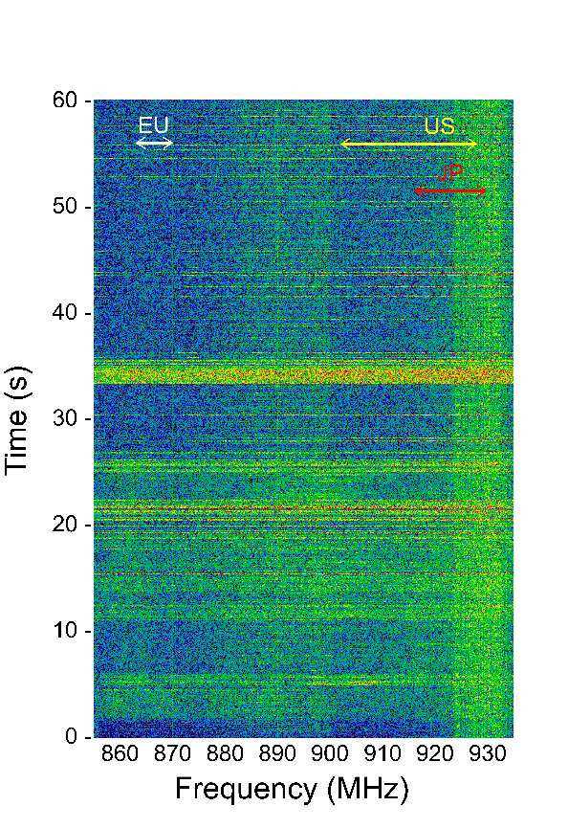
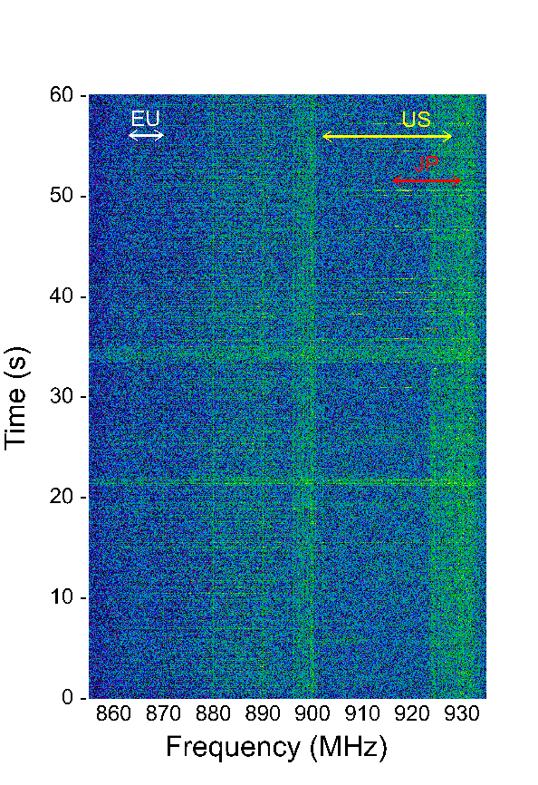
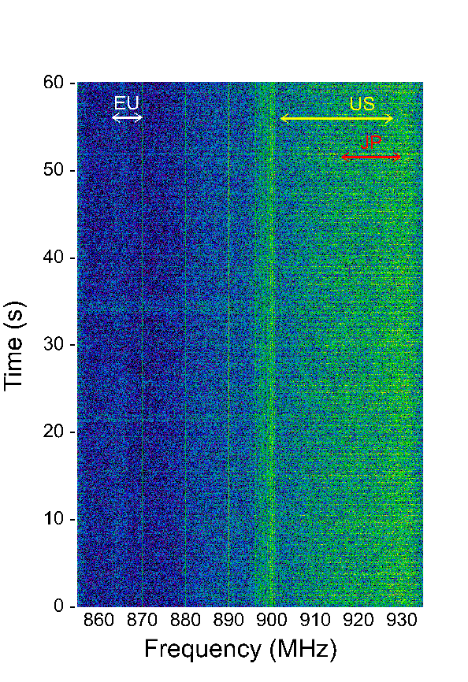
Measurement result for 60 seconds (mini PC-C)
Strong wideband radio emission (higher than -80 dBm / 1 MHz) is observed at 2 cm from mini PC-C. Even at 15 cm, radio noise level is sometimes higher than -85 dBm / 1 MHz.
Distance: 2 cm
Distance: 15 cm
Distance: 100 cm
Distance: 200 cm

Slide 12
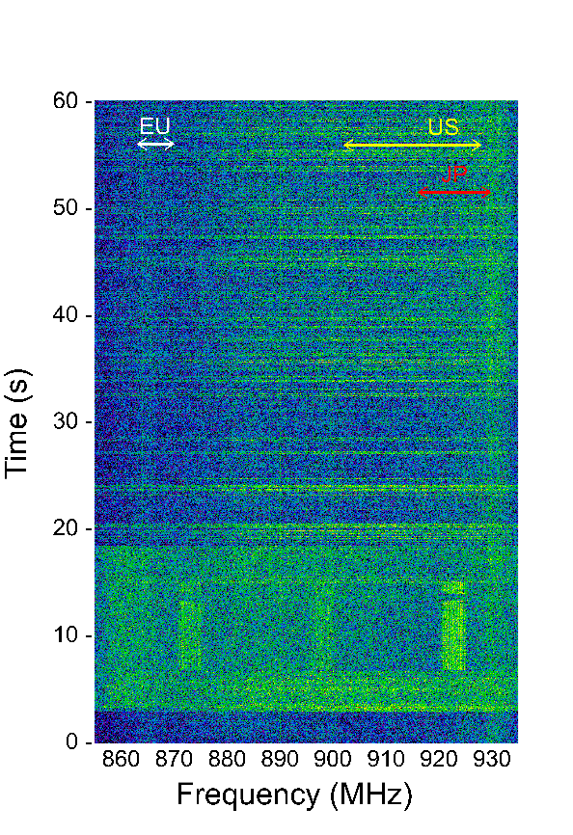
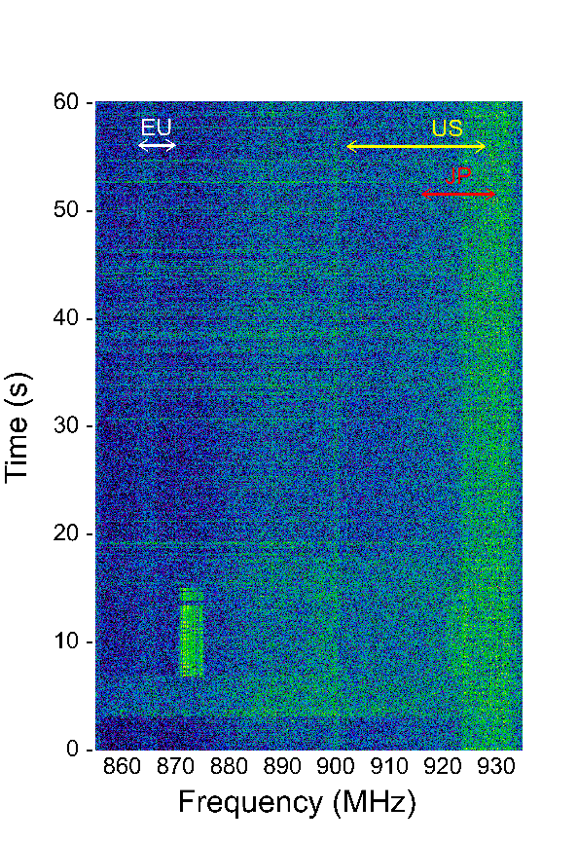
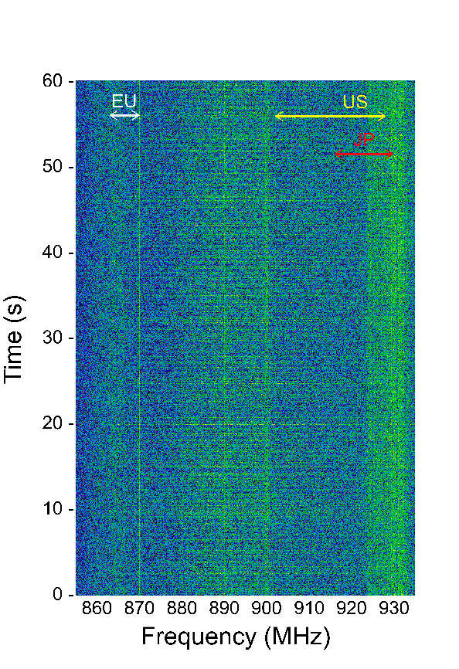
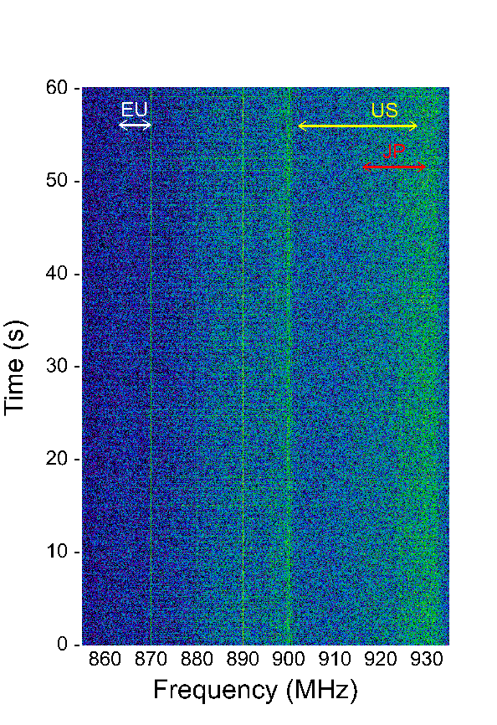
Measurement result for 60 seconds (laptop PC-A)
The level of radio noise emitted from laptop PC-A is lower than -90 dBm / 1 MHz.
Distance: 2 cm
Distance: 15 cm
Distance: 100 cm
Distance: 200 cm
Kazuto Yano, ATR

Slide 13
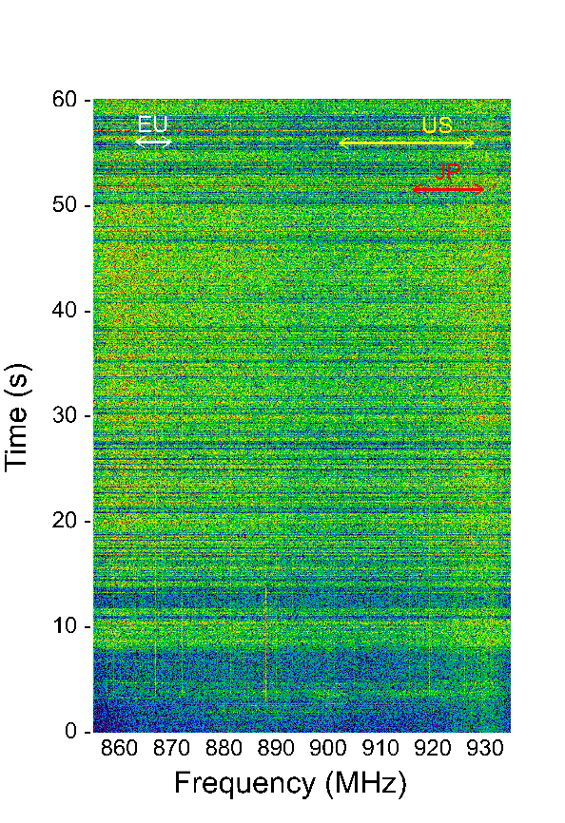
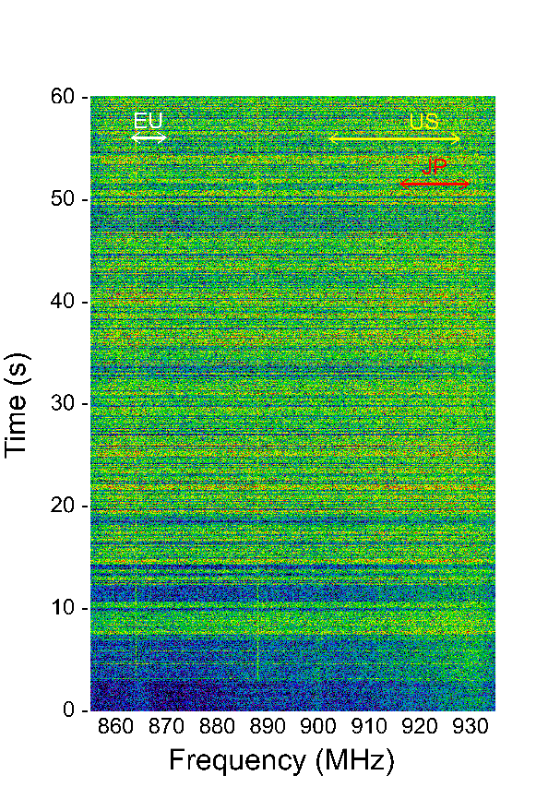
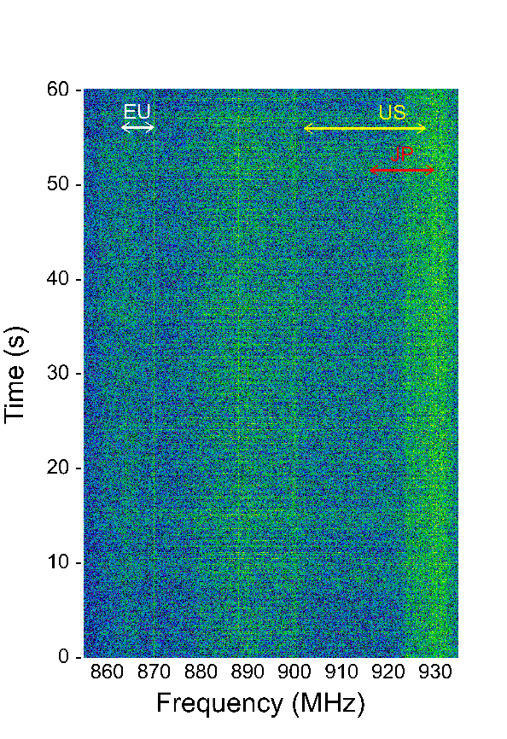
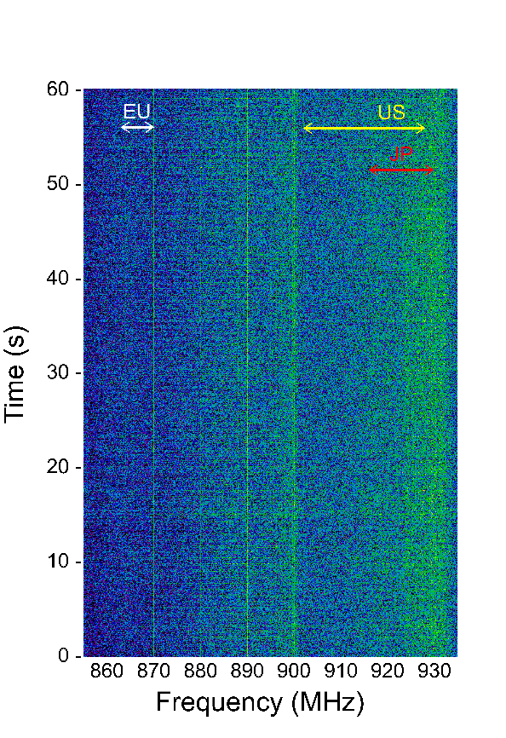
Measurement result for 60 seconds (laptop PC-B)
The level of radio noise emitted from laptop PC-B sometimes exceeds -85 dBm / 1 MHz even at 15 cm.
Distance: 2 cm
Distance: 15 cm
Distance: 100 cm
Distance: 200 cm

Slide 14
Measurement of communication performance of IEEE 802.11ah near mini PC-C
The receiver power of the radio emission from mini PC-C sometimes exceeds -80 dBm / 1 MHz at 2 cm. This is 15 dB higher than the minimum sensitivity for MCS0 with 1 MHz signal bandwidth of IEEE 802.11ah.
Hence, we measured the communication performance between two laptop PCs using Iperf over IEEE 802.11ah in an anechoic chamber. An IEEE 802.11ah STA is located near mini PC-C.
HUB
Laptop PC
Ethernet
HDMI
2 cm
or
15 cm
Router
（DHCP server）
Monitor
5 m
mini PC-C
(radio noise source)
IEEE 802.11ah
STA
IEEE 802.11ah
AP
Laptop PC

Slide 15
Configurations of measurement of communication performance
Measurement: 60 s, 10 times
Transmission power: AP = 11.2 dBm or 0.9 dBm, STA = 11 dBm
MCS index: MCS0, MCS3, MCS7
Signal bandwidth: 1 MHz
Center frequency: 921 MHz
Traffic: UDP, 1470 bytes payload
Offered load: 30 kb/s @ MCS0, 84 kb/s @ MCS3, 195 kb/s @ MCS7
Status od mini PC: Power off, booting (flowing boot messages on the screen), high CPU load (using stress command of Linux, no change on the screen)

Slide 16
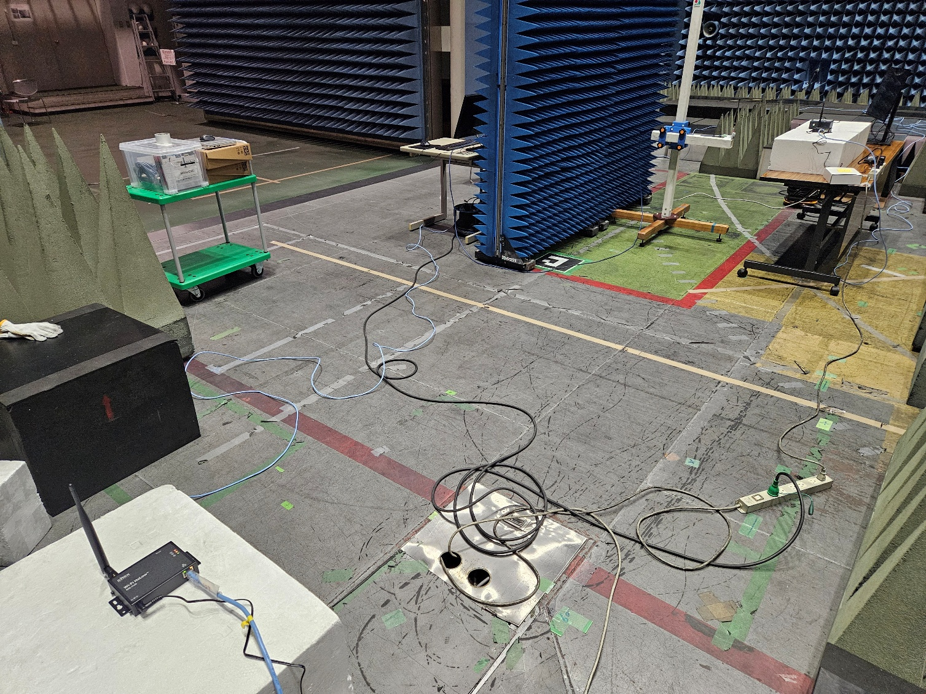
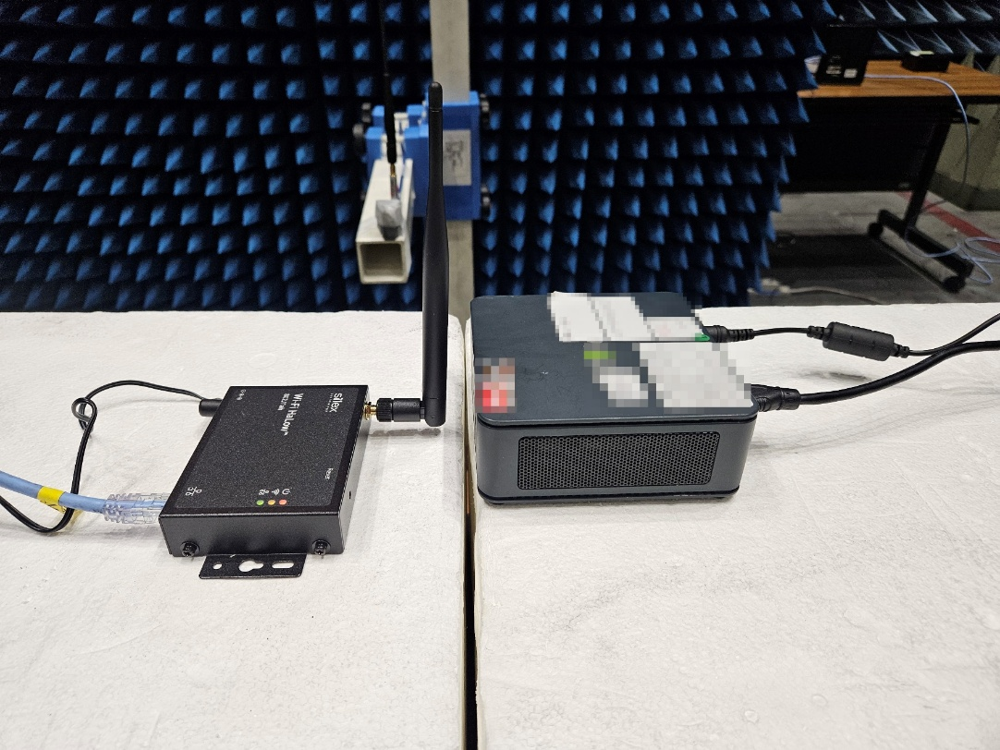
Measurement environment
Monitor
IEEE 802.11ah STA and mini PC-C
IEEE 802.11ah
AP
Distance between
AP and mini PC-C: 5 m
Mini PC-C
IEEE 802.11ah
STA

Slide 17
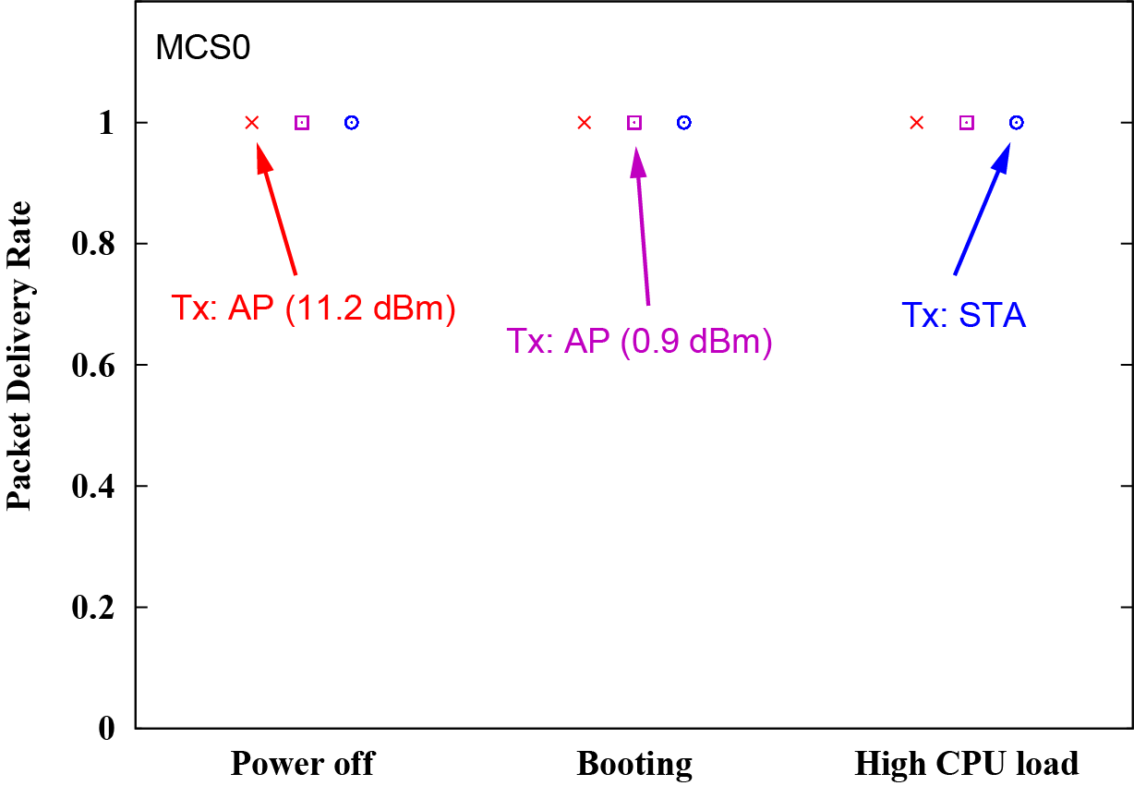
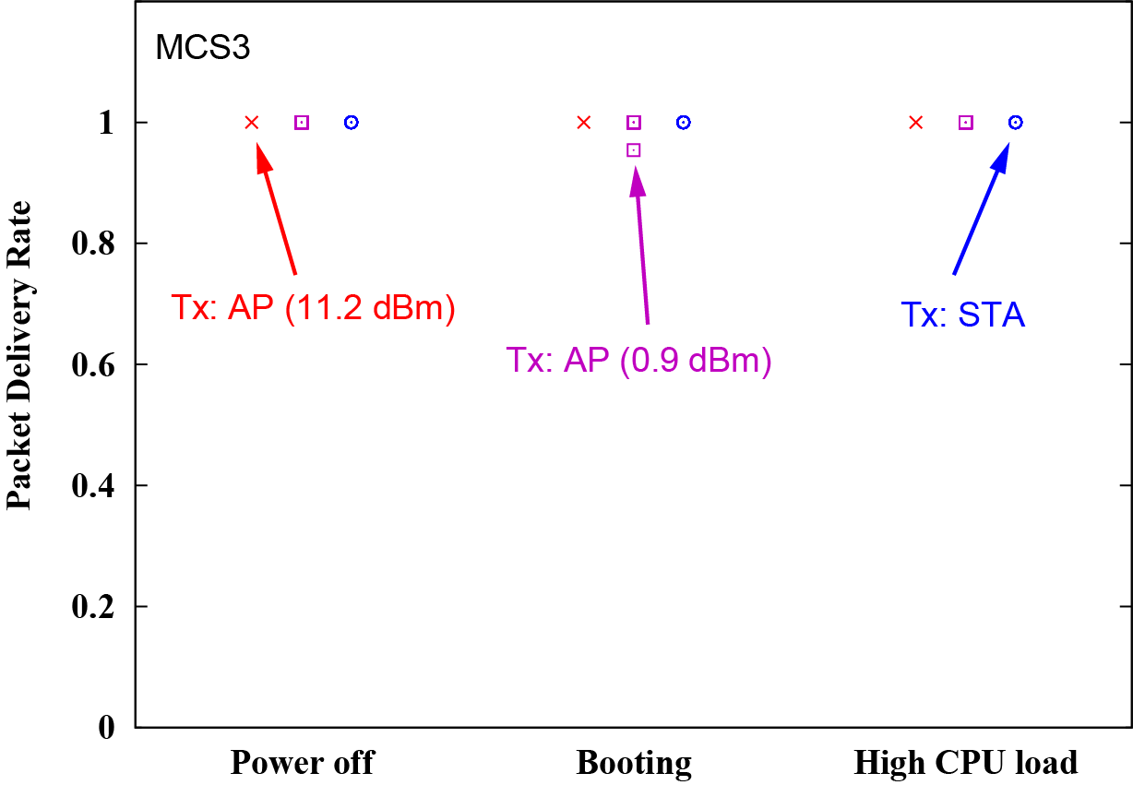
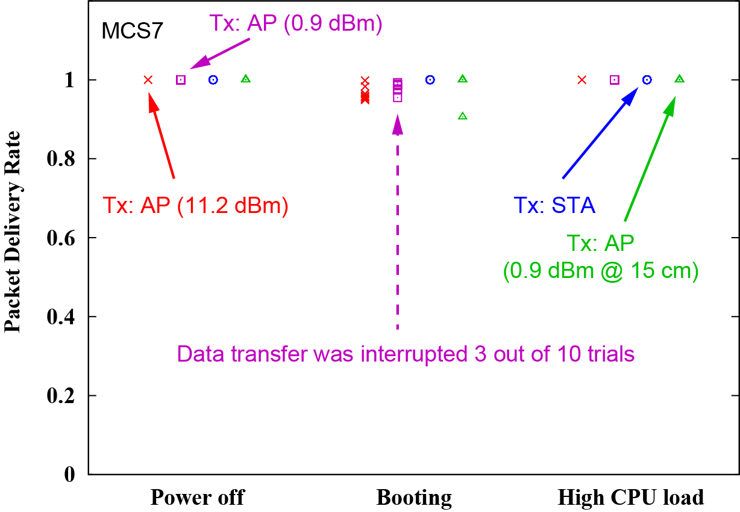
Packet delivery rate performance
Only when mini PC-C was booting, packet loss occurred in downlink transmission at MCS3 and MCS7. This result implies that data frames collided with radio noise, and the monitor or HDMI cable/connector can also be a radio noise source.
MCS0
MCS3
MCS7

Slide 18
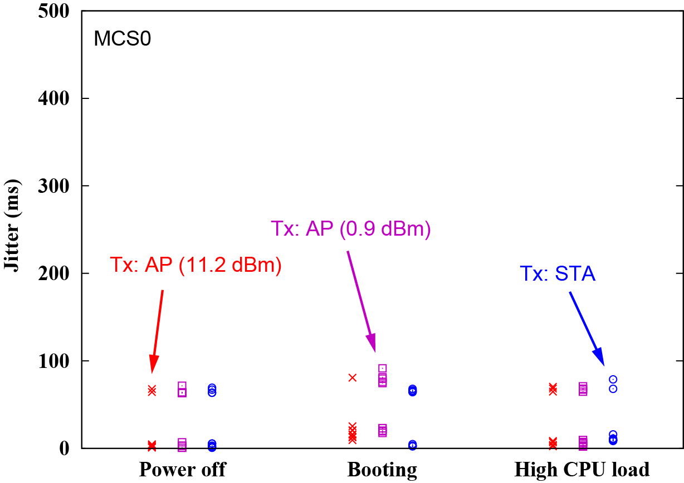
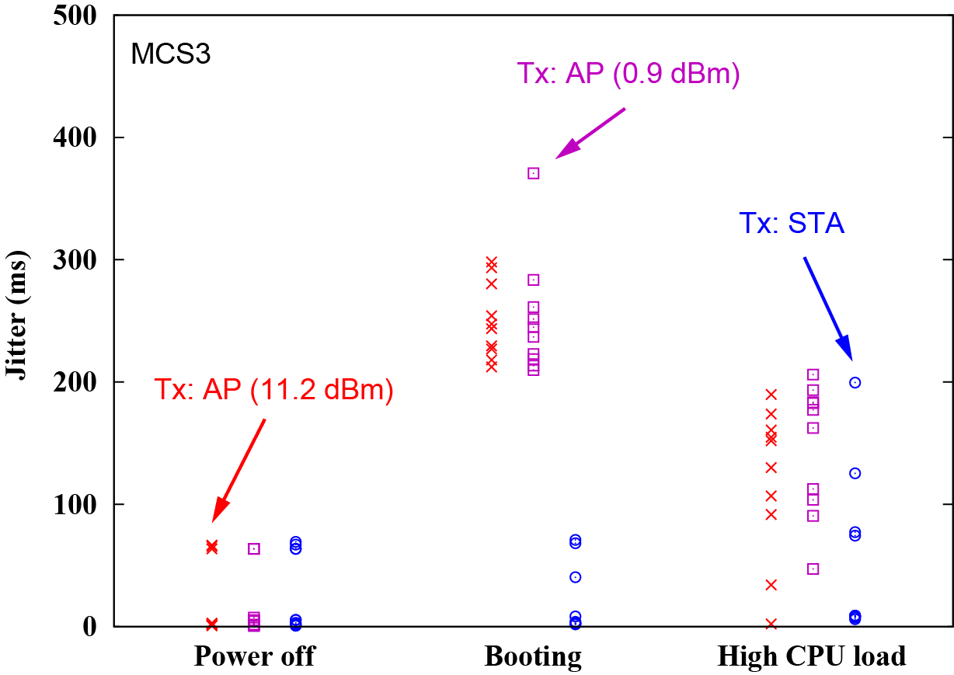
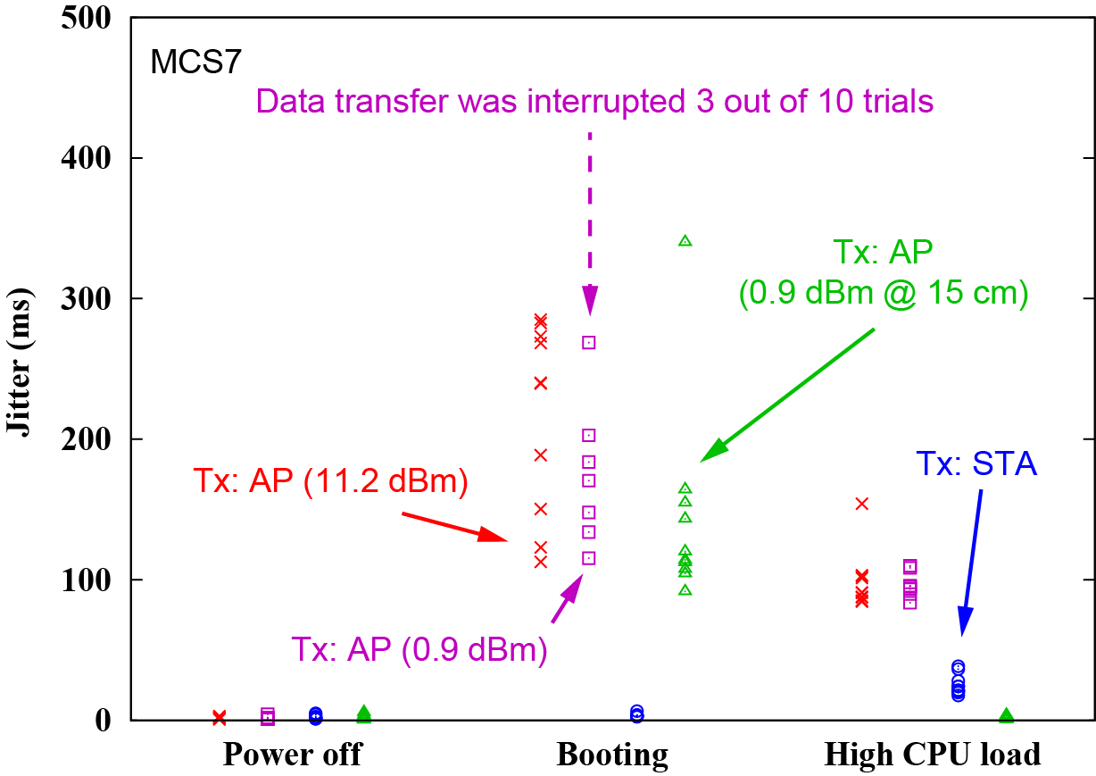
Jitter performance
When mini PC-C was both booting and at high CPU load, the jitter performance was degraded. In particular, the jitter performance of uplink transmission was degraded only when mini PC-C us at high CPU load. It means that mini PC-C itself emits radio noise.
MCS0
MCS3
MCS7

Slide 19
Summary
This contribution showed calibrated measurement results of radio noise emitted over the Sub-1 GHz bands from three mini PCs and two laptop PCs at different distances.
One of mini PC and laptop PC emit strong radio noise. The radio noise level is higher than -85 dBm / 1 MHz at 15 cm from the radio noise source.
This contribution also showed the packet delivery rate and jitter performance of UDP data transmission over an IEEE 802.11ah link near the mini PC that emits strong radio noise.
The result of experiment showed that the radio noise degrades the communication performance of an IEEE 802.11ah link if an IEEE 802.11ah device is located near the mini PC.
It was also shown that a monitor or HDMI cable/connector can also be a radio noise source.

Slide 20
Reference
[1] doc. IEEE 802.19-24/0038r0

