Slide 1
Measurement result of radio noise over 920 MHz band emitted from mini PC
Date: 2024-09-08
Authors:
Notice: This document has been prepared to assist IEEE 802.19. It is offered as a basis for discussion and is not binding on the contributing individual(s) or organization(s). The material in this document is subject to change in form and content after further study. The contributor(s) reserve(s) the right to add, amend or withdraw material contained herein.

Slide 2
Introduction
The sub-1 GHz band is used by not only IEEE 802.11ah and IEEE 802.15.4, but also other radio systems. Moreover, several kinds of machinery emit powerful radio noise in this frequency band, and it may have a large impact on the system performance of wireless communication systems.
Mini PCs are used in various use cases. However, some of them cause severe radio noise over the Sub-1 GHz bands.
Hence, we conducted measurement of radio noise emitted from different mini PCs. This contribution shows initial measurement results.

Slide 3
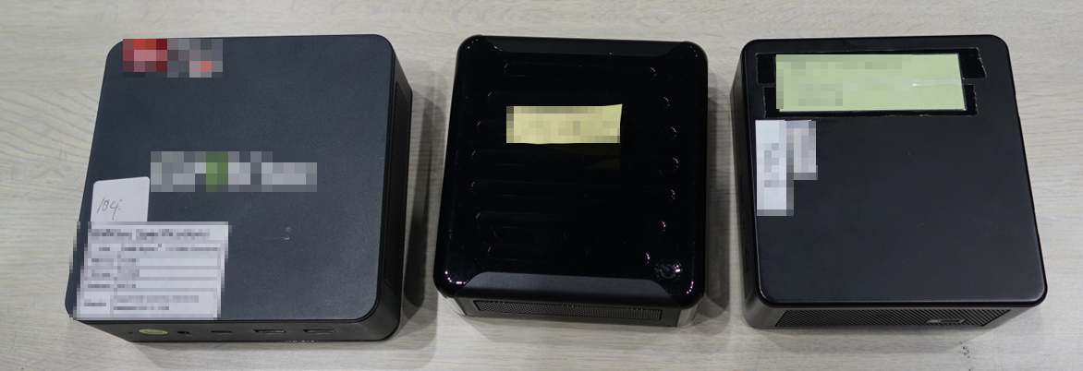
Measured mini PCs
We measured radio emission of 3 different mini PCs. They are made in different countries/area.
Mini PC-C
Mini PC-B
Mini PC-A

Slide 4
Measurement equipment
We conducted measurement in an anechoic chamber. In the experiment, IQ sampling data was recorded by a data logger during 60 seconds in booting the mini PCs. Measurement covers the Sub-1 GHz bands in EU, USA (US) and Japan (JP).
The recorded I/Q data was converted to spectrogram.
Configurations of measurement:
Sampling: 16-bit sampling for I/Q data @ 80 Msamples/s
Center frequency: 895 MHz
FFT size: 5120 (without overlapping)
Window function: Hann window

Slide 5
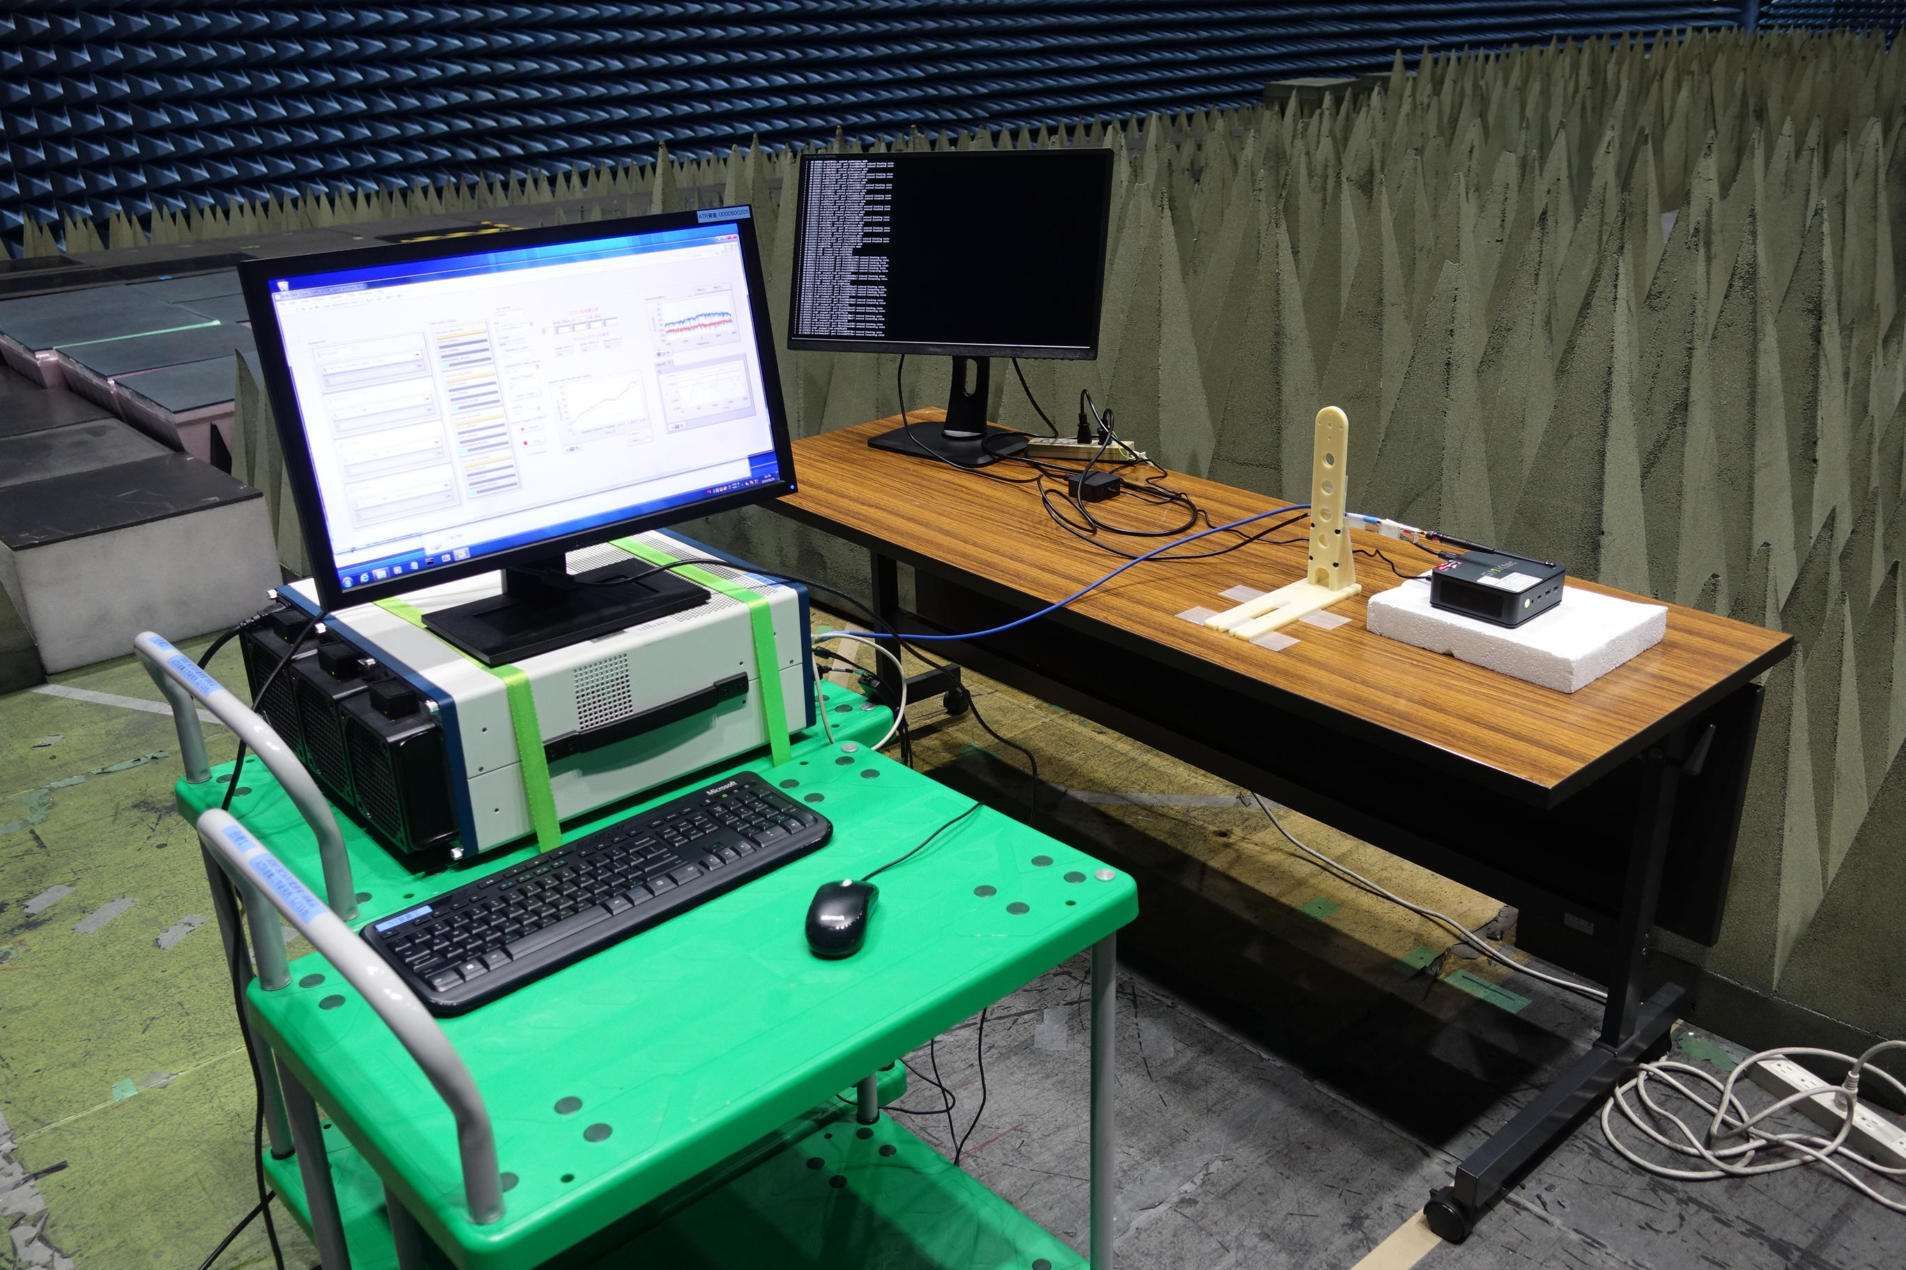
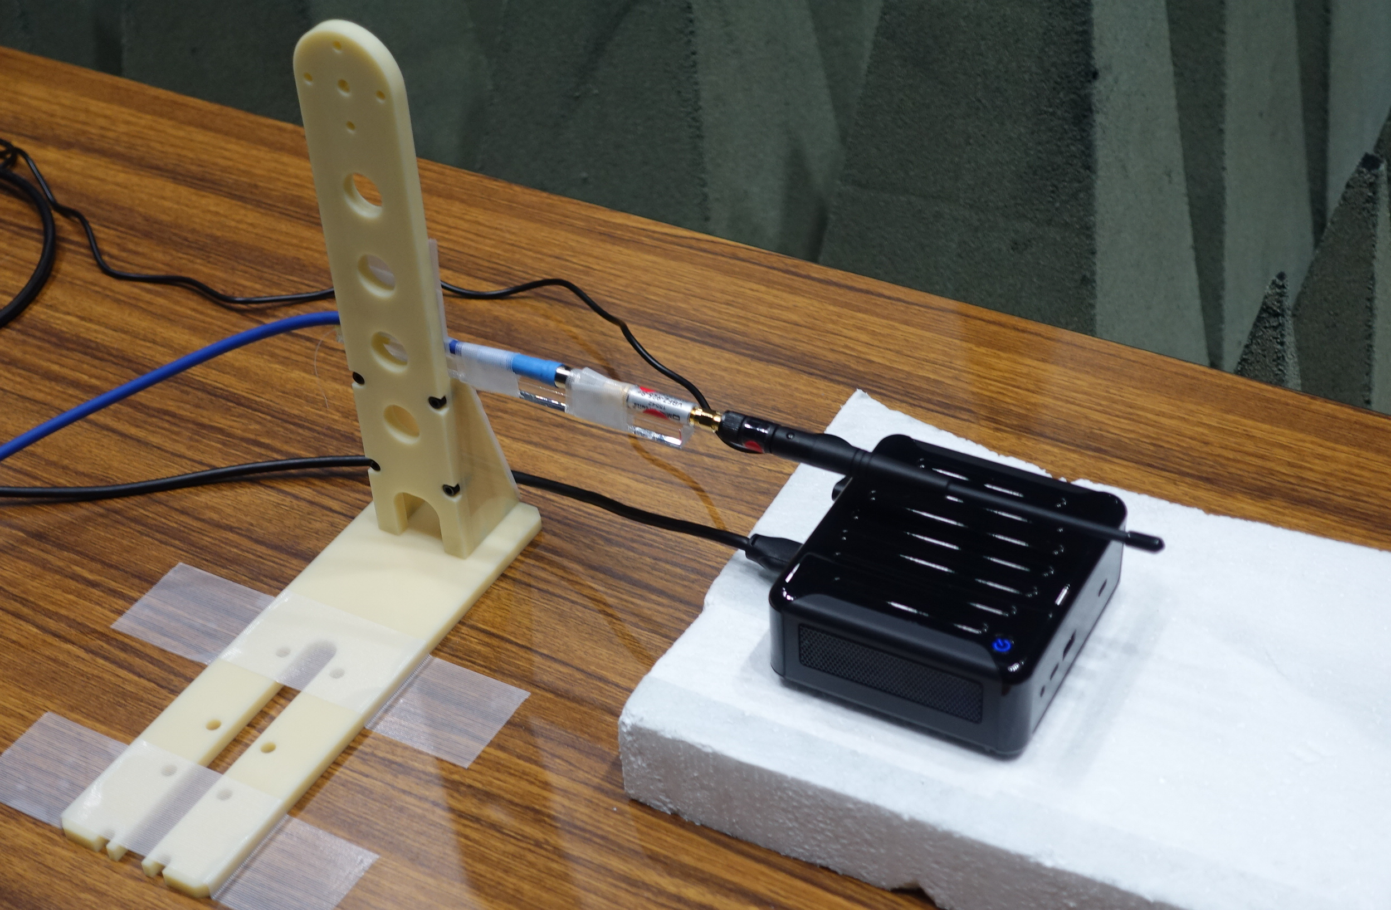
Measurement environment
BPF
(Mini-Circuits
VBFZ-925-S
800M-1050MHz)
Monopole antenna
(Distance between
the antenna and
DUT: 2 cm)
DUT
Data logger
DUT

Slide 6
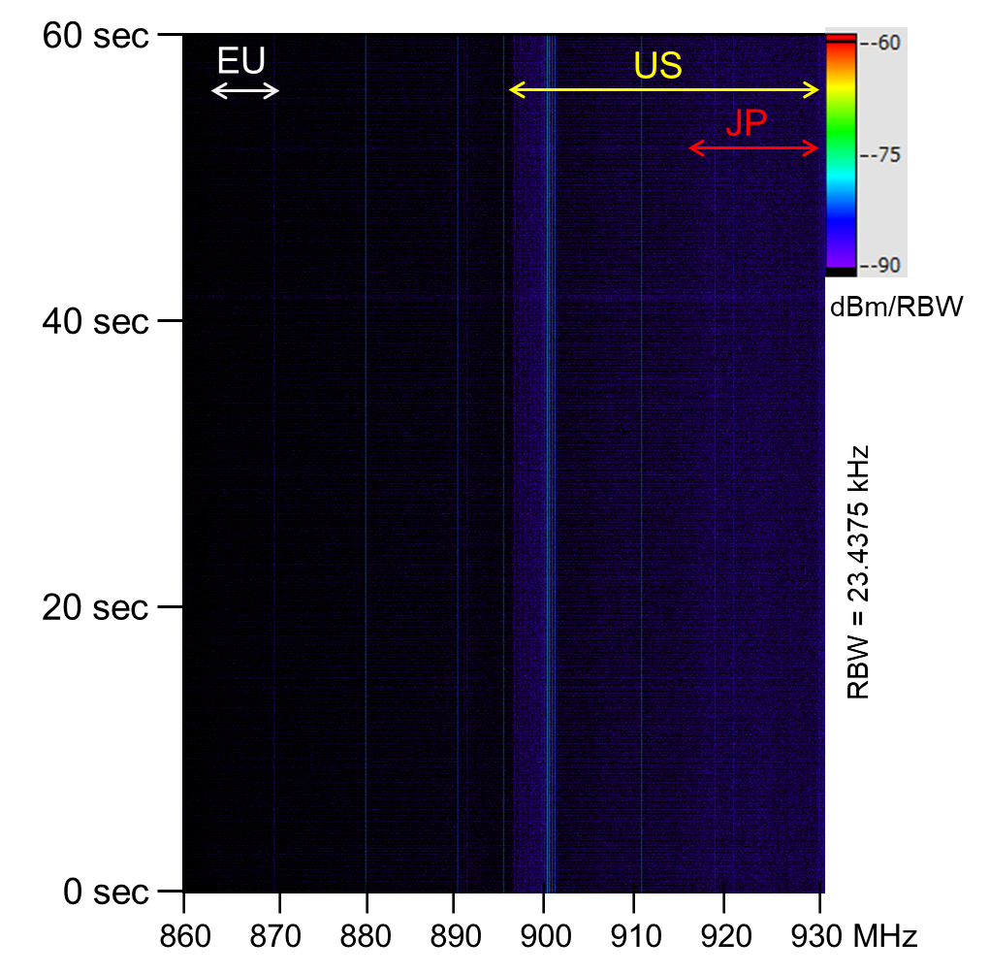
Measurement result for 60 seconds (without mini PC)
Continuous radio noise is observed at several frequencies. It seems the internal noise of the measurement equipment.
｜ ｜ ｜ ｜
900 910 920 930MHz

Slide 7
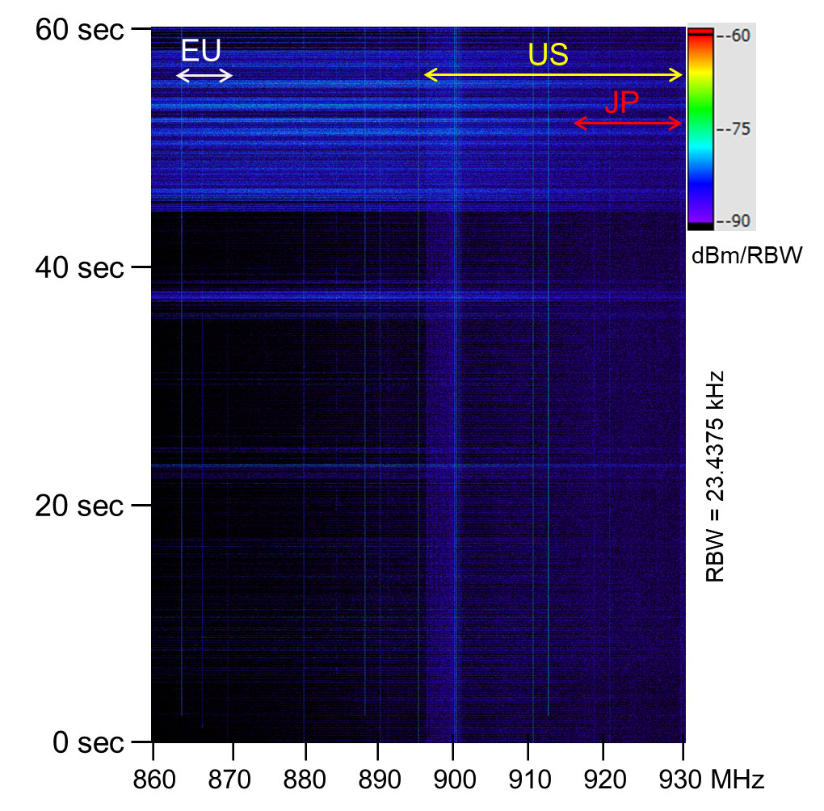
Measurement result for 60 seconds (with mini PC-A)
Mini PC-A starts to frequently emit radio noise at 44 second. Its bandwidth covers the Sub-1 GHz bands in EU, US and JP.
｜ ｜ ｜ ｜
900 910 920 930MHz

Slide 8
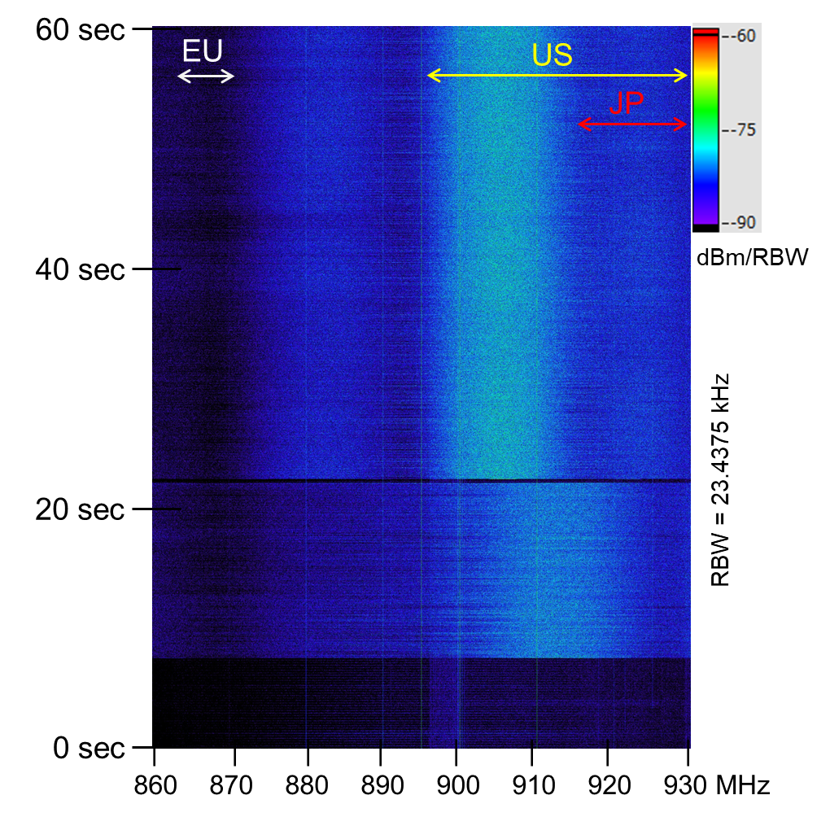
Measurement result for 60 seconds (with mini PC-B)
Mini PC-B emits radio noise, and emitted frequency changes at 22 second.
After 22 seconds, radio noise with relatively strong power covers lower half of the Sub-1 GHz band in US with a high duty.
｜ ｜ ｜ ｜
900 910 920 930MHz

Slide 9
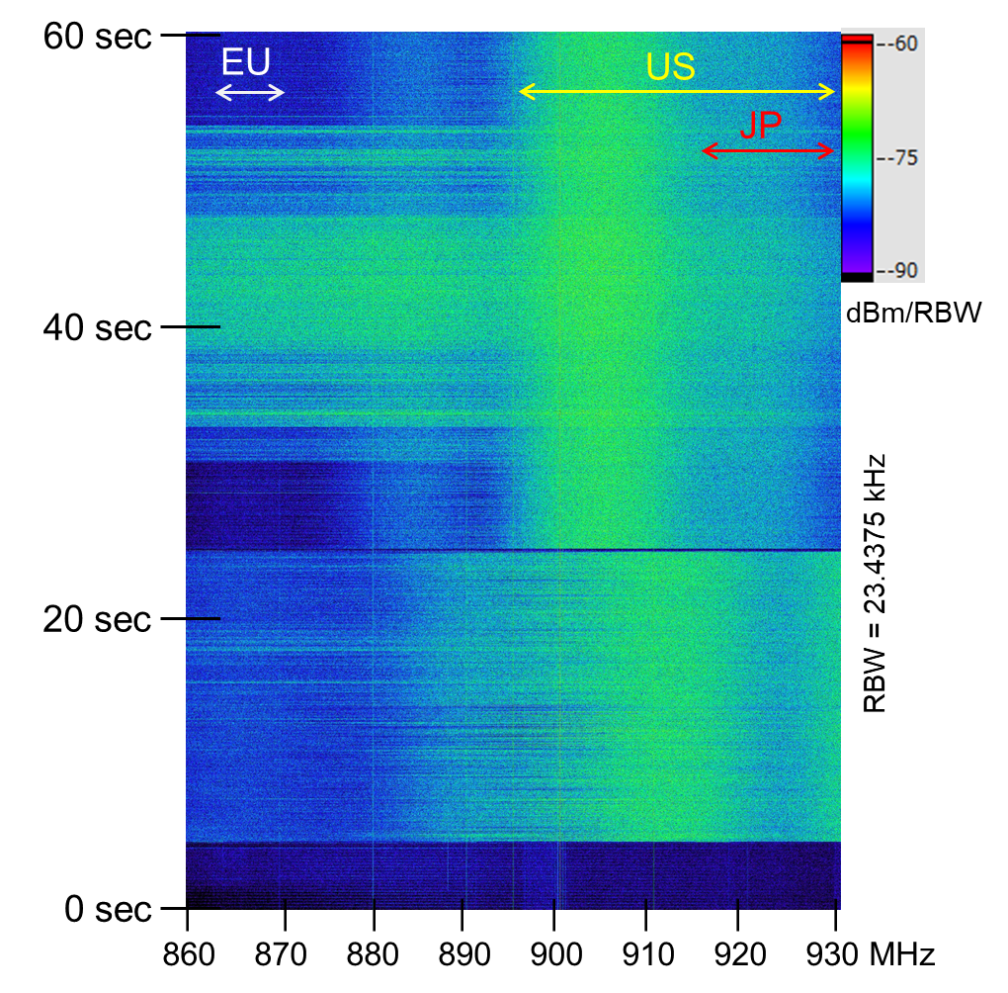
Measurement result for 60 seconds (with mini PC-C)
Mini PC-C emits strong radio noise with a high duty. It mainly covers the Sub-1 GHz bands in US and JP .
Moreover, wideband radio noise is sometimes emitted, and it also covers the Sub-1 GHz band in EU.
｜ ｜ ｜ ｜
900 910 920 930MHz

Slide 10
Summary
We conducted measurement of radio noise emitted over the Sub-1 GHz bands from different mini PCs.
Some mini PCs emit strong radio noise with a high duty. One of them sometimes emits wideband radio noise that covers the Sub-1 GHz bands in EU, US and JP.
In order to assess whether such radio noise can affect the channel access of IEEE 802.15.4 and IEEE 802.11ah systems, we will further investigate with a fine time resolution how mini PCs emit radio noise.

