Slide 1
802.15.4w Overview and Status
Date: 2019-09-17
Authors:
Notice: This document has been prepared to assist IEEE 802.19. It is offered as a basis for discussion and is not binding on the contributing individual(s) or organization(s). The material in this document is subject to change in form and content after further study. The contributor(s) reserve(s) the right to add, amend or withdraw material contained herein.

Slide 2
Abstract
Introduction to LPWAN
LPWAN challenges
802.15.4w technological approaches
802.15.4w performance and co-existence performance

Slide 3
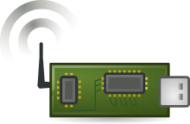
Introduction to Low Power Wide Area Networks
up to 100m
e.g. >10km
e.g. 10dBm (10mW)
Low Power Wide Area Networks (LPWAN) enable long-range transmission with very low transmit powers by using
  very low payload bit-rates (~1kBit/s) → high sensitivity (e.g. -140dBm)
  highly exposed base-station antennas → reduced path-loss
Focus is almost completely on uplink traffic

Slide 4
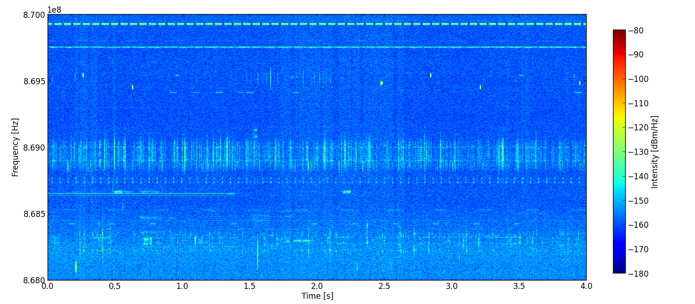
Measured Spectrum Use at 868MHz
Measured spectrum use in license-exempt sub-GHz band (868-870 MHz) in Erlangen, Germany
The sub-bands have different access parameters (e.g. TX power, duty cycle)

Slide 5
LPWAN Challenges
Large spectral footprint of LPWAN signals due to low payload bit-rates
  High probability of collision with interferer
Very low required reception levels
  Other systems may not be able to detect our LPWAN transmissions
Highly exposed base-stations
  Listen before talk (CCA) will not work due to hidden node problem
Significantly increased use of license-exempt bands expected in the future
  Introduction of new systems, e.g. sub-GHz WiFi (IEEE 802.11ah), and increased use of other sub-GHz systems

Slide 6
802.15.4w Approaches
Amends 802.15.4k FSK PHY as it operates already quite close to the theoretical bounds in the AWGN channel
Adds additional lower bit-rates and frequency hopping
Adds improved forward error correction using powerful LDPC and convolutional codes
All additional features on the transmitter side can be achieved purely by software using existing FSK transmitter chips
Performance in extensively analyzed in CA document [1]

Slide 7
802.15.4w Frequency Bands
(a) 169.4 – 169.475 MHz (Europe)
(b) 262 – 264 MHz (Korea)
(c) 433.05 – 434.79 MHz (North America, Europe)
(d) 470 – 510 MHz (China)
(e) 779 – 787 MHz (China)
(f) 863 – 876 MHz (Europe)
(g) 902 – 928 MHz (Americas)
(h) 915 – 928 MHz (Australia)
(i) 917 – 923 MHz (Korea)
(j) 920.5 – 923.5 MHz (Japan)
(k) 921 – 928 MHz (New Zealand)
Typical LPWAN bands are in the 900MHz range

Slide 8
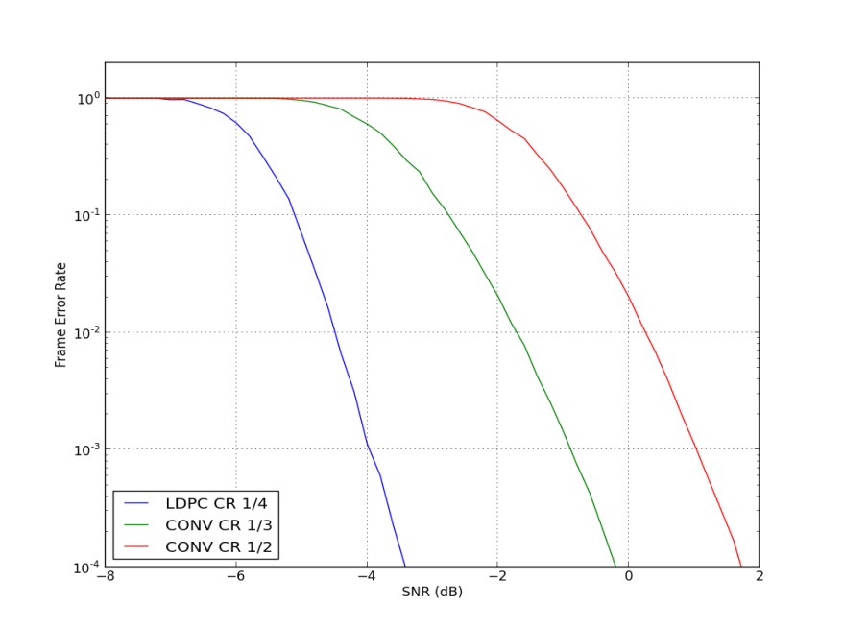
SNR Requirements for the Available Forward Error Correction Code-Rates
Operates also at negative SNR
Preamble is optimized for reliable synchronization at low SNR

Slide 9
Typical Parameter Configurations
System | PHY | PHY Mode | Coding | SNR for FER < 1% | Sensitivity | Eff. Bit-rate*)
802.15.4.w | MSK, SF1 | 19.04kS/s | Conv. 1/2 | 0.3 dB | -131 dBm | 9.5kb/s
 |  | 9.52kS/s | Conv. 1/3 | -1.7 dB | -136 dBm | 3.2kb/s
 |  | 2.38kS/s | Conv. 1/3 | -1.7 dB | -142 dBm | 0.8kb/s
 | MSK, SF2 | 2.38kS/s | LDPC 1/4 | -7.5dB | -148 dBm | 0.3kb/s
CCA will not be able to reliably detect 802.15.4w transmissions

Slide 10
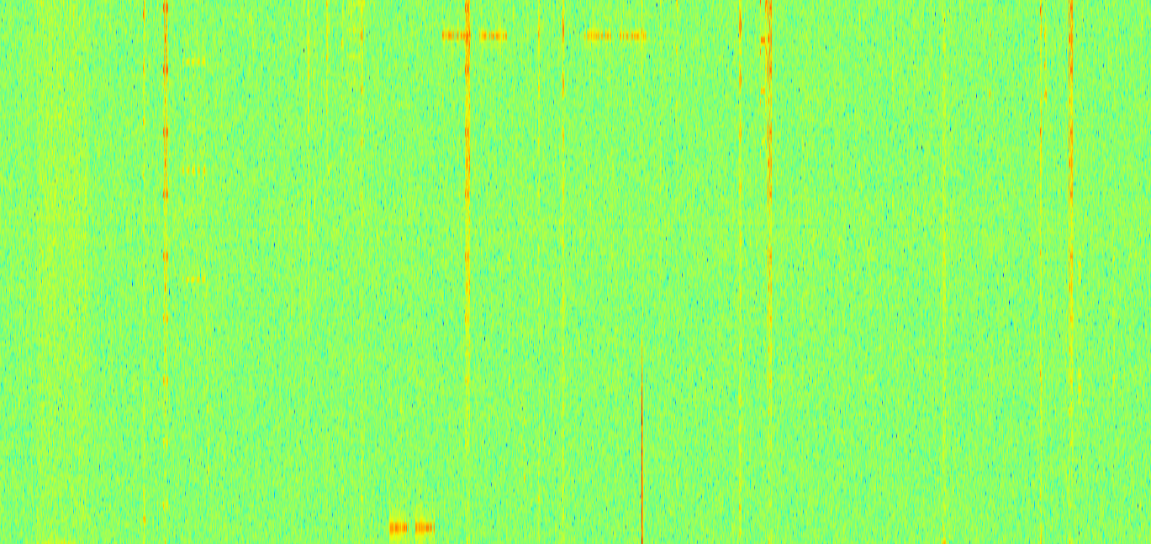
802.15.4w Frequency Hopping
Frequency
Collided Hop
Non-Collided Hop
Time
Number of lost hops gets predictable (law of large numbers)
Coexistence mechanism for highly occupied frequency bands

Slide 11
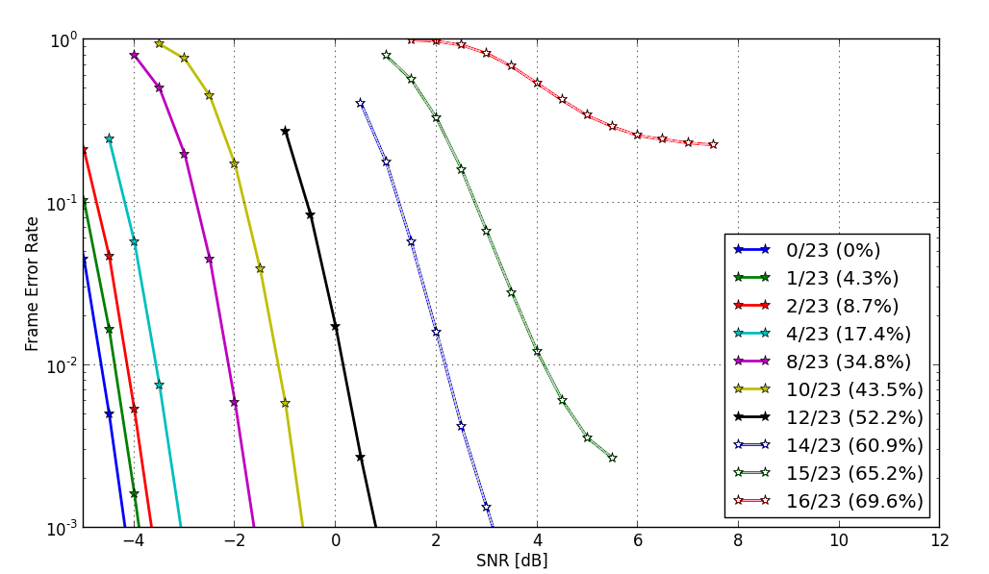
Simulation Results SNR vs. Number of Collided Hops
LDPC Code-Rate ¼, 23 Hops
Still works with 65% lost hops

Slide 12
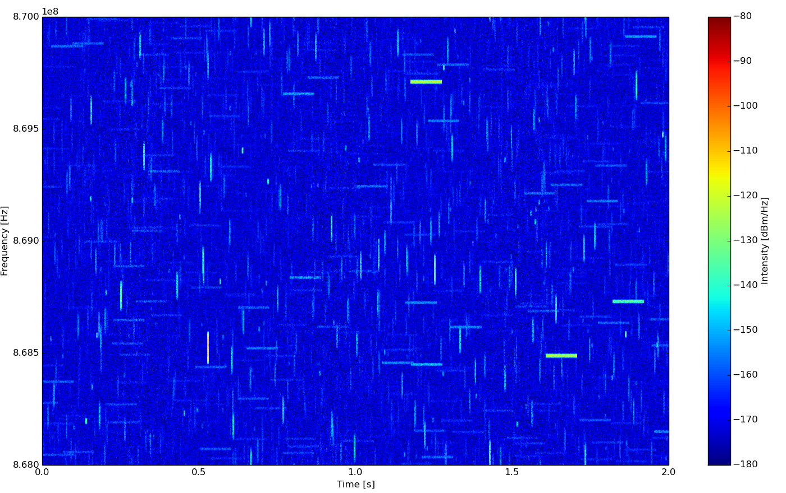
802.15.4w Interference Model
Special interference model was created to simulate interference in LPWAN [2]

Slide 13
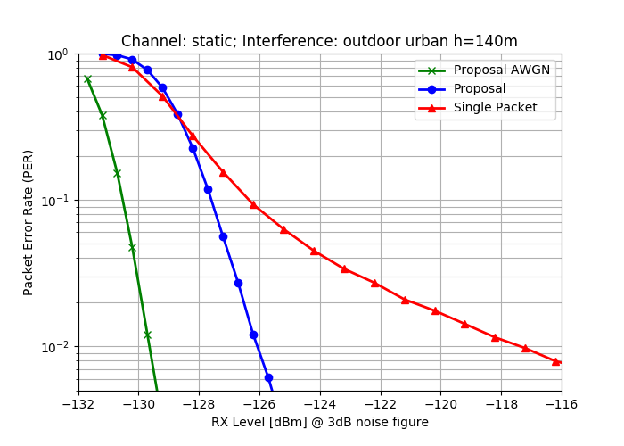
Simulation Results Using Interference Model with
19.04kS/s, Code-Rate 1/3, 3dB noise figure
Only small loss compared to AWGN, no error-floor

Slide 14
Co-Existence Simulations
Coexistence report is available on mentor [2]
Primary focus was on general performance and co-existence with 802.11ah
All simulations assume a distance of 10m between victim signal transmitter and receiver
The distance between the victim receiver and the interfering transmitter is varied
The results shown here are worst-case results without CCA (which would be used in practical systems) and any interference cancellation techniques

Slide 15
802.11ah Co-Existence – Victim 802.11ah
Interferer is closer than
desired transmitter
802.15.4w also allows for additional CCA for the detection per hop to further reduce the interference to other systems

Slide 16
802.11ah Co-Existence – Victim 802.15.4w
Interferer is closer than
desired transmitter
Low bandwidth makes 802.15.4w very robust wrt. 802.11ah

Slide 17

Current Status of IEEE 802.15.4w
TASK | Completed
Start of TG work | Mar, 2018
Call for Proposals | Mar, 2018
Technical Guidelines Doc. | Mar, 2018
Initial discussion of proposals | July, 2018
Editing Draft | Jan, 2019
LB | Mar, 2019
LB Comment Resolution | May, 2019
LB Recirculation / SB | July, 2019
SB Comment Resolution | Nov, 2019
Submission to RevCom | ?, 2020
802.15.4w has to wait for current 802.15.4 revision to complete before publication

Slide 18
Summary
LPWAN will suffer strong interference from other systems due to their system design
802.15.4w uses diversity and strong forward error correction for reliable communication in densely used license-exempt frequency bands
802.15.4w offers passive co-existence by design
All additional transmitter features can be implemented on state-of-the-art FSK transmitter chips using software only
Co-Existence simulations show no significant interference between 802.11ah and 802.15.4w

Slide 19
References
[1] 802.15.4w CA document, 15-19/212r2
[2] J. Robert, S. Rauh, H. Lieske and A. Heuberger, "IEEE 802.15 Low Power Wide Area Network (LPWAN) PHY Interference Model," 2018 IEEE International Conference on Communications (ICC), Kansas City, MO, 2018

