Slide 1
Questions about LAA deployment scenarios
Document | IEEE 802.19-15-0060-02-0000
Submitted | 2015-08-07
Source | Roger B. Marks BaiCells r.b.marks@ieee.org +1-802-capable
Abstract | This document proposes some slides concerning unlicensed LTE deployment and evaluation scenarios. [Note: For background explanation, see earlier revisions of this document.]
Purpose | For review by the IEEE 802.19 WG and incorporation into comments into IEEE 802 input to 3GPP LAA workshop of 29 August 2015.

Slide 2
Topic: Macrocell LAA Scenarios
3GPP TR 36.889 V1.0.1 (2015-06) provides a carrier aggregation feasibility study.
Macrocell scenarios are included.
The one macrocell scenario evaluated in TR 36.889 requires different licensed bands for macrocell and small cell.
The other macrocell scenarios may result in unique challenges for LBT.
Has the feasibility of the macrocell scenarios been established?

Slide 3
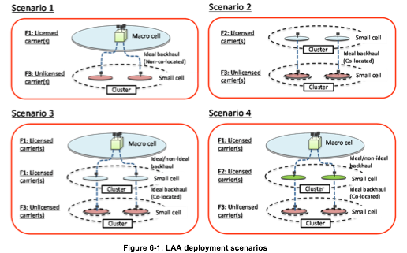
LAA Deployment Scenarios
source: 3GPP TR 36.889

Slide 4
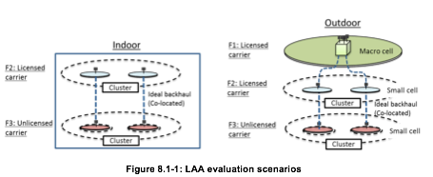
LAA Evaluation Scenarios
per TR 36.889, indoor scenario based on Scenario 3 of TR 36.872
but comparable to Scenario 2 of TR 36.889
per TR 36.889, outdoor scenario based on Scenario 2a of TR 36.872
but comparable to Scenario 4 of TR 36.889

Slide 5
Macrocell LAA Scenarios: Scenarios 1, 3, 4
Scenario 4 is evaluated in TR 36.889
requires different licensed channels for macro and small cell
limited applicability: not all operators have multiple licensed channels available
Scenario 1 is not evaluated in TR 36.889
Requires “ideal backhaul” between the macro site and the unlicensed small cell.
DL and UL scheduling take place at the macro site, not at remote radio head.
CCA takes place at the small cell, and at remote UE for uplink.
Scenario 3 is not evaluated in TR 36.889
Macrocell and small cell share the same licensed channel.
may require coordination of scheduling between macrocell and small-cell licensed

Slide 6
Questions: Macrocell LAA Scenarios
In Scenario 1
Is the scheduler, at the macrocell, aware of remote CCA status?
Have simulations studied LBT in Scenario 1? Do these consider:
“ideal” but realistic backhaul latency
when unlicensed uplink is supported, latency in passing CCA status from UE over the air (using licensed or unlicensed uplink)
In Scenario 3
In case of “ideal” backhaul, see questions from Scenario 1.
In case of “non-ideal” backhaul, have simulations studied LBT?
Can the presence of the macrocell affect the latency of the DL and UL LBT operation, considering that small-cell licensed and unlicensed carriers are carrier-aggregated while licensed small-cell operation is not independent but must be coordinated with co-channel macrocell?

