Slide 1
Coexistence system in a cognitive radio testbed
Date: 2012-05-17
Authors:
Notice: This document has been prepared to assist IEEE 802.19. It is offered as a basis for discussion and is not binding on the contributing individual(s) or organization(s). The material in this document is subject to change in form and content after further study. The contributor(s) reserve(s) the right to add, amend or withdraw material contained herein.

Slide 2
Abstract
This presentation gives an overview of coexistence management system implemented to a cognitive radio testbed developed and implemented in Nokia Research Center.
The coexistence management system builds upon the system architecture and logical elements developed in the 802.19 TG1.

Slide 3
Cognitive radio testbed design
CDIS
CDIS Coexistence Discovery and Information Server/System
CSP Cognitive Service Provider
CM Coexistence Manager
CE Coexistence Enabler
BWM Bandwidth Manager
BWL Bandwidth Logger
Radio Physical Radio Device
Data Collection and Visualization Servers External servers for demo and debug purposes
Visualization
Server
CSP
CM
BWM
Data Collection Server
CE
BWL
Radio

Slide 4
Deployment of functional entities
PC server
CDIS
Visualization UI
CSP
Visualization server
CM
BWM
KTS_CE
DIR-825
CE
BWM logger
ADR
Internet
Mobile
TV WS radio
TV WS primary DB
NCG/ CCM
WLAN radio

Slide 5
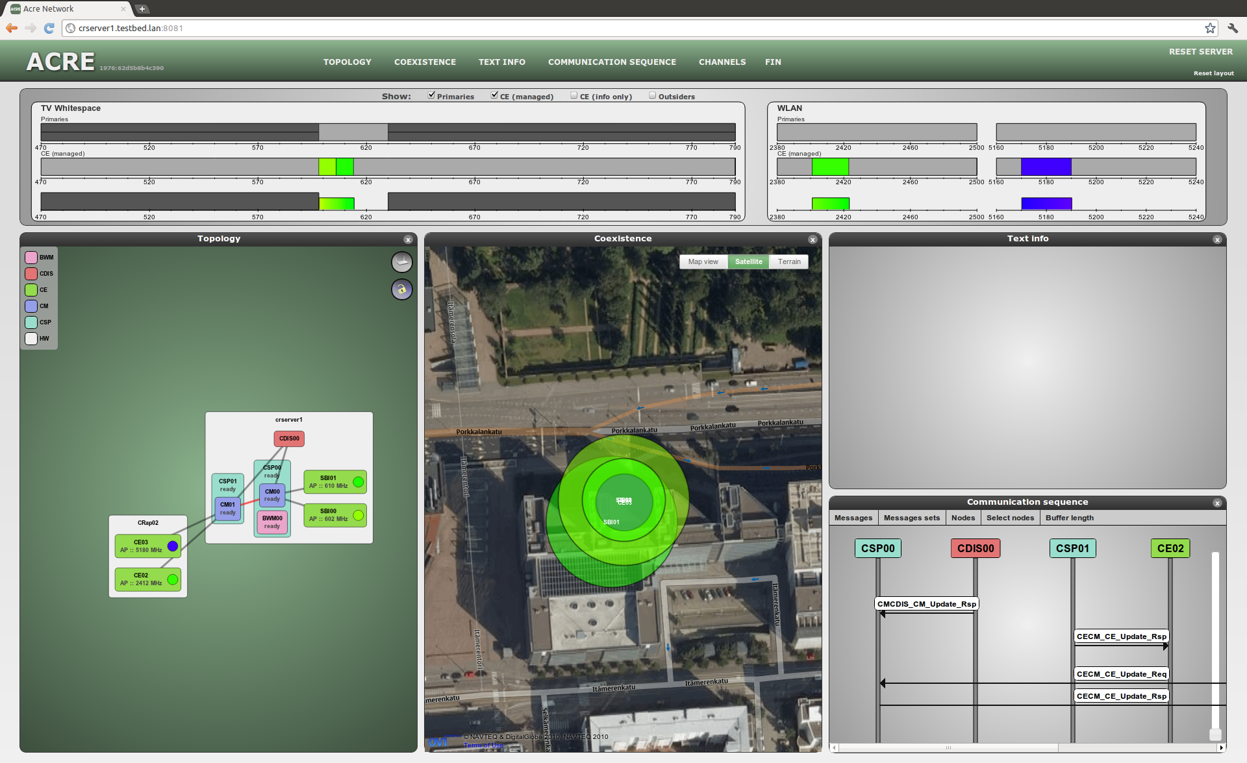
Visualization view 1

Slide 6
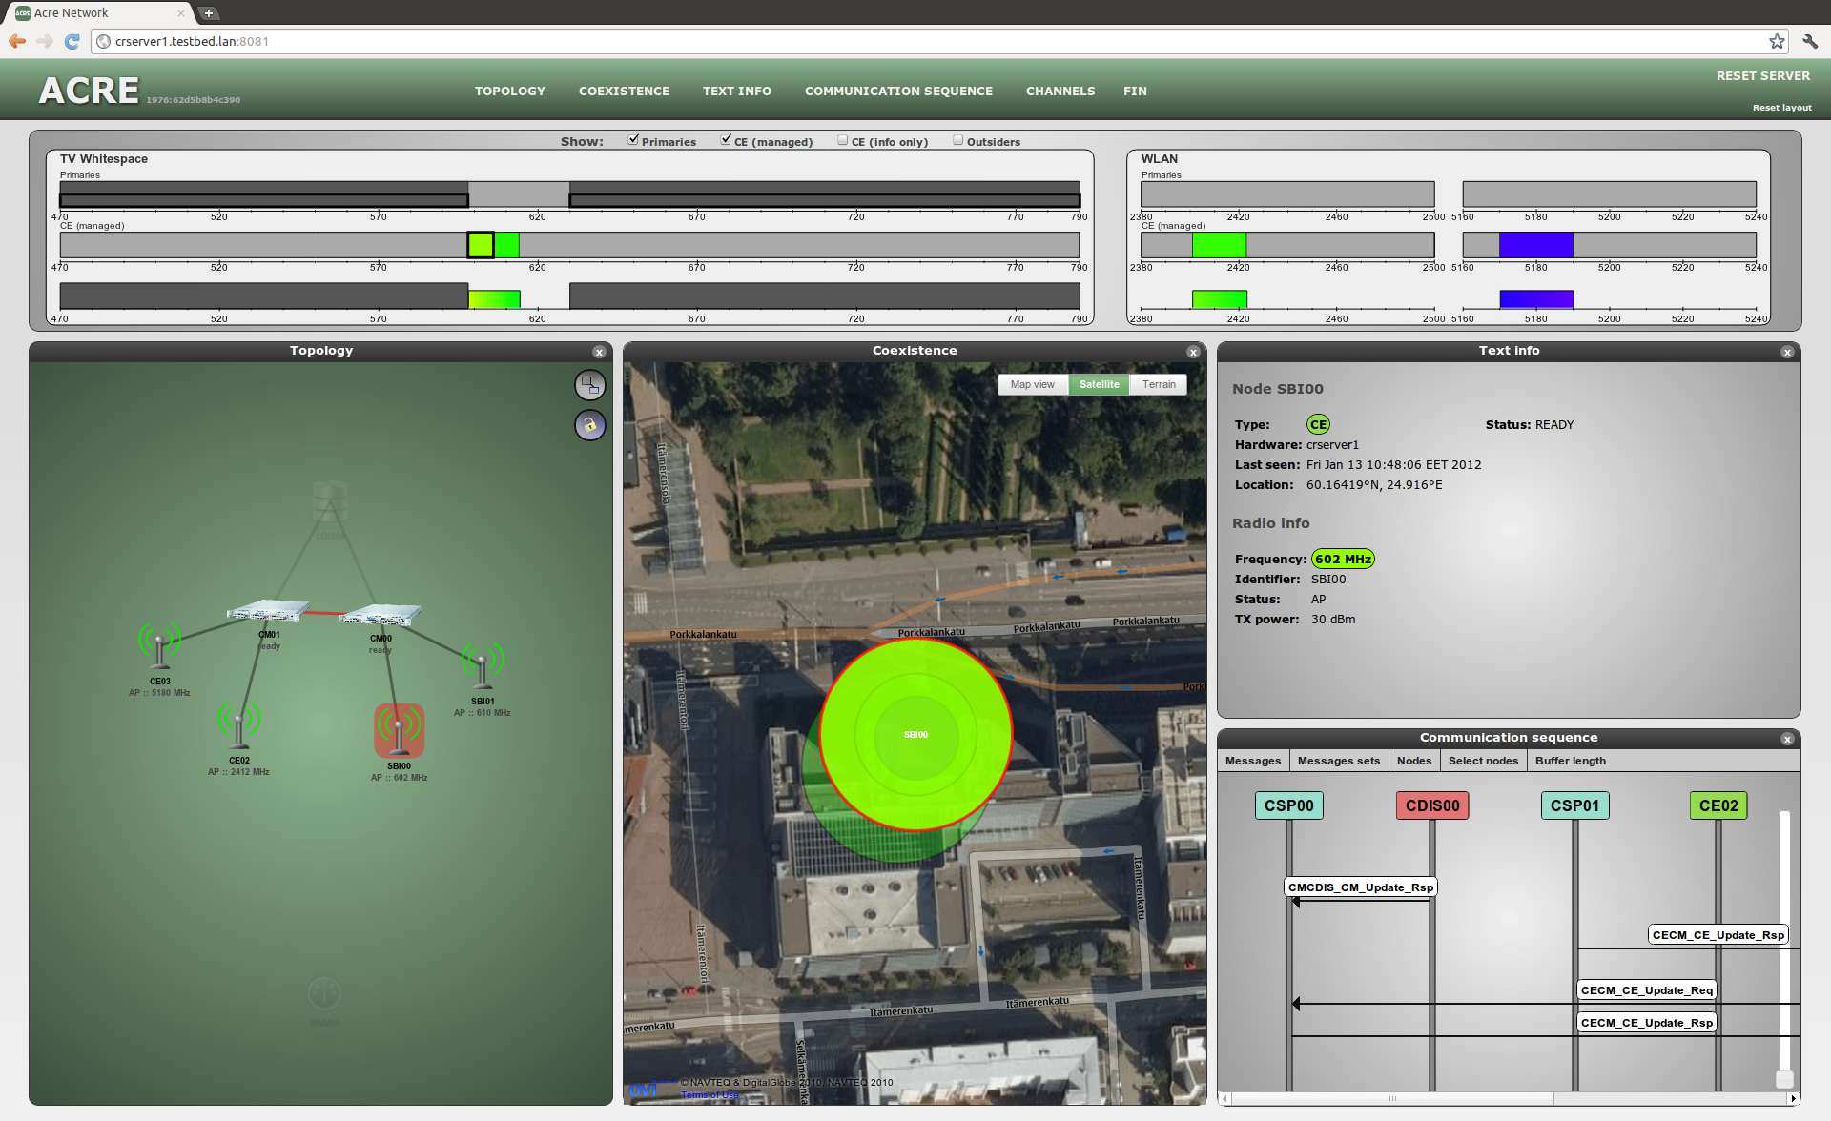
Visualization view 2

