Slide 1
IEEE 802.18 RR-TAG 2025 May Chair’s Opening Report
Date: 13 May 2025
Author:

Slide 2
RR-TAG at a glance
Membership as of 14 March 2025
65 voters (including 10 on LMSC)
6 nearly voters
14 aspirants
Officers
Chair: Edward Au (Huawei Technologies)
Co-Vice Chair: Gaurav Patwardhan (Hewlett Packard Enterprise)
Co-Vice Chair: Al Petrick (Jones-Petrick Associates)
Secretary: Chenhe Ji (Huawei Technologies)
IEEE SA Program Manager: Jodi Haasz (IEEE SA)

Slide 3
Progress since the 2025 March plenary
Reviewed the latest ongoing consultations
Approved the following IEEE 802 LMSC submissions:
Australia ACMA: Five-year spectrum outlook 2025–30 and 2025–26 work program
Lithuania RRT: Public survey on the prospects for the use of the radio frequency band 6425-7125 MHz
UK Ofcom: Proposals for AFC in Lower 6 GHz and mobile / Wi-Fi sharing in Upper 6 GHz
Australia ACMA: Remaking the low interference potential devices class licence
USA FCC: Promoting the Development of Positioning, Navigation, and Timing Technologies and Solutions (WT Docket No. 25-110)
Discussed the latest topics related to spectrum and regulation in Europe, North America, and Asia Pacific.

Slide 4
Objectives this week (1)
Review and approve draft responses to the following consultations:
Iraqi CMC: Draft regulation on Short Range Devices (SRD) and UWB
South Africa ICASA: Draft regulations on dynamic spectrum access and opportunistic spectrum management in the innovation spectrum 3800-4200 MHz and 5925-6425 MHz
South Africa ICASA: National radio frequency plan 2025 (NRFP)
Discuss the latest topics related to spectrum and regulation in Europe, North America, and Asia Pacific, including ETSI BRAN May 2025 update.

Slide 5
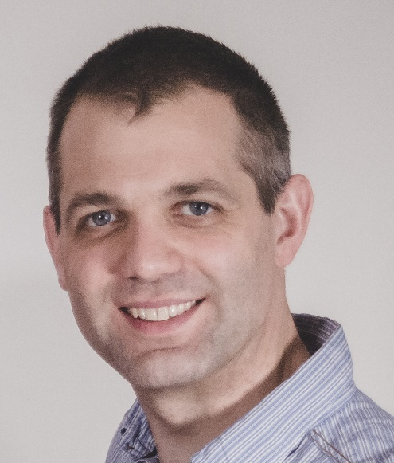
Objectives this week (2)
Invited presentation (bimonthly member enrichment activities)
Dr. Steve Leach (Principal Spectrum Engineer, Ofcom)
Moving forward with 6 GHz band for commercial mobile and Wi-Fi services: update on UK and CEPT progress
Abstract:
In February this year, Ofcom published its latest proposals to enable Wi-Fi and commercial mobile in the upper 6 GHz band and to expand access for Wi-Fi services in the Lower 6 GHz band in the UK. Steve will present the details of these proposals, which aim to provide early access for indoor Wi-Fi across the whole band as soon as possible whilst committing to introduce mobile at a later stage in at least part of the band. This talk will also cover the progress that has been made in CEPT on evaluating how Wi-Fi and mobile networks can share the Upper 6 GHz band. The resulting report is under public consultation and is intended to be finalised in June.
To facilitate shared use by both networks, it is likely that some enhanced sensing of mobile transmissions by Wi-Fi access points will be necessary. Steve will present the approaches currently in discussion in Europe and which the UK intends to align with once they are finalised – along with the implications for the 802.11 and 3gpp standardisation processes.
Finally Steve will offer his longer term views on how better integration between mobile and Wi-Fi networks could facilitate services for indoor users, through the use of protocols such as Open Roaming and Passpoint.
Source: Steve Leach

