Slide 1
IEEE 802.18 RR-TAG Tutorial
Date: 11 March 19
Authors:

Slide 2
Agenda
IEEE 802.18 – The RR-TAG
History / Charter
Regulatory / ETSI-FCC-Other Internationally
Global Regulators / WRC
License-exempt
Looking to the Future
Agenda

Slide 3
IEEE 802.18 – The Radio Regulatory Technical Advisory Group
IEEE 802 includes four wireless technology standards working groups
802.11 Wireless Local Area Networks (WLAN)
802.15 Wireless Specialty Networks (WSN)
802.16 Wireless Metropolitan Area Networks (WMAN)
Hibernating
802.22 Wireless Regional Area Networks (WRAN)
These groups develop the standards that drive the development of wireless technologies operating in Radio Frequency (RF) spectrum
Use of the RF spectrum is regulated by governmental bodies to protect licensed and authorized license-exempt users
IEEE 802.18 provides guidance for the standards development process, and works with government regulators to ensure that spectrum is available to support the technologies based on the standards

Slide 4
History
The TAG was started in January 2002 by Vic Hayes, with its first formal meeting in July of the same year
Charter approved in March 2002 (see next slide)
Chair was Carl Stevenson (Agere)
Originally focusing on the upcoming 2003 World Radiocommunication Conference (WRC-03)

Slide 5
Charter for the RR-TAG Approved during Formation
To encourage collaborative participation in the radio regulatory process by members of the TAG including official representatives from the relevant Working Groups
To prepare, review, and submit balanced position statements on radio regulatory matters for those Working Groups responsible for producing standards for radio devices and to fairly reflect all points of view
To serve as the official communications channel between the 802 WGs and TAGs and other standards and industry bodies on radio regulatory matters
To liaise and seek cooperative relationships on radio regulatory matters of mutual interest with other standards and industry bodies
To serve as the official communications channel between the 802 WGs and TAGs and regulatory agencies and spectrum management bodies
To establish and maintain contacts within, and understand the processes for interaction with, radio regulatory and spectrum management bodies
To liaise with such co-existence groups as may exist in the 802 domain on radio regulatory matters

Slide 6
Regulatory
Regulations are specific to countries and regions
In general terms, regulations of the Europe (ETSI) and the US (FCC) are the model for many national regulations
As wireless device transmissions do not obey national boundaries, the International Telecommunications Union (ITU) makes rules and negotiates treaties to deal with regulatory difference between bordering countries, and provides Recommendations to guide global harmonization

Slide 7
ETSI / FCC / Other-based versus World Economies
 | World | 151,081 | 131%
Rank | Country | 2020($B) | from 2015 | Focus Stds
1 | China | 29,713 | 150% | ETSI
2 | United States | 22,289 | 122% | FCC
3 | India | 12,531 | 156% | ETSI
4 | Japan | 5,935 | 115% | Other
5 | Germany | 4,716 | 121% | ETSI
6 | Russia | 4,508 | 117% | Other
7 | Indonesia | 4,023 | 141% | Other
8 | Brazil | 3,673 | 114% | FCC
9 | United Kingdom | 3,253 | 119% | ETSI
10 | France | 3,189 | 119% | ETSI
11 | Mexico | 2,823 | 124% | FCC
12 | Italy | 2,543 | 116% | ETSI
13 | Turkey | 2,480 | 130% | ETSI
14 | Korea | 2,348 | 126% | FCC
15 | Spain | 2,024 | 125% | ETSI
16 | Saudi Arabia | 2,017 | 118% | ETSI
17 | Canada | 2,003 | 122% | FCC
18 | Islamic Republic of Iran | 1,676 | 123% | ETSI
19 | Egypt | 1,507 | 140% | ETSI
20 | Thailand | 1,483 | 133% | FCC
21 | Australia | 1,448 | 125% | Other
Estimates from 2015 to 2020, for the top 21 countries for GDP:
These characterizations for the regulatory bodies are with more focus on regulations for RLANs, as it was a few years ago.
Other indicates mixture of regulations; much their own, though maybe some ETSI, FCC or from others.
65,650 | ETSI | 57%
34,620 | FCC | 30%
15,914 | Other | 14%
116,184 | total | 100%
*IMF Projected - http://www.imf.org/external/pubs/ft/weo/2018/02/weodata/index.aspx

Slide 8
ETSI / FCC / Other-based versus World Economies
 | World | 177,424 | 131%
Rank | Country | 2023($B) | from 2018 | Focus Stds
1 | China | 37,198 | 147% | Other
2 | United States | 24,671 | 120% | FCC
3 | India | 16,575 | 159% | Other
4 | Japan | 6,380 | 113% | Other
5 | Germany | 5,184 | 118% | ETSI
6 | Indonesia | 4,969 | 142% | Other
7 | Russia | 4,966 | 119% | Other
8 | Brazil | 4,149 | 123% | FCC
9 | United Kingdom | 3,609 | 119% | ETSI
10 | France | 3,541 | 119% | ETSI
11 | Mexico | 3,256 | 126% | FCC
12 | Turkey | 2,808 | 121% | ETSI
13 | Italy | 2,748 | 115% | ETSI
14 | Korea | 2,690 | 126% | FCC
15 | Saudi Arabia | 2,277 | 123% | ETSI
16 | Spain | 2,249 | 120% | ETSI
17 | Canada | 2,227 | 120% | FCC
18 | Egypt | 1,897 | 146% | ETSI
19 | Islamic Republic of Iran | 1,885 | 114% | ETSI
20 | Thailand | 1,741 | 132% | FCC
21 | Australia | 1,654 | 125% | Other
Estimates from 2018 to 2023, for the top 21 countries for GDP:
Now, the characterizations are somewhat broaden with IoT and other wireless devices.
(Bolded %s indicates above the world’s average growth.)
26,199 | ETSI | 19%
38,732 | FCC | 28%
71,741 | Other | 52%
136,673 | total | 100%
*IMF Projected - http://www.imf.org/external/pubs/ft/weo/2018/02/weodata/index.aspx

Slide 9
ETSI vs FCC vs Other
Estimates

Slide 10
Global Radio Regulators
The International Telecommunications Union (ITU)
Asia-Pacific Telecommunity (APT)
Arab Spectrum Management Group (ASMG)
African Telecommunications Union (ATU)
European Conference of Postal and Telecommunications Administrations (CEPT)
Inter-American Telecommunications Commission (CITEL)
[Russia] Regional Commonwealth in the Field of Communications (RCC)
[USA]Federal Communications Commission (FCC)
[UK] Office of Communication (Ofcom)

Slide 11
ITU-R Recommendations
ITU-R Recommendations constitute a set of international technical standards developed by the Radiocommunication Sector (formerly CCIR) of the ITU. They are the result of studies undertaken by Radiocommunication Study Groups
ITU-R Recommendations are approved by ITU Member States. Their implementation is not mandatory; however, as they are developed by experts from administrations, operators, the industry and other organizations dealing with radiocommunication matters from all over the world, they enjoy a high reputation and are implemented worldwide.
An example: WRC-2003 opened segments of the 5 GHz band, yet even today parts of the world still have not enabled them

Slide 12
World Radio Conferences
World Radiocommunication Conferences (WRC) are held every three to four years to review, and, if necessary, revise the Radio Regulations, the international treaty governing the use of the radio-frequency spectrum and the geostationary-satellite and non-geostationary-satellite orbits
The general scope of the agenda of world radiocommunication conferences is established four to six years in advance, with the final agenda set by the ITU Council two years before the conference, with the concurrence of a majority of Member States
This year is the next WRC,
World Radiocommunication Conference 2019 (WRC-19), Sharm el-Sheikh, Egypt, 28 October to 22 November 2019
https://www.itu.int/en/ITU-R/conferences/wrc/2019/Pages/default.aspx

Slide 13
World Radio Conference - 2019
Last year IEEE 802.18 put together IEEE 802 viewpoints on WRC-19 Agenda Items that relate to current IEEE 802 standards activity.
https://mentor.ieee.org/802.18/dcn/17/18-17-0073-07-0000-ieee-802-viewpoints-on-wrc-19-agenda-items.pptx
AI 1.12 ITS Harmonization
AI 1.13 IMT
AI 1.15 275 GHz
AI 1.16 5 GHz
AI 9.1 RLAN operation with new radar systems
AI 10 Consideration for WRC-23
Have added – Would like to not see any 6GHz actions in WRC-23.

Slide 14
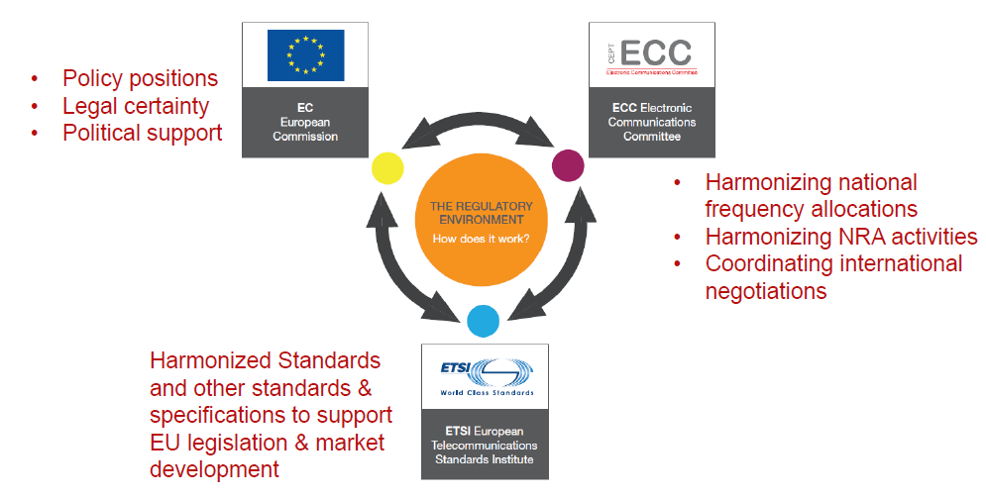
EU Environment for Radio Equipment & Spectrum
We monitor Frequency Management and Spectrum Engineering as a prelude to regulations, via IEEE 802.18
Our primary focus is ETSI, where the regulations are written

Slide 15
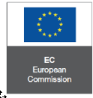
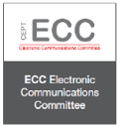
EMEA
European Commission (EC)
Directives
Mandates
CEPT
48 European countries cooperating to regulate posts, radio, spectrum and communications networks
ECC
The ECC considers and develops policies on electronic communications activities in European context, taking account of European and international legislations and regulations
ETSI
ETSI, the European Telecommunications Standards Institute, produces globally-applicable standards for Information and Communications Technologies (ICT), including fixed, mobile, radio, converged, broadcast and Internet technologies.

Slide 16
EMEA - EU – More on ECC and ETSI
Electronic Communications Committee
Conference Preparatory Group (CPG)
Working Group Frequency Management (WGFM)
Working Group Spectrum Engineering (WGSE)
European Telecommunications Standards Institute
Develop and revise Harmonised Standards / European Norms (ENs)
EMC and Radio Spectrum Matters (ERM)
EN 300 220 (<1 GHz)
EN 300 328 (2.4 GHz)
Broadband Radio Access Networks (BRAN)
EN 301 598 (TVWS)
EN 301 893 (5 GHz)
EN 302 567 (60 GHz)
Regulations adopted by regulatory domains around the world

Slide 17
EMEA - Others
Ofcomm
The Office of Communications commonly known as Ofcom, is the UK government-approved regulatory and competition authority for the broadcasting, telecommunications and postal industries of the United Kingdom.
Ofcom has wide-ranging powers across the television, radio, telecoms and postal sectors. It has a statutory duty to represent the interests of citizens and consumers by promoting competition and protecting the public from harmful or offensive material.
Some of the main areas Ofcom presides over are licensing, research, codes and policies, complaints, competition and protecting the radio spectrum from abuse (e.g. pirate radio stations).
The regulator was initially established by the Office of Communications Act 2002 and received its full authority from the Communications Act 2003.

Slide 18
EMEA - Others
ASMG
The Arab Spectrum Management Group was established in 1997 to cooperate in the field of Spectrum Management by sharing and exchanging views on the emerging radio communication aspects as well as to manage and coordinate all issues related to Spectrum Management, World Radiocommunications Conferences and other spectrum matters between Arab States
22 member ASMG countries
ATU
Founded in Kinshasa in 1977 as a specialized agency of the Organization of African Unity (OAU) now African Union (AU) in the field of telecommunications, ATU is the leading continental organization fostering developments of information and communications technologies infrastructure and services.

Slide 19
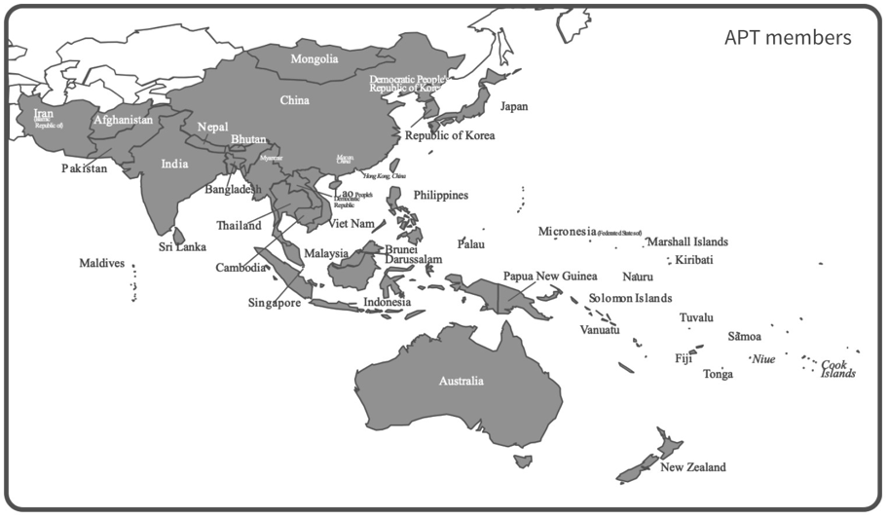
APAC
APT Wireless Group
The APT is an intergovernmental organization that operates in conjunction with telecom service providers, manufacturers of communications equipment, and research and development organizations active in the field of communication, information and innovation technologies
Established in 1979,
HQ in Bangkok, Thailand
38 member APAC countries,
4 Associate Members and
130 Affiliate Members (Private sector)

Slide 20
Americas – CITEL and FCC
CITEL Vision
The full integration of the American States into the Global Information Society, with a view to enabling and accelerating social, economic and environmentally sustainable development for all the region’s inhabitants through the development of telecommunications and information and communication technologies (ICTs).
CITEL Mission
To facilitate and promote the integral and sustainable development of interoperable, innovative and reliable telecommunications/ICTs in the Americas, under the principles of universality, equity and affordability.

Slide 21
Americas - FCC
The Federal Communications Commission regulates non-government interstate and international communications by radio, television, wire, satellite and cable in all 50 states, the District of Columbia and U.S. territories. An independent U.S. government agency overseen by Congress, the commission is the United States primary authority for communications law, regulation and technological innovation. In its work facing economic opportunities and challenges associated with rapidly evolving advances in global communications.
Chairman and four Commissioners
Political appointees (generally Republican and Democrats)
The OET - Office of Engineering Technology provides technical advice (many other offices)
Technical Certification Bodies (TCBs) now test and review equipment compliance test data (not the FCC themselves)
https://www.fcc.gov/about/overview
Developing rules, high level process:
Notice of Inquiry (NOI) usually starts the process; general information gathering
Notice of Proposed Rule Making (NPRM) specific questions for public comment
(Further NPRM if needed, i.e. need more information)
Report & Order (R&O) includes wording for the Code of Federal Regulations (CFR)
(Second R&O if needed)

Slide 22
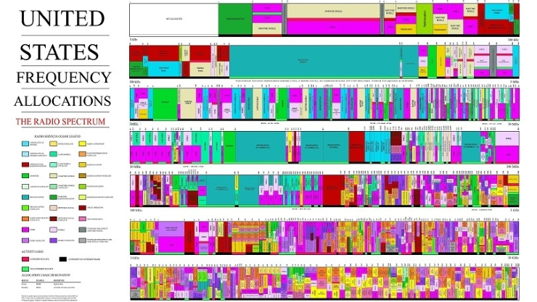
The US Frequency Chart
Unallocated spectrum is in white, to show the spectrum crunch is here.
3-9kHz

Slide 23
Spectrum Sharing Is Here
Regulators worldwide know that with spectrum being a finite resource, changes are needed to support the future
Spectrum efficiency is now a critical factor
Going from not using to using is the biggest change in efficiency.
TV White Spaces (TVWS)
Many countries using TVWS, expanding TVWS or looking at TVWS.
USA, UK, Canada, Columbia, Jamaica, Namibia, Philippines, Singapore, South Africa, Thailand to name just a few.
Response time/demand is shorter, what makes TVWS unique.
Data Base use to aid in sharing is growing
Government versus private
Privacy of the data in the data base is being questioned
Other sharing technologies continue to emerge, sensing, beacons, etc.

Slide 24
The License-exempt (Unlicensed) Bands
433 MHz
Very narrow
863 – 876 MHz
Mostly in the EU
900 MHz (ISM) bands
US: 902-928 MHz
Intl: 915-921 or 928 or xxx MHz
2400-2483.5 MHz (ISM) band
US: 1W EIRP
EU: 100mW ERP
3550-3700 MHz band (US only) –
Citizen Band Radio Service (CBRS)
licensed by rule
General Authorized Access 3-level sharing with incumbents and Priority Access Licensees
5150-5250 MHz band (US U-NII-1)
EU: Low power, indoor only
US: 1W EIRP, 125mW EIRP outdoor max above 30 degrees
5250-5350 MHz band (US U-NII-2a)
DFS required
5470-5725 MHz band (US U-NII-2c)
5725-5850 MHz band (US U-NII-3)
US: 4W+ EIRP
EU: 25mW SRD
57 – 71 GHz
Country specific

Slide 25
More on License-Exempt and IoT
Relatively narrow-band technologies have other options
Parts of the 800-900 MHz band are available in some regions for unlicensed use
EU 863-870 MHz low duty cycle, low power, some specific applications, evolving
US 902-928 MHz,
EU 915-921 MHz bandwidth (600kHz) and duty cycle (1%) limits
Spotty availability globally, though growing rapidly
SigFox Ultra Narrow Band for low bit-rate (~5kbps), long range communications
Primarily EU in 868 MHz band
LoRaWAN long range low power applications
Sensor networks
Short Range Devices (SRDs)
Wide variety of use cases
European REC 70-03 with license-exempt availability is constantly being updated
TV White Spaces (IEEE 802.11af, 802.22)
Use of “white spaces” between TV channels, hampered by no global standard for TV spectrum, regulators consideration for LTE auction revenues
Backhaul where broadcast TV is sparse, e.g. developing countries, US farmland

Slide 26
Looking to the Future
US and EU studying license-exempt sharing of the 6 GHz band
FCC looking at 5925-7125 MHz (Extremely Active NPRM now….)
ETSI/CEPT-WGFM/WGSE looking at 5925-6425 MHz (Also extremely active)
US legislation proposing 3700-4200 MHz band
Wireless applications continue to grow unabated
Old rules and allocations must be reviewed
Better and more sharing methods must be explored and are being explored
“Internet access for all” still billions short of its goal
Wireless backhaul is the only option in many regions
IEEE 802.18 will continue to support the standardization for all of the wireless LAN/MAN technologies
Fairness in the use of spectrum
Outreach with regulators to drive the needed actions

Slide 27
Questions?
Thank You
Acknowledgement:
Some of the material in this presentation is from March 2018 Tutorial given by Rich Kennedy of Unlicensed Spectrum Advocates.

Slide 28
Other

Slide 29
Sunday Welcome – 1 of 2 802.18 Radio Regulatory Technical Advisory Group
Represents IEEE 802 as the leader in wireless access networking Standards development
Provide regulators with roadmap and rationale of new standards work
Develop a relationship with regulators that encourages dialogs, both formal and informal
Develop common 802 positions, accommodating differences among 802 subgroups, as feasible in accordance with deadlines
Draft regulatory inputs on topics involving multiple Working Groups
Provide regulators with IEEE 802 comments/feedback to their request for comments, consultations, rule making and etc.
To support the Radio Regulatory Mission, Working Groups can notify the Radio Regulatory TAG of relevant regulatory inquiries, activities and timelines as they become aware of them also.

Slide 30
Sunday Welcome – 2 of 2 802.18 Radio Regulatory Technical Advisory Group
Internal communication, from the RR-TAG
Notifies Working Groups of relevant regulatory inquiries, activities and timelines
Notification is made as information becomes available rather than based on meeting schedule
Provides a forum that encourages Working Groups to promptly contribute and discuss regulatory issues and activities
Provides expert advice to improve Working Group positions during review
This week:
Monday, AM2 – 802.18 Tutorial – Windsor, 3rd floor
Tuesday, AM2 – RR-TAG opening session – Plaza A, 2nd floor
Thursday, AM1 – RR-TAG closing session – Plaza A, 2nd floor
Agenda this week for 802.18 as of putting this slide together.
No active comments being worked on
Members share what is the latest in EU regulation activities,
For example ETSI BRAN and ERM TG-11, and in CEPT SE45 and FM57.
General open discussion items:
E.g. FCC NPRM on 6GHz, Ofcom consultation, DSRC analysis, etc.
Activities since the January face to face

Slide 31
Backup – or out of date

