Slide 1
IEEE 802.18 RR-TAG Vancouver Meeting DRAFT Agenda
Date: 2017-03-14
2017-03-16
Authors:

Slide 2
Agenda
Approve Atlanta minutes
Discussion items
Regulatory work in progress
Status of completed work
Actions required
ISED (Canada) 5150-5250 MHz consultation
Ofcom 5.8 GHz proposal
Advancing the 6 GHz effort in the US and EU
AOB and Adjourn
Agenda

Slide 3
Administrative Items
Required notices
Affiliation FAQ - http://standards.ieee.org/faqs/affiliationFAQ.html
Anti-Trust FAQ - http://standards.ieee.org/resources/antitrust-guidelines.pdf
Ethics - http://www.ieee.org/portal/cms_docs/about/CoE_poster.pdf
IEEE 802 WG Policies and Procedures - http://www.ieee802.org/devdocs.shtml
Officers
Chair is Rich Kennedy (HP Enterprise)
Vice-chair is Jay Holcomb (Itron) and Acting Chair for this meeting
Secretary: Allan Zhu (Huawei)

Slide 4
Other Guidelines for IEEE WG Meetings
All IEEE-SA standards meetings shall be conducted in compliance with all applicable laws, including antitrust and competition laws.
Don’t discuss the interpretation, validity, or essentiality of patents/patent claims.
Don’t discuss specific license rates, terms, or conditions.
Relative costs, including licensing costs of essential patent claims, of different technical approaches may be discussed in standards development meetings.
Technical considerations remain primary focus
Don’t discuss or engage in the fixing of product prices, allocation of customers, or division of sales markets.
Don’t discuss the status or substance of ongoing or threatened litigation.
Don’t be silent if inappropriate topics are discussed … do formally object.
---------------------------------------------------------------
See IEEE-SA Standards Board Operations Manual, clause 5.3.10 and “Promoting Competition and Innovation: What You Need to Know about the IEEE Standards Association's Antitrust and Competition Policy” for more details.
Notes:
4

Slide 5
Approve the Atlanta Minutes
Motion: To approve the minutes from the IEEE 802.18 meeting at the Atlanta Wireless Interim in document 18-17/0042r0.
Posted: 10-Mar-2017 12:03:13 ET
Moved by:
Seconded by:
Discussion?
Vote: Unanimous consent

Slide 6
Discussion Items
FCC
EU
Other Regulatory
ITU-R Liaisons

Slide 7
FCC Updates
Amtrak waiver request (IEEE 802 filed comments)
High power for trackside networks in the Northeast corridor
DSRC testing still in phase 1
Now 2 months behind schedule
5350-5470 MHz band closed to unlicensed sharing
Final blow to contiguous 5 GHz band
TVWS resurgence following close of Incentive Auction

Slide 8
EU Updates
ECC approves WGFM sharing study in 5925-6425 MHz band
Will be done in SE24
ETSI BRAN looking to do Technical Report
Ofcom 5725-5850 MHz band proposal
See Action Items
EU Radio Equipment Directive & standards updates
CPG PT-D working towards WRC-19
EUMETNET request to close 5600-5650 MHz
No DFS or technology failure
Enforcement issue should not harm users

Slide 9
EU Radio Equipment Directive (RED)
The transition has already started
RED in THE LAW as of June 13, 2016
R&TTE expires June 12, 2017
After June 2017, all devices must meet the RED requirements, i.e. R&TTE certifications during the transition must be re-certified
Following the deadline, ALL equipment to be placed on the EU market must meet the RED provisions
EN 300 328 published in the OJEU!
It appears that EN 301 893 will not be not published in time
EC has NOT approved use of v1.8.1 with note that v2.0.7 Receiver Requirements must also be met
Passed ENAP; official publication date in August 19th, but could happen sooner

Slide 10
Other Regulatory
Canada
See Action Items
Mexico
http://www.ift.org.mx/industria/consultas-publicas/consulta-publica-sobre-el-anteproyecto-de-clasificacion-de-la-banda-de-57-64-ghz-como-espectro-libre
Documento en Consulta Pública: Anteproyecto de clasificación de la banda de 60 GHz como espectro libre
Harmonization of 57-64 GHz with US rules
Includes ITS in 63-64 GHz

Slide 11
ITU-R Liaisons
18-17-0043 - LIAISON STATEMENT TO EXTERNAL ORGANIZATIONS ON THE SCHEDULE FOR UPDATING RECOMMENDATION ITU-R M.1457 TO REVISION 14 – This recommendation is titled “Detailed specifications of the terrestrial radio interfaces of International Mobile Telecommunications-2000 (IMT-2000)”. The current revision is number 13 and this is asking for contributions for the update to Revision 14. The next WP5D meeting begins June 13th in Niagara Falls, Ontario, Canada.
18-17-0044 - Further information on the invitation for submission of proposals for candidate radio interface technologies for the terrestrial components of the radio interface(s) for IMT-2020 and invitation to participate in their subsequent evaluation – This liaison is to bring attention to Addendum 1 to Circular Letter 5/LCCE/59 which was issued to announce the availability of further relevant information including the availability of Document IMT-2020/2 - Submission and evaluation process and consensus building for IMT-2020. Those interested in the development of IMT-2020 (aka 5G) will have an interest in this effort.

Slide 12
ITU-R Liaisons [2]
18-17-0045 - ITU-R WORKING PARTY 5D WORKSHOP ON IMT-2020 – The invitation for submission of proposals for candidate radio interface technologies for the terrestrial components of IMT-2020 was issued with Circular Letter 5/LCCE/59 by ITU-R on 22 March 2016. This liaison provides the date for that workshop (October 4th) which is to be held at an as yet undetermined location in Germany.
18-17-0047 - CONSOLIDATION OF REPORTS FROM THE WORKING GROUPS OF WORKING PARTY 5A – It provides a summary of current WP5A activity. It provides a summary of the work currently being done in WP5A which deals with mobile communications other than IMT. Topics include train to rail side communications and the millimetric frequency range.

Slide 13
Actions Required
ISED (Canada) Consultation
Comments for Ofcom 5.8 GHz band proposal
Support for unlicensed sharing in 6 GHz
IEEE 802 positions for WRC-19

Slide 14
ISED (Canada) Consultation
ISED Consultation.pdf
Comments due March 29, 2017
Whether to modify the current technical and policy framework for radio local area network (RLAN) devices operating in the 5150-5250 MHz frequency band now, or wait for the results in WRC-19
Harmonizing with the US changes

Slide 15
Ofcom 5.8 GHz Band Proposal
May 2016 consultation: https://www.ofcom.org.uk/__data/assets/pdf_file/0037/79777/improving-spectrum-access-consumers-5ghz.pdf
Statement: https://www.ofcom.org.uk/__data/assets/pdf_file/0032/98159/5p8-Regs.pdf
Comments due April 11th, 2017

Slide 16
Unlicensed Sharing of the 6 GHz Band
Wi-Fi volume growth and technology advancement are hampered by lack of significant 80 and 160 MHz channels
The (near) future demands gigabit speeds to avoid becoming the bottleneck
Sharing with FSS and fixed microwave links
Industry coalition to drive needed regulatory changes
Joint exploration of the 5925-7250 MHz with the intent of obtaining an unlicensed designation
Joint funding of third parties and engineering support to conduct interference analyses (incl. spectrum measurements, sharing studies, and potential mitigations) in support of unlicensed designation
Joint exploration of mitigation techniques and proposals, which may require standards contributions
Drive regulatory changes in the US, EU and globally

Slide 17
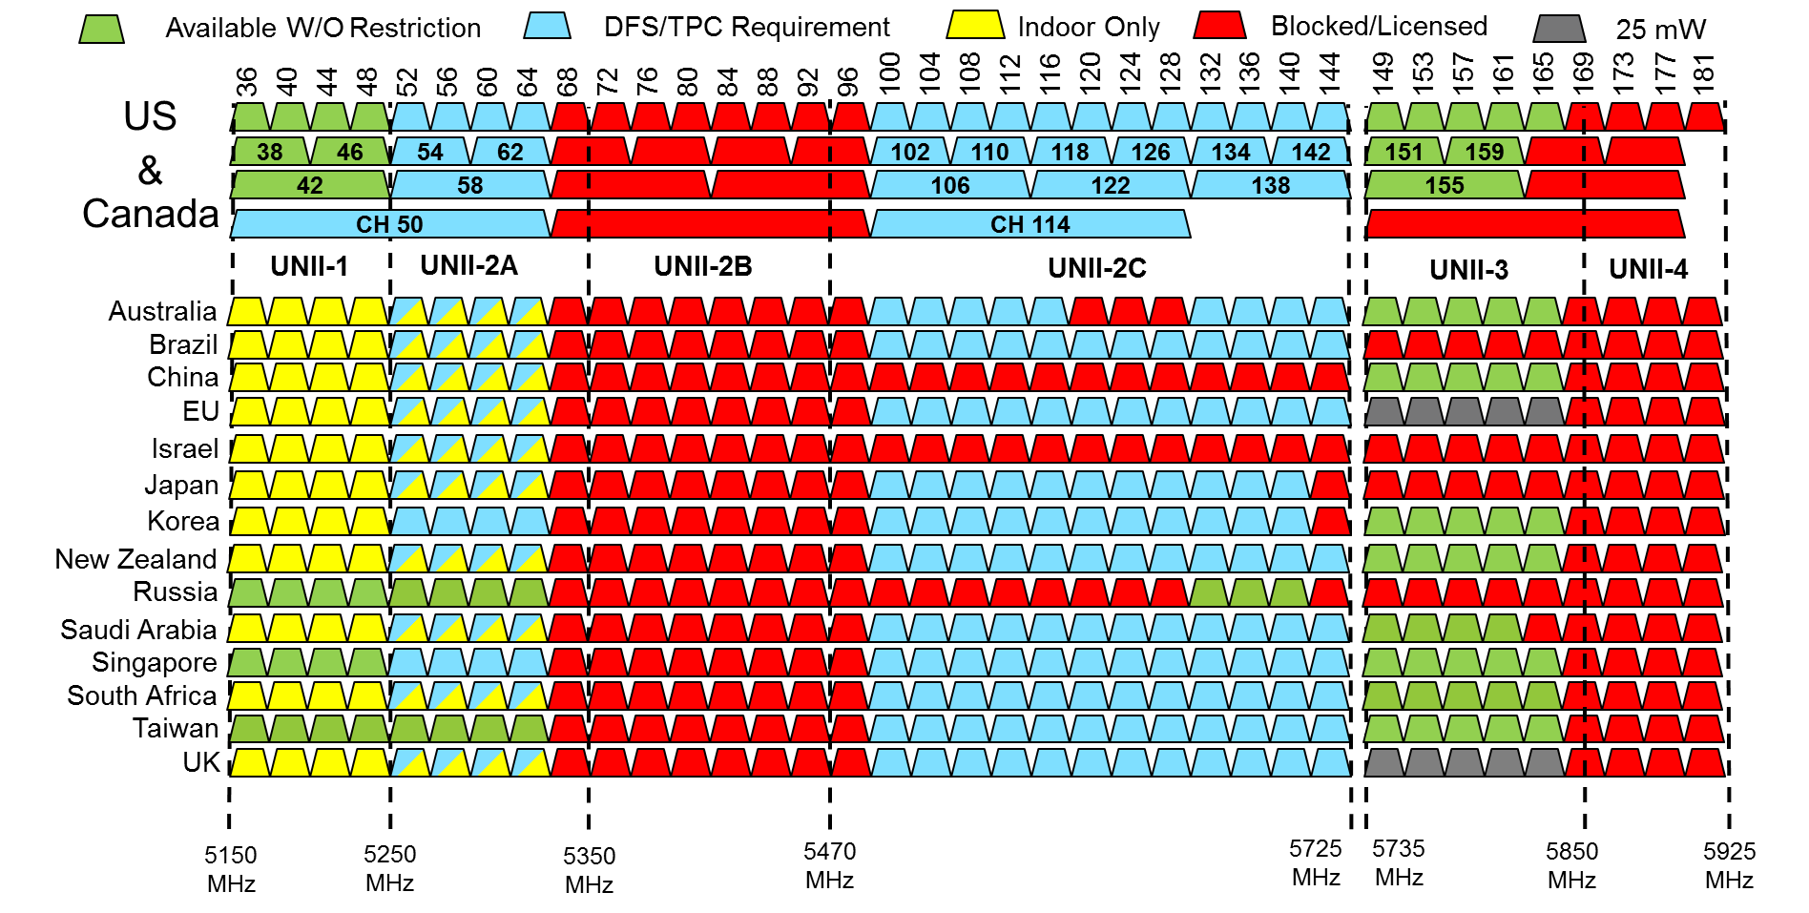
Disappointing 5 GHz Landscape
?

Slide 18
Terahertz Responses

Slide 19
IEEE 802 positions for WRC-19
Regulators in developing countries are interested in the IEEE 802 positions, to help them formulate their inputs
Applicable agenda items
1.12 ITS harmonization
1.13 IMT
1.14 HAPS
1.15 275 GHz
1.16 5 GHz
Issue 9.1.5
Formal “Position Paper”
Do we want to submit as a sector member

Slide 20
Thursday Agenda
Review and approve the agenda
Review the week
Possible actions
Actions required
…
AOB and Adjourn

Slide 21
Any Other Business
Teleconferences: Thursdays at 2:30pm ET through xxx
Next Teleconference: March 29th

