Slide 1
802.16 Working Group Treasurer’s Report - Session #100
[IEEE 802.16 Mentor Presentation Template (Rev. 0)]
Document Number:
IEEE 802. 16-15-0046-00-Gcon
Date Submitted:
11 November 2015
Source:
Tim Godfrey Voice:
EPRI E-mail:
*<http://standards.ieee.org/faqs/affiliationFAQ.html>
Re:
Base Contribution:
N/A
Purpose:
Session #100 Working Group Treasurer Report (November 2015)
Notice:
This document does not represent the agreed views of the IEEE 802.16 Working Group or any of its subgroups. It represents only the views of the participants listed in the “Source(s)” field above. It is offered as a basis for discussion. It is not binding on the contributor(s), who reserve(s) the right to add, amend or withdraw material contained herein.
Copyright Policy:
The contributor is familiar with the IEEE-SA Copyright Policy <http://standards.ieee.org/IPR/copyrightpolicy.html>.
Patent Policy:
The contributor is familiar with the IEEE-SA Patent Policy and Procedures:
<http://standards.ieee.org/guides/bylaws/sect6-7.html#6> and <http://standards.ieee.org/guides/opman/sect6.html#6.3>.
Further information is located at <http://standards.ieee.org/board/pat/pat-material.html> and <http://standards.ieee.org/board/pat >.

Slide 2
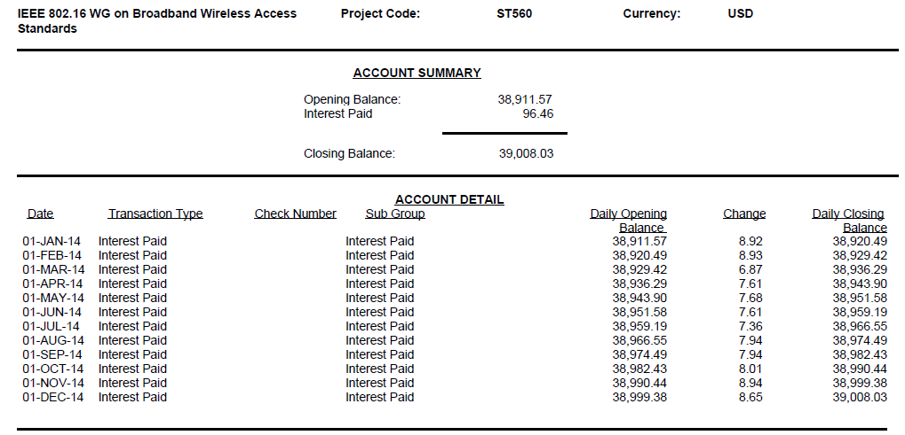
2014 Transactions Summary
Closing Balance at end of 2014 $39,008.03

Slide 3
2015 year to date

Slide 4
Summary
No account activity other than interest
Balance at November 2015 Plenary: $39,068.80
November 2015 Interest is not posted in account as of November 13, 2015

