Slide 1
Project: IEEE P802.15 Working Group for Wireless Personal Area Networks (WPANs)
Submission Title: [Simulation Results of our Implementation of the Long Range Mode]
Date Submitted: [21 October, 2025]
Source: [Joerg ROBERT] Company [FAU Erlangen-Nuernberg/ Fraunhofer IIS]
Address []
Voice:[], FAX: [], E-Mail:[Joerg.Robert@ieee.org]
Re: []
Abstract: []
Purpose: [Presentation in TG 802.15.4ad telephone call]
Notice: This document has been prepared to assist the IEEE P802.15. It is offered as a basis for discussion and is not binding on the contributing individual(s) or organization(s). The material in this document is subject to change in form and content after further study. The contributor(s) reserve(s) the right to add, amend or withdraw material contained herein.
Release: The contributor acknowledges and accepts that this contribution becomes the property of IEEE and may be made publicly available by P802.15.

Slide 2
Simulation Results of our Implementation of the Long Range Mode
Joerg Robert (FAU/Fraunhofer IIS)

Slide 3
Motivation
The group agreed on a baseline for the LR-OFDM mode
In this presentation I will present simulation results of the OFDM LR-Mode proposal of the University of Kyoto (DCN 15-25-0496-00, pp. 11-12)
The intention of the simulation results is a cross check of the simulation environments
For all simulations I assume perfect synchronization
The noise figure is F=0 with thermal noise power spectral density of -174dBm-Hz

Slide 4
Simulation Results for 1.2 MHz Channel Bandwidth
The first simulation results assume the LR-mode with 1.2MHz bandwidth, FFT size N=128, I=104 active sub-carriers (only one is actually used at a time)
The frequency interleaver is the frequency interleaver proposed by TI (this makes no difference here, because only AWGN)
The decoder is the differential decoder (Python code in 15-25-0199-00, p. 5), which does not require any channel estimation
For the SF modes, the LLRs of the decoder are summed

Slide 5
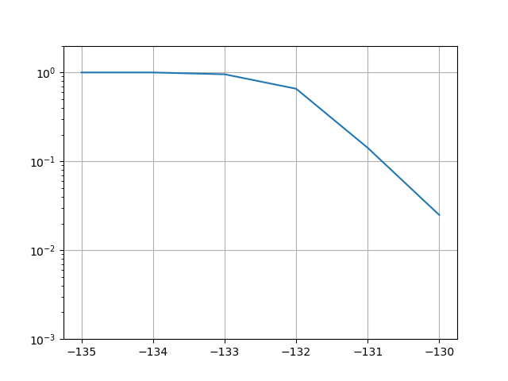
Mode MCS3: BL=8, SF=1
We require around -130dBm for 1% PER and -131dBm for 10% PER
This mode does not work for FCC
PER
P_RX in [dBm]

Slide 6
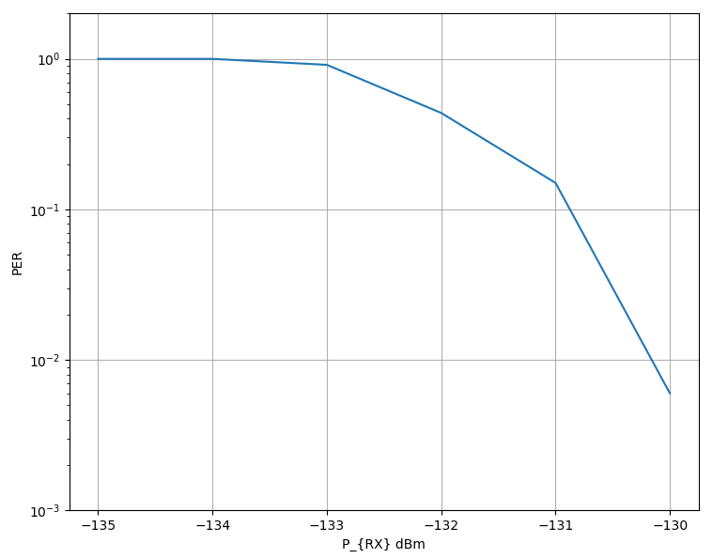
Results of Original TI Proposal
These are the simulation results of the original TI proposal in 15-25-0136-00, p.6
The would correspond to BL=1, SF1
They ideally overlap MCS3, but have 50% less throughout due to the higher pilot overhead (1pilot, 1 payload) instead of (1 pilot, 8 payload for MCS3)

Slide 7
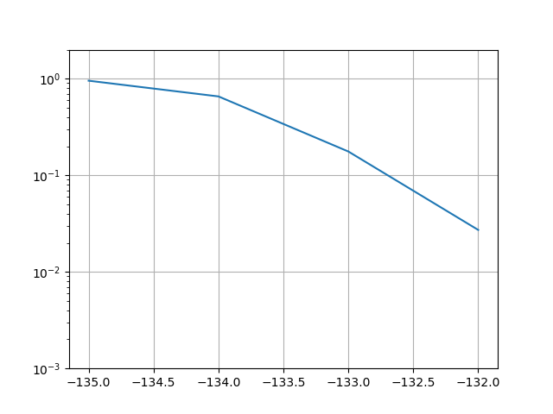
Mode MCS2: BL=4, SF=2
Redundancy is double compared to MCS3
We require around -132dBm for 1% PER and -133dBm for 10% PER
A gain of 2dB compared to MCS3, but ideally this should be 3dB (non-linear LLR demod)
PER
P_RX in [dBm]

Slide 8

BL=8, SF=2
Almost identical to MCS2, but with BL=8 instead of BL=4
There is no difference to BL=4 in the AWGN channel, but we reduce the overhead signficantly
PER
P_RX in [dBm]

Slide 9
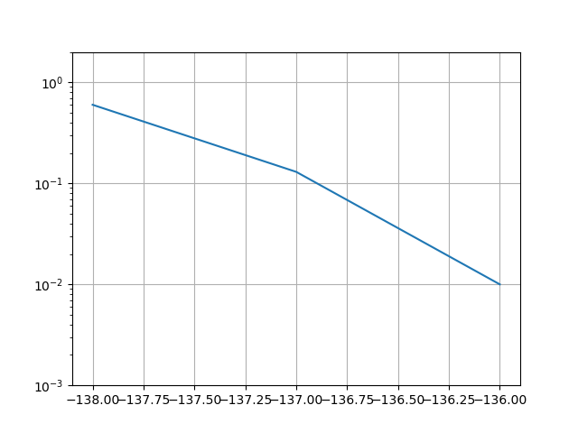
MCS0: BL=1, SF=8
This is the most robust mode of the Kyoto University proposal
We require -137dBm for 10% PER and -136dBm for 1% PER
The theoretical gain should be 9dB to MCS3, but is “only” 6dB due to non-linear demapping
PER
P_RX in [dBm]

Slide 10
BL=8, SF=8
If will provide simulation results soon
They are almost similar to MCS0 with BL=1 and SF=8, but with close to 50% less overhead

Slide 11
Conclusions and Future Work
We implemented the proposal of Kyoto University
The simulation results match exactly the expectations
For SF=1 the results exactly match the TI results
An improved demodulator can further improve the results
BL<8 does not show any performance gain compared to BL=8, but requires higher overhead
Next results will show also results for 200 kHz channels

