Slide 1

159th Session of meetings of the IEEE 802.15 Working Group for Wireless Specialty Networks (WSN)
Opening Report
November 9-14, 2025
Held in Bangkok & Hybrid via Webex

Slide 2
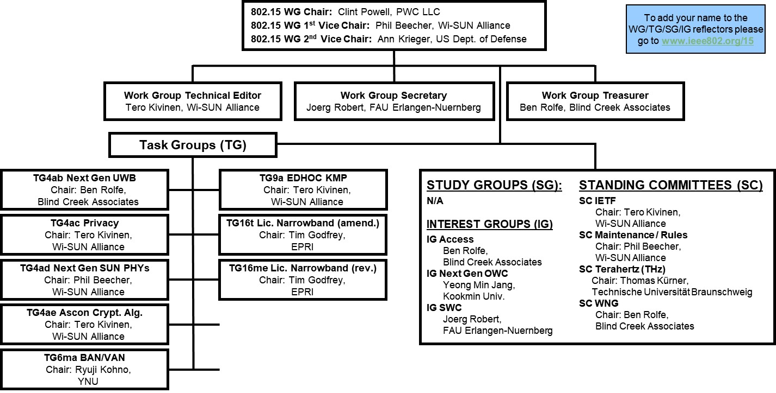
802.15 WG Org. Chart

Slide 3
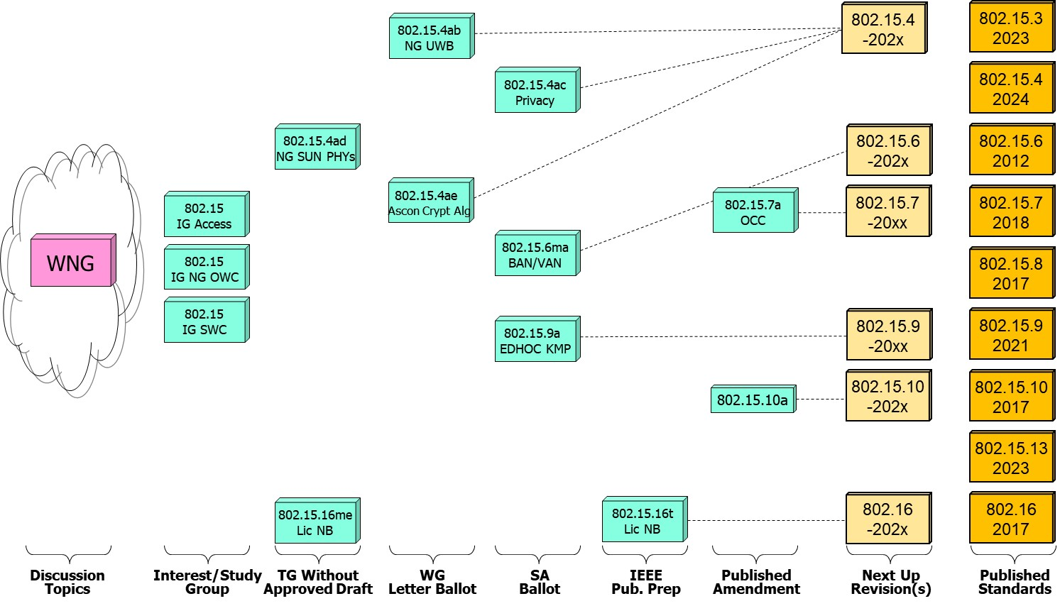
802.15 WG Standards Pipeline

Slide 4
WG15 LB Closings Update
WG15 Letter Ballots closing since the close of the previous session
Project P802.15.4ab P802.15.4ae P802.15.xyz P802.15.xyz P802.15.xyz
LB 225 226
Draft D03 D02 Dx Dx Dx
VOTERS 133 129 x x x
VOTED 112 92 x x x
YES 96 89 x x
ABSTAIN 3 3 x x x
NO 13 0 x x
% VOTERS 84.21 71.32 x x x
% YES 88.07 100.00 x x x
% ABSTAIN 2.68 3.26 x x x
Did Not Vote 21 37 x x x
Did Not Vote % 15.8 28.7 x x x
Open Date 9/21/25 9/28/25 x x x
Close Date 10/6/25 10/13/25 x x x

Slide 5
WG15 Active PARS
Project Project Status Approval Date Expiration Date
P802.15.14 In Hibernation 9/23/21 12/31/25 (PAR Withdrawn - Approved 9/10/25 by SA Stds. Board)
P802.15.15 In Hibernation 9/23/21 12/31/25 (PAR Withdrawn - Approved 9/10/25 by SA Stds. Board)
P802.15.4ab Active 9/23/21 12/31/25 (PAR Extended to 12/31/27 - Approved 9/10/25 by SA Stds. Board)
P802.15.6 Active 5/13/22 12/31/26
P802.15.4ac Active 6/5/23 12/31/27
P802.15.4ad Active 3/21/24 12/31/28
P802.15.4ae Active 11/12/24 12/31/28
P802.15.9a Active 11/12/24 12/31/28

Slide 6
802.15 WG Administrative
Voting members: 136
Nearly voting members: 10
Aspirant voting members: 27
Membership roster: 802.15 WG Membership Status
802.15 WG Officers - Elected March 2024
Clint Powell - Chair
Phil Beecher - 1st Vice-Chair
Ann Krieger - 2nd Vice-Chair
Joerg Robert - Secretary (appointed)
Tero Kivinen - Tech. Editor (appointed)
Ben Rolfe - Treasurer (appointed)

Slide 7
802.15 WG Operations
802.15 Operations Manual - covering Membership rules, Voting in the subgroup, Parliamentary procedures for approval to move any deliverables to the Standards Committee for action, officer scope of duties and much more…
WG15 Op's Manual
802 Operations Links
802 LMSC Op’s Manual
802 LMSC P&P
802 LMSC Chairs Guidelines
802 WCSC Op’s Manual

Slide 8
802 LMSC Annual Review of 802.15
Scope
The 802.15 Working Group (WG) on Wireless Specialty Networks (WSN) focuses on the development of open consensus standards addressing wireless networking for the emerging Internet of Things (IoT), allowing these devices to communicate and interoperate with one another, mobile devices, wearables, etc.
The goal of 802.15 is to publish standards, recommended practices, or guides that have broad market applicability and deal effectively with the issues of coexistence and interoperability with other wired and wireless networking solutions.
Duties
Maintain and revise the 802.15 standards, amendments, and recommended practices
Develop new standards when a PAR is approved by IEEE SASB and is assigned to the 802.15 WG by the IEEE 802 LMSC
Maintain liaisons with other groups within IEEE 802 LMSC, and other relevant standards setting bodies and radio spectrum regulatory bodies
Membership
See slide 6

Slide 9
November 2025 802.15 WG Agenda

Slide 10
Session Registration Badges Required at All Times (meetings, breaks, and social)
NO BADGES,
NO SERVICE! *
* If you are found not wearing a badge, you will be reminded to put your badge, and if not to leave the area.

Slide 11
2.6a: Designation of Individual Experts for this Session
Individual experts who attend electronically for a specific purpose/presentation can be designated as such by the WG Chair and receive a registration fee waiver and limited attendance rights.
See section 5 in https://mentor.ieee.org/802-ec/dcn/17/ec-17-0090-26-0PNP-ieee-802-lmsc-operations-manual.pdf.
The Working Group Chair may designate specific individual experts who are allowed to participate in Working Group discussions via electronic means during an in-person meeting for the benefit of the group. These individuals are not considered to be attending the meeting and so they are not required to pay meeting fees and they do not get participation credit. The participation of these individuals should be limited to specific technical topics. Such participation shall be documented in the minutes of the Working Group meeting.
The individuals listed below are hereby designated as specific individual experts on their respective topics and subject to the restrictions and benefits described in the 802 OM.
Expert: n/a Topic: n/a Mtg.: n/a
Expert: n/a Topic: n/a Mtg.: n/a
For WNG, attendance for each is limited to the WNG timeslot in which the respective presentation is scheduled.

Slide 12


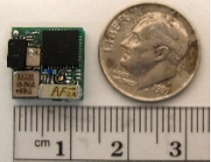

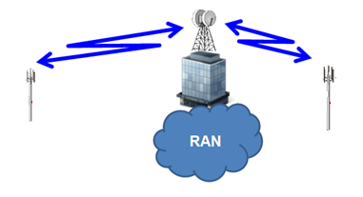
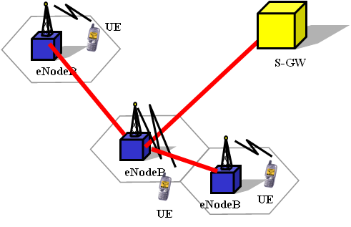



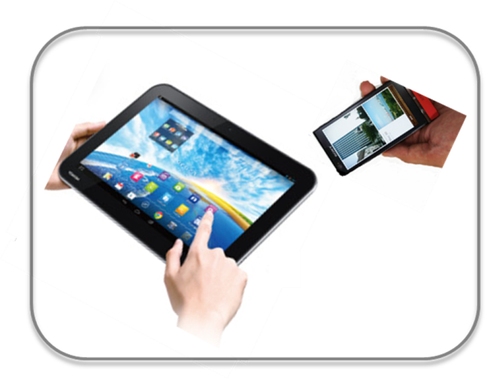


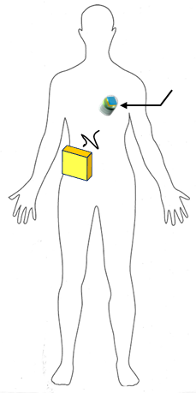
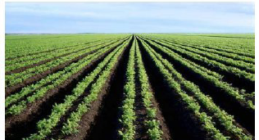
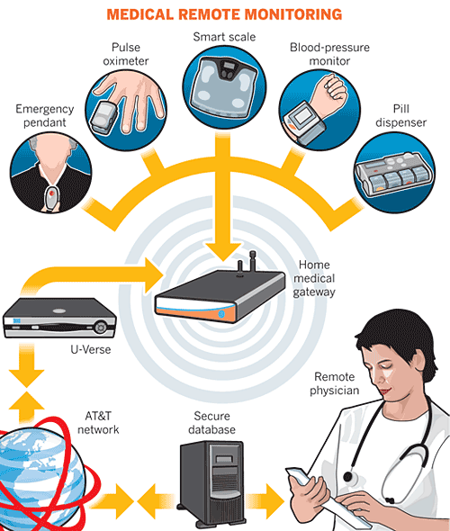

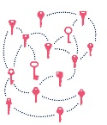
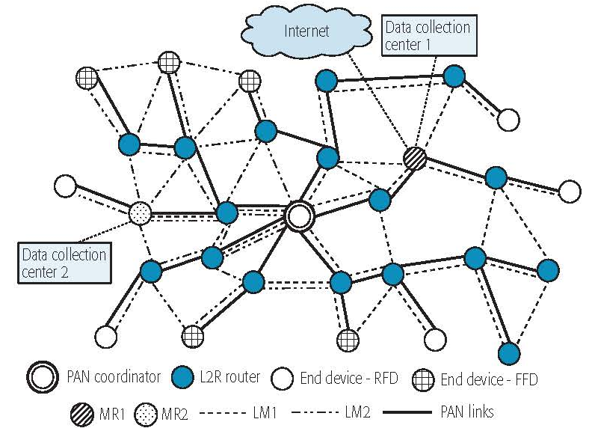

IEEE 802.15 Standards & their Applications
Locating and Tracking
Ultra-low Power Sensors
Automotive
802.15.16
802.15.4
FAN/MAN/RAN
Industrial Networks
Multi-media networks &
High Speed Interconnect
802.15.4
802.15.3
Structural Monitoring
802.15.7
802.15.13
802.15.6
Medical
802.15.9
802.15.10
Optical Communications
Key Management
Layer 2 Routing
Agricultural Monitoring
Consumer Devices
12

Slide 13
IEEE 802.15 Frequency Band Usage

Slide 14
IEEE 802.15
Subgroups Objectives

Slide 15
TG4ab (NG UWB) -
Next Gen. Ultra WideBand Amendment
Chair: Ben Rolfe
Objective:
Enhancements to 802.15.4 Ultra Wideband (UWB) physical layers (PHYs) media access control (MAC) and associated ranging techniques while retaining backward compatibility with enhanced ranging capable devices (ERDEVs).
TG4ab Webpage
Areas being worked on include:
Ranging
Link budget improvements
Improvements to accuracy, precision and reliability
Sensing
Pulse shape improvements
Channel impulse response reporting to support multistatic sensing
To better support presence detection, environment mapping and other uses
Data
Higher data rates for shorter transmission duration and power savings
Channel coding and packet format improvements for robustness
Additional options for even greater power savings
Protocol enhancements to support very low latency, low energy communications
Interference mitigation techniques to support:
Greater device density
Coexistence in the presence of other users
This amendment builds on top of the existing 802.15.4 standard and the 802.15.4z amendment.

Slide 16
TG4ac (Privacy) - Privacy Amendment
Chair: Tero Kivinen
Objective:
This amendment specifies modifications to the IEEE Std 802.15.4 MAC specification to specify mechanisms that address and improve user privacy. These mechanisms include randomized addresses, and exchanges that support session continuity. This amendment maintains backward compatibility with the base standard.
TG4ac Webpage
This amendment builds on top of the existing 802.15.4 standard.

Slide 17
TG4ad (NG SUN PHYs) -
Next Gen. SUN PHYs Amendment
Chair: Phil Beecher
Objective:
The amendment specifies modifications for the development of a second-generation physical layer (PHY) for Smart Utility Networks (SUN). The primary focus is the improvement of the OFDM (Orthogonal Frequency Division Multiplexing) modes for higher data rates and longer-range communication, particularly in congested license-exempt frequency bands.
TG4ad Webpage
Areas being worked on include:
Definition of use-cases
Number of devices in given area
Max. payload bit-rate
Latency requirements
Definition of frequency bands
…
Channel Models
Channel models for indoor and outdoor use
Interference models for license-exempt band operation
…
This amendment builds on top of the existing 802.15.4 standard.

Slide 18
TG4ae (Ascon Crypt. Alg.) - Amendment
Chair: Tero Kivinen
Objective:
This amendment adds the use of Ascon-128 and Ascon-128a cryptographic algorithms to the IEEE Std 802.15.4.
Ascon-128 and Ascon-128a: Ascon is a family of lightweight authenticated ciphers that has been selected by US National Institute of Standards and Technology (NIST) for future standardization of the lightweight cryptography. Ascon provides the same Authenticated Encryption with Associated Data (AEAD) functionality as Advanced Encryption Standard (AES), allowing an Ascon algorithm to be a drop-in.
TG4ae Webpage
This amendment builds on top of the existing 802.15.4 standard.

Slide 19
TG6ma (BAN/VAN) - BAN with Enhanced Dependability Revision
Chair: Ryuji Kohno
Objective:
Enhancements to the Body Area Networks (BAN) Ultra Wideband (UWB) physical layer (PHY) and media access control (MAC) to support enhanced dependability to a human BAN (HBAN), adding support for vehicle BAN (VBAN.
TG6ma Webpage
Areas being worked on include:
Channel Modeling
Precise modeling of radio propagation of implant and wearable human BANs and around vehicle BANs for dependable data transmission
Classified modeling of multiple BANs and coexistence with other radios for resolution in PHY and MAC
Data transmission
Cognition of channel environment and coexistence
Initial acquisition and synchronization in coexisting BANs
FEC and hybrid ARQ according to QoS levels of data packets for various channel models and coexistence classes
Packet contention
Control and data channels, superframe formant, and MAC function to avoid packet contention in various classes of coexistence
Hybrid protocol of contention-free and contention access according to required QoS levels of data packets
Inter coordinators or hubs negotiation among coexisting BANs
Interference mitigation in coexistence
Interference surprising and canceling technologies for theoretical and feasible implementation in coexistence
Result in simpler classes of coexistence by mitigation of interference from non-BAN
Ranging
Optional ranging for cognition of dynamism of coexisting BANs
This revision builds on the existing 802.15.6 standard with enhanced dependability for human BAN and additional vehicle BAN.

Slide 20
TG9a (EDHOC KMP) - Amendment
Chair: Tero Kivinen
Objective:
This amendment specifies the use of EDHOC (RFC 9528) KMP for the IEEE Std 802.15.9. This standard describes support for transporting KMP datagrams to support the security functionality present in IEEE Std 802.15.4.
TG9a Webpage
This amendment builds on top of the existing 802.15.4 standard.

Slide 21
TG16t (Lic NB) - Licensed Narrowband Amendment
Chair: Tim Godfrey
Objective:
Enhancements to IEEE 802.16-2017 physical layer (PHYs) and media access control (MAC) to enable operation in licensed spectrum with channel bandwidths greater than or equal to 5 kHz and less than 100 kHz. The amendment is frequency independent but focuses on spectrum less than 2 GHz. The range and data rate supported by the narrower channels are commensurate with those of the base standard, as scaled by the reduced channel bandwidth. The project also amends IEEE Std 802.16 as required to support aggregated operation in adjacent and non-adjacent channels.
TG16t Webpage
Areas being worked on include:
Definition of the Wireless MAN-NB PHY to enable operation in narrow channels
Aggregation of non-contiguous narrow channels to provide higher capacity
Enhancements to MAC to improve efficiency and reduce control overhead
Definition of a Direct Peer-to-Peer (DPP) mode to support operation without fixed infrastructure
Updates to security protocols
This amendment builds on top of the existing 802.16 standard.

Slide 22
TG16me (Lic NB) - Licensed Narrowband Revision
Chair: Tim Godfrey
Objective:
802.16-2017 is coming up on it’s 10-year anniversary and as such a revision needs to be started to incorporate any amendments (802.16t) since the 802.16-2017 standard.
TG16me Webpage
Areas being worked on include:
Roll up of 802.16t amendment
Address any issues
This is a revision to the 802.16-2017 standard.

Slide 23
IG Access -
WG15 Access Techniques
Chair: Ben Rolfe
Objective:
Determine interest in starting efforts for development of projects on 802.15 Access Techniques.
This group will evaluate the interest in developing Access capabilities

Slide 24
IG (NG-OWC) - Next Gen. Optical Wireless Communication
Chair: Yeong Min Jang
Objective:
Determine interest in next-generation optical wireless communication (NG-OWC) characteristics and its future applications.
Areas being worked on include:
Artificial Intelligence (AI) for NG-OWC
Integration of various AI technologies into the OWC system
Lightweight AI utilization for each developed AI technology
Channel modelling for NG-OWC
Integration of machine-learning for channel estimation
Utilization of machine learning for channel estimation for dynamic and complex channel conditions
Future applications of NG-OWC
NG-OWC encompasses fields such as IoT, underwater communication, joint communication, sensing, and localization (V2V, M2M, Drone/UAV, etc.)
NG-OWC for OWC based drone Networks
NG-OWC for Indoor/Outdoor Positioning through OWC and LiDAR integration
Deep learning-based OWC to support high mobility vehicle
Preferred camera types for OWC
Resolution: Minimum 720x540 (single-link), maximum 3840 x 2160 (multi-link)
Frame rate: Minimum 30 FPS, preferred more than 120 FPS
Spectrum: Mono, color
Light sources: IR, VL, and UV
This group will evaluate the interest in developing Next Gen OWC capabilities

Slide 25
IG (SWC) – Surface Wave Communications
Chair: Joerg Robert
Objective:
Determine interest in starting efforts for development of projects on 802.15 surface wave communications.
This group will evaluate the interest in developing Surface Wave Communications capabilities

Slide 26
SC IETF -
Internet Engineering Task Force
Chair: Tero Kivinen
Objective:
This standing committee brings in the information from the Internet Engineering Task Force (IETF) to the 802.15 working group. It concentrates on the IETF working groups that might be of interest to the 802.15 working group members.
SC IETF Webpage
IETF working groups followed include:
6lo, lake, suit

Slide 27
SC MAINT -
802.15 Maintenance Activities
Chair: Phil Beecher
Objective:
The Standing Committee Maintenance (SCM) has the following roles:
Reviewing comments related to possible errata on 802.15 standards and making recommendations to 802.15 Working Group
Managing and maintaining the 802.15 Operations Manual
Managing and maintaining the 802.15 Motion templates and project checklist template
Reviewing 802 PARs and ICAIDs on behalf of 802.15 Working Group
SC MAINT Webpage
SCM meets at least once during every 802 plenary and 802 wireless interim session

Slide 28
SC THz -
THz Standing Committee
Chair: Thomas Kürner
Objective:
The IEEE 802.15 Standing Committee Terahertz is chartered to explore the feasibility of Terahertz for wireless communications. The Terahertz frequency band runs roughly from 300 GHz to 3 THz, a staggering 2700 GHz of bandwidth.
SC THz Webpage
Areas being worked on include:
The IEEE 802.15 Standing Committee Terahertz is soliciting, and hearing, contributions that address numerous THz issues.
There are no immediate plans to transition the group to a study group or a task group; rather, we want to fully understand the technology status in regards to a further amendment of IEEE Std. 805.15.3-2023 or a completely new standard.
Apart from the implementation aspects of THz Communications there are important regulatory aspects to be considered. For example the allocation and identification of THz spectrum especially in conjunction with the agenda items at WRC-27 and WRC-31 are topics of the THz standing committee.

Slide 29
SC WNG -
Wireless Next Generation
Chair: Ben Rolfe
Objective:
The IEEE 802.15 Standing Committee Wireless Next Generation is chartered to facilitate discussions on new Wireless related Technologies that may be of interest to the 802.15 community, and that may lead to new 802.15 standardization projects. The WNG also provides the opportunity to address the whole 802.15 work group with issues or concerns with current techniques or technologies.
SC WNG Webpage
Areas being worked on include:
WNG topics are not limited to only the PHY layer and/or the MAC sublayer since information on the layers above the MAC including the application is very important to making sure that the PHY and MAC are appropriate, especially in the WSN environment.
Presenters in WNG are usually asked to relate the material presented and/or discussed to the work of the WG via the “usual question”:
What do you propose the Working Group do next?
The answer usually falls into one of these categories:
Information for the group
Form an interest group to pursue
Consider in the future a new project

Slide 30
Subgroups Objectives this Session
TG 4ab (NG UWB) Amendment
Conduct comment resolution for latest Letter Ballot Recirc
Determine whether or not to start next Letter Ballot Recirc or Request to go to SA Ballot
Update timeline of TG
TG 4ac (Privacy) Amendment
Conduct comment resolution for latest SA Ballot Recirc
Determine whether or not to start next SA Ballot Recirc or Request to go to RevCom
Update timeline of TG
TG 4ad (NG SUN PHYs) Amendment
Continue hearing presentations on technical draft content
Scope out initial Letter Ballot time frame
Update timeline of TG

Slide 31
Subgroups Objectives this Session
TG 4ae (Ascon Crypt. Alg.) Amendment
Conduct comment resolution for latest Letter Ballot Recirc
Determine whether or not to start next Letter Ballot Recirc or Request to go to SA Ballot
Update timeline of TG
TG 6ma (Revision + BAN/VAN) Revision
Conduct comment resolution for latest SA Ballot Recirc
Determine whether or not to start next SA Ballot Recirc or Request to go to RevCom
Update timeline of TG
TG 9a (EDHOC KMP) Amendment
Conduct comment resolution for latest SA Ballot Recirc
Determine whether or not to start next SA Ballot Recirc or Request to go to RevCom
Update timeline of TG

Slide 32
Subgroups Objectives this Session
TG 16t (Lic NB) Amendment
Address any feedback/comments from IEEE Publication Editors
TG 16me (Lic NB) Revision
Continue discussing roll-up and additional topics for revision
Update timeline of TG

Slide 33
Subgroups Objectives this Session
Joint 802.1/802.15
Continue discussion on current and next up joint activities
Joint 802.11/802.15
Discuss/Hear Updates related to coexistence
IG Access
Continue hearing presentations on related technical areas
IG NG OWC
Continue hearing presentations on related technical areas
IG SWC
Continue hearing presentations on related technical areas

Slide 34
Subgroups Objectives this Session
SC MAINTENANCE
Review PARs submitted by other WG’s
Review draft of detailed development process steps checklist
Review list of all templates for WG15 Subpage for completeness
Review WG15 P&P for any updates
SC IETF
Discuss IETF activities related to 802/802.15 at WG15 mid-week
SC THz
Hear presentations on future potential THz topics
SC WNG
Hear presentations on future potential WG15 topics

