Slide 1
Project: IEEE P802.15 Working Group for Wireless Specialty Networks (WSN)
Submission Title: TG4ab Closing Report September 2025
Date Submitted: 18 Sept 2025
Source: Benjamin A. Rolfe (Blind Creek Associates)
Contact:
Voice: [deprecated]
E-Mail: ben.rolfe @ ieee.org
Re: Task Group 4ab: 802.15.4 UWB Next Generation
Abstract: Closing Report 802 Wireless Interim September 2025
Purpose: Continue project progress and continue the illusion of organization
Notice: This document has been prepared to assist the IEEE P802.15. It is offered as a basis for discussion and is not binding on the contributing individual(s) or organization(s). The material in this document is subject to change in form and content after further study. The contributor(s) reserve(s) the right to add, amend or withdraw material contained herein.
Release: The contributor acknowledges and accepts that this contribution becomes the property of IEEE and may be made publicly available by P802.15.

Slide 2



Task Group 15.4ab Next Generation UWB Amendment
September 2025
802 Wireless Interim Session
Mixed Mode
Live from
The Big Island
And remote worldwide

Slide 3
5.2.b Scope of the project (As approved):
This amendment enhances the Ultra Wideband (UWB) physical layers (PHYs) medium access control (MAC), and associated ranging techniques while retaining backward compatibility with enhanced ranging capable devices (ERDEVs). Areas of enhancement include:
additional coding, additional coding, preamble and modulation schemes to support improved link budget and/or reduced air-time relative to IEEE Std 802.15.4 UWB;
additional channels and operating frequencies;
interference mitigation techniques to support greater device density and higher traffic use cases relative to the IEEE Std 802.15.4 UWB;
improvements to accuracy, precision and reliability and interoperability for high-integrity ranging; schemes to reduce complexity and power consumption;
definitions for tightly coupled hybrid operation with narrowband signaling to assist UWB;
enhanced native discovery and connection setup mechanisms;
sensing capabilities to support presence detection and environment mapping;
and mechanisms supporting low-power low-latency streaming as well as high data-rate streaming allowing at least 50 Mb/s of throughput.
Support for peer-to-peer, peer-to-multi-peer, and station-to-infrastructure protocols are in scope, as are infrastructure synchronization mechanisms. This amendment includes safeguards so that the high throughput data use cases do not cause significant disruption to low duty-cycle ranging use cases.
https://development.standards.ieee.org/myproject-web/app#viewpar/9081

Slide 4
Near Term Working Milestones
 | Current Schedule
First letter ballot | June 2024
Initial LB comment resolution | Start: July 2024
First recirculation | March 2025
Recirculation comment resolution | April-Sept 2025
LMSC Conditional Approval for SA-Ballot | Sept 2025
Second recirculation | Sept 2025
Recirculation comment resolution | Oct 2025
First SA-Ballot | Depends ….
SA-Ballot comment resolution | ???
Now
Action | Date
Approve comment resolutions and RC2 | 18-Sep-2025
Start RC2 | 20-Sep-2025
Close RC2 | 5-Oct-2025
Resolve comments | 7-Oct-2025
Start RC3 | TBD
Close RC3 | TBD
Start Nov Plenary | 10-Nov-2025

Slide 5
Closing Report
Goals for the week:
Resolve All Remaining Comments on D02
Approve recirculation of D03 (WG)
SA-Ballot planning

Slide 6
Comment Resolution Status

Slide 7
Project Information

Slide 8
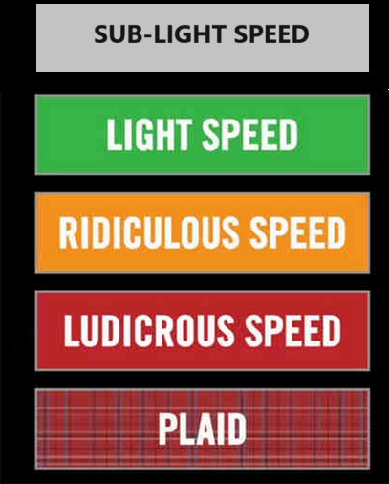

Comment Resolution Approvals

Slide 9
Approval of Comment Resolution in Document 15-25-0424
Motion: Move to approve the resolution to P802.15.4ab-D02 comment index 167 contained in document 15-25-0424-00.
Moved by: Alex Krebs
Second by: Mickael Maman
Yes/no/abstain: 26/10/2 - Motion fails

Slide 10
Approval of Consolidated Comments
Motion: Approve all comment resolutions contained in document 15-25-0174-0042 and direct the technical editor to apply the resolutions to produce P802.15.4ab-D03
Moved by: Clint Chaplin
Second by: Billy Verso
Motion carries by unanimous consent

Slide 11
Request WG start Recirculation
Motion: TG4ab requests the Working Group initiate recirculation ballot on P802.15.4ab-D03
Moved by: Clint Chaplin
Second by: Billy Verso
Motion carries by unanimous consent

Slide 12
WG motion: Draft needs edits before recirculation
Move that 802.15 WG start a WG Letter Ballot requesting approval of CA document [15-23-0452-16] and document P802.15.4ab_D02 (as edited in accordance with the instructions in document 15-25-0174-42) and to forward document P802.15.4ab_D03, as edited in accordance with the instructions in document 15-25-0174-42, and CA document [15-23-0452-16] to Standards Association ballot pending the completion and inclusion of the edits in the draft.
Moved by: Benjamin Rolfe
Seconded by: Phil Beecher
(run by WG VC)

Slide 13
Working Group Motion: Motion to approve the formation of CRG
Move that 802.15 WG approve the formation of a Comment Resolution Group (CRG) for the WG balloting of P802.15.4ab with the following membership: Ben Rolfe (chair), Billy Verso, Clint Chaplin, Riku Pirhonen, Mickael Maman, Bin Qian, Alex Krebs, Pooria Pakrooh, Carlos Aldana, Sven Zeisberg and Li-Hsiang Sun. The 802.15.4ab CRG is authorized to approve comment resolutions, edit the draft according to the comment resolutions, and to approve the start of recirculation ballots of the revised draft on behalf of the 802.15 WG.
Move: Ben Rolfe
Second: Phil Beecher

Slide 14

Next Steps

Slide 15
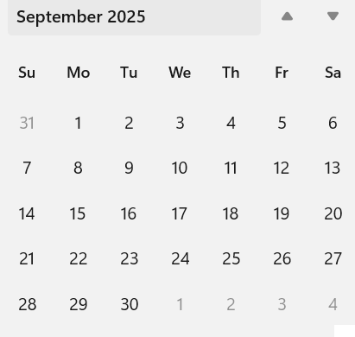
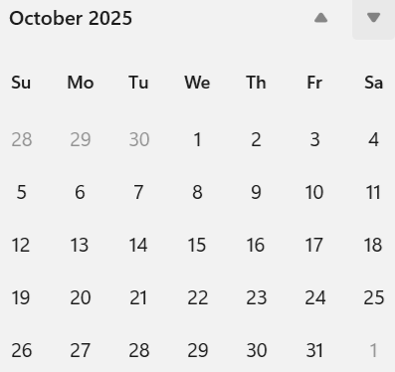
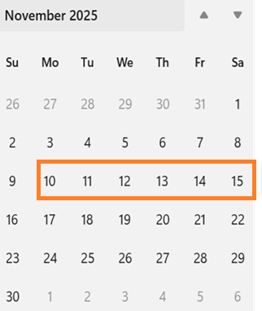
Telecom/Webex Schedule
Close
Plenary
Open
Agenda: Comment Resolution
2 hours, Tuesdays, commence 7th Oct 06:00 PT
Overflow: Thursday 9th and 16th Oct, 1 hour 14:00 PT

Slide 16

Thanks for Listening

