Slide 1
Project: IEEE P802.15 Working Group for Wireless Personal Area Networks (WPANs)
Submission Title: [Summary of Discussion on Merged baseline for SUN OFDM LR]
Date Submitted: 18 Sept 2025
Source: Hiroshi Harada (Kyoto University)
Address Yoshidahonmachi. Sakyo, Kyoto, 606-8501, Japan
Voice: +81-75-753-5317 , E-Mail: hiroshi.harada@i.kyoto-u.ac.jp
Re: [Wireless Next Generation, Long Range extension enhancements to 802.15.4-2020]
Abstract: The SUN OFDM LR (Low Rate) proposed for 802.15.4ad in documents 15-25/0280r4 and 15-25/0392r0 has been organized. Based on these documents, the Next Step following the Hawaii meeting was discussed. At the Hawaii meeting, the proposal merging and the standard baseline were discussed among the proposers. This document is a summary of the discussion on SUN OFDM LR among these proposers. A part of this contribution supported from the commissioned research (No. JPJ012368C05101) by National Institute of Information and Communications Technology (NICT) , Japan is included.
Purpose:
Notice: This document has been prepared to assist the IEEE P802.15. It is offered as a basis for discussion and is not binding on the contributing individual(s) or organization(s). The material in this document is subject to change in form and content after further study. The contributor(s) reserve(s) the right to add, amend or withdraw material contained herein.
Release: The contributor acknowledges and accepts that this contribution becomes the property of IEEE and may be made publicly available by P802.15.

Slide 2
Summary of Discussion on Merged Baseline for SUN OFDM Low Rate (LR)
September 18 , 2025
Hiroshi Harada, Vice chair of 802.15.4ad
(Kyoto University)

Slide 3
Background
The SUN OFDM LR (Low Rate) proposed for 802.15.4ad in documents 15-25/0280r4 and 15-25/0392r0 has been organized.
Based on these documents, the Next Step following the Hawaii meeting was discussed.
At the Hawaii meeting, the proposal merging and the standard baseline were discussed among the proposers.
This document is a summary of the discussion on SUN OFDM LR among these proposers.

Slide 4
Discussion topics
Regarding SUN OFDM LR, there is discussion about SHR and Payload.
SHR's proposals include those from TI and Kyoto University (KU).

Slide 5
SHR for SUN OFDM LR

Slide 6
Current proposal of SHR for
SUN-OFDM LR 1 (15-25/0348r3)
SHR
PHR
PHY payload
32bits
64/128/256 bit
64/128/256 bit
Preamble data = [0101…]
Golay seq a
Golay seq b
In this SC-OFDM, SHR consists of two Golay sequences a and b of equal length.
This is because the PHR and PHY payload parts are transmitted in blocks, and pilot data is stored in each block.
Good auto correlation function and good cross correlation function with exsiing 802.15.4g SFD
The length of Golay code can be changed (128,256 bit…)
Example (256 bit)
 | Golay seq. a | Golay seq. b
Value | 0xEDE2ED1DEDE212E2EDE2ED1D121DED1DEDE2ED1DEDE212E2121D12E2EDE212E2 | 0xEDE2ED1DEDE212E2EDE2ED1D121DED1D121D12E2121DED1DEDE2ED1D121DED1D

Slide 7
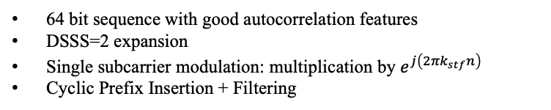
Current proposal of SHR for
SUN-OFDM LR (15-25/0481r0)
SHR
PHR
PHY payload
STF = [ 1 0 0 1 0 1 1 0 1 1 1 0 0 1 0 0 0 1 0 1 1 0 1 1 0 0 1 1 0 0 0 0 0 0 1 1 1 1 1 0 0 1 1 1 0 0 0 1 1 1 0 0 1 0 1 0 0 0 1 0 1 0 1 0 ];
Preamble(16bit)+DSSS2
STF (64bit) +DSSS2 (Spread Factor 2)
Preamble = [0 0 0 0 0 0 0 0 0 0 0 0 0 0 0 0 ];
64 bit sequence with good autocorrelation features
DSSS=2 expansion
Single subcarrier modulation: multiplication by $e^{j\left(2πk_{stf}n\right)}$
Cyclic Prefix Insertion + Filtering
DSSS
K | Input bit | Chip Values (c0 c1)
K=even | 1 | 0 0
 | 0 | 0 1
K=odd | 1 | 1 1
 | 0 | 1 0
16 preamble + DSSS2 = 32 chips
[ 0 1 1 0 0 1 1 0 0 1 1 0 0 1 1 0 0 1 1 0 0 1 1 0 0 1 1 0 0 1 1 0 ]
64 correlation sequence + DSSS2 = 128 chips
[ 0 0 1 0 0 1 1 1 0 1 1 1 0 0 1 0 0 0 1 1 0 0 1 0 0 1 1 1 0 1 1 0 0 1 1 1 0 1 1 1 0 0 1 0 0 0 1 1 0 1 1 0 0 0 1 1 0 1 1 0 0 1 1 0 0 1 1 0 0 0 1 1 0 0 1 1 0 0 1 0 0 1 1 1 0 0 1 1 0 1 1 0 0 1 1 1 0 0 1 1 0 1 1 0 0 0 1 0 0 0 1 0 0 1 1 0 0 0 1 0 0 0 1 0 0 0 1 0 ]

Slide 8
Discussion point on SHR
Consider the length of the SHR
Consider to add the 0101 series
More performance analysis is required
  Synchronization performance
  PER performance
  Cross correlation with existence SFD of 802.15.4g …
Resolution
Continue to discuss in Bangkok meeting

Slide 9
Payload for OFDM LR

Slide 10
Reference modulator diagram
SHR
BPSK
modulation mapper
Subcarrier
mapper
PHR
PHY
payload
IDFT
Data Spreading,
Block configurationand
BPSK
modulation mapper
Concatenation
Scrambler
FEC
encoder
Interleaver
Subcarrier
mapper
Scrambler is used for PHY payload.
Pilot data
Pilot data
generator
Modulated signal
Filtering
Cyclic prefix
insertion

Slide 11





Modulation and coding scheme
(Option 1, 15-25/0348r3)
Information
bits
Coded
bits
Interleaved
bits
MCS0 (PL=1 BL=1, SF=8)
Mapping block
p1
e1
p8
e8
a₀ [133]
Interleaver
$P_{j}$: PN9(the seed is all one)
j =1,$⋯$
MCS1 (PL=1 BL=2, SF=4)
x
d_{k}
p1
e1
e2
p4
e7
e8
Subcarrier
mapper
a₁ [171]
$e_{(k−1)×SF+i}$ = $d_{k}$
$$1≤i≤SF$$
MCS2(PL=1 BL=4, SF=2)
p1
e1
e2
e3
e4
SF is the number of repetitions of $d_{k}$.
p2
e5
e6
e7
e8
MCS3 (PL=1 BL=8, SF=1)
p1
e1
e2
e3
e4
e5
e6
e7
e8

Slide 12

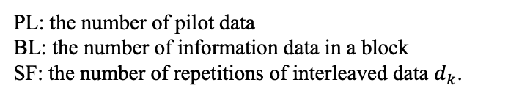



Modulation and coding scheme
(Option 1, 15-25/0348r3)
FEC
encoder
Data Spreading and Mapping Block
Interleaver
Conventional convolutional code for OFDM SUN
(R=1/2, K=7)
$P_{j}$: PN9
j =1,$⋯$
$e_{(k−1)×SF+i}$ = $d_{k}$
$$1≤i≤SF$$
PL: the number of pilot data
BL: the number of information data in a block
SF: the number of repetitions of interleaved data $d_{k}$.
Example of block mapped
MCS0 (PL=1 BL=1, SF=8)
MCS1 (PL=1 BL=2, SF=4)
MCS2(PL=1 BL=4, SF=2)
MCS3 (PL=1 BL=8, SF=1)
p1
e1
p8
p1
e1
e2
p4
e7
e8
p1
e1
e2
e3
e4
e8
p1
e1
e2
e3
e4
e5
e6
e7
e8
p2
e5
e6
e7
e8

Slide 13
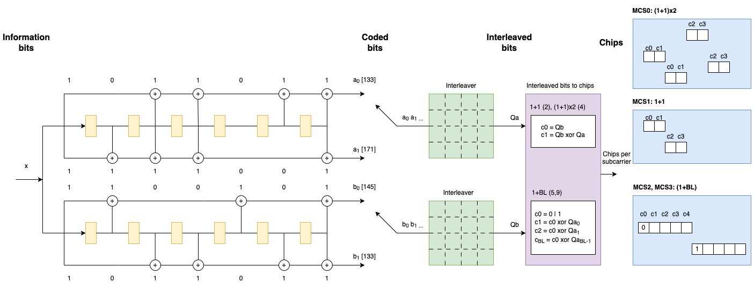
Modulation and coding scheme (Option 2, 15-25/0351r0)
x

Slide 14
Agreement point on payload
Basic Configuration of the Transmitter
Two modulation and coding schemes (Option 1 and 2)
Resolution
Agreement point should be the baseline of the 802.15.4ad
Caution:
The two options may be merged if there are common part in Bangkok meeting.
Other OFDM LR proposal shown in 15-25/392r1 may be merged if if there are common part in Bangkok meeting.

