Slide 1
Project: IEEE P802.15 Working Group for Wireless Specialty Networks (WSNs)
Submission Title: Adaptive Beamforming Prediction using LSTM for Enhanced ATP in UAV FSO Communication
Date Submitted: September 17, 2025
Source: Fadhila Ahmad, Irzal Zaini, Ida Bagus Krishna Yoga Utama, Md Minhazur Rahman, Nguyen Ngoc Huy, Yeong Min Jang(Kookmin University), Hyoung-Jun Park, Chan Il Yeo, Siwoong Park (ETRI)
Address: Kookmin University, 77 Jeongneung-Ro, Seongbuk-Gu, Seoul, 02707, Republic of Korea
Voice: +82-2-910-5068 E-Mail: yjang@kookmin.ac.kr
Honam Research Division/ Optical ICT Convergence Research Section, ETRI, Republic of Korea
Voice: +82-62-970-6635 E-Mail: swp@etri.re.kr
Re:
Abstract: Present advancements and future directions of ATP for UAV FSO communication.
Purpose: Presentation for contribution on IG NG-FSO.
Notice: This document has been prepared to assist the IG NG-FSO. It is offered as a basis for discussion and is not binding on the contributing individual(s) or organization(s). The material in this document is subject to change in form and content after further study. The contributor(s) reserve(s) the right to add, amend or withdraw material contained herein.
Release: The contributor acknowledges and accepts that this contribution becomes the property of IEEE and may be made publicly available by IG NG-FSO

Slide 2
Adaptive Beamforming Prediction using LSTM for Enhanced ATP in UAV FSO Communication
Contribution
September 17, 2025

Slide 3
Contents
Introduction
Importance in FSO UAV Communication
Challenges in Current ATP for FSO
Proposed Contribution: LSTM-based Adaptive Beamforming Prediction
Conclusion

Slide 4
Introduction
A drone network (UAV-to-UAV) connects multiple drones to work together on specific missions.
Free-Space Optical (FSO) communication offers high data rates and secure links using laser beams but requires very accurate alignment due to narrow optical beams.
Acquisition, Tracking, and Pointing (ATP) systems are essential to maintain precise beam alignment and stable communication in turbulent and dynamic conditions.
LSTM-based AI predicts turbulence and beam misalignment in FSO ATP, boosting robustness and efficiency in dynamic UAV environments.

Slide 5
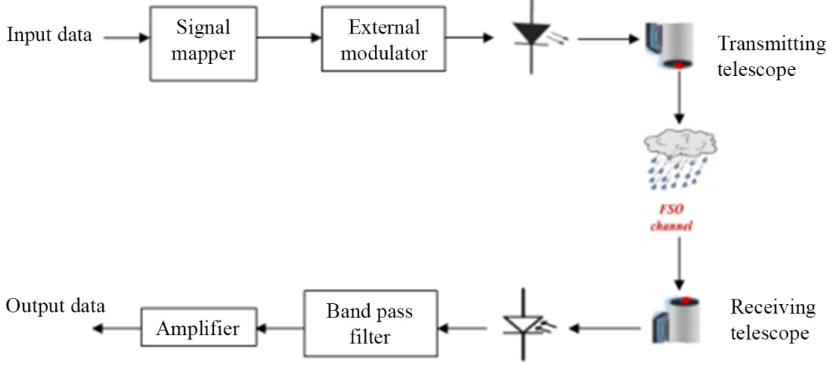
Importance in FSO UAV Communication
Fig [1] FSO Communication System
UAVs bring fast and unpredictable movement creating rapid beam misalignment risks, requiring highly responsive ATP.
Maintaining Gbps link quality in UAV-FSO communication requires proactive beamforming and precise tracking.
Conventional ATP systems struggle with high dynamics and require AI-enhanced prediction to stay effective.

Slide 6
Challenges in Current ATP for FSO
Atmospheric turbulence modeling remains complex and nonlinear, making accurate, real time prediction difficult.
Sensor limitations such as quadrant photodiodes (QPD) show nonlinear response and sensitivity issues depending on incident beam size, affecting tracking precision.
Integration of adaptive beamforming with constrained mobile platforms demands efficient, lightweight ATP solutions that balance accuracy and processing overhead.
Limited and imbalanced datasets restrict AI model training and robustness, necessitating advanced data augmentation techniques.

Slide 7
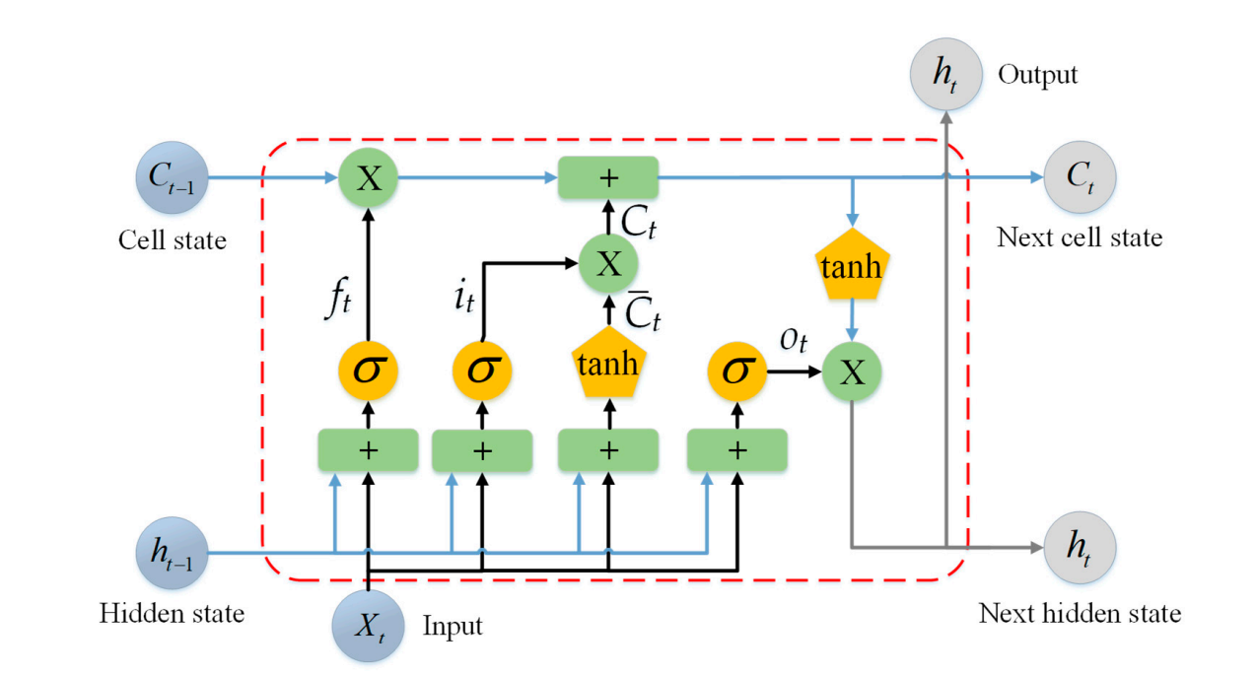
Proposed Contribution: LSTM-based Adaptive Beamforming Prediction
Develop a long short-term memory (LSTM) model to predict forecast atmospheric turbulence and beam misalignment with multi-step ahead prediction.
Fig [2] Architecture of LSTM cell

Slide 8
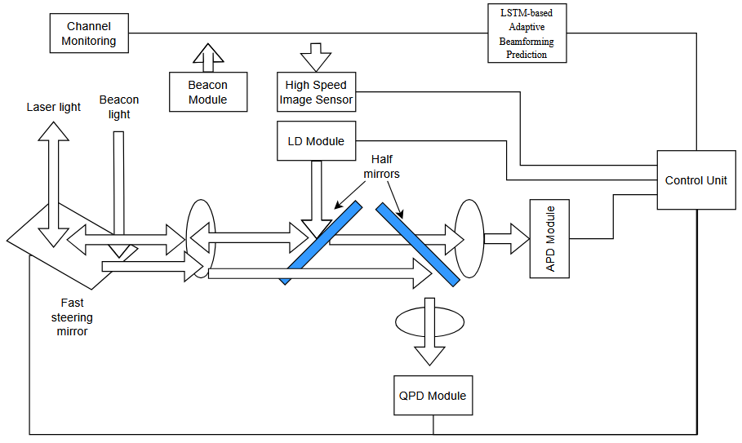
Proposed Contribution: LSTM-based Adaptive Beamforming Prediction
Lightweight LSTM predictors optimized for real-time deployment in mobile FSO UAV terminals, enhancing ATP responsiveness and link stability.
Fig [3] LSTM based ATP mechanism Block Diagram for high mobility FSO communication system

Slide 9
Conclusion and Future Directions
Neural network methods improve beam position detection and turbulence handling in ATP in UAV-based FSO communication systems.
Deep learning models like LSTM enhance robustness by adapting to dynamic atmospheric and UAV motion conditions.
Future work should focus on integrating adaptive AI-driven ATP with UAV-FSO links for real-time beam control, improved security, and dynamic environment adaptation.

Slide 10
Reference
Li, Q. et al. (2024) ‘Optimized Neural-network-based Calibration Method for Quadrant Detector Array’, Physics Letters A, 510, pp. 129550–129550. https://doi.org/10.1016/j.physleta.2024.129550
Bui, V., Le, N. T., Nguyen, V. H., Kim, J., & Jang, Y. M. (2021). Multi-Behavior with Bottleneck Features LSTM for Load Forecasting in Building Energy Management System. doi: https://doi.org/10.3390/electronics10091026
Li, Y., Zhang, H., Li, L., Shi, L., Huang, Y. and Fu, S. (2023). Multistep ahead atmospheric optical turbulence forecasting for free-space optical communication using empirical mode decomposition and LSTM-based sequence-to-sequence learning. Frontiers in Physics, 11. doi: https://doi.org/10.3389/fphy.2023.1070762
Y. Kaymak, R. Rojas-Cessa, J. Feng, N. Ansari, M. Zhou and T. Zhang, "A Survey on Acquisition, Tracking, and Pointing Mechanisms for Mobile Free-Space Optical Communications," in IEEE Communications Surveys & Tutorials, vol. 20, no. 2, pp. 1104-1123, Secondquarter 2018, doi: 10.1109/COMST.2018.2804323
Liu, M., Liang, L. and Guan, W. (2025). SA-TBP: A Speed-Adaptive Temporal Beam Prediction Framework With AI for mmWave Communications. IEEE Wireless Communications Letters, pp.1–1. doi: https://doi.org/10.1109/lwc.2025.3604852
Park, S. et al. (2022) ‘Tracking Efficiency Improvement According to Incident Beam Size in QPD-Based PAT System for Common Path-Based Full-Duplex FSO Terminals’, Sensors, 22(20), pp. 7770–7770. https://doi.org/10.3390/s22207770
Park, S., Yeo, C.I., Heo, Y.S., Ryu, J.H., Kang, H.S., Kim, S.C. and Jang, J.H. (2021). Common path-based mobile free-space optical terminal with adaptive beamforming function for Gbps out-of-band full-duplex connectivity to UAVs. Optics Communications, 494, p.127041. doi: https://doi.org/10.1016/j.optcom.2021.127041

