Slide 1
September 17th, 2025
        DCN 15-25-0485-00-04ab
Project: IEEE P802.15 Working Group for Wireless Personal Area Networks (WPANs)
Submission Title: CID 266-270 Control Phase Length Recap
Date Submitted: September 17th, 2025
Source: Riku Pirhonen (NXP)
Abstract: Comments 266-270 provides a solution to avoid sending a SP0 packet in UWB driven ranging by setting control phase length to 0.
Purpose: Improve UWB driven MMS link budget, reduce power consumption and make ranging faster.
Notice: This document has been prepared to assist the IEEE P802.15. It is offered as a basis for discussion and is not binding on the contributing individual(s) or organization(s). The material in this document is subject to change in form and content after further study. The contributor(s) reserve(s) the right to add, amend or withdraw material contained herein.
Release: The contributor acknowledges and accepts that this contribution becomes the property of IEEE and may be made publicly available by P802.15.

Slide 2
Comment #266, #267-#270
September 17th, 2025
        DCN 15-25-0485-00-04ab
Name | Index # | Page | Sub-clause | Line # | Comment | Proposed Change
Pirhonen, Riku Assigned to Billy and Carl | 266 | 80 | 10.39.4.1 | 2 | In case of UWB driven MMS, the MMS UWB packet has SYNC+SFD fragment, which can be used to estimate carrier frequency offset. Sending separate Poll and Response Control packets is not always needed and in that case control phase duration can be set to 0 to indicate that there are no separate physical poll and response frames. | Add text: In case of UWB driven MMS the SYNC+SFD fragment of UWB MMS packet can be used for carrier frequency offset estimation. If there is no other reason to send a dedicated poll and response frame, macMmsRcpPollNSlots and/or macMmsRcpRespNSlots can be set to 0 to indicate zero length control phase and the SYNC+SFD fragment of the UWB MMS packet serves as the poll or the response.
CID #266 is the main comment, 267 – 270 are implementation of an approving resolution.
Name | Index # | Page | Sub-clause | Line # | Comment | Proposed Change
Pirhonen, Riku | 267 | 105 | 10.39.11.1.3.9 | 7 | The minimum value for macMmsRcpPollNSlots can be 0 | change the range from 1 - 15 to 0 – 15
Pirhonen, Riku | 268 | 105 | 10.39.11.1.3.9 | 10 | The minimum value for macMmsRcpRespNSlots can be 0 | change the range from 1 - 15 to 0 – 15
Pirhonen, Riku | 269 | 145 | 10.39.12 | 1 | The minimum value for macMmsRcpPollNSlots can be 0 | Change the value range for macMmsRcpPollNSlots to 0 – 15
Pirhonen, Riku | 270 | 145 | 10.39.12 | 1 | The minimum value for macMmsRcpRespNSlots can be 0 | Change the value range for macMmsRcpRespNSlots to 0 – 15
References
  For comment resolution to 267 – 270 see DCN 15-25-278-0-04ab
  For further information DCN 15-25-194-0-4ab
Slide 1
R. Pirhonen

Slide 3
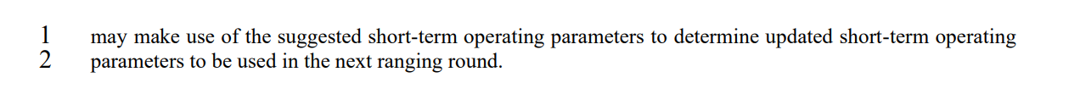
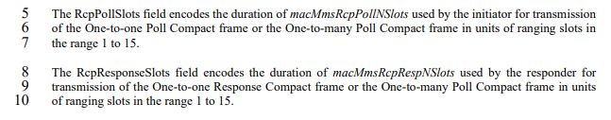
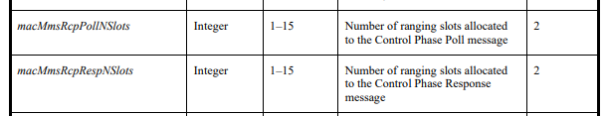
September 17th, 2025
        DCN 15-25-0485-00-04ab
Resolutions to CIDs 266, 267, 268, 269, 270 – Recommendation: Accepted
CID 266 Page 80, line 2
In case of UWB driven MMS the SYNC+SFD fragment of UWB MMS packet can be used for carrier frequency offset estimation. If there is no other reason to send a dedicated poll and response frame, macMmsRcpPollNSlots and/or macMmsRcpRespNSlots can be set to 0 to indicate zero length control phase and the SYNC+SFD fragment of the UWB MMS packet serves as the poll or the response.
CID 267, 268 Page 105, lines 7 and 10.
0 to15.
0 to15.
CID 269, 270 Page 145, table 31.
0-15
0-15
Slide 2
R. Pirhonen

Slide 4
September 17th, 2025
        DCN 15-25-0485-00-04ab
NBA-MMS and UWB Driven MMS
NBA-MMS (UWB MMS packet Config 2)
UWB Driven MMS (UWB MMS packet Config 1)
NB
RSF/RIF
RSF/RIF
RSF/RIF
RSF/RIF
SP0
SYNC+SFD
RSF/RIF
RSF/RIF
RSF/RIF
RSF/RIF
CONTROL
RANGING PHASE
CONTROL
RANGING PHASE
macMmsRcpPollNSlots
macMmsRcpRespNSlots
macMmsRpDuration
macMmsRcpPollNSlots
macMmsRcpRespNSlots
macMmsRpDuration
SYNC and message content in one NB packet
Message content in SP0 packet
SYNC and SFD for fragment reception
NB has good link budget so both SYNC and data can be provided in one packet
In UWB Driven mode short SYNC+SFD fragment is used for synchronization
  Unfortunately, the link budget is limited by the SP0 data packet before the SYNC+SFD fragment.
Avoiding the SP0 UWB transmission would improve link budget, reduce power consumption, reduce interference and make ranging faster
Slide 3
R. Pirhonen

Slide 5
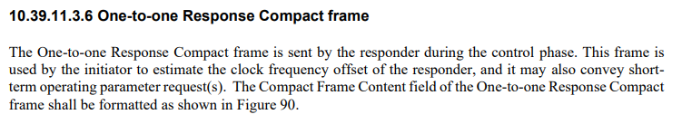
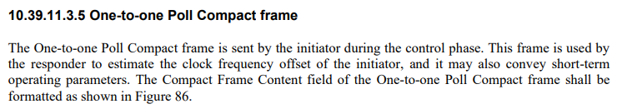
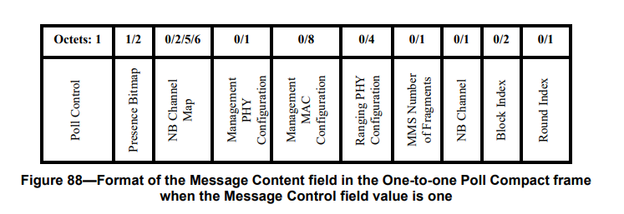
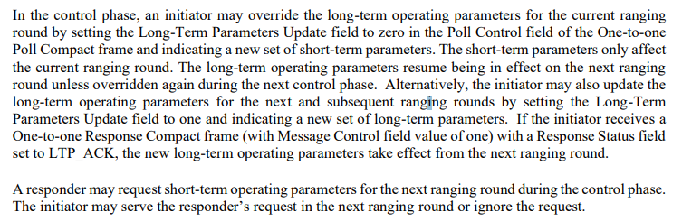
Impact on protocol - When you have to use SP0
September 17th, 2025
        DCN 15-25-0485-00-04ab
All Control Field values
Control Field value 1
When short- or long-term parameters are to be set or requested, the Poll and Response SP0 frames have message content and SP0 has to be used.
The default value is 1, and unless all the devices agree, SP0 is used.
R. Pirhonen

Slide 6
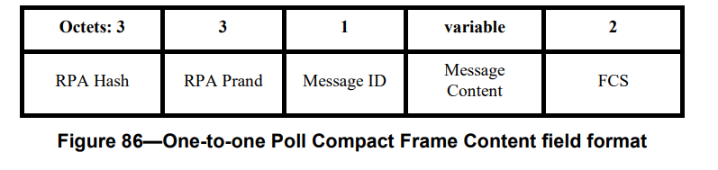
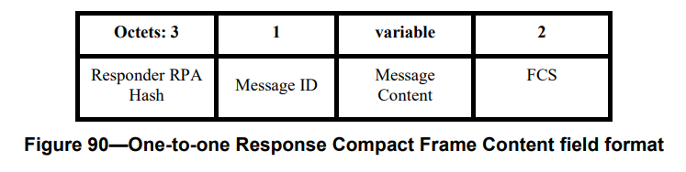
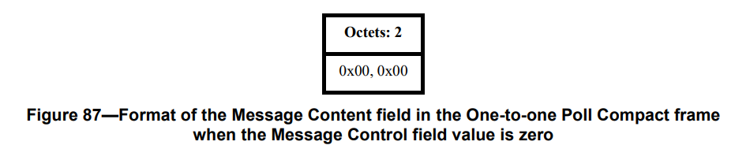
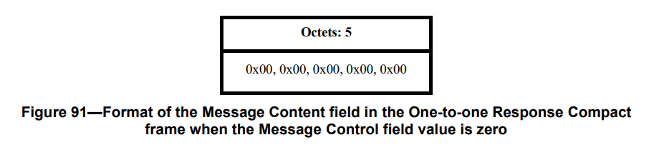
September 17th, 2025
        DCN 15-25-0485-00-04ab
Impact on protocol - When you don’t necessarily need the SP0
All Control Field values
Control Field value 1
Poll compact frame content (Control field value 0)
Response compact frame content (Control field value 0)
Setting control phase length to zero would lead to skipping the SP0 packet with zeroes as message content
Slide 5
R. Pirhonen

Slide 7
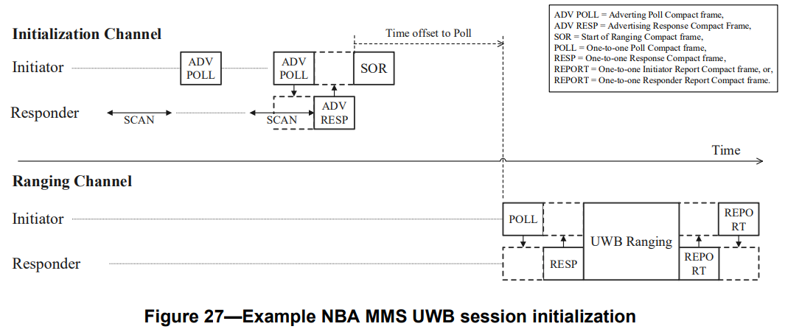
September 17th, 2025
        DCN 15-25-0485-00-04ab
Impact on protocol – Finding the SYNC
Start of Ranging (SOR) Time offset to Poll indicates start of SYNC + SFD
  Poll can be NB or UWB
If macMmsRcpPollNSlots and macMmsRcpRespNSlots are set to zero,
  Control phase becomes zero length
  SOR points directly to the SYNC + SFD of the UWB MMS packet
SYNC + SFD of the MMS UWB ranging packet can be used for more robust Poll and Response
If macMmsRcpPollNSlots and macMmsRcpRespNSlots are set to zero, the SOR Time Offset points directly to the SYNC+SFD of the ranging packet, which are used for POLL and RESP.
Slide 6
R. Pirhonen

Slide 8
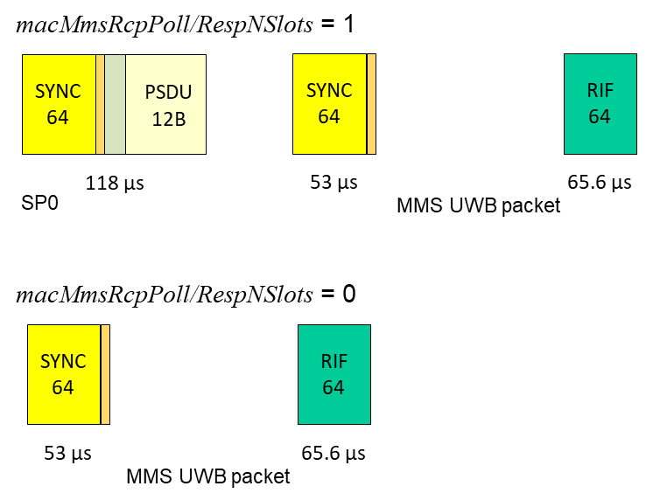
Benefits of zero control phase length
September 17th, 2025
        DCN 15-25-0485-00-04ab
Poll and Response use robust SYNC + SFD, no need for message content decoding
Integrity through robust RIF
In the minimalistic case of one ranging fragemtn
  Link budget improved by 3.8 dB, 55% more range and 140% more area (FSPL)
  Power consumption reduced (to ~half)
  Interference time and collisions reduced to half
  Poll and response performance improved with shorter SYNC + SFD based poll and response, no need to decode SP0 packet.
  Ranging speed improved by 50%
1 ms
1 ms
1 ms
1 ms
1 ms
Control phase length 1 ms vs 0 ms
R. Pirhonen

Slide 9
Summary
September 17th, 2025
        DCN 15-25-0485-00-04ab
Start of Ranging Time offset to Poll parameter points to the start of SYNC + SFD
In case of UWB Driven MMS, also the MMS UWB packet has SYNC + SFD
Setting macMmsRcpPollNSlots and macMmsRcpRespNSlots to 0 allows skipping the SP0 packet
Instead of SP0 based Poll and Response, more reliable Poll and Response can be done with higher peak power SYNC + SFD fragments
High integrity achieved with RIF based integrity check
SP0 control packets are used by default (NSlots parameter values 1 – 15)
Recommendation for comment resolution is to Accept the Comments
R. Pirhonen

