Slide 1
Project: IEEE P802.15 Working Group for Wireless Specialty Networks (WSN)
Submission Title: Investigation on DPP Single Channel Modulation Schemes under Channel conditions.
July 2025
Date Submitted: 2025-09-17
Source: Vishal Kalkundrikar, Ondas Networks
Abstract: For DPP mode various modulations like QPSK, pi/4 DQPSK and GMSK are investigated under the channel conditions.
Purpose: Understand the performance of single carrier modulations under channel conditions and add the mitigation schemes.
Notice: This document has been prepared to assist the IEEE P802.15. It is offered as a basis for discussion and is not binding on the contributing individual(s) or organization(s). The material in this document is subject to change in form and content after further study. The contributor(s) reserve(s) the right to add, amend or withdraw material contained herein.
Release: The contributor acknowledges and accepts that this contribution becomes the property of IEEE and may be made publicly available by P802.15.

Slide 2
Channel Model
Rayleigh Channel Model.
  NO-LOS conditions.
  Three Multipaths
    Delays: 0.022ns, 2.33ns, 5.31 ns.
    Attenuation: 5dB, 10 dB, 15 dB.
  Speed: 10mph, 40mph, 70mph.
  RF Frequency: 450 MHz.
  Doppler: 6.7Hz, 26.8Hz, 46.9Hz.
  SNR Range: -10 to 5 dB (RSSI : -130 dBm to -115 dBm).

Slide 3
Waveforms under consideration:
Modulations:
  GMSK
  SQPSK
  Pi/4 DQPSK
Forward Error Correction:
  CTC Rate ½
  CTC Rate 2/3
  CTC Rate ¾
  CTC Rate 5/6
Repetition Combining:
  No Repetition
  8x Repetition

Slide 4
DPP- OFDM based Single Subchannel Parameters
Modulation used is QPSK with slot structure as defined in 802.16t.
Single Subchannel 12.5 kHz BW.
FEC Used for simulations: CC ½ (Next version of simulations to be with CTC 1/2)
Both simple repetitions and repetition/combining use 8 repetitions
Simple repetition: all message are decoded, and an error free instance is selected if available.
Repetition Combining: All the repeated blocks are combined to get the additional processing gain.
Packet size: 36 bytes

Slide 5
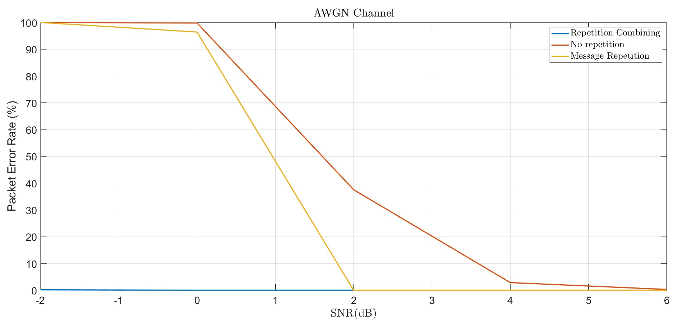
AWGN Channel (Perfect Synchronization, CC-1/2 Soft Demodulation)

Slide 6
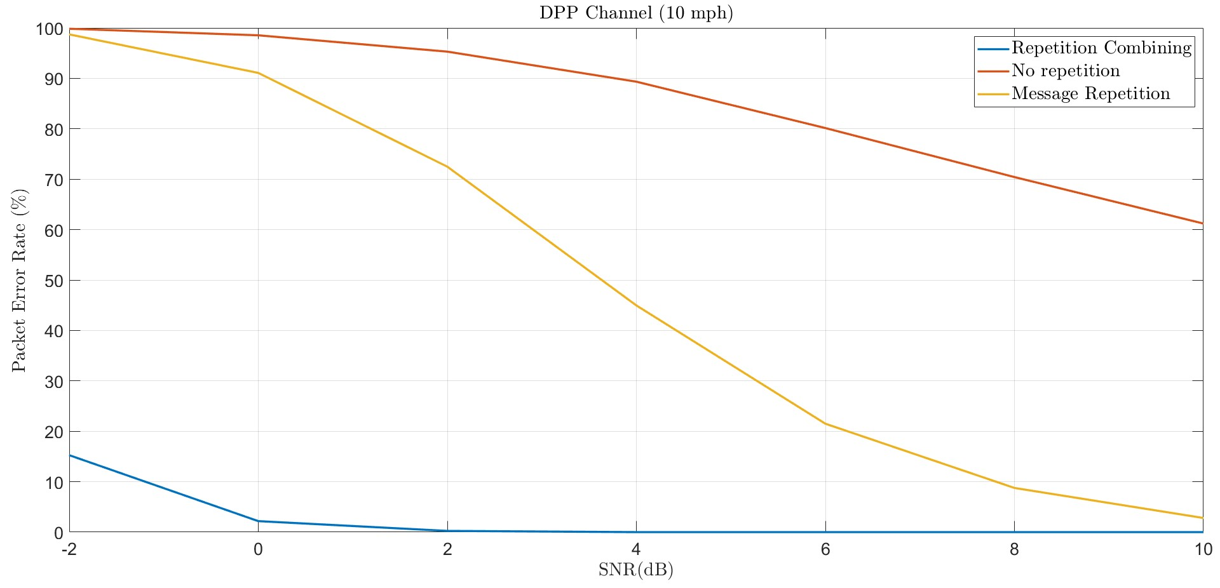
DPP Channel (10 mph, 3 Multipath, Perfect Synchronization, CC-1/2 Soft Demodulation)

Slide 7
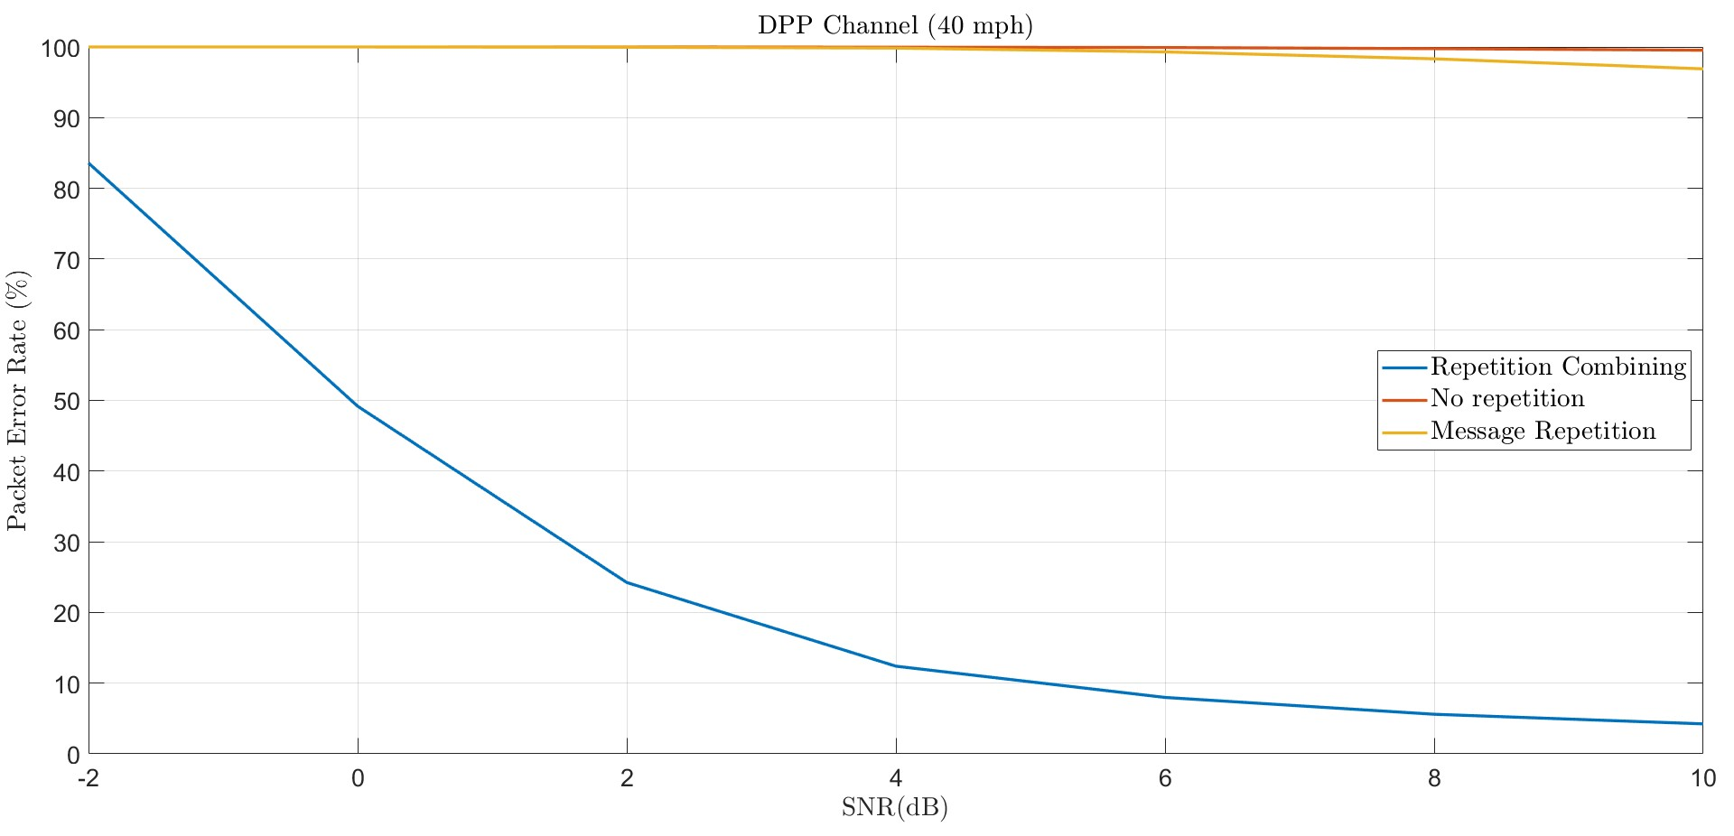
DPP Channel (40 mph, 3 Multipath, Perfect Synchronization, CC-1/2 Soft Demodulation)

Slide 8
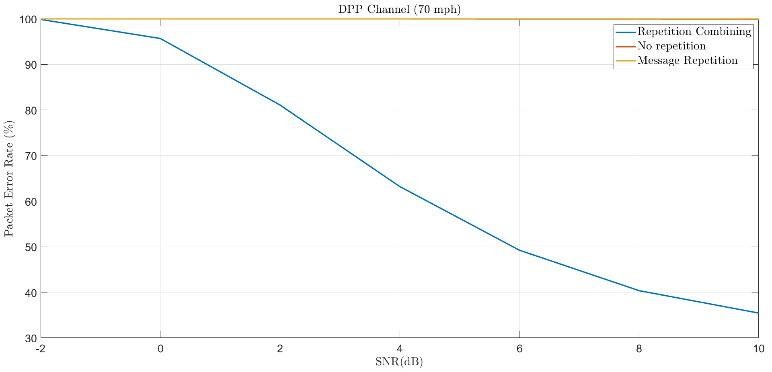
DPP Channel (70 mph, 3 Multipath, Perfect Synchronization, CC-1/2 Soft Demodulation)

Slide 9
DPP Single Channel Modulation and Waveform
For all the modulations 31 length Preamble sequence with same modulation as data was used for channel estimation and equalization.
There are No pilots within the data.
There is no Error correction scheme or repetition combining used.
Perfect Synchronization is considered.

Slide 10
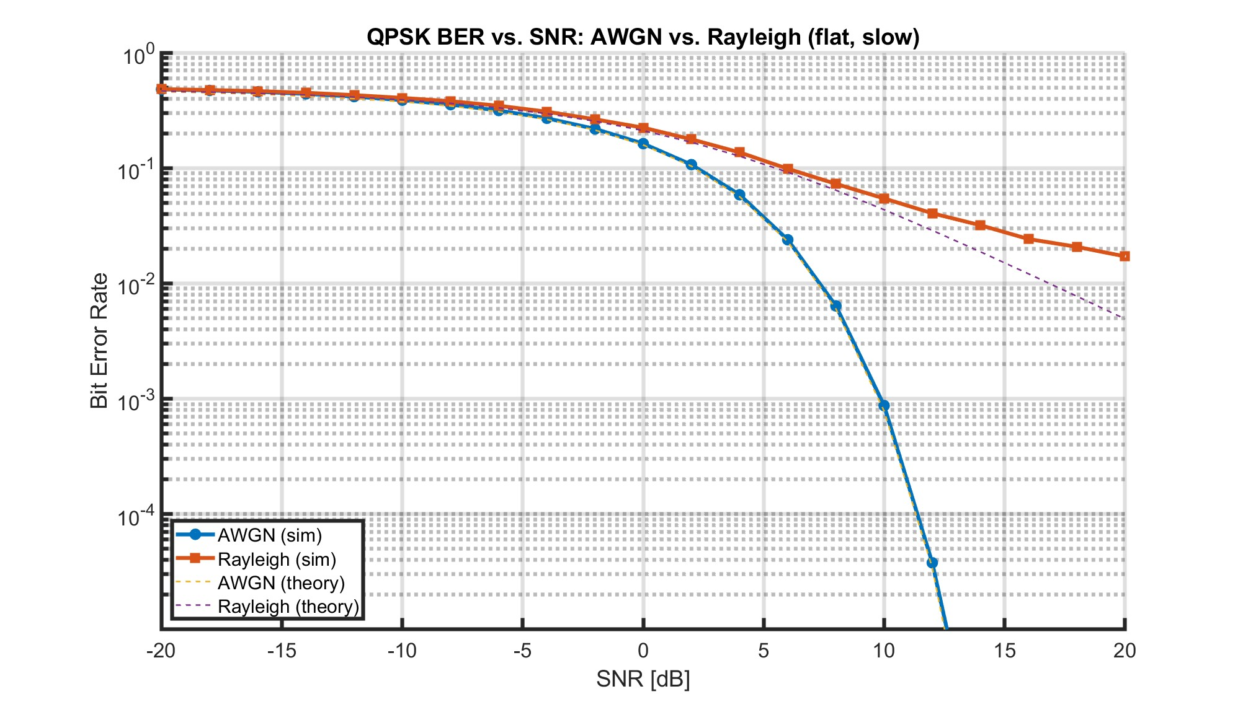
QPSK

Slide 11
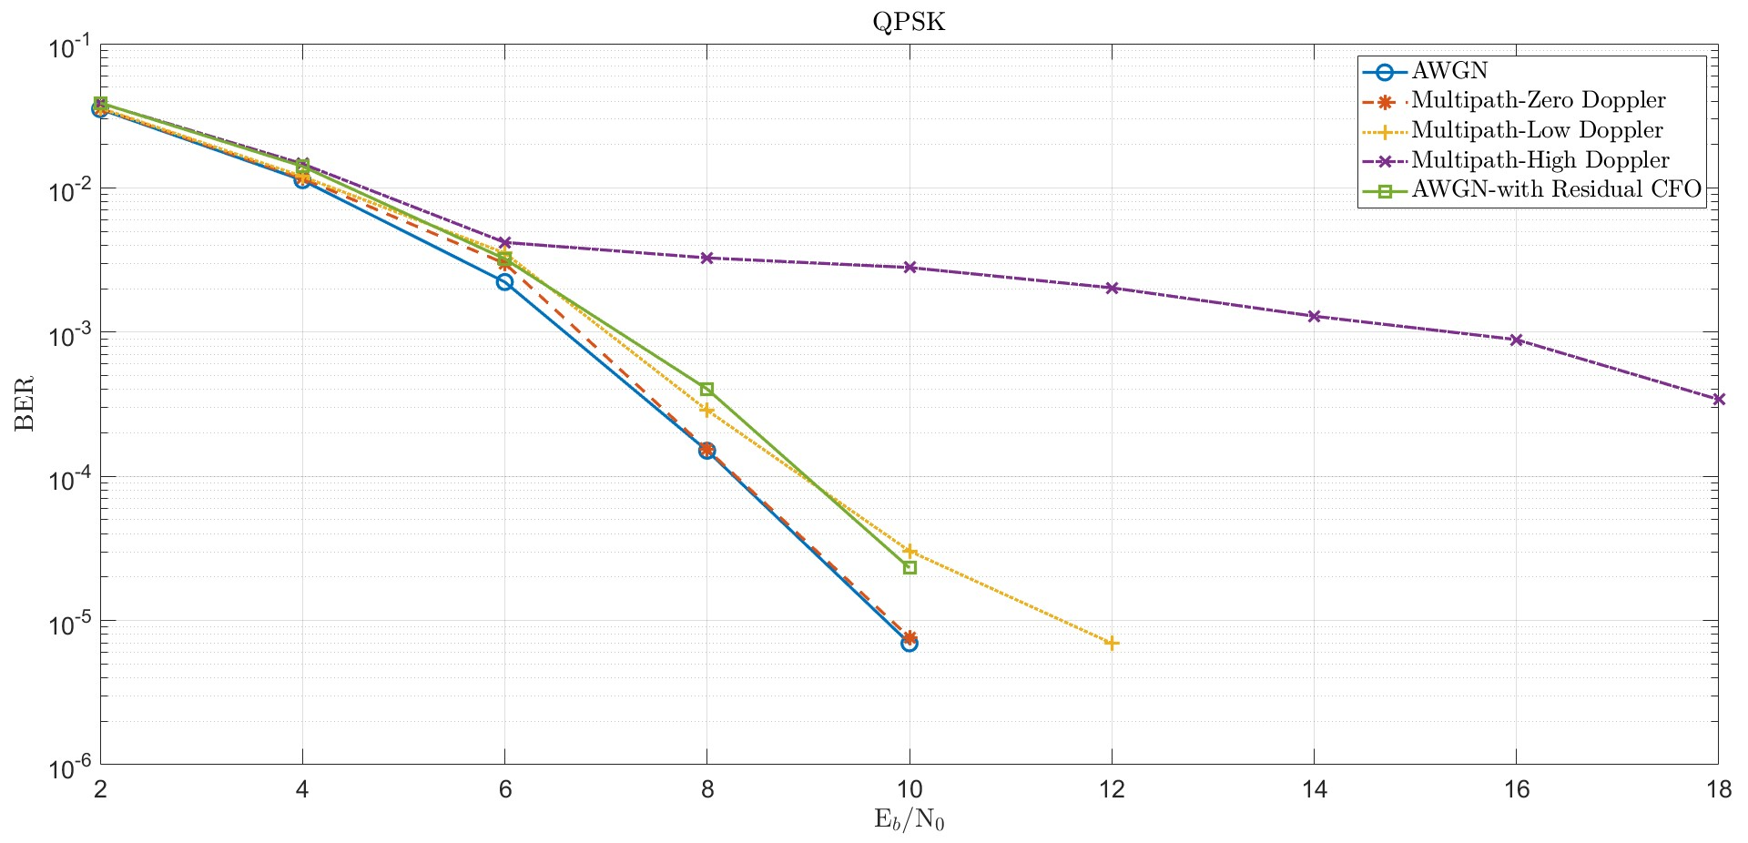
QPSK continued

Slide 12
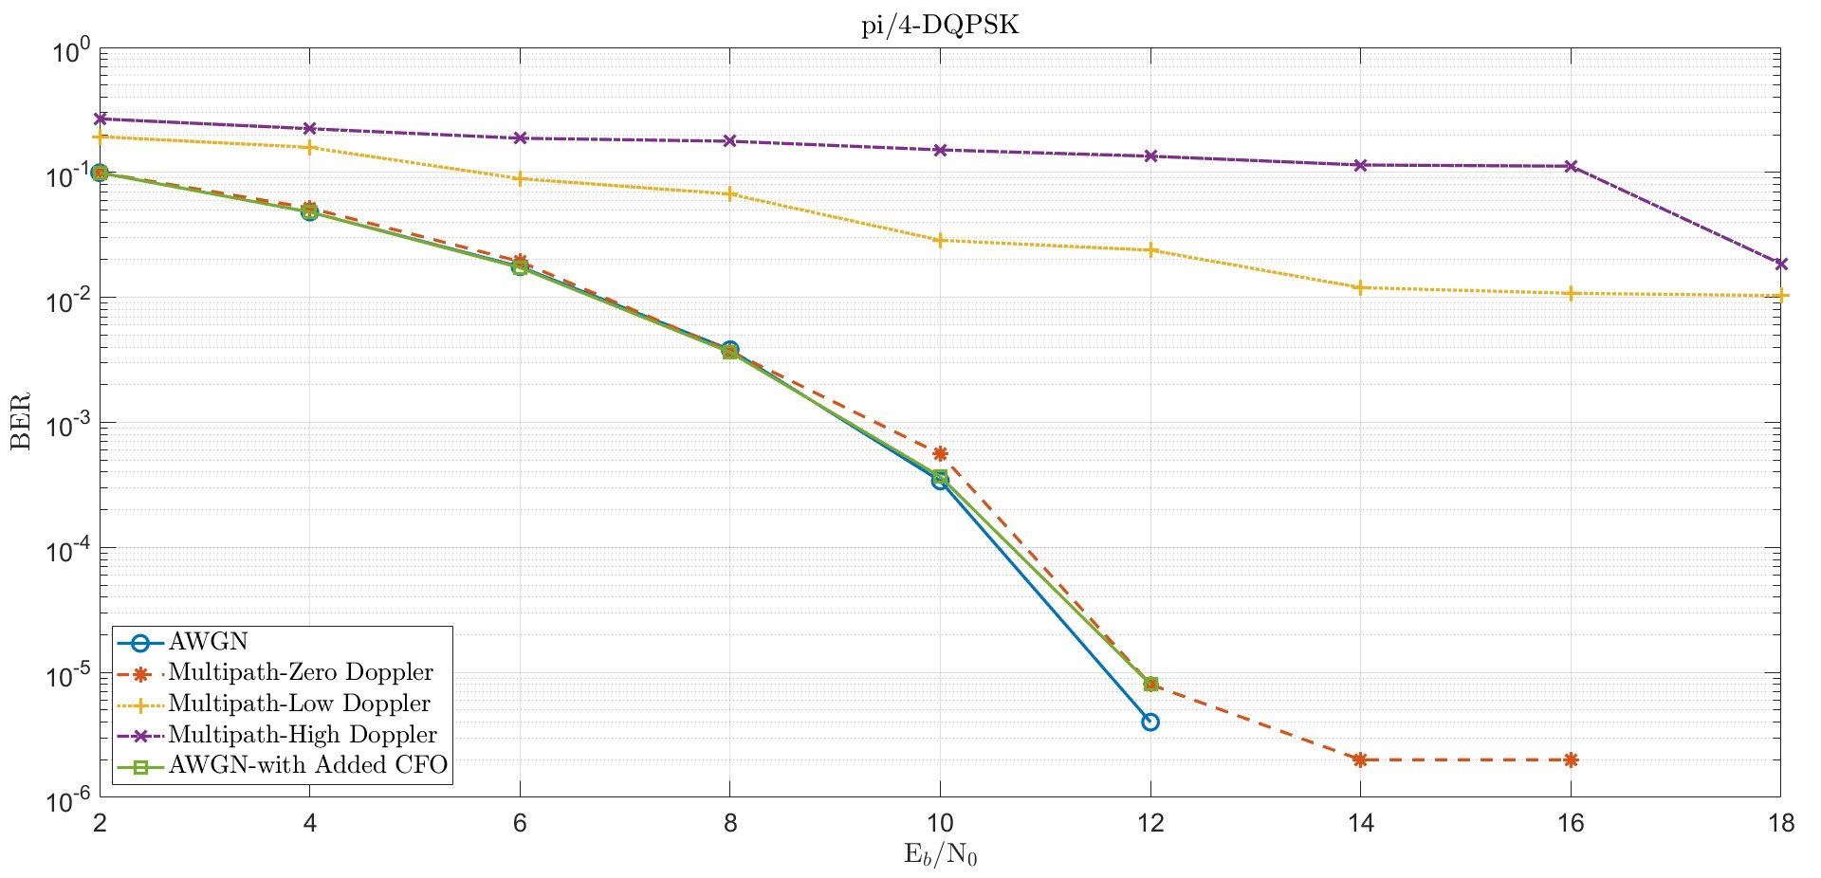
PI/4 DQPSK

Slide 13
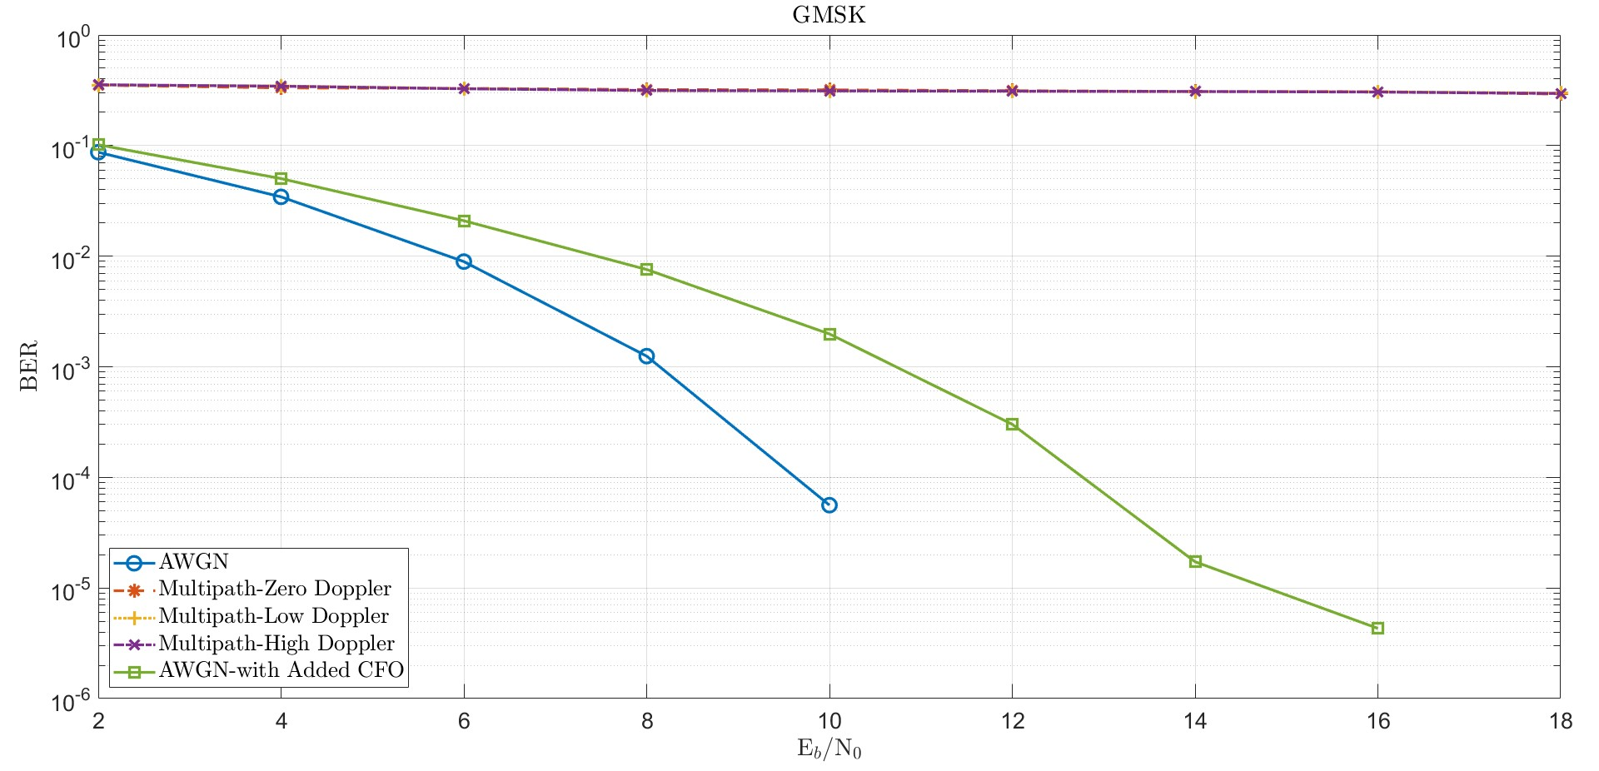
GMSK

Slide 14
Next Actions
Repeat the channel model analysis with Forward Error Correction.
Consider the Repetition combining to get the additional gain.
Explore diversity techniques.
Explore pilots addition for better channel estimation and corrections.
Compare the theoretical Vs simulation results under channel conditions.

Slide 15
M-Files for the DPP Single Channel Modulations under Channel
QPSK Modulation M-file
Pi/4 DQPSK Modulation M-file
GMSK Modulation M-file

Slide 16
Thank You

