Slide 1
Project: IEEE P802.15 Working Group for Wireless Specialty Networks (WSN)
Submission Title: Investigation on DPP Single Channel Modulation Schemes under Channel conditions.
July 2025
Date Submitted: 2025-09-17
Source: Vishal Kalkundrikar, Ondas Networks
Abstract: For DPP mode various modulations like QPSK, pi/4 DQPSK and GMSK are investigated under the channel conditions.
Purpose: Understand the performance of single carrier modulations under channel conditions and add the mitigation schemes.
Notice: This document has been prepared to assist the IEEE P802.15. It is offered as a basis for discussion and is not binding on the contributing individual(s) or organization(s). The material in this document is subject to change in form and content after further study. The contributor(s) reserve(s) the right to add, amend or withdraw material contained herein.
Release: The contributor acknowledges and accepts that this contribution becomes the property of IEEE and may be made publicly available by P802.15.

Slide 2
DPP Single Channel mode Parameters
RF Frequency – 450 MHz
Number of Multipaths – 3
Path Delays – 0.022ns, 2.33ns, 5.314ns
Path Attenuations in dB – -15, -18, -22.5
Maximum Doppler Shift – 0.1 to 1 Hz
Channel Model used – Rayleigh

Slide 3
DPP Single Channel Modulation and Waveform
For all the modulations 31 length Preamble sequence with same modulation as data was used for channel estimation and equalization.
There are No pilots within the data.
There is no Error correction scheme or repetition combining used.
Perfect Synchronization is considered.

Slide 4
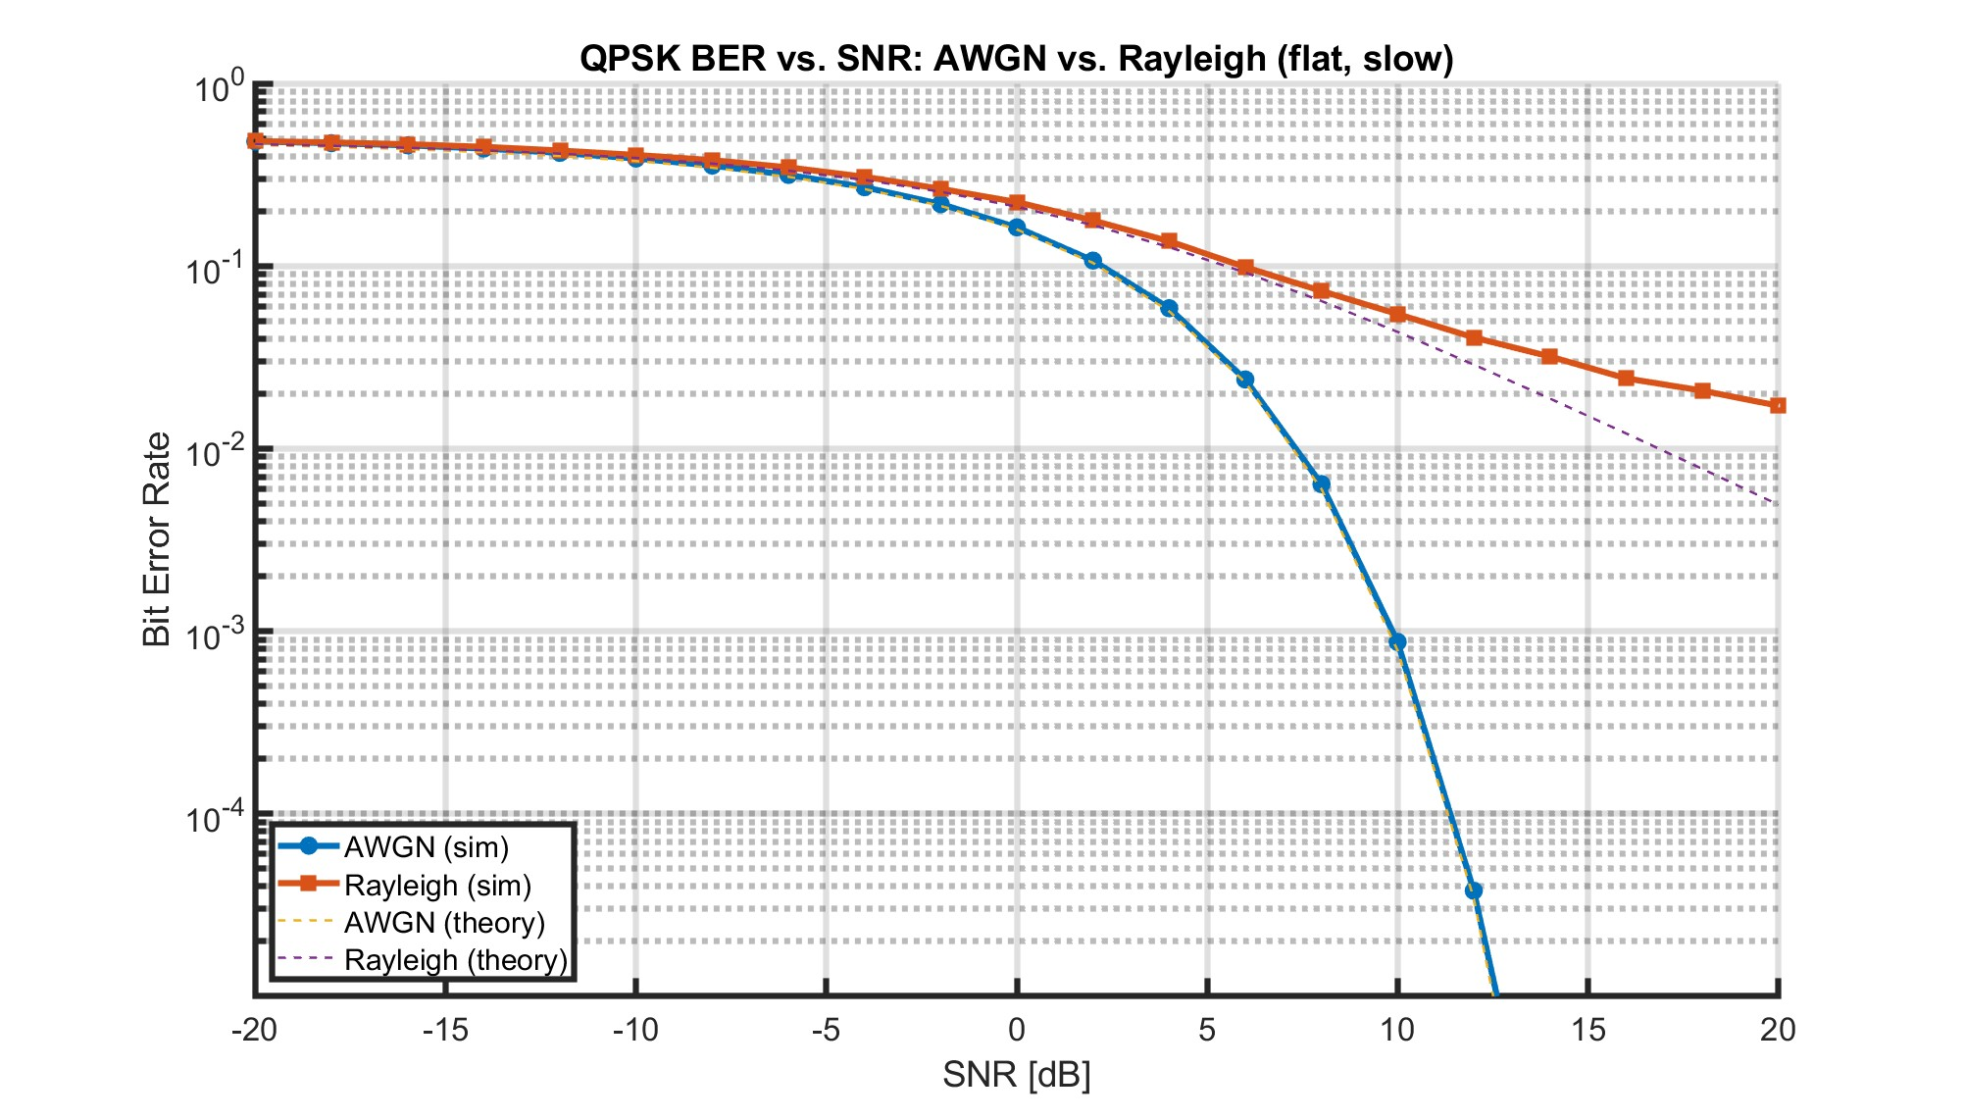
QPSK

Slide 5
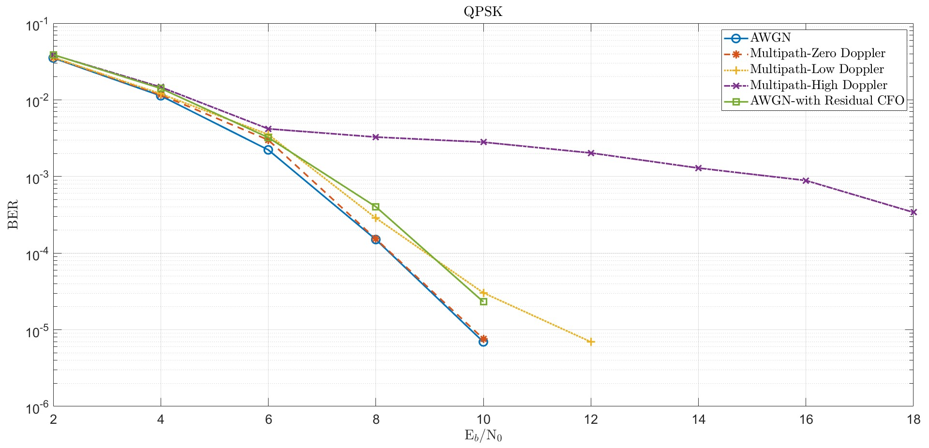
QPSK continued

Slide 6
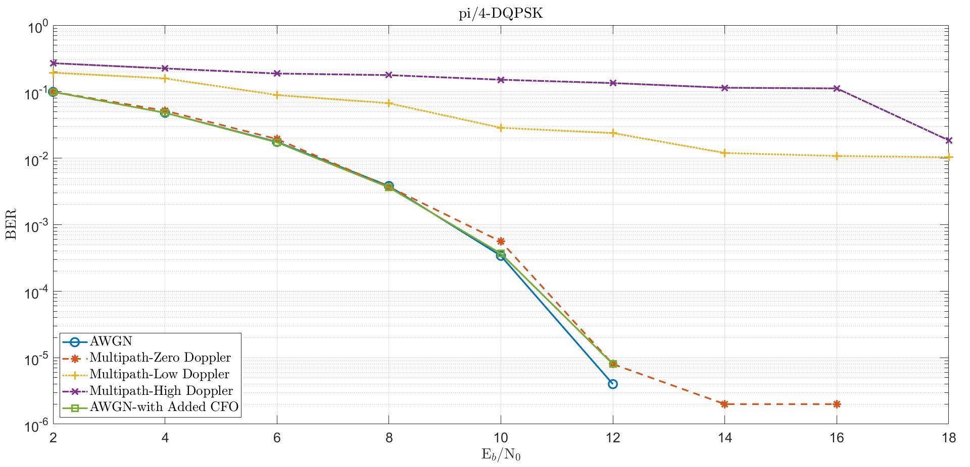
PI/4 DQPSK

Slide 7
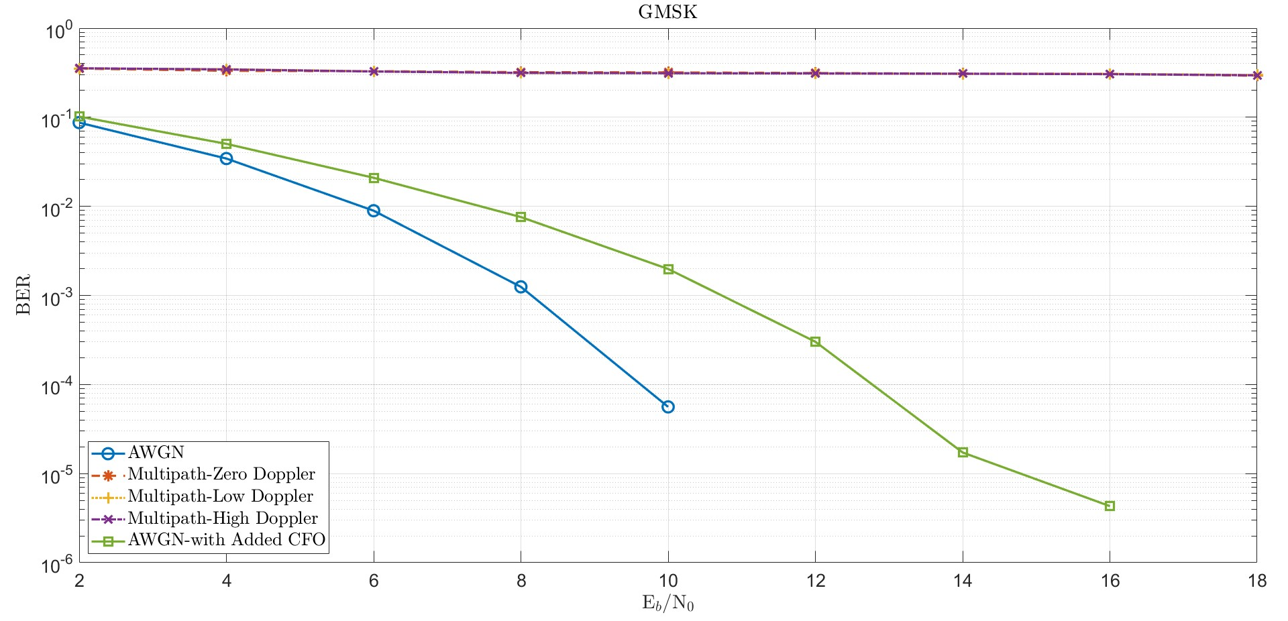
GMSK

Slide 8
Next Actions
Repeat the channel model analysis with Forward Error Correction.
Consider the Repetition combining to get the additional gain.
Explore diversity techniques.
Explore pilots addition for better channel estimation and corrections.
Compare the theoretical Vs simulation results under channel conditions.
Some simulations done earlier on the DPP single subchannel configuration are presented on the next slides.

Slide 9
DPP- OFDM based Single Subchannel Parameters
Modulation used is QPSK with slot structure as defined in 802.16t.
Both simple repetitions and repetition/combining use 8 repetitions
Message repetition decoding scheme for simple repetition: all message are decoded, and an error free instance is selected if available
Packet size: 36 bytes
3 Multipath model:
  Delays: 0.022 ns, 2.33 ns, and 5.31 ns
  Attenuation: 5, 10 & 15 dB
RF Frequency: 450 MHz

Slide 10
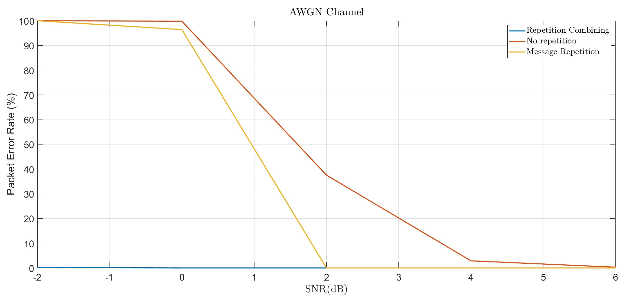
AWGN Channel (Perfect Synchronization, CC-1/2 Soft Demodulation)

Slide 11
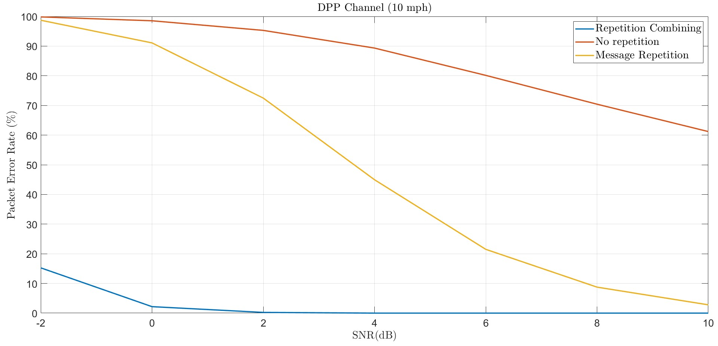
DPP Channel (10 mph, 3 Multipath, Perfect Synchronization, CC-1/2 Soft Demodulation)

Slide 12
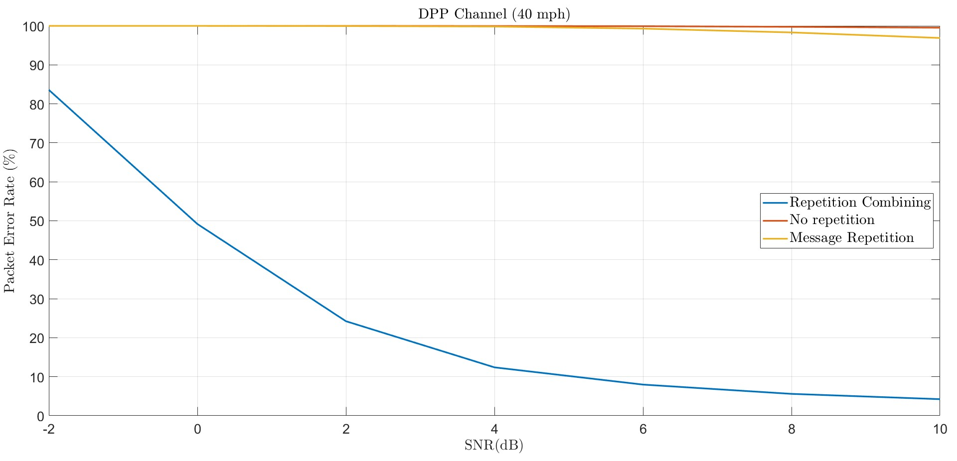
DPP Channel (40 mph, 3 Multipath, Perfect Synchronization, CC-1/2 Soft Demodulation)

Slide 13
Summary
Mainly Repetition combining along with FEC and pilots helps in mitigating the channel conditions.
Some of these techniques will be applied to the Singe channel modulation schemes and results will be shared in the November meeting.

Slide 14
Thank You

