Slide 1
Project: IEEE P802.15 Working Group for Wireless Personal Area Networks (WPANs)
Submission Title : Long Range extension of the 802.15.4-2020 OFDM PHY
Date Submitted : September 17, 2025
Source : Thomas Almholt (Texas Instruments, Inc), Tomas Motos (Texas Instruments, Inc)
Re : TG4ad Next Generation SUN PHYs
Abstract : This contribution describes the synchronization of OFDM-LR frame
Purpose: Long Range technology proposal
Notice: This document has been prepared to assist the IEEE P802.15.4ad It is offered as a basis for discussion and is not binding on the contributing individual(s) or organization(s). The material in this document is subject to change in form and content after further study. The contributor(s) reserve(s) the right to add, amend or withdraw material contained herein.
Release: The contributor acknowledges and accepts that this contribution becomes the property of IEEE and may be made publicly available by P802.15.
Slide 1
Notes:
Jul 12, 2010
Page 1

Slide 2
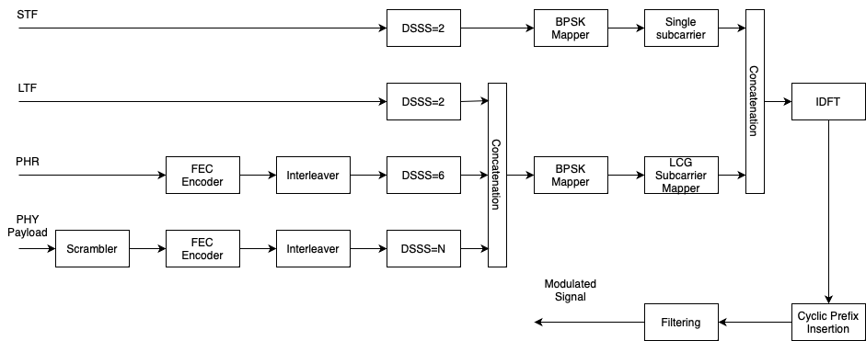
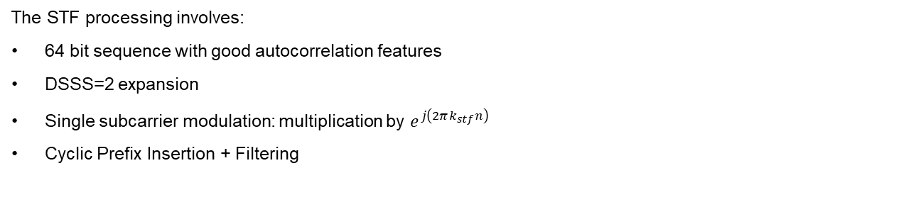
STF Modulation
The STF processing involves:
64 bit sequence with good autocorrelation features
DSSS=2 expansion
Single subcarrier modulation: multiplication by $e^{j\left(2πk_{stf}n\right)}$
Cyclic Prefix Insertion + Filtering

Slide 3
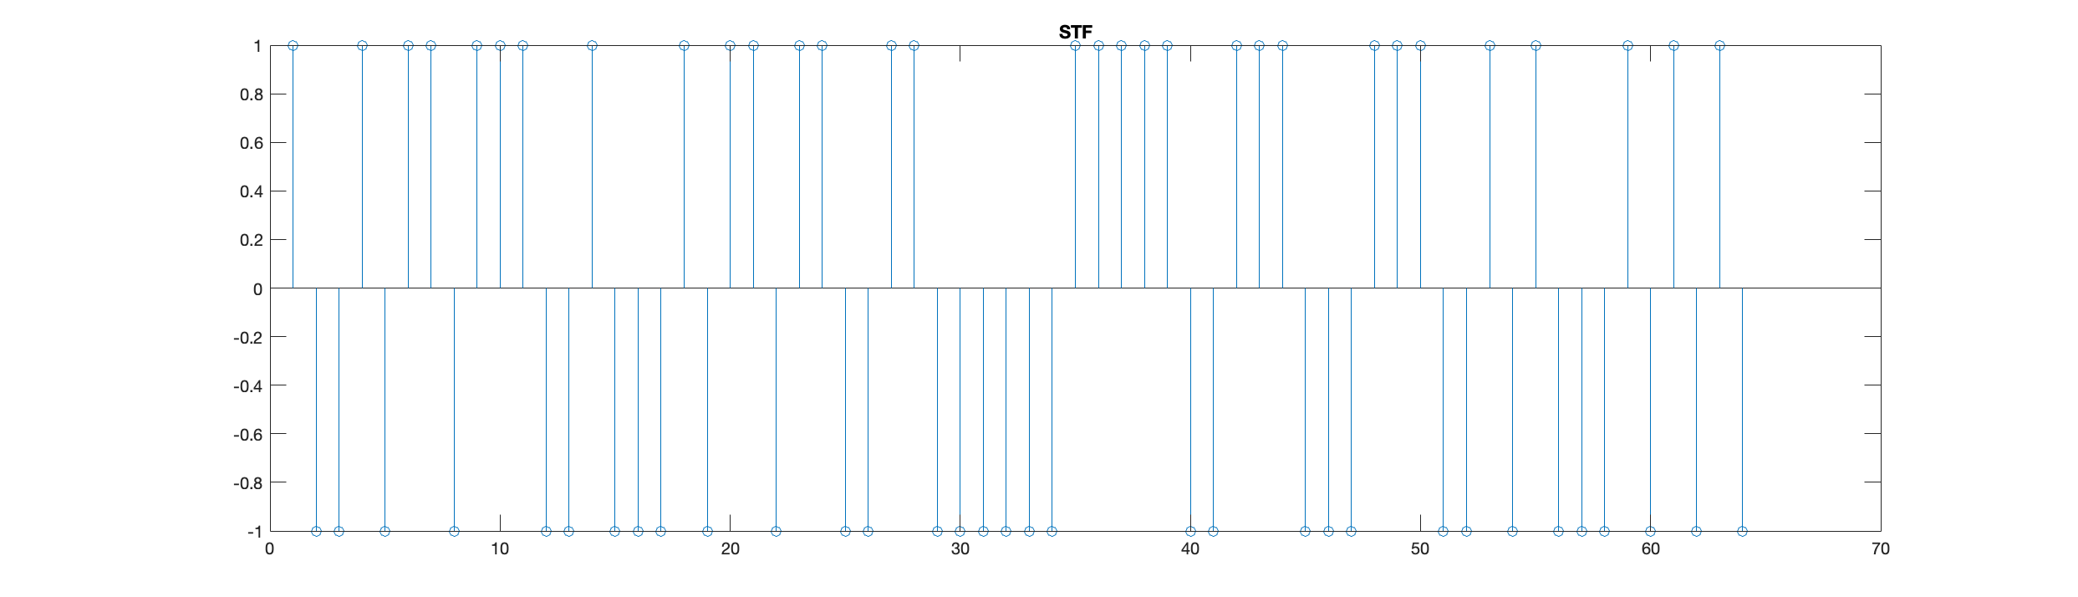
STF Modulation
SFF is transmitted left to right and defined below:
STF = [ 1 0 0 1 0 1 1 0 1 1 1 0 0 1 0 0 0 1 0 1 1 0 1 1 0 0 1 1 0 0 0 0
0 0 1 1 1 1 1 0 0 1 1 1 0 0 0 1 1 1 0 0 1 0 1 0 0 0 1 0 1 0 1 0 ];
Input bit to chip is defined:
Final bit to chip table is defined as below
K | Input bit | Chip Values (c0 c1)
K=even | 0 | 0 0
 | 1 | 0 1
K=odd | 0 | 1 1
 | 1 | 1 0

Slide 4
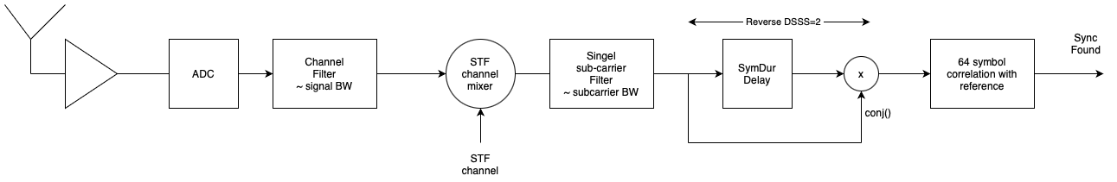
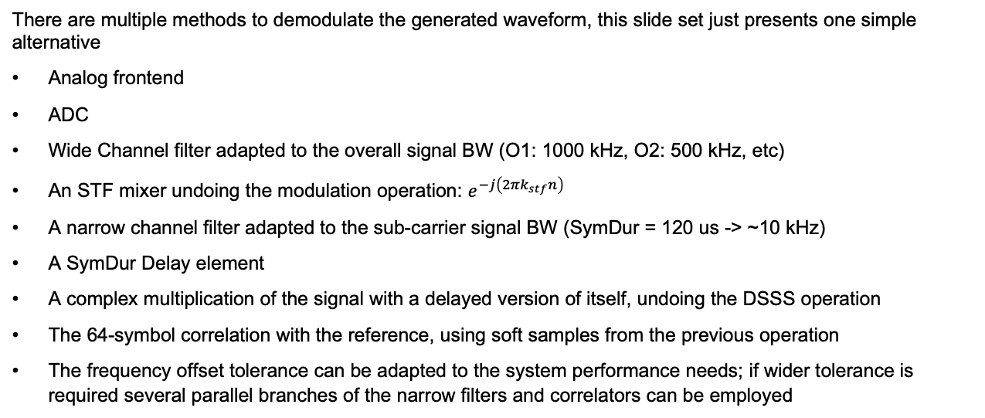
STF Demodulation
There are multiple methods to demodulate the generated waveform, this slide set just presents one simple alternative
Analog frontend
ADC
Wide Channel filter adapted to the overall signal BW (O1: 1000 kHz, O2: 500 kHz, etc)
An STF mixer undoing the modulation operation: $e^{−j\left(2πk_{stf}n\right)}$
A narrow channel filter adapted to the sub-carrier signal BW (SymDur = 120 us -> ~10 kHz)
A SymDur Delay element
A complex multiplication of the signal with a delayed version of itself, undoing the DSSS operation
The 64-symbol correlation with the reference, using soft samples from the previous operation
The frequency offset tolerance can be adapted to the system performance needs; if wider tolerance is required several parallel branches of the narrow filters and correlators can be employed

Slide 5
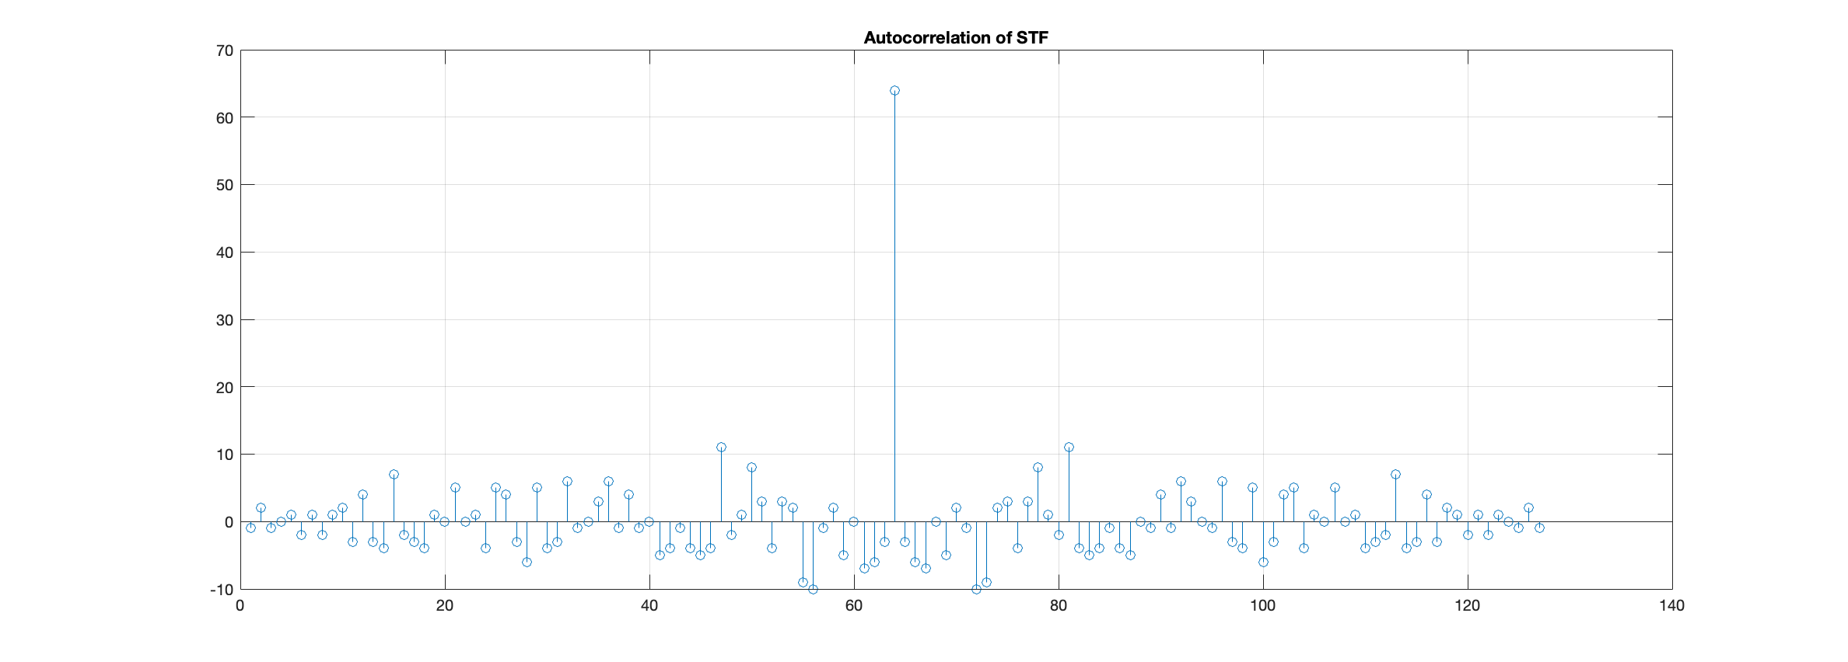
STF Demodulation
Autocorrelation properties of the proposed STF
Secondary peak is more than 15 dB below the main peak
Allows robust detection of the STF even for low SNR conditions
Does not limit the overall PER of the packet reception

Slide 6
Conclusions
This material presents a simple synchronization scheme for the proposed STF sequence
The HW requirements of this proposal are limited and allow low-cost implementations to exist

