Slide 1
Project: IEEE P802.15 Working Group for Wireless Personal Area Networks (WPANs)
Submission Title: IG Access September Meeting Slides
Date Submitted: September 16, 2025
Source: Benjamin A. Rolfe (Blind Creek Associates)
Contact:
Voice: +1 408 395 7207, E-Mail: ben.rolfe @ ieee.org
Re: Wireless Next Generation
Abstract: Agenda and Meeting Slides for the September 2025 Plenary Session. Interest group access
Purpose: Support the illusion of organization.
Notice: This document has been prepared to assist the IEEE P802.15. It is offered as a basis for discussion and is not binding on the contributing individual(s) or organization(s). The material in this document is subject to change in form and content after further study. The contributor(s) reserve(s) the right to add, amend or withdraw material contained herein.
Release: The contributor acknowledges and accepts that this contribution becomes the property of IEEE and may be made publicly available by P802.15.
Notes:
Jul 12, 2010
Page 1

Slide 2
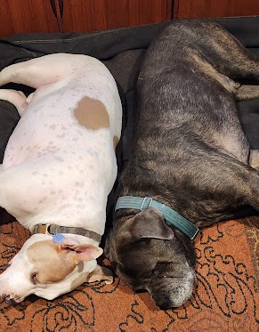
September 2025 Wireless Interim
Interest Group Spectrum Access
Live from Waikoloa Beach, Big Islands, HI, USA
And
Remote around the world

Slide 3
Hybrid Meeting
Registration is required
Please remember to enter your attendance in IMAT
Reminder:
This is a non-PAR activity
All the rules of conduct apply https://grouper.ieee.org/groups/802/sapolicies.shtml

Slide 4
Agenda 16 September 2025
Opening and Meeting Reminders
Overview of Interest Group
Technical Discussion
  Effect of using different CCA Modes and different ED Threshold in suspendable CSMA-CA
  Enhancement of SRM for Adapting Coexisting Environments
Any other business
Adjourn

Slide 5
Opportunity Statement
Need to share spectrum
Need to share with uncoordinated, random access
Sharing through coexistence is essential
Need to accommodate reality
We need a systems view to expand sharing methods
Positive Sharing through Coexistence

Slide 6

Technical Contributions

Slide 7
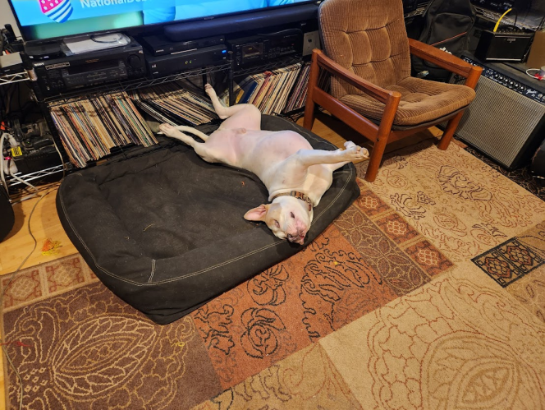
Discussion

Slide 8

Any Other Business

Slide 9
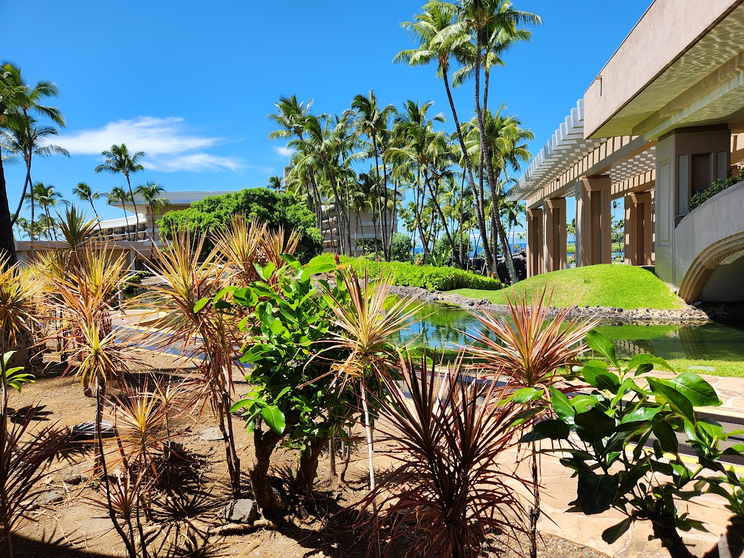
Adjourned

Slide 10
Minutes
  TBD

Slide 11
IG Attendance

