Slide 1
Project: IEEE P802.15 Working Group for Wireless Specialty Networks (WSN)
Submission Title: PtMP 802.16s Overlapping Coverage.
July 2025
Date Submitted: 2025-09-16
Source: Vishal Kalkundrikar, Ondas Networks
Abstract: When two or more BSs with same configuration have overlapped coverages the degradation in CINR is higher than expected due to pilots-based channel estimation and correction.
Purpose: Proposal for the possible solutions to address the overlapping BSs with same configuration.
Notice: This document has been prepared to assist the IEEE P802.15. It is offered as a basis for discussion and is not binding on the contributing individual(s) or organization(s). The material in this document is subject to change in form and content after further study. The contributor(s) reserve(s) the right to add, amend or withdraw material contained herein.

Slide 2
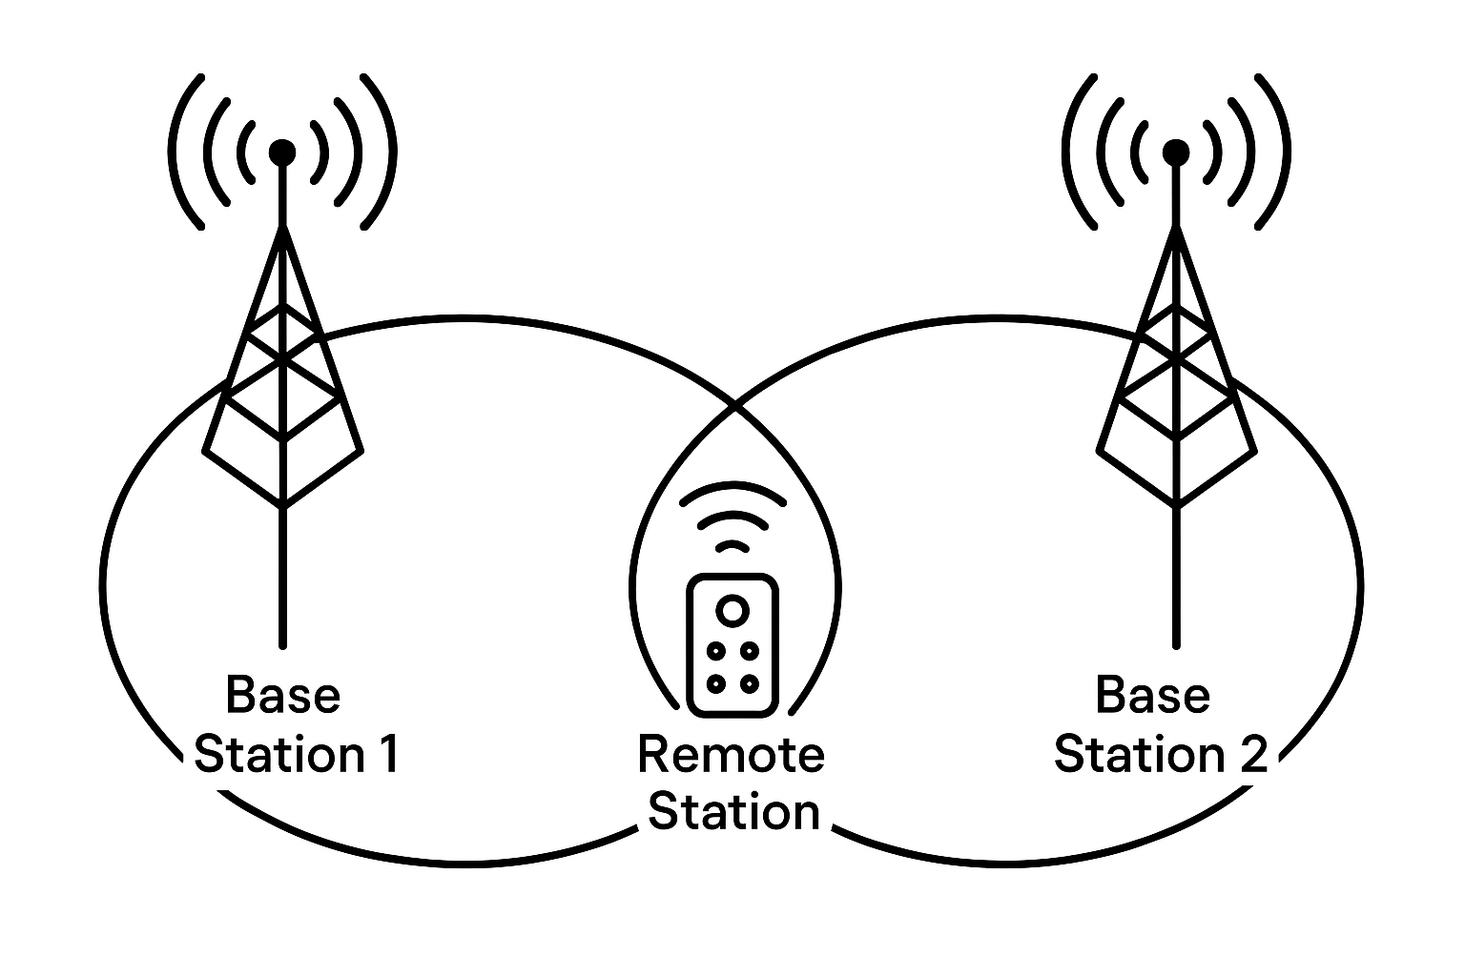
Two or more Base Stations with same configuration and Remote operating in Overlapped area

Slide 3
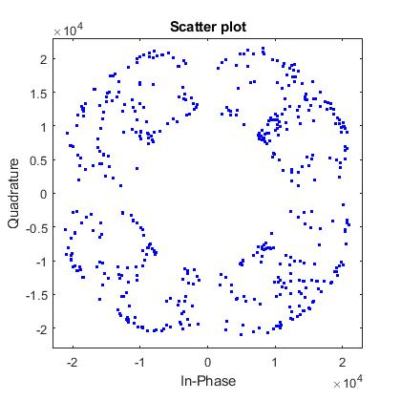
Two BS overlapped with Main BS is 10 dB higher power than the secondary BS
Expected CINR: 10 dB
Measured CINR: 5 to 6 dB
Simulation done with residual CFO of 10 Hz.
Both the BSs transmit same pilot pattern.

Slide 4
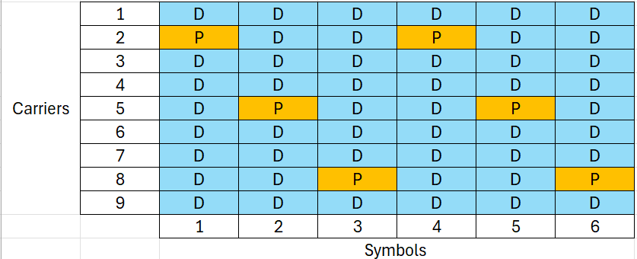
IEEE 802.16s Slot Structure
Slot has 9 subcarriers over 6 symbols.
Pilots are present on subcarrier index 2,5,8.

Slide 5
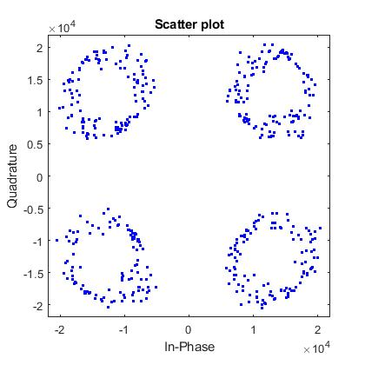
Two BS overlapped with Main BS is 10 dB higher power than the secondary BS
Expected CINR: 10 dB
Measured CINR: 9 to 10 dB
Simulation done with residual CFO of 10 Hz.
Only Main BS transmits pilots, secondary BS only data No pilots.

Slide 6
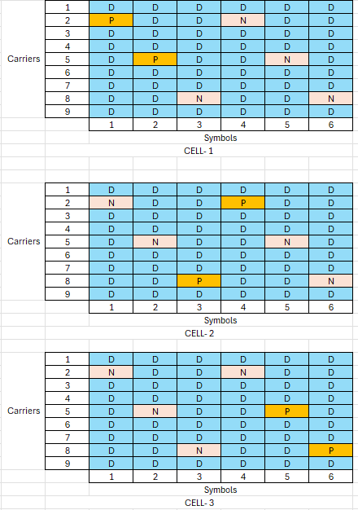
Proposed Solution: Mutually Exclusive Pilots
Two Pilots per Slot Per BS

Slide 7
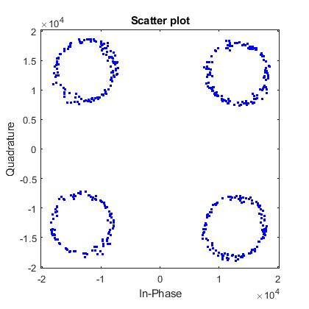
Two BS overlapped with Main BS is 10 dB higher power than the secondary BS
Expected CINR: 10 dB
Measured CINR: 9 to 10 dB
Simulation done with residual CFO of 10 Hz.
Two Pilots Per BS with Mutually exclusive Pilots pattern.

Slide 8
Summary
Problem with overlapping BSs with same configuration worsens with same pilot pattern due to channel estimation and corrections.
Mutual Exclusive pilots scheme with minimum two pilots per BS is proposed and shown to help in achieving the expected CINR.
With this only 3 overlapping BSs will be supported for more better solution to be found.

Slide 9
Thank You

