Slide 1
Project: IEEE P802.15 Working Group for Wireless Specialty Networks (WSNs)
Submission Title: Small Form-factor and Lightweight Construction for Fast-Mobility FSO UAV Communication System
Date Submitted: September 17, 2025
Source: Irzal Zaini, Ida Bagus Krishna Yoga Utama, Md Minhazur Rahman, Huy Nguyen, Yeong Min Jang (Kookmin University)
Address: Kookmin University, 77 Jeongneung-Ro, Seongbuk-Gu, Seoul, 136702, Republic of Korea
Voice: +82-2-910-5068 E-Mail: yjang@kookmin.ac.kr
Re:
Abstract: Present the use case of Lightweight FSO UAV Design for Fast-Mobility Communication
Purpose: Presentation for contribution on IG NG-FSO
Notice: This document has been prepared to assist the IG NG-FSO. It is offered as a basis for discussion and is not binding on the contributing individual(s) or organization(s). The material in this document is subject to change in form and content after further study. The contributor(s) reserve(s) the right to add, amend or withdraw material contained herein.
Release: The contributor acknowledges and accepts that this contribution becomes the property of IEEE and may be made publicly available by IG NG-FSO.

Slide 2
Small Form-factor and Lightweight Construction for Fast-Mobility FSO UAV Communication System
Contribution
September 17, 2025

Slide 3
Contents
Background
FSO UAV Communication System
Fast-Mobility FSO Communication
Proposed Lightweight FSO UAV Design
Conclusion

Slide 4
Background
Relay-assisted FSO communication systems are used to mitigate the effects of the atmospheric turbulence. However, conventional ground relays are fixed, so the optimal placement is not always achievable.
Due to their mobility and flexibility, Unmanned Aerial Vehicles (UAVs) provide solution for FSO relaying systems.
To allow efficient operations, it is highly recommended to have a lightweight construction of FSO UAV platform.

Slide 5
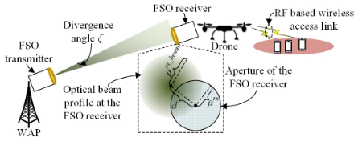
FSO UAV Communication System
In a UAV assisted wireless network, a UAV is deployed to relay traffic between the users and nearby wireless access point (WAP).
To alleviate the bottleneck in the fronthaul link between the UAV and the WAP, FSO is applied as the fronthaul communications solution.
However, due to the mobility of the UAV, a low cost and lightweight Acquisition, Tracking, and Pointing (ATP) system is required to ensure the low pointing loss for the FSO based fronthaul link.
Although many high-accurate ATP systems have been designed for the FSO system to achieve, for example, ground-to-satellite communications, these ATP systems have high weight and cost, and so may not be suitable to be applied in the UAV assisted wireless network, which may not require such high pointing accuracy.
<Example of FSO UAV Communication Network>

Slide 6
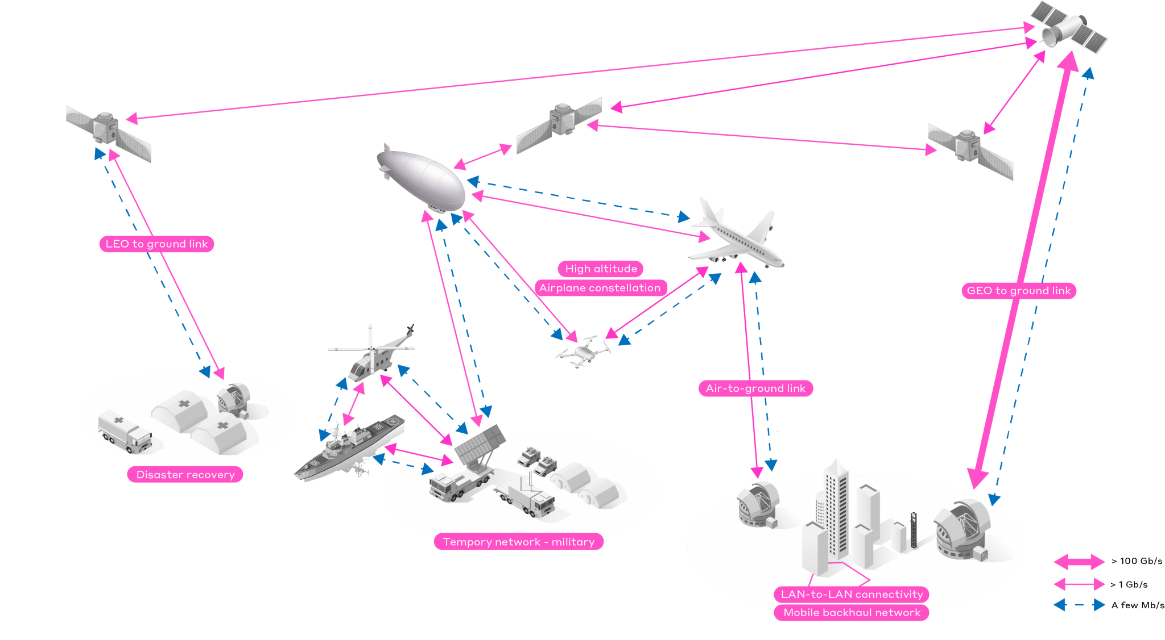
Fast-Mobility FSO Communication
Major challenge in FSO UAV Communication Link is the fast scanning, high-bandwidth Acquisition, Pointing, and Tracking (ATP) approach to achieve rapid link establishment and handover as well as to compensate for errors caused by vibrations of the aircraft platform.
The current standard for FSO system is quite heavy to implement in real UAV system, therefore a compact Small Form-factor Construction is necessary.
<Mobile UAV FSO Communication Environment>

Slide 7
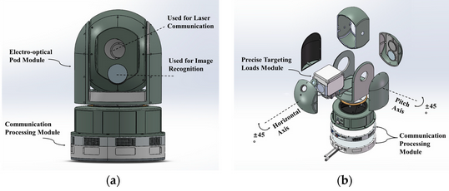
Proposed Lightweight FSO UAV Design
Reducing the Payload of UAV device is a challenging task.
FSO with ATP system that include gimbals, mirrors and sensors must be designed in minimized structure.
A combination of polymer-based skeletons should be used as the base material.
A further study is required to find the optimized minimum size of the FSO system without sacrificing performance.
<Small Form-factor FSO UAV Design>

Slide 8
Conclusion
Research and Development of Small Form-factor and Lightweight Construction for Fast-Mobility FSO UAV Communication System is necessary to employ real system with optimal efficiency.
A further study on polymer-based material is required to create compact FSO and ATP system, so that it can be deployed on UAV platforms.

Slide 9
Reference
Sun, X., et al. (December 2021). Low Cost ATP System Design for Free Space Optics based Drone Assisted Wireless Networks. IEEE Globecom Workshops (GC Wkshps): Workshop on Cellular UAV and Satellite Communications. 10.1109/GCWkshps56602.2022.10008619.
Sun. N., et al. (September 2024). High-Precision Tracking of Free-Space Optical Communication System on Mobile Platforms. Photonics 2024. https://doi.org/10.3390/photonics11100900.
Wang, J., et al. (October 2021). Hovering UAV-Based FSO Communications: Channel Modelling, Performance Analysis, and Parameter Optimization. IEEE Journal on Selected Areas in Communications. 10.1109/JSAC.2021.3088656.
Wu, D., et al. (September 2020). An FSO-Based Drone Assisted Mobile Access Network for Emergency Communications. IEEE Transactions on Network Science and Engineering. 10.1109/TNSE.2019.2942266.

