Slide 1
Project: IEEE P802.15 Working Group for Wireless Specialty Networks (WSNs)
Submission Title: Adaptive Beamforming and QPD-Based ATP for UAV FSO Links: Physical and MAC Layer Perspectives
Date Submitted: September 17, 2025
Source: Fadhila Ahmad, Ida Bagus Krishna Yoga Utama, Md Minhazur Rahman, Nguyen Ngoc Huy, Yeong Min Jang(Kookmin University), Hyoung-Jun Park, Chan Il Yeo, Siwoong Park (ETRI)
Address: Kookmin University, 77 Jeongneung-Ro, Seongbuk-Gu, Seoul, 02707, Republic of Korea
Voice: +82-2-910-5068 E-Mail: yjang@kookmin.ac.kr
Honam Research Division/ Optical ICT Convergence Research Section, ETRI, Republic of Korea
Voice: +82-62-970-6635 E-Mail: swp@etri.re.kr
Re:
Abstract: Present advancements and future directions of adaptive beamforming and QPD-based ATP for UAV-to-UAV FSO communication at the physical and MAC layer.
Purpose: Presentation for contribution on ATP for UAV-to-UAV FSO Communication
Notice: This document has been prepared to assist the IG NG-OCC. It is offered as a basis for discussion and is not binding on the contributing individual(s) or organization(s). The material in this document is subject to change in form and content after further study. The contributor(s) reserve(s) the right to add, amend or withdraw material contained herein.
Release: The contributor acknowledges and accepts that this contribution becomes the property of IEEE and may be made publicly available by IG NG-OWC

Slide 2
Adaptive Beamforming and QPD-Based ATP for UAV FSO Links: Physical and MAC Layer Perspectives
Contribution
September 17, 2025

Slide 3
Contents
Introduction
QPD-Based ATP Fundamentals
Challenges in UAV FSO ATP
AI-Enhanced ATP at Physical Layer
MAC Layer Innovations
Conclusion and Future Directions

Slide 4
Introduction
A drone network (UAV-to-UAV) connects multiple drones to work together on specific missions.
Free-Space Optical (FSO) communication offers high data rates and secure links using laser beams but requires very accurate alignment due to narrow optical beams.
Small UAVs can’t carry heavy gimbals, so using a QPD helps widen the field of view and allows fine pointing to be handled by other UAVs or a ground station.
Recent advances include the use of artificial intelligence (AI) to improve tracking accuracy and hybrid systems combining different pointing methods.
These improvements aim to support reliable, fast, and efficient UAV optical links.

Slide 5
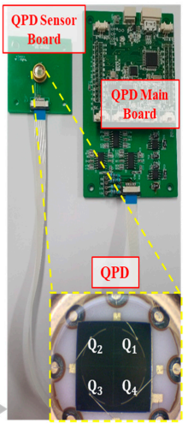
QPD-Based ATP Fundamentals
Quadrant Photodiode (QPD) has 4 photodiode segments detect laser spot position in X and Y directions.
Advantages using QPD is lightweight design, fast and accurate tracking ideal for small UAVs.
Previous ETRI Project: Prototype system achieved 1.25 Gbps full-duplex communication with 4.25× faster tracking.
Fig [1] Custom-designed QPD sensor board and main board for precision PAT by ETRI

Slide 6
Current Challenges in ATP for UAV-to-UAV FSO
Dual mobility: Both UAVs move independently in 3D space, causing rapid and complex beam misalignment.
QPD limitations: The sensor’s response varies with beam spot size and position, resulting in nonlinearity and sensitivity issues.
Environmental factors: Atmospheric turbulence, vibration, and UAV motion cause beam distortion and jitter affecting tracking accuracy.
Symmetric link complexity: UAV transceivers must serve as both transmitter and receiver, increasing system complexity and requiring tight coordination.

Slide 7
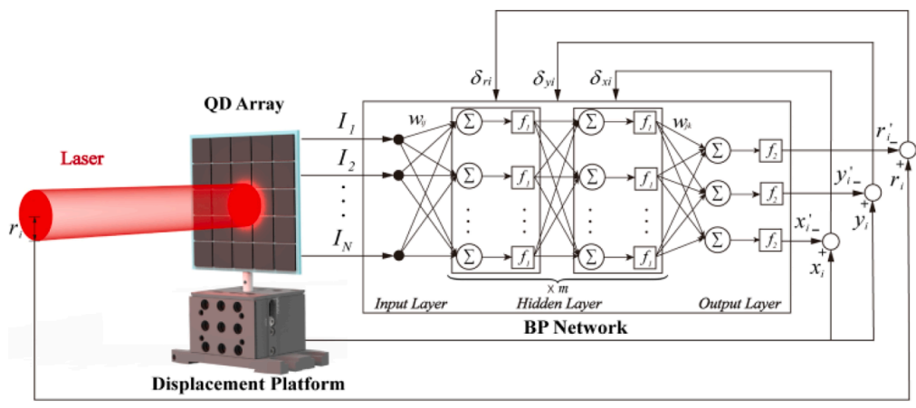
AI-Enhanced ATP at Physical Layer
Fig [2] The training structure of BP neural network.
Neural networks and LSTM models are used to predict QPD error signals caused by UAV motion and noise.
AI helps adaptively calibrate QPD sensors, making tracking more accurate in changing conditions.
Hybrid systems combine AI-enhanced QPD sensing with fast steering mirrors (FSM) or MEMS actuators for better beam control.

Slide 8
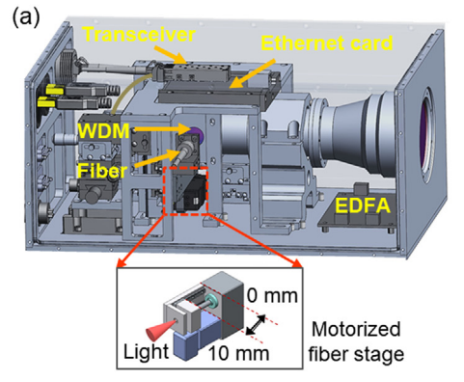
MAC Layer Innovations
ETRI previous system uses a Gigabit Ethernet interface as the core data link and MAC framing mechanism.
Adaptive beamforming works with MAC protocols to manage resources efficiently in UAV FSO networks.
Directional communication through beamforming reduces interference and increases data rates.
Integrating MAC with physical layer ATP improves link stability and network performance.
Fig [3] Schematic diagram of the mobile FSO terminal for UAV

Slide 9
Conclusion and Future Directions
QPD-based ATP with adaptive beamforming enables fast, accurate UAV FSO links.
AI enhances tracking performance at the physical layer.
MAC layer innovations optimize resource use for stable, high-speed communication.
Future work: deeper AI integration, hybrid ATP systems, and scalable network protocols for broader UAV FSO deployment.

Slide 10
Reference
Park, S. et al. (2022) ‘Tracking Efficiency Improvement According to Incident Beam Size in QPD-Based PAT System for Common Path-Based Full-Duplex FSO Terminals’, Sensors, 22(20), pp. 7770–7770. doi.org/10.3390/s22207770
Wang, J. et al. (2021) ‘Hovering UAV-Based FSO Communications: Channel Modelling, Performance Analysis, and Parameter Optimization’, IEEE Journal on Selected Areas in Communications, 39(10), pp. 2946–2959. https://doi.org/10.1109/jsac.2021.3088656
Li, Q. et al. (2024) ‘Optimized Neural-network-based Calibration Method for Quadrant Detector Array’, Physics Letters A, 510, pp. 129550–129550. Available at: https://doi.org/10.1016/j.physleta.2024.129550
Singh, N. et al. (2024) ‘Modelling and analysis of QPD based track sensor developed for inter-satellite optical communication’, pp. 1–6. https://doi.org/10.1109/ants63515.2024.10898355
Shah, A. and Rangan, S. (2022) ‘Multi-Cell Multi-Beam Prediction Using Auto-Encoder LSTM for mmWave Systems’, IEEE Transactions on Wireless Communications, 21(12), pp. 10366–10380. https://doi.org/10.1109/twc.2022.3183632

