Slide 1
Project: IEEE P802.15 Working Group for Wireless Specialty Networks (WSNs)
Submission Title: Future Directions for UAV FSO Link Pointing Error Optimization.
Date Submitted: September 16, 2025
Source: Rafat Bin Mofidul, Ida Bagus Krishna Yoga Utama, Md Minhazur Rahman, Huy Nguyen, Yeong Min Jang (Kookmin University)
Address: Room #603 Mirae Building, Kookmin University, 77 Jeongneung-Ro, Seongbuk-Gu, Seoul, 136702, Republic of Korea
Voice: +82-2-910-5068 E-Mail: yjang@kookmin.ac.kr
Re:
Abstract: Present the future directions for advancing FSO technologies for drone applications.
Purpose: Presentation for contribution on IG NG-OWC.
Notice: This document has been prepared to assist the IG NG-OWC. It is offered as a basis for discussion and is not binding on the contributing individual(s) or organization(s). The material in this document is subject to change in form and content after further study. The contributor(s) reserve(s) the right to add, amend or withdraw material contained herein.
Release: The contributor acknowledges and accepts that this contribution becomes the property of IEEE and may be made publicly available by IG NG-OWC.

Slide 2
Future Directions for UAV FSO Link Pointing Error Optimization.
September 2025

Slide 3
Contents
Introduction & Motivation
Current Challenges in FSO
Emerging Solutions (Currently)
Future Direction 1 – Intelligent Control
Future Direction 2 – Network-Level Optimization
Future Direction 3 – Security & Reliability
Conclusion

Slide 4
Introduction
Unmanned aerial vehicles (UAVs) paired with free-space optical (FSO) communications provide a high-speed, secure solution for 6G backhaul, targeting applications such as disaster recovery and IoT connectivity.
However, pointing errors from UAV instability and atmospheric turbulence pose significant challenges, with milliradian deviations far exceeding space FSO’s microradian precision. Motivated by the need for lightweight, cost-effective mitigations, drawing on relay optimization and secrecy analyses, this work proposes intelligent, network-level strategies to enhance FSO reliability for wireless specialty networks (WSNs).
UAV-FSO Potential for 6G: Delivers Gbps rates and security via narrow beams, ideal for remote backhaul, supported by 25% SNR gains from relay optimization. Jitter challenges limit deployment, driving the need for software-based fixes[1].
Pointing Error Challenge: UAV wobble and turbulence cause mrad-scale misalignments, cutting link reliability by 30-50%, necessitating innovative over hardware solutions[2].
Security and Scalability Push: Beam divergence risks eavesdropping, urging adaptive security for scalable 6G WSNs[3].

Slide 5
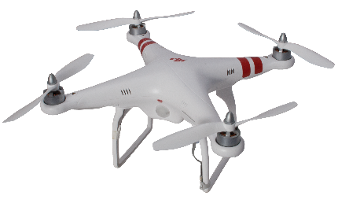

Current Challenges in FSO
Boresight errors: fixed misalignment between Tx–Rx optical axes.
Orientation fluctuations: UAV vibrations cause angle-of-arrival deviations.
Atmospheric effects: turbulence + beam wander further degrade SNR.
Secrecy risks: beam divergence exposes vulnerability to eavesdropping.
Power, payload, and computational limitations of UAVs restrict heavy stabilization.
fog
Figure 1: Drone FSO communication affected by fog, experiencing beam turbulence and pointing errors.

Slide 6
Emerging Solutions (Current Time)
Relay Positioning Optimization: Use convex optimization algorithms to dynamically adjust multi-hop UAV spacing, minimizing cumulative angle-of-arrival variance in serial or parallel configurations. This reduces end-to-end pointing losses, thereby enhancing SNR and coverage in 6G backhaul scenarios[2].
Advanced Modulation: Implement adaptive L-ary multipulse position modulation (L-MPPM) with decision thresholds like ODT or DDT to handle fluctuations, encoding data resiliently against misalignment. This boosts spectral efficiency and reduces SER in turbulent channels, supporting high-rate UAV relays[3].
Channel Modeling Improvements (Log-Normal, Gamma-Gamma with Boresight Errors): Employ log-normal or Gamma-Gamma distributions integrated with nonzero boresight models to statistically characterize UAV jitter and turbulence effects in FSO channels. This enables accurate outage probability predictions, improving link reliability for multi-hop deployments in varying weather[4].
Low-Cost Stabilization (Servo-Based PAT): Integrate servo actuators in pointing-acquisition-tracking (PAT) systems, such as Volz or Hitec models, for real-time beam alignment without heavy gimbals. This achieves sub-mrad corrections at a low payload cost, enabling stable FSO links in lightweight drones for disaster response[5].

Slide 7
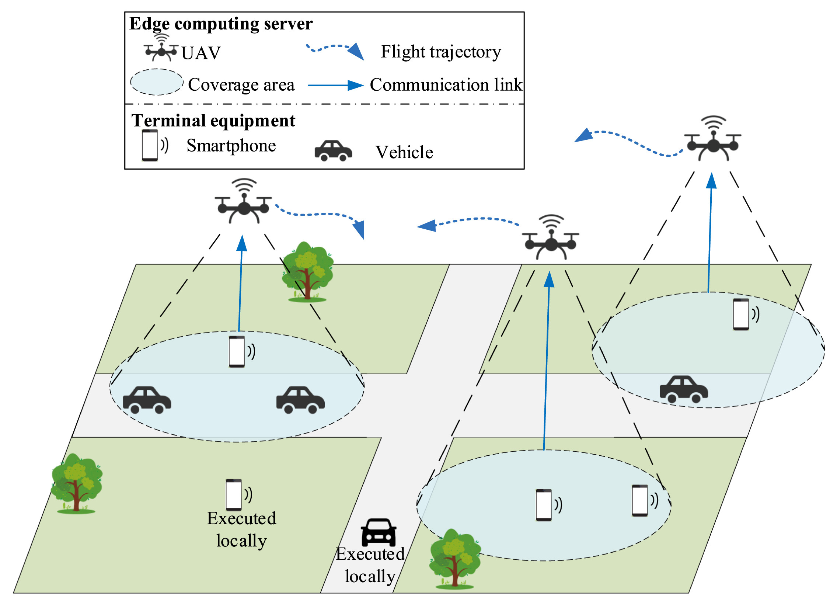
Future Direction 1 – Intelligent Control
Edge Federated Learning for PAT: Use federated learning to enable UAVs to collaboratively train PAT models with real-time, privacy-preserving updates from local jitter data. This reduces alignment errors and supports scalable, secure FSO deployment in resource-constrained swarms.
Sensor Fusion (IMU + GPS + LiDAR/Vision): Integrate IMU, GPS, and LiDAR/vision data with predictive algorithms to fuse sensor inputs for sub-mrad orientation corrections. This enhances link reliability in turbulent conditions, minimizing outage risks for 6G backhaul.
Predictive Alignment: Apply machine learning to anticipate UAV drift and proactively adjust beam steering based on forecasted environmental changes. This ensures consistent link stability, particularly in dynamic settings like disaster response scenarios.
Figure 2: intelligently controlling the pointing with the communication link.

Slide 8
Future Direction 2 – Network-Level Optimization
Graph Neural Networks for Dynamic Hop Optimization: This facilitates self-reconfiguration in response to channel variations, reducing outage risks in low-SNR conditions. It is particularly useful for disaster-response deployments where topology must evolve rapidly.
Reinforcement Learning for Hybrid FSO-RF Switching: Leverage reinforcement learning agents to trigger seamless switches between FSO and RF during misalignment events, integrating with multi-hop parallel hybrids for weather-resilient performance, which ensures uninterrupted connectivity by preempting pointing errors in time-varying channels.
Trajectory Optimization for Energy-Efficient Paths: Apply particle swarm optimization and proximal policy optimization to co-design fixed-wing UAV routes with FSO constraints, minimizing exposure to high-turbulence altitudes and jitter-prone directions. It enhances sustainability for long-mission wireless specialty networks in remote areas.
Swarm Cooperation with PAT-Enhanced Relaying: This fosters robust coverage by combining coarse-to-fine alignment techniques across nodes. It is essential for scalable 6G applications, such as surveillance or IoT backhaul, where the dynamics of behavioral UAVs influence link stability.

Slide 9
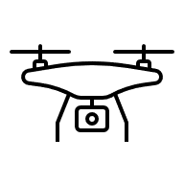
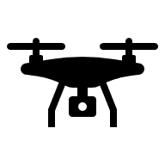
Future Direction 3 – Security & Reliability
Physical-Layer Security: Use adaptive beam divergence techniques to dynamically narrow optical beams, reducing eavesdropping exposure in relay-assisted links. This enhances confidentiality, particularly in military or sensitive 6G applications where jitter might otherwise expose data.
Blockchain-Enabled UAV Coordination: Implement blockchain to coordinate UAVs and detect malicious node misalignments through distributed consensus, preventing intentional jitter disruptions. This enhances trust and reliability in swarm-based FSO networks, which are crucial for autonomous operations.
Resilient Coding + Error Correction: Develop jitter-integrated error correction codes, leveraging pointing error models, to address beam wander effects preemptively. This ensures high availability and data integrity, supporting robust performance in turbulent environments.
Adaptive Jitter Compensation with Redundancy: Employ real-time jitter compensation algorithms combined with redundant relay paths to maintain link stability during misalignment events. This enhances system resilience, minimizing outages in dynamic 6G wireless specialty networks.
Eavesdropper
Receiver
Transmitter
Figure 3: UAV FSO communication system with the potential risk of an eavesdropper.

Slide 10
Conclusion
UAV-based FSO links offer strong potential for next-generation wireless backhaul and emergency connectivity, leveraging high data rates and rapid deployment capabilities.
Pointing errors remain the primary limitation, representing the most significant performance bottleneck that must be carefully mitigated in practical deployments.
Advancements in channel modeling, relay design, adaptive modulation, and AI-assisted pointing, acquisition, and tracking (PAT) are driving steady improvements in link reliability and efficiency.
Future research should emphasize cross-layer approaches that integrate control, network-level optimizations, and security mechanisms to develop robust and resilient UAV-FSO systems for real-world applications.

Slide 11
Reference
[1]R. Rajkumar, Likitha R, S. Acharya, M. Ramesh, and N. M. Kedlaya, “From Sky to Spectrum: Unveiling the Potential of 6G for UAV Communication,” pp. 1–9, Mar. 2025, doi: https://doi.org/10.1109/comp-sif65618.2025.10969874.
[2] M. S. Bashir and Mohamed-Slim Alouini, “Optimal Positioning of Hovering UAV Relays for Mitigation of Pointing Error in Free-Space Optical Communications,” IEEE Transactions on Communications, vol. 70, no. 11, pp. 7477–7490, Sep. 2022, doi: https://doi.org/10.1109/tcomm.2022.3204830.
[3]H. S. Khallaf, Sherief Hashima, M. Rihan, E. M. Mohamed, and H. M. Kasem, “Quantifying Impact of Pointing Errors on Secrecy Performance of UAV-Based Relay-Assisted FSO Links,” IEEE Internet of Things Journal, vol. 11, no. 2, pp. 2979–2989, Jul. 2023, doi: https://doi.org/10.1109/jiot.2023.3297857.
[4]N. A. Androutsos, H. E. Nistazakis, H. Khalid, S. S. Muhammad, and G. S. Tombras, “Serial DF Relayed FSO Links over Mixture Gamma Turbulence Channels and Nonzero Boresight Spatial Jitter,” Computation, vol. 7, no. 3, pp. 34–34, Jul. 2019, doi: https://doi.org/10.3390/computation7030034.
‌[5]Y. Tumma and V. K. Kappala, “A Review on Deployment of UAV-FSO System for High-Speed Communication,” IEEE Access, vol. 12, pp. 124915–124930, 2024, doi: https://doi.org/10.1109/access.2024.3453918.
‌‌

