Slide 1
Project: IEEE P802.15 Working Group for Wireless Specialty Networks (WSNs)
Submission Title: Lightweight Cryptographic Algorithm for Drone-to-Drone Communication
Date Submitted: Sep 16, 2025
Source: Lai Yi Aung, Ida Bagus Krishna Yoga Utama, Nguyen Ngoc Huy, Yeong Min Jang (Kookmin University)
Address: Room #603 Mirae Building, Kookmin University, 77 Jeongneung-Ro, Seongbuk-Gu, Seoul, 136702, Republic of Korea
Voice: +82-2-910-5068 E-Mail: yjang@kookmin.ac.kr
Re:
Abstract: Present Lightweight Cryptographic Algorithm for Drone-to-Drone Communication
Purpose: Presentation for contribution on IG NG-OWC
Notice: This document has been prepared to assist the IG NG-OWC. It is offered as a basis for discussion and is not binding on the contributing individual(s) or organization(s). The material in this document is subject to change in form and content after further study. The contributor(s) reserve(s) the right to add, amend or withdraw material contained herein.
Release: The contributor acknowledges and accepts that this contribution becomes the property of IEEE and may be made publicly available by IG NG-OWC.

Slide 2
Lightweight Cryptographic Algorithm for Drone-to-Drone Communication
Contribution
Sep 16, 2025

Slide 3
Contents
Introduction
Research Motivation
Challenges
Existing Solution
Proposed System
Advantages and Disadvantages
Conclusion
References

Slide 4
Introduction
Unmanned Aerial Vehicles (UAVs) are increasingly used in defense, logistics, surveillance, and disaster response.
Secure communication between drones is critical to prevent unauthorized access and data tampering.
However, UAVs are limited by battery power and computational resources, making traditional cryptographic algorithms inefficient for real-time operations [2].

Slide 5
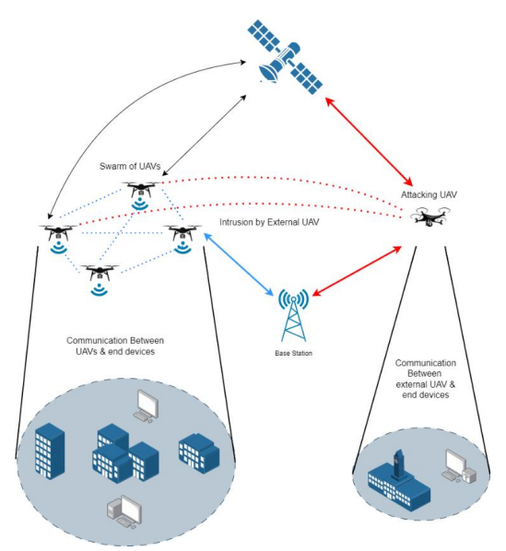
Research Motivation
UAV networks are vulnerable to several cyber threats, including eavesdropping, spoofing attacks, and replay attacks.
These vulnerabilities can lead to mission failure or compromised safety.
A lightweight cryptographic algorithm is required to provide real-time secure communication while conserving battery life [3].
<Intrusion Within UAV Network by External UAV>

Slide 6
Challenges
The development of secure drone communication faces multiple challenges.
First, UAVs have limited power and energy resources, which restrict complex cryptographic computations.
Second, drones possess low processing capacity and memory, limiting the complexity of algorithms they can run.
Third, UAV networks require real-time data exchange for navigation and control.
Finally, dynamic swarm topology leads to frequent connection changes, increasing the complexity of maintaining secure connections [4].

Slide 7
Existing Solutions
Traditional cryptographic algorithms such as AES and RSA provide strong security but consume excessive energy and processing power.
On the other hand, lightweight algorithms like PRESENT, SPECK, and SIMON are optimized for constrained devices but often lack the highest level of security [1].
A balance must be achieved between performance and security to ensure feasibility in UAV networks [4].

Slide 8
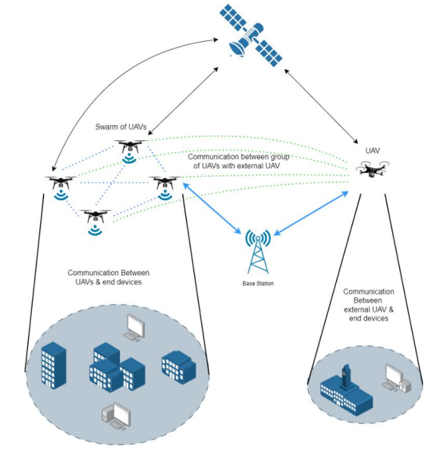
Proposed System
The proposed hybrid cryptographic system combines Elliptic Curve Diffie-Hellman (ECDH) for secure key exchange with a lightweight XOR stream cipher for data encryption.
ECDH provides a secure handshake to generate session keys, while the XOR cipher ensures fast and energy-efficient message encryption [2].
<Data transmission in secured UAV network>

Slide 9
Advantages vs. Disadvantages
Advantages:
1. The system reduces computational, and energy requirements compared to traditional cryptographic algorithms.
2. It supports real-time UAV operations with minimal latency.
3. It provides secure key exchange and fast encryption suitable for UAV swarm communication [3].
Disadvantages:
1. The XOR cipher alone is weak if the key is compromised.
2. A secure initial handshake is critical to overall safety.
3. The system may not defend against advanced persistent threats [5].

Slide 10
Conclusion & Future Work
This presentation proposed a lightweight cryptographic algorithm combining ECDH and XOR for secure drone-to-drone communication.
The system demonstrated improved energy efficiency and speed while maintaining a secure communication channel.
Future work will focus on integrating AI-based intrusion detection and testing the algorithm on large UAV swarms [2].

Slide 11
References
A. Bogdanov et al., “PRESENT: An ultra-lightweight block cipher,” in Proc. Cryptographic Hardware and Embedded Systems (CHES 2007), Vienna, Austria, 2007, pp. 450–466. doi: 10.1007/978-3-540-74735-2_31.
M. H. Eldefrawy, F. Al-Turjman, and R. Steinke, “Lightweight cryptographic protocol for UAVs,” IEEE Access, vol. 11, pp. 74533–74546, 2023. doi: 10.1109/ACCESS.2023.3256700.
A. Patel, M. Singh, and R. Sharma, “Analysis of lightweight cryptography algorithms for UAV networks,” arXiv preprint, arXiv:2504.04063, Apr. 2025. https://arxiv.org/pdf/2504.04063.
National Institute of Standards and Technology (NIST), “Lightweight cryptography project,” NIST, Gaithersburg, MD, USA, 2025. https://csrc.nist.gov/projects/lightweight-cryptography.
J. Kim, J. Park, and H. Kim, “Securing the MAVLink protocol for UAV systems,” arXiv preprint, arXiv:1905.00265, May 2019. https://arxiv.org/pdf/1905.00265.pdf

