Slide 1
Project: IEEE P802.15 Working Group for Wireless Specialty Networks (WSNs)
Submission Title: Mobility-Aware MAC Protocol for Next-Generation OWC Systems
Date Submitted: Sept 16, 2025
Source: Muhammad Ayaz, Ida Bagus Krishna Yoga Utama, Nguyen Ngoc Huy, Yeong Min Jang (Kookmin University)
Address: Room #603 Mirae Building, Kookmin University, 77 Jeongneung-Ro, Seongbuk-Gu, Seoul, 136702, Republic of Korea
Voice: +82-2-910-5068 E-Mail: yjang@kookmin.ac.kr
Re:
Abstract: Present the Mobility-Aware MAC Protocol for Next-Generation OWC Systems
Purpose: Presentation for contribution on IG NG-OWC
Notice: This document has been prepared to assist the IG NG-OWC. It is offered as a basis for discussion and is not binding on the contributing individual(s) or organization(s). The material in this document is subject to change in form and content after further study. The contributor(s) reserve(s) the right to add, amend or withdraw material contained herein.
Release: The contributor acknowledges and accepts that this contribution becomes the property of IEEE and may be made publicly available by IG NG-OWC.

Slide 2
Mobility-Aware MAC Protocol for Next-Generation OWC Systems
Sept 16, 2025

Slide 3
Contents
Background
Challenges of Mobility in OWC MAC
Limitations of Existing MAC Protocols
Proposed Mobility-Aware MAC Protocol
Future Directions
Conclusion

Slide 4
Background
OWC (Optical Wireless Communication)
Optical Wireless Communication utilizes optical frequencies (visible, infrared, ultraviolet) to transfer data, offering higher bandwidth and lower electromagnetic interference than conventional RF systems.
OWC is crucial for environments needing secure, fast communication (e.g., hospitals, industrial plants, vehicular systems), but suffers from alignment and obstruction sensitivity, which is aggravated in mobile scenarios.
MAC Protocol
MAC (Medium Access Control) protocol coordinates how multiple devices share a communication medium, balancing throughput, delay, fairness, and energy efficiency in wireless networks.
MAC protocols for OWC include contention-based, schedule-based (e.g., TDMA), and hybrid approaches; future trends include multi-channel support and full-duplex schemes to boost efficiency for next-gen systems
Mobility
Mobility introduces dynamic network topology changes, affecting packet delivery, latency, and energy usage—thus requiring special MAC designs to maintain reliability and minimize overhead
Mobility-aware MAC protocols incorporate models (like, GPS-based detection) to adapt duty cycles and scheduling in real-time as devices move, essential for drones, vehicles, and mobile sensors in OWC environments

Slide 5
Background
Mobility-Aware MAC Protocols
Design Approaches: Protocols dynamically adjust channel access and synchronization to optimize energy and delay under mobile conditions.
Limitations: While mobility-aware MACs reduce delay and improve throughput, they may suffer increased communication overhead, energy consumption, and adaptability challenges as mobility intensity rises.
Next-Generation Systems
Next-gen OWC systems target integration with IoT, 6G, and smart infrastructure, requiring MAC protocols with flexible, scalable access, enhanced by AI for mobility prediction
Open Research Directions: Key areas include real-time mobility management, multi-user interference mitigation, and energy-efficient scheduling for high-throughput, low-latency OWC networks under dynamic scenarios
CSMA/CA-based MAC for OCC
The author [1] implemented CSMA/CA MAC with MIMO-OOK modulation and introduced transform alignment for better BER and throughput. this article provides efficient channel access management, Collision avoidance & reduced packet drops and Low latency compared to ALOHA-based protocols.
Limitation: The design assumes stationary or low-mobility users. Tracking and mobility management are missing.

Slide 6
Challenges of Mobility in OWC MAC
Mobility Handling
Existing MAC schemes struggle to maintain reliable performance under high mobility, as frequent network topology changes cause synchronization issues and packet loss, resulting in increased delay and reduced throughput
Limited Scalability and Flexibility
Many MAC protocols are designed for static or low-mobility scenarios, leading to poor scalability when the number of devices or data demands increases, especially in dynamic OWC environments. Contention-based methods often suffer from congestion and inefficient resource usage as user density grows.
High Collision and Overhead
Protocols such as traditional CSMA/CA encounter collisions and retransmissions, especially in environments with hidden node problems or multiple access, increasing communication overhead and power consumption.
Latency and Throughput Constraints
Delay-sensitive applications suffer as legacy MACs cannot efficiently prioritize traffic types or adapt to varying data rates, limiting real-time performance.
Spectrum Efficiency Issues
The use of fixed channel allocation and lack of dynamic scheduling reduces spectral efficiency, particularly in scenarios requiring high data rates like IoT or vehicular networks.
Energy Consumption
Existing protocols do not adequately optimize energy usage in mobility-heavy situations, increasing battery drain and reducing lifespan in sensor or IoT devices.

Slide 7
Limitations of Existing MAC Protocols
Existing MAC Protocols
Existing MAC protocols for Optical Camera Communication (OCC) are insufficient for its specific needs.
Standards: Standards like IEEE 802.15.7-2011 and 802.15.7-2018 define mechanisms like slotted and unslotted CSMA/CA, but they were designed for traditional, photodiode-based Visible Light Communication (VLC).
High Collision Rates: These protocols are not optimized for camera-based receivers, leading to poor user coordination and high collision rates in OCC environments.
Limitations
IEEE 802.15.7a-2024: This recent update improves data rates, communication range, and security. Inadequate Multi-User Support: Despite these enhancements, the protocol still lacks full support for real-time multi-user access.
Performance Risk: This limitation risks reduced performance in dynamic or crowded settings where multiple users are present.

Slide 8
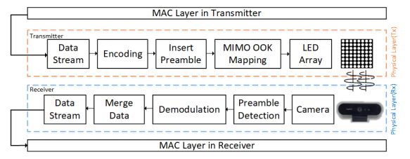
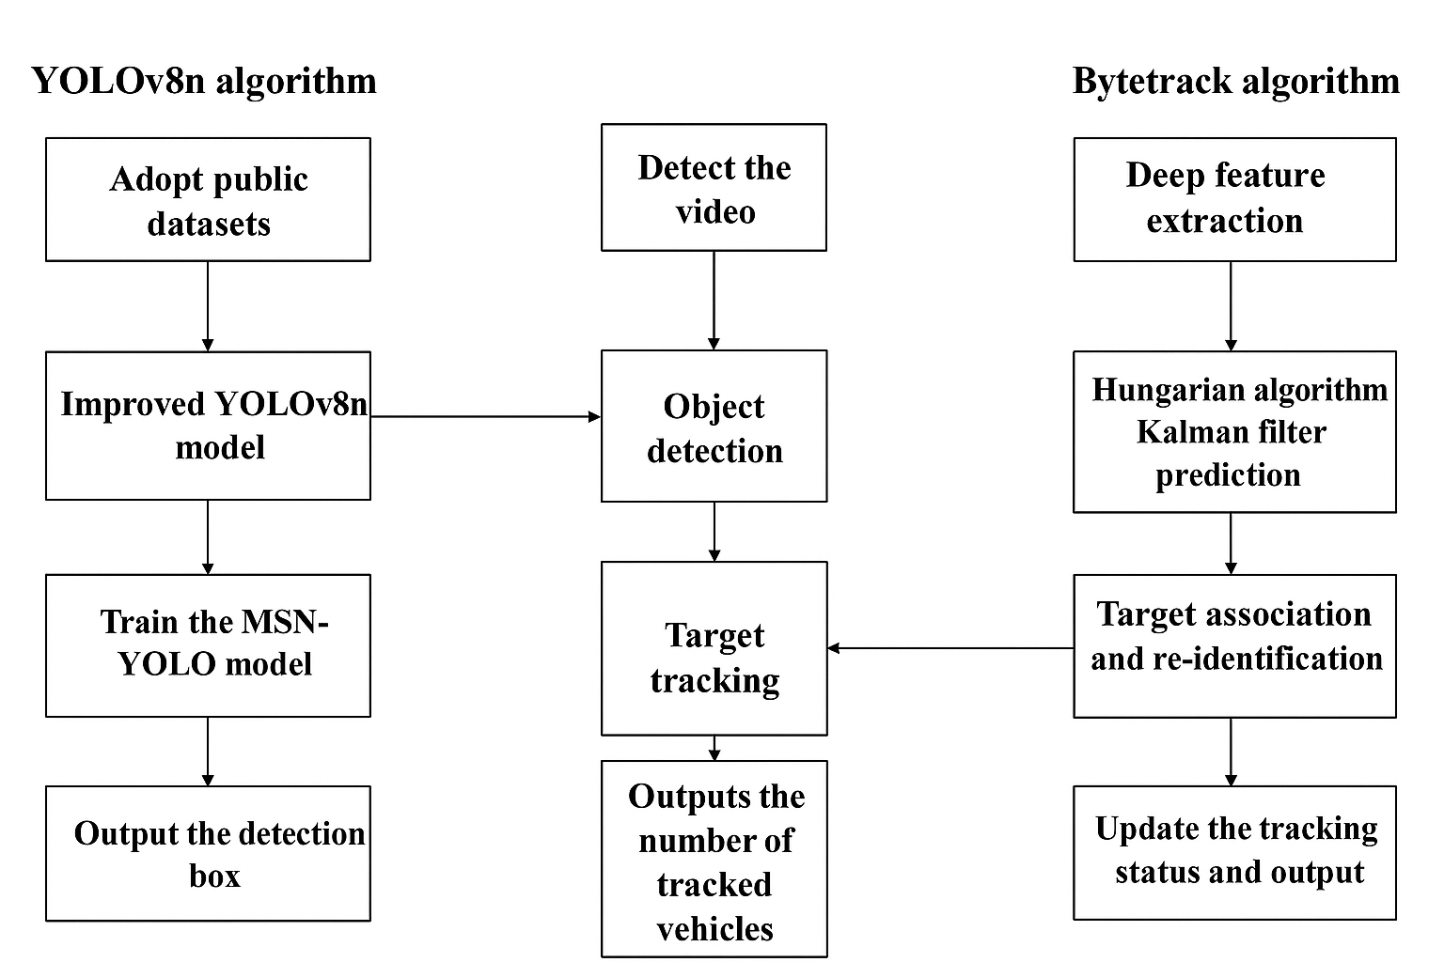
Proposed Mobility-Aware MAC Protocol
MAC Layer Architecture for OWC Systems
Transmitter uses LED array; receiver uses camera.
Data processing at transmitter:
  Encoding → Preamble insertion → MIMO OOK mapping → Transmission via LED array.
Data processing at receiver:
Optical signal capture → Preamble detection → Demodulation → Data merging
Ensures synchronization, error correction, and reliable data transfer
< (a) OCC Physical layer architecture.[1] (b) Detection and tracking [6]>

Slide 9
Proposed Mobility-Aware MAC Protocol
YOLOv8 (Object Detection)
This model uses CNNs with improved architecture for higher accuracy and speed.
Detects multiple objects simultaneously with bounding boxes and confidence scores.
Lightweight and efficient; suitable for real-time, mobility-aware OWC applications.
ByteTrack (Object Tracking)
State-of-the-art multi-object tracking algorithm.
Associates detected objects across frames using both high- and low-confidence detections.
Robust in crowded or dynamic environments.
Highly efficient and accurate for tracking moving devices/users in OWC systems.

Slide 10
Future Directions
Integration of deep reinforcement learning for adaptive MAC decision-making.
Development of cross-layer optimization strategies linking PHY, MAC, and mobility management.
Energy-efficient MAC protocols tailored for real-time mobility-aware OWC systems
Exploration of hybrid tracking methods combining YOLOv8, ByteTrack, and sensor fusion
Support for ultra-dense and large-scale OWC networks with scalable MAC mechanisms
Implementation of predictive mobility management to minimize handover delays.
Standardization efforts for next-generation OWC protocols integrating mobility-aware designs.

Slide 11
Conclusion
Proposed MAC layer design ensures reliable and synchronized data transfer in OWC systems.
Integration of YOLOv8 enables accurate real-time detection of mobile users/devices.
ByteTrack provides robust multi-object tracking, even in dynamic and crowded environments.
Real-time mobility information allows the MAC layer to perform adaptive resource allocation.
Supports seamless handover and improves link quality management.
Reduces handover latency and enhances overall system reliability.

Slide 12
References
Faridh, M. M., Herfandi, H., Sitanggang, O. S., Nasution, M. R. A., Nguyen, H., & Jang, Y. M. (2025). Implementation of CSMA/CA-based MAC protocol for optical camera communication. IEEE Access, 1. https://doi.org/10.1109/access.2025.3531198.
Bhutani, M., Lall, B., & Agrawal, M. (2022). Optical Wireless Communications: Research challenges for MAC Layer. IEEE Access, 10, 126969–126989. https://doi.org/10.1109/access.2022.3225913
Herfandi, H., Sitanggang, O. S., Nasution, M. R. A., Utama, I. B. K. Y., Rahman, M. M., Nguyen, H., Ko, S. M., & Jang, Y. M. (2025). Implementation of a Multiple-Transmitter RS-OFDM based OCC system with advanced ByteTrack for mobility environments. IEEE Access, 13, 119411–119426. https://doi.org/10.1109/access.2025.3587140
Edirisinghe, S., Ranaweera, C., Wong, E., Lim, C., & Nirmalathas, A. (2021). An adaptable contention-free MAC protocol for full-duplex split-plane optical wireless network. ICC 2022 - IEEE International Conference on Communications, 1–7. https://doi.org/10.1109/icc42927.2021.9500719
Torres-Zapata, E., Guerra, V., Rabadan, J., Luna-Rivera, M., & Perez-Jimenez, R. (2021). VLC network design for high mobility users in urban tunnels. Sensors, 22(1), 88. https://doi.org/10.3390/s22010088
Liu, J., Xie, Y., Zhang, Y., & Li, H. (2024). Vehicle flow detection and tracking based on an improved YOLOV8N and ByteTrack framework. World Electric Vehicle Journal, 16(1), 13. https://doi.org/10.3390/wevj16010013

