Slide 1
Project: IEEE P802.15 Working Group for Wireless Specialty Networks (WSNs)
Submission Title: UAV Swarm Localization and Synchronization via OCC
Date Submitted: September 16, 2025
Source: Falak Niaz, Ida Bagus Krishna Yoga Utama, Nguyen Ngoc Huy, Yeong Min Jang (Kookmin University)
Address: Room #603 Mirae Building, Kookmin University, 77 Jeongneung-Ro, Seongbuk-Gu, Seoul, 136702, Republic of Korea
Voice: +82-2-910-5068 E-Mail: yjang@kookmin.ac.kr
Re:
Abstract: UAV Swarm Localization and Synchronization via OCC
Purpose: Presentation for contribution on IG NG-OWC
Notice: This document has been prepared to assist the IG NG-OWC. It is offered as a basis for discussion and is not binding on the contributing individual(s) or organization(s). The material in this document is subject to change in form and content after further study. The contributor(s) reserve(s) the right to add, amend or withdraw material contained herein.
Release: The contributor acknowledges and accepts that this contribution becomes the property of IEEE and may be made publicly available by IG NG-OWC.

Slide 2
UAV Swarm Localization and Synchronization via OCC
September 16, 2025

Slide 3
Contents
Overview of OCC
Advantages of OCC for Swarm
Limitations of OCC
UAV Swarm localization and synchronization
Deployment scenario
Framework architecture
Conclusion
References

Slide 4
Overview of OCC
OCC uses LEDs and cameras for transmitting and receiving data via light signals [1].
Enables spectrum-free, low-cost communication suitable for UAV swarms[2].
Drones equipped with LEDs (transmitters) and cameras (receivers) exchange light pulses[3].
Navigation, synchronization, and data transfer in swarm operations.
Works in RF-congested environments and supports precise optical-based positioning.

Slide 5
Overview of OCC
Advantages of OCC for Swarm
Avoids RF interference and congestion.
Uses existing low-cost hardware (LEDs & cameras).
Provides centimeter-level positioning accuracy in controlled conditions
Lightweight solution with low power requirements.
Can support large drone network with minimal infrastructure.
Provides both communication and localization functions

Slide 6
Overview of OCC
Limitations of OCC
Effective mostly for short to medium distances.
Communication requires clear visibility.
Sunlight, glare, and weather (fog/rain) can affect signals.
Limited by the receiving device’s capture speed.
Requires precise calibration to avoid delays.
Buildings, trees, or drones blocking LOS disrupt links.

Slide 7
UAV Swarm Localization and Synchrnization
Localization:
Drones estimate positions using OCC signal strength, angles, and patterns.
Synchronization:
Light pulses provide time references for aligning drone clocks.
Swarm Behavior
Accurate coordination for formation flying and collaborative tasks.
UAVs in formation can detect and follow each other’s OCC signals, enabling GPS-free navigation.
Impact
Enhances safety, efficiency, and autonomous capabilities of drone swarms.

Slide 8
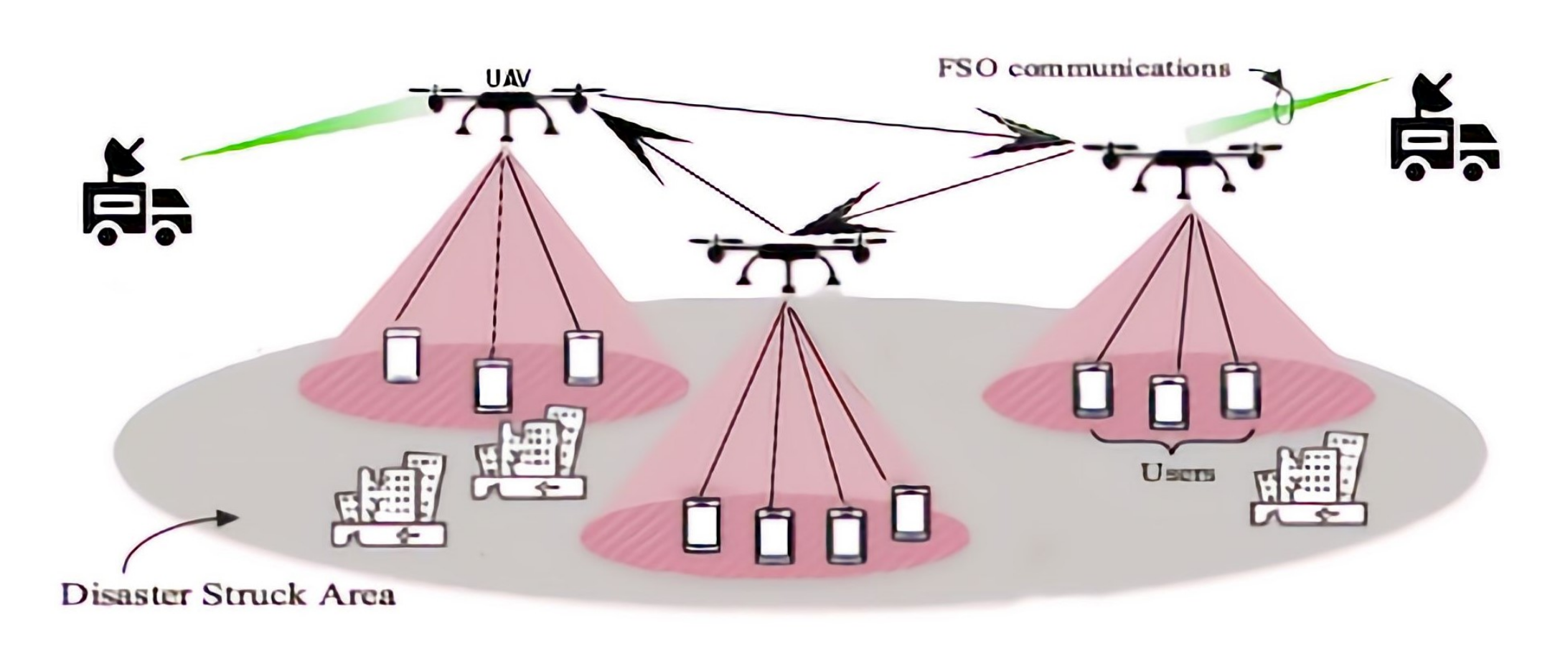
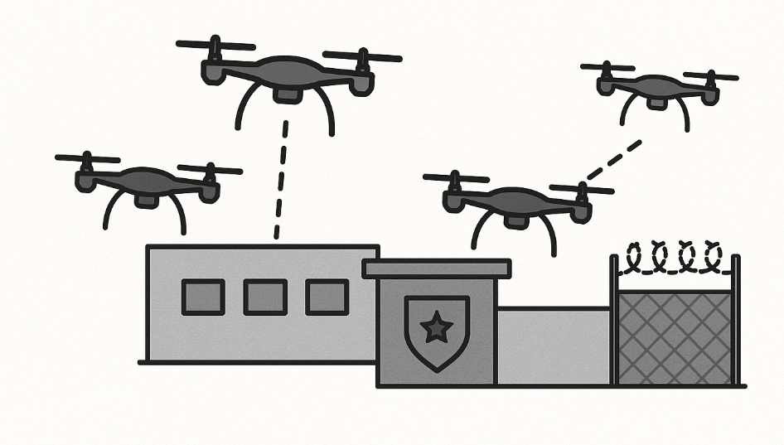
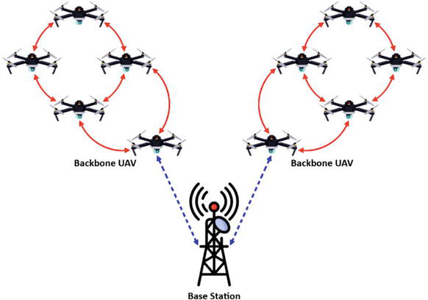
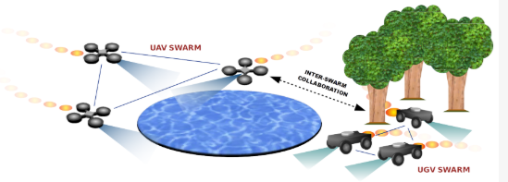
Deployment scenarios
Disaster response
Military/Surveillance
Deployment scenarios
Hybrid networks
Agriculture
Figure.1.UAV Swarm Localization and synchronization via OCC [4][5]

Slide 9
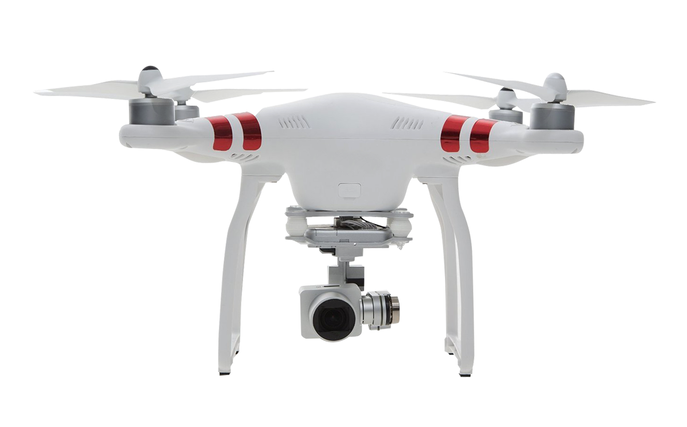
Framework Architecture
Each UAV transmits OCC signals via LEDs and receives through onboard cameras.
Modules:
Each UAV transmits OCC signals via LEDs and receives through onboard cameras.
Synchronization unit for time alignment.
Controller (centralized or distributed) for swarm logic.
Enables precise position sharing and synchronized flight across the swarm.
Localization Module
LD
OCC Links
Synchronization Module
Central Controller or Distribute Swarm logic
OCC Links
Figure.2. UAV Swarm Localization and synchronization via OCC

Slide 10
Conclusion
OCC is a low-cost, spectrum-free solution for UAV swarm communication.
Supports localization and synchronization critical for coordinated swarm tasks.
Interference from sunlight, LOS dependence, and frame-rate limitations.
Hybrid OCC + RF/FSO systems for robust, large-scale deployments.

Slide 11
References
[1] Teli, S. R., et al. Optical Camera Communications: Principles, Modulation, and Applications. IEEE Comms Surveys & Tutorials, 2023.
[2] Kashef, M., & Fawaz, W. Optical Wireless Communication for UAV Networks. IEEE Access, 2022.
[3]Nguyen, T., et al. UAV Swarm Communication and Synchronization via OCC. MDPI Drones, 2024.
[4] Rajbhandari, S., et al. Optical Camera Communications for Autonomous Systems. IEEE Photonics Journal, 2021.
[5] Kim, S., et al. OCC-Based Time Synchronization for Multi-UAV Systems. IEEE Transactions on Vehicular Technology, 2024.

