Slide 1
Project: IEEE P802.15 Working Group for Wireless Specialty Networks (WSNs)
Submission Title: Optical Camera Communication System Using DMT Modulation for RGB LED
Date Submitted: July 30, 2025
Source: Sianturi Patar Parlindungan, Md Minhazur Rahman, Ida Bagus Krishna Yoga Utama, Huy Nguyen, Yeong Min Jang (Kookmin University)
Address: Room #603 Mirae Building, Kookmin University, 77 Jeongneung-Ro, Seongbuk-Gu, Seoul, 136702, Republic of Korea
Voice: +82-2-910-5068 E-Mail: yjang@kookmin.ac.kr
Re:
Abstract: Present the other modulation method for Optical Camera Communication System.
Purpose: Presentation for contribution on IG NG-OWC
Notice: This document has been prepared to assist the IG NG-OWC. It is offered as a basis for discussion and is not binding on the contributing individual(s) or organization(s). The material in this document is subject to change in form and content after further study. The contributor(s) reserve(s) the right to add, amend or withdraw material contained herein.
Release: The contributor acknowledges and accepts that this contribution becomes the property of IEEE and may be made publicly available by IG NG-OWC.

Slide 2
Optical Camera Communication System Using DMT Modulation for RGB LED
Contribution
September 16, 2025

Slide 3
Contents
Introduction
DMT Modulation Technology
Why DMT Modulation
VLC experiment using DMT Modulation
Advantage and disadvantage using DMT Modulation for OCC System
Conclusion
References

Slide 4
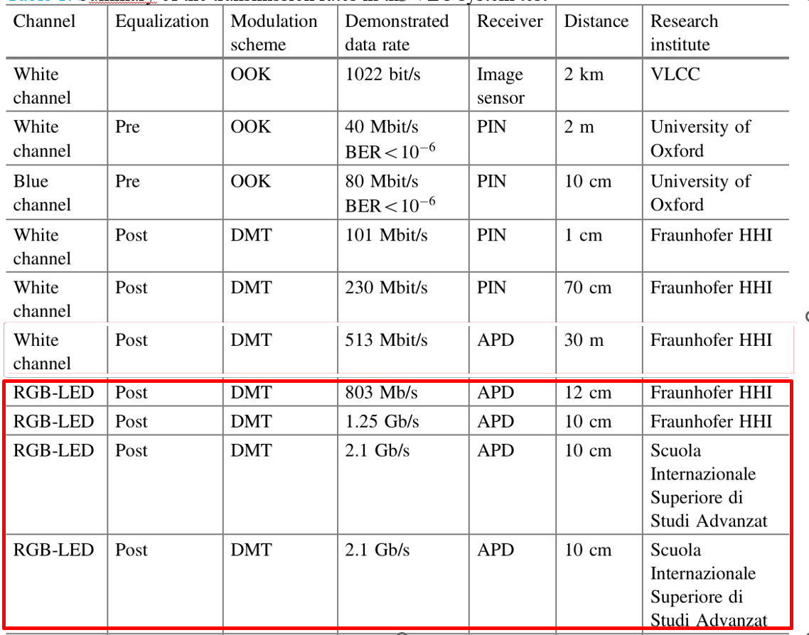
Introduction
Table 1. Summary of the transmission rates in the VLC system test
OOK modulation and PPM/PMW modulation have an advantage regarding the system complexity; however, DMT modulation, OFDM modulation, and CAP modulation have better spectral efficiency and can overcome multipath effects.
Notes:
By this way, there is no need to use the IQ modulation, thereby reducing the complexity and cost of the system and thus making it suitable for a system with a low complexity, such as visible light communication systems.

Slide 5
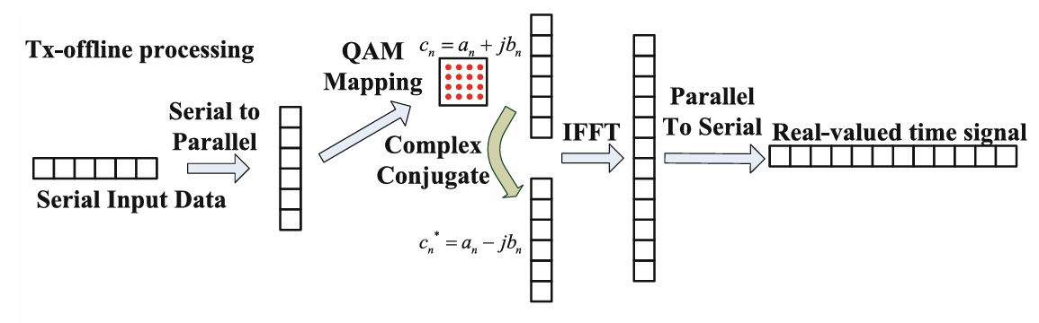
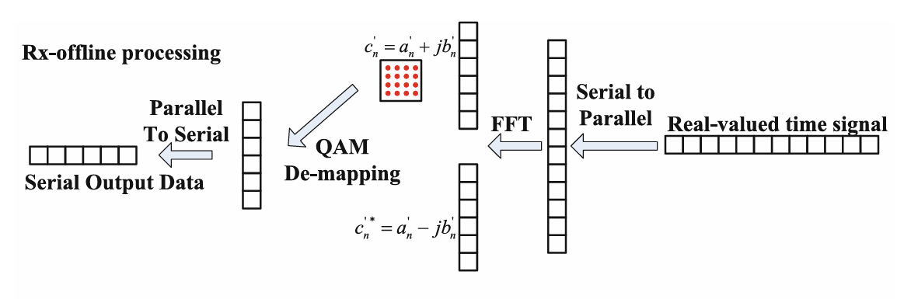
DMT Modulation Technology
The input data is divided into the N parallel subcarrier streams, and each sub carrier is modulated by the encoded high-order QAM complex symbols. Then, just like the OFDM modulation, these symbols are sent for DMT modulation, which is achieved by IFFT processing.
FIGURE 1. Schematic Diagram of DMT Modulation
FIGURE 2. Schematic Diagram of DMT Demodulation
Notes:
To make all the DMT modulated data real, DMT modulation requires a 2N-point IFFT transformation, and the values inputted into the IFFT transformation are needed to satisfy the Hermitian symmetry properties.

Slide 6
Why DMT Modulation
DMT is a multi-carrier modulation technique, essentially a variant of Orthogonal Frequency Division Multiplexing (OFDM).It splits the available bandwidth into many orthogonal subcarriers, each modulated independently (e.g., with QAM or PSK).
RGB LEDs emit in multiple bands: Red, Green, and Blue. These can be used as independent channels (WDM), boosting data rates. DMT can be applied individually on each color channel, exploiting parallel transmission.
Notes:
In “1.25 Gbit/s Visible Light WDM Link based on DMT Modulation of a Single RGB LED Luminary” Paper, the authors have made use of DMT modulation to achieve a 1.25 Gbit/s WDM VLC trans mission using RGB-LED and APD, which is the highest data rate using DMT in VLC systems.

Slide 7
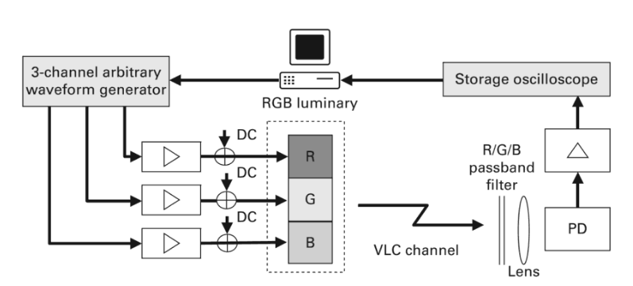
VLC Experiment using DMT Modulation
This method combine the high frequency OFDM signal with the low-frequency PWM dimming signal while both transmit signal is generated by software and an Arbitrary Waveform Generator (AWG), while the received signal is recorded and subsequently evaluated by software. A typical setup of such an experiment is sketched in Fig 3.
FIGURE 3. VLC Experiment

Slide 8
Advantage and disadvantage using DMT Modulation for OCC System
Advantages of DMT Modulation in OCC:
High Data Rate via Color Multiplexing (WDM)
Spectral Efficiency
Channel Adaptation per Color
Reduced Inter-Channel Interference
Disadvantages of DMT Modulation in OCC:
Synchronization Complexity with Camera Receivers
High Computational Complexity
Camera Sensor Limitations
Low SNR for Some Channels
Notes:
Advantages of DMT Modulation in OCC:
High Spectral Efficiency:
DMT effectively utilizes the available bandwidth by dividing it into numerous narrow sub-channels, each carrying a portion of the data. This allows for higher data rates compared to single-carrier modulation schemes.
Robustness to Channel Impairments:
DMT is inherently more resilient to frequency-selective fading and interference, which are common in optical wireless channels. It can adaptively allocate bits to sub-channels based on their individual channel characteristics, optimizing performance.
Flexibility in Bit Loading:
DMT allows for bit loading, where each sub-channel can carry a different number of bits based on its signal-to-noise ratio (SNR). This maximizes data throughput by utilizing the available resources efficiently.
Improved Performance with Equalization:
DMT's multi-carrier nature allows for simpler and more effective equalization techniques to compensate for channel distortions, leading to better overall performance.
Disadvantages of DMT Modulation in OCC:
High Peak-to-Average Power Ratio (PAPR):
DMT signals can exhibit a high PAPR, meaning the peak power can be significantly higher than the average power. This can lead to non-linear distortion in the optical transmitter and reduce transmission efficiency.
Increased Complexity:
DMT implementation requires more complex signal processing and hardware compared to simpler modulation schemes like OOK (On-Off Keying). This can increase the cost and power consumption of the system.
Synchronization Challenges:
Maintaining synchronization between the transmitter and receiver across multiple sub-carriers can be challenging, especially in dynamic OCC environments.
Hardware Requirements:
Implementing DMT requires significant hardware resources, especially for the FFT (Fast Fourier Transform) operations involved in modulation and demodulation.

Slide 9
Conclusion
DMT with RGB LEDs is best when have a high-end camera with a global shutter or high frame rate, the environment is controlled (e.g., indoor signage, automotive OCC) and color separation and calibration can be precisely managed.
Notes:
In the experiment, the BER performance of all three wavelengths is measured. The analysis and experimental results have demonstrated that DMT modulation is suitable for high-speed VLC systems due to its low complexity and high spectral efficiency.

Slide 10
References
Kottke, C., Hilt, J., Habel, K., Vučić, J., Langer, K.: 1.25 Gbit/s visible light WDM link based on DMT modulation of a single RGB LED luminary. In: Optical Fiber Communication Conference & Explosion, We.3.B.4 (2012)
Chi-Wai Chow, "Recent Advances and Future Perspectives in Optical Wireless Communication, Free Space Optical Communication and Sensing for 6G," J. Lightwave Technol. 42, 3972-3980 (2024)
C. -W. Chow et al., "Display Light Panel and Rolling Shutter Image Sensor Based Optical Camera Communication (OCC) Using Frame-Averaging Background Removal and Neural Network," in Journal of Lightwave Technology, vol. 39, no. 13, pp. 4360-4366, July1, 2021
Deng-Cheng Tsai, Yun-Han Chang, Chi-Wai Chow, Yang Liu, Chien-Hung Yeh, Ching-Wei Peng, and Li-Sheng Hsu, "Optical camera communication (OCC) using a laser-diode coupled optical-diffusing fiber (ODF) and rolling shutter image sensor," Opt. Express 30, 16069-16077 (2022)
T. Nguyen, M. S. Islim and H. Haas, "A hybrid OCC-LiFi system with dimming capability," 2021 IEEE 94th Vehicular Technology Conference (VTC2021-Fall), Norman, OK, USA, 2021

