Slide 1
Project: IEEE P802.15 Working Group for Wireless Personal Area Networks (WPANs)
Submission Title: [Effect of using different CCA Modes and different ED Threshold in suspendable CSMA-CA]
Date Submitted: [16 Sep. 2025]
Source: [Susumu Ishihara¹, Kohei Agata¹, Masakatsu Ogawa², Tetsushi Ikegami³, Shugo Kajita⁴, Arata Kato⁴, Mineo Takai⁵]
Company [¹Shizuoka University, ²Sophia University, ³Meiji University, ⁴Space-Time Engineering Japan, Inc., ⁵Space-Time Engineering, LLC]
Address []
Voice:[], FAX: [], E-Mail:[ishihara.susumu@shizuoka.ac.jp, agata.kohei.20@shizuoka.ac.jp, m-ogawa@sophia.ac.jp, ikegami@meiji.ac.jp, skajita@spacetime-eng.com, akato@spacetime-eng.com, mineo@ieee.org]
Re: []
Abstract: [This document evaluates the effect of using multiple CCA modes in suspendable CSMA-CA]
Purpose: [This document evaluates the effect of using multiple CCA modes in suspendable CSMA-CA]
Notice: This document has been prepared to assist the IEEE P802.15. It is offered as a basis for discussion and is not binding on the contributing individual(s) or organization(s). The material in this document is subject to change in form and content after further study. The contributor(s) reserve(s) the right to add, amend or withdraw material contained herein.
Release: The contributor acknowledges and accepts that this contribution becomes the property of IEEE and may be made publicly available by P802.15.

Slide 2
Effect of using different CCA Modes and different ED Threshold in suspendable CSMA-CA
Susumu Ishihara¹, Kohei Agata¹, Masakatsu Ogawa², Tetsushi Ikegami³, Shugo Kajita⁴, Arata Kato⁴, Mineo Takai⁵
¹Shizuoka University, ²Sophia University, ³Meiji University, ⁴Space-Time Engineering Japan, Inc., ⁵Space-Time Engineering, LLC

Slide 3
Topics in this presentation
Recap of the last presentation [1]
  Scenario
    Coexistence of different modulation networks working at the same frequency.
  Suspendable CSMA-CA
    Improves packet delivery ration in congested scenarios
  Proposed Strategy:
    Use different CCA modes for backoff slots in Suspendable CSMA-CA
      The last slot, A few slots before the last slot, and others
Evaluation of the proposed strategy

Slide 4
Scenarios
Coexistence of different modulation networks working at the same frequency.
Slow, Long communication range
Narrow frequency occupation bandwidth
Long Airtime (e.g. 2FSK with low symbol rate)
Fast, Short communication range
Wide frequency occupation bandwidth
Short Airtime (e.g. 2FSK with high symbol rate)

Slide 5
Example: 50 kbps networks & 200 kbps networks [SUN 920 MHz]
Slow net: SUN FSK PHY 50 kbps 2FSK
Fast net: SUN FSK PHY 200 kbps 2FSK
They work on the same channel.
Each coordinator is not aware of the coordinator of the other network.
50 kbps
200 kbps
Coordinator
600 kHz

Slide 6
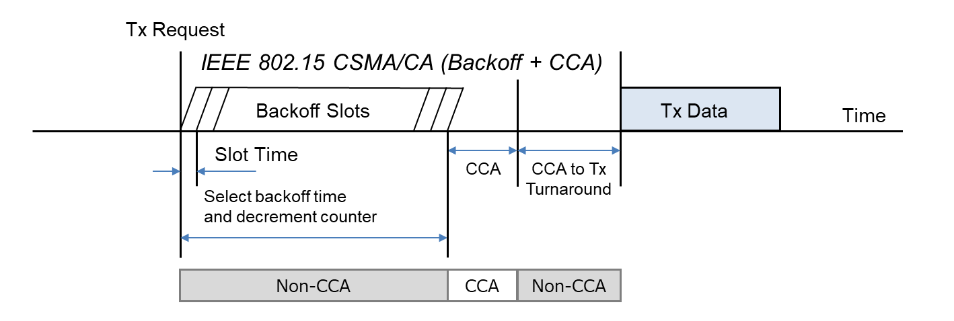
IEEE 802.15.4 CSMA-CA
IEEE 802.15.4 CSMA-CA performs CCA (Clear Channel Assessment) only when the backoff timer expires, and does not perform carrier sense in order to minimize power consumption during backoff. (IEEE 802.11 CSMA/CA performs CCA even during the backoff periods.)
Cited from IEEE 802.19-25/0006r0 [2]
Cited from IEEE 802.19-25/0006r0 [1]

Slide 7
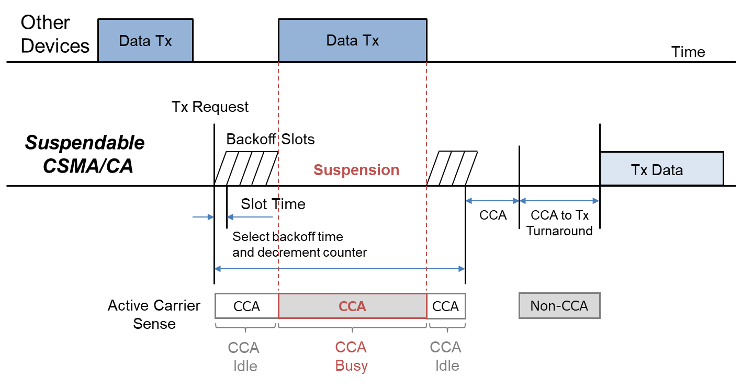
Suspendable CSMA-CA introduced in IEEE 802.15.4-2024 [3]
With the suspendable CSMA-CA option, CCA (mode 1, 2, or 3) is performed during the backoff period, and the backoff timer is suspended until CCA indicates that the channel is clear or macSuspendedCsmaMaxTime is exceeded.
If macSuspendedCsmaMaxTime is exceeded, backoff ends in “Failure” and CSMA-CA algorithm terminates with a channel access failure.
Cited from IEEE 802.19-25/0006r0 [2]

Slide 8
Operations in CCA Mode 3
CCA Mode3 = {3a: CS and ED, 3b: CS or ED}
  CS: Carrier Sense, ED: Energy Above Threshold
In the context of Suspendable CSMA-CA, we can select CCA for each slot.
  What CCA do we use for each slot?
  e.g.
What ED threshold in ED-CCA?
  Fixed value vs. Dynamic selection of ED threshold
    If we use a Dynamic threshold, how do we select the threshold value?
CS
CS
CS
CS
ED
CS
ED
CS
ED
CS
ED
ED
CS
CS
CS
ED

Slide 9
Proposed Strategy in July Plenary [1]
Link speed | CCA during backoff period (all but the last few slots) | CCA in the last few backoff slots | CCA at the end of backoff
Fast | No CCA, CS or ED with a higher threshold (Decreasing the effect of Slow channel) | ED with a higher threshold | CS
Slow | ED with a higher threshold | ED with a lower threshold | ED with a lower threshold
Less Sensitive
Most Sensitive
Intermediate
Adapting the receiver’s environment
  Use lower ED-threshold (make conservative) if the receiver is in a congested area.

Slide 10
The Role of CCAs in backoff period in Suspendable CSMA-CA
The failure at the end of backoff directly leads to an increase in the number of backoffs (NB) and transmission failure.
CCAs in the backoff period contribute to avoiding failure (i.e., CCA busy) at the end of the backoff.
A more sensitive CCA is needed to avoid failure at the end of the backoff.
  Sensitive CCA: ED CCA.
    With a lower ED threshold, it is more sensitive.

Slide 11
Do we always need such a sensitive CCA?
CCA “busy” prolongs the backoff period (including the suspended period)
  It may lead to needlessly longer latency.
  How about using a sensitive CCA for the last few backoff slots?
    It is sufficient to avoid the CCA failure at the end of the backoff.
    It will contribute to shortening the frame transmission latency.

Slide 12
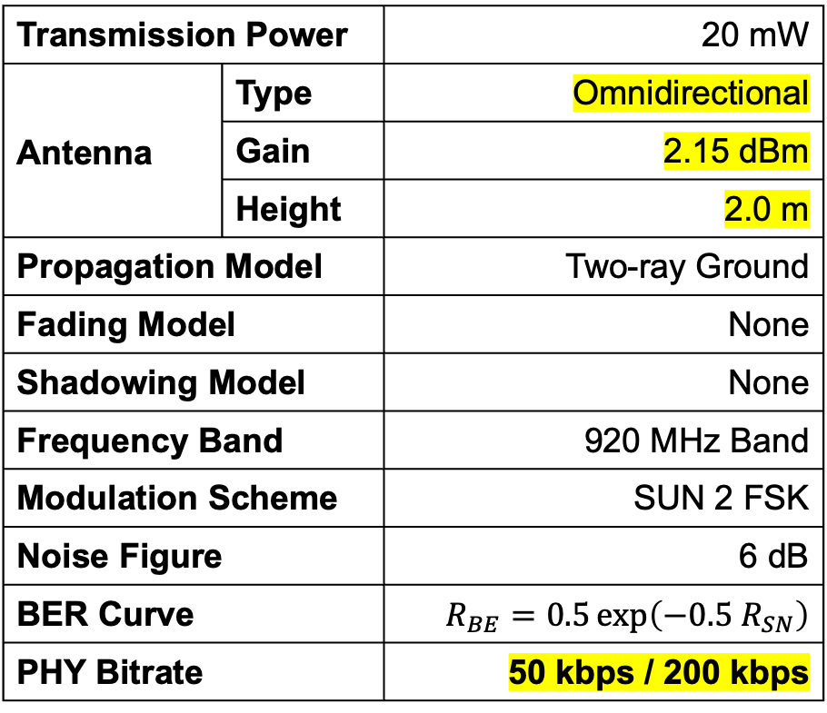
Simulation Parameters (1)
Parameters are based on ECHONET Lite[4], some parameters are changed. / Simulator: Scenargie [5]
Transmission Power |  | 20 mW
Antenna | Type | Omnidirectional
 | Gain | 2.15 dBm
 | Height | 2.0 m
Propagation Model |  | Two-ray Ground
Fading Model |  | None
Shadowing Model |  | None
Frequency Band |  | 920 MHz Band
Modulation Scheme |  | SUN 2 FSK
Noise Figure |  | 6 dB
BER Curve |  | $$R_{BE}=0.5\exp\left(−0.5 R_{SN}\right)$$
PHY Bitrate |  | 50 kbps / 200 kbps
CSMA-CA | Unslotted Suspendable
aTurnaroundTime | 1000 us
macSuspendedCsmaMaxTime | 32
macLifsPeriod | 40 period
macMaxCsmaBackoffs | 4
macMaxFrameRetries | 3
macMaxBE | 5
macMinBE | 3
macUnitBackoffPeriod | 1000 us + 4 period
phyCcaDuration | 4 period
ACK Request | Disabled
Application | CBR

Slide 13
Simulation Parameters (2)
Slow
Fast
50 kbps
200 kbps
Channel Spacing |  | 200 kHz
CS Level (Rx Sensitivity) |  | -97.00 dBm
ED Threshold | normal (high) | -87.00 dBm
 | low | -92.00 dBm
PSDU Length |  | 255 byte
Channel Spacing |  | 600 kHz
CS Level (Rx Sensitivity) |  | -90.98 dBm
ED Threshold | normal (high) | -80.98 dBm
 | low | -85.98 dBm
PSDU Length |  | 511 byte

Slide 14
Simulation Node Positions
50 kbps
200 kbps
Coordinator
Device
Device
Coordinator
600 m
300 m
100 m
ED
ED low
ED low
ED

Slide 15
Simulated CCA patterns
ED
Energy Detection
CS
Carrier Sense
ED
Low
Energy Detection
with lower threshold
Name
Slow Net.
Fast Net.
Proposed
ED
ED
ED
ED
Low
ED
Low
CS
CS
CS
ED
CS
Slow ED / Fast CS
ED
ED
ED
ED
ED
CS
CS
CS
CS
CS
Slow CS / Fast ED
CS
CS
CS
CS
CS
ED
ED
ED
ED
ED
All CS
CS
CS
CS
CS
CS
CS
CS
CS
CS
CS
All ED
ED
ED
ED
ED
ED
ED
ED
ED
ED
ED
All ED or CS
(Busy if ED busy or CS busy)
CS
CS
CS
CS
CS
CS
CS
CS
CS
CS
ED
ED
ED
ED
ED
ED
ED
ED
ED
ED

Slide 16
Simulation Results
Comparison between patterns using different CCAs

Slide 17
Packet Delivery Rate (PDR)
(ALL)
Slow (10 kbps)
Fast (150 kbps)
Slow CS / Fast ED
Proposed
Proposed
Slow ED / Fast CS
Slow CS / Fast ED
CI 95%
Slow ED / Fast CS
CI 95%
Offered load [kbps]
Offered load [kbps]

Slide 18
Throughput
(ALL)
Slow (10 kbps)
Fast (150 kbps)
Proposed
Slow CS / Fast ED
Slow ED / Fast CS
Proposed
Slow ED / Fast CS
Slow ED / Fast CS
CI 95%
CI 95%
Slow
Fast
Offered load [kbps]
Fast
Offered load [kbps]
Slow

Slide 19
Simulation Results
Comparison between the proposed CCA scheme and ones with homogeneous CCA

Slide 20
Packet Delivery Rate (PDR)
(Device to Coordinator)
Slow (50 kbps)
Fast (200 kbps)
All ED
All ED
All ED or CS
All ED or CS
Proposed
Proposed
All CS
All CS
CI 95%
CI 95%
Slow
Fast
Fast
Slow
0
25
50
75
100
125
150
175
200
0
10
20
30
40
50
Offered load [kbps]
Offered load [kbps]

Slide 21
Packet Delivery Rate (PDR)
(Coordinator to Device)
Slow (50 kbps)
Fast (200 kbps)
All ED or CS
All ED or CS
All ED
All ED
All CS
Proposed
Proposed
CI 95%
CI 95%
All CS
Slow
Fast
Fast
Slow
0
25
50
75
100
125
150
175
200
0
10
20
30
40
50
Offered load [kbps]
Offered load [kbps]

Slide 22
Packet Delivery Rate (PDR)
(ALL)
Slow (50 kbps)
Fast (200 kbps)
All ED or CS
All ED or CS
Proposed
Proposed
All ED
All ED
All CS
CI 95%
All CS
CI 95%
Slow
Fast
Fast
Slow
0
25
50
75
100
125
150
175
200
0
10
20
30
40
50
Offered load [kbps]
Offered load [kbps]

Slide 23
Throughput
(Device to Coordinator)
Slow (50 kbps)
Fast (200 kbps)
All ED
Proposed
All ED or CS
All CS
Proposed
All ED
All ED or CS
All CS
CI 95%
CI 95%
Slow
Fast
Fast
Slow
0
25
50
75
100
125
150
175
200
0
10
20
30
40
50
Offered load [kbps]
Offered load [kbps]

Slide 24
Throughput
(Coordinator to Device)
Slow (50 kbps)
Fast (200 kbps)
All ED or CS
All ED
All ED or CS
Proposed
All CS
All CS
All ED
Proposed
CI 95%
CI 95%
Slow
Fast
Fast
Slow
0
25
50
75
100
125
150
175
200
0
10
20
30
40
50
Offered load [kbps]
Offered load [kbps]

Slide 25
Throughput
(ALL)
Slow (50 kbps)
Fast (200 kbps)
All ED or CS
Proposed
All ED
All ED or CS
All ED
Proposed
All CS
All CS
CI 95%
CI 95%
Slow
Fast
Fast
Slow
0
25
50
75
100
125
150
175
200
0
10
20
30
40
50
Offered load [kbps]
Offered load [kbps]

Slide 26
Conclusions
Evaluated the effect of a strategy that uses different CCA modes in suspendable CSMA-CA in coexisting environments
  CCA mode, ED threshold
Simulation Results (in a scenario w. hidden/exposed terminals)
  The proposed strategy contributes to improving the throughput of exposed terminals in the fast network, while their PDR is decreased.
    This result aligns with the concept underlying the proposed strategy.
    The throughput and PDR of the slow network are also decreased.
Next step
  Extended simulation scenarios for various settings and confirm the effect of the proposed strategy.
  Develop guidelines / recommendations for using suspended CSMA-CA

Slide 27
References
[1] S. Ishihara, et al., CCA Modes and Adaptive ED threshold in suspendable CSMA-CA,
DCN: 15-25-0353-02-acss
[2] T. Sumi, Y. Nagai, J. Guo, P. Orlik, K. Parsons, IEEE 802.11ah and IEEE 802.15.4g SUN OFDM PHY Coexistence Simulation for Case 1-3 with Suspendable CSMA/CA, DCN: 802.19-25/0006r0
[3] IEEE Standard for Low‐Rate Wireless Networks, IEEE Std 802.15.4-2024.
[4] JJ-300.10 Home network Communication Interface for ECHONET Lite (IEEE802.15.4/4e/4g 920MHz-band Wireless)
[5] Scenargie - Space-Time Engineering, Inc. (https://www.spacetime-eng.com/)

