Slide 1
Project: IEEE P802.15 Working Group for Wireless Specialty Networks (WSN)
Submission Title: Ranging Sequences for PtMP System.
July 2025
Date Submitted: 2025-09-16
Source: Vishal Kalkundrikar, Ondas Networks
Purpose: Proposal for the changes in Ranging sequences for 802.16t.
Notice: This document has been prepared to assist the IEEE P802.15. It is offered as a basis for discussion and is not binding on the contributing individual(s) or organization(s). The material in this document is subject to change in form and content after further study. The contributor(s) reserve(s) the right to add, amend or withdraw material contained herein.
Release: The contributor acknowledges and accepts that this contribution becomes the property of IEEE and may be made publicly available by P802.15.

Slide 2
Abstract
In 802.16 PtMP, system Ranging is used for UL synchronization (initial and periodic ranging), Bandwidth Request and during Hand Over indication. In the 802.16t Gold code sequences are used for the ranging purpose; this analysis proposes the change in the length of the sequences and hence change in the sequence type.

Slide 3
Ranging Sequence Length
In 802.16t, the minimum allocation is one slot, which is 54 symbols over one subchannel, but the ranging sequence lengths are not integer multiple of the symbols per slot.
Since Gold code sequences are 31, 63, etc; Zadoff-Chu (ZC) sequence are proposed which can be of lengths integer multiple of 54.
Analysis shows the number of codes detected at various SNR for the Gold and ZC sequences for various lengths.

Slide 4
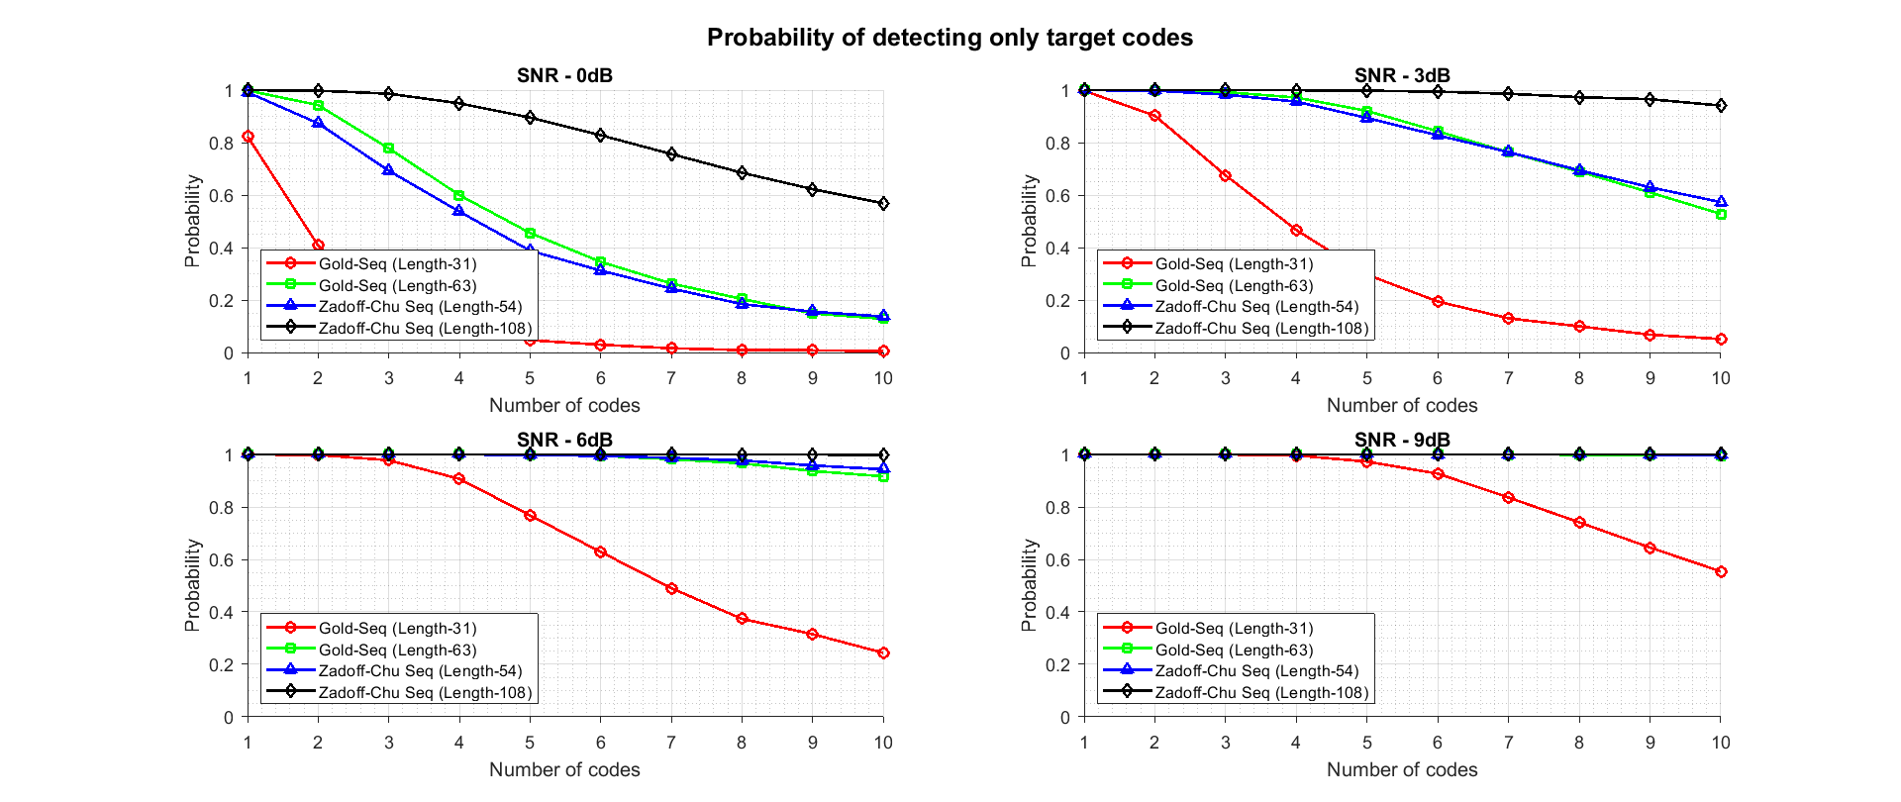
Detection Analysis

Slide 5
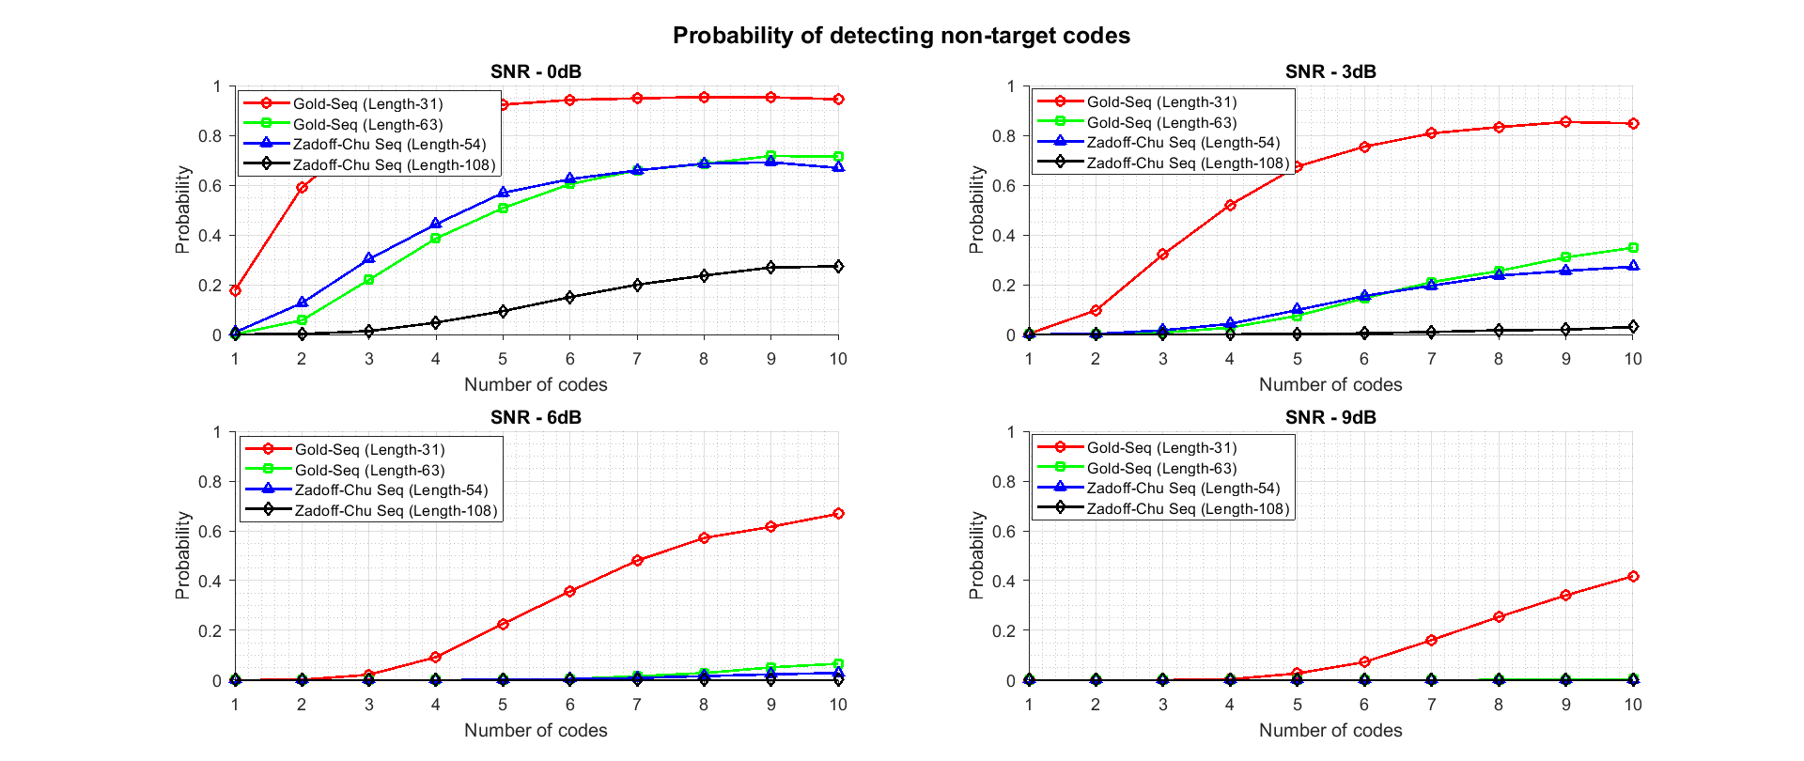

Slide 6
Summary
ZC sequences will help in utilizing the full slot symbol for ranging.
ZC sequence offers better detection capabilities due to increase in the length.
Increase sequence length also means we’ve higher number of sequences to select from during the ranging code partition and selection.

