Slide 1
Ranging Sequences Analysis for PtMP
Date: 2025-09-15

Slide 2
Abstract
In 802.16 PtMP, system Ranging is used for UL synchronization (initial and periodic ranging), Bandwidth Request and during Hand Over indication. In the 802.16t Gold code sequences are used for the ranging purpose; this analysis proposes the change in the length of the sequences and hence change in the sequence type.

Slide 3
Ranging Sequence Length
In 802.16t, the minimum allocation is one slot, which is 54 symbols over one subchannel, but the ranging sequence lengths are not integer multiple of the symbols per slot.
Since Gold code sequences are 31, 63, etc; Zadoff-Chu (ZC) sequence are proposed which can be of lengths integer multiple of 54.
Analysis shows the number of codes detected at various SNR for the Gold and ZC sequences for various lengths.

Slide 4
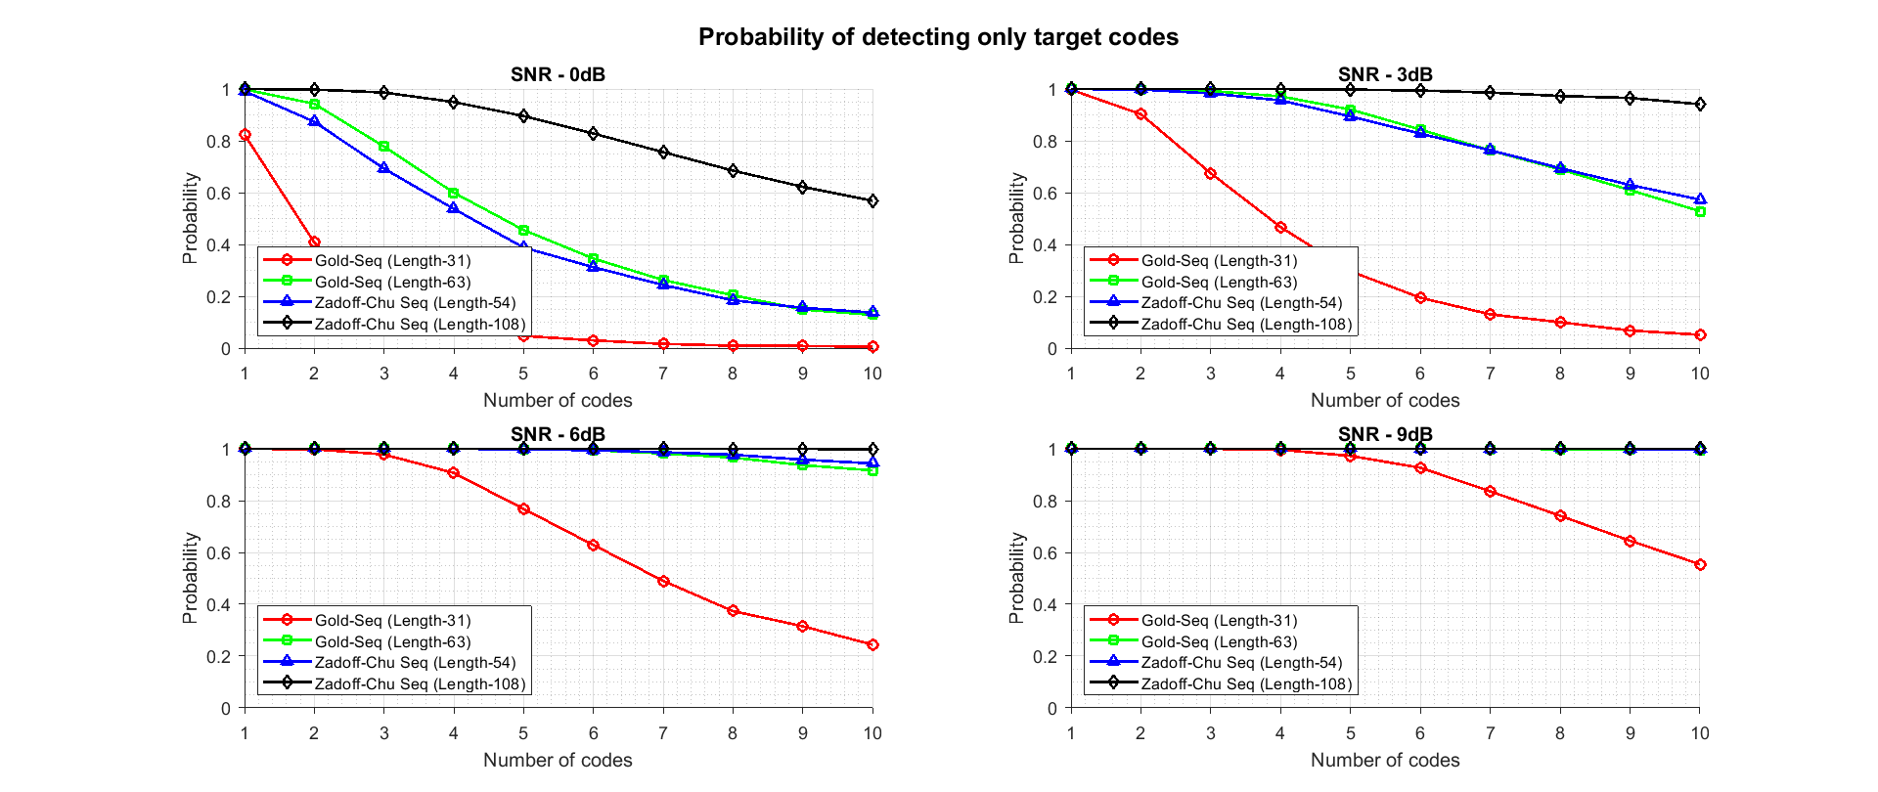
Detection Analysis

Slide 5
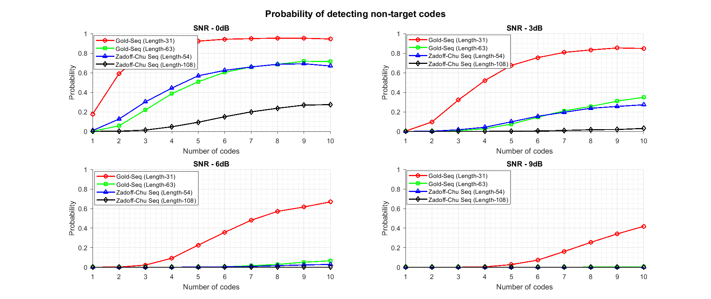

Slide 6
Summary
ZC sequences will help in utilizing the full slot symbol for ranging.
ZC sequence offers better detection capabilities due to increase in the length.
Increase sequence length also means we’ve higher number of sequences to select from during the ranging code partition and selection.

