Slide 1
Project: IEEE P802.15 Working Group for Wireless Specialty Networks (WSN)
Submission Title: Synchronization Sequences Lengths and Gain Adjustment Sequence.
July 2025
Date Submitted: 2025-09-16
Source: Vishal Kalkundrikar, Ondas Networks
Purpose: Analysis showing the Synchronization performance of various lengths of Preamble.
Notice: This document has been prepared to assist the IEEE P802.15. It is offered as a basis for discussion and is not binding on the contributing individual(s) or organization(s). The material in this document is subject to change in form and content after further study. The contributor(s) reserve(s) the right to add, amend or withdraw material contained herein.
Release: The contributor acknowledges and accepts that this contribution becomes the property of IEEE and may be made publicly available by P802.15.

Slide 2
Abstract
For single channel mode performance analysis using ideal synchronization method is presented. Various lengths of Gold code sequences like 31,63,127,255 are considered for the analysis. The preamble detection and synchronization must be robust enough to support the repetition factors 1,2,4,8 etc.

Slide 3
Ideal Synchronization Method
Let y[n] be the received data and x[n] be the reference preamble.
Select a set of possible frequency offsets f_1, f_2… f_k.
For each frequency offset calculate the frequency shifted data
  yk[n] = y[n]*exp(-1i*2*pi*f(k)/Fs*n)
  For this analysis frequency step used is 5 Hz.
Correlate the shifted data yk with the reference preamble x.
This results in the two-dimensional array of correlation values with respect to time and various frequency offsets.
Find the peak of this correlation matrix. This peak will be maximum likelihood estimate of the time and frequency offset.
For each SNR multiple iterations are run and RMSE is calculated.

Slide 4
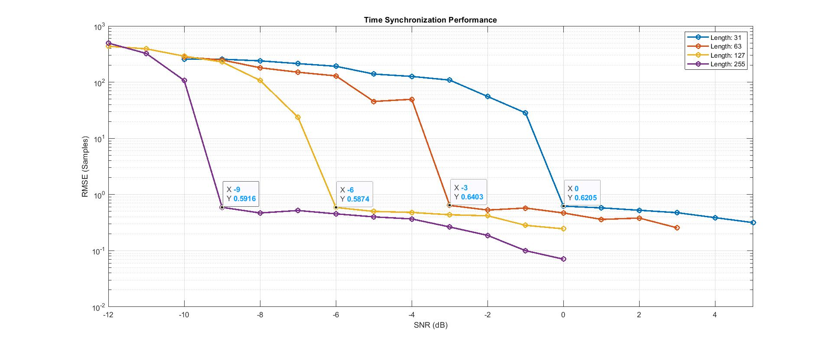
Time Estimation Results

Slide 5
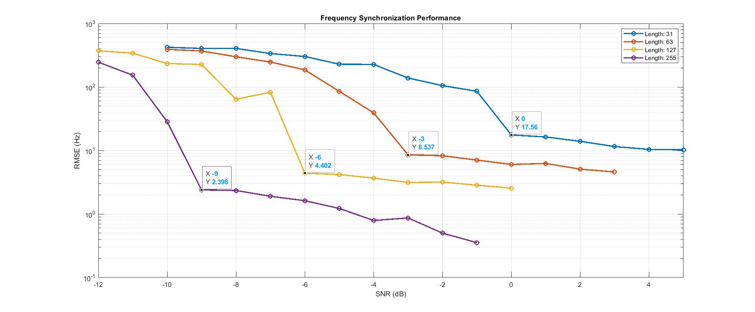
Frequency Estimation Results

Slide 6
Observations on the Synchronization Analysis
  Analysis shows the Time and Frequency estimation performance of 31,63, and 127 length preamble sequence.
  31 length timing RMSE is less than 1 sample for SNR more than 0 dB and for frequency error it is less than 18 Hz.
  63 length timing RMSE is less than 1 sample for SNR more than -3 dB and for frequency error it is less than 9 Hz.
  127 length timing RMSE is less than 1 samples for SNR more than -6 dB and for frequency error it is less than 5 Hz.
  255 length timing RMSE is less than 1 samples for SNR more than -9 dB and for frequency error it is less than 3 Hz.
  We can see 6 dB gain between 31 and 127 and 9 dB gain between 31 and 255 length as expected.

Slide 7
Gain Adjustment Sequence
In PtMP, Base Station based system previous frames history can be used to decide the starting gain of the current frame, but in burst based system we need to decide the gain on the current received burst.
Gain Adjustment Sequence helps in adjusting the receiver gain such that quantization error is minimized.
Gain Adjustment sequence will use same modulation scheme as data.
Next slide shows the basic gain adjustment flow.
Considering four such iterations might be needed in worst case scenario we need at least 12 symbols for the gain adjustment.

Slide 8
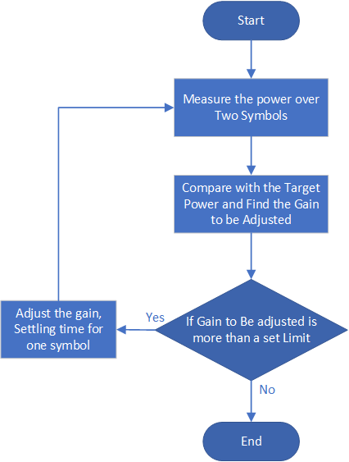
Basic Gain Adjustment Flow

