Slide 1
Project: IEEE P802.15 Working Group for Wireless Specialty Networks (WSNs)
Submission Title : Preliminary Surface-wave Propagation Characteristics in metal-rich environments
Date Submitted : Sep. 14, 2025
Source : Jae-Joon Park, Seok-bong Hyun, Jung-hwan Hwang, Seung-Hyun Jang (ETRI)
Re : IG Surface Wave Communication (SWC)
Abstract : This contribution investigates preliminary propagation characteristics of SWC in metal-rich environments
Purpose: Discussion
Notice: This document has been prepared to assist the IG SWC. It is offered as a basis for discussion and is not binding on the contributing individual(s) or organization(s). The material in this document is subject to change in form and content after further study. The contributor(s) reserve(s) the right to add, amend or withdraw material contained herein.
Release: The contributor acknowledges and accepts that this contribution becomes the property of IEEE and may be made publicly available by P802.15.
Notes:
Jul 12, 2010
Page 1

Slide 2
Introduction
See ‘15-25-0350-00-04ad-surface-wave-propagation-for-ng-sun-phy-in-ship-area-netwok.pdf’
Proposes a new PHY for surface-wave communication (SWC), considering distinct propagation characteristics from conventional space-waves
In this document,
investigate surface-wave propagation characteristics in metal-rich environments
compare them with conventional space-wave propagation
present both simulation and experiment results

Slide 3
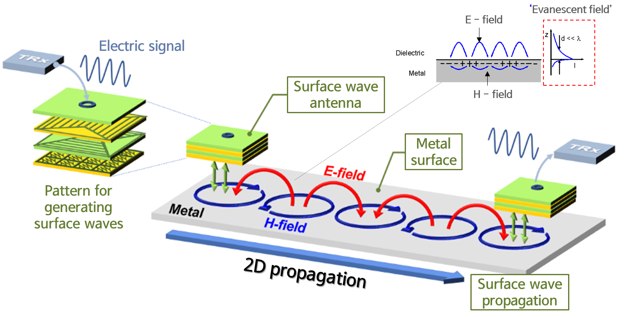
(Review) Surface Wave Propagation
(Definition) Wave mode propagating along boundary between air and metal layers or air and metal-dielectric layers

Slide 4
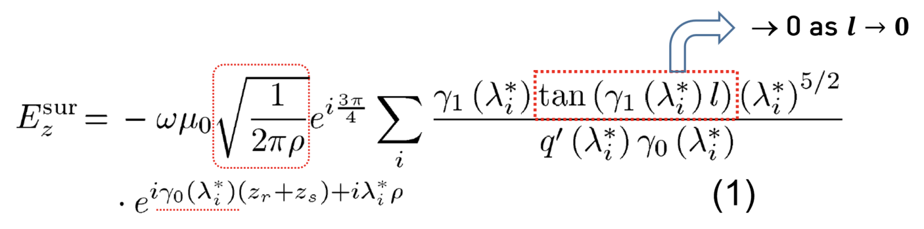
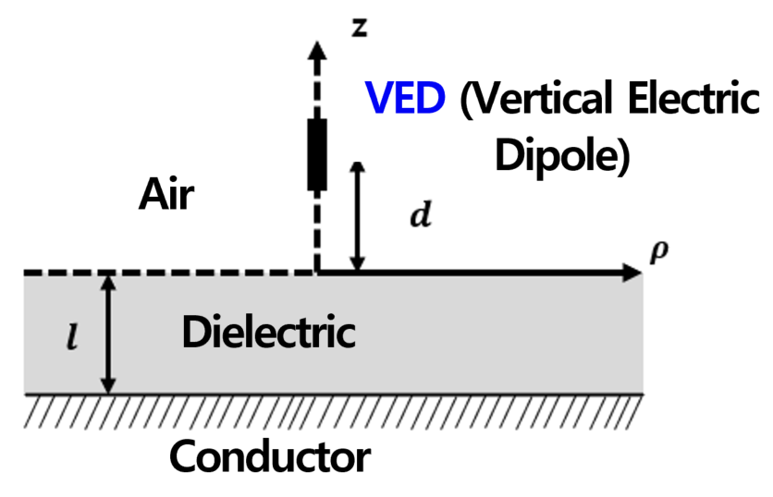
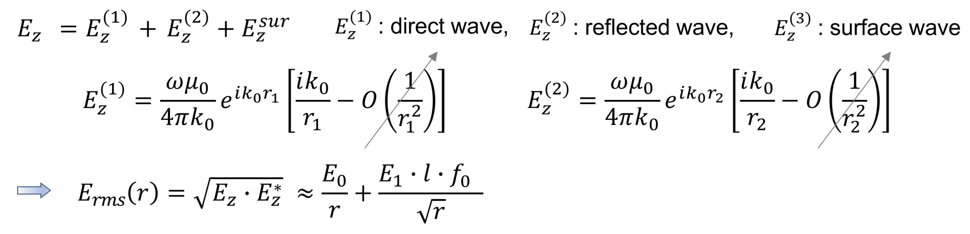

Mathematical Model
Applying Maxwell equations to VED over flat dielectric layer^{[1]}
E-field decreases exponentially in the z-direction, resulting in an Evanescent field characteristics
In the $ρ$ (that means r) direction along the boundary, E-field decreases as $ρ^{−1/2}$ instead of as $ρ^{−1}$
Total far-field solution
[1] T. Fei, et. al., “A comparative study of radio wave propagation over the Earth due to a Vertical Electric Dipole,”, IEEE Trans. Antennas Propag., vol.55, no.10, 2007

Slide 5
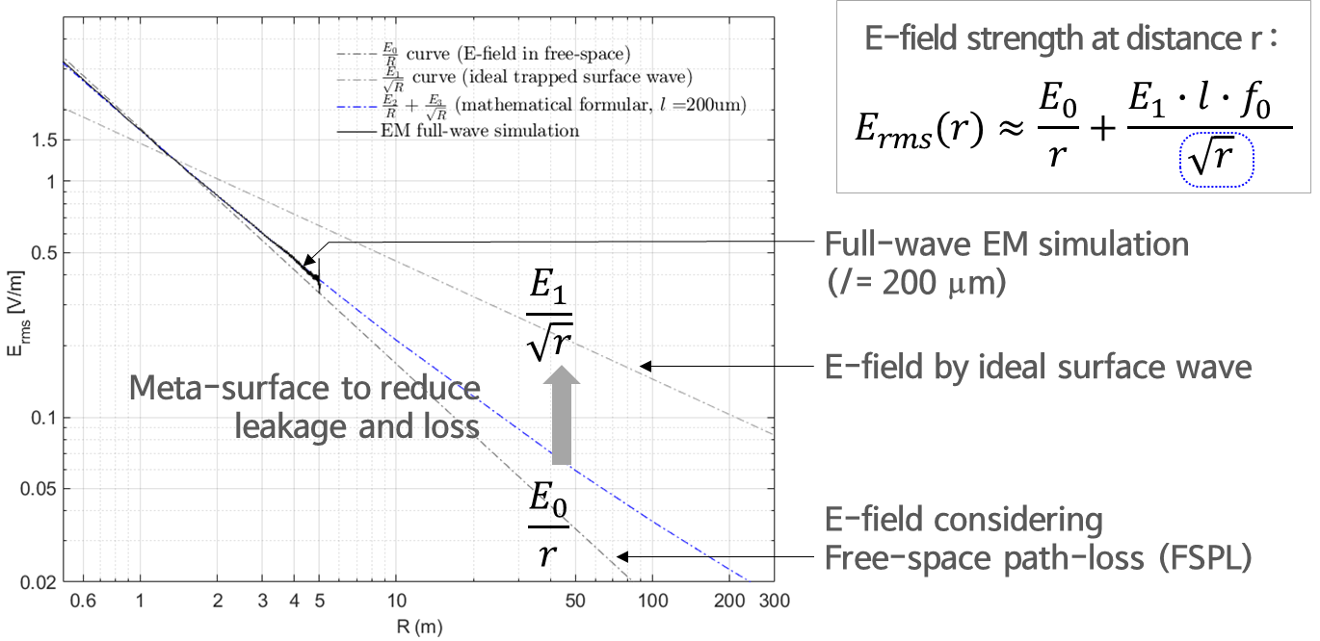
Distinct Property(1) : Long Distance Propagation
Conventional space-wave
Received power is proportional to 1/r² in free space
Surface-wave
Received power is proportional to 1/r on the surface of flat metal
This is a well-known characteristic of surface-waves

Slide 6
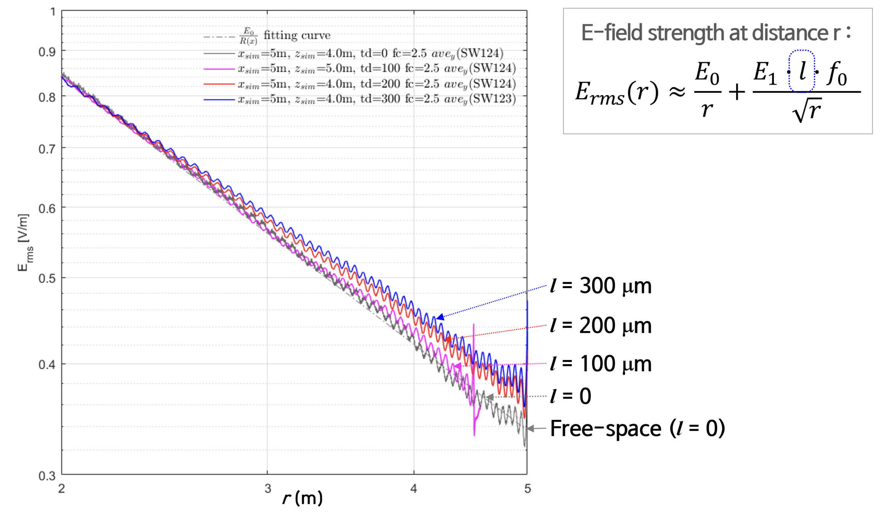
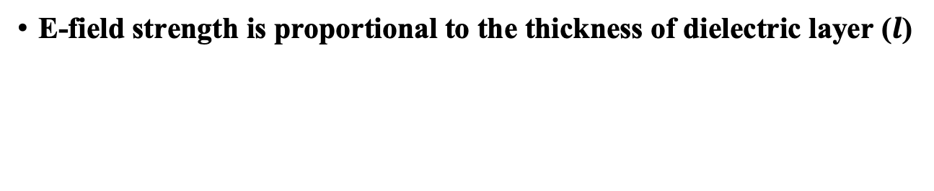
Distinct Property(2) : Dielectric thickness effect
E-field strength is proportional to the thickness of dielectric layer ($l$)

Slide 7
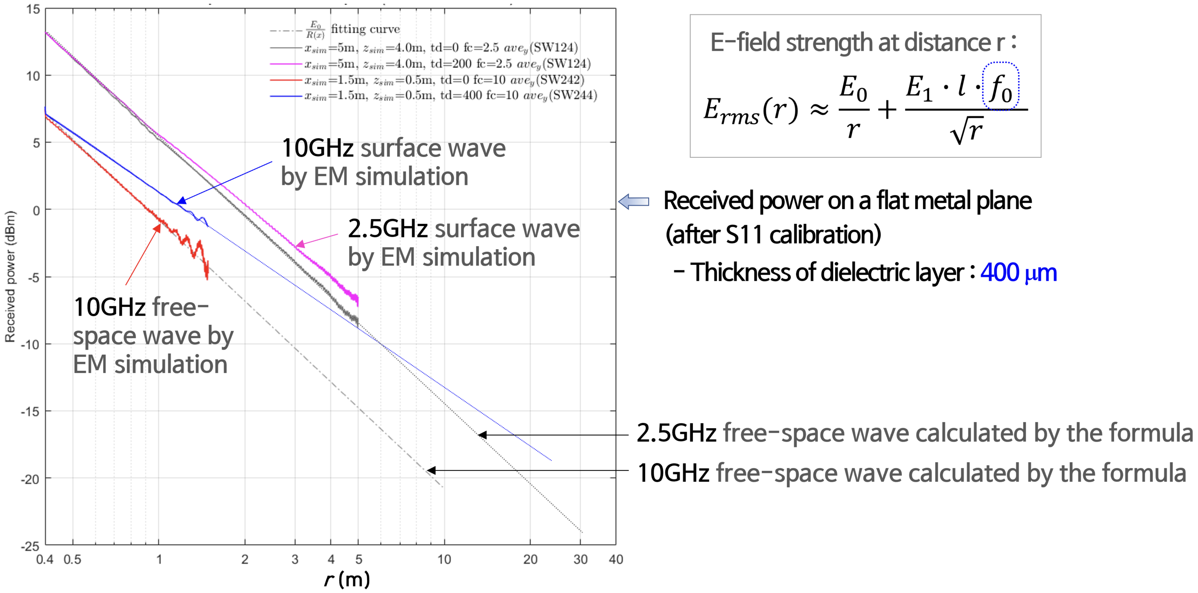
Distinct Property(3) : Frequency effect
Beyond 6 m, the 10 GHz surface-wave exhibits a stronger E-field than the 2.5 GHz free space-wave

Slide 8
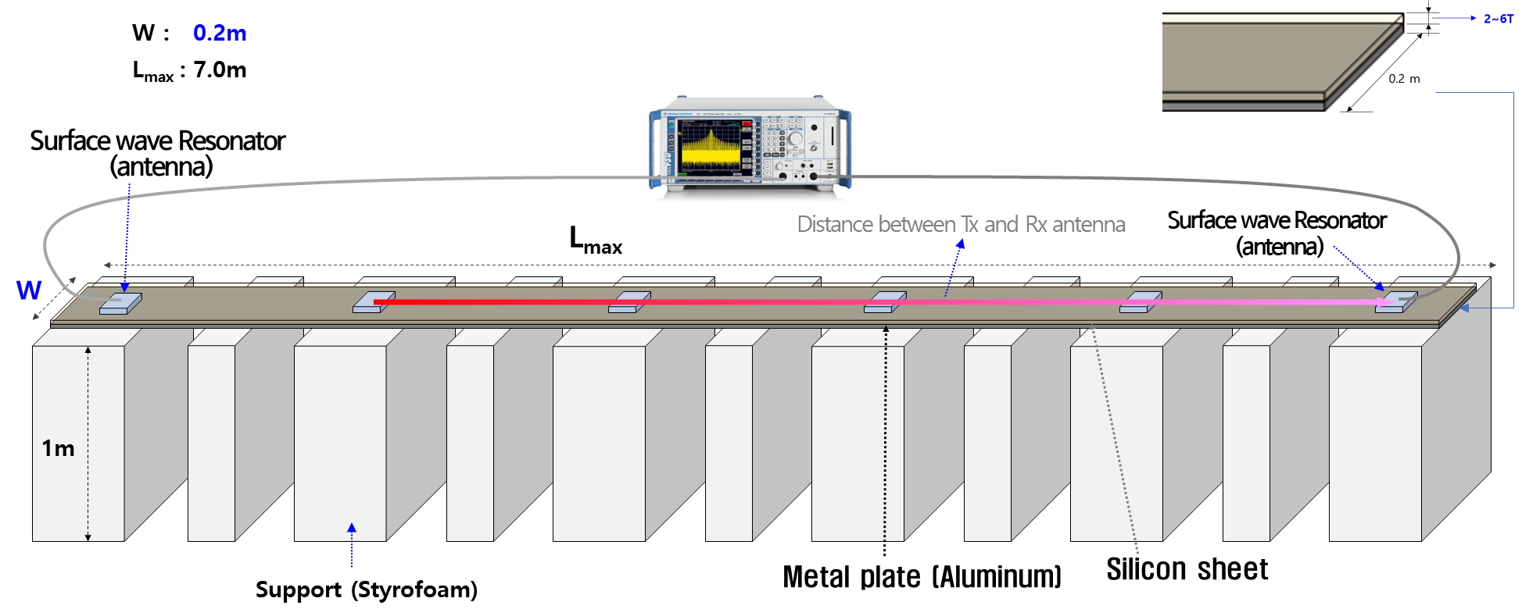
Experiment #1
To investigate surface-wave path loss characteristics as a function of Tx–Rx distance

Slide 9
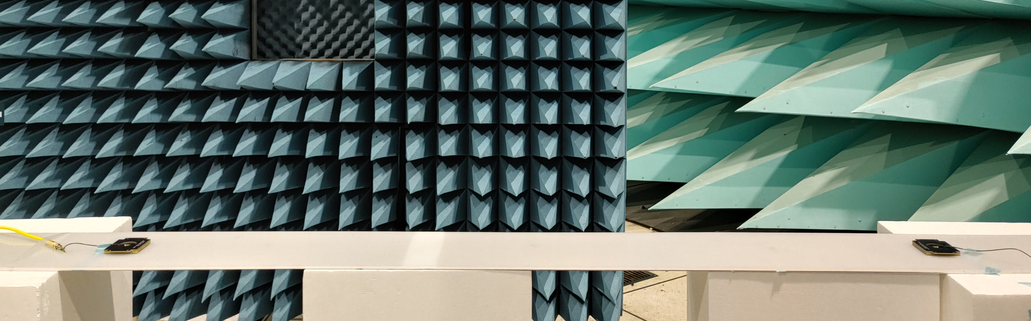
Experiment #1
Measurement setup
Surface wave
Resonator
(antenna)
Surface wave
Resonator
(antenna)

Slide 10
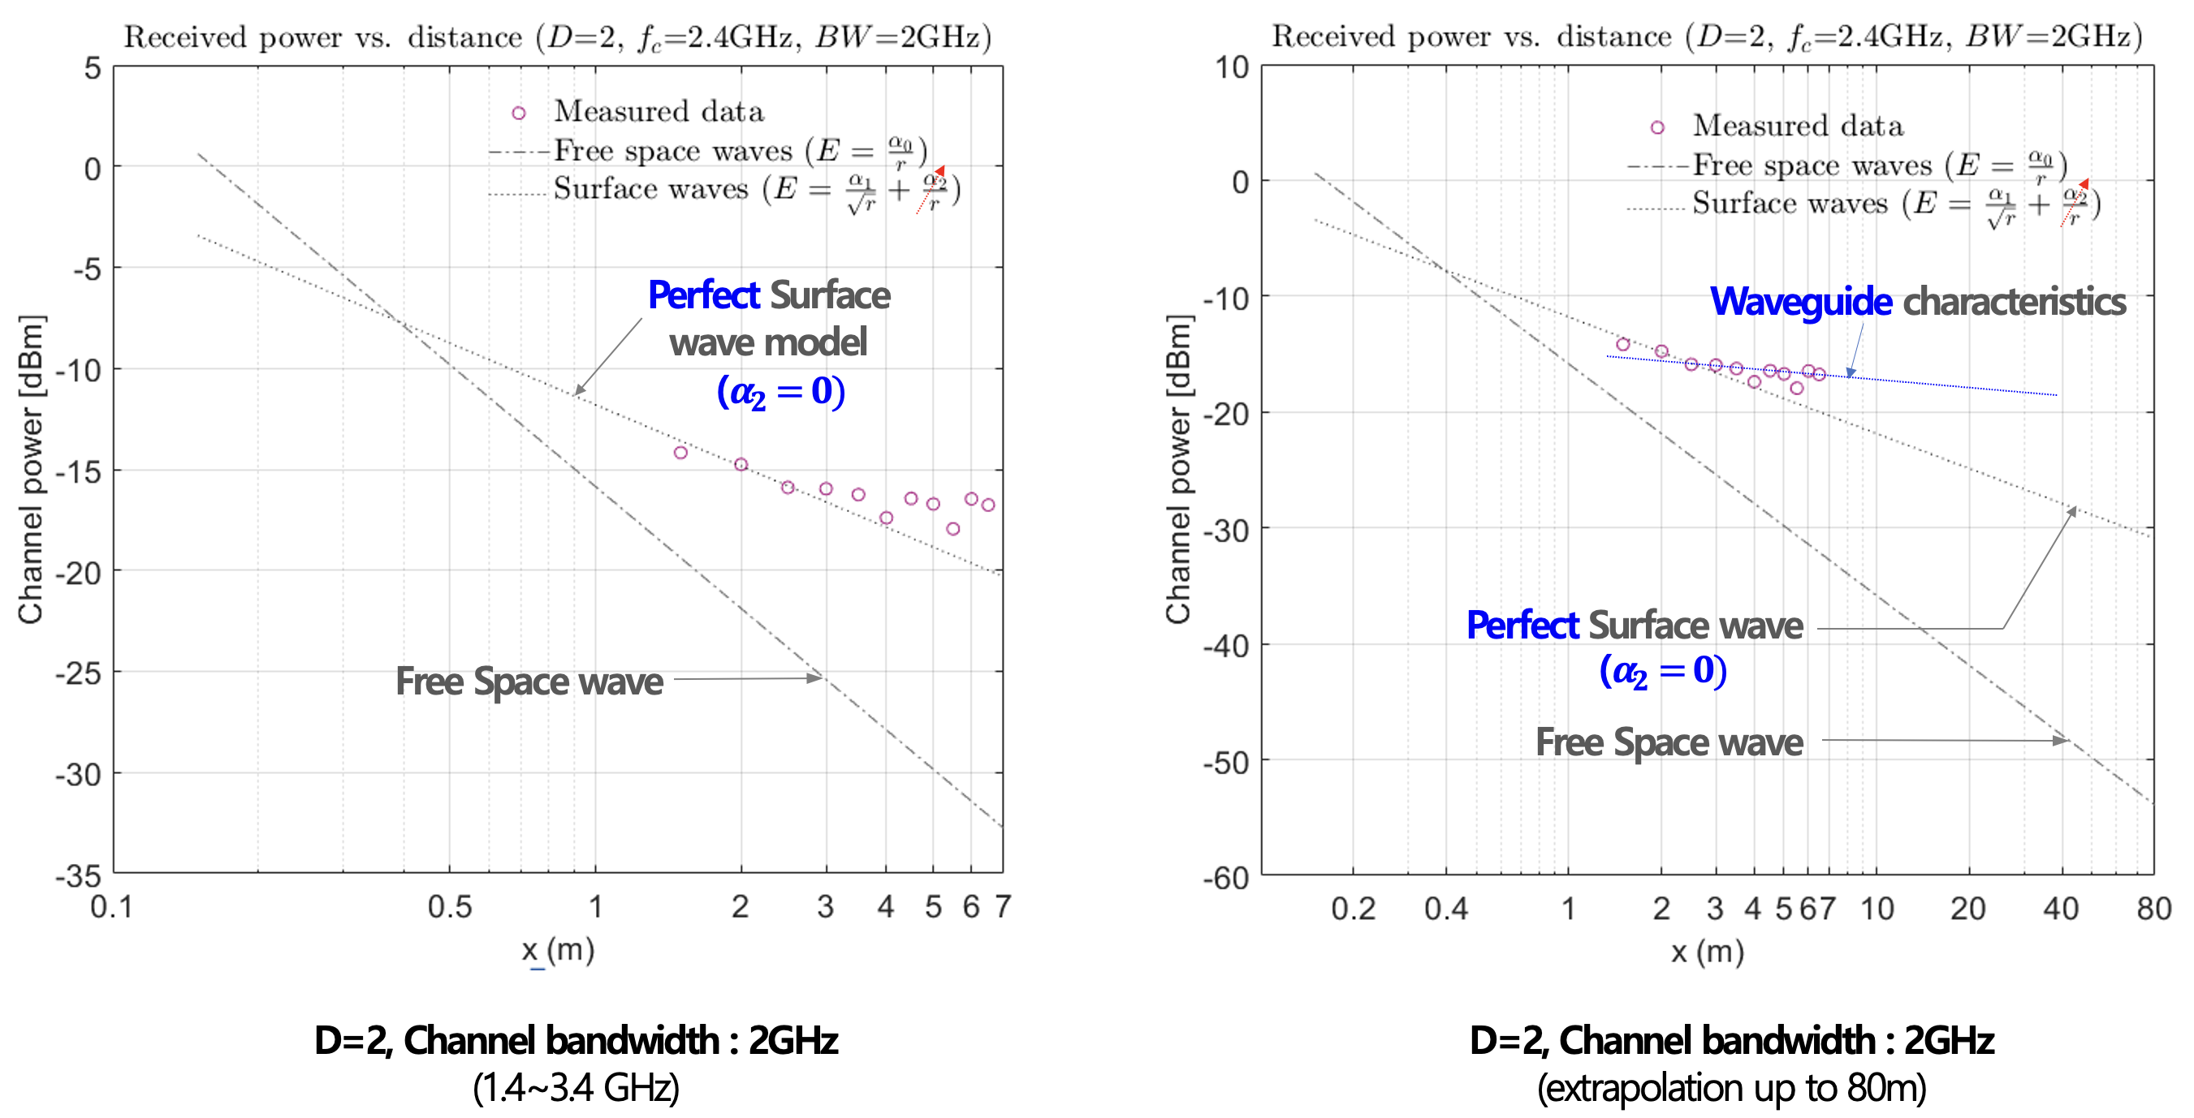
Experiment #1
Measurement results
Path-loss characteristics for metal strip (D=2)
  The measured results are higher than the theoretical values
  The theoretical model assumes an infinite metallic surface, whereas the measurements, due to the finite length and width, exhibit waveguide effects
D: dielectric thickness [mm]

Slide 11
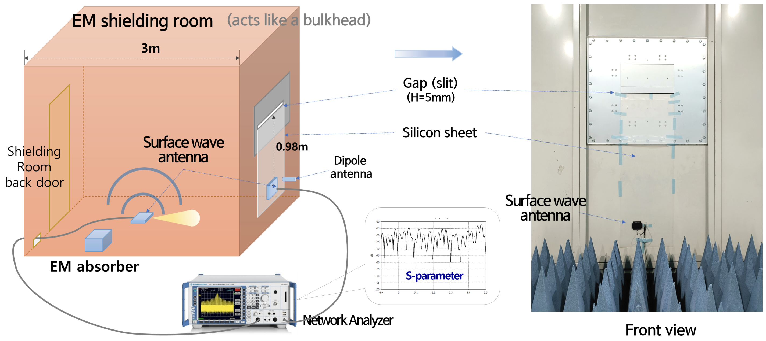
Experiment #2
Testing the characteristics of surface waves propagating along the silicon sheet in a vertical direction

Slide 12
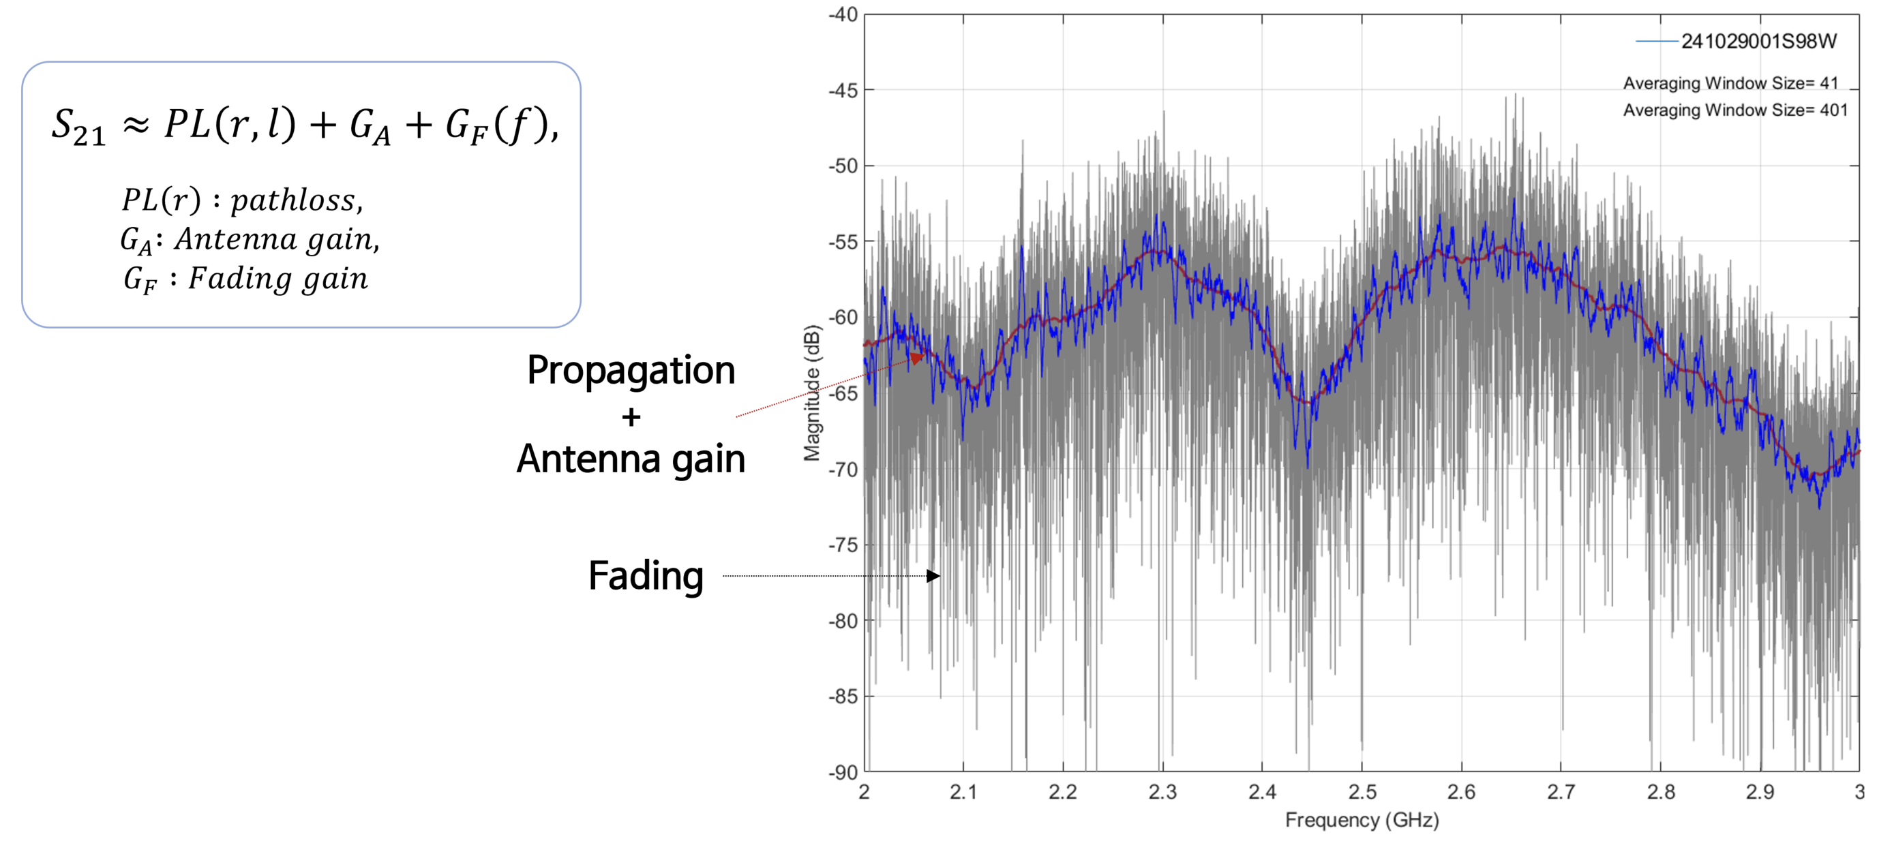
Experiment #2
Measurement results
Initial S-parameter measurement
Severe fading observed (approximately 30dB or more fluctuations)

Slide 13
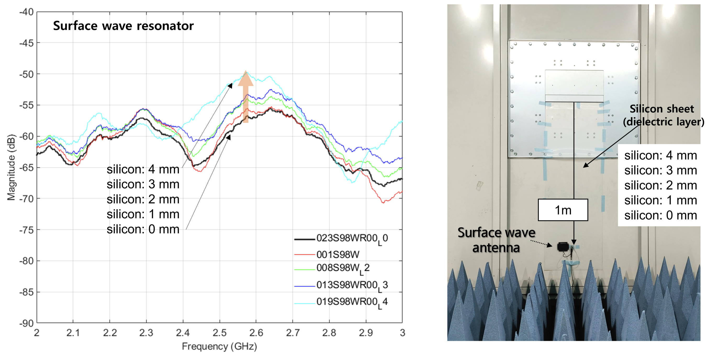
Experiment #2
Measurement results
Dielectric material (silicon sheet) thickness increase → S21 increase

Slide 14
Summary
Surface-wave vs. Space-wave
Surface-wave propagation shows slower decay (1/r) compared to space-wave (1/r²)
Dielectric thickness and frequency strongly affect field strength of SWC
Experiments confirm multipath fading (≥ 30 dB) in metal-rich environments
Results imply
Surface-waves enable long-distance, alternative communication paths
Require careful PHY design to mitigate multipath fading

Slide 15
Thanks for Listening !
Q&A

