Slide 1
Project: IEEE P802.15 Working Group for Wireless Personal Area Networks (WPANs)
Submission Title : The Use cases for Metal Surface Magnetic Communications(MSMC) in ship
Date Submitted : Sep. 15, 2025
Source : Haksun Kim(Sunnywave Tech. Ltd)
Re : IG SWC
Abstract : This contribution describes the use cases of MSMC PHYs in Shadow zones and discuss the requirements of PHYs for MSMC applications
Purpose: Discussion
Notice: This document has been prepared to assist the IEEE P802.15 IG SWC. It is offered as a basis for discussion and is not binding on the contributing individual(s) or organization(s). The material in this document is subject to change in form and content after further study. The contributor(s) reserve(s) the right to add, amend or withdraw material contained herein.
Release: The contributor acknowledges and accepts that this contribution becomes the property of IEEE and may be made publicly available by P802.15.
Notes:
Jul 12, 2010
Page 1

Slide 2
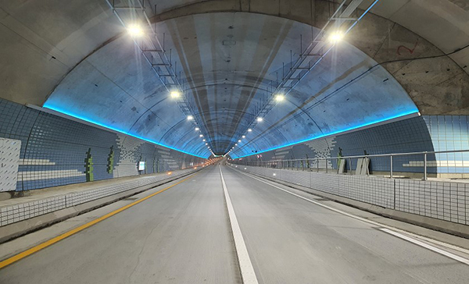
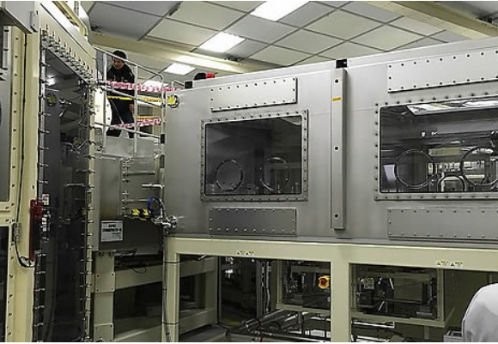
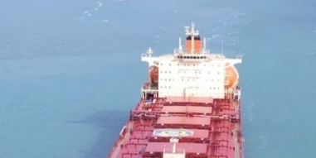
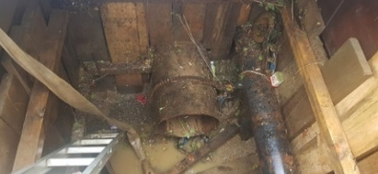
Introduction
Shadow Zone Problem
Metallic structures block RF signals
Examples : ships, pipelines, chambers
Shadow zones with no coverage
Safety and monitoring compromised
New solution urgently needed

Slide 3
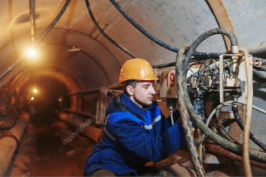
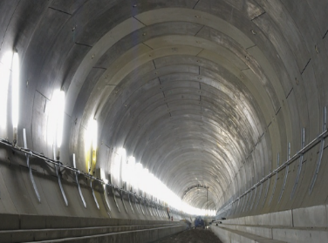
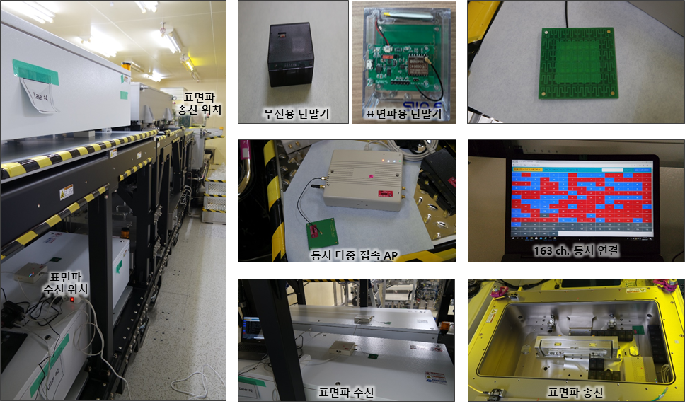
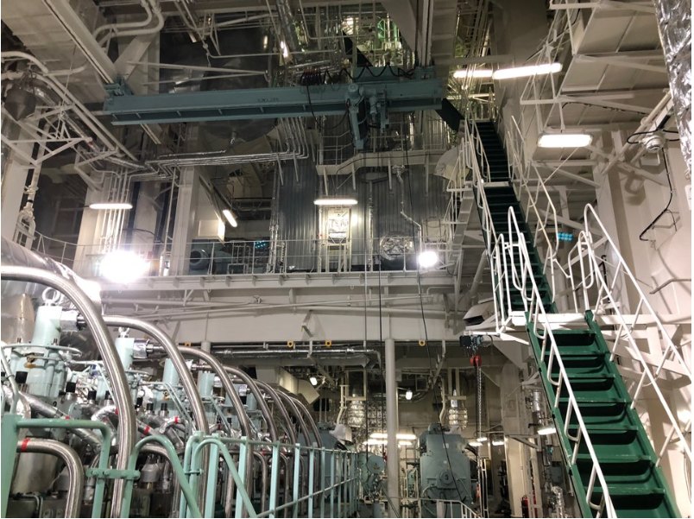
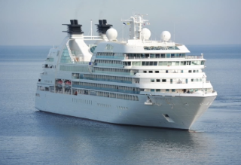
Limitations of RF Communication
High attenuation in metallic structures
Multipath fading and distortion
EMI vulnerability
Unreliable in extreme environments
Limited industrial scalability
Underground
Metal Chamber
Metal Chamber
Inside Ship
Inside Ship
Notes:
Surface wave can be launched directly by specially designed generators. However, in most cases, surface wave modes are generated when ordinary space-waves encounter the boundary between heterogeneous media.

Slide 4
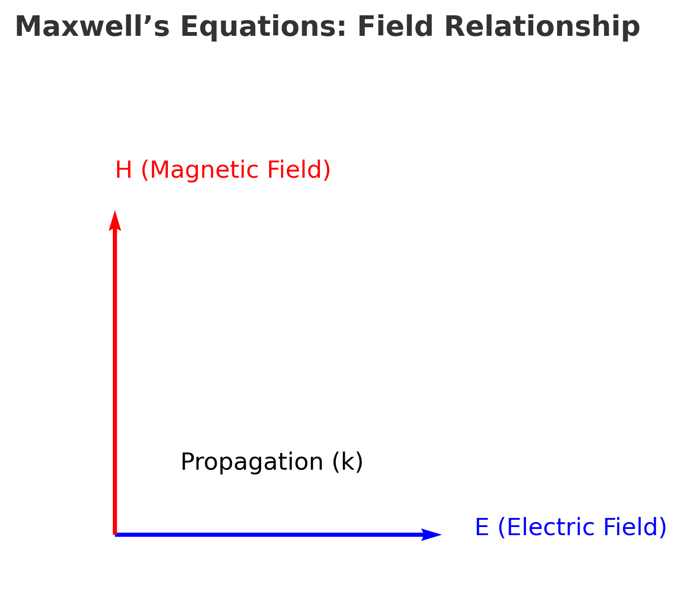
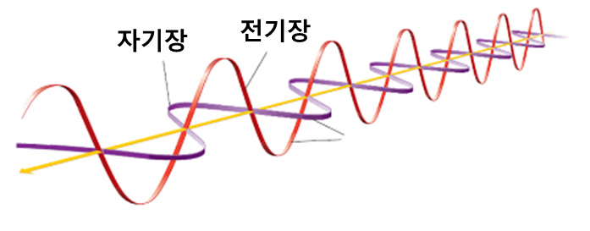
Maxwell’s Equations – Foundation
Core principle of EM interaction
Electric & magnetic fields interrelated
Surface-bound wave solutions exist
Theoretical basis for MSC
Verified experimentally

Slide 5
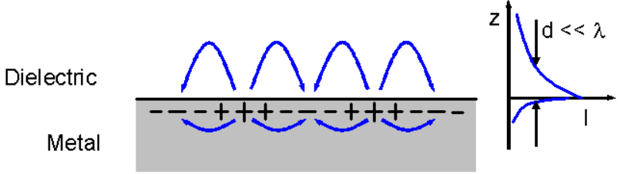
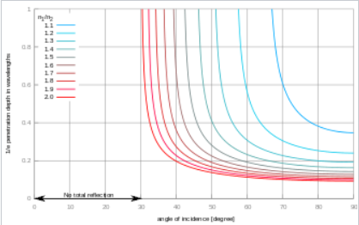
Evanescent Mode
Generated at boundary interfaces
E-field decays along Z-axis
H-field spreads laterally
Rapid attenuation limits distance
Observed in near-field tests
In literature, measured delay spread is large than 400ns inside a merchant ship [5]
E - field
H - field
Wikipedia
‘Evanescent field’

Slide 6
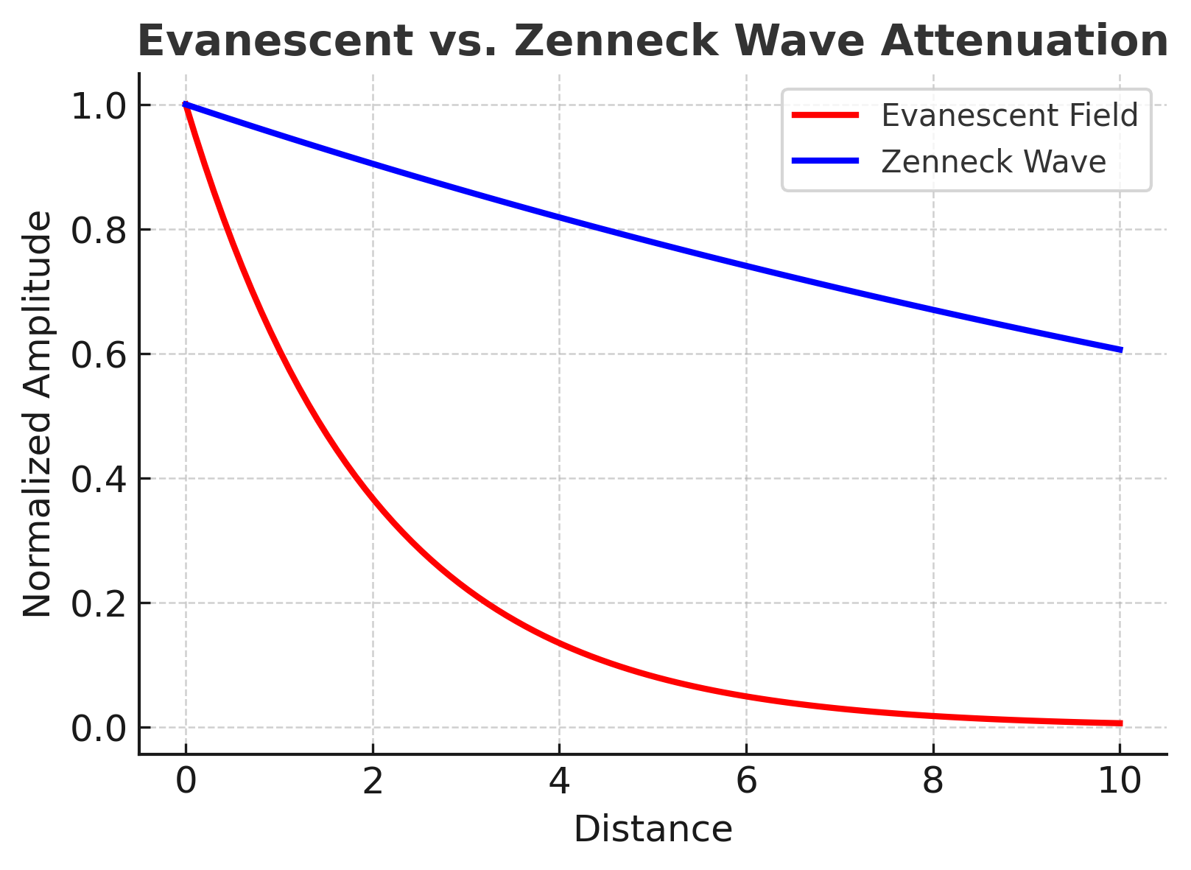
Zenneck Wave
Surface waves along metal boundary
Slower attenuation than evanescent
Travels with surface-guided propagation
Supports long-distance reliability
Foundation for MSC

Slide 7
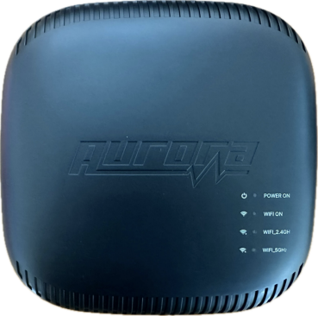
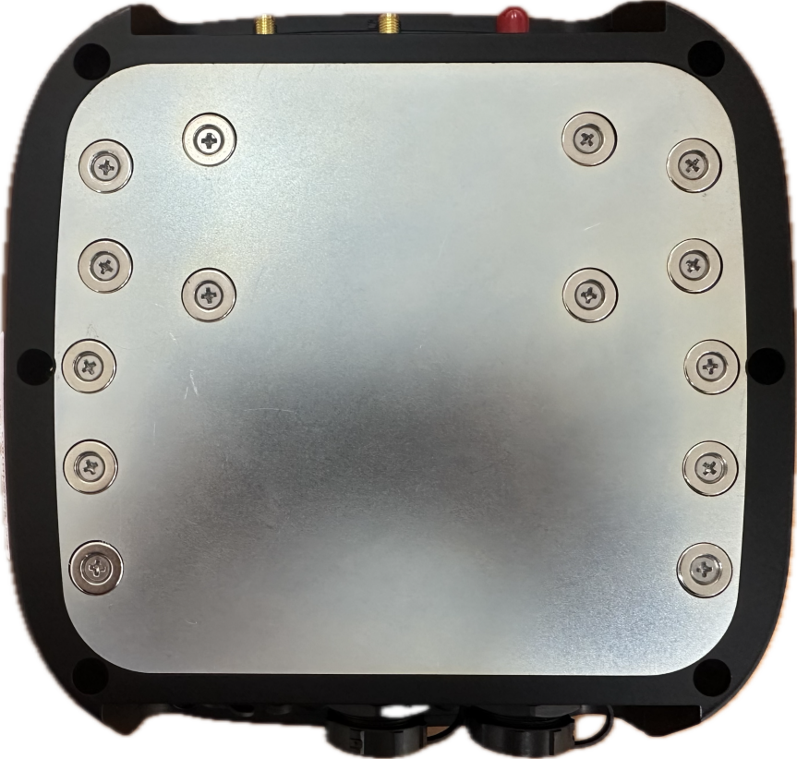
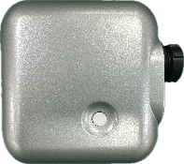
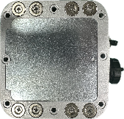
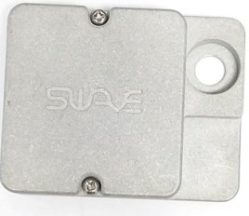
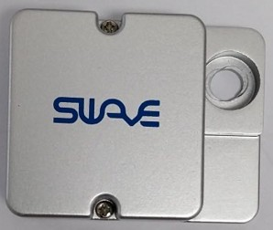
MSMC Concept
AP(Access Point)
Magnetic Communication Network
Aurora resonator converts E ↔ H
Access Point : Data gather and transfer
Bridge : repeater and widening service
Terminal and Sensor
▲ AP
Bridge
Terminal with Sensor
▲ Bridge

Slide 8
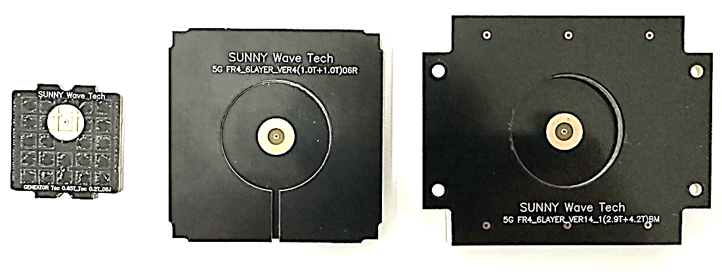
Aurora Resonator
Magnetic surface propagation
Aurora resonator converts E ↔ H
Compact / Light / Pro versions
Customizable by frequency
Verified in field tests
Signal (z)
GND
Dielectric
Patch
Dielectric
Slot
▲ Compact
▲ Light
▲ Pro

Slide 9
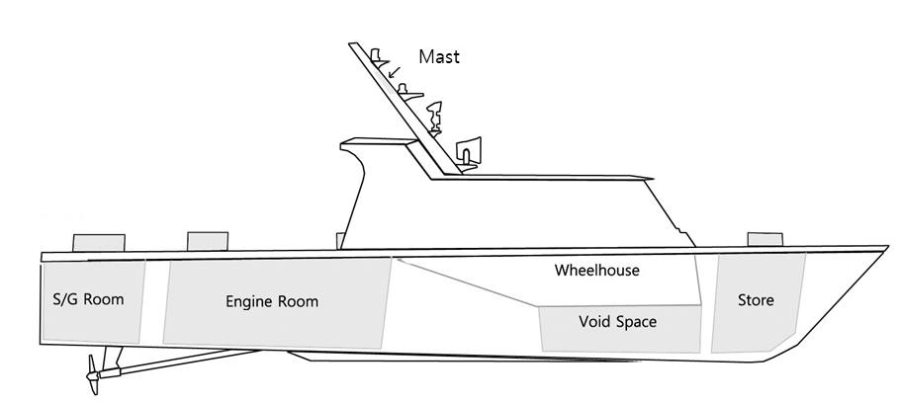


PoC – Aluminum Ship Case
Tested inside aluminum vessel
2–3x faster than Wi-Fi
Stable transfer in engine rooms
Reliable in compartments
Industrial feasibility proven
Result of PoC
Mbps

Slide 10
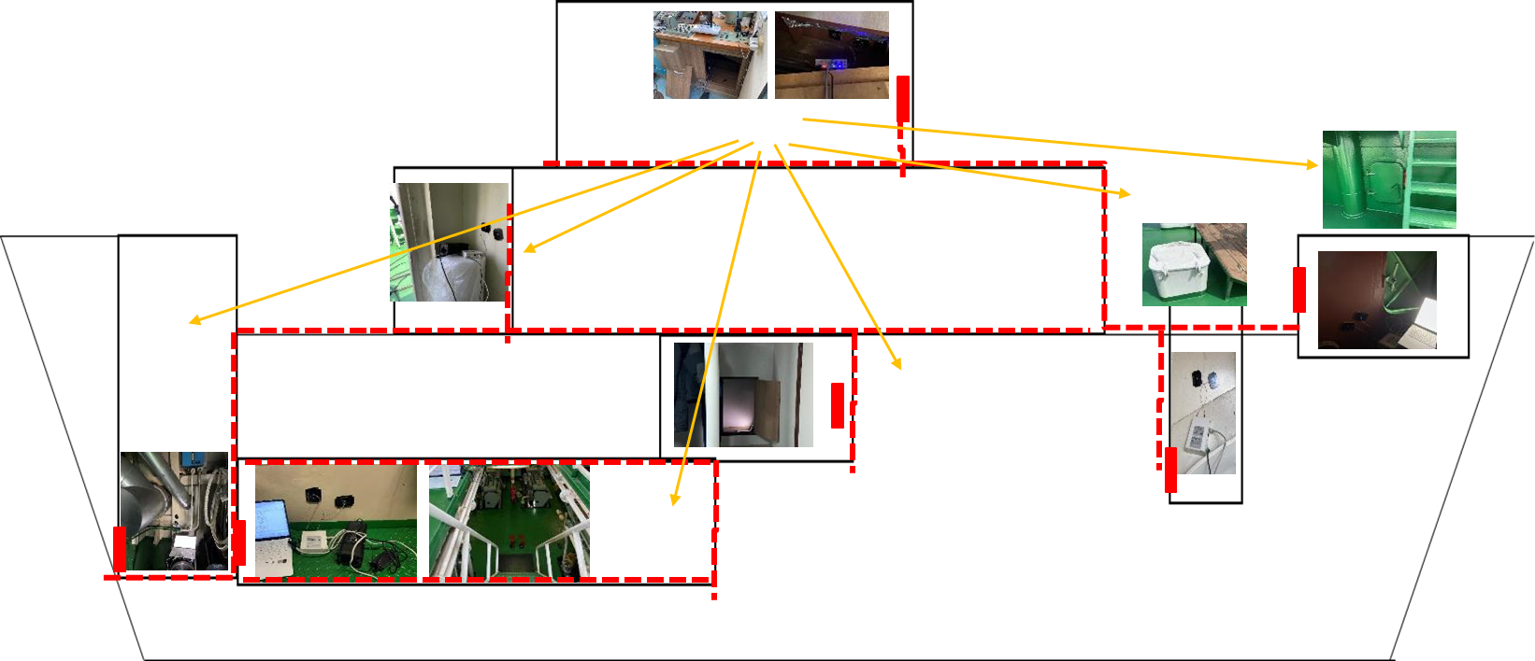
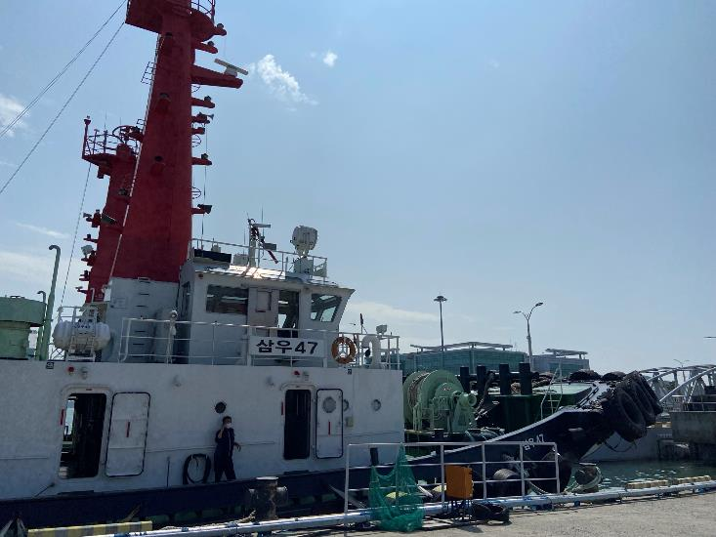
PoC – Steel Ship Case
Tested in heavy steel compartments
10x faster than RF
Overcame multipath fading
Stable backbone established
Ready for deployment
Warehouse
Bridge
Bow Store
Deck
Store
Steering Gear Room
Cabin
Engine
Room
MSMC Verification Result
Mbps
10 times higher data rate

Slide 11
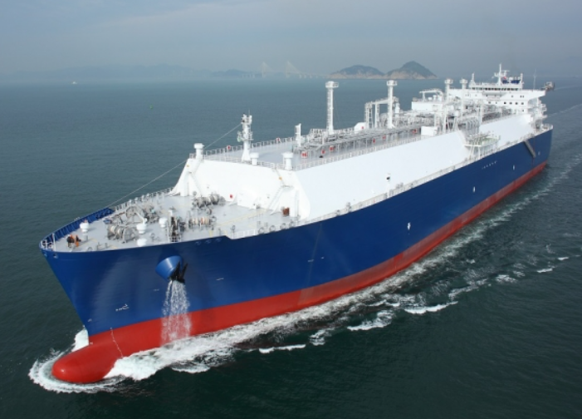
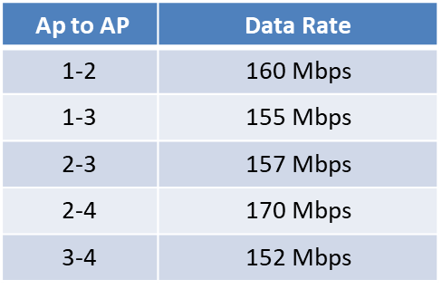
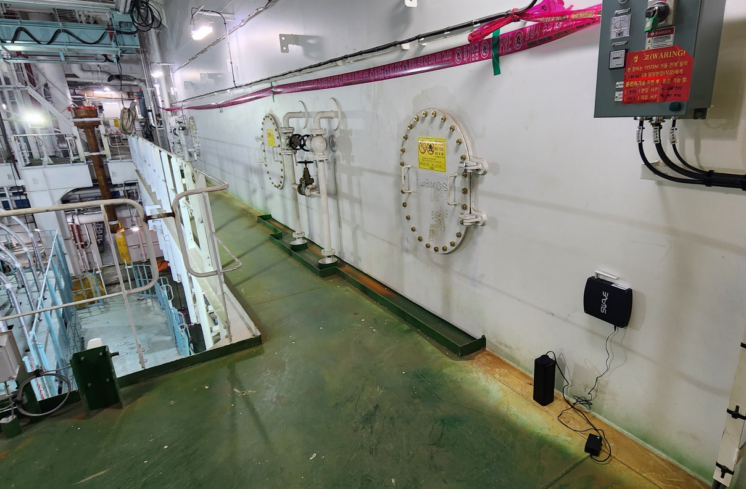
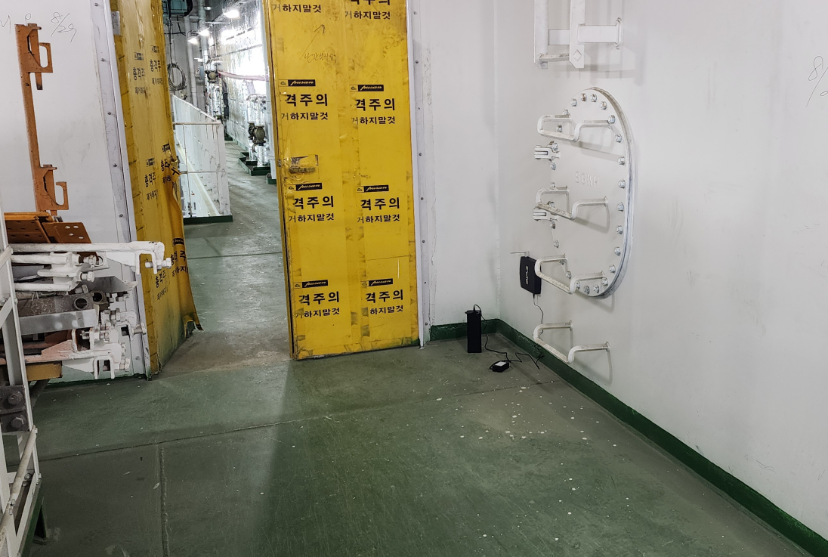
PoC – LNG Vessel Backbone
Deployed across 4 decks
150+ Mbps throughput
Magnetic backbone
Mesh connectivity validated
Mobile devices supported

Slide 12
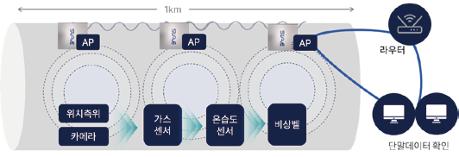
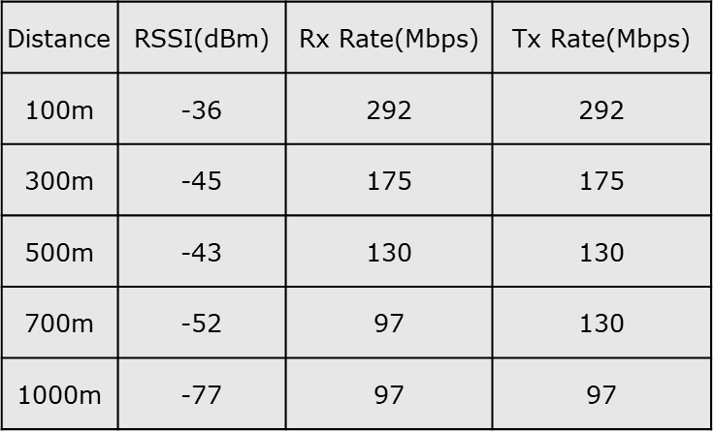
PoC – Underground Pipeline
1 km distance verified
90 Mbps sustained throughput
Video & sensor data transfer
No harness needed
Reduced cost

Slide 13
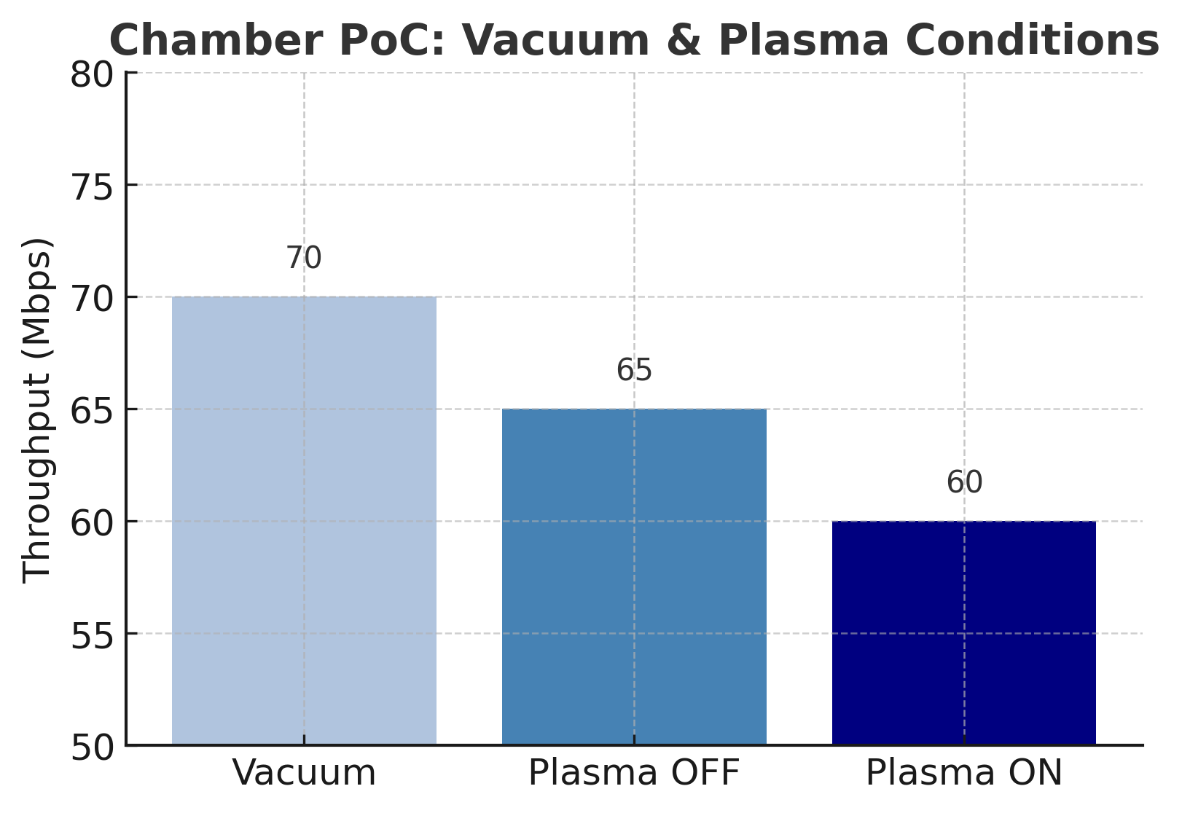
PoC – Semiconductor Chamber
High vacuum (10⁻⁷ torr)
Plasma ON stable 58–72 Mbps
Real-time monitoring
No wiring needed
Improved productivity

Slide 14
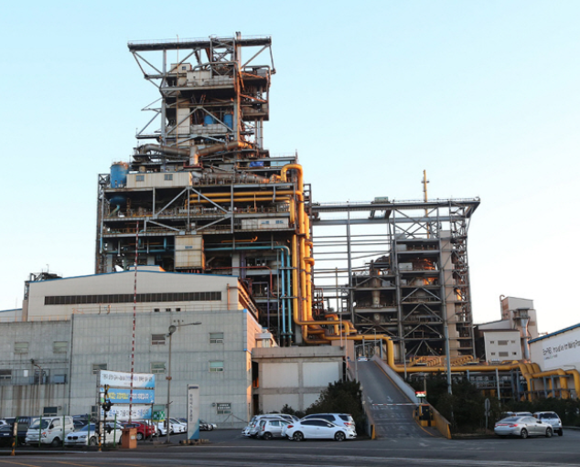

PoC – Construction Site CCTV
N18-floor building deployment
Stable video streaming
Harness-free installation
40% cost saving
Flexible camera placement
AP 18F
MSMC
AP 9F
MSMC
AP 2F

Slide 15
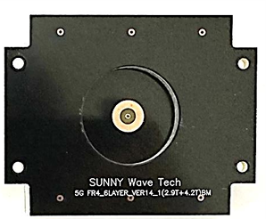

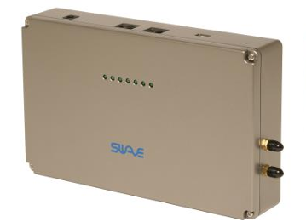



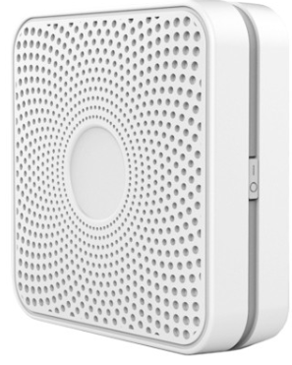
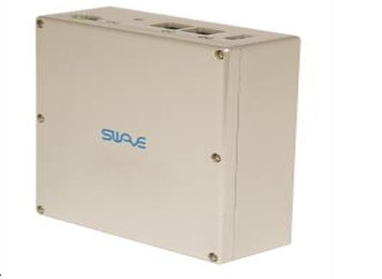
PoC – Confined Space Safety
Aurora SAFETY terminal
Gas/temp sensors + CCTV
Used in petrochemical plants
Worker monitoring
Compliance ensured
Gas Sensor
Temp. Sensor
Smart Safe vest
CC TV

Slide 16
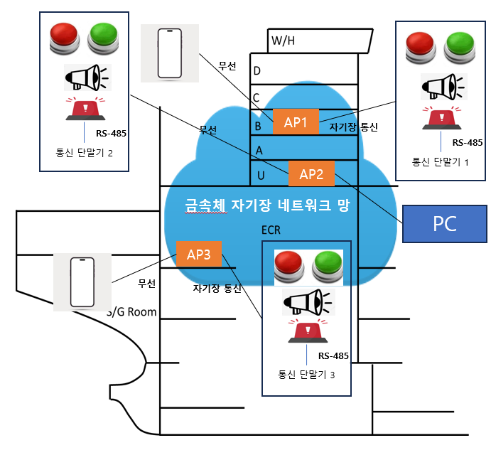
PoC – Emergency SOS
Aurora SOS terminal
Instant emergency alarm
Tested in shipyards
Fast accident response
Golden time secured

Slide 17
Key Technical Features
EMI immunity
Enhanced security
Harness-free operation
Low-power structure
High reliability

Slide 18
Summary of PoC Results
Ships: 2–10x faster vs. RF
Pipelines: 1 km, 90 Mbps stable
Chambers: works under plasma
Construction: 40% cost saving
Safety: emergency support

Slide 19
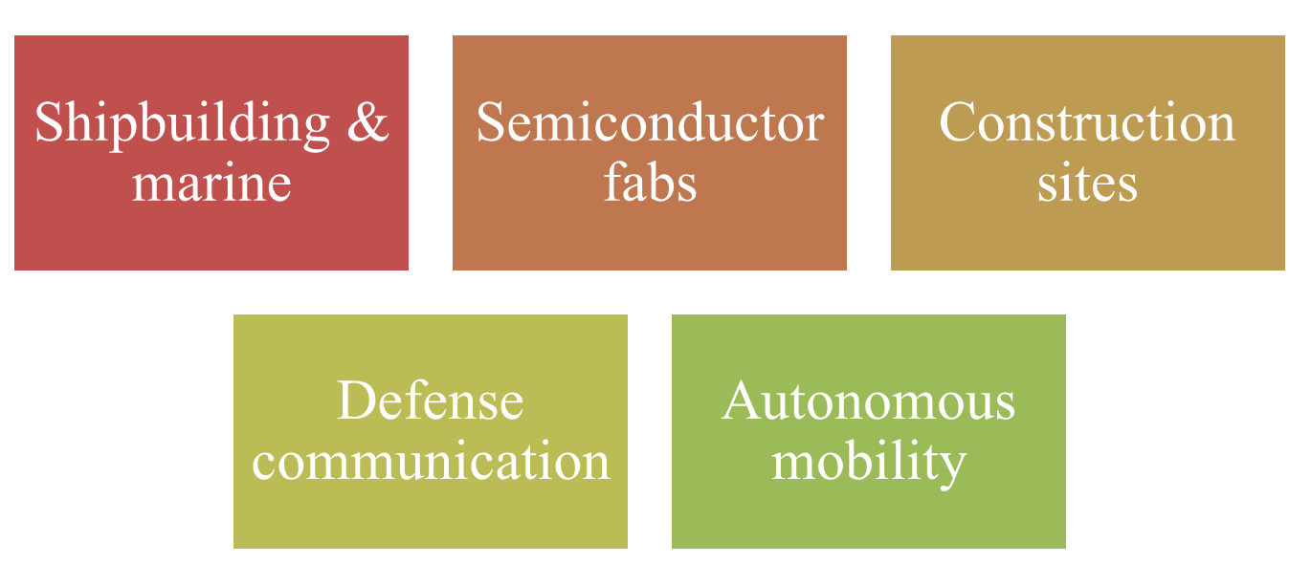
Application Scenarios

Slide 20
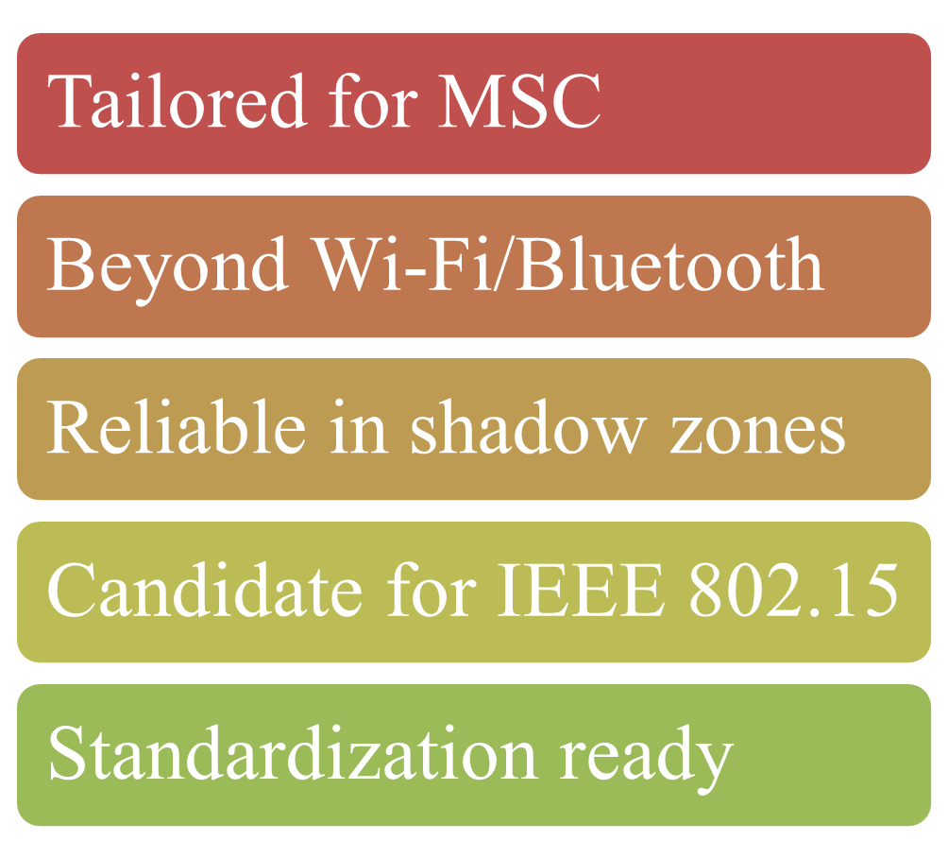
Future Research – Mod/Demod

Slide 21
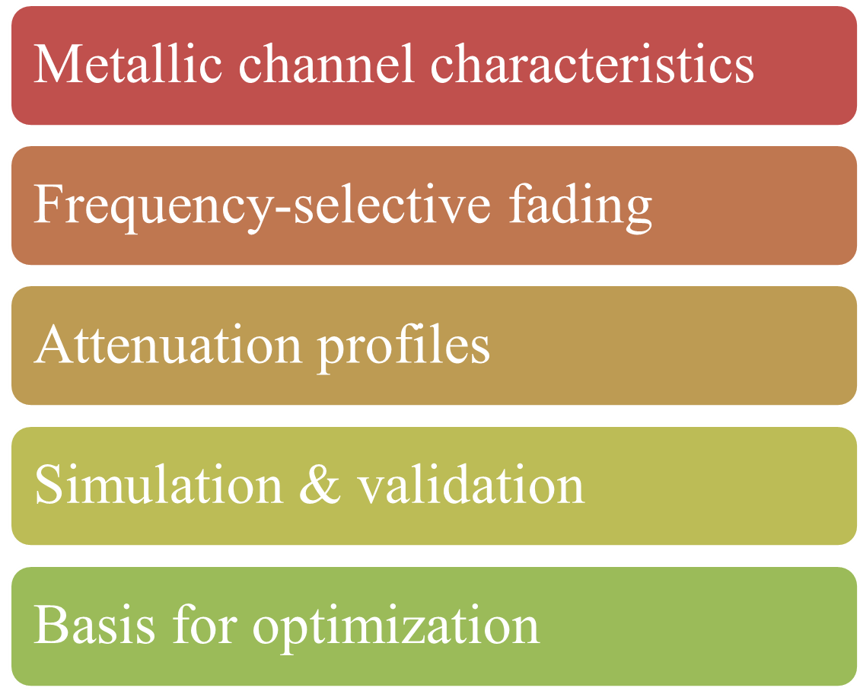
Future Research – Channel Modelling

Slide 22
Dedicated PHY Layer

Slide 23
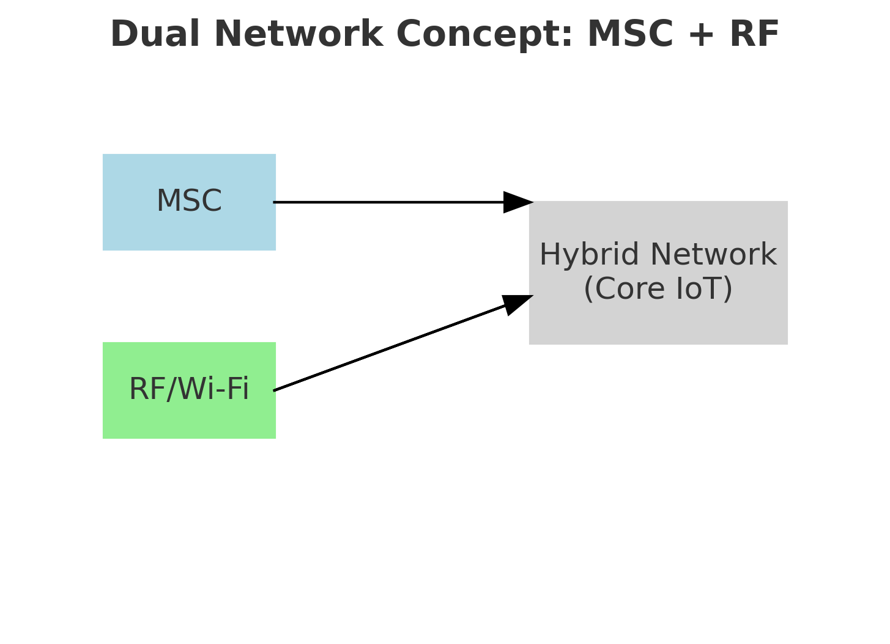
Dual Network Concept
MSC + conventional RF
Extended coverage
Redundancy supported
Failover capability
Robust IoT networks

Slide 24
Standardization Path
Aligned with IEEE 802.15
Contribution to C-IoT
Extension to 5G/6G
Industry collaboration
Global adoption

Slide 25
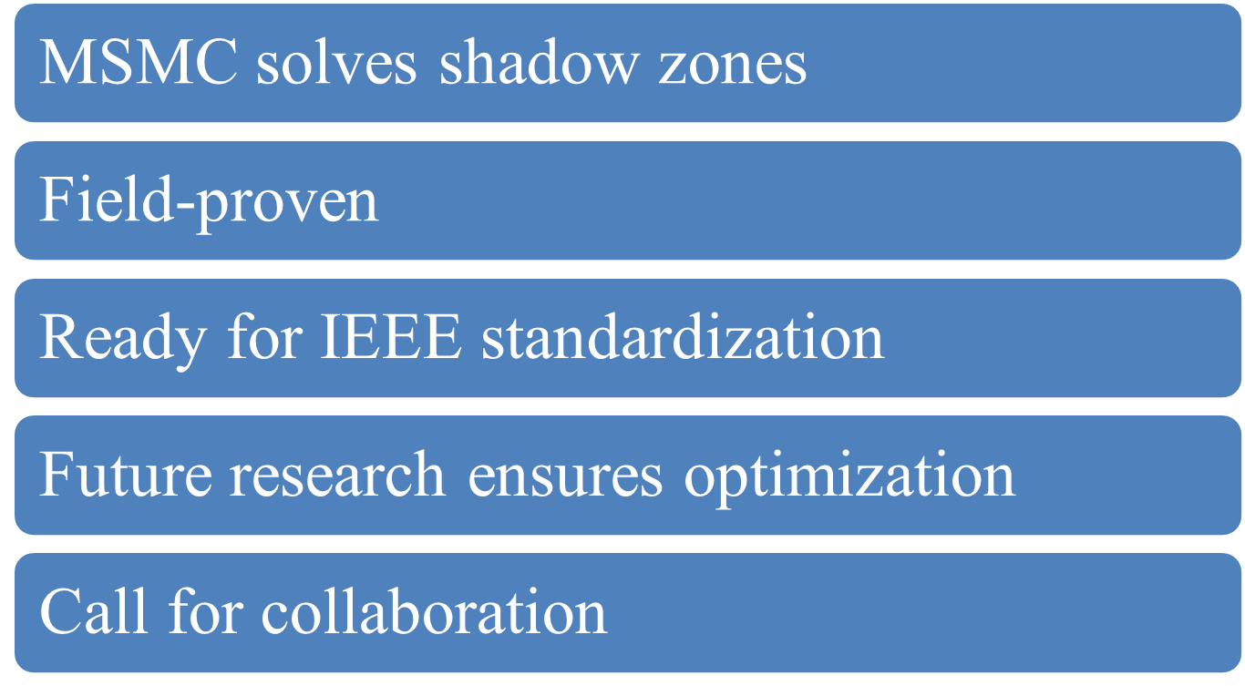
Conclusion

Slide 26
Thanks for Listening !
Q&A

