Slide 1
Project: IEEE P802.15 Working Group for Wireless Personal Area Networks (WPANs)
Submission Title : Proposal for a PHY frame considering the effect of metal structures on surface wave propagation characteristics
Date Submitted : Sep. 14, 2025
Source : Seok-bong Hyun, Jung-hwan Hwang, Seung-Hyun Jang, Jae-Joon Park(ETRI), Kai-Kit Wong (Univ. College London)
Re : IG SWC
Abstract : This contribution proposes new low-cost PHY frame structure that considers surface wave channel characteristics in metal-rich environments
Purpose: Discussion
Notice: This document has been prepared to assist the IEEE P802.15 IG SWC. It is offered as a basis for discussion and is not binding on the contributing individual(s) or organization(s). The material in this document is subject to change in form and content after further study. The contributor(s) reserve(s) the right to add, amend or withdraw material contained herein.
Release: The contributor acknowledges and accepts that this contribution becomes the property of IEEE and may be made publicly available by P802.15.
Notes:
Jul 12, 2010
Page 1

Slide 2
Introduction
See ‘15-25-0350-00-04ad-surface-wave-propagation-for-ng-sun-phy-in-ship-area-netwok.pdf’
A new PHY is required for surface wave communications, due to channel characteristics that differ from those of commonly used electromagnetic waves, such as space waves
Severe multipath fading is caused by multiple reflections from metallic bulkhead structures onboard ships
Large delay spread is observed in indoor wireless channels of metal ships (> 600us), caused by highly reflective metallic structures
Relatively low path loss is observed, since the metal walls of bulkheads, corridors, and cargo holds act as waveguides or highly reflective reverberation chambers

Slide 3
PHY requirements
Low-cost
Minimal changes to existing devices using conventional PHY hardware
Some devices (STA or UE) can be used without replacement
High data-rate mode support
Multiple video signals from monitor cameras in corridors and cargo hold should be transmitted to the central control system with low latency
Backward compatibility
Support wireless networks based on legacy standards already deployed onboard ships
Considering that some Wireless LAN devices are already being used to test ship area networks (SAN)
Notes:
‘Non-AP STA implemented in sensor devices’

Slide 4
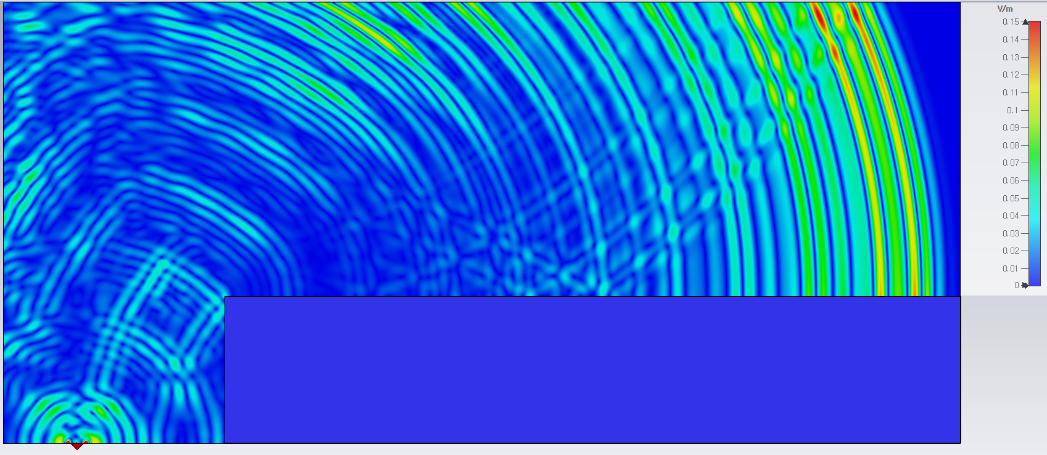
Review – Surface waves
Semi-2D wave propagation mode along the boundary between heterogeneous media [2]
Surface waves are generated in the following two ways
Mode conversion from space waves when they encounter a structured surface, such as metals with a dielectric layers or EM meta-surfaces
Antennas that generate an E-field normal to the metallic surface and, in the patch configuration, are specially designed to provide high gain in the end-fire direction
Mode conversion
Example
Space-wave mode
Mode conversion
Patch
antenna
Surface-wave mode
E-field distribution
at t =11.2ns
0.5m
3m
Notes:
Surface wave can be launched directly by specially designed generators. However, in most cases, surface wave modes are generated when ordinary space-waves encounter the boundary between heterogeneous media.

Slide 5
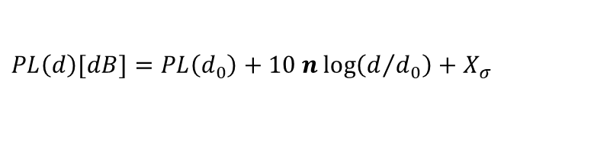
Propagation characteristics in ship environments
In metal-rich environments, the key factor limiting wireless communication coverage is severe multipath fading caused by large delay spread
Numerous reflections from the metallic surfaces result in a very large RMS delay spread
According to the literature, the measured RMS delay spread inside a merchant ship exceeds 600 ns [3]
Path loss and antenna gain for space waves are important, but they are not the only factors determining communication coverage in ship environments
Metal walls such as bulkheads, corridors, and cargo holds act as waveguides, so the pass loss measured inside ships is relatively small compared to that in a typical office or outdoor environment [4]
  Pass loss exponent n < 1.6, instead of 2~3 in office environment
$$PL\left(d\right)[dB]=PL\left(d_{0}\right)+10 n\log\left(d/{d_{0}}\right)+X_{σ}$$
(basic log-distance model)

Slide 6
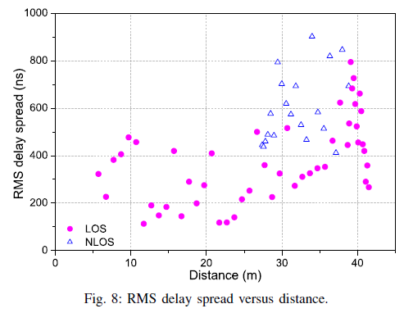
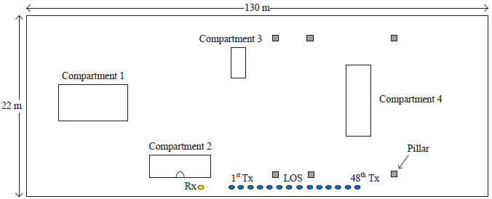
Delay spread vs. distance
Examples of measured delay spread a inside ship
The RMS delay spread measured under LOS and NLOS conditions inside a 130m cargo hold surrounded by metallic walls was as follows[3]
The delay spread tends to increase as the distance between Tx and Rx increases, and it may exceed 600ns
Delay spread becomes more significant with increasing propagation distance
Measurement setup inside the cargo area[3]
RMS delay spread versus distance [3]

Slide 7
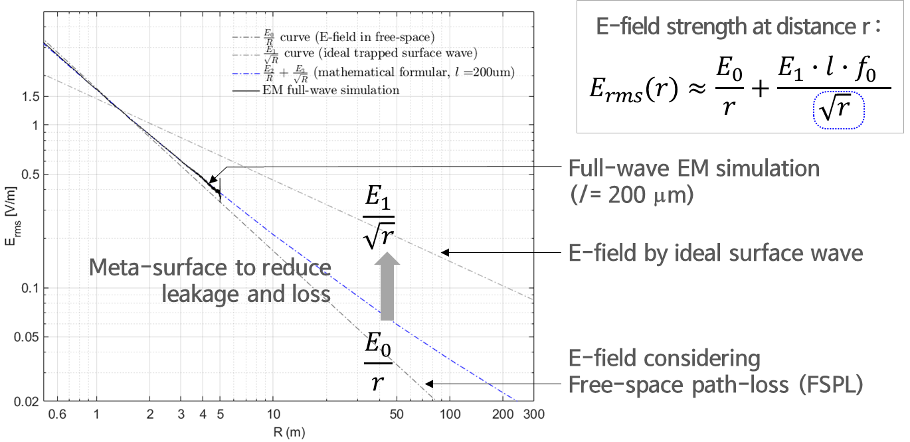
Review - Path loss characteristics
Conventional space wave
Received power is proportional to 1/r² in free space
Surface waves
Received power is proportional to 1/r on the surface of flat metal

Slide 8
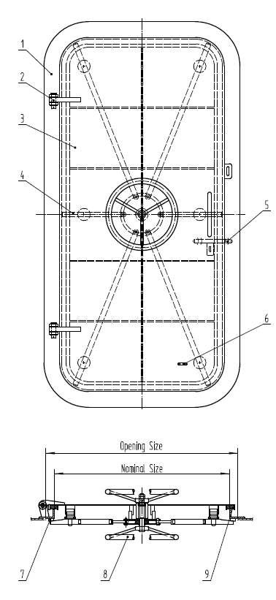
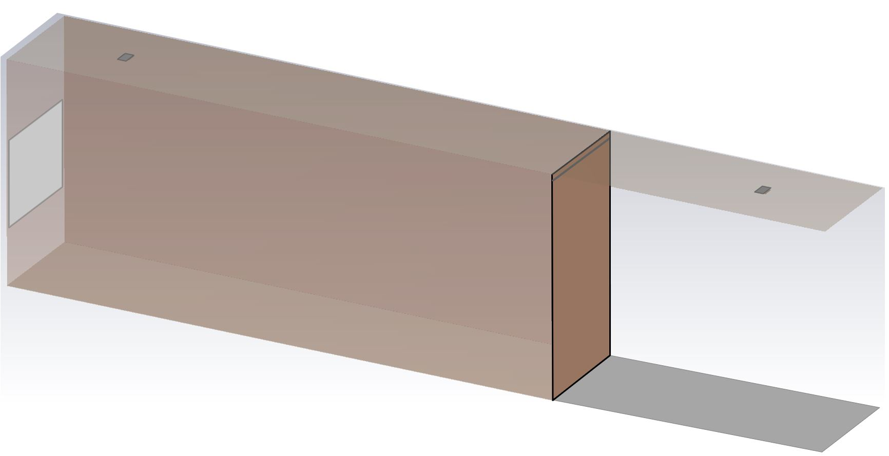

Structure model for EM simulation (1/2)
3D full-wave EM simulation including a shielding room with bulkheads
Perfect shielding room acts as a reverberation chamber or resonant cavity
A slit or gap acts as a sealing in the watertight steel door (silicon rubber)
This very narrow slit acts as a new source of waves through diffraction
Tx antenna
(SW generator)
(dimension unit: mm)
Gap (slit)
Rx antenna
(SW Receiver)
EM absorber
(open window)
ceiling
Shielding room
(cabin, cargo hold)
1200
Watertight
Steel door
2500
Corridor
Sealing
(Silicon Rubber)
600
(5λ)
Marine watertight door
3D EM simulation model

Slide 9
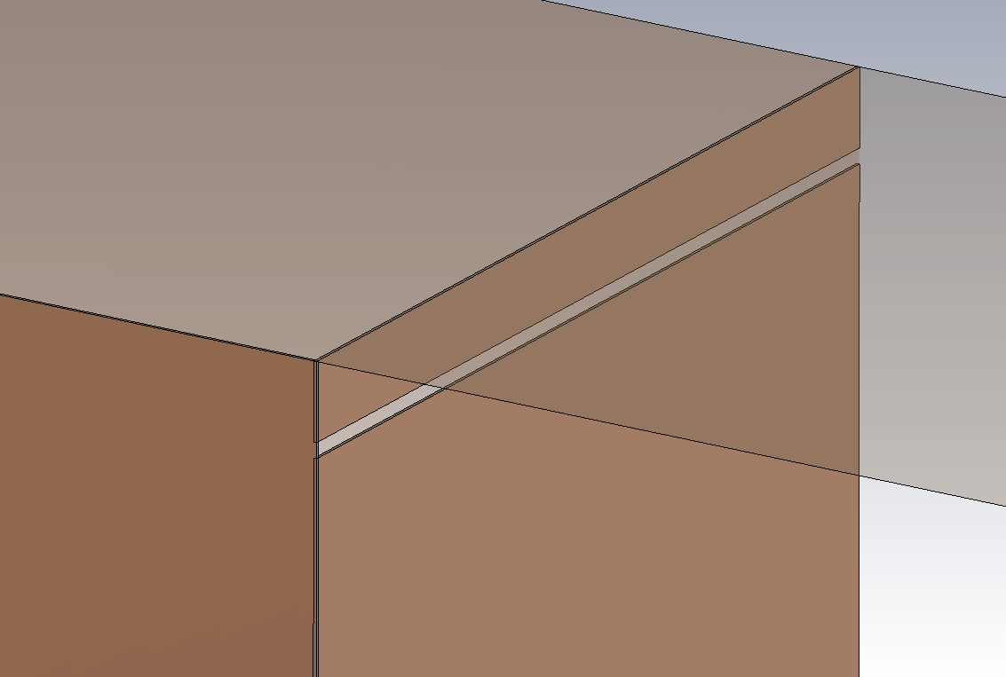
Structure model for EM simulation (2/2)
Simulation parameters and conditions (dimension unit: mm)
Gap width (W) : 2, 5, 10, 200
Gap height from the flat metal base or ceil (H) : 0, 10, 20, 800
EM absorber : open windows leaking EM waves
Tx antenna
(SW generator)
Gap (slit)
H
Gap (slit)
W
Bulkhead
Door frame
Watertight
Steel door
3D EM simulation model

Slide 10
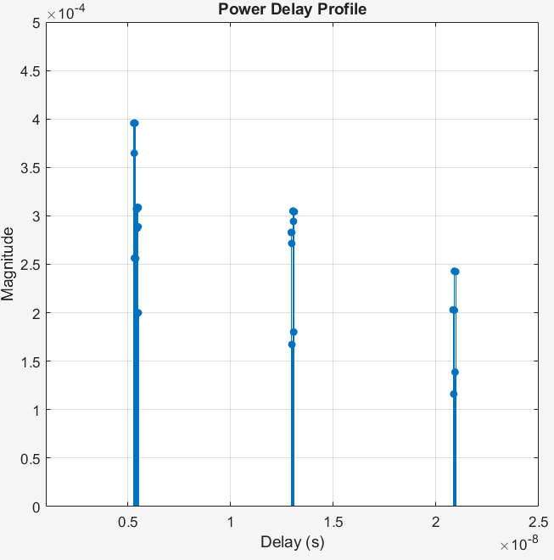
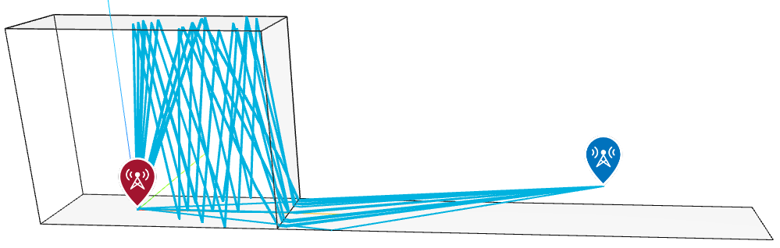
Delay spread of space waves (1/3)
Ray tracing simulation
Without surface waves, conventional ray-tracing method can be applied
Multiple reflections from metal walls, ceiling, and floor produce delayed replicas
Ideal dipole antenna
Ideal
point source
Gap
Ray tracing simulation

Slide 11
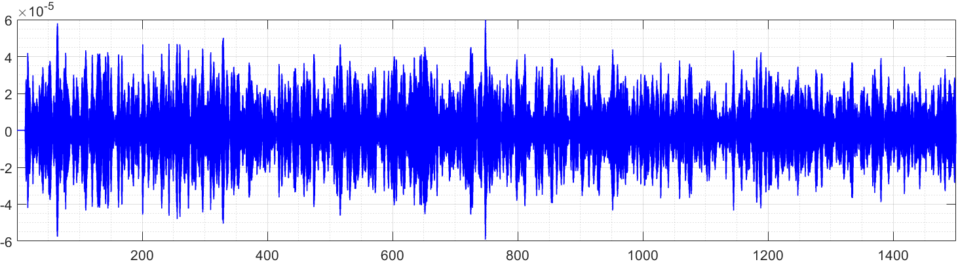
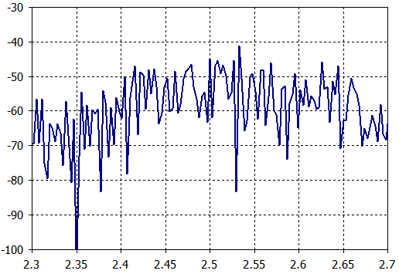
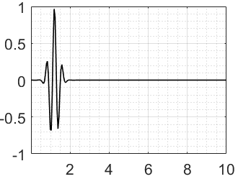
Delay spread of space waves (2/3)
EM Simulation results (gap W: 2, H: 0, w/o absorber)
Output
Signal
(Rx)
Impulse response (time domain)
Time[ns]
Input pulse
(Tx)
S21 [dB]
Deep fading
Time[ns]
Delay spread : >> 2μs

Slide 12
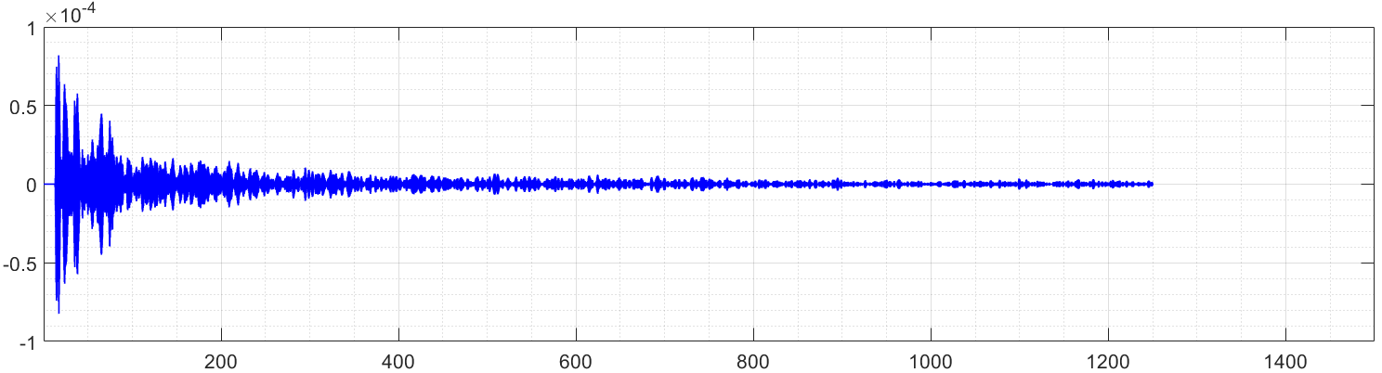
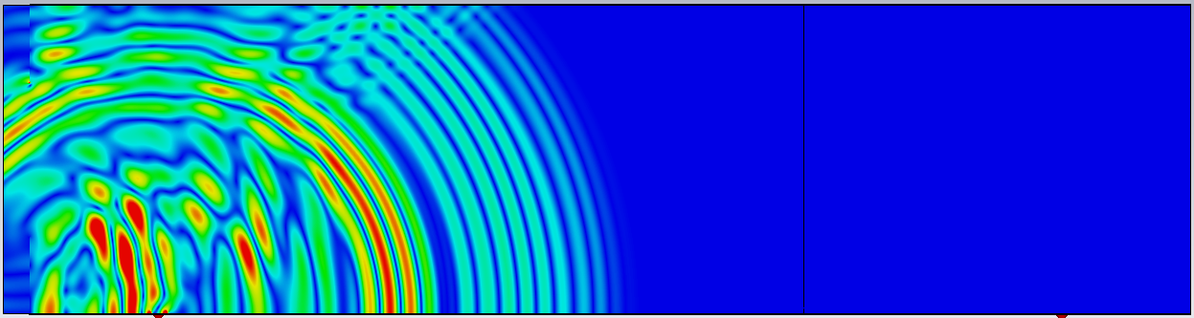

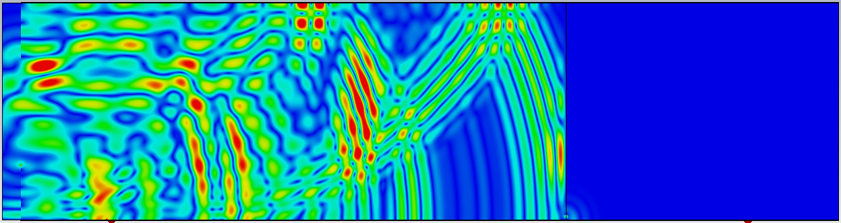
Delay spread of space waves (3/3)
EM Simulation results (gap W: 5, H: 20, w/i absorber)
Delay spread ≈ 395ns
Output
Signal
(Rx)
Time[ns]
Time[ns]
Tx. antenna
Gap
(slit)
Rx
Ant.
Gap (slit)
t =7ns
bulkheads
Rx
Ant.
Reflected
wave
bulkheads
Perspective view
Gap
(slit)
Rx
Ant.
E-field distribution
(sideview)
t =10ns
(animation)

Slide 13
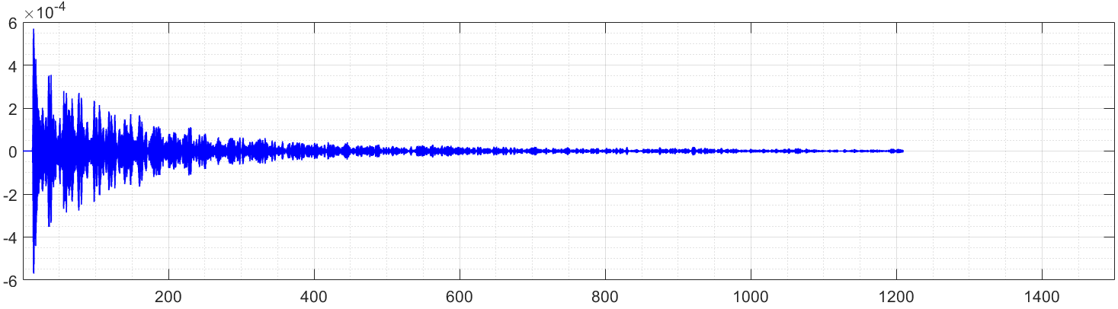
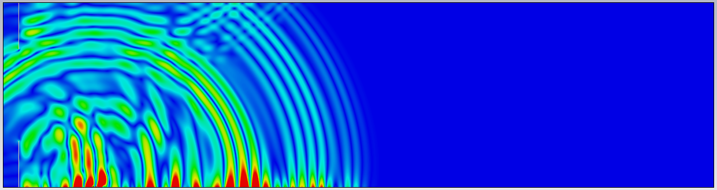
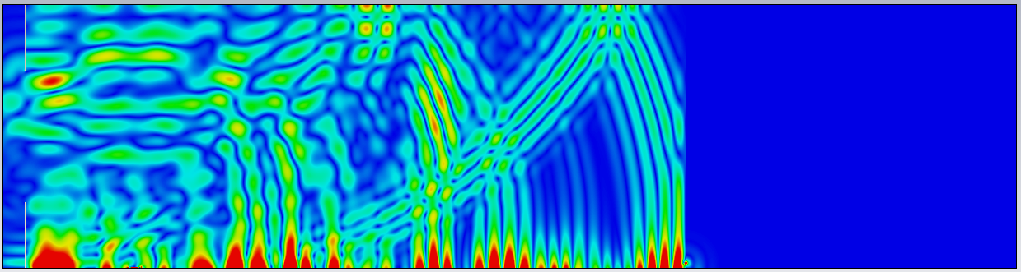
Delay spread of surface waves
EM Simulation results (gap W: 5, H: 20, w/i absorber)
(Simulation time > 4 days)
Delay spread ≈ 468ns
Signal level : 6 times larger than that of the space wave
Output
Signal
(Rx)
Time[ns]
Tx. antenna
Gap
(slit)
Rx
Ant.
Gap (slit)
Surface
wave
t =7ns
bulkheads
Rx
Ant.
Reflected
wave
bulkheads
Perspective view
Gap
(slit)
Rx
Ant.
E-field distribution
(sideview)
t =10ns
(animation)

Slide 14
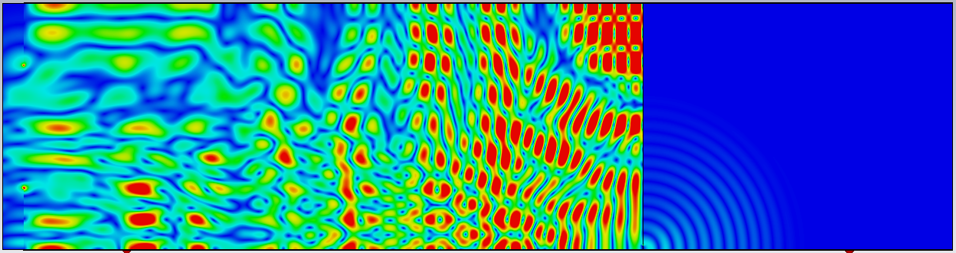
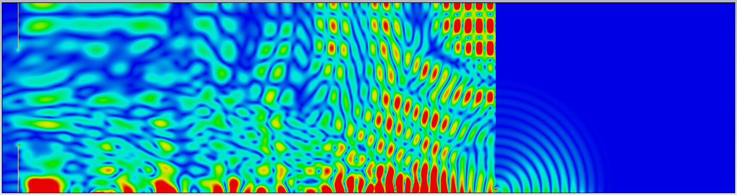
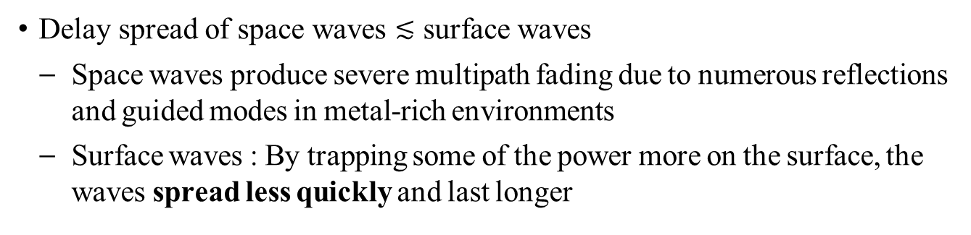
Comparison of delay spread
Delay spread of space waves $≲$ surface waves
Space waves produce severe multipath fading due to numerous reflections and guided modes in metal-rich environments
Surface waves : By trapping some of the power more on the surface, the waves spread less quickly and last longer
Comparison table of delay spread
Sideview (t =12ns)
D=0mm
(dimension unit: mm)
Antenna Type | W | H | D* | surface wave | delay spread (ns)
Surface | 5 | 20 | 0 | X | 395
Surface | 5 | 20 | 2 | O | 468
Patch | 200 | 800 | 0 | X | 660
Surface | 200 | 800 | 2 | O | 486
D=2mm
Surface
wave
(D: dielectric layer thickness)

Slide 15
PHY performance simulation
Purpose of simulation: testing the delay spread effect by surface waves
Simulation parameters in Matlab code
Base standard: IEEE 802.11g/n
Modulation mode: QPSK (un-coded and 1/2-coded), 16-QAM
Channel model: AWGN, TGn-F (ETSI-C, delay spread=150ns), generated model from EM simulation in a ship (delay spread ≈ 400ns)
Frame structure: STF(8μs), LTF(8μs), SIG(4μs), DATA(4μs x Nsym)
Perfect synchronization including CFO & packet detection by STF
Channel estimation by LTF
Guard Interval: 800ns (standard), 1200ns (proposed)
Performance evaluation index: BER

Slide 16
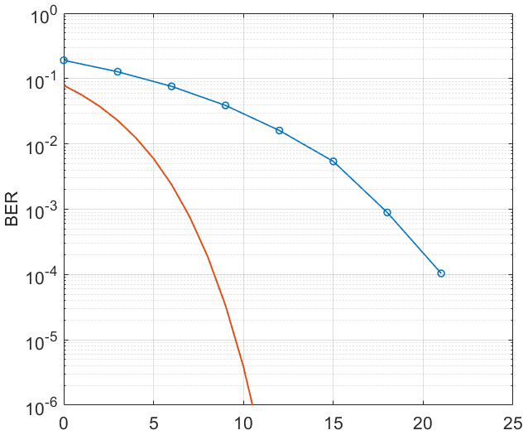
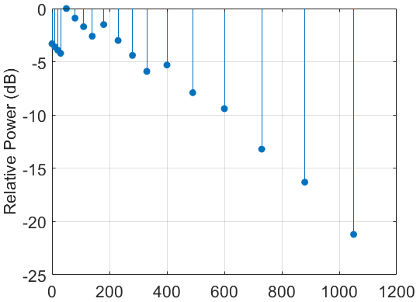
BER simulation (1/3)
QPSK-OFDM BER over TGn Model F (ETSI-C) channel model
ETSI-C model : delay spreading = 150ns
CP length : 800ns according to the 802.11g/n standard
Uncoded QPSK-OFDM over ETSI-C, CP=800ns
AWGN theoretical BPSK vs. Eb/No (w/o OFDM mod.)
Delay (ns)
SNR (dB)
Power Delay Profile (TGn Model F)[5]
BER vs. SNR simulation

Slide 17
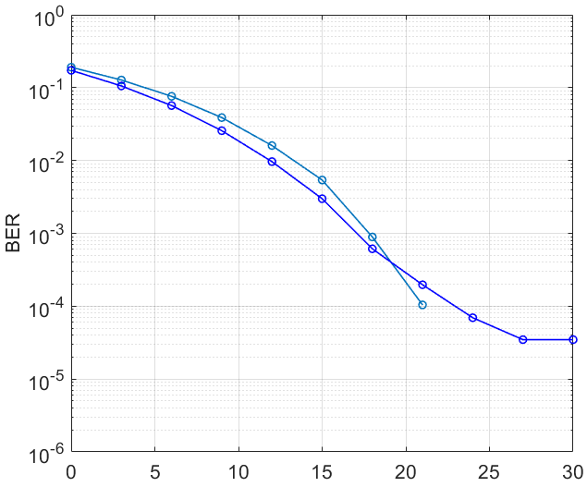
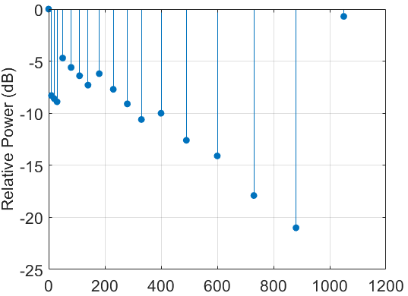
BER simulation (2/3)
QPSK-OFDM BER over a generated channel model from EM simulation
Channel model in a ship: delay spreading ≈ 400ns
CP length : 800ns according to the 802.11g/n standard
There is BER floor due to ISI
Late long tail
Uncoded QPSK-OFDM
(DS ≈ 400ns)
A portion of energy outside GI
Uncoded QPSK-OFDM
(DS ≈ 150ns)
BER floor
Delay (ns)
SNR (dB)
Simplified PDP for 400ns RMS DS
BER vs. SNR simulation
Notes:
A portion of energy leaks outside GI, making ISI that is independent of SNR

Slide 18
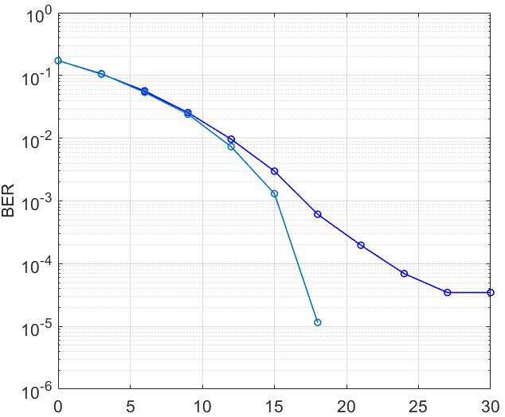
BER simulation (3/3)
QPSK-OFDM BER over a generated channel model from EM simulation
Channel model in a ship: delay spreading ≈ 400ns
CP length : 1200ns → PHY frame structure should be modified
BER floor removed
Demodulation can be achieved with virtually no frame errors after applying FEC such as convolutional coding
BER performance comparison
Uncoded QPSK-OFDM
(DS ≈ 400ns)
Uncoded QPSK-OFDM
(DS ≈ 400ns,
GI=1200ns)
No BER floor
BER vs. SNR simulation

Slide 19
Performance of the proposed PHY
MCS table and comparison of data-rates
MCS | Spatial steams | Modulation | Coding Rate
 |  |  |  | GI 800ns | GI 1.2us | GI 2.0us | Performance degradation
0 | 1 | BPSK | 1/2 | 6.5 | 5.91 | 5.00 | 91%, 77%
1 | 1 | QPSK | 1/2 | 13.0 | 11.82 | 10.00 | “
2 | 1 | QPSK | 3/4 | 19.5 | 17.73 | 15.00 | “
3 | 1 | 16-QAM | 1/2 | 26.0 | 23.64 | 20.00 | “
4 | 1 | 16-QAM | 3/4 | 39.0 | 35.45 | 30.00 | “
5 | 1 | 64-QAM | 2/3 | 52.0 | 47.27 | 40.00 | “
6 | 1 | 64-QAM | 3/4 | 58.5 | 53.18 | 45.00 | “
7 | 1 | 64-QAM | 5/6 | 65.0 | 59.09 | 50.00 | “
8 | 2 | BPSK | 1/2 | 13.0 | 11.82 | 10 | “
9 | 2 | QPSK | 1/2 | 26.0 | 23.64 | 20 | “
10 | 2 | QPSK | 3/4 | 39.0 | 35.45 | 30 | “
14 | 2 | 64-QAM | 3/4 |  | 118.18 | 100 | “

Slide 20
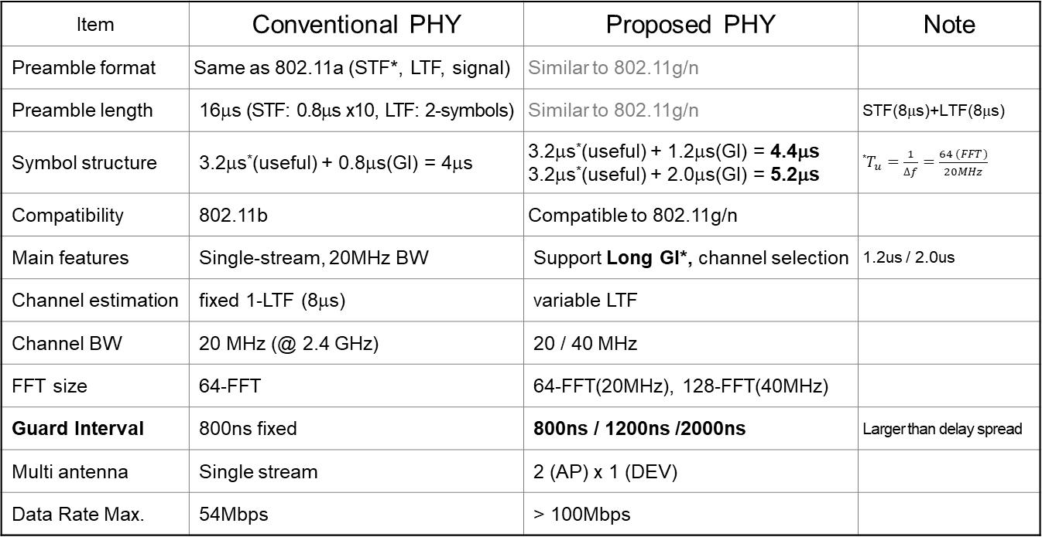
Design parameters of the proposed PHY
Frame structure
Item | Conventional PHY | Proposed PHY | Note
Preamble format | Same as 802.11a (STF*, LTF, signal) | Similar to 802.11g/n
Preamble length | 16μs (STF: 0.8μs x10, LTF: 2-symbols) | Similar to 802.11g/n | STF(8μs)+LTF(8μs)
Symbol structure | 3.2μs*(useful) + 0.8μs(GI) = 4μs | 3.2μs*(useful) + 1.2μs(GI) = 4.4μs 3.2μs*(useful) + 2.0μs(GI) = 5.2μs | *$T_{u}=\frac{1}{∆f}=\frac{64 (FFT)}{20MHz}$
Compatibility | 802.11b | Compatible to 802.11g/n
Main features | Single-stream, 20MHz BW | Support Long GI*, channel selection | 1.2us / 2.0us
Channel estimation | fixed 1-LTF (8μs) | variable LTF
Channel BW | 20 MHz (@ 2.4 GHz) | 20 / 40 MHz
FFT size | 64-FFT | 64-FFT(20MHz), 128-FFT(40MHz)
Guard Interval | 800ns fixed | 800ns / 1200ns /2000ns | Larger than delay spread
Multi antenna | Single stream | 2 (AP) x 1 (DEV)
Data Rate Max. | 54Mbps | > 100Mbps

Slide 21
Summary
Metal-rich environments require new channel model and PHY architecture
Relatively low path loss is observed, since the metal walls of bulkheads, corridors, and cargo holds act as waveguides or highly reflective reverberation chambers
Surface waves propagating along protective coating paints inside ships reduce pathloss and increase received power, but they also worsen multipath fading problem
Delay spread increases with Tx-Rx distance, implying that it becomes more significant as the propagation distance is extended by surface waves
A more accurate analysis of delay spread will be provided next time
The proposed PHY structure mitigates the multipath delay spread problem by increasing GI
The actual data-rate is somewhat reduced, however, long distance communication between multiple camera sensors and AP remains feasible

Slide 22
References
[1] 15-24-0376-00-04ad. The use-case for NG-SUN PHYs in ship area network
[2] A. Ishimaru, Electromagnetic Wave Propagation, Radiation, and Scattering, Wiley-IEEE Press, 2017
[3] X. H. Mao and Y. H. Lee, “UHF Propagation Along a Cargo Hold on Board a Merchant Ship,” IEEE Trans. Wireless Comm., Vol. 12, No.1, Jan. 2013
[4] H. Kdouh, G. E. Zein, et.al., “Measurements and Path Loss Models for Shipboard Environments at 2.4GHz,” Proceedings of the 41th European Microwave Conference, 2011
[5] IEEE 802.11-03/940r4, “TGn Channel Models”, May 10, 2004
[6] J. Medbo and P. Schramm, “Channel models for HIPERLAN/2,” ETSI/BRAN document no. 3ERI085B

Slide 23
Thanks for Listening !
Q&A

Slide 24
Supplement
E-field propagation characteristics from 3D full-wave EM simulations for various structures

