Slide 1
Project: IEEE P802.15 Working Group for Wireless Personal Area Networks (WPANs)
Submission Title: [TG15.6ma(Revision of IEEE802.15.6-2012) Opening Information for September 2025]
Date Submitted: 17th September 2025
Source: [Ryuji Kohno] [1;Yokohama National University(YNU), 2;YRP International Alliance Institute(YRP-IAI)]
Address [1; 79-5 Tokiwadai, Hodogaya-ku, Yokohama, 240-8501 Japan
2; YRP1 Blg., 3-4 HikarinoOka, Yokosuka-City, Kanagawa, 239-0847 Japan]
Voice:[1; +81-90-5408-0611], FAX: [+81-45-383-5528],
Email:[1: kohno@ynu.ac.jp, 2: kohno@yrp-iai.jp] Re: []
Abstract: [This document contains opening information and meeting agenda for the TG15.6ma, that is a task group of Revision of IEEE802.15.6-2012, meeting in September 2025.]
Purpose: [information]
Notice: This document has been prepared to assist the IEEE P802.15. It is offered as a basis for discussion and is not binding on the contributing individual(s) or organization(s). The material in this document is subject to change in form and content after further study. The contributor(s) reserve(s) the right to add, amend or withdraw material contained herein.
Release: The contributor acknowledges and accepts that this contribution becomes the property of IEEE and may be made publicly available by P802.15.

Slide 2
IEEE 802.15 TG15.6ma
(Revision of IEEE802.15.6-2012)
Opening Information
In Personal and Virtual Hybrid Interim Session
Wakoloa, Hawaii, USA
September 15th, 2025
Ryuji Kohno
Yokohama National University(YNU),
YRP International Alliance Institute(YRP-IAI)

Slide 3
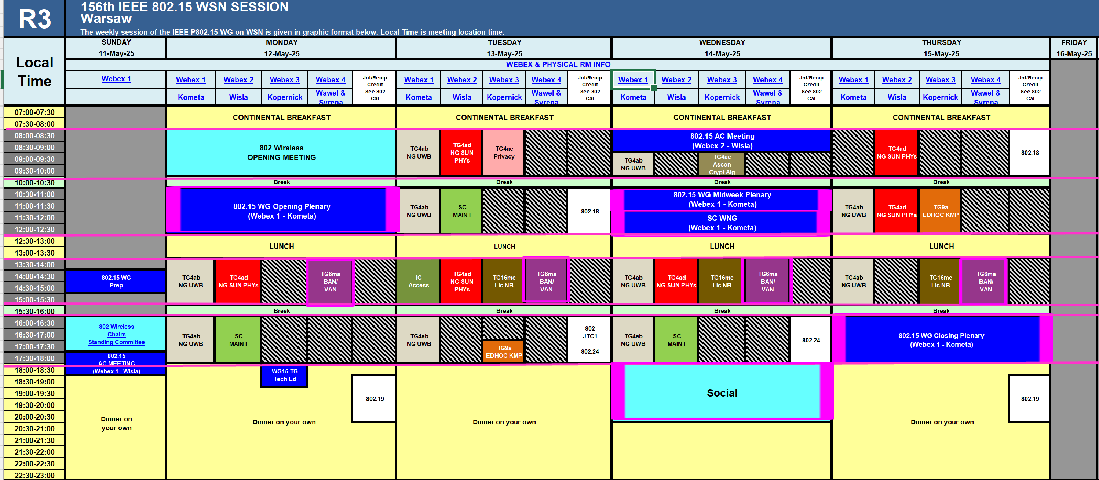
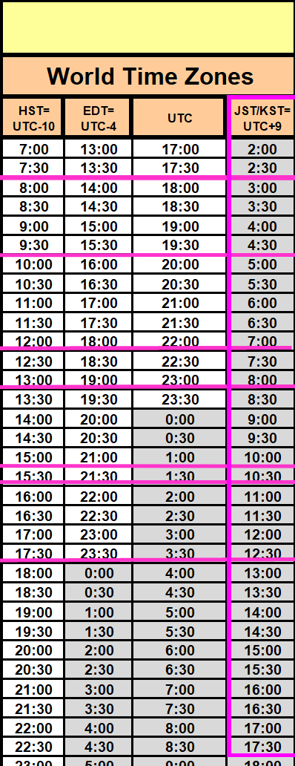
TG15.6ma Plenary Session in Madrid Schedule for 15-19th Sept, 2025
TG15.6ma has three own sessions such as
Session1(Virtual RM#4) PM1 13:30-15:30 Sept.15(MON)in Hawaii time, 8:30-10:30 Sept.16(TUE)in JST/KST
Session2(Virtual RM#4) PM1 13:30-15:30 Sept.16(TUE) in Hawaii time, 8:30-10:30 Sept.17(WED)in JST/KST
Session3(Virtual RM#4) PM1 13:30-15:30 Sept.17(WED) in Hawaii time, 8:30-10:30 Sept.18(THU)in JST/KST
Session4(Virtual RM#4) PM1 13:30-15:30 Sept.18(THU) in Hawaii time, 8:30-10:30 Sept.19(FRI)in JST/KST
Slide 3

Slide 4
TG15.6ma Plenary Session in Madrid Schedule for 15-19th Sept, 2025
TG15.6ma has three own sessions such as
Session1(Virtual RM#4) PM1 13:30-15:30 Sept.15(MON)in Hawaii time, 8:30-10:30 Sept.16(TUE)in JST/KST
Session2(Virtual RM#4) PM1 13:30-15:30 Sept.16(TUE) in Hawaii time, 8:30-10:30 Sept.17(WED)in JST/KST
Session3(Virtual RM#4) PM1 13:30-15:30 Sept.17(WED) in Hawaii time, 8:30-10:30 Sept.18(THU)in JST/KST
Session4(Virtual RM#4) PM1 13:30-15:30 Sept.18(THU) in Hawaii time, 8:30-10:30 Sept.19(FRI)in JST/KST
Virtual RM#1
Webex 1
802.15 - Sept Webex 1
Join information
Meeting link: https://ieeesa.webex.com/ieeesa/j.php?MTID=m4a570911bed065d8ddbfcd3aebb432a0
Meeting number: 2346 647 1357
Password: 80215sept25wbx1
Virtual RM#4
Webex 4 802.15 - Sept Webex 4 Join information Meeting link: https://ieeesa.webex.com/ieeesa/j.php?MTID=m14f8a0680e2ac0a54a883406c3705c40 Meeting number: 2340 103 0246 Password: 80215sept25wbx4

Slide 5
Agenda
Opening Session
  Attendance Check
  Administrative Items
  Call for Patents
  Session Schedule of This and Next Weeks
  Review minutes and approve minutes from last virtual meeting in July 2025. Doc.# 15-25-0390-00-06ma
  Current Meeting Agenda Doc.# 15-25-0421-01-06ma

Slide 6
Attendance
https://imat.ieee.org
Register
Indicate attendance
Please sign attendance sheet

Slide 7
Administrative Items
Required notices
  Affiliation FAQ - http://standards.ieee.org/faqs/affiliationFAQ.html
  Anti-Trust FAQ - http://standards.ieee.org/resources/antitrust-guidelines.pdf
  Ethics - http://www.ieee.org/portal/cms_docs/about/CoE_poster.pdf
Chair and Secretary
  Chair; Ryuji Kohno(YNU/YRP-IAI)
  1st Vice Chair; Marco Hernandez(YRP-IAI/CWC)
  2nd Vice Chair; Daisuke Anzai(Osaka Metropolitan Univ.)
  Secretary; Takumi Kobayashi(Osaka Metropolitan Univ.)
  Technical Co-Editors; Minsoo Kim(YRP-IAI).
  Seong-Soon Joo(KPST),
  Kento Takabayashi(Toyo U),
  Marco Hernandez (YRP-IAI/CWC)

Slide 8
Participants, Patents, and Duty to Inform
All participants in this meeting have certain obligations under the IEEE-SA Patent Policy.
  Participants [Note: Quoted text excerpted from IEEE-SA Standards Board Bylaws subclause 6.2]:
    “Shall inform the IEEE (or cause the IEEE to be informed)” of the identity of each “holder of any potential Essential Patent Claims of which they are personally aware” if the claims are owned or controlled by the participant or the entity the participant is from, employed by, or otherwise represents
      “Personal awareness” means that the participant “is personally aware that the holder may have a potential Essential Patent Claim,” even if the participant is not personally aware of the specific patents or patent claims
    “Should inform the IEEE (or cause the IEEE to be informed)” of the identity of “any other holders of such potential Essential Patent Claims” (that is, third parties that are not affiliated with the participant, with the participant’s employer, or with anyone else that the participant is from or otherwise represents)
  The above does not apply if the patent claim is already the subject of an Accepted Letter of Assurance that applies to the proposed standard(s) under consideration by this group
  Early identification of holders of potential Essential Patent Claims is strongly encouraged
  No duty to perform a patent search

Slide 9
Patent Related Links
  All participants should be familiar with their obligations under the IEEE-SA Policies & Procedures for standards development.
  Patent Policy is stated in these sources:
  IEEE-SA Standards Board Bylaws (http://standards.ieee.org/develop/policies/bylaws/sect6-7.html#6)
  IEEE-SA Standards Board Operations Manual (http://standards.ieee.org/develop/policies/opman/sect6.html#6.3)
Material about the patent policy is available at
http://standards.ieee.org/about/sasb/patcom/materials.html
If you have questions, contact the IEEE-SA Standards Board Patent Committee Administrator at patcom@ieee.org or visit http://standards.ieee.org/about/sasb/patcom/index.html
This slide set is available at https://development.standards.ieee.org/myproject/Public/mytools/mob/slideset.ppt

Slide 10
Call for Potentially Essential Patents
If anyone in this meeting is personally aware of the holder of any patent claims that are potentially essential to implementation of the proposed standard(s) under consideration by this group and that are not already the subject of an Accepted Letter of Assurance:
  Either speak up now or
  Provide the chair of this group with the identity of the holder(s) of any and all such claims as soon as possible or
  Cause an LOA to be submitted

Slide 11
Other Guidelines for IEEE WG Meetings
All IEEE-SA standards meetings shall be conducted in compliance with all applicable laws, including antitrust and competition laws.
  Don’t discuss the interpretation, validity, or essentiality of patents/patent claims.
  Don’t discuss specific license rates, terms, or conditions.
    Relative costs, including licensing costs of essential patent claims, of different technical approaches may be discussed in standards development meetings.
      Technical considerations remain primary focus
  Don’t discuss or engage in the fixing of product prices, allocation of customers, or division of sales markets.
  Don’t discuss the status or substance of ongoing or threatened litigation.
  Don’t be silent if inappropriate topics are discussed … do formally object.
---------------------------------------------------------------
See IEEE-SA Standards Board Operations Manual, clause 5.3.10 and “Promoting Competition and Innovation: What You Need to Know about the IEEE Standards Association's Antitrust and Competition Policy” for more details.

Slide 12
Instructions for Chairs of
standards development activities
At the beginning of each standards development meeting the chair or a designee is to:
  Show the following slides (or provide them beforehand)
  Advise the standards development group participants that:
  IEEE SA’s copyright policy is described in Clause 7 of the IEEE SA Standards Board Bylaws and Clause 6.1 of the IEEE SA Standards Board Operations Manual;
  Any material submitted during standards development, whether verbal, recorded, or in written form, is a Contribution and shall comply with the IEEE SA Copyright Policy;
  Instruct the Secretary to record in the minutes of the relevant meeting:
  That the foregoing information was provided and that the copyright slides were shown (or provided beforehand).

Slide 13
IEEE SA Copyright Policy
By participating in this activity, you agree to comply with the IEEE Code of Ethics, all applicable laws, and all IEEE policies and procedures including, but not limited to, the IEEE SA Copyright Policy.
  Previously Published material (copyright assertion indicated) shall not be presented/submitted to the Working Group nor incorporated into a Working Group draft unless permission is granted.
  Prior to presentation or submission, you shall notify the Working Group Chair of previously Published material and should assist the Chair in obtaining copyright permission acceptable to IEEE SA.
  For material that is not previously Published, IEEE is automatically granted a license to use any material that is presented or submitted.

Slide 14
IEEE SA Copyright Policy
The IEEE SA Copyright Policy is described in the IEEE SA Standards Board Bylaws and IEEE SA Standards Board Operations Manual
  IEEE SA Copyright Policy, see
  Clause 7 of the IEEE SA Standards Board Bylaws
  https://standards.ieee.org/about/policies/bylaws/sect6-7.html#7
  Clause 6.1 of the IEEE SA Standards Board Operations Manual
  https://standards.ieee.org/about/policies/opman/sect6.html
IEEE SA Copyright Permission
  https://standards.ieee.org/content/dam/ieee-standards/standards/web/documents/other/permissionltrs.zip
IEEE SA Copyright FAQs
  http://standards.ieee.org/faqs/copyrights.html/
IEEE SA Best Practices for IEEE Standards Development
  https://standards.ieee.org/develop/policies/best_practices_for_ieee_standards_development_051215.pdf
Distribution of Draft Standards (see 6.1.3 of the SASB Operations Manual)
  https://standards.ieee.org/about/policies/opman/sect6.html

Slide 15
[802.15-ALL] 142nd IEEE 802.15 WSN Session
Registration for this Session
This session is part of the Nov. IEEE 802 Mtg.
- You must pay the registration fee in order to attend
- If you have not already done so, you can follow the registration link below
- If you do not intend to register for this session you must leave this meeting and, if you have already logged attendance on IMAT,
email Jon Rosdahl (jrosdahl@ieee.org), or your WG leadership to have it removed

Slide 16
Necessary Registration
158th IEEE 802.15 WSN Session
Registration for this Session
This session is part of the May IEEE 802 Mtg. - You must pay the registration fee in order to attend - If you have not already done so, you can follow the registration link below - If you do not intend to register for this session you must leave this meeting and, if you have already logged attendance on IMAT, email Jon Rosdahl (jrosdahl@ieee.org), or your WG leadership to have it removed
Registration Link: | https://grouper.ieee.org/groups/802/15/pub/Meeting_Plan.html

Slide 17
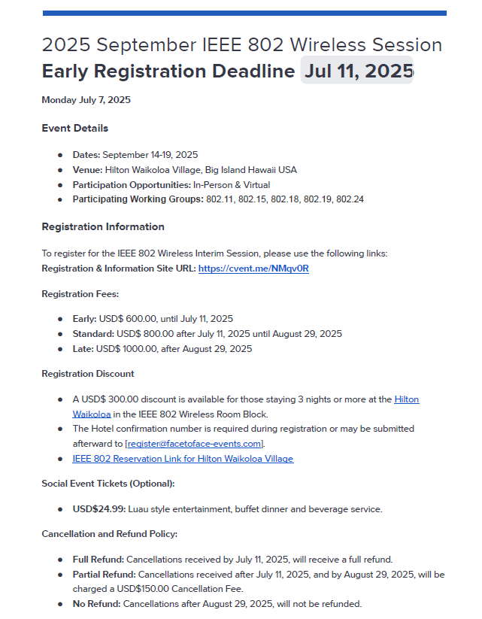
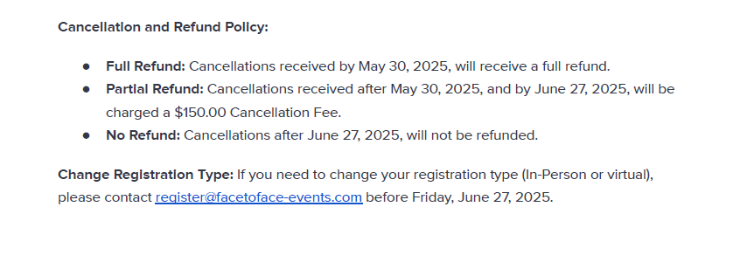
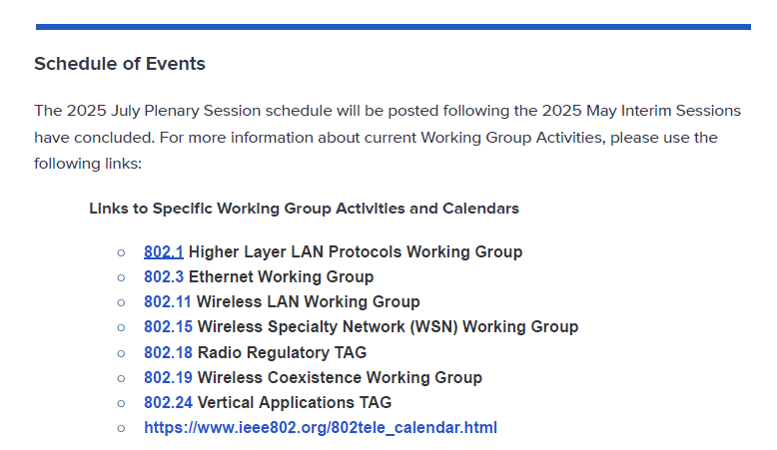
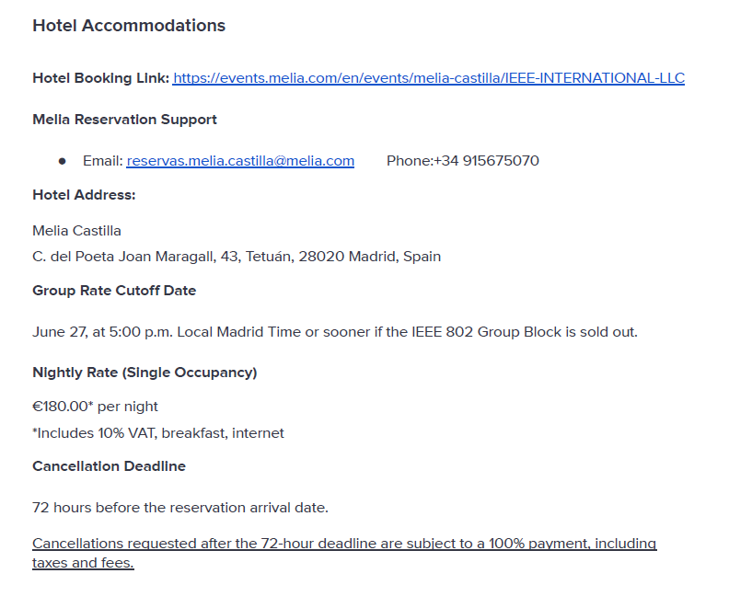
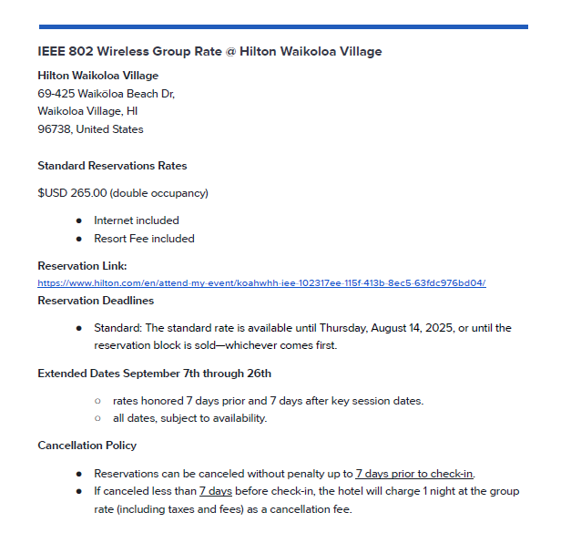
https://web.cvent.com/event/b4fe1917-82ff-44d5-b34a-afe989945a9e/summary
Registration for this Session
Registration Link: | https://grouper.ieee.org/groups/802/15/pub/Meeting_Plan.html

Slide 19


Slide 20
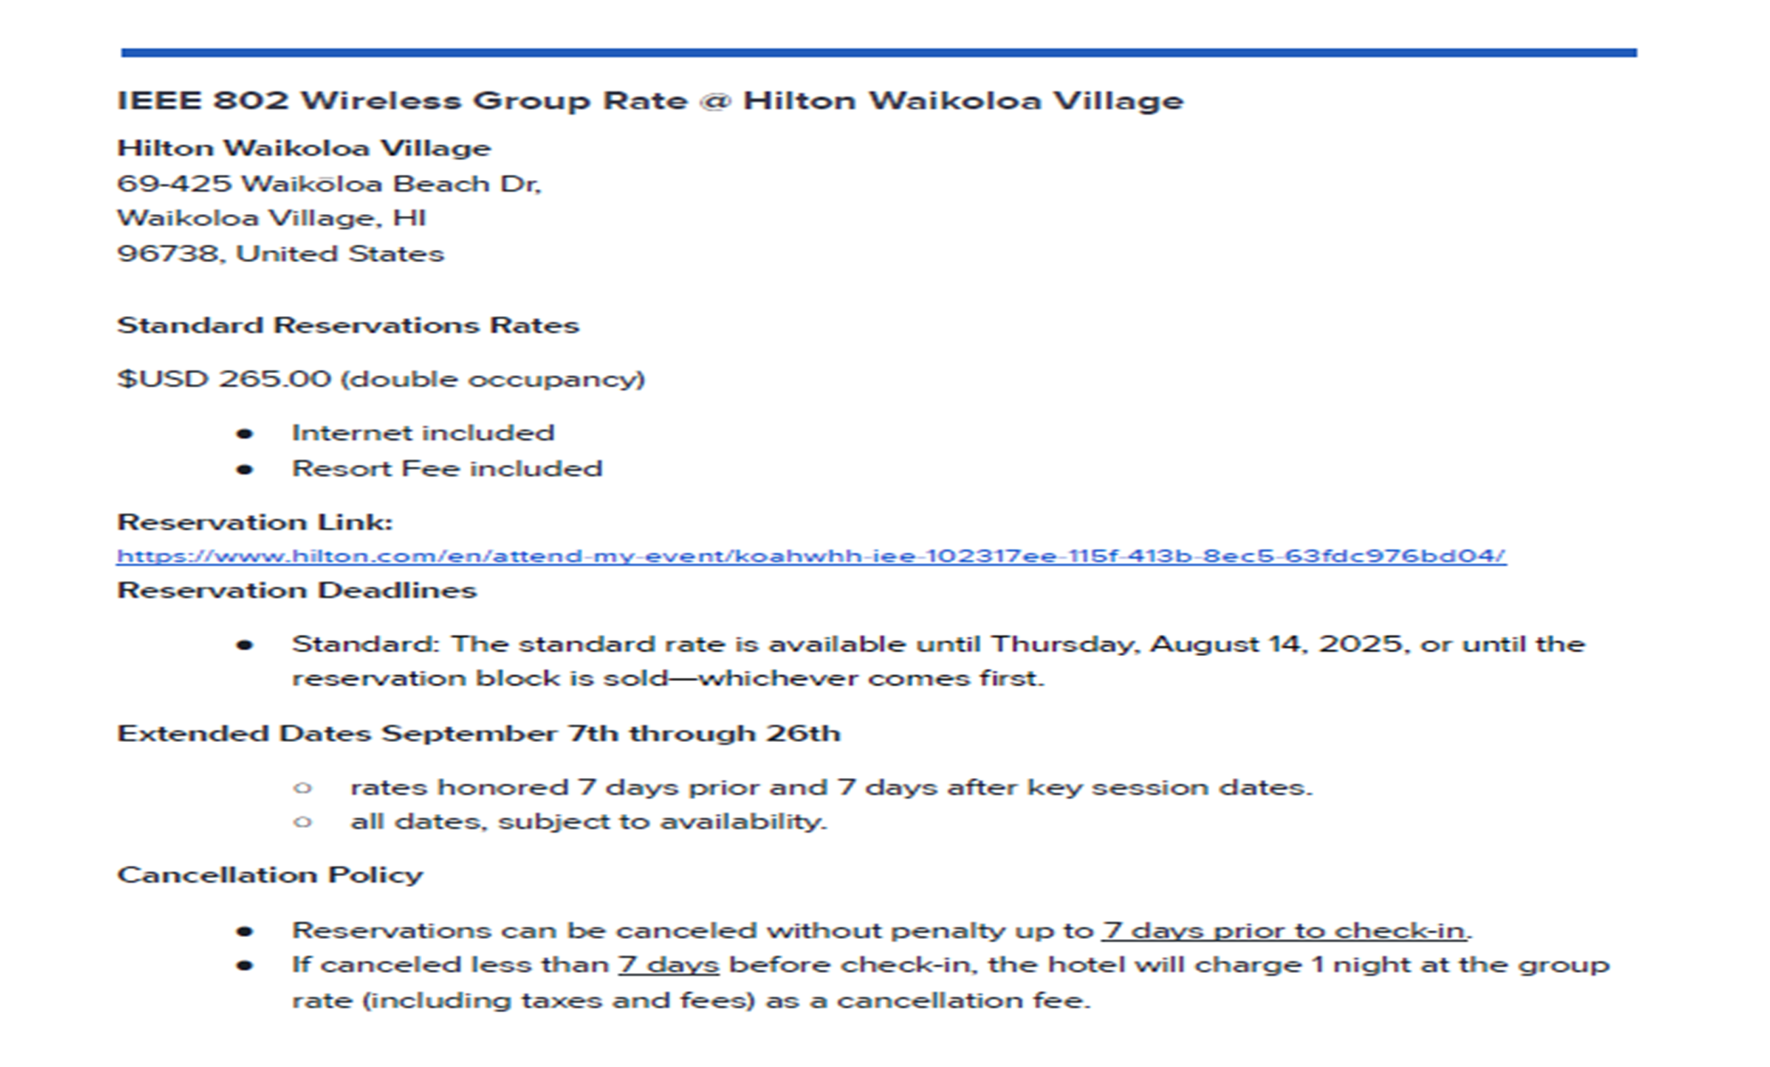

Slide 21
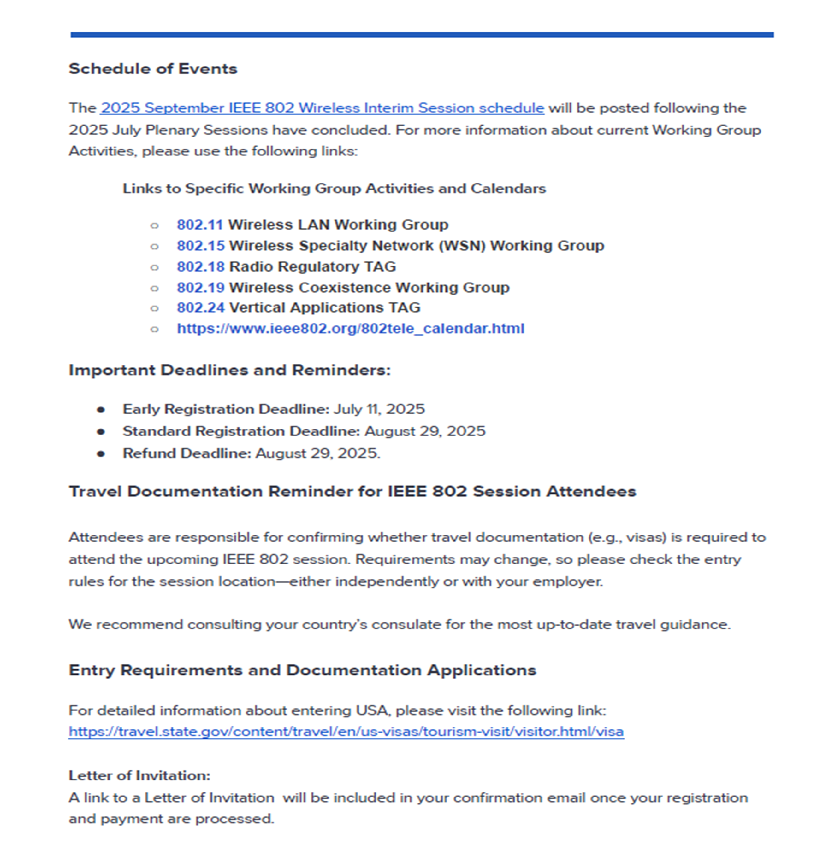

Slide 22
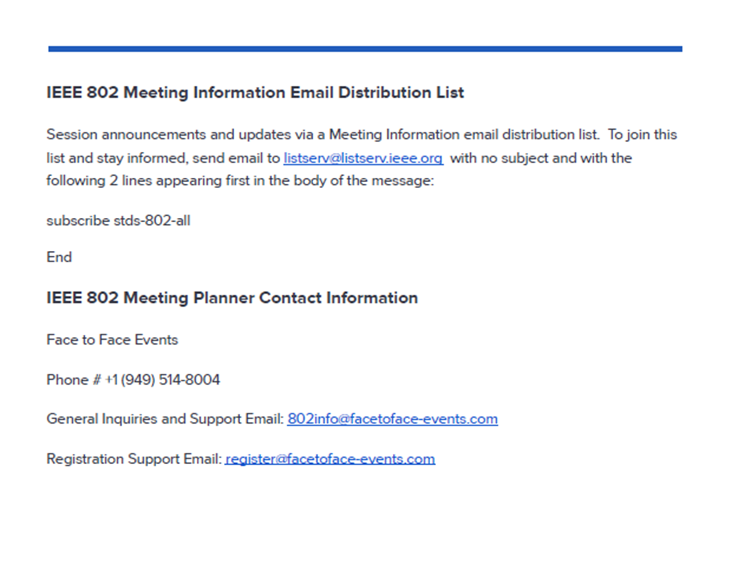

Slide 23
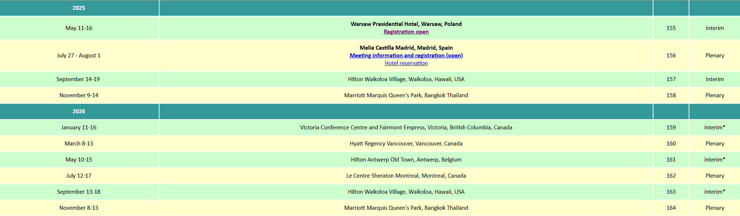
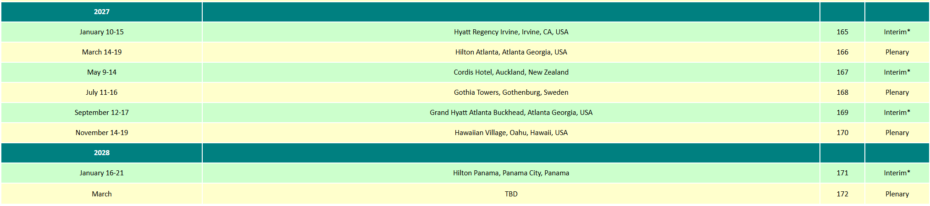
Future Meeting Schedule https://grouper.ieee.org/groups/802/15/pub/Meeting_Plan.html

Slide 24
TG6ma(BAN/VAN) – BAN with Enhanced Dependability Revision
Chair: Ryuji Kohno
Objective:
Enhancements to the Body Area Networks (BAN) Ultra Wideband (UWB) physical layer (PHY) and media access control (MAC) to support enhanced dependability to a human BAN (HBAN) and adds support for vehicle BAN (VBAN), a coordinator in a vehicle with devices around the vehicular body.
TG6ma Webpage
Areas being worked on include:
Channel Modeling
Precise modeling of radio propagation of implant and wearable human BANs and around vehicle BANs for dependable data transmission
Classified modeling of multiple BANs and coexistence with other radios for resolution in PHY and MAC
Data transmission
Cognition of channel environment and coexistence
Initial acquisition and synchronization in coexisting BANs
Channel coding in forward error correction (FEC) and hybrid automatic repeat request (HARQ) according to required QoS levels of data packets in various channel propagation models and coexistence classes
Packet contention
Control and data channels, superframe formant, and MAC function to avoid packet contention in various classes of coexistence
Hybrid protocol of contention-free and contention access according to required QoS levels of data packets
Inter coordinators or hubs negotiation among coexisting BANs
Interference mitigation in coexistence:
Interference surprising and canceling technologies for theoretical and feasible implementation in coexistence
Result in simpler classes of coexistence by mitigation of interference from non-BAN
Ranging:
Optional ranging for cognition of dynamism of coexisting BANs
This revision builds on the existing standard 802.15.6-2012 with enhanced dependability for human BAN and additional vehicle BAN

Slide 25
Objectives of TG 6ma – Enhanced Dependability Body Area Network (ED-BAN)
Objective: Enhancements to the BAN Ultra Wideband (UWB) physical layer (PHY) and media access control (MAC) to support enhanced dependability to a human BAN (HBAN) and adds support for vehicle body area networks (VBAN), a coordinator in a vehicle with devices around the vehicular cabin.
Action:
•Review of the 1st SA Ballot for Draft D06
•Comment Resolution for the 1st SA Ballot
•Performance Evaluation of Technologies in PHY; Channel Coding According to 8 QoS Levels of Packets and Coexistence Levels, Interference Mitigation, etc.
•Performance Evaluation of Technologies in MAC; Channel Management, CCA, Hybrid Contention Free/Access Protocol According to 8 QoSs and Coexistences.
•Harmonization or Commonality with 4ab in Coexistence and Feasible Implementation of 6ma and 4ab
•Feasibility of TSN of 802.1 in MAC
Next Things to Do： SA 2nd Ballot Approval

Slide 26
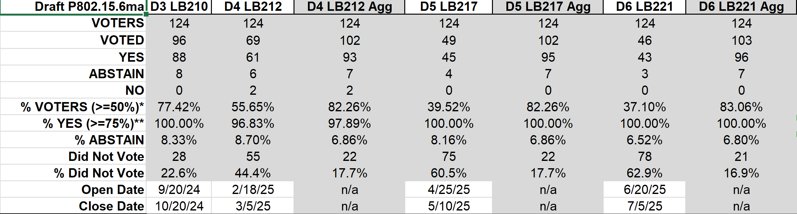
Result of Letter Ballots LB210, 212, 217, 221 for the Draft P802.15.6ma_D03, 04, 05, and 06 （Sept. 2024- July 2025)
Result of LB221(June 20-July 05, 2025): 83.06% of Voters voted YES in aggregation which is over 75%. Then LB221 was officially Approved.
Voted YES with and without Comments were 103 while No. of Comments is 0.
In Madrid Plenary Meeting July 2025, Working Group approved to submit to SA Ballot.
Slide 26

Slide 27
Result of Initial SA Ballot
(August 5th to Sept. 4th entended to Sept. 15th )
The initial ballot hits the minimum 75% return rate with a 94% approval and 235 comments received.
TG6ma starts comments resolution for the initial SA Ballot.
Propose 2nd SA Ballot approval.

Slide 28
TG motion:
Draft needs to be edited before 2nd SA Ballot
Move that 802.15 WG start a WG recirculation requesting approval of document P802-15-6ma_D07 (as edited in accordance with the instructions in document 15-15-23-0138-01-0mag) and to forward document P802-15-6ma_D06, as edited in accordance with the instructions in document 15-15-23-0138-01-0mag, and CA document 15-24-0348-06 to Standards Association ballot pending the completion and inclusion of the edits in the draft.
Moved by: Ryuji Kohno
Seconded by:
Result:

Slide 29
TG Motion to approve the formation of CRG
Move that 802.15 WG approve the formation of a Comment Resolution Group (CRG) for the WG balloting of the P802-15-6ma with the following membership: Ryuji Kohno, Chair (YNU/YRP-IAI), Marco Hernandez (CWC), Huan-Bang Li (NICT), Takumi Kobayashi (OMU), Seong-Soon Joo (NHT). The 802.15.6ma CRG is authorized to approve comment resolutions, edit the draft according to the comment resolutions, and to approve the start of recirculation ballots of the revised draft on behalf of the 802.15 WG. Comment resolution on recirculation ballots between sessions will be conducted via reflector email and via teleconferences announced to the reflector as per the LMSC 802 WG P&P.
Moved By: Ryuji Kohno
Seconded By:
Result:

Slide 30
Agenda items for the week
TG15.6ma meeting call to order
Call for essential patents and policies & procedures reminder doc.#15-25-0420-02-06ma
Approve last meeting minutes: TG 15.6ma Meeting Minutes for July 2025 doc.#15-25-0390-00-06ma
Agenda of TG15.6ma September 2025 doc.#15-25-0421-05-06ma
Review and Summary
  Overview of IG, SG, TG15.6ma doe Dependable BAN Revision of IEEE802.15.6-2012 doc.#15-25-0033-04-06ma
  Basic Consensus in MAC and PHY of Revision of IEEE802.15.6-2012(IEEE802.15.6ma) doc.#15-23-0557-08-06ma
  Review of SA Ballot for draft D06 doc.#15-25-0xxx-00-06ma
  Consolidated comments & resolutions SA Ballot doc.#15-25-0453-00-06ma
  Rescheduling Timeline doc.#15-23-0361-14-06ma
  Draft P802.15.6ma_D06
  Presentation
  1.. Hybrid ARQ Scheme for High QoS Packets in High Class of Coexistence of IEEE 802.15.6ma #15-23-0576-0906ma 2. Evaluation of IEEE 802.15.6 Ultra-wideband Physical Layer Utilizing Super Orthogonal Convolutional 22-0562-16-06ma
  3. Ranging Accuracy Evaluation under TG6ma Communication Senarios doc.#15-24-0248-07-06ma
  4. MAC Performance Evaluation of Multiple BAN Coexistence Under TG6ma Channel doc.#15-24-0246-07-06ma
  5 MAC superframe structure and frames doc.#15-24-0573-05-06ma
  6 15.6ma MAC time reference base for superframe and group superframe structure d0c.#15-25-0132-02-06ma
  7. TG Motion to Recirculation doc.#15-25-0zzz-00-06ma
  8. Interference Mittigation Schemes in Class 3, 5, 6, and 7 of Coexisitence in TG6ma doc.#15-24-0074-09-06ma
  9. Coordinator-to-Coordinator(C2C) Ranging and Communication for Multiple BAN Coexistence 15-25-0vvv-00-06ma
  10. TG15.6ma Coexistence Assessment Document doc.#15-24-0348-06-06ma
  11 MAC services support for IEEE P802.1ACea doc.#15-24-0594-03-006a
  12..TG6ma Channel Model Document for Enhanced Dependability doc.#15-22-0519-10-06ma
  13. Comments to channel-model-document doc.#15-24-0073-05-06ma
  14. Progress Report of TG6ma doc8#15-23-0056-11-06ma
  15. Timeline of TG6ma doc.#15.23-0056-11-06ma
  16. TG15.6ma Closing Report for Sept 2025 doc.#15-25-0492-00-06ma
  17. TG15.6ma Meeting Minutes for Sept 2025 doc.#15-25-0493-00-06ma

Slide 31
TG15.6ma Plenary Session in Madrid Schedule for 15-19th Sept, 2025
TG15.6ma has three own sessions such as
Session1(Virtual RM#4) PM1 13:30-15:30 Sept.15(MON)in Hawaii time, 8:30-10:30 Sept.16(TUE)in JST/KST
Session2(Virtual RM#4) PM1 13:30-15:30 Sept.16(TUE) in Hawaii time, 8:30-10:30 Sept.17(WED)in JST/KST
Session3(Virtual RM#4) PM1 13:30-15:30 Sept.17(WED) in Hawaii time, 8:30-10:30 Sept.18(THU)in JST/KST
Session4(Virtual RM#4) PM1 13:30-15:30 Sept.18(THU) in Hawaii time, 8:30-10:30 Sept.19(FRI)in JST/KST
Slide 31

Slide 32
July 2025
Timeline for Starting Global Business with the New Standard IEEE802.15.6ma
Final SB recirculation, if required. Submission to RevCom
Jan 2026
Tech Req Doc July 2022
Presentation of proposals
May 2023
Comment Resolutionfor LB210
Nov. 2024
Comment Resolutionfor LB212
March 2025
Comment Resolutionfor LB217
May
2025
Comment Resolution for LB217
July
2025
SA Ballot
Sept
2025
WG PreBallot submission for Draft2.5 August 2024
Revcom Approve
March 2026
SA recirculation if required
Oct 2025
^{Draft V1,18 Com}
May. 2024
Recirculation (LB212)
Jan. 2025
RevcomSubmission
Feb. 2026
TRD,CMD
Call Proposals Sept 2022
Std. Draf V1.9 Proposals
Nov. 2023
Comment Resolution fo Draft v2.3 on WG for PreBallot July 2024
1st Letter Ballot(LB210)
Sept. 2024
2nd Recirculation (LB217)
April 2025
3rd Recirculation (LB)
June 2025
Unconditional approval for Standard Association Ballot (SA)
July 2025
Request EC approval for SA Ballot
Nov. 2026
Comment Resolution for SA Ballot
Oct. 2025
Notes: SASB/RevCom scheduled for 2024 a guess

Slide 33
Expecting Timeline detail
Topic item | Deadline | Action items | Notes
Std Draft D2_3 WG pre-ballot recirculation. | July/2024 |  | Editorial comments from 802.15 technical editor were addressed. Still missing cross-references.
Towards the July 2024 meeting | July/2024 | Adding MAC text. Revise PHY text. Editorial revisions.
Target WG letter ballot (LB) submission: submit draft to TEG | August/2024 | Disposition of comments. | 1. Based on pre-ballot resolutions, prepare Draft D2_4 2. Request LB submission before the September meeting. Consequently, the July meeting is used to resolve comments.
TG and WG Motion to letter ballot (LB) submission: submit draft to EC | Sep/2024 | TG and WG Motion to LB | Prepare all necessary documents: Project Task List, Progress Repor, Coexistence Assurance(CA) document, TG Motion to LB, WG Motion to LB
1st LB circulation | Sep/2024 |  | Comment-resolutions to LB recirculation.
Comment Resolution for LB210 | Nov/2024 |  | Comment-resolutions to LB recirculation.
1st LB recirculation LB212 | Jan/2025 |  | Comment-resolutions to LB recirculation.
Comment Resolution for LB212 | Jan/2025 |  | Seek conditional approval for SB by the Executive Committee.
2nd LB recirculation. LB217 | Mar/2025 |  | WG approval to request SB submission.
Comment Resolution for LB217 | May/2025 |  | Comment-resolutions to LB recirculation.
3rd LB recirculation. LB221 | Jun/2025 |  | WG approval to request SB submission.
Complete draftinig D06 for LB221 | July/2025 |  | Comment-resolutions to LB recirculation.
IEEE SA Sponsor Ballot unconditional approval Submission | July//2025 |  | One month for IEEE SA editorial review.
1st SB recirculation | Aug/2025 |  | Comment-resolutions to SB and recirculation.
Comment Resolution for 1st SB Ballot | Sept/2025 |  | Comment resolution for 1st SB Ballot in Sept. Meeting
2nd SB recirculation | Oct/2025 |  | SB and recirculation if 1st SB Ballot has comments etc.
Comment Resolution for 2nd SB Ballot | Nov/2025 |  | Comment resolution for 1st SB Ballot in Sept. Meeting
Request conditional/unconditional approval to RevCom | Jan/2026 |  | Submission to LMSC agenda
Final SB recirculation, if required. Submission to RevCom | Jan/2025 |  | Submission to SASB
RevCom submission | Feb/2025 |  | RevCom approval
Note: the deadlines are subject to change.
Reference: doc.#15-23-0369-09-06ma
Ryuji Kohno(YNU/YRP-IAI)

Slide 34
Contacts and Conference call
Chair; Ryuji Kohno, YNU/YRP-IAI
kohno@ynu.ac.jp, kohno@yrp-iai.jp
1st Vice-Chair; Marco Hernandez, YRP-IAI/CWC
marco.hernandez@ieee.org
2nd Vice-Chair; Daisuke Anzai, Osaka Metropolitan Univ.
d.anzai@omu.ac.jp
Secretary; Takumi Kobayashi, Osaka Metropolitan Univ./YRP-IAI
kobayashi-takumi@yrp-iai.jp, Kobayashi.takumi@omu.ac.jp
Technical Editors;
Minsoo Kim, YRP-IAI minsoo@minsookim.com
Seong-Soon Joo, Nano HiTech ssjoo@etri.sci.kr
Kento Takabayashi, Toyo U. takabayashi@toyo.jp
Marco Hernandez, YRP-IAI/CWC marco.hernandez@ieee.org

Slide 35
Thank you for your attention

