Slide 1

157th Session of meetings of the
IEEE 802.15 Working Group for Wireless Specialty Networks (WSN)
Closing Report
July 27-31, 2025
Held in Madrid & Hybrid via Webex

Slide 2
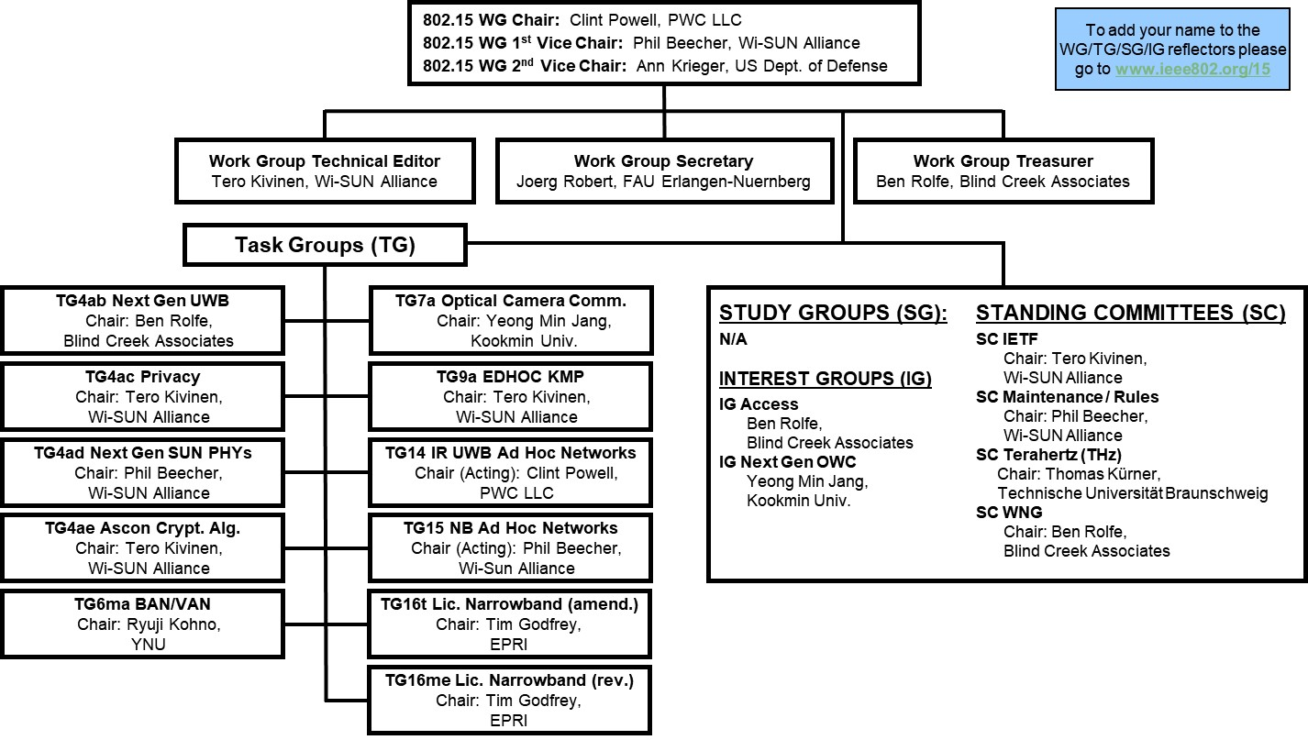
802.15 WG Org. Chart

Slide 3
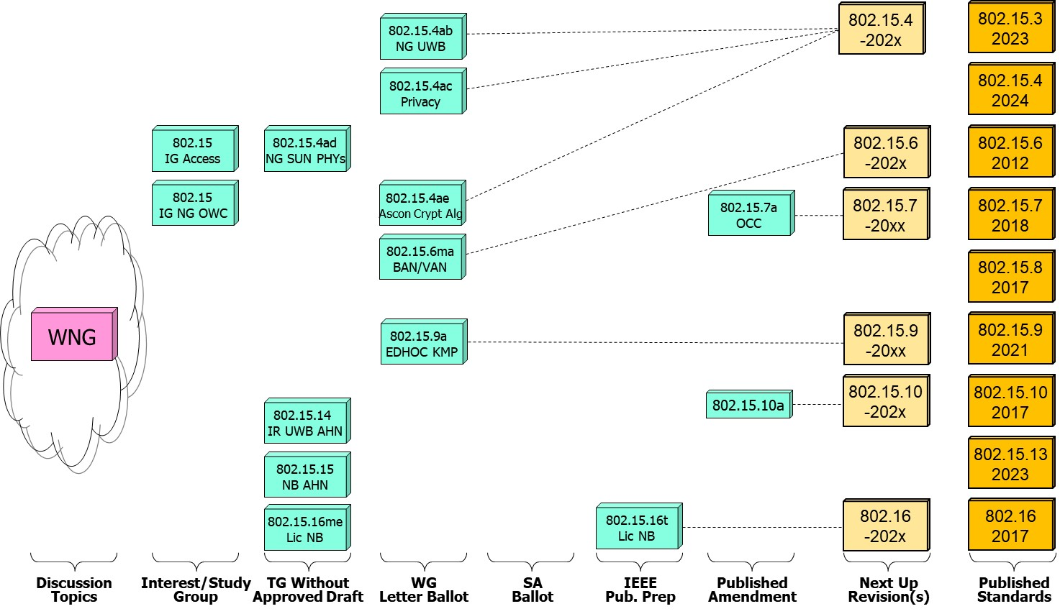
802.15 WG Standards Pipeline

Slide 4
WG15 LB Closings Update
WG15 Letter Ballots closing since the close of the previous session
  Project P802.15.4ac P802.15.4ae P802.15.9a P802.15.6ma P802.15.xyz
  Draft / LB # D2/LB218 D0/LB219 D1/LB220 D6/LB221 D0/LB222
  VOTERS 116 129 129 124 x
  VOTED 96 73 95 104 x
  YES 82 64 83 97 x
  ABSTAIN 12 9 11 7 x
  NO 2 0 1 0 x
  % VOTERS 82.76 59.59 73.164 83.37 x
  % YES 97.62 100.0 93.81 100.00 x
  % ABSTAIN 12.50 12.33 11.58 6.73 x
  Did Not Vote 20 56 34 20 x
  Did Not Vote % 17.2 43.4 26.4 16.1 x
  Open Date 6/2/25 6/6/25 6/6/25 6/20/25 x
  Close Date 6/2/25 7/6/25 6/21/25 7/5/25 x

Slide 5
WG15 Active PARS
  Project Project Status Approval Date Expiration Date
  P802.15.14 In Hibernation 9/23/21 12/31/25
  P802.15.15 In Hibernation 9/23/21 12/31/25
  P802.15.4ab Active 9/23/21 12/31/25
  P802.15.6 Active 5/13/22 12/31/26
  P802.15.4ac Active 6/5/23 12/31/27
  P802.15.4ad Active 3/21/24 12/31/28
  P802.15.4ae Active 11/12/24 12/31/28
  P802.15.9a Active 11/12/24 12/31/28

Slide 6
802.15 WG Administrative
Voting members: 129
Nearly voting members: 26
Aspirant voting members: 19
Membership roster: 802.15 WG Membership Status
802.15 WG Officers - Elected March 2024
Clint Powell - Chair
Phil Beecher - 1st Vice-Chair
Ann Krieger - 2nd Vice-Chair
Joerg Robert - Secretary (appointed)
Tero Kivinen - Tech. Editor (appointed)
Ben Rolfe - Treasurer (appointed)

Slide 7
802.15 WG Operations
802.15 Operations Manual - covering Membership rules, Voting in the subgroup, Parliamentary procedures for approval to move any deliverables to the Standards Committee for action, officer scope of duties and much more…
WG15 Op's Manual
802 Operations Links
802 LMSC Op’s Manual
802 LMSC P&P
802 LMSC Chairs Guidelines
802 WCSC Op’s Manual

Slide 8
802 LMSC Annual Review of 802.15
Scope
  The 802.15 Working Group (WG) on Wireless Specialty Networks (WSN) focuses on the development of open consensus standards addressing wireless networking for the emerging Internet of Things (IoT), allowing these devices to communicate and interoperate with one another, mobile devices, wearables, etc.
    The goal of 802.15 is to publish standards, recommended practices, or guides that have broad market applicability and deal effectively with the issues of coexistence and interoperability with other wired and wireless networking solutions.
Duties
  Maintain and revise the 802.15 standards, amendments, and recommended practices
  Develop new standards when a PAR is approved by IEEE SASB and is assigned to the 802.15 WG by the IEEE 802 LMSC
  Maintain liaisons with other groups within IEEE 802 LMSC, and other relevant standards setting bodies and radio spectrum regulatory bodies
Membership
See slide 6

Slide 9
July 2025 802.15 WG Agenda

Slide 10
2.6a: Designation of Individual Experts
for this Session
Individual experts who attend electronically for a specific purpose/presentation can be designated as such by the WG Chair and receive a registration fee waiver and limited attendance rights.
See section 5 in https://mentor.ieee.org/802-ec/dcn/17/ec-17-0090-26-0PNP-ieee-802-lmsc-operations-manual.pdf.
  The Working Group Chair may designate specific individual experts who are allowed to participate in Working Group discussions via electronic means during an in-person meeting for the benefit of the group. These individuals are not considered to be attending the meeting and so they are not required to pay meeting fees and they do not get participation credit. The participation of these individuals should be limited to specific technical topics. Such participation shall be documented in the minutes of the Working Group meeting.
The individuals listed below are hereby designated as specific individual experts on their respective topics and subject to the restrictions and benefits described in the 802 OM.
  Expert: n/a
  Topic: n/a
  Mtg.: n/a
  Expert: n/a
  Topic: n/a
  Mtg.: n/a
For WNG, attendance for each is limited to the WNG timeslot in which the respective presentation is scheduled.

Slide 11
















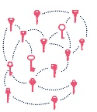
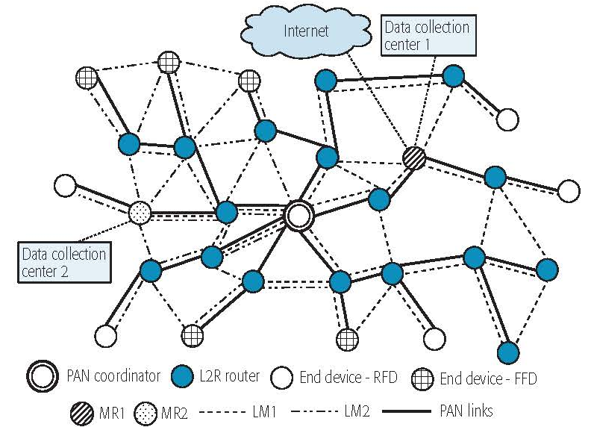

IEEE 802.15 Standards & their Applications
Locating and Tracking
Ultra-low Power Sensors
Automotive
802.15.16
802.15.4
FAN/MAN/RAN
Industrial Networks
Multi-media networks
&
High Speed
Interconnect
802.15.4
802.15.3
Structural Monitoring
802.15.7
802.15.13
802.15.6
Medical
802.15.9
802.15.10
Optical
Communications
Key
Management
Layer 2
Routing
Agricultural Monitoring
Consumer Devices
11

Slide 12
IEEE 802.15 Frequency Band Usage

Slide 13
July 26th Joint IETF/802 Leadership Mtg.
Summary/Overview
802.15 2nd Vice-Chair: Ann Krieger
Last joint meeting was in Thailand, November 2018.
Russ Housley (IETF liaison) gave an overview of the IETF to include their governess, organization, how they start new work and their demographics (I hope to have a link later today for this)
https://datatracker.ietf.org/meeting/interim-2025-ietfieee-03/materials/slides-interim-2025-ietfieee-03-sessa-internet-engineering-task-force-standards-process-overview-00
Dorothy Stanley (IEEE 802 liaison) gave an overview of IEEE and where IEEE 802 fits in to include our organization and starting new work
https://datatracker.ietf.org/meeting/interim-2025-ietfieee-03/materials/slides-interim-2025-ietfieee-03-sessa-ieee-ieee-standards-association-and-ieee-802-lanman-standards-process-overview-00
IETF mentioned they are interested in low power consumption and are working on any efforts in this area
Current Areas of discussion:
Post-Quantum Computing
TSN
YANG
Capability Discovery
Jumbo Ethernet Frames
L4S
Minutes: https://datatracker.ietf.org/meeting/interim-2025-ietfieee-03/materials/minutes-interim-2025-ietfieee-03-202507260700-00
Joint mtg. folder: https://datatracker.ietf.org/meeting/interim-2025-ietfieee-03/session/ietfieee
LMSC July 2025 802 IETF SC Report: https://mentor.ieee.org/802-ec/dcn/25/ec-25-0136-01-LMSC-2025-july-ietf-sc-report.pptx

Slide 14
IEEE 802.15
Subgroups Objectives

Slide 15
TG4ab (NG UWB) -
Next Gen. Ultra WideBand Amendment
Chair: Ben Rolfe
Objective:
Enhancements to 802.15.4 Ultra Wideband (UWB) physical layers (PHYs) media access control (MAC) and associated ranging techniques while retaining backward compatibility with enhanced ranging capable devices (ERDEVs).
TG4ab Webpage
Areas being worked on include:
Ranging
Link budget improvements
Improvements to accuracy, precision and reliability
Sensing
Pulse shape improvements
Channel impulse response reporting to support multistatic sensing
To better support presence detection, environment mapping and other uses
Data
Higher data rates for shorter transmission duration and power savings
Channel coding and packet format improvements for robustness
Additional options for even greater power savings
Protocol enhancements to support very low latency, low energy communications
Interference mitigation techniques to support:
Greater device density
Coexistence in the presence of other users
This amendment builds on top of the existing 802.15.4 standard and the 802.15.4z amendment.

Slide 16
TG4ac (Privacy) - Privacy Amendment
Chair: Tero Kivinen
Objective:
This amendment specifies modifications to the IEEE Std 802.15.4 MAC specification to specify mechanisms that address and improve user privacy. These mechanisms include randomized addresses, and exchanges that support session continuity. This amendment maintains backward compatibility with the base standard.
TG4ac Webpage
This amendment builds on top of the existing 802.15.4 standard.

Slide 17
TG4ad (NG SUN PHYs) -
Next Gen. SUN PHYs Amendment
Chair: Phil Beecher
Objective:
The amendment specifies modifications for the development of a second-generation physical layer (PHY) for Smart Utility Networks (SUN). The primary focus is the improvement of the OFDM (Orthogonal Frequency Division Multiplexing) modes for higher data rates and longer-range communication, particularly in congested license-exempt frequency bands.
TG4ad Webpage
Areas being worked on include:
Definition of use-cases
Number of devices in given area
Max. payload bit-rate
Latency requirements
Definition of frequency bands
…
Channel Models
Channel models for indoor and outdoor use
Interference models for license-exempt band operation
…
This amendment builds on top of the existing 802.15.4 standard.

Slide 18
TG4ae (Ascon Crypt. Alg.) - Amendment
Chair: Tero Kivinen
Objective:
This amendment adds the use of Ascon-128 and Ascon-128a cryptographic algorithms to the IEEE Std 802.15.4.
Ascon-128 and Ascon-128a: Ascon is a family of lightweight authenticated ciphers that has been selected by US National Institute of Standards and Technology (NIST) for future standardization of the lightweight cryptography. Ascon provides the same Authenticated Encryption with Associated Data (AEAD) functionality as Advanced Encryption Standard (AES), allowing an Ascon algorithm to be a drop-in.
TG4ae Webpage
This amendment builds on top of the existing 802.15.4 standard.

Slide 19
TG6ma (BAN/VAN) - BAN with Enhanced Dependability Revision
Chair: Ryuji Kohno
Objective:
Enhancements to the Body Area Networks (BAN) Ultra Wideband (UWB) physical layer (PHY) and media access control (MAC) to support enhanced dependability to a human BAN (HBAN), adding support for vehicle BAN (VBAN.
TG6ma Webpage
Areas being worked on include:
Channel Modeling
Precise modeling of radio propagation of implant and wearable human BANs and around vehicle BANs for dependable data transmission
Classified modeling of multiple BANs and coexistence with other radios for resolution in PHY and MAC
Data transmission
Cognition of channel environment and coexistence
Initial acquisition and synchronization in coexisting BANs
FEC and hybrid ARQ according to QoS levels of data packets for various channel models and coexistence classes
Packet contention
Control and data channels, superframe formant, and MAC function to avoid packet contention in various classes of coexistence
Hybrid protocol of contention-free and contention access according to required QoS levels of data packets
Inter coordinators or hubs negotiation among coexisting BANs
Interference mitigation in coexistence
Interference surprising and canceling technologies for theoretical and feasible implementation in coexistence
Result in simpler classes of coexistence by mitigation of interference from non-BAN
Ranging
Optional ranging for cognition of dynamism of coexisting BANs
This revision builds on the existing 802.15.6 standard with enhanced dependability for human BAN and additional vehicle BAN.

Slide 20
TG7a (OCC) - Higher Rate, Longer Range Optical Camera Comms. Amendment
Chair: Yeong Min Jang
Objective:
This standard offers a global, secure, high-speed optical communication solution up to 100 Mbps and 200 m, with advantages like access to unlicensed spectrum, inherent security, and AI-enhanced features, promising for commercial and business markets.
TG7a Webpage
Areas being worked on include:
Wavelength range: 10000 nm to 190 nm in optically transparent media.
Data rate: Capable of delivering up to 100 Mbit/s.
Communication types: Designed for point-to-point and point-to-multipoint communication.
Adaptation features:
Adaptation to varying channel conditions.
Maintaining connectivity during high mobility (up to 350 km/h).
Flicker mitigation.
Radio Frequency (RF) co-existence.
Communication range: Up to 200 m.
Technology utilized:
Multiple-Input-Multiple-Output (MIMO).
MIMO-Orthogonal frequency-division multiplexing (MIMO-OFDM) for dealing with high levels of optical interference while maintaining high-rate data transmission.
Additional mechanisms:
Relaying mechanisms for enabling heterogeneous operation with existing RF wireless data communications standards.
Safety and regulation: Adheres to applicable eye safety regulations.
This amendment builds on top of the existing 802.15.7 standard.

Slide 21
TG9a (EDHOC KMP) - Amendment
Chair: Tero Kivinen
Objective:
This amendment specifies the use of EDHOC (RFC 9528) KMP for the IEEE Std 802.15.9. This standard describes support for transporting KMP datagrams to support the security functionality present in IEEE Std 802.15.4.
TG9a Webpage
This amendment builds on top of the existing 802.15.4 standard.

Slide 22
TG14 (IR UWB AHN) - Impulse Radio UWB Wireless Ad Hoc Networks
Chair: Clint Powell
Objective:
Focused on impulse radio (IR) Ultra Wideband (UWB) PHY and MAC providing precision ranging capability that is accurate to the centimeter level by including (via. referencing) the 802.15.4 IR UWB functionality into a simple focused specification.
TG14 Webpage
Objective
This TG is currently in hibernation awaiting the outcome/conclusion of the TG4me revision, to see if has satisfied the objective of this project.
This project is for a new standard that references the 802.15.4 standard.

Slide 23
TG15 (NB AHN) - Narrow Band Wireless Ad Hoc Networks
Chair: Phil Beecher
Objective:
Focused on narrow band ad hoc network PHY and MAC by including (via referencing) functionality and features of 802.15.4 into a simple focused specification.
TG15 Webpage
Objective
This TG is currently in hibernation awaiting the outcome/conclusion of the TG4me revision, to see if has satisfied the objective of this project.
This project is for a new standard that references the 802.15.4 standard.

Slide 24
TG16t (Lic NB) - Licensed Narrowband Amendment
Chair: Tim Godfrey
Objective:
Enhancements to IEEE 802.16-2017 physical layer (PHYs) and media access control (MAC) to enable operation in licensed spectrum with channel bandwidths greater than or equal to 5 kHz and less than 100 kHz. The amendment is frequency independent but focuses on spectrum less than 2 GHz. The range and data rate supported by the narrower channels are commensurate with those of the base standard, as scaled by the reduced channel bandwidth. The project also amends IEEE Std 802.16 as required to support aggregated operation in adjacent and non-adjacent channels.
TG16t Webpage
Areas being worked on include:
Definition of the Wireless MAN-NB PHY to enable operation in narrow channels
Aggregation of non-contiguous narrow channels to provide higher capacity
Enhancements to MAC to improve efficiency and reduce control overhead
Definition of a Direct Peer-to-Peer (DPP) mode to support operation without fixed infrastructure
Updates to security protocols
This amendment builds on top of the existing 802.16 standard.

Slide 25
TG16me (Lic NB) - Licensed Narrowband Revision
Chair: Tim Godfrey
Objective:
802.16-2017 is coming up on it’s 10-year anniversary and as such a revision needs to be started to incorporate any amendments (802.16t) since the 802.16-2017 standard.
TG16me Webpage
Areas being worked on include:
Roll up of 802.16t amendment
Address any issues
This is a revision to the 802.16-2017 standard.

Slide 26
IG Access -
WG15 Access Techniques
Chair: Ben Rolfe
Objective:
Determine interest in starting efforts for development of projects on 802.15 Access Techniques.

Slide 27
IG (NG-OWC) - Next Gen. Optical Wireless Communication
Chair: Yeong Min Jang
Objective:
Determine interest in next-generation optical wireless communication (NG-OWC) characteristics and its future applications.
Areas being worked on include:
Artificial Intelligence (AI) for NG-OWC
Integration of various AI technologies into the OWC system
Lightweight AI utilization for each developed AI technology
Channel modelling for NG-OWC
Integration of machine-learning for channel estimation
Utilization of machine learning for channel estimation for dynamic and complex channel conditions
Future applications of NG-OWC
NG-OWC encompasses fields such as IoT, underwater communication, joint communication, sensing, and localization (V2V, M2M, Drone/UAV, etc.)
NG-OWC for OWC based drone Networks
NG-OWC for Indoor/Outdoor Positioning through OWC and LiDAR integration
Deep learning-based OWC to support high mobility vehicle
Preferred camera types for OWC
Resolution: Minimum 720x540 (single-link), maximum 3840 x 2160 (multi-link)
Frame rate: Minimum 30 FPS, preferred more than 120 FPS
Spectrum: Mono, color
Light sources: IR, VL, and UV
This group will evaluate the interest in developing Next Gen OWC capabilities

Slide 28
SC IETF -
Internet Engineering Task Force
Chair: Tero Kivinen
Objective:
This standing committee brings in the information from the Internet Engineering Task Force (IETF) to the 802.15 working group. It concentrates on the IETF working groups that might be of interest to the 802.15 working group members.
SC IETF Webpage
IETF working groups followed include:
6lo, lake, suit

Slide 29
SC MAINT -
802.15 Maintenance Activities
Chair: Phil Beecher
Objective:
The Standing Committee Maintenance (SCM) has the following roles:
Reviewing comments related to possible errata on 802.15 standards and making recommendations to 802.15 Working Group
Managing and maintaining the 802.15 Operations Manual
Managing and maintaining the 802.15 Motion templates and project checklist template
Reviewing 802 PARs and ICAIDs on behalf of 802.15 Working Group
SC MAINT Webpage
SCM meets at least once during every 802 plenary and 802 wireless interim session

Slide 30
SC THz -
THz Standing Committee
Chair: Thomas Kürner
Objective:
The IEEE 802.15 Standing Committee Terahertz is chartered to explore the feasibility of Terahertz for wireless communications. The Terahertz frequency band runs roughly from 300 GHz to 3 THz, a staggering 2700 GHz of bandwidth.
SC THz Webpage
Areas being worked on include:
The IEEE 802.15 Standing Committee Terahertz is soliciting, and hearing, contributions that address numerous THz issues.
There are no immediate plans to transition the group to a study group or a task group; rather, we want to fully understand the technology status in regards to a further amendment of IEEE Std. 805.15.3-2023 or a completely new standard.
Apart from the implementation aspects of THz Communications there are important regulatory aspects to be considered. For example the allocation and identification of THz spectrum especially in conjunction with the agenda items at WRC-27 and WRC-31 are topics of the THz standing committee.

Slide 31
SC WNG -
Wireless Next Generation
Chair: Ben Rolfe
Objective:
The IEEE 802.15 Standing Committee Wireless Next Generation is chartered to facilitate discussions on new Wireless related Technologies that may be of interest to the 802.15 community, and that may lead to new 802.15 standardization projects. The WNG also provides the opportunity to address the whole 802.15 work group with issues or concerns with current techniques or technologies.
SC WNG Webpage
Areas being worked on include:
WNG topics are not limited to only the PHY layer and/or the MAC sublayer since information on the layers above the MAC including the application is very important to making sure that the PHY and MAC are appropriate, especially in the WSN environment.
Presenters in WNG are usually asked to relate the material presented and/or discussed to the work of the WG via the “usual question”:
  What do you propose the Working Group do next?
The answer usually falls into one of these categories:
Information for the group
Form an interest group to pursue
Consider in the future a new project

Slide 32
Subgroups Objectives this Session
TG 4ab (NG UWB) Amendment
  Conduct comment resolution for latest Letter Ballot Recirc
  Determine whether or not to start next Letter Ballot Recirc
  Update timeline of TG
TG 4ac (Privacy) Amendment
  Conduct comment resolution for latest Letter Ballot Recirc
  Determine whether or not to start next Letter Ballot Recirc
  Update timeline of TG
TG 4ad (NG SUN PHYs) Amendment
  Continue hearing presentations on technical areas to include in the draft
  Update timeline of TG
TG 4ae (Ascon Crypt. Alg.) Amendment
  Conduct comment resolution for latest Letter Ballot Recirc
  Determine whether or not to start next Letter Ballot Recirc
  Update timeline of TG

Slide 33
Subgroups Objectives this Session
TG 6ma (Revision + BAN/VAN) Revision
  Conduct comment resolution for latest Letter Ballot Recirc
  Determine whether or not to start next Letter Ballot Recirc
  Update timeline of TG
TG 7a (OCC) Amendment
  Not meeting this session
TG 9a (EDHOC KMP) Amendment
  Conduct comment resolution for latest Letter Ballot Recirc
  Determine whether or not to start next Letter Ballot Recirc
  Update timeline of TG

Slide 34
Subgroups Objectives this Session
TG 14 (IR UWB AHN) – in hibernation, no meetings
TG 15 (NB AHN) – in hibernation, no meetings
TG 16t (Lic NB) Amendment
  Address any feedback/comments from IEEE Publication Editors
TG 16me (Lic NB) Revision
  Continue discussing approach to the revision
  Update timeline of TG

Slide 35
Subgroups Objectives this Session
Joint 802.1/802.15
  Discuss/Hear Updates
Joint 802.11/802.15
  Not meeting this session
IG Access
  Continue hearing presentations on related technical areas
IG NG OWC
  Continue hearing presentations on related technical areas

Slide 36
Subgroups Objectives this Session
SC MAINTENANCE
  Review draft PARs from other WG’s and provide feedback
  Review draft of detailed development process steps checklist
  Review list of all templates for WG15 Subpage for completeness
  Review WG15 P&P for any updates
SC IETF
  Discuss IETF activities related to 802/802.15 at WG15 mid-week
SC THz
  Hear presentations on future potential THz topics
SC WNG
  Hear presentations on future potential WG15 topics

Slide 37
TG4ab (NG-UWB)
July 2025
Closing Report

Slide 38
Session Objectives
Goals for the week:
Resolve Comments
Complete comment resolution on D02

Slide 39
Goals for the week
Resolve comments through friendly and productive collaboration
Work on outstanding issues
Complete comment resolution ☹

Slide 40
Stats, Opening
Comments and Resolution Status
Total # Comments | # with Blank resolution | # with non-blank resolution | # with "Rejected" resolution | # with "Accepted" resolution | # with "Revised" resolution | # Assigned | No Resolution, not Assigned
663 | 254 | 409 | 35 | 234 | 140 | 254 | 0
Technical | Editorial | Okay | 409
447 | 211
General | Okay | 61.69% | 5.28% | 35.29% | 21.12% | 38.31% | 0.00%
5 | 663

Slide 41
Stats, Closing
Comments and Resolution Status
Total # Comments | # with Blank resolution | # with non-blank resolution | # with "Rejected" resolution | # with "Accepted" resolution | # with "Revised" resolution | # Assigned | No Resolution, not Assigned
663 | 123 | 540 | 69 | 268 | 203 | 123 | 0
Technical | Editorial | Okay | 540
447 | 211
General | Okay | 81.45% | 10.41% | 40.42% | 30.62% | 18.55% | 0.00%
5 | 663

Slide 42

Agenda
https://mentor.ieee.org/802.15/dcn/25/15-25-0288-12-04ab-tg4ab-detailed-agenda-july-2025.xlsx

Slide 43
5.2.b Scope of the project (As approved):
This amendment enhances the Ultra Wideband (UWB) physical layers (PHYs) medium access control (MAC), and associated ranging techniques while retaining backward compatibility with enhanced ranging capable devices (ERDEVs).
Areas of enhancement include:
  additional coding, additional coding, preamble and modulation schemes to support improved link budget and/or reduced air-time relative to IEEE Std 802.15.4 UWB;
  additional channels and operating frequencies;
  interference mitigation techniques to support greater device density and higher traffic use cases relative to the IEEE Std 802.15.4 UWB;
  improvements to accuracy, precision and reliability and interoperability for high-integrity ranging; schemes to reduce complexity and power consumption;
  definitions for tightly coupled hybrid operation with narrowband signaling to assist UWB;
  enhanced native discovery and connection setup mechanisms;
  sensing capabilities to support presence detection and environment mapping;
  and mechanisms supporting low-power low-latency streaming as well as high data-rate streaming allowing at least 50 Mb/s of throughput.
Support for peer-to-peer, peer-to-multi-peer, and station-to-infrastructure protocols are in scope, as are infrastructure synchronization mechanisms. This amendment includes safeguards so that the high throughput data use cases do not cause significant disruption to low duty-cycle ranging use cases.
https://development.standards.ieee.org/myproject-web/app#viewpar/9081

Slide 44
Near Term Working Milestones
 | Current Schedule
First letter ballot | June 2024
Initial LB comment resolution | Start: July 2024
First recirculation | March 2025
Recirculation comment resolution | April-July 2025
Second recirculation | Aug 2025??
Recirculation comment resolution | Sept-Oct 2025
LMSC Conditional Approval for SA-Ballot | Sept 2025
First SA-Ballot | Oct-Nov 2025
SA-Ballot comment resolution | December 2025 to ….
We are here

Slide 45
SA Ballot and Beyond
Conditional LMSC approval Sept 2025
 | Current Schedule
First SA-Ballot | October 2025
SA-Ballot comment resolution | November 2025 - January 2026
First recirculation | Feb/Mar 2026
Recirculation comment resolution | Mar 2026
Second recirculation | April 2026
Recirculation comment resolution | May 2026
Final comment resolution | July 2026
Third and final recirculation | Aug 2026
REVCOM and SASB | Nov 2026
Conditional LMSC approval for REVCOM

Slide 46
TG4ac (Privacy)
July 2025
Closing Report

Slide 47
Agenda for July
Resolve letter ballot comments
Prepared draft for recirculation
Form a CRG
Start recirculation ballot
Conditinal submittal to start standard association ballot
Slide 47

Slide 48
Detailed Agenda for July
Tuesday 19th of July 09:00-11:00
  Opening slides
  Approve agenda (this document)
  Approve minutes 15-25-0236-00
  Resolve letter ballot comments
  Review draft ready for the recirculation ballot
  Do motion to start recirculation ballot
  Do motion to form a CRG
  Do motion for conditional submittal to standard association ballot
  Review the package going to the LMSC
  Update project task list
  Closing report
Thursday 31st of July 11:30-13:30
  Cancelled
Slide 48

Slide 49
More information
Project tasklist
  15-23-0397 latest version
Letter ballot comments
  15-25-0107 latest version
Slide 49

Slide 50
LB211 results
Draft |  | D0
Open Date | 2025-01-23 | Close Date | 2025-02-22
Voters | 116
Voted | 85 | % Voters | 73.28%
Yes | 76 | % Yes | 96.20%
Abstain | 6 | % Abstain | 7.06%
No | 3
Did not vote | 31 | Did not vote % | 26.7%
Slide 50

Slide 51
LB211 comments
Comments
Total | 131
Editorial | 94 | Accepted | 71
Technical | 29 | Revised | 33
General | 8 | Rejected | 27
Slide 51

Slide 52
LB214 results
Draft |  | D1
Open Date | 2025-03-24 | Close Date | 2025-04-08
Voters | 116
Voted | 92 | % Voters | 79.31%
Yes | 82 | % Yes | 97.62%
Abstain | 8 | % Abstain | 8.70%
No | 2
Did not vote | 24 | Did not vote % | 20.7%
Slide 52

Slide 53
LB214 comments
Comments
Total | 59
Editorial | 27 | Accepted | 39
Technical | 32 | Revised | 19
General | 0 | Rejected | 1
Slide 53

Slide 54
LB219 results
Draft |  | D2
Open Date | 2025-06-06 | Close Date | 2025-06-22
Voters | 116
Voted | 96 | % Voters | 82.76%
Yes | 84 | % Yes | 100%
Abstain | 12 | % Abstain | 12.50%
No | 0
Did not vote | 20 | Did not vote % | 17.2%
Slide 54

Slide 55
LB219 comments
Comments
Total | 1
Editorial | 1 | Accepted | 1
Technical | 0 | Revised | 0
General | 0 | Rejected | 0
Slide 55

Slide 56
TG motion:
Draft ready for recirculation
Move that TG4ac formally request that 802.15 WG start a WG recirculation requesting approval of document P802.15.4ac_D03 and to forward document P802.15.4ac_D03, to Standards Association ballot.
Moved by: Tero Kivinen
Seconded by: Ann Krieger
Result: Motion passes
Slide 56

Slide 57
WG motion:
Draft ready for recirculation
Move that 802.15 WG start a WG recirculation requesting approval of document P802.15.4ac_D03 and to forward document P802.15.4ac_D03, to Standards Association ballot.
Moved by:
Seconded by:
Result:
Slide 57

Slide 58
TG motion:
CRG formation for LB
Move that TG4ac requests that 802.15 WG approve the formation of a Comment Resolution Group (CRG) for the WG balloting of the P802.15.4ac_D03 with the following membership: Tero Kivinen (Chair), Ann Krieger, Alex Krebs, Ben Rolfe, and Peter Yee. The 802.15.4ac CRG is authorized to approve comment resolutions, edit the draft according to the comment resolutions, and to approve the start of recirculation ballots of the revised draft on behalf of the 802.15 WG. Comment resolution on recirculation ballots between sessions will be conducted via reflector email and via teleconferences announced to the reflector as per the LMSC 802 WG P&P.
Moved by: Tero Kivinen
Seconded by: Ann Krieger
Result: Motion passes
Slide 58

Slide 59
WG motion:
CRG formation for LB
Move that 802.15 WG approve the formation of a Comment Resolution Group (CRG) for the WG balloting of the P802.15.4ac_D03 with the following membership: Tero Kivinen (Chair), Ann Krieger, Alex Krebs, Ben Rolfe, and Peter Yee. The 802.15.4ac CRG is authorized to approve comment resolutions, edit the draft according to the comment resolutions, and to approve the start of recirculation ballots of the revised draft on behalf of the 802.15 WG. Comment resolution on recirculation ballots between sessions will be conducted via reflector email and via teleconferences announced to the reflector as per the LMSC 802 WG P&P.
Moved by:
Seconded by:
Result:
Slide 59

Slide 60
TG motion:
Conditional submittal
Move that TG4ac formally request that 802.15 reviews and requests conditional approval from the LMSC to submit P802.15.4ac_D03 (or current revision) to Standards Association ballot.
Moved by: Tero Kivinen
Seconded by: Ann Krieger
Result: Motion passes
Slide 60

Slide 61
WG motion:
Conditional submittal to SA Ballot
IEEE 802.15 WG requests conditional approval from the LMSC to submit P802.15.4ac_D03 (or current revision) to Standards Association ballot.
Moved by:
Seconded by:
Result:
Slide 61

Slide 62
CRG telechat
LB223 ends at 2025-08-14 18:00 EDT, so we schedule telechat immediately after that at 18:30 EDT:
Location | Local Time | Time Zone | UTC Offset
Helsinki (Finland) | Friday, 15 August 2025, 01:30:00 | EEST | UTC+3 hours
Los Angeles (USA – California) | Thursday, 14 August 2025, 15:30:00 | PDT | UTC-7 hours
New York (USA – New York) | Thursday, 14 August 2025, 18:30:00 | EDT | UTC-4 hours
Tokyo (Japan) | Friday, 15 August 2025, 07:30:00 | JST | UTC+9 hours
Corresponding UTC (GMT) | Thursday, 14 August 2025, 22:30:00
Slide 62

Slide 63
Timeline
Finalize the list of issues to be solved | Jan 2024
First version of the draft for WG pre-ballot commenting | Nov 2024
Draft ready for letter ballot | Jan 2025
Letter ballot recirculation | Mar 2025
Draft ready for SA ballot | May 2025
SA ballot start | Aug 2025
SA ballot done | Sep 2025
Submit to RevCom | Jan 2026
Standard published | Apr 2026
Slide 63

Slide 64
Meeting achievements
Processed all letter ballot comments
Prepared draft for recirculation
Start recirculation ballot after this session
Form a CRG
Requested conditional submittal for standard association ballot
Slide 64

Slide 65
Agenda of TG4ac for September
Two meetings
Not overlapping with TG9a, or TG4ae.
Process comments received in the letter ballots (if any), or process initial standard association ballot comemnts
Form a CRG
Slide 65

Slide 66
TG4ad (NG-SUN PHY)
July 2025
Closing Report

Slide 67
TG4ad Leadership
Chair: Phil Beecher (Wi-SUN Alliance)
Vice Chair: Joerg Robert (FAU /Fraunhofer IIS)
Vice Chair: Hiroshi Harada (Kyoto University)
Secretary: Gary Stuebing (Cisco Systems)
Slide 67

Slide 68
Agenda
Monday PM1:
Policies and guidelines
Call for Patents
Approval of the agenda
Approval of May minutes - 15-25-0222-00
Current proposal status
Hear updated proposals and simulation results
Recess
Tuesday AM1:
Evaluation criteria
Hear updated proposals and simulation results
Recess
Tuesday PM1:
Hear updated proposals and simulation results
Recess
Wednesday PM1:
Hear updated proposals and simulation results
Recess
Thursday AM1:
Hear updated proposals and simulation results
Recess
Thursday AM2:
Hear updated proposals and simulation results
Next Steps and Timeline
AoB
Adjourn
Slide 68

Slide 69
Presentation Timeslots
Thomas Almholt (Tuesday 9AM Tuesday AM1)
Sangsung Choi – Tuesday PM 1/2
Hiroshi Harada – Wednesday (2 presentation), Thursday (3 presentation)
Fabrice Portier – 1 presentation - Wednesday or Thursday
Joerg Robert – 1 presentation – Wednesday, Thursday
Jung-Hwan Hwang Daniel (ETRI) – Tuesday
Slide 69

Slide 70
Achievements
Approval of minutes
Presentations (see next page)
July meeting minutes posted as 15-25-0333-00
Slide 70

Slide 71
Presentations heard
Slide 71

Slide 72
Conference Call Schedule
Wednesday 3 September 2025, 22:00 JST, 15:00 CEST, 14:00 BST, 08:00 CDT, 06:00 PDT for 2 hours.
Goals: status reporting and preliminary outcomes of merges.
Slide 72

Slide 73
Proposed Timeline
2024
November: Approve Technical Guidance Document
Call for proposals issued
2025
January: Hear initial proposals
March: Hear updated proposals
March to May – 2 conference calls
  Simulation results of remaining proposals not yet provided
  Prepare table of proposals for analysing against technical guidance document
May: Hear final proposals
May to July – 2 conference calls
  Simulation results and proposal categorisation.
July: Heard final proposals. Categorized and summarized proposals
July – September: Merging proposals
September: Finish merging and start drafting the standard
Slide 73

Slide 74
TG4ae (ASCON)
July 2025
Closing Report

Slide 75
Agenda for July
Resolve letter ballot comments
Prepare draft ready for letter ballot recirculation
Start letter ballot recirculation after the session
Slide 75

Slide 76
Detailed Agenda for May
Monday 28th of July 14:30-16:30
  Opening slides
  Approve agenda (this document)
  Approve minutes 15-25-0227-00
  Resolve letter ballot comments received
  Review the updated draft
  Do motion to start letter ballot
  Do motion to form CRG
  Update the project task list
  Closing report
Wednesday 30th of July 09:00-10:00
  Cancelled
Slide 76

Slide 77
More information
Project tasklist
  15-24-0466 latest version
Letter ballot comments
  15-25-0317 latest version
Comments NIST received during IPD:
  https://csrc.nist.gov/pubs/sp/800/232/ipd
  sp800-232-ipd-public-comments-received.pdf
Slide 77

Slide 78
LB219 results
Draft |  | D0
Open Date | 2025-06-06 | Close Date | 2025-07-06
Voters | 129
Voted | 73 | % Voters | 56.59%
Yes | 64 | % Yes | 100.00%
Abstain | 9 | % Abstain | 12.33%
No | 0
Did not vote | 56 | Did not vote % | 43.4%
Slide 78

Slide 79
LB219 comments
Comments
Total | 28
Editorial | 23 | Accepted | 21
Technical | 5 | Revised | 7
General | 0 | Rejected | 0
Slide 79

Slide 80
TG motion:
Draft ready for recirculation
Move that TG4ae formally request that 802.15 WG start a WG recirculation requesting approval of document P802-15-4ae_D01 and to forward document P802-15-4ae_D01, to Standards Association ballot.
Moved by: Ann Krieger
Seconded by: Peter Yee
Result: Motion passes
Slide 80

Slide 81
WG motion:
Draft ready for recirculation
Move that 802.15 WG start a WG recirculation requesting approval of document P802-15-4ae_D01 and to forward document P802-15-4ae_D01, to Standards Association ballot.
Moved by:
Seconded by:
Result:
Slide 81

Slide 82
TG motion:
CRG formation for LB
Move that TG4ae requests that 802.15 WG approve the formation of a Comment Resolution Group (CRG) for the WG balloting of the P802-15-4ae_D01 with the following membership: Tero Kivinen (Chair), Ann Krieger, Ben Rolfe, Alex Krebs, and Peter Yee. The 802.15.4ae CRG is authorized to approve comment resolutions, edit the draft according to the comment resolutions, and to approve the start of recirculation ballots of the revised draft on behalf of the 802.15 WG. Comment resolution on recirculation ballots between sessions will be conducted via reflector email and via teleconferences announced to the reflector as per the LMSC 802 WG P&P.
Moved by: Ann Krieger
Seconded by: Peter Yee
Result: Motion passes
Slide 82

Slide 83
WG motion:
CRG formation for LB
Move that 802.15 WG approve the formation of a Comment Resolution Group (CRG) for the WG balloting of the P802-15-4ae_D01 with the following membership: Tero Kivinen (Chair), Ann Krieger, Ben Rolfe, Alex Krebs, and Peter Yee. The 802.15.4ae CRG is authorized to approve comment resolutions, edit the draft according to the comment resolutions, and to approve the start of recirculation ballots of the revised draft on behalf of the 802.15 WG. Comment resolution on recirculation ballots between sessions will be conducted via reflector email and via teleconferences announced to the reflector as per the LMSC 802 WG P&P.
Moved by:
Seconded by:
Result:
Slide 83

Slide 84
Timeline
Finalize the list of issues to be solved | Nov 2024
First version of the draft for WG pre-ballot commenting | Mar 2025
Draft ready for letter ballot | May 2025
Draft ready for SA ballot | Sep 2025
SA ballot start | Nov 2025
SA ballot done | Jan 2026
Submit to RevCom | Mar 2026
Standard published | Jul 2026
Slide 84

Slide 85
Meeting achievements
Resolved letter ballot comments
Created draft ready for letter ballot recirculation
Start letter ballot recirculation after this meeting.
Slide 85

Slide 86
Agenda of TG4ae for September
Two meetings
Not overlapping with TG4ac, or TG9a.
Process comments received in the recirculation letter ballot
Form a CRG
Start recirculation ballot
Slide 86

Slide 87
TG6ma (BAN/VAN)
July 2025
Closing Report

Slide 88
Objectives of TG 6ma – Enhanced Dependability Body Area Network (ED-BAN)
Objective: Enhancements to the BAN Ultra Wideband (UWB) physical layer (PHY) and media access control (MAC) to support enhanced dependability to a human BAN (HBAN) and adds support for vehicle body area networks (VBAN), a coordinator in a vehicle with devices around the vehicular cabin.
Action:
•Review of the Third Recirculation Letter Ballot LB221 for draft D06
•Preparation for Report to LMSC for Unconditional Approval to go to SA Ballot
•Feasibility Study of the Draft by Performance Evaluation of Technologies in PHY; Channel Coding According to 8 QoS Levels of Packets and Coexistence Levels, Interference.
•Feasibility Study of the Draft by Performance Evaluation of Technologies in MAC; Channel Management, CCA, Hybrid Contention Free/Access Protocol According to 8 QoSs and Coexistences.
•Harmonization or Commonality with 4ab in Coexistence and Feasible Implementation of 6ma and 4ab
•Feasibility of TSN of 802.1 in MAC
Next Things to Do： Proceed to SA Ballot and Comment Resolution for SA Ballot

Slide 89
Agenda items for the week
TG15.6ma meeting call to order
Call for essential patents and policies & procedures reminder doc.#15-25-0192-00-06ma
Approve last meeting minutes: TG 15.6ma Meeting Minutes for May 2025 doc.#15-25-0266-00-06ma
Agenda of TG15.6ma July 2025 doc.#15-25-0298-06-06ma
Review and Summary
  Overview of IG, SG, TG15.6ma doe Dependable BAN Revision of IEEE802.15.6-2012 doc.#15-25-0033-03-06ma
  Basic Consensus in MAC and PHY of Revision of IEEE802.15.6-2012(IEEE802.15.6ma) doc.#15-23-0557-08-06ma
  Review of Letter Ballot(LB)221 for draft D06 doc.#15-25-0xxx-00-06ma
  Consolidated comments & resolutions LB221 doc.#15-25-0yyy-00-06ma
  Rescheduling Timeline doc.#15-23-0361-13-06ma
  P802.15.6ma Report to LMSC on Unconditional Approval to go to SA Ballot doc.#15-25-0324-01-06ma
  Presentation
  1.. Hybrid ARQ Scheme for High QoS Packets in High Class of Coexistence of IEEE 802.15.6ma #15-23-0576-08-06ma 2. Evaluation of IEEE 802.15.6 Ultra-wideband Physical Layer Utilizing Super Orthogonal Convolutional 22-0562-15-06ma
  3. Ranging Accuracy Evaluation under TG6ma Communication Senarios doc.#15-24-0248-06-06ma
  4. MAC Performance Evaluation of Multiple BAN Coexistence Under TG6ma Channel doc.#15-24-0246-06-06ma
  5 MAC superframe structure and frames doc.#15-24-0573-04-06ma
  6 15.6ma MAC time reference base for superframe and group superframe structure d0c.#15-25-0132-01-06ma
  7 MAC Service Feature doc.#15-24-0356-03-06ma
  8. TG Motion to Recirculation doc.#15-25-0zzz-00-06ma
  9. Interference Mittigation Schemes in Class 3, 5, 6, and 7 of Coexisitence in TG6ma doc.#15-24-0074-08-06ma
  10. Coordinator-to-Coordinator(C2C) Ranging and Communication for Multiple BAN Coexistence 15-25-0vvv-00-06ma
  11. TG15.6ma Coexistence Assessment Document doc.#15-24-0348-05-06ma
  12 MAC services support for IEEE P802.1ACea doc.#15-24-0594-02-006a
  13..TG6ma Channel Model Document for Enhanced Dependability doc.#15-22-0519-10-06ma
  14. Comments to channel-model-document doc.#15-24-0073-05-06ma
  15. Progress Report of TG6ma doc8#15-23-0056-10-06ma
  16. Timeline of TG6ma doc.#15.23-0056-10-06ma
  17. TG15.6ma Closing Report for July 2025 doc.#15-25-0389-00-06ma
  18. TG15.6ma Meeting Minutes for July 2025 doc.#15-25-0390-00-06ma

Slide 90
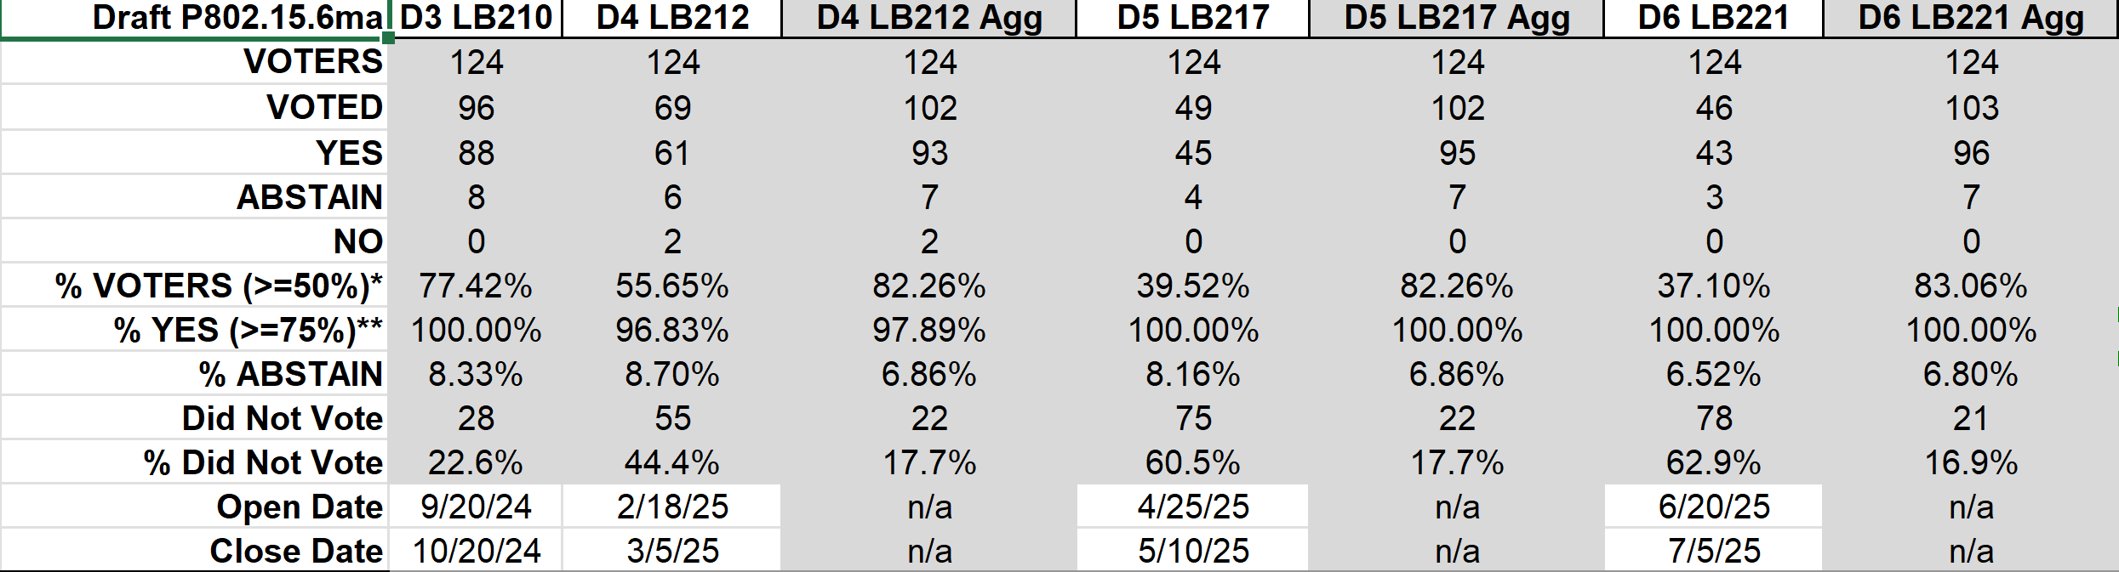
Result of Letter Ballots LB210, 212, 217, 221 for the Draft P802.15.6ma_D03, 04, 05, and 06 （Sept. 2024- July 2025)
Result of LB221(June 20-July 05, 2025): 83.06% of Voters voted YES in aggregation which is over 75%. Then LB221 was officially Approved.
Voted YES with and without Comments are 103 while No. of Comments is 0.
In Madrid Plenary Meeting July 2025, Working Group will approve to submit to SA Ballot.

Slide 91
TG 6ma Timeline(expected)
Final SB recirculation, if required. Submission to RevCom
Jan 2026
Tech Req Doc July 2022
Presentation of proposals
May 2023
Comment Resolutionfor LB210
Nov. 2024
Comment Resolutionfor LB212
March 2025
Comment Resolutionfor LB217
May
2025
Comment Resolution for LB217
July
2025
SA Ballot
Sept
2025
WG PreBallot submission for Draft2.5 August 2024
Revcom Approve
March 2026
SA recirculation if required
Oct 2025
^{Draft V1,18 Com}
May. 2024
Recirculation (LB212)
Jan. 2025
RevcomSubmission
Feb. 2026
TRD,CMD
Call Proposals Sept 2022
Std. Draf V1.9 Proposals
Nov. 2023
Comment Resolution fo Draft v2.3 on WG for PreBallot July 2024
1st Letter Ballot(LB210)
Sept. 2024
2nd Recirculation (LB217)
April 2025
3rd Recirculation (LB)
June 2025
Unconditional approval for Standard Association Ballot (SA)
July 2025
Request EC approval for SA Ballot
Nov. 2026
Comment Resolution for SA Ballot
Oct. 2025
Notes: SASB/RevCom scheduled for 2024 a guesstimate
Slide 91

Slide 92
Expecting Timeline detail
Topic item | Deadline | Action items | Notes
Std Draft D2_3 WG pre-ballot recirculation. | July/2024 |  | Editorial comments from 802.15 technical editor were addressed. Still missing cross-references.
Towards the July 2024 meeting | July/2024 | Adding MAC text. Revise PHY text. Editorial revisions.
Target WG letter ballot (LB) submission: submit draft to TEG | August/2024 | Disposition of comments. | 1. Based on pre-ballot resolutions, prepare Draft D2_4 2. Request LB submission before the September meeting. Consequently, the July meeting is used to resolve comments.
TG and WG Motion to letter ballot (LB) submission: submit draft to EC | Sep/2024 | TG and WG Motion to LB | Prepare all necessary documents: Project Task List, Progress Repor, Coexistence Assurance(CA) document, TG Motion to LB, WG Motion to LB
1st LB circulation | Sep/2024 |  | Comment-resolutions to LB recirculation.
Comment Resolution for LB210 | Nov/2024 |  | Comment-resolutions to LB recirculation.
1st LB recirculation LB212 | Jan/2025 |  | Comment-resolutions to LB recirculation.
Comment Resolution for LB212 | Jan/2025 |  | Seek conditional approval for SB by the Executive Committee.
2nd LB recirculation. LB217 | Mar/2025 |  | WG approval to request SB submission.
Comment Resolution for LB217 | May/2025 |  | Comment-resolutions to LB recirculation.
3rd LB recirculation. LB221 | Jun/2025 |  | WG approval to request SB submission.
Complete draftinig D06 for LB221 | July/2025 |  | Comment-resolutions to LB recirculation.
IEEE SA Sponsor Ballot unconditional approval Submission | July//2025 |  | One month for IEEE SA editorial review.
1st SB recirculation | Aug/2025 |  | Comment-resolutions to SB and recirculation.
Comment Resolution for 1st SB Ballot | Sept/2025 |  | Comment resolution for 1st SB Ballot in Sept. Meeting
2nd SB recirculation | Oct/2025 |  | SB and recirculation if 1st SB Ballot has comments etc.
Comment Resolution for 2nd SB Ballot | Nov/2025 |  | Comment resolution for 1st SB Ballot in Sept. Meeting
Request conditional/unconditional approval to RevCom | Jan/2026 |  | Submission to LMSC agenda
Final SB recirculation, if required. Submission to RevCom | Jan/2025 |  | Submission to SASB
RevCom submission | Feb/2025 |  | RevCom approval
Note: the deadlines are subject to change.
Reference: doc.#15-23-0369-09-06ma
Slide 92

Slide 93
Contributions
・TG15.6ma opening report for July 2025 meeting 15-25-0299-01-06ma
・TG15.6ma Agenda of July 2025 Meeting 15-25-0298-06-06ma
・Overview of IG, SG, TG15.6ma doe Dependable BAN Revision of IEEE802.15.6-2012 15-25-0033-03-06ma
・P802.15.6ma Report to LMSC on Unconditional Approval to go to SA Ballot 15-25-0324-01-06ma
・Review of Letter Ballot(LB)221 for draft D05 15-25-0xxx-00-06ma
・Hybrid ARQ Scheme for High QoS Packets in High Class of Coexistence of IEEE 802.15.6ma 23-0576-09
・ 15.6ma MAC updates 15-25-0368-00-06ma
・ Evaluation of IEEE 802.15.6 UWB Physical Layer Utilizing Super Orthogonal Convolutional 22-0562-16-06ma
・Ranging Accuracy Evaluation under TG6ma Communication Senarios 15-24-0248-07-06ma
・MAC Performance Evaluation of Multiple BAN Coexistence Under TG6ma Channel 15-24-0246-07-06ma
・TG motion for Unconditional submittal to LMSC and CRG formation for SA Ballot 15-25-0377-00-06ma
・TG15.6ma Coexistence Assessment Document 15-24-0348-04-06ma
・MAC services support for IEEE P802.1ACea 15-24-0594-01-006a
・TG6ma Channel Model Document for Enhanced Dependability 15-22-0519-09-06ma
・Progress Report of TG6ma 15-23-0056-14-06ma
・Timeline of TG6ma 15.23-0361-14-06ma
・TG15.6ma Closing Report for July 2025 15-25-0389-00-06ma
・TG15.6ma Meeting Minutes for July 2025 15-25-0390-00-06ma
Slide 93

Slide 94
Contacts and Conference call
Chair; Ryuji Kohno, YNU/YRP-IAI
kohno@ynu.ac.jp, kohno@yrp-iai.jp
1st Vice-Chair; Marco Hernandez, YRP-IAI/CWC
marco.hernandez@ieee.org
2nd Vice-Chair; Daisuke Anzai, Osaka Metropolitan Univ.
d.anzai@omu.ac.jp
Secretary; Takumi Kobayashi, Osaka Metropolitan Univ./YRP-IAI
kobayashi-takumi@yrp-iai.jp, Kobayashi.takumi@omu.ac.jp
Technical Editors;
Minsoo Kim, YRP-IAI minsoo@minsookim.com
Seong-Soon Joo, Nano HiTech ssjoo@etri.sci.kr
Kento Takabayashi, Toyo U. takabayashi@toyo.jp
Marco Hernandez, YRP-IAI/CWC marco.hernandez@ieee.org
Slide 94

Slide 95
TG9a (EDHOC)
July 2025
Closing Report

Slide 96
Agenda for July
Resolve letter ballot comments
Prepare draft for recirculation
Form a CRG
Start recirculation ballot
Conditional submittal to standard association ballot
Slide 96

Slide 97
Detailed Agenda for July
Tuesday 29th of July 18:00-19:00
  Opening slides
  Approve agenda (this document)
  Approve minutes 15-25-0231-00
  Resolve letter ballot comments
  Review draft ready for the recirculation
  Do motion to start recirculation
  Do motion to form a CRG
  Do motion for conditional submittal to standard association ballot
  Review the LMSC package for conditional SA ballot submittal
  Update the project task list
  Closing report
Thursday 31st of July 10:00-11:00
  Cancelled
Slide 97

Slide 98
More information
Project tasklist
  15-24-0468 latest version
Letter ballot comments
  15-25-0218 latest version
Slide 98

Slide 99
LB215 results
Draft |  | D0
Open Date | 2025-03-26 | Close Date | 2025-04-25
Voters | 129
Voted | 84 | % Voters | 65.12%
Yes | 75 | % Yes | 97.40%
Abstain | 7 | % Abstain | 8.33%
No | 2
Did not vote | 45 | Did not vote % | 34.9%
Slide 99

Slide 100
LB215+rogue comments
Comments
Total | 13+18 = 31
Editorial | 7+8 = 15 | Accepted | 5+16 = 21
Technical | 5+10 = 15 | Revised | 5+2 = 7
General | 1+0 = 1 | Rejected | 3+0 = 3
Slide 100

Slide 101
LB220 results
Draft |  | D1
Open Date | 2025-06-06 | Close Date | 2025-06-21
Voters | 129
Voted | 95 | % Voters | 73.64%
Yes | 84 | % Yes | 100%
Abstain | 11 | % Abstain | 11.58%
No | 0
Did not vote | 34 | Did not vote % | 26.4%
Slide 101

Slide 102
LB220+rogue comments
Comments
Total | 2+14 = 16
Editorial | 2+11=13 | Accepted | 2+11
Technical | 0+2=2 | Revised | 0+2
General | 0+1 | Rejected | 0+1
Slide 102

Slide 103
TG motion:
Draft ready for recirculation
Move that TG9a formally request that 802.15 WG start a WG recirculation requesting approval of document P802.15.9a_D02 and to forward document P802.15.9a_D02, to Standards Association ballot.
Moved by: Tero Kivinen
Seconded by: Ann Krieger
Result: Motion passes
Slide 103

Slide 104
WG motion:
Draft ready for recirculation
Move that 802.15 WG start a WG recirculation requesting approval of document P802.15.9a_D02 and to forward document P802.15.9a_D02, to Standards Association ballot.
Moved by:
Seconded by:
Result:
Slide 104

Slide 105
TG motion:
CRG formation for LB
Move that TG9a requests that 802.15 WG approve the formation of a Comment Resolution Group (CRG) for the WG balloting of the P802.15.9a_D02 with the following membership: Tero Kivinen (Chair), Ann Krieger, Ben Rolfe, Alex Krebs, and Peter Yee. The 802.15.9a CRG is authorized to approve comment resolutions, edit the draft according to the comment resolutions, and to approve the start of recirculation ballots of the revised draft on behalf of the 802.15 WG. Comment resolution on recirculation ballots between sessions will be conducted via reflector email and via teleconferences announced to the reflector as per the LMSC 802 WG P&P.
Moved by: Tero Kivinen
Seconded by: Ann Krieger
Result: Motion passes
Slide 105

Slide 106
WG motion:
CRG formation for LB
Move that 802.15 WG approve the formation of a Comment Resolution Group (CRG) for the WG balloting of the P802.15.9a_D02 with the following membership: Tero Kivinen (Chair), Ann Krieger, Ben Rolfe, Alex Krebs, and Peter Yee. The 802.15.9a CRG is authorized to approve comment resolutions, edit the draft according to the comment resolutions, and to approve the start of recirculation ballots of the revised draft on behalf of the 802.15 WG. Comment resolution on recirculation ballots between sessions will be conducted via reflector email and via teleconferences announced to the reflector as per the LMSC 802 WG P&P.
Moved by:
Seconded by:
Result:
Slide 106

Slide 107
TG motion:
Conditional submittal
Move that TG9a formally request that 802.15 reviews and requests conditional approval from the LMSC to submit P802.15.9a_D02 (or current revision) to Standards Association ballot.
Moved by: Tero Kivinen
Seconded by: Ann Krieger
Result: Motion passes
Slide 107

Slide 108
WG motion:
Conditional submittal to SA Ballot
IEEE 802.15 WG requests conditional approval from the LMSC to submit P802.15.9a_D02 (or current revision) to Standards Association ballot.
Moved by:
Seconded by:
Result:
Slide 108

Slide 109
CRG telechat
LB222 ends at 2025-08-14 18:00 EDT, so we schedule telechat immediately after that at 18:00 EDT:
Location | Local Time | Time Zone | UTC Offset
Helsinki (Finland) | Friday, 15 August 2025, 01:00:00 | EEST | UTC+3 hours
Los Angeles (USA – California) | Thursday, 14 August 2025, 15:00:00 | PDT | UTC-7 hours
New York (USA – New York) | Thursday, 14 August 2025, 18:00:00 | EDT | UTC-4 hours
Tokyo (Japan) | Friday, 15 August 2025, 07:00:00 | JST | UTC+9 hours
Corresponding UTC (GMT) | Thursday, 14 August 2025, 22:00:00
Slide 109

Slide 110
Timeline
Finalize the list of issues to be solved | Nov 2024
First version of the draft for WG pre-ballot commenting | Jan 2025
Draft ready for letter ballot | Mar 2025
Draft ready for SA ballot | Jul 2025
SA ballot start | Aug 2025
SA ballot done | Dec 2025
Submit to RevCom | Mar 2026
Standard published | May 2026
Slide 110

Slide 111
Meeting achievements
Processed all letter ballot comments
Prepared draft for recirculation
Start recirculation ballot after this session
Form a CRG
Requested conditional submittal for standard association ballot
Slide 111

Slide 112
Agenda of TG9a for September
Two meetings
Not overlapping with TG4ac or TG4ae.
Process comments received in the letter ballots (if any), or process initial standard association ballot comments
Form a CRG
Slide 112

Slide 113
TG16me (LIC-NB)
July 2025
Closing Report

Slide 114
Plan for week
Monday PM2 17:00 CEST
Tuesday PM1 14:30 CEST
Wednesday PM1 14:30 CEST
Thursday PM1 14:30 CEST
Slide 114

Slide 115
New Contributions
Remember to use new Mentor section for TG16me Revision documents
28-Jul-2025 ET | 2025 | 342 | 0 | TG16me (LIC-NB) Revision to 2017 | Synchronization Sequence Length and Repetitions | Vishal Kalkundrikar (Ondas) | 28-Jul-2025 09:21:31 ET | Download
28-Jul-2025 ET | 2025 | 338 | 0 | TG16me (LIC-NB) Revision to 2017 | Proposed Modification and Additions to 802.16t | Menashe Shahar (Ondas) | 28-Jul-2025 08:34:28 ET | Download
31-Jul-2025 ET | 2025 | 367 | 5 | TG16me (LIC-NB) Revision to 2017 | WaveformSelectionForLowPowerMode | Menashe Shahar, Vishal Kalkundrikar (Ondas)
Slide 115

Slide 116
Initial Discussion
Bivesh will contact AAR.org to see if a link to the adoption of 802.16t can be referenced by IEEE for their public visibility committee.
Discussion on 15-25-0338-00-16me-proposed-modification-and-additions-to-802-16t
  Is there a need for better definition of transitions between DPP and P-MP modes?
Slide 116

Slide 117
16t amendment roll-in
July 2025 Roll-in process
  We will inform IEEE staff (Christy and Michelle) that we will proceed with rollup.
  We will ask IEEE to send everything for 16t and base standard to Harry.
  When IEEE is ready to publish the 16t amendment, they will send us any changes to review.
Expedite sending materials to Harry in August so an initial roll-in can be completed by September meeting.
Slide 117

Slide 118
Discussion on applicability of ASCON
Adoption underway in 802.15.4ae, and 802.15.9a
  Look at draft in private area 802.15.4ae-D0
802.15.9a adds key management
  Draft in private area 802.15.9a-D2
Slide 118

Slide 119
Discussion on waveforms for single carrier optimization
An identified issue is the need for improved power efficiency in the special case where a single carrier is being used.
Conclusion from document 367r5
  SOQPSK and GMSK are very close in performance.
  Other waveforms could be considered if they can be identified in a contribution.
  A further update to r6 will correct typos in table.
Slide 119

Slide 120
Project Timeline
Milestone | Date
Task Group Start | March 2025
Draft Development | May – Sept 2025
Informal TG review of draft | Nov 2025
Working Group Letter Ballot | March 2026
Working Group Recirculation Letter Ballot | May 2026
SA Ballot | Sept 2026
SA Recirc | Jan 2027
Forward to RevCom | March 2027
Slide 120

Slide 121
IG Access
July 2025
Closing Report

Slide 122
Agenda 13 May 2025
Opening and Meeting Reminders
Overview of Interest Group
Technical Discussion
  ED thresholds for suspendable CSMA-CA
Any other business
Adjourn
Slide 122

Slide 123
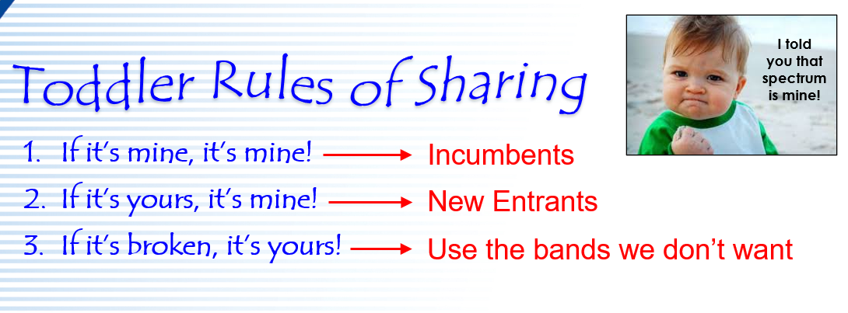
Opportunity and problem consideration
Overview of Interest Group

Slide 124
Opportunity Statement
Need to share spectrum
  Need to share with uncoordinated access
  Need multiple sharing methods
  Sharing through coexistence is essential
Need to accommodate reality
A systems view of coexistence will help to advance
  With over 5 decades of wireless channel access experience a lot has been learned
  We can do more than what we’ve already done!
Slide 124

Slide 125
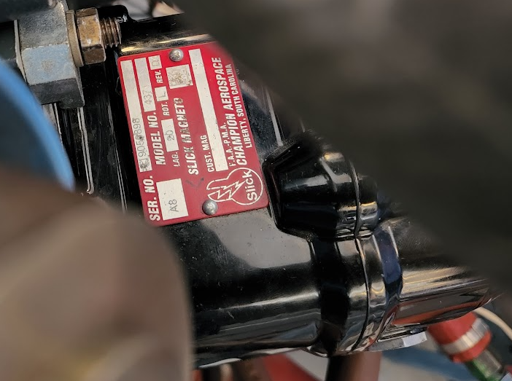
Technical Contributions
Slide 125

Slide 126
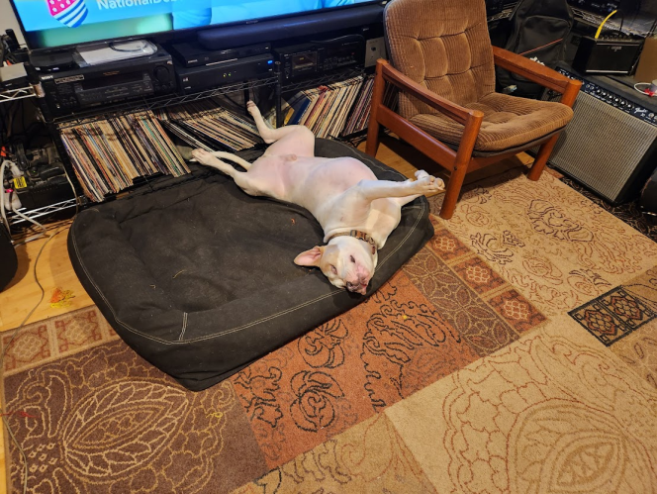
Discussion
Slide 126

Slide 127
Minutes
  Called to order @14:32 CEST
  Introduction and meeting reminders
  IEEE policy for non-PAR activity
  Agenda review. Agenda in 15-25-0345-00 approved by unanimous consent
  Overview of IG access: purpose and goals
  Technical presentation “CCA Modes and Adaptive ED Threshold in suspendable CSMA-CA” Doc: 15-25-0353-02
  Discussion followed
  Any other business: non heard
  Adjourned @15:45 CEST
Slide 127

Slide 128
IG Attendance
Berger, Christian
Dolmans, Guido
Grosswindhager, Bernhard
Gruber, Josef
Guo, Jianlin
HOSAKO, IWAO
Ikegami, Tetsushi
Ishihara, Susumu
JOO, SEONG-SOON
Kato, Arata
Kitazawa, Shoichi
Kivinen, Tero
KOBAYASHI, Takumi
kristem, vinod
Kuechler, Wolfgang
Kuerner, Thomas
Li, Huan-Bang
LIU, CHENCHEN
Luo, Xiliang
Maman, Mickael
Nabki, Frederic
Neirynck, Dries
Ogawa, Masakatsu
Pakrooh, Pooria
Patel, Tushar
Rolfe, Benjamin
Sand, Stephan
Sasaki, Shigenobu
Schmidt, Reinhold
Sumi, Takenori
Verso, Billy
Wisland, Dag
Zakaib, Larry
Zhang, Xiaolong
Zhou, Chengzhi

Slide 129
IG NG-OWC
July 2025
Closing Report

Slide 130
Session Objectives
Present Nine contributions related to the future of next generation OWC(OCC, FSO) technology
Prepared extended Call for Applications on NG OWC
Slide 130

Slide 131
Session Schedule
IG NG-OWC scheduled 3 time slots in this week meeting
- Wed. AM1, Thur. AM1, and Thur. PM1
Slide 131

Slide 132
Accomplishment for the meeting
1st Slot: Wed. AM1
  Meeting Objectives and Agenda Approval (334-01)
  Review and Approval for IG NG-OWC March 2025 Wireless Plenary Meeting Minutes (166-00)
  Present and accept the presentation from Kookmin University titled "AI Equalizer for signal processing in NG-OCC (372-00)
  Present and accept the presentation from Kookmin University titled "Future Direction of NG OCC MAC Technologies (373-00)
  Recess
Slide 132

Slide 133
Accomplishment for the meeting
2nd Slot: Thur. AM1
  Meeting objectives and agenda approval (334-01)
  Present and accept the presentation from Kookmin University titled "Optical Camera Communication System Using DMT Modulation (374-00)
  Present and accept the presentation from Kookmin University titled "Future directions of AMC for NG FSO Technologies (383-00)
  Present and accept the presentation from Kookmin University titled "Future Directions of ARQ & HARQ Assisted NOMA For NG FSO Technologies (384-00)
  Present and accept the presentation from Kookmin University titled "Improving Code Rate of Drone-FSO Communication Using Deep Learning Joint Source-Channel Coding (385-00)
  Present and accept the presentation from Kookmin University titled "Future Directions for Handover Mechanism in Hybrid FSO/OCC-RF Networks (386-00)
  Present and accept the presentation from Kookmin University titled "Smart and Secure Drones: A Next-Generation OWC-Enabled Framework for IoD Networks (393-00)
  Recess
Slide 133

Slide 134
Accomplishment for the meeting
3rd Slot: Thur. PM1
  Meeting objectives and agenda approval (334-01)
  Present and accept the presentation from Kookmin University and ETRI titled "Symmetric UAV-to-UAV FSO Communication with Dual-Mode QPD-Based ATP (394-00)
  IEEE 802.15 IG NG OWC Call For Applications (162-02)
  https://mentor.ieee.org/802.15/dcn/25/15-25-0162-02-07ma-ieee-802-15-ig-ng-owc-call-for-applications.doc
  Possible PAR and CSD for future SG/TG
  Plan for Sept. meeting
  Plan for IG NG-OWC
  Adjourn
Slide 134

Slide 135
Plan for Sept. Meeting
2 Time slots: PM1 or PM2(Monday, Tuesday, and Wed.))
Slide 135

Slide 136
  Plan for IG NG-OWC
Invite contributors from companies
IEEE 802.15 IG NG OWC (OCC or FSO) Extended Call For Applications (162-02)
https://mentor.ieee.org/802.15/dcn/25/15-25-0162-02-07ma-ieee-802-15-ig-ng-owc-call-for-applications.doc
Slide 136

Slide 137
SC IETF
July 2025
Closing Report

Slide 138
Agenda for July
Discuss what happened in IETF 123 Madrid (July 19 – 25, 2025)
Slide 138

Slide 139
IETF 123
IETF 123 was held in Madrid, July 19 – 25, 2025
  Held last week in this same hotel.
  Proceedings are in process of being generated.
Slide 139

Slide 140
Working groups to cover
6lo – Ipv6 over Networks of Resource-constrained Nodes
Lake – Lightweight Authenticated Key Exchange
Suit – Software Updates for Internet of Things
Slide 140

Slide 141
6lo – Ipv6 over Networks of Resource-constrained Nodes
Did meet in IETF 123
  Agenda
  Minutes
  Recording
  Ipv6 Neighbor discovery prefix registration, path-aware semantic addressing, generic address assignment, SCHC-compressed Packets over IEEE 802.15.4, Ipv6 packets over short-range OWC
Slide 141

Slide 142
6lo – Work in progress
RFC Editor Queue
  IPv6 Neighbor Discovery Prefix Registration
    draft-ietf-6lo-prefix-registration
  Fixing the C-Flag in Extended Address Registration Option (EARO)
    draft-ietf-6lo-updating-rfc-8928
WG documents
  Path-Aware Semantic Addressing (PASA) for Low power and Lossy Networks
    draft-ietf-6lo-path-aware-semantic-addressing
  Transmission of SCHC-compressed packets over IEEE 802.15.4 networks
    draft-ietf-6lo-schc-15dot4
  Transmission of IPv6 Packets over Short-Range Optical Wireless Communications
    draft-ietf-6lo-owc
  Generic Address Assignment Option for 6LowPAN Neighbor Discovery
    draft-ietf-6lo-nd-gaao
Slide 142

Slide 143
Lake – Lightweight Authenticated Key Exchange
Did meet in IETF 123
  Agenda
  Minutes
  Recording
  Authz, app profiles, implementation considerations, grease, remote attestation, PSK, QR discussion
Slide 143

Slide 144
Lake – Work in progress
WG documents
  Coordinating the Use of Application Profiles for Ephemeral Diffie-Hellman Over COSE (EDHOC)
    draft-ietf-lake-app-profiles
  Lightweight Authorization using Ephemeral Diffie-Hellman Over COSE (ELA)
    draft-ietf-lake-authz
  Implementation Considerations for Ephemeral Diffie-Hellman Over COSE (EDHOC)
    draft-ietf-lake-edhoc-impl-cons
  Remote attestation over EDHOC
    draft-ietf-lake-ra
  EDHOC Authenticated with Pre-Shred Keys (PSK)
    draft-ietf-lake-edhoc-psk
  Applying Generate Random Extensions And Sustain Extensibility (GREASE) to EDHOC Extensibility
    draft-ietf-lake-edhoc-grease
Slide 144

Slide 145
Suit – Software Updates for Internet of Things
Did meet in IETF 123
  Agenda
  Minutes
  Recording
  Suit manifest, trust domains, firmware encryption, report, mud, mti, update management
Slide 145

Slide 146
Suit – Work in progress
RFC Editor Queue
  Mandatory-to-Implement Algorithms for Authors and Recipients of Software Update for the Internet of Things manifests
    draft-ietf-suit-mti
  SUIT Manifest Extensions for Multiple Trust Domains
    draft-ietf-suit-trust-domains
  Encrypted Payloads in SUIT Manifests
    draft-ietf-suit-firmware-encryption
  A Concise Binary Object Representation (CBOR)-based Serialization Format for the Software Updates for Internet of Things (SUIT) Manifest
    draft-ietf-suit-manifest
  Strong Assertions of IoT Network Access Requirements
    draft-ietf-suit-mud
IETF Last call
  Secure Reporting of Update Status
    draft-ietf-suit-report
AD Evaluation
  Update Management Extensions for Software Updates for Internet of Things (SUIT) Manifests
    draft-ietf-suit-update-management
Slide 146

Slide 147
BOFs
Expat – TLS Exported Attestation
Webbotauth – Web Bot Auth
Fantel – Fast Notification for Traffic Engineering and Load Balacing
Ptth – Protocol for Transposed Transactions over HTTP
Slide 147

Slide 148
Expat – TLS Exported Attestation
Traditional TLS handshakes authenticate peers primarily based on static, long-term credentials like X.509 certificates.
Remote attestation addresses this by allowing an entity to produce verifiable Evidence about its current state—such as proving that its software and firmware haven't been tampered with, that secure boot is enabled, or that cryptographic keys are securely stored within a hardware-protected environment.
This provides a much stronger assurance of trustworthiness, helping to prevent attacks that might compromise a system even if its traditional credentials remain valid, and enables authorization policies based on richer security signals.
To address this need for enhanced, verifiable trustworthiness, this BOF proposes to standardize a post-handshake exchange for TLS that enables the attestation of one or both TLS endpoints.
Such a mechanism would allow an entity to produce Evidence about itself for another party to evaluate. A standard method for secure communication incorporating attestation into and from these environments using TLS would foster the growth of the application ecosystem, independent of the specific remote attestation technology.
This effort will focus on leveraging TLS 1.3 as-is and will not extend the TLS protocol itself or create new remote attestation technologies.
The scope of this effort is on IoT devices, confidential computing workloads and similar closed environments; Attestation of workloads on the open Internet is not in scope, and the proponents acknowledge the privacy concerns that would be associated with attestation on the Internet.
The goal is to produce a single specification for this post-handshake attestation exchange.
WG Forming
Slide 148

Slide 149
Webbotauth – Web Bot Auth
Currently, wide practice is for Web sites to identify non-browser clients using IP addresses, the User-Agent header field, and/or reverse DNS. All of these techniques have limitations and deficiencies, and at the same time the need for stronger identify for bots is becoming stronger, as non-browser traffic on the Web grows in volume and importance.
The community appears to be converging on cryptographic identity as a solution. This BoF proposes a Working Group to define such mechanisms.
WG Forming
Slide 149

Slide 150
Fantel – Fast Notification for Traffic Engineering and Load Balacing
Optimal routing requires more than topology awareness. Real-time, reliable notification of network conditions is essential to enable adaptive, intelligent path selection, detect degraded or high-cost links, and identify congestion hotspots. The Fast Notification for Traffic Engineering and Load Balancing (FANTEL) BoF will examine the use cases to perform gap analysis and identify the problem statement and requirements for such real-time signaling to convey dynamic network state. The goal is to enable faster restoration, improve the responsiveness of traffic engineering, and enhance load balancing across diverse topologies.
The BoF seeks to highlight the problem space and bring together a community of interested participants to evaluate agreement on the use cases and requirements. A key objective is to assess whether there is sufficient interest to pursue technical work within the IETF.
Non-WG Forming
Slide 150

Slide 151
Ptth – Protocol for Transposed Transactions over HTTP
The HTTP protocol family provides a rich request-response facility between HTTP clients (which emit requests) and HTTP servers (which return responses). Each version of HTTP relies on a transport protocol to provide the connection – typically TCP, TLS, or QUIC. The transport also identifies a client (which initiates the connection) and a server (which accepts the connection).
In every standard version of HTTP, the transport client is also the HTTP client. This is sensible in ordinary HTTP use cases, in which the client knows how to reach the desired server, but the server does not know how or when to reach all potential clients. However, there are some specialized service architectures in which the situation is reversed:
  The server is only intended to be accessed directly by a small number of clients.
  The server knows how to reach these approved clients.
  The server is not widely accessible by arbitrary clients due to security or routing constraints.
This arrangement most commonly occurs for servers that are subject to a strict transport firewall or have no fixed location. Examples include:
  Servers that are only publicly reachable via a CDN or DDoS defense service, to avoid unauthorized access and DDoS attacks on the backend server.
  Servers whose IP address changes frequently, and rely on an HTTP gateway to provide a stable destination for clients.
  “Hidden services” whose server location is a secret, concealed by an anonymizing transport proxy service.
  On-premise corporate servers, answering queries from an approved externally hosted service.
  Untrusted clients that need access to specific resources but are not permitted to initiate outgoing connections.
An additional area of emerging use cases is fueled by advances in MASQUE that enable tunneling of arbitrary UDP and TCP flows over HTTP. Proprietary solutions such as Zero Trust Network Access services commonly reverse initiator and responder transport roles for encapsulated network flows to provide security benefits and deployment flexibility.
Currently, there are multiple proprietary or vendor-specific deployed solutions for each of these use cases. In the absence of a standard, they are served by custom protocols and software. This impedes migration between service providers and cross-vendor integration.
Slide 151

Slide 152
SC MAINT
July 2025
Closing Report

Slide 153
SC Meeting Objectives – Agenda
    Meetings 1 (Monday)
    Policy and Procedure
    Approve Agenda
    PAR reviews
    Recess
    Meeting 2&3 (Tuesday and Wednesday)
    Review comments received from IEC/ISO/JTC1/SC6 (none)
    Review any comments or questions on existing or new standards (none)
    Review any change requests for Operations Manual (none)
    Motion templates (none)
    Review Project Checklist (none)
    Adjourn
Notes:
August 25
Page 153

Slide 154
802 PARs for Review
Information at https://www.ieee802.org/PARs.shtml
Jul 27-Aug 1, 2025, Madrid, Spain
IEC/IEEE P60802 - Standard - Time-Sensitive Networking Profile for Industrial Automation, PAR Extension
P802.1Qdq - Amendment - Shaper Parameter Settings for Bursty Traffic requiring Bounded Latency, PAR Extension
P802.1Qee - Amendment - Traffic Engineering for Bridged Networks with Significant Delay Variance, PAR and CSD
P802.3dq - Amendment - Pin-Optimized PHY Interfaces, PAR and CSD
P802.11bt - Amendment - Post-Quantum Cryptography, PAR and CSD
P802.11bi - Amendment - Enhanced Service with Data Privacy Protection, PAR Extension
Notes:
August 25
Page 154

Slide 155
Achievements
    Reviewed PARs / CSDs – comments submitted as https://mentor.ieee.org/802.15/dcn/25/15-25-0362-00-0mag-802-15-comments-on-pars-july-2025.pptx
    Worked on templates
    Discussion about IMAT and other rules issues.
Notes:
August 25
Page 155

Slide 156
SC THz
July 2025
Closing Report

Slide 157
SC THz July 2025
Closing Report

Slide 158
Meetings/Contributions
2 meetings on Tue AM1 and We AM1
Contributions
  Heuristic Path Loss Modeling for RIS Links (25/0294) by Thomas Kürner (TU Braunschweig/Germany)
  Double Directional Channel Measurements at 300 GHz in Indoor Environments Enhanced by Reconfigurable Intelligent Surfaces (25/0296r1) by Thomas Kürner (TU Braunschweig/Germany)
  Next-generation indoor network enabled by photonics- and electronics-based sub-THz technology (24/0297) by Seung-Hyun Cho (ETRI)
  Human Motion Sensing through Blockage and Reflection Measurements at 60 GHz and 300 GHz (25/0295r2) by Thomas Kürner (TU Braunschweig/Germany)
  x

Slide 159
Next Meetings
  Requested September meetings slots for SC THz: None
    Next SC THz meetings planned are
      IEEE802 Plenary on November 9-14 2025, at Bangkok, Thailand
      IEEE802 Wireless Interim on 10-15 May 2026 at Antwerp, Belgium

Slide 160
SC WNG
March 2025
Closing Report

Slide 161
802.15 WNG Agenda
Topic | Presenter | Time
WNG Open | Ben Rolfe | 0:05
Technical presentation: Surface Wave Propagation for NG-SUN PHY in Ship Area Netwo | Jung-Hwan Hwang (Daniel) | 0:45
WNG Close | Ben Rolfe | 0:05

Slide 162
The usual question
What would you like the group to do now?
Options:
Information for the group
Form an interest group to pursue
Consider in the future a new project

Slide 163
References
Surface Wave Propagation for NG-SUN PHY in Ship Area Network https://mentor.ieee.org/802.15/dcn/25/15-25-0350-00-04ad-surface-wave-propagation-for-ng-sun-phy-in-ship-area-netwo.pdf

