Slide 1
Project: IEEE P802.15 Working Group for Wireless Specialty Networks (WSN)
Submission Title: Interim Call Slides Aug – Sept 2025
Date Submitted: 11 Aug 2025
Source: Benjamin A. Rolfe (Blind Creek Associates)
Contact:
Voice: [deprecated],
E-Mail: ben.rolfe @ ieee.org
Re: Task Group 4ab: 802.15.4 UWB Next Generation
Abstract: Meeting Slides for the interim Webex Aug 2025 through Sept 2025
Purpose: Continue project progress and continue the illusion of organization
Notice: This document has been prepared to assist the IEEE P802.15. It is offered as a basis for discussion and is not binding on the contributing individual(s) or organization(s). The material in this document is subject to change in form and content after further study. The contributor(s) reserve(s) the right to add, amend or withdraw material contained herein.
Release: The contributor acknowledges and accepts that this contribution becomes the property of IEEE and may be made publicly available by P802.15.

Slide 2

Task Group 15.4ab
Next Generation UWB Amendment
Meeting Slides for the Interim meeting
August12th, 2025
through
Sept 9th 2025

Slide 3
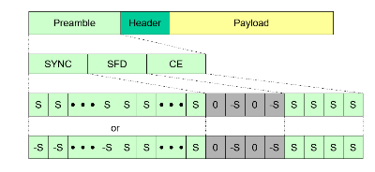
Meeting Preamble
Stuff you need to know before we get to the meeting content

Slide 4
Task Group Rules
Discussion: Everyone present is welcome*
Straw polls: Everyone present may vote
Formal motions: WG voters
To make, second and vote
Patent policy for PAR activities applies
All the usual rules of conduct
Please identify yourself on first contact with name and affiliation
*at the discretion of the WG and TG chairs

Slide 5
IEEE-SA Patent, Copyright, and Participation Policies
See: https://grouper.ieee.org/groups/802/sapolicies.shtml
IEEE-SA Patent Slides for Standards Development Meetings (.pdf)
https://development.standards.ieee.org/myproject/Public/mytools/mob/slideset.pdf
https://standards.ieee.org/about/sasb/patcom/materials/
IEEE-SA Standards Board Patent Committee (PatCom) home page
https://standards.ieee.org/content/ieee-standards/en/about/sasb/patcom/index.html
IEEE-SA Participation Policy meeting slide set - individual method (.pdf)
https://standards.ieee.org/content/dam/ieee-standards/standards/web/documents/other/Participant-Behavior-Individual-Method.pdf
Working Group Copyright Materials
https://standards.ieee.org/ipr/copyright-materials.html
https://standards.ieee.org/content/dam/ieee-standards/standards/web/documents/other/ieee-sa-copyright-policy-2019.pdf

Slide 6

Participants have a duty to inform the IEEE
  Participants shall inform the IEEE (or cause the IEEE to be informed) of the identity of each holder of any potential Essential Patent Claims of which they are personally aware if the claims are owned or controlled by the participant or the entity the participant is from, employed by, or otherwise represents
  Participants should inform the IEEE (or cause the IEEE to be informed) of the identity of any other holders of potential Essential Patent Claims
  Early identification of holders of potential Essential Patent Claims is encouraged
08 June 2021 – Slide 1

Slide 7
Participants have a duty to inform the IEEE
Ways to inform IEEE
Cause an LOA to be submitted to the IEEE SA (patcom@ieee.org); or
Provide the chair of this group with the identity of the holder(s) of any and all such claims as soon as possible; or
Speak up now and respond to this Call for Potentially Essential Patents
If anyone in this meeting is personally aware of the holder of any patent claims that are potentially essential to implementation of the proposed standard(s) under consideration by this group and that are not already the subject of an Accepted Letter of Assurance, please respond at this time by providing relevant information to the WG Chair
08 June 2021 – Slide 1

Slide 8
Other Guidelines for IEEE Working Group Meetings
All IEEE SA standards meetings shall be conducted in compliance with all applicable laws, including antitrust and competition laws.
  Don’t discuss the interpretation, validity, or essentiality of patents/patent claims.
  Don’t discuss specific license rates, terms, or conditions.
    Relative costs of different technical approaches that include relative costs of patent licensing terms may be discussed in standards development meetings.
      Technical considerations remain the primary focus.
  Don’t discuss or engage in the fixing of product prices, allocation of customers, or division of sales markets.
  Don’t discuss the status or substance of ongoing or threatened litigation.
  Don’t be silent if inappropriate topics are discussed. Formally object to the discussion immediately.
---------------------------------------------------------------
For more details, see IEEE SA Standards Board Operations Manual, clause 5.3.10 and
Antitrust and Competition Policy: What You Need to Know at http://standards.ieee.org/develop/policies/antitrust.pdf
08 June 2021 – Slide 3

Slide 9
Patent-related information
The patent policy and the procedures used to execute that policy are documented in the:
      IEEE SA Standards Board Bylaws (http://standards.ieee.org/develop/policies/bylaws/sect6-7.html#6)
      IEEE SA Standards Board Operations Manual (http://standards.ieee.org/develop/policies/opman/sect6.html#6.3)
  Material about the patent policy is available at http://standards.ieee.org/about/sasb/patcom/materials.html
If you have questions, contact the IEEE SA Standards Board Patent Committee Administrator at patcom@ieee.org
08 June 2021 – Slide 4

Slide 10
Participant Behavior – Individual Method

Slide 11
Participant behavior in IEEE-SA activities is guided by the IEEE Codes of Ethics & Conduct
• All participants in IEEE-SA activities are expected to adhere to the core
principles underlying the:
  – IEEE Code of Ethics
  – IEEE Code of Conduct
• The core principles of the IEEE Codes of Ethics & Conduct are to:
  – Uphold the highest standards of integrity, responsible behavior, and ethical and
  professional conduct
  – Treat people fairly and with respect, to not engage in harassment,
  discrimination, or retaliation, and to protect people's privacy.
  – Avoid injuring others, their property, reputation, or employment by false or
  malicious action
• The most recent versions of these Codes are available at
http://www.ieee.org/about/corporate/governance

Slide 12
Participants in the IEEE-SA “individual process” shall act independently of others, including employers
The IEEE-SA Standards Board Bylaws require that “participants in the IEEE standards development individual process shall act based on their qualifications and experience”
This means participants:
  Shall act & vote based on their personal & independent opinions derived from their expertise, knowledge, and qualifications
  Shall not act or vote based on any obligation to or any direction from any other person or organization, including an employer or client, regardless of any external commitments, agreements, contracts, or orders
  Shall not direct the actions or votes of other participants or retaliate against other participants for fulfilling their responsibility to act & vote based on their personal & independently developed opinions
By participating in standards activities using the “individual process”, you are deemed to accept these requirements; if you are unable to satisfy these requirements then you shall immediately cease any participation

Slide 13
IEEE-SA standards activities shall allow the fair & equitable consideration of all viewpoints
The IEEE-SA Standards Board Bylaws (clause 5.2.1.3) specifies that “the standards development process shall not be dominated by any single interest category, individual, or organization”
  This means no participant may exercise “authority, leadership, or influence by reason of superior leverage, strength, or representation to the exclusion of fair and equitable consideration of other viewpoints” or “to hinder the progress of the standards development activity”
This rule applies equally to those participating in a standards development project and to that project’s leadership group
Any person who reasonably suspects that dominance is occurring in a standards development project is encouraged to bring the issue to the attention of the Standards Committee or the project’s IEEE-SA Program Manager

Slide 14
Ieee sa copyright policy
November 2019

Slide 15
Instructions for Chairs of standards development activities
At the beginning of each standards development meeting the chair or a designee is to:
    Show the following slides (or provide them beforehand)
    Advise the standards development group participants that:
    IEEE SA’s copyright policy is described in Clause 7 of the IEEE SA Standards Board Bylaws and Clause 6.1 of the IEEE SA Standards Board Operations Manual;
    Any material submitted during standards development, whether verbal, recorded, or in written form, is a Contribution and shall comply with the IEEE SA Copyright Policy;
    Instruct the Secretary to record in the minutes of the relevant meeting:
    That the foregoing information was provided and that the copyright slides were shown (or provided beforehand).

Slide 16
IEEE SA Copyright Policy
By participating in this activity, you agree to comply with the IEEE Code of Ethics, all applicable laws, and all IEEE policies and procedures including, but not limited to, the IEEE SA Copyright Policy.
    Previously Published material (copyright assertion indicated) shall not be presented/submitted to the Working Group nor incorporated into a Working Group draft unless permission is granted.
    Prior to presentation or submission, you shall notify the Working Group Chair of previously Published material and should assist the Chair in obtaining copyright permission acceptable to IEEE SA.
    For material that is not previously Published, IEEE is automatically granted a license to use any material that is presented or submitted.

Slide 17
IEEE SA Copyright Policy
    The IEEE SA Copyright Policy is described in the IEEE SA Standards Board Bylaws and IEEE SA Standards Board Operations Manual
      IEEE SA Copyright Policy, see
      Clause 7 of the IEEE SA Standards Board Bylaws
      https://standards.ieee.org/about/policies/bylaws/sect6-7.html#7
      Clause 6.1 of the IEEE SA Standards Board Operations Manual
      https://standards.ieee.org/about/policies/opman/sect6.html
    IEEE SA Copyright Permission
      https://standards.ieee.org/content/dam/ieee-standards/standards/web/documents/other/permissionltrs.zip
    IEEE SA Copyright FAQs
      https://standards.ieee.org/faqs/copyrights/
    IEEE SA Best Practices for IEEE Standards Development
    http://standards.ieee.org/content/dam/ieee-standards/standards/web/documents/other/best_practices_for_ieee_standards_development_051215.pdf
    Distribution of Draft Standards (see 6.1.3 of the SASB Operations Manual)
      https://standards.ieee.org/about/policies/opman/sect6.html

Slide 18
IEEE 802 Ground Rules
Respect … give it, get it
NO product pitches
NO corporate pitches
NO prices
NO restrictive notices – (no confidentially notices in email)
Presentations must be openly available

Slide 19

Detailed Call Schedule
https://mentor.ieee.org/802.15/dcn/25/15-25-0276-00-04ab-call-detailed-schedule-may-july-2025.xlsx

Slide 20
5.2.b Scope of the project (As approved):
This amendment enhances the Ultra Wideband (UWB) physical layers (PHYs) medium access control (MAC), and associated ranging techniques while retaining backward compatibility with enhanced ranging capable devices (ERDEVs).
Areas of enhancement include:
  additional coding, additional coding, preamble and modulation schemes to support improved link budget and/or reduced air-time relative to IEEE Std 802.15.4 UWB;
  additional channels and operating frequencies;
  interference mitigation techniques to support greater device density and higher traffic use cases relative to the IEEE Std 802.15.4 UWB;
  improvements to accuracy, precision and reliability and interoperability for high-integrity ranging; schemes to reduce complexity and power consumption;
  definitions for tightly coupled hybrid operation with narrowband signaling to assist UWB;
  enhanced native discovery and connection setup mechanisms;
  sensing capabilities to support presence detection and environment mapping;
  and mechanisms supporting low-power low-latency streaming as well as high data-rate streaming allowing at least 50 Mb/s of throughput.
Support for peer-to-peer, peer-to-multi-peer, and station-to-infrastructure protocols are in scope, as are infrastructure synchronization mechanisms. This amendment includes safeguards so that the high throughput data use cases do not cause significant disruption to low duty-cycle ranging use cases.
https://development.standards.ieee.org/myproject-web/app#viewpar/9081

Slide 21
Near Term Working Milestones
 | Current Schedule
First letter ballot | June 2024
Initial LB comment resolution | Start: July 2024
First recirculation | March 2025
Recirculation comment resolution | April-Aug? 2025
Second recirculation | Aug 2025
Recirculation comment resolution | Sept-Nov 2025
First SA-Ballot | ???
SA-Ballot comment resolution | ???
We are here
Coult still happen
Ballot start 30-Aug

Slide 22
SA Ballot and Beyond
Conditional LMSC approval Sept 2025
 | Current Schedule
First SA-Ballot | October 2025
SA-Ballot comment resolution | November 2025 - January 2026
First recirculation | Feb/Mar 2026
Recirculation comment resolution | Mar 2026
Second recirculation | April 2026
Recirculation comment resolution | May 2026
Final comment resolution | July 2026
Third and final recirculation | Aug 2026
REVCOM and SASB | Nov 2026
There’s Still Hope!
Conditional LMSC approval for REVCOM

Slide 23
Ways to accelerate schedule
Current Plan
Seek LMSC in July Sept 2025 for conditional approval for SA ballot
  Conditional approval allows for up to 2 WG recirculation ballots allowed after approval
  If we can complete a recirc with no technical changes we can start initial SA ballot
Then we can start SA ballot when
  We resolve all comments
  Recirculation with no technical changes and new valid disapprove votes

Slide 24

Editor’s Corner

Slide 25
Operation of Task Group
(WG15 Operations Manual)
For amendments and revisions to IEEE 802.15 standards it is expected that the task group thoroughly read and understand the whole standard being modified. Specifically, the task group’s draft document shall maintain the standard’s structure and conventions, adhere to the PAR and CSD, that effort be made to reuse or leverage existing behavior whenever possible, that changes do not “break” existing behaviors, and that backward compatibility is achieved.

Slide 26

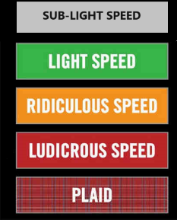
Comment resolution

Slide 27
Consolidated Comments Recirc 1
https://mentor.ieee.org/802.15/dcn/25/15-25-0174-32-04ab-consolidated-comments-draft-2-0.xlsm

Slide 28

Next Steps

Slide 29
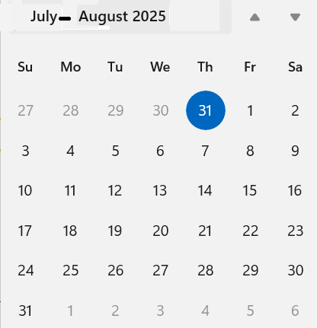
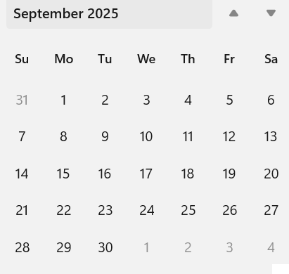
Telecom/Webex Schedule
Sept Interim
Ballot Opens
Ballot Closes
Agenda: Resolve comments, produce D03, recirculate
Commencing 12th Aug 2025, continuing through 8th Sept 2025
Extra: Comment res and CRG meeting 28-Aug Time TBD (if it looks close)
Once per week, 1.5 hour Tuesday 06:00

Slide 30
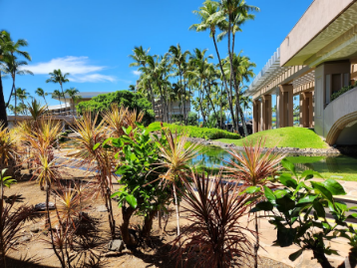
Recess

Slide 31
Resume from Recess
Task Group 15.4ab
Next Generation UWB Amendment

Slide 32
IEEE-SA Patent, Copyright, and Participation Policies
See: https://grouper.ieee.org/groups/802/sapolicies.shtml
IEEE-SA Patent Slides for Standards Development Meetings (.pdf)
https://development.standards.ieee.org/myproject/Public/mytools/mob/slideset.pdf
IEEE-SA Standards Board Patent Committee (PatCom) home page
https://standards.ieee.org/content/ieee-standards/en/about/sasb/patcom/index.html
IEEE-SA Participation Policy meeting slide set - individual method (.pdf)
https://standards.ieee.org/content/dam/ieee-standards/standards/web/documents/other/Participant-Behavior-Individual-Method.pdf
Working Group Copyright Materials
https://standards.ieee.org/ipr/copyright-materials.html
https://standards.ieee.org/content/dam/ieee-standards/standards/web/documents/other/ieee-sa-copyright-policy-2019.pdf

Slide 33
Participants have a duty to inform the IEEE
  Participants shall inform the IEEE (or cause the IEEE to be informed) of the identity of each holder of any potential Essential Patent Claims of which they are personally aware if the claims are owned or controlled by the participant or the entity the participant is from, employed by, or otherwise represents
  Participants should inform the IEEE (or cause the IEEE to be informed) of the identity of any other holders of potential Essential Patent Claims
  Early identification of holders of potential Essential Patent Claims is encouraged

Slide 34
Participants have a duty to inform the IEEE
Ways to inform IEEE
Cause an LOA to be submitted to the IEEE SA (patcom@ieee.org); or
Provide the chair of this group with the identity of the holder(s) of any and all such claims as soon as possible; or
Speak up now and respond to this Call for Potentially Essential Patents
If anyone in this meeting is personally aware of the holder of any patent claims that are potentially essential to implementation of the proposed standard(s) under consideration by this group and that are not already the subject of an Accepted Letter of Assurance, please respond at this time by providing relevant information to the WG Chair
  Participants shall inform the IEEE (or cause the IEEE to be informed) of the identity of each holder of any potential Essential Patent Claims of which they are personally aware if the claims are owned or controlled by the participant or the entity the participant is from, employed by, or otherwise represents
  Participants should inform the IEEE (or cause the IEEE to be informed) of the identity of any other holders of potential Essential Patent Claims
  Early identification of holders of potential Essential Patent Claims is encouraged

Slide 35
Next Steps

Slide 36
Any Other Business

Slide 37

Adjourned

