Slide 1
Project: IEEE P802.15 Working Group for Wireless Specialty Networks (WSNs)
Submission Title: AI Equalizer for signal processing in IG NG-OCC
Date Submitted: July 28, 2025
Source: Md Minhazur Rahman, Yeong Min Jang, Kookmin University
Address: Room #603 Mirae Building, Kookmin University, 77 Jeongneung-Ro, Seongbuk-Gu, Seoul, 136702, Republic of Korea
Voice: +82-2-910-5068 E-Mail: yjang@kookmin.ac.kr
Re:
Abstract: Present the use case AI Equalizer for IG NG-OCC
Purpose: Presentation for contribution on IG NG-OCC
Notice: This document has been prepared to assist the IG NG-OCC. It is offered as a basis for discussion and is not binding on the contributing individual(s) or organization(s). The material in this document is subject to change in form and content after further study. The contributor(s) reserve(s) the right to add, amend or withdraw material contained herein.
Release: The contributor acknowledges and accepts that this contribution becomes the property of IEEE and may be made publicly available by IG NG-OCC.

Slide 2
AI Equalizer for signal processing in IG NG-OCC
Contribution
July 30, 2025

Slide 3
Contents
Background
Advantages of AI Equalizer over Traditional Equalizer
Exploring AI Models for Signal Equalization
AI Equalizer for signal denoising for IG NG-OCC
Conclusion

Slide 4
Background
Optical Camera Communication suffers from severe channel impairments such as motion blur, defocusing, ambient light interference, and multipath effects, flickering. AI-based equalizers learn to compensate for these distortions directly from data.
Traditional equalizers like ZF (Zero Forcing) and LMMSE (Linear Minimum Mean Square Error) require accurate channel knowledge and pilot signals. AI models can adaptively equalize signals without explicit channel estimation.
Architectures like U-Net, ResNet, and BiLSTM can model temporal and spatial dependencies in OCC signals, extracting robust features for high-accuracy data recovery from image sequences.
AI equalizers can generalize across varying conditions such as lighting changes, camera angles, and motion, enabling robust performance in real-world OCC deployments.

Slide 5
Advantages of AI Equalizer over Traditional Equalizer
AI Based Equalizer | Traditional Equalizer (MMSE, ZF)
Uses a deep learning model to learn noise patterns and reconstruct clean signals. | Uses mathematical models to estimate and compensate for channel effects.
Does not require channel estimation; learns patterns from data | Requires channel estimation; relies on pilots sequences
High computational cost due to deep learning models | Lower complexity with closed-form solutions
Learns and adapts to nonlinear distortions and varying channel conditions | Works well in linear channels but struggles with nonlinear distortions
Highly effective in denoising and mitigating complex noise patterns | Sensitive to high noise and requires tuning for different environments
Requires training with real/simulated data | Direct implementation using known mathematical models

Slide 6
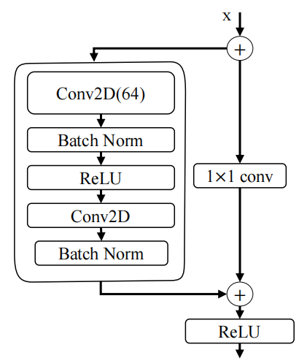
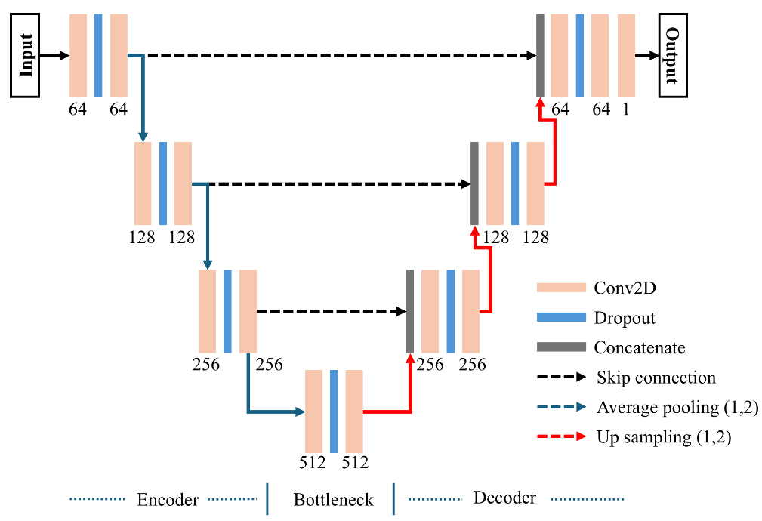
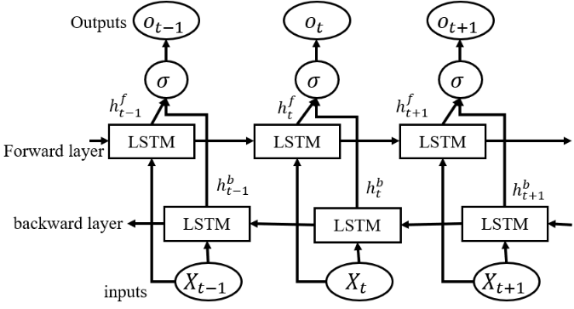
Exploring AI Models for Signal Equalization
<Structure of the BiLSTM model>
<Structure of the ResNet model>
< UNet architecture>
BiLSTM was developed for sequential data tasks like language modeling and time-series prediction.
In equalization, BiLSTM effectively mitigates inter-symbol interference by learning temporal dependencies in distorted signals.
ResNet was originally created for deep image classification, overcoming training difficulties in very deep networks through skip connections.
ResNet preserves key signal features through residual connections, making it effective at detecting and correcting subtle distortions in noisy channels.
Originally developed for biomedical segmentation, UNet's encoder-decoder structure and skip connections enable effective reconstruction of corrupted signals in equalization tasks.
UNet acts as a powerful denoiser and symbol reconstructor, especially useful in optical or multipath channels where detail preservation is key.

Slide 7
AI Equalizer for signal denoising for NG-OCC
Implicit Channel Estimation Without Pilots:
AI-based equalizers learn the characteristics of the communication channel directly from data, eliminating the need for explicit pilot symbols. This improves spectral efficiency by freeing up bandwidth.
Adaptation to Environmental Variability:
The model is trained on diverse lighting conditions (daylight, low light, varying background illumination), allowing it to handle real-world noise and dynamic motion more robustly than traditional algorithms.
Superior Performance Over Traditional Equalizers:
Compared to linear or LMMSE equalizers, AI models (like U-Net) better handle nonlinear distortions, ambient noise, and motion blur, resulting in lower Bit Error Rates (BER) across distances.
Large and Diverse Training Dataset:
A comprehensive dataset including Rx and Tx pairs, captured under varying conditions, enables the AI model to generalize well. The format (e.g., 1 symbol × N subcarriers for OFDM) supports subcarrier-wise equalization.

Slide 8
AI Equalizer for signal denoising for NG-OCC
Scalable to Real-Time Applications:
With efficient architectures and GPU acceleration, AI-based equalizers can be deployed in real-time OCC systems (e.g., vehicular communication, drones), making them practical for latency-sensitive use cases.
Denoising and Signal Reconstruction:
AI models not only equalize but also denoise signals distorted by ambient conditions, restoring the true transmitted data even from heavily corrupted image frames.
Dataset Expansion:
Extending datasets to include more camera types, modulations (QAM, OOK, OFDM variants), and motion scenarios (e.g., drone-to-drone, V2X) will improve model robustness and enable standardized benchmarking.
Integration with End-to-End OCC Systems:
Future OCC architectures may integrate AI-based equalization with AI-based demodulation and synchronization, forming a fully neural communication pipeline with minimal reliance on handcrafted algorithms.

Slide 9
Conclusion
AI-based equalizers significantly enhance signal robustness in OCC systems by learning complex channel characteristics directly from noisy image data, outperforming traditional mathematical equalizers.
improves spectral efficiency and system throughput, making AI-driven methods ideal for bandwidth-constrained or latency-sensitive applications.
Robustness to environmental variability, including lighting conditions and motion-induced distortions, makes AI models highly adaptable for real-world OCC scenarios such as vehicular and drone communication.
Future development will benefit from large, diverse datasets and lightweight, scalable architectures, paving the way for real-time, secure, and intelligent OCC deployment in next-generation wireless networks.

Slide 10
Reference
Rahman, Md Minhazur, et al. "Real-time implementation of OFDM modulation for an OCC system: UNet-based equalizer for signal denoising and BER optimization." ICT Express (2025).
M.O. Ali, M.K. Hasan, Y. Wang, M. Shehata, J. Fu, S. Luong, K. Wang, U-Net-based optical camera communication in intensity-constrained scenarios, J.Lightwave Technol. (2025)
T.L. Pham, T. Nguyen, M.D. Thieu, H. Nguyen, H. Nguyen, Y.M. Jang, Anartificial intelligence-based error correction for optical camera communication,in: Proc. 11th Int. Conf. Ubiquitous Future Netw, ICUFN, IEEE, 2019.
Dong, Ke, Xizheng Ke, and Mingjun Wang. "Equalization of camera-based channel to mitigate uncertain sampling for optical camera communications." Optics Express 30.26 (2022).

