Slide 1
Project: IEEE P802.15 Working Group for Wireless Personal Area Networks (WPANs)
Submission Title: [Multiple advertising NB channels for MMS initialization]
Date Submitted: [July 30, 2025]
Source: [Wenzheng Li (Calterah Semiconductor)]
E-Mail: [wenzheng.li@calterah.com]
Re: [Input to the Working Group]
Abstract:
According to the current IEEE 802.15.4ab D02, in prior to MMS initialization and setup phase, the NB initialization channel and the modulation configuration should be selected by macMmsNbInitChannel and macMmsNbInitMode attributes. However, only one value can be configured for the macMmsNbInitChannel and macMmsNbInitMode, which may lead to the NB channel congestion/conflictions in the case that multiple UWB devices attempt to employ the same NB channel for MMS initialization simultaneously. This contribution aims to configure multiple NB initialization channels for both initiator and responder(s) engaged in the MMS.
The initiator randomly select a NB channel to advertising ADV POLL Compact Frame
The responder(s) scan multiple NB channels to capture the ADV POLL Compact Frame and continue the MMS initialization procedure
Purpose: [Provide the points to be discussed and further to optimize the MMS in 4ab]
Notice: This document has been prepared to assist the IEEE P802.15. It is offered as a basis for discussion and is not binding on the contributing individual(s) or organization(s). The material in this document is subject to change in form and content after further study. The contributor(s) reserve(s) the right to add, amend or withdraw material contained herein.
Release: The contributor acknowledges and accepts that this contribution becomes the property of IEEE and may be made publicly available by P802.15.

Slide 2
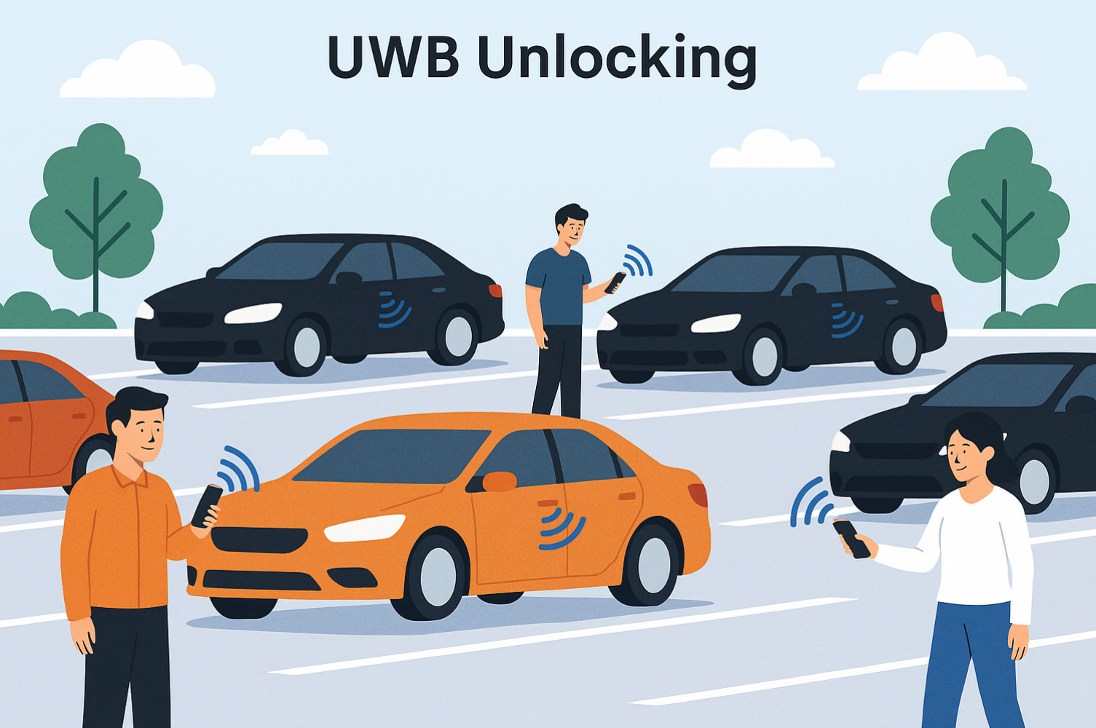
Possible use case for MMS
After the closing of a concert or cinema, lots of people may go to the car park and use NBA MMS for passive entry or to locate their car
congestion and conflictions for one NB initialization channel is very likely to happen

Slide 3
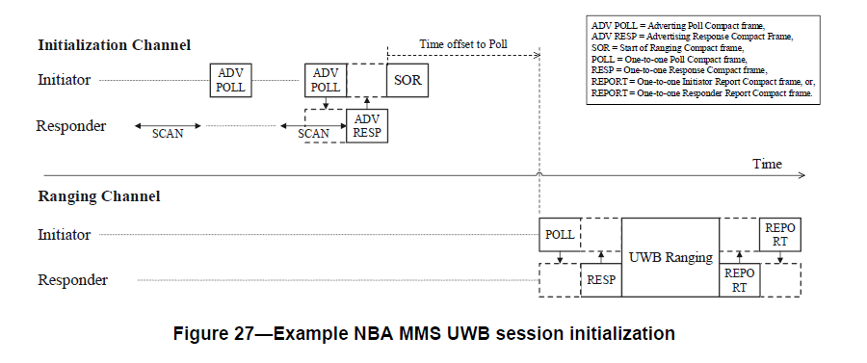
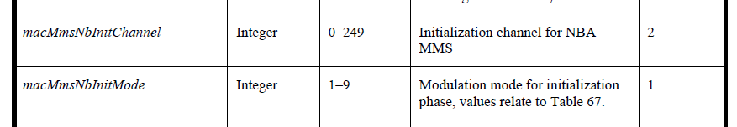
Current NBA MMS Initialization Procedure
NB Initialization Channel is defined:
macMmsNbInitChannel: NB channel Number used for initialization
macMmsNbInitMode: Modulation mode used for NB initialization channel
These attributes shall be set by the higher layer prior 1 to the initialization and setup phase.
NB
Only one NB initialization channel can be defined
NB initialization channel congestion may be cased by:
Multiple one to one and one to many NBA MMS are ongoing within a limited area
Contention based MMS initialization: multiple responders select same slot in the same NB channel

Slide 4
Congestion/Confliction for NB initialization channel
Multiple O2O/O2M NB MMS initializations
Contention based MMS initialization
Initiator 1
ADV POLL
Initiator 2
ADV POLL
CAP
X
Initiator 1
Initiator 3
ADV POLL
ADV POLL
X
Responder 1
ADV RESP
Responder 1
ADV RESP
X
Responder 2
ADV RESP
Responder 2
ADV RESP
Responder 3
X
ADV RESP
One common case: in the Car Park, multiple individual NBA MMS initializations happen at same time without knowing the NB initialization channels used by each other
Conflictions may happen between different initiators and different responders
Conflictions may happen between different responders
Short CAP may cause more conflictions
Long CAP may increase the NBA MMS initialization time

Slide 5
Proposed multiple NB Initialization channels method
Initiator 1
ADV POLL
NB CH0
Initiator 2
ADV POLL
NB CH1
Initiator 3
ADV POLL
NB CH2
Responder 1
ADV RESP
WLAN unoccupied channel is preferred to be selected as NB initialization channel:
NB channel 0-3, 50-57
Responder 2
ADV RESP
Responder 3
ADV RESP
Amendment 1: Multiple NB Initialization Channels can be configured for each MMS initialization:
macMmsNbInitChannelList: extend to an array of NB channels
macMmsNbInitMode: retain one modulation mode for all NB channels in the macMmsNbInitChannelList
Amendment 2: Initiator randomly selects one of the NB channels in the macMmsNbInitChannelList and corresponding modulation mode in macMmsNbInitMode to start MMS initialization
Amendment 3: Responder scan all NB channels in the macMmsNbInitChannelList to capture the ADV POLL and response ADV RESP POLL in the same NB channel;
Amendment 4: All the following MMS Initialization procedure is carried on this NB channel until responder need to capture the ADV POLL again

Slide 6

Congestion evaluation based on multiple NB Initialization Channels
Number of MMS session(N) | Number of the inilization slots (S) | Number of NB channels(C=1) | Number of NB channels(C=3) | Confliction Decrease | Number of NB channels(C=5) | Confliction Decrease | Number of NB channels(C=12) | Confliction Decrease
5 | 10 | 69.76% | 29.63% | 57.50% | 18.64% | 73.30% | 8.09% | 88.40%
 | 20 | 41.86% | 15.72% | 62.50% | 9.65% | 76.90% | 4.11% | 90.20%
 | 50 | 18.64% | 6.14% | 67.10% | 3.80% | 79.60% | 1.67% | 91.00%
10 | 10 | 99.96% | 81.54% | 18.40% | 61.83% | 38.10% | 31.98% | 68.00%
 | 20 | 93.45% | 36.02% | 61.50% | 22.19% | 76.30% | 9.67% | 89.70%
 | 50 | 61.83% | 19.77% | 68.00% | 12.10% | 80.40% | 5.28% | 91.50%
20 | 10 | 100.00% | 99.98% | - | 98.80% | 1.20% | 81.30% | 18.70%
 | 20 | 100.00% | 93.03% | 6.97% | 72.09% | 27.91% | 29.02% | 70.98%
 | 50 | 98.80% | 67.10% | 32.10% | 41.73% | 57.80% | 17.62% | 82.20%
P(no confliction)=
Multiple NB channels can reduce the possible confliction dramatically

Slide 7
Suggestion
NB initialization for MMS may be performed in some very complicated cases
  E.g. after the closing of a concert or cinema, lots of people may go to the car park and use NBA MMS for passive entry or to locate their car; congestion and conflictions for one NB initialization channel is very likely to happen
Simply configure multiple NB initialization channels for each initiator and responder(s) can benefit the randomness of NB initialization channel occupation, thus relieve the possible congestion and conflictions of the NB initialization channel
Suggest to add multiple NB initialization channels configuration in the 4ab.

